Slide 2
Course: HEI-A1
Module: Agricultural sustainability, management of natural resources and climate action
Learning Unit:Renewable energy and its application as green agricultural energy source
Author: UNIFI

Slide 3
Summary
Introduction to Renewable Energy Sources and Efficiency
Solar Energy
Wind Energy
Biomass to Energy
Energy Storage
Agrivoltaics
Other RES based solutions for agriculture

Slide 4
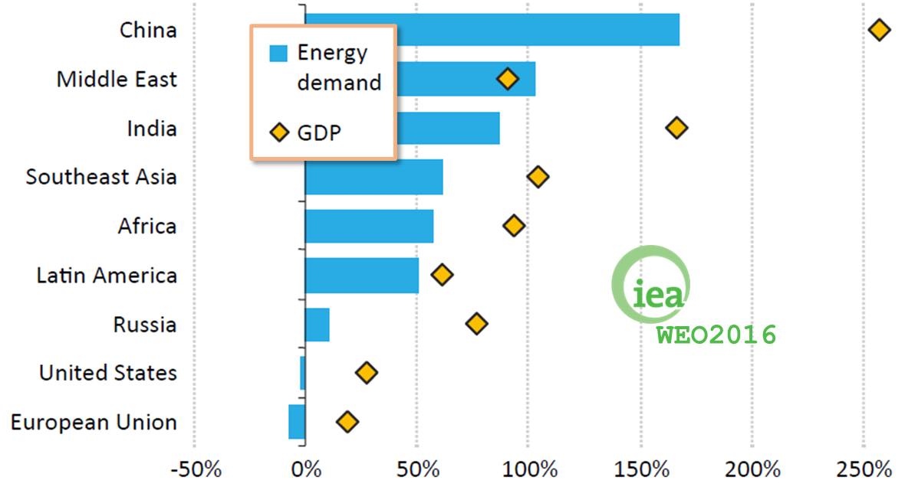
Changes in GDP and energy demand 2000-2014
For the world as a whole, GDP growth is pushing energy consumption higher.
Overall, for every one percentage point rise in non-OECD economic growth over the period 2000-2014, energy demand increased by around 0.7%.

Slide 5
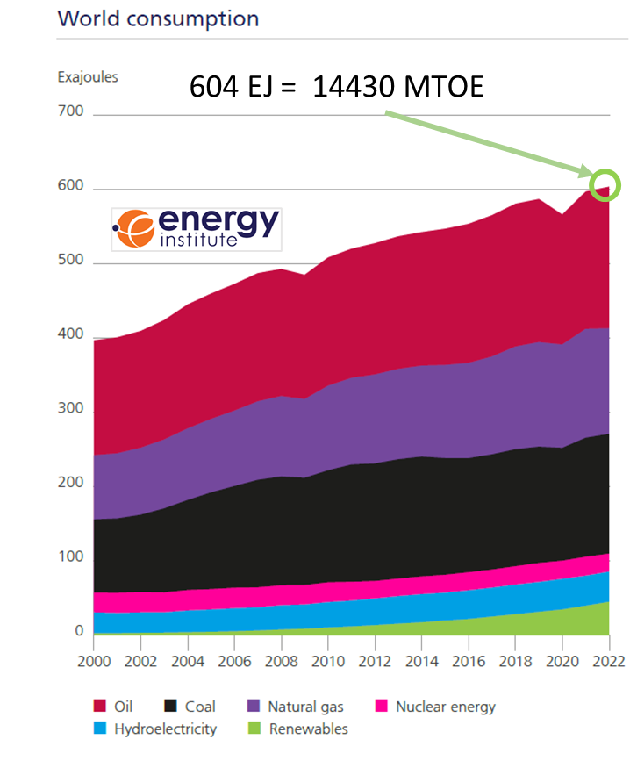
World Consumption
In 2022, the world needed an amount of energy equivalent to that contained in 14430 million barrels of oil. Renewables’ (excluding hydroelectricity) share of primary energy consumption reached 7.5%, while Fossil fuel consumption as a percentage of primary energy remained steady at 82%.
Greenhouse gas (GHG) emissions resulting from the provision of energy services from fossils (coal, oil, and gas) have contributed significantly to the historic increase in atmospheric GHG concentrations.

Slide 6
Energy Demand & increase in anthropogenic greenhouse gas concentrations
Greenhouse gas (GHG) emissions resulting from the provision of energy services have contributed significantly to the historic increase in atmospheric GHG concentrations.
The IPCC Fourth Assessment Report (AR4) concluded that “Most of the observed increase in global average temperature since the mid-20th century is very likely due to the observed increase in anthropogenic greenhouse gas concentrations.”
Recent data confirm that consumption of fossil fuels accounts for the majority of global anthropogenic GHG emissions.
Emissions continue to grow and CO2 concentrations had increased to over 390 ppm, or 39% above preindustrial levels, by the end of 2010. 400 ppm were reached in 2015.

Slide 7
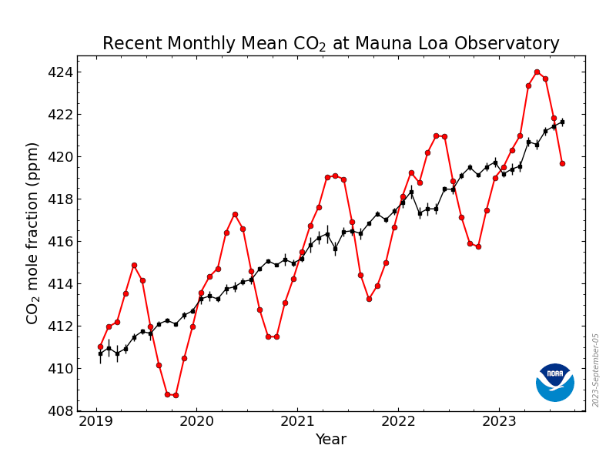
Greenhouse gas concentrations: CO2
No COVID effect
In the figure, the dashed red line with diamond symbols represents the monthly mean values, centered on the middle of each month. The black line with the square symbols represents the same, after correction for the average seasonal cycle
August 2023:. 419.68 ppm
September 2022: 415.95 ppm
September 2021: 413.30 ppm
September 2020: 411.29 ppm
September 2019: 408.54 ppm
September 2018: 405.51 ppm
September 2017: 403.37 ppm

Slide 8
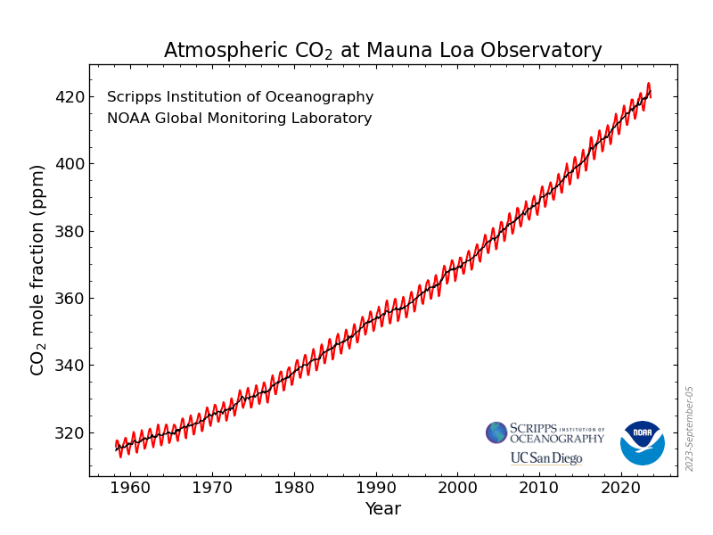
Greenhouse gas concentrations: CO2 Full Records

Slide 9
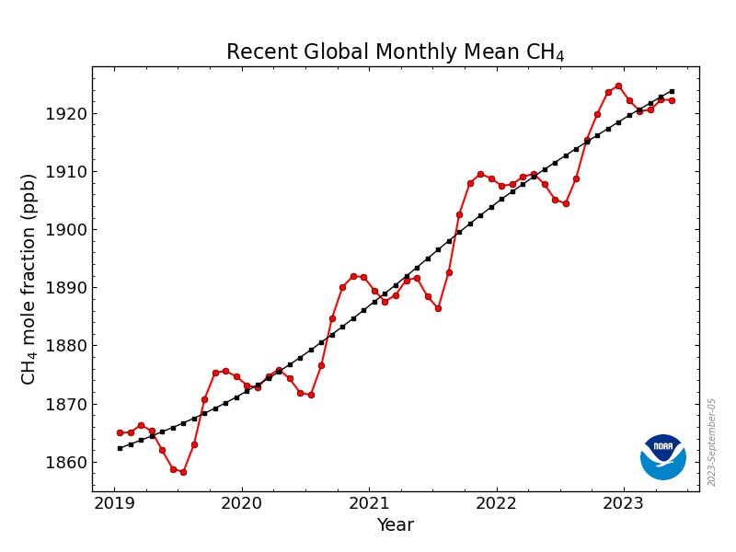
Greenhouse gas concentrations: CH₄
CH₄ 100-year Global warming potentials (CO₂=1): 25

Slide 10
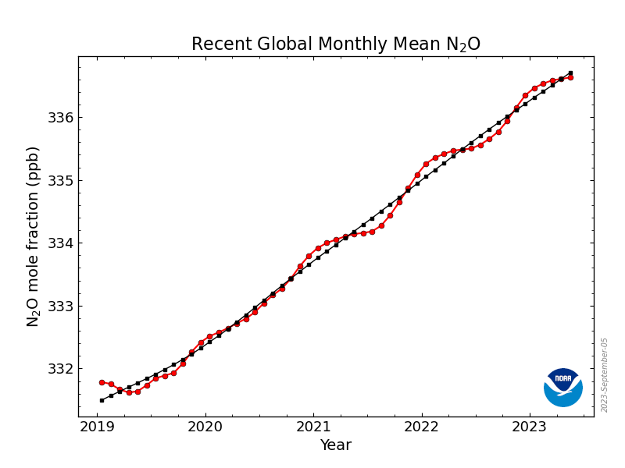
Greenhouse gas concentrations: N₂O
N₂O 100-year Global warming potentials (CO₂=1): 298

Slide 11
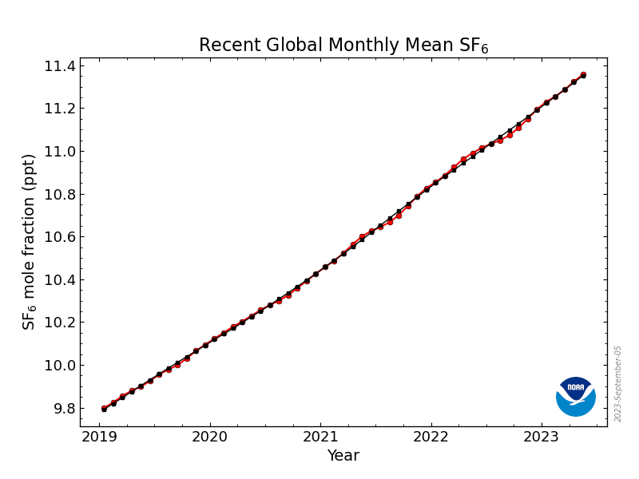
Greenhouse gas concentrations: SF₆
SF₆ 100-year Global warming potentials (CO₂=1): 22800

Slide 12
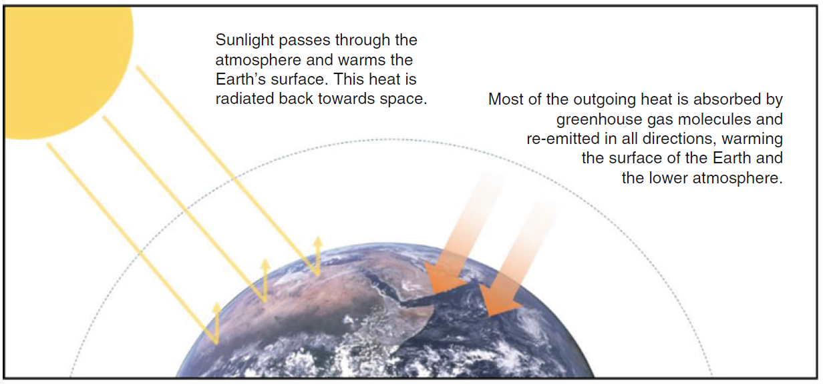
How greenhouse gases lead to global warming
Module: Agricultural sustainability, management of natural resources and climate action Learning Unit: Renewable energy and its application as green agricultural energy source - Sub Unit: Introduction to Renewable Energy Sources and Efficiency

Slide 13
Lowering GHG emissions
There are multiple options for lowering GHG emissions from the energy system while still satisfying the global demand for energy services.
Some of these possible options are: energy conservation and efficiency, fossil fuel switching, Renewable Energies, nuclear and carbon capture and storage (CCS).
A comprehensive evaluation of any portfolio of mitigation options would involve an evaluation of their respective mitigation potential as well as their contribution to sustainable development and all associated risks and costs.
Module: Agricultural sustainability, management of natural resources and climate action Learning Unit: Renewable energy and its application as green agricultural energy source - Sub Unit: Introduction to Renewable Energy Sources and Efficiency

Slide 14
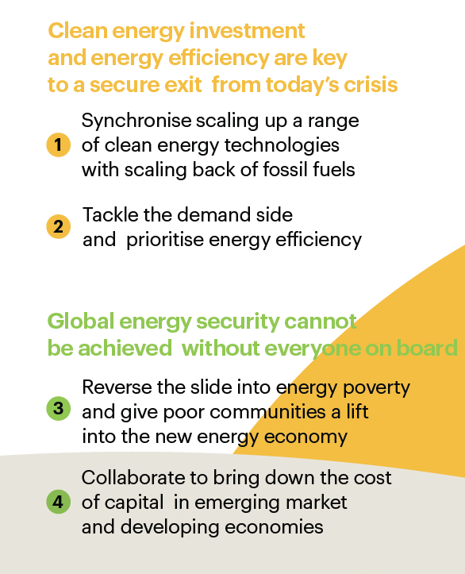

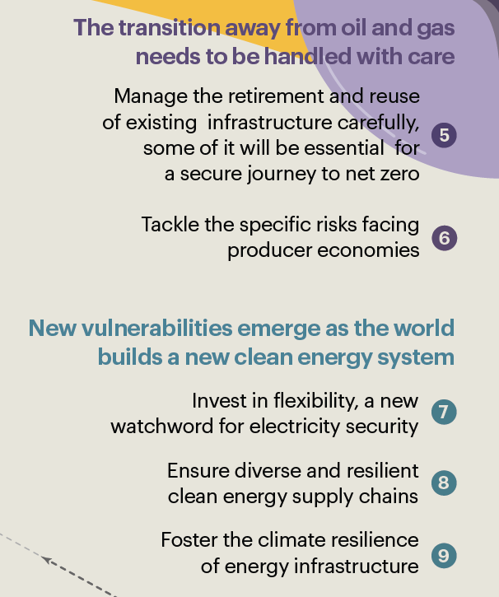
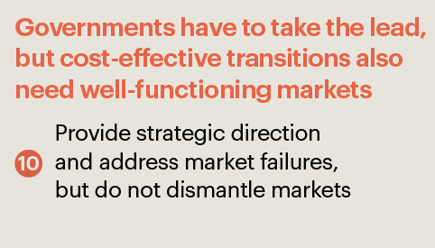
10 guidelines for secure energy transitions

Slide 15
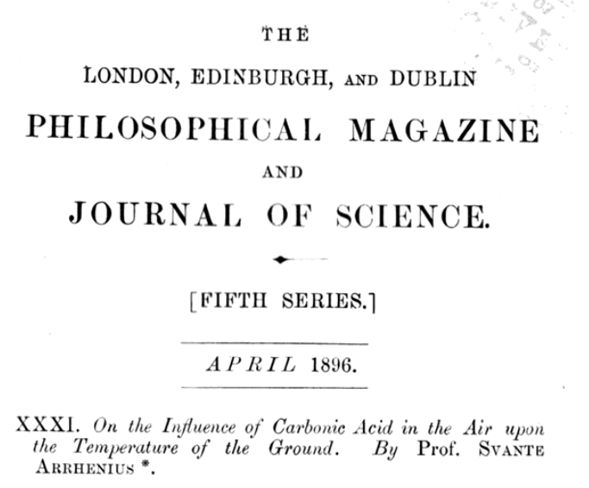
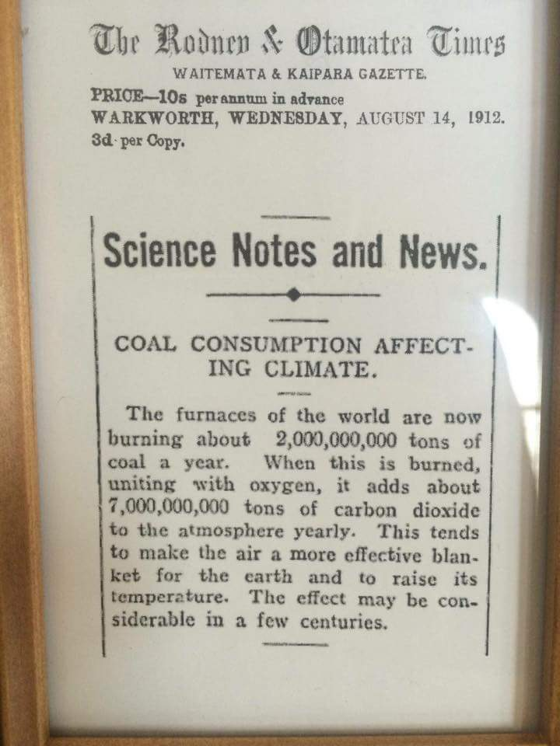
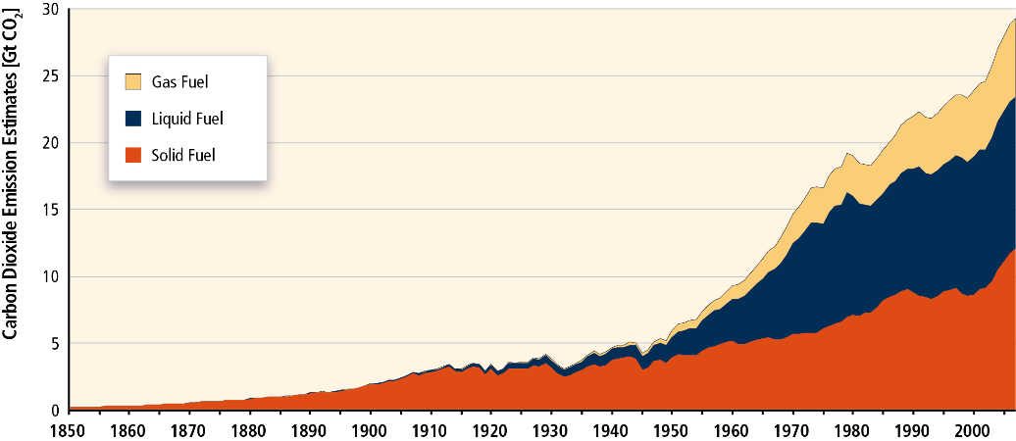
Not a brand new issue...
Did you know?
1912
1896

Slide 16
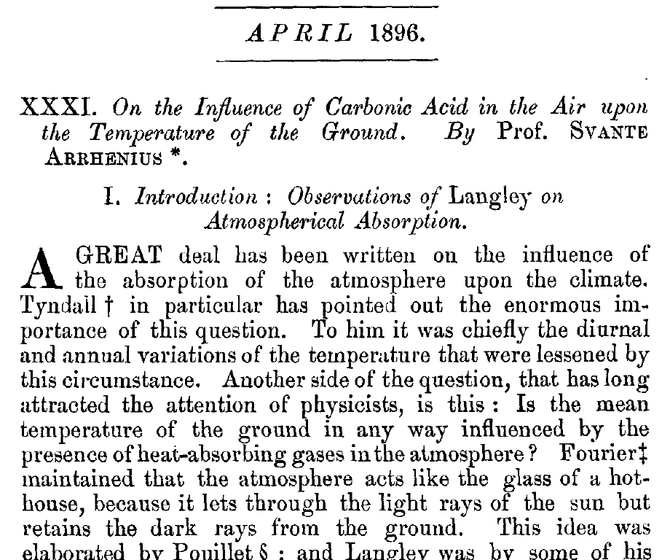
Joseph Fourier (1824): gases in the atmosphere must create barriers trapping heat;
Eunice Newton Foote (1856): An atmosphere of CO2 would give to our earth a high temperature.
John Tyndall (1861): tiny amounts of CO2 — a few hundred parts per million — could alter the planet temperature.
Did you know?
https://daily.jstor.org/how-19th-century-scientists-predicted-global-warming/

Slide 17
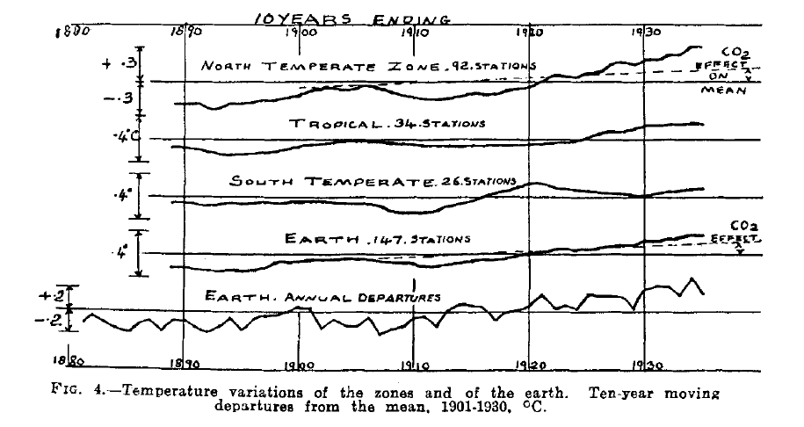
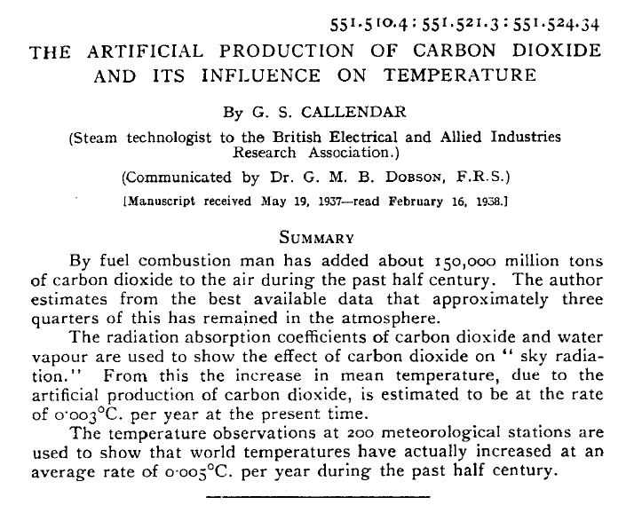
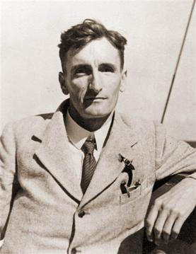
Global Warming: First time observed and measured
Did you know?
Guy Stewart Callendar
First time published a scientific research showing, by the use of meteorological measurements from 200 stations taken across 19th and 20th Century, that world temperatures had actually increased at an average rate of 0.005°C per year during period 1880-1930 (the “Callendar effect”).
Callendar, G. S.; The artificial production of carbon dioxide and its influence on temperature; (1938) doi.org/10.1002/qj.49706427503

Slide 18
Energy Efficiency
While the transition to renewable energy is a critical step, optimising the way we use energy plays an equally important role in creating a more sustainable and resilient energy ecosystem.
Improving energy use is an integral part of the broader transition from fossil fuels to renewable energy sources. Improving energy efficiency in various sectors such as industry, transport, buildings and appliances is of paramount importance. By optimising the way we use energy, we can significantly reduce overall energy demand. This in turn will reduce the burden on both fossil fuels and renewable resources, paving the way for a more sustainable energy future.
Improving energy use increases the effectiveness of renewable energy deployment. When we use energy more efficiently, demand is reduced, making it easier for renewable energy sources to meet a greater proportion of this reduced demand. This symbiotic relationship between efficiency and renewables is essential for a more sustainable and resilient energy landscape.
In addition, energy efficiency measures not only lower energy bills, but also reduce emissions and environmental impact. By using energy more effectively, we can achieve several goals at once: reduce costs, minimise pollution and ease pressure on natural resources.

Slide 19
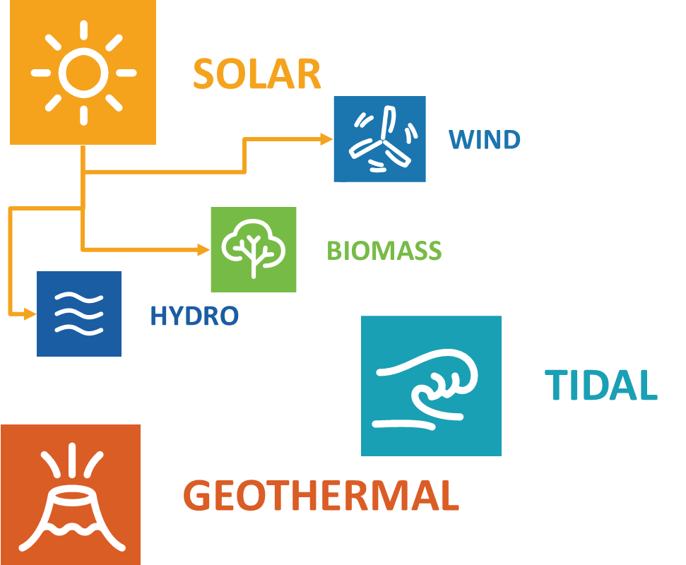
Lowering GHG emissions
There are multiple options for lowering GHG emissions from the energy system while still satisfying the global demand for energy services. Renewable Energies are one of these.
Renewable energy includes all forms of energy produced from renewable sources in a sustainable manner, including bioenergy, geothermal energy, hydropower, ocean energy, solar energy and wind energy. (IRENA).

Slide 20
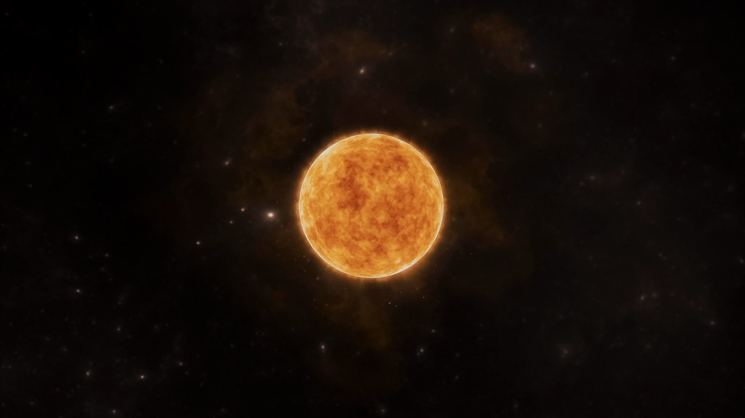
Solar Energy
Solar Heat
Converting the sun’s radiant energy to heat comes from the past and has today evolved into a well-developed technology.
The basic principle of solar thermal collection is that when solar radiation strikes a surface, a part of it is absorbed, thereby increasing the temperature of the surface.
Photovoltaic (PV) conversion
Direct conversion of sunlight into electricity with no intervening heat engine.
Conversion of solar radiation into electrical energy by means of solar cells developed since early 1960’s as a part of satellite and space-travel technology.
PV devices: stand-alone systems to give outputs from microwatts to megawatts.
Sun emits about 175~178 Billions MW
Irradiance, an instantaneous quantity often identified as the intensity of sunlight, is the measure of the power density of sunlight. It is usually measured in W/m².
The irradiance received from the sun at the top of the atmosphere (AKA solar constant for the earth) is approximately equal to 1367 W/m².
After passing through the atmosphere the irradiance is reduced to approximately 1000 W/m² (on average).
Solar energy has a share of more than 99.9 % of all the energy converted on earth.
Image by freepik

Slide 21
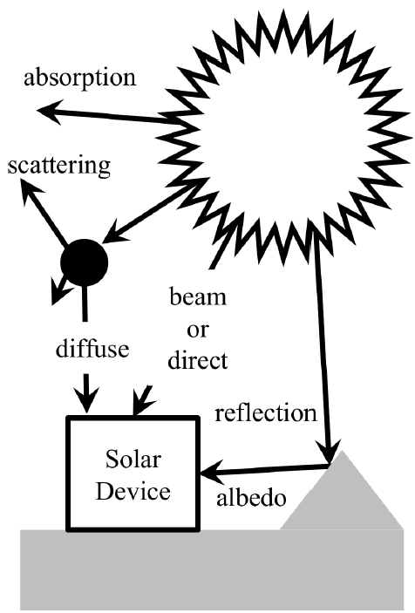
Solar Radiation
Solar radiation will reach a solar device in three different ways; either directly from the Sun, reflection from the surrounding terrain to produce an albedo component and scattered from particles or molecules for a diffuse component. Some radiation is absorbed by the atmosphere and doesn’t reach the device at all.
[Source: Mackay 2015]

Slide 22
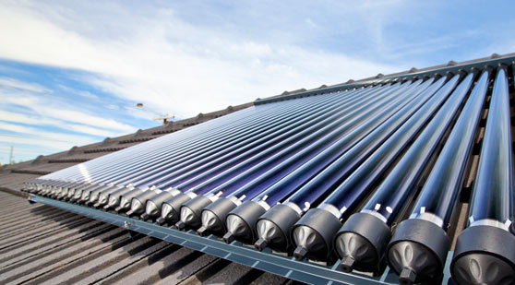
Solar Thermal Energy
Harnessing the sun's radiant energy and converting it into heat has evolved from the past into a sophisticated technology today.
In solar thermal collection, when solar radiation hits a surface, it absorbs a portion, raising the surface temperature.
The effectiveness of a solar collector depends on absorption efficiency and minimizing thermal and reradiation losses to the surroundings, as well as efficiently extracting energy for practical use.

Slide 23
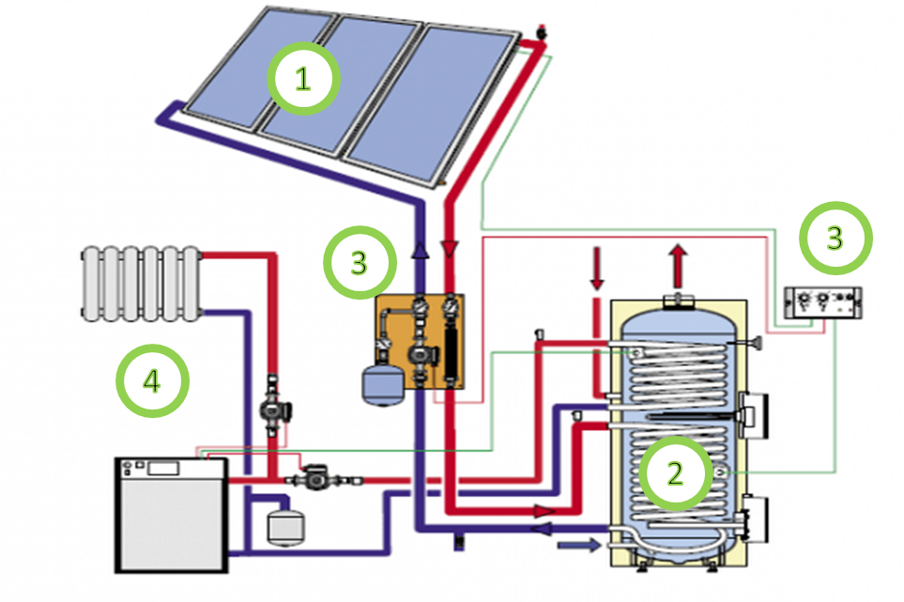
Domestic Solar Heat System
A traditional solar thermal system operates following three main actions:
“Harvesting” of the solar radiation with the panels (1)
Transfer of heat to a storage system/boiler (2) with natural or forced circulation,
The control system (3) manages the distribution of the heat to the utilisation (4), such as heating or domestic hot water.
Picture Credits: buildersontario.com

Slide 24
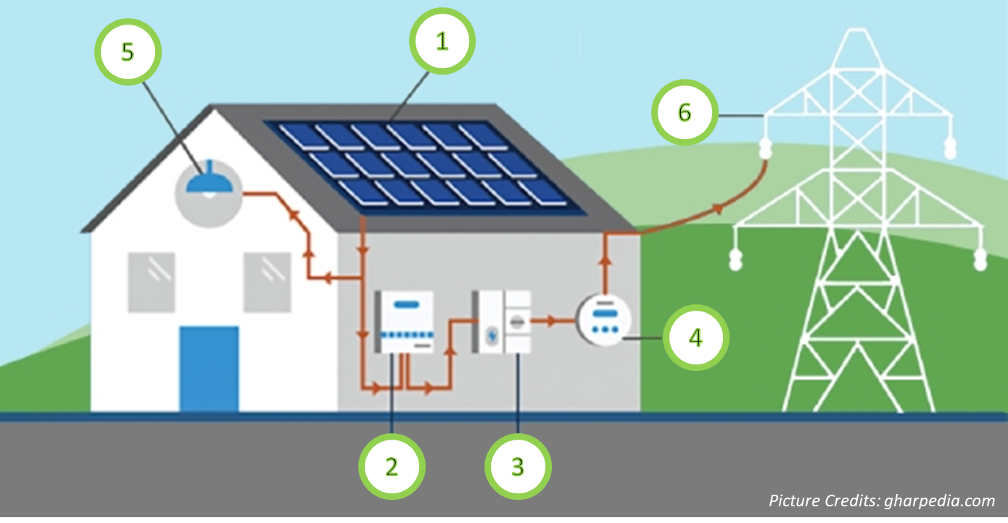
Domestic Solar PV System
The solar panel (1) is mounted on the roof.
An inverter (2) converts the electricity produced by the system from DC (Direct Current) energy into AC (Alternating Current).
An electric panel (3) is connected to the AC system of the home.
A power meter (4) accounts for how much energy is exchanged and balanced between the system users (5) either in DC or AC and the grid (6).

Slide 25
Photovoltaics
Photovoltaic (PV) conversion: direct conversion of sunlight into electricity with no intervening heat engine.
PV devices are solid state:
  simple design
  require very little maintenance.
Conversion of solar radiation into electrical energy by means of solar cells developed as a part of satellite and space-travel technology.
PV devices: stand-alone systems to give outputs from microwatts to megawatts.
In the early days of solar cells (1960s and 1970s) more energy was required to produce a cell than it could deliver during its lifetime. Dramatic improvements (i.e. 2008 status):
  energy payback periods reduced to ~2 to 5 years;
  panel lifetimes increased to more than 30 years.
Present technology utilises the band gap of semiconductor materials to generate electrons and conduct them in a preferred direction using a p–n junction.

Slide 26
Photovoltaics: pros and cons
Pros
Clean, Sustainable and Free energy source
once manufactured, photovoltaic cells produce pollution-free energy
CAPEX of commercial modules reach record low
LCOE for utility plants reaches record low
efficiencies are quickly increasing; projections indicate that higher efficiencies will soon be met
provide electricity to remote places
Cons
Sun is not always shining or 100% solar radiation is available; alternative methods required to store energy and match production with energy demand.
expensive to produce advanced photovoltaic cells (but costs decreasing)
maintenance to prevent degradation of performance (dust etc.).
reliability depends on location
environmental impact of PV cell production (decreasing with increased technology)

Slide 27
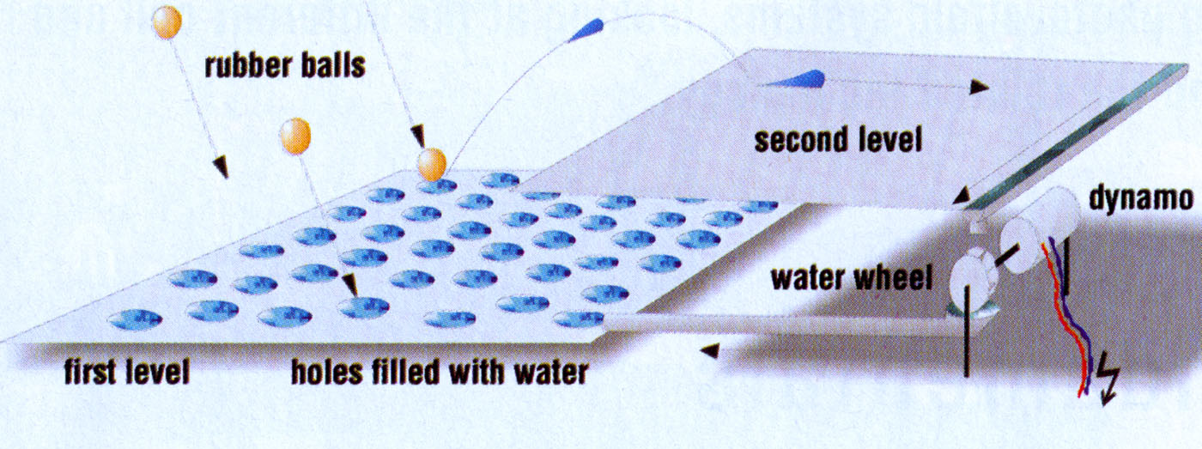
Modelling the Principle of solar cell operation: analogy of the process
If photon (rubber ball) energy is lower than 1.12 eV, the drop will not be able to reach the second level: this energy is lost.
If photon energy is higher than 1.12 eV the drop will in any case reach the “same” second level and it will produce the same amount of energy, whatever the energy received from the photon (rubber ball).

Slide 28
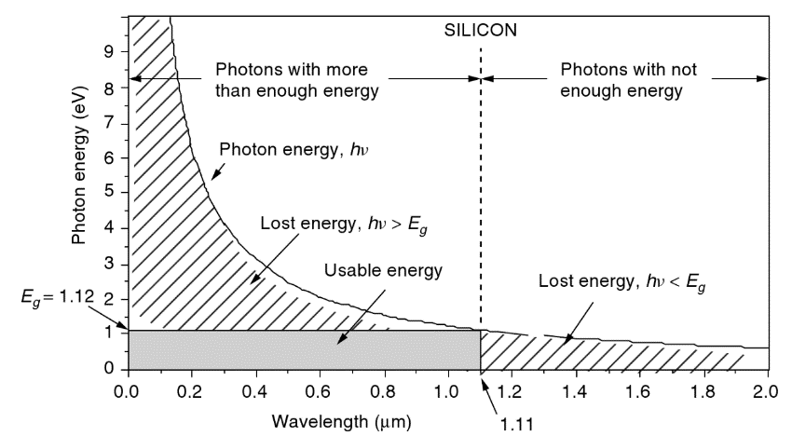
Silicon and the PV effect
Photons with wavelengths above 1.11 μm don't have the 1.12 eV needed to excite an electron, and this energy is lost. Photons with shorter wavelengths have more than enough energy, but any energy above 1.12 eV is wasted as well.

Slide 29
PV Technology Classification
Silicon Crystalline Technology
Mono Crystalline PV Cells
Multi Crystalline PV Cells
Crystalline silicon (c-Si) is an umbrella term for the crystalline forms of silicon encompassing multicrystalline silicon (multi-Si) and monocrystalline silicon (mono-Si), the two dominant semiconducting materials used in photovoltaic technology for the production of solar cells, that are assembled into a solar panel and part of a photovoltaic system to generate solar power from sunlight.
Thin Film Technology
Amorphous Silicon PV Cells
Poly Crystalline PV Cells
(Non-Silicon based)
A thin-film solar cell is a second generation solar cell that is made by depositing one or more thin layers, or thin film (TF) of photovoltaic material on a substrate, such as glass, plastic or metal. Thin-film solar cells are commercially used in several technologies, including cadmium telluride (CdTe), copper indium gallium diselenide (CIGS), and amorphous thin-film silicon (a-Si, TF-Si).

Slide 30
How Fast Do Solar Panels Degrade?
On average, solar panels degrade at a rate of 1% each year. That’s backed up by the solar panel manufacturer’s warranty, which guarantees 90% production in the first ten years and 80% by year 25 or 30.
However, a study conducted by The National Renewable Energy Laboratory (NREL) shows a more accurate picture of solar panel degradation. This study took a look at the degradation rates for almost 2,000 solar systems across the world in a variety of climates and found that monocrystalline panels made after the year 2000 degraded at a rate of just 0.4% - less than half of the 1% rate used in the warranties.
While solar panels lose a few percentages right away due to LID, the degradation rate slows down significantly for the remainder of their lifetime.
LID (Light Induced Degradation) is a loss of performances arising in the very first hours of exposition to the sun, with Crystalline modules.
NREL - Photovoltaic Degradation Rates — An Analytical Review

Slide 31
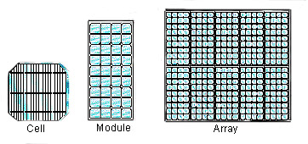
Cells and PV Panels
Surface Area = 100 cm²
Open Circuit V = 0,6 V
Power = 1 ~ 2 W
Losses
Cover
Reflection
Heating
Elementary unite of the PV panel:
PV Cell
More Cells: modules
More modules: array
Generation of direct current
It is often necessary to convert it into alternate current through a device (inverter)
Module: Agricultural sustainability, management of natural resources and climate action Learning Unit: Renewable energy and its application as green agricultural energy source - Sub Unit: Solar Energy

Slide 32
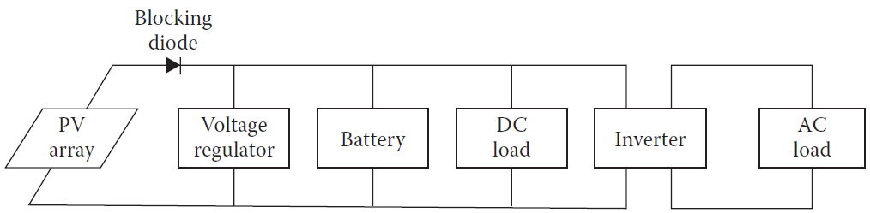
Connecting to the AC grid: inverters
An inverter is an electrical circuit capable of turning DC power into AC power, while at the same time regulating the voltage, current, and frequency of the signal.
To connect to the grid or to the household devices an inverter is necessary, since solar panels provide DC power (mostly 12V) while grid and household devices use AC power (mostly 220V~230/50Hz or 120V/60Hz).

Slide 33
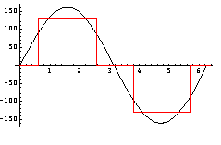
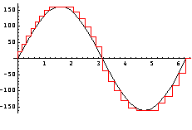
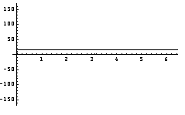
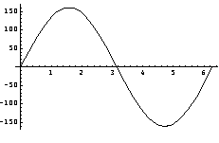
Electrical wave forms
Power from a PV panel is usually 12V DC Power.
Different types of inverters give outputs with different AC wave forms.
Square Wave
12V DC Power
Modified Sine Wave
True Sine Wave

Slide 34
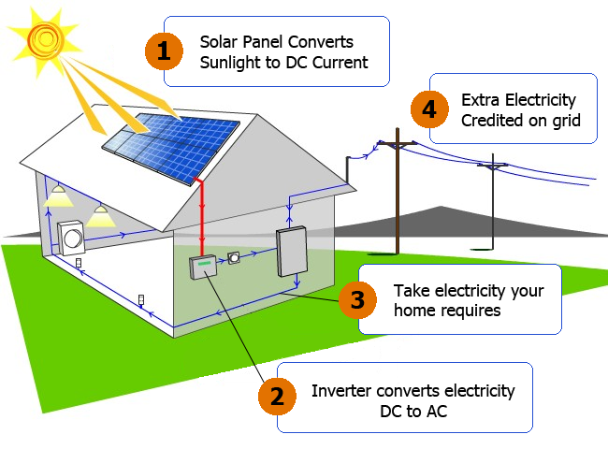
Grid connected systems
No battery is needed: the grid is the storage
!
Module: Agricultural sustainability, management of natural resources and climate action Learning Unit: Renewable energy and its application as green agricultural energy source - Sub Unit: Solar Energy

Slide 35
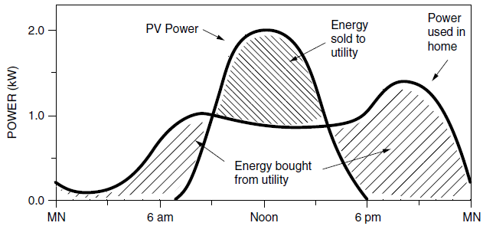
Grid connected systems: net metering
The System is connected to the utility; during the day, excess power from the array is sold to the utility; at night, the energy deficit is purchased from the utility
[Source: Masters 2004]

Slide 36
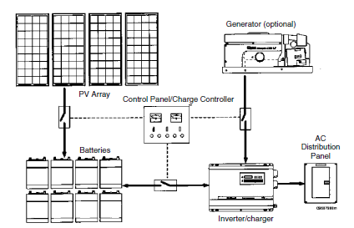
Stand-alone systems
In the stand-alone system, an inverter converts battery dc voltages into ac for conventional household electricity, but in very simple systems everything may be run on dc and no inverter may be necessary.
The charging function of the inverter allows the generator to top up the batteries when solar is insufficient
[Source: Masters 2004]

Slide 37
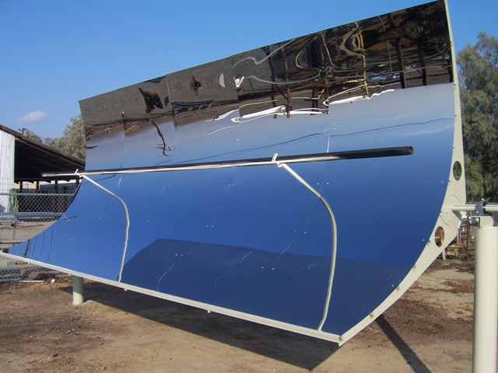
Solar Tracking Concentrators
Parabolic Trough Concentrator (PTC)
The PTC is the most common commercially available solar concentrator.
The PTC concentrates the solar radiation over a single line (of focus) where the absorber is located. They reach high Temperatures, up to 350°C.
PTC collectors usually track the sun with one degree of freedom using one of three orientations: east–west, north–south, or polar. A single axis solar tracking is then required. A very simple seasonal adjustment is also required on the other axis.
The absorber of a PTC is usually tubular, enclosed in a glass tube to reduce radiative and convective losses.

Slide 38
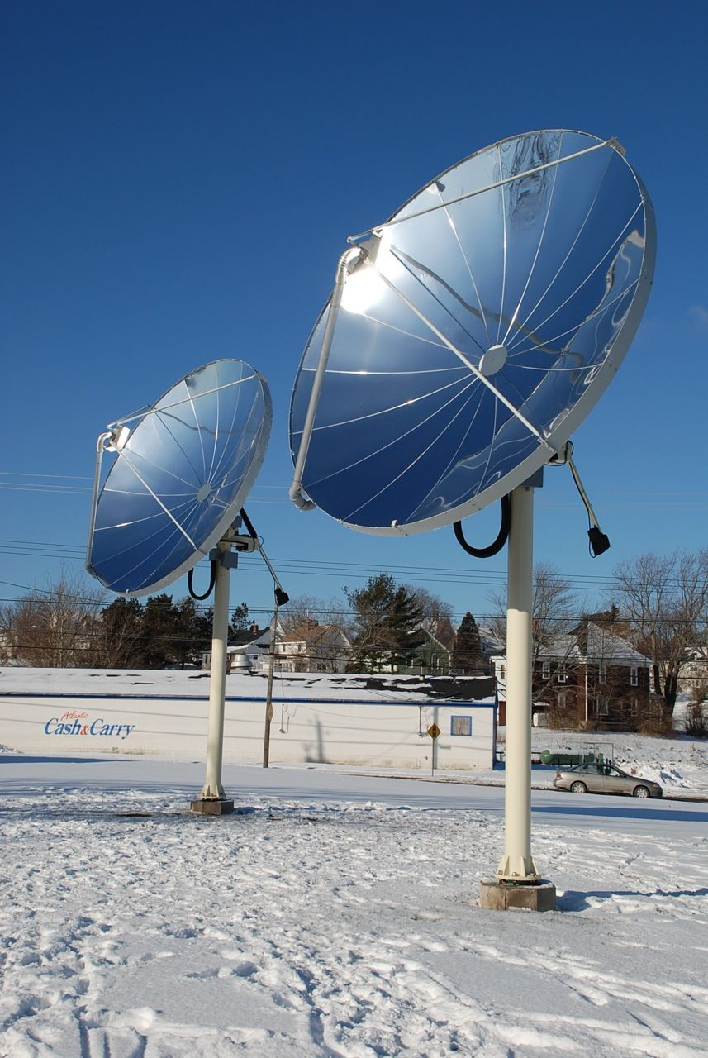
Solar Tracking Concentrators
Paraboloidal Concentrators
The paraboloid is a geometrical shape obtained by rotating a parabola about its optical axis.
The cross section ideal optics of such a reflector is the same as those of the PTC but, owing to the compound curvature, the focus occurs ideally at a point instead of along a line.
Paraboloidal concentrators reach a
CR = 500–3000 and
T=250°C – 500°C
A tracking device with two degrees of freedom is required.

Slide 39
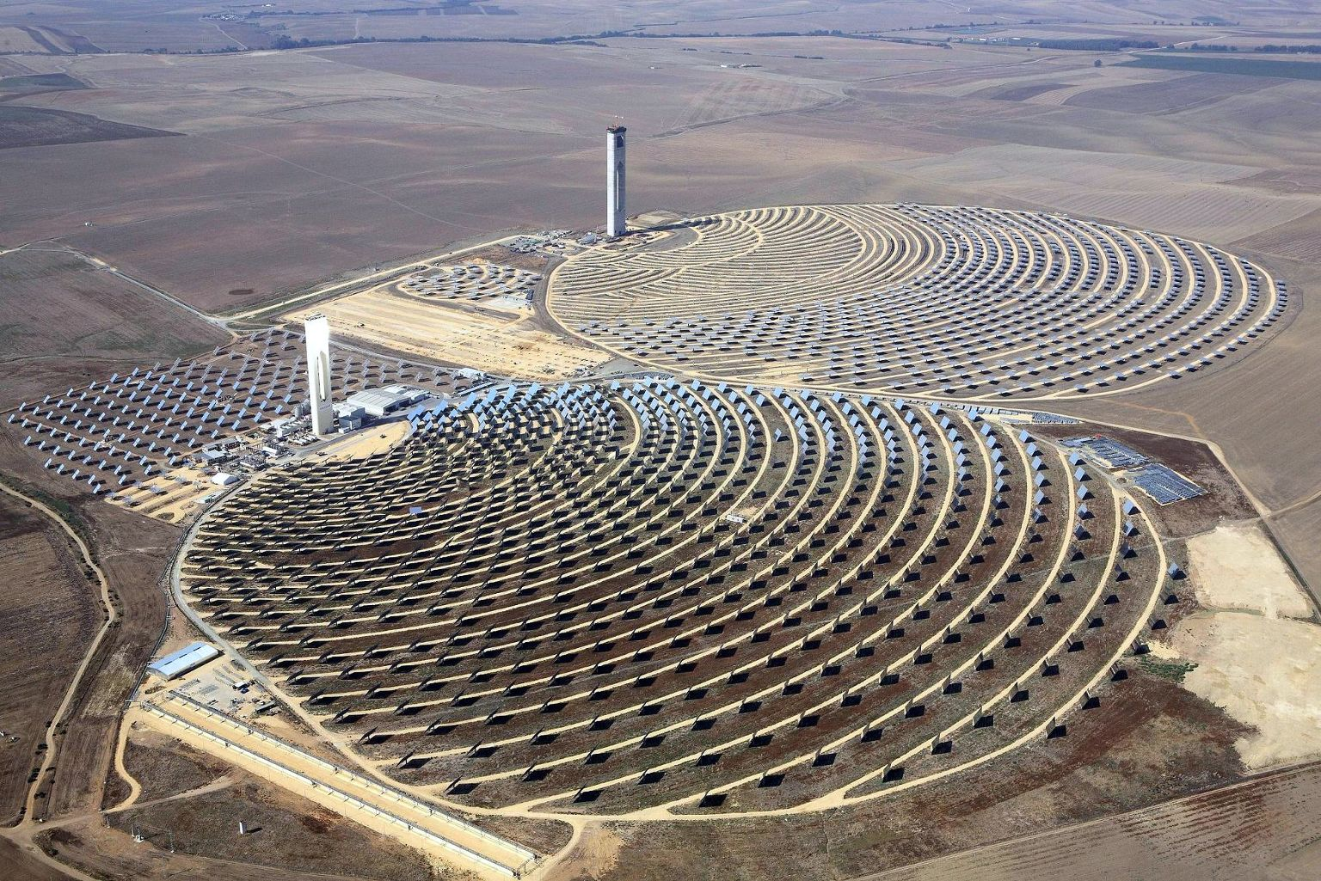
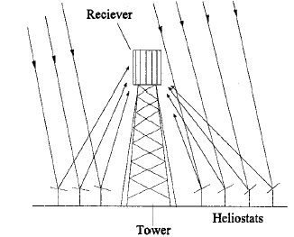
Solar Tracking Concentrators
Central Receiver Collectors
A central receiver collector consists of a large field of mirrors on the ground tracking the sun so that the reflected radiation is concentrated on a receiver/absorber on top of a tower.
The mirrors are called heliostats.
Central receivers can achieve temperatures ranging between 500°C and 1000°C or even higher.
A central receiver concentrator based power plant is suitable for thermal electric power production.

Slide 40
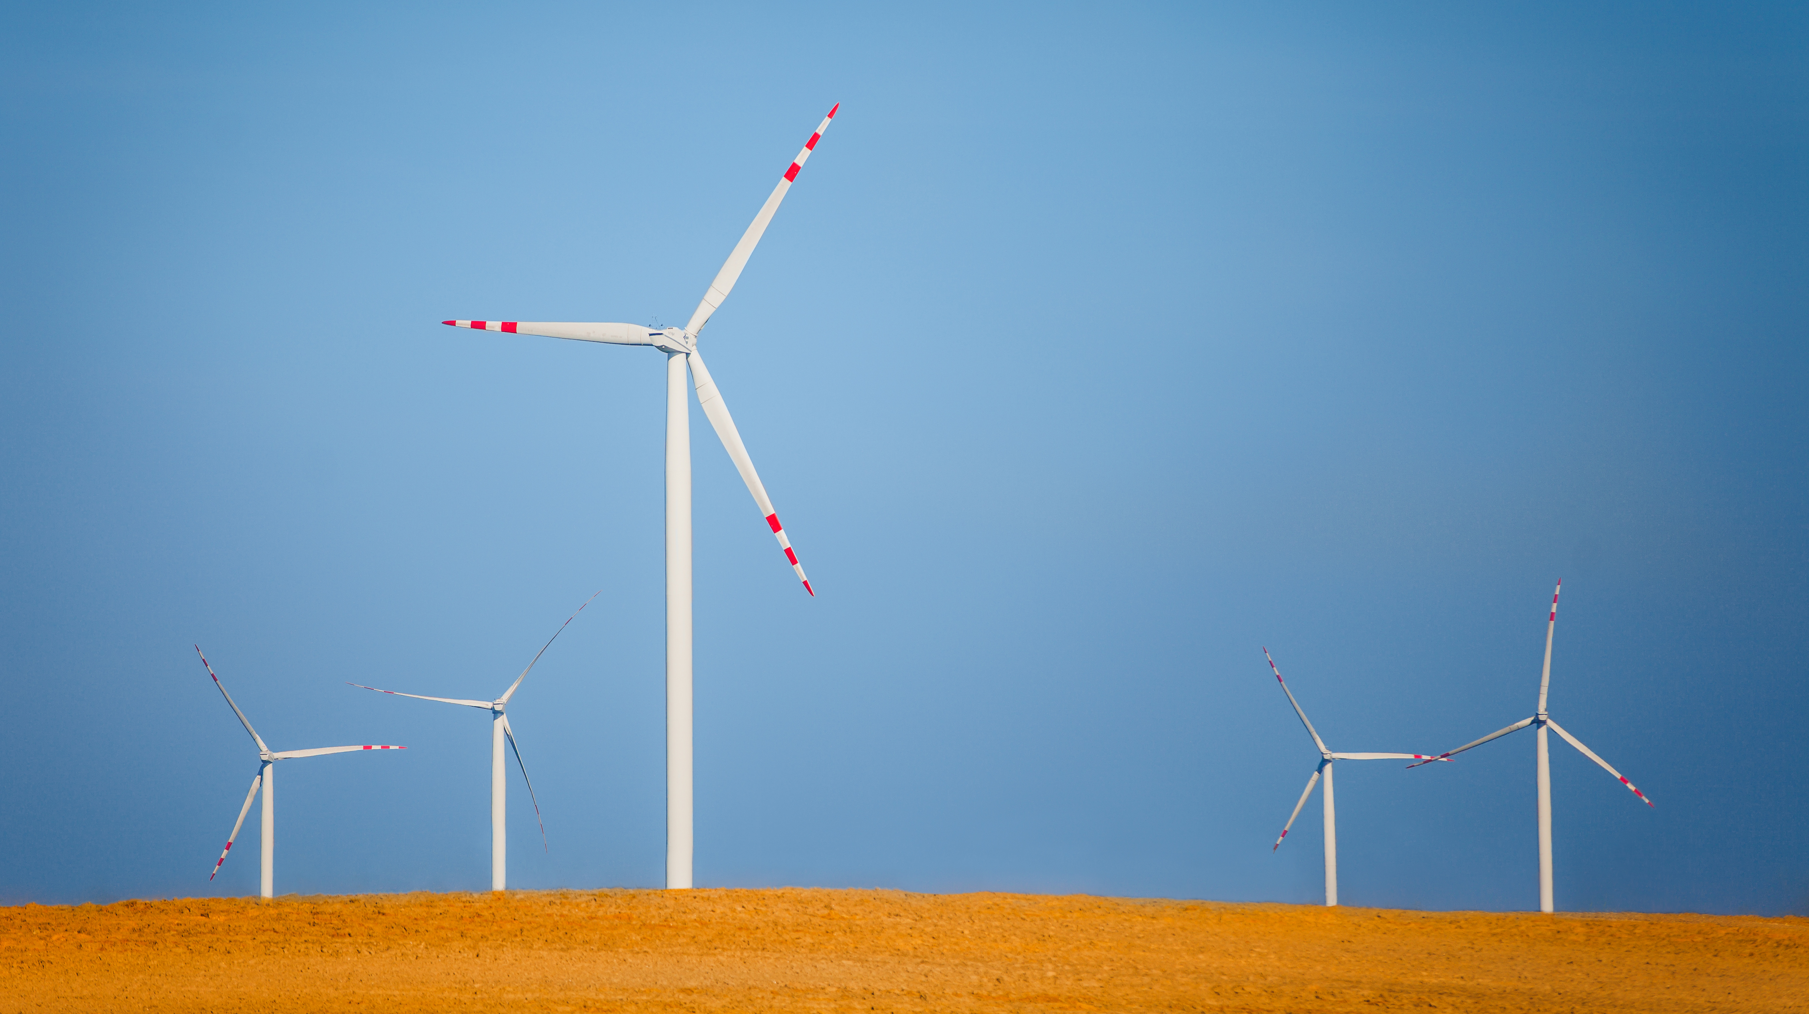
Wind Energy
Solar radiation maintains the movement of the air masses within the atmosphere of the earth.
Of the total solar radiation incident on the outer layer of the atmosphere, approximately 2.5% or 1.4 10²⁰ J/a are utilised for the atmospheric movement.
The energy contained in the moving air masses, that can be converted into mechanical and/or electrical energy by wind mills, is a secondary form of solar energy.
First windmills were developed for grain-grinding and water-pumping; earliest known design is Persian vertical axis system developed 500-900 A.D. but probably first development earlier in China
In Europe ~1400 Dutch Windmill (horizontal axis)
1888 first windmill for Electricity production (12 kW) from Charles Brush; then Paul La Cour in 1891
Modern Wind generators from 1970’s on
Image by gpointstudio on Freepik

Slide 41
Basic atmospheric concepts: where do winds come from?
The simple answer to this question is that air moves in response to pressure differences, or gradients, between different parts of the earth’s surface.
An air mass tends to move toward a zone of low pressure and away from a zone of high pressure. Left alone, the resulting wind would eventually equalize the pressure difference and die away.
The reason air pressure gradients never completely disappear is that they are continually being powered by the uneven solar heating of the earth’s surface.
When the surface heats up, the air above it expands and rises, and the pressure drops. When there is surface cooling, the opposite process occurs, and the pressure rises.
Owing to differences in the amount of solar radiation received and retained at different points on the earth’s surface, variations in surface temperature and pressure, large and small, are continually being created. Thus, there is always wind somewhere on the planet.

Slide 42
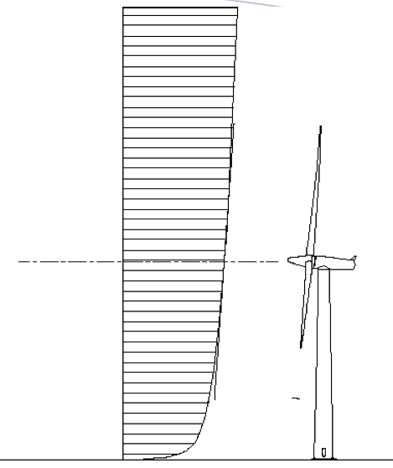
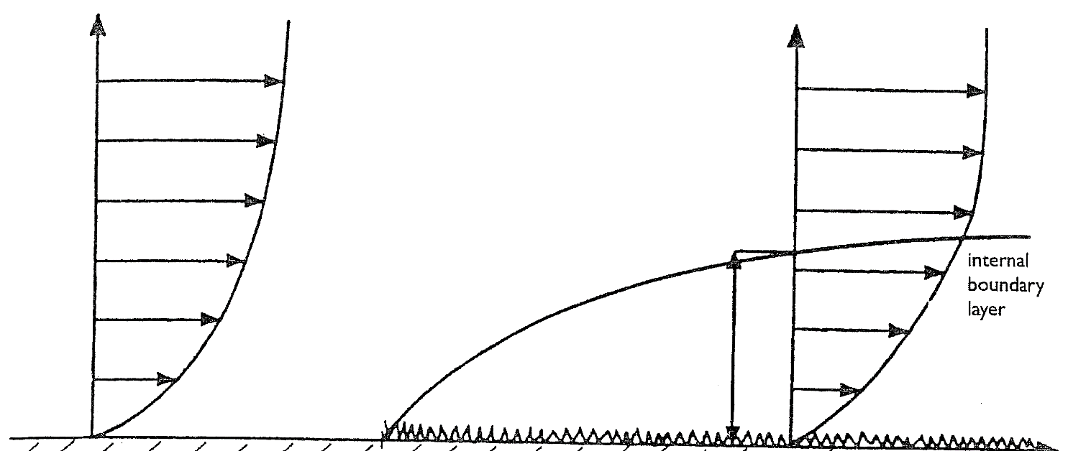
Wind Resource: wind shear / boundary layer
The variation in speed with height is known as wind shear.
Usually, shear is positive: speed increases with increasing height because of the declining influence of surface drag.
Knowing shear is important for projecting wind speed measurements from one height (such as the top of a mast) to another (such as the hub height of a turbine).
v_{o}
v=99%v_{o}
Wind Shear

Slide 43
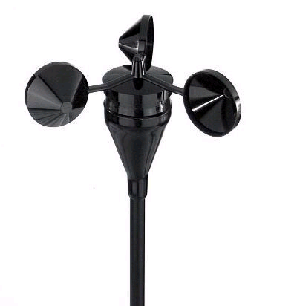
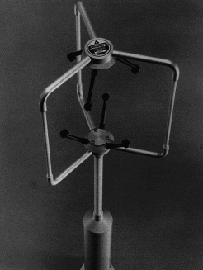
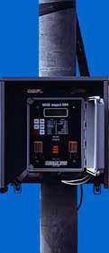
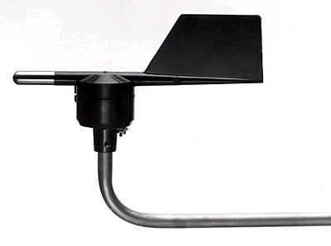

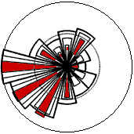
Anemometers
Speed
Direction
Data logger
Wind Measurement
speed and direction
  Anemometers
    Usually measures at 10, 20 & 40 m
    Precision
      Speed: 0.1 m/s in the range 5 - 25 m/s
    10 minutes average
    Take care of positioning
    (roughness, complex terrain, obstacles...)
Windrose for wind energy
Windrose for air pollution

Slide 44
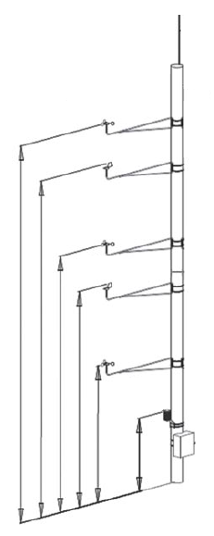
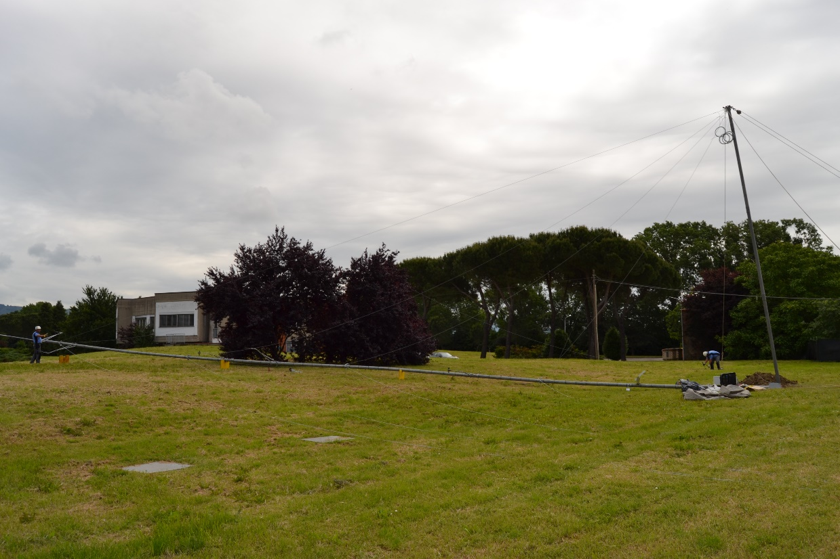
Mast: example
30m speed
28m direction
20m speed
18m direction
10m speed
3m temperature

Slide 45
Wind Measurement Campaigns
Wind measurement campaigns are typically extensive, spanning multiple years, often at least three, to comprehensively capture the wind characteristics of a specific location. These campaigns employ anemometers installed on masts, strategically positioned to measure wind speed and direction.
By collecting data at various heights above the ground (typically three distinct levels) these campaigns facilitate the reconstruction of the wind profile over the terrain, since wind speed tends to increase with increasing distance from the ground due to the diminishing effect of ground friction as one moves higher above the surface.
The data gathered from these anemometers at different heights contribute to the formulation of a comprehensive wind profile for the area under investigation. This detailed profile aids in understanding how wind patterns evolve and change across various elevations, providing crucial insights for wind energy projects.

Slide 46
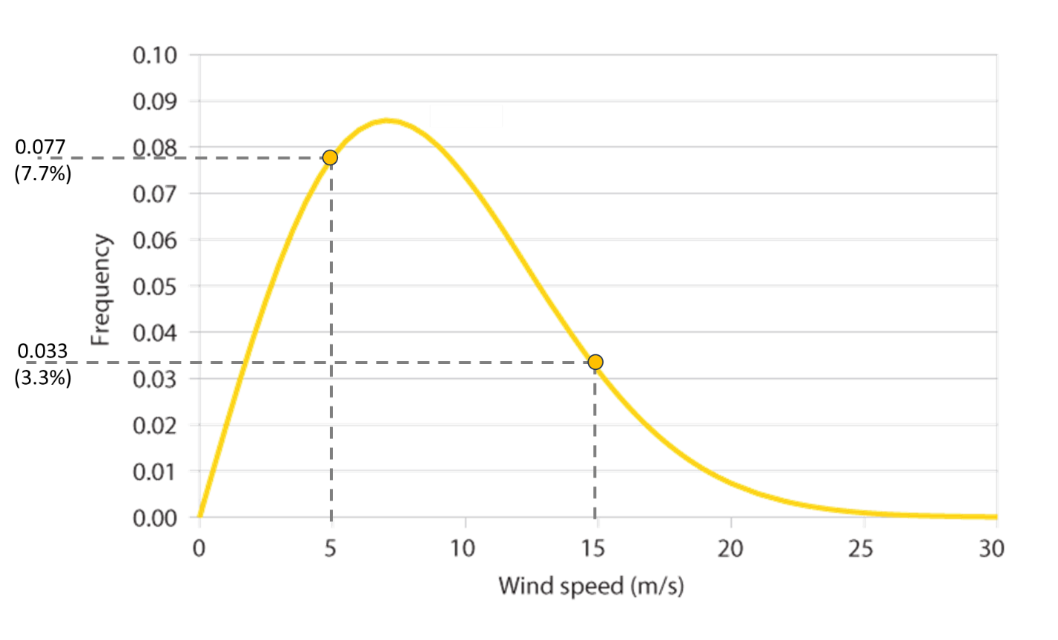
Wind Measurement Campaigns
The synthesis of this measurement data often involves statistical tools such as the Weibull curve and a wind rose. The Weibull curve helps in modelling wind speed frequency distribution, offering insights into the likelihood of different wind speeds occurring at the site. Meanwhile, the wind rose visually represents wind direction frequency, showcasing predominant wind directions and their occurrences throughout the measurement period.

Slide 47

Power of the Wind
P = (1/2) r A V3 = (1/2) r pR2 V3 = (1/2) r p(D2/4) V3
Doubling Wind Speed V → Power P increases 8 times
Doubling the Diameter D → Power P increases 4 times
Doubling the Area A → Power P increases 2 times
P = (1/2) ρ A V³
  ρ = Air density
  A = Considered Area
  V = Wind Speed
  Tipical values for air density ranges between
  0.9 – 1.4 kg/m³ (Standard value: 1.225 kg/m³ -minor values for warm climates and highest latitudes)
P.Gipe, 2002

Slide 48
Betz’s Elementary Momentum Theory
The essential findings derived from the momentum theory can be summarised in words as follows:
The mechanical power which can be extracted from a free-stream airflow by an energy converter increases with the third power of the wind velocity.
The power increases linearly with the cross-sectional area of the converter traversed, it thus increases with the square of its diameter.
Even with an ideal airflow and lossless conversion, the ratio of extractable mechanical work to the power contained in the wind is limited to a value of 0.593. Hence, only about 60 % of the wind energy of a certain cross-section can be converted into mechanical power.
Betz limit (or the ‘Betz–Joukowsky limit’) does not include the losses due to rotation of the wake, and therefore, it represents a conservative upper maximum.
Anyway, there is no interest in a wind turbine with high “efficiency” since the fuel of wind generators is for free; what’s important is the production of energy at the lowest price possible.

Slide 49

Wind generators: classification
There are several different design concepts for wind turbines. One basic classification is Horizontal Axis Wind Turbines (HAWT) versus Vertical Axis Wind Turbines (VAWT).
Horizontal Axis Wind Turbines can have the rotor upwind, that is, facing the wind or downwind so that the wind will pass the tower and nacelle before it hits the rotor.
Today most turbines have an upwind rotor, but there are turbines, from prototypes in the MW-class to smaller turbines with a nominal power of 20-150kW, as well as water pumping wind wheels from the 19th century, with downwind rotors.
T.Wizelius, 2007

Slide 50

Vertical Axis Wind Turbines
The specific advantages of vertical axis turbine concepts are that their basically simple design includes the
possibility of housing mechanical and electrical components, gearbox and generator at ground level and that
there is no yaw system.
This is countered by disadvantages such as its
low tip-speed ratio, its
inability to self-start,
not being able to control power output or speed by pitching the rotor blades,
bearing substitution implies disassembling the whole machine,
the generator operates also near the ground (lowest wind speeds) and
in some cases (i.e.Darrieus) guy cables have a high impact on the local environment.
Source: Hau, Wind Turbines

Slide 51

Horizontal Axis Wind Turbines
Wind energy converters, which have their axis of rotation in a horizontal position, are realised almost exclusively based on “propeller-like” concepts.
This design is the dominant design principle in wind energy technology today and, because of advantages listed in the following, wind turbines for generating electricity built to date mostly have horizontal-axis rotors.
The undisputed superiority of this design to date is largely based on the following characteristics:
In propeller designs, rotor speed and power output can be controlled by pitching the rotor blades about their longitudinal axis (blade pitch control).
Moreover, rotor blade pitching is the most effective protection against overspeed and extreme wind speeds, especially in large wind turbines.
The rotor blade shape can be aerodynamically optimised and it has been proven that it will achieve its highest efficiency when aerodynamic lift is exploited to a maximum degree.
The swept area is far from the ground, thus limiting the boundary layer effect.
In large-scale wind generator operators can reach the nacelle and directly operate on the mechanical and electrical components.
T.Wizelius, 2007
P.Gipe, 2002

Slide 52

Upwind or downwind
v
The rotor may be placed downwind or upwind of the tower.
In upwind rotors, both tail vanes and fan tails use the force of the wind itself to orient the rotor upwind of the tower. They passively change the orientation, or yaw, of the wind turbine with respect to changes in wind direction without the use of human or electrical power. Otherwise active yaw mechanisms drive the rotor upwind.
Downwind rotors don't necessarily need tail vanes or fan tails. Instead, the blades are swept slightly downwind, giving the spinning rotor the shape of a shallow cone with its apex at the tower. This coning of the blades causes the rotor to inherently orient itself downwind.
P.Gipe, 2002

Slide 53

Power Curve
A power curve shows how much electrical power a wind turbine will produce at different wind speeds. The curve can be calculated if the efficiency of the different components at different wind speeds is known.
However, the curve also has to be verified by measurements when the turbine is online. There are very specific rules for how such measurements should be performed, and independent certification institutes or companies carry them out to verify the power curve.

Slide 54


The annual energy production (AEP) is calculated by applying the normalized and averaged power curve to the reference wind speed frequency distribution.

Slide 55

Capacity Factor C_{F}
The Capacity Factor depicts the overall availability of a wind turbine including the wind regime for a certain site.
$$C_{F}=\frac{Annual Energy Yield (kWh)}{Rated Power \left(kW\right)∙8760h}$$

Slide 56

Equivalent Full-load Hours
Equivalent full-load hours are calculated from the annual energy yield divided by the turbine's rated power.
$$h_{eq}=\frac{Annual Energy Yield (kWh)}{Rated Power \left(kW\right)}$$
It represents the amount of hours per year the turbine should run at rated power to produce the same amount of energy.

Slide 57

Wind project development: from site selection to commissioning

Slide 58

Small wind generation for rural areas
Small Wind Turbines (SWTs) offer decentralized power solutions, providing energy independence and resilience, especially in areas with limited access to centralized electricity grids. While large wind farms cater to utility-scale electricity generation, SWTs continue to serve localized needs and specific applications, contributing to sustainable energy access and rural development worldwide. Some examples of applications are:
Households and Rural Areas.
Hybrid Energy Systems.
Direct Energy Services.
Rural Development.
Picture Credits: jannoon028 on Freepik

Slide 59

Biomass
Biomass to energy used by humanity form the discover of fire use for cooking, heating and later metallurgy
The term biomass includes all the organic materials coming from vegetables and animals (marine or soil origin) with the exclusion of the fossils, able to be used for energy production purposes
Biomass is solar energy fixed in organic material through photosynthesis
Picture Credits: prostooleh on Freepik

Slide 60


Multiple sources of biomass
Source: IEA ETP 2017

Slide 61

Biomass: CO₂ “neutral”
As biomass (forests, crops etc.) grow, CO₂ is removed from the atmosphere via photosynthesis, converted into organic carbon and stored into the biomass.
Trees and crops release the stored carbon when they die, decay or are combusted.
As the biomass releases carbon as CO₂, the carbon cycle is completed. The carbon in biomass will return to the atmosphere regardless of whether it is burned for energy, allowed to biodegrade or lost in a forest fire.
Overall, the flow of forest CO₂ is carbon positive when forests are sustainably managed, and the forest system remains a net sink of CO₂ from the atmosphere.

Slide 62

Overview of bioenergy pathways
Source: IEA Bioenergy Roadmap, 2017

Slide 63

Agriculture 4.0
Digital Farming (also known as Digital Agriculture or Agriculture 4.0) is represented by the use of automation and robotics, soil, plant and climate sensors, data processing and storage in the cloud, AI and connectivity. These are at the heart of a new agricultural revolution, creating what many are calling a new green revolution. Vast amounts of data, terabytes of information, are being collected to ensure the most efficient and sustainable use of finite agricultural resources such as land, water, labour and inputs. Much of this data is collected by drones, satellites and other platforms

Slide 64
Energy Storage
The role of wind and solar in electricity production is rapidly increasing but the integration of these intermittent, variable, and uncertain electric energy sources within the power grid places significant pressure on grid operation as the supply of electricity, especially from wind, cannot be fully controlled or rapidly predicted and easily matched with the demand.
Flexibility is the capability of a power system to cope with the variability and uncertainty that solar and wind energy introduce at different time scales, from the very short to the long term, avoiding curtailment of power from these variable renewable energy (VRE) sources and reliably supplying all customer energy demand.
Energy storage allows the shifting flexibility, by storing excess energy for later use when the production is not enough to cover the demand. Five different typologies of energy storage are usually used for classification: Chemical, Electrical, Electrochemical, Mechanical, and Thermal.

Slide 65


Main typologies of energy storage
Energy Storage distribution at Global Level (gesdb.sandia.gov)

Slide 66

Pumped Hydro Storage
Pumped Hydro Storage (PHS) plants are electric energy storage systems based on hydropower. They operate through the connection of two or more reservoirs with a hydraulic head. The lower and upper reservoirs are connected to each other through tunnels or penstocks.
A PHS plant operates thanks to the exchange of water between the two reservoirs. In production mode, also known as turbine mode, the plant operates like a conventional hydroelectric plant: water is released from the upper reservoir and passes through the turbines in order to generate electricity. In pumping mode, electrical power from the grid is used to pump the water from the lower reservoir to the upper one, thus allowing storing electric energy as potential energy in the form of elevated water for on demand generation.

Slide 67

The concept of Agri-Photovoltaics (APV)
Under the regulated shadow of the APV system (1) crops (2) grow with less water needs, animals (3) may find shadow, and tractors (4) can operate without interfering with the PV structures and panels (5).
Electricity can be either self-consumed (6), sold following Power Purchase Agreements with local residentials and industrial estates (7), or it can be fed into the power grid (8).

Slide 68

Agri-Photovoltaics: a Win-Win solution
Category I (DIN SPEC 91434):
Overhead PV with vertical clearance > 2.1 m
Farming under the APV system
A_{L} Cultivatable agricultural areas
A_{N} Uncultivatable agricultural areas
h₁ Clearance height below 2.1 m
h₂ Clearance height above 2.1 m
1 Examples of PV modules
2 Mounting structure
3 Examples of crops
Credits: Fraunhofer ISE

Slide 69

Agri-Photovoltaics: a Win-Win solution
Category II (DIN SPEC 91434) Variant 1:
Interspace PV with vertical clearance < 2.1 m
Farming between the rows of APV systems
A_{L} Cultivatable agricultural areas
A_{N} Uncultivatable agricultural areas
h₁ Clearance height below 2.1 m
h₂ Clearance height above 2.1 m
1 Examples of PV modules
2 Mounting structure
3 Examples of crops
Credits: Fraunhofer ISE

Slide 70

Agri-Photovoltaics: a Win-Win solution
Category II (DIN SPEC 91434) Variant 2:
Interspace PV with vertical clearance < 2.1 m
Farming between the rows of APV systems
A_{L} Cultivatable agricultural areas
A_{N} Uncultivatable agricultural areas
h₁ Clearance height below 2.1 m
h₂ Clearance height above 2.1 m
1 Examples of PV modules
2 Mounting structure
3 Examples of crops
Credits: Fraunhofer ISE

Slide 71

Micro and pico hydro power
Micro and pico hydro power are a feasible option for generating off-grid electricity in remote areas with accessible flowing water.
These systems provide reliable power, reducing reliance on distant grids. Economically, they offer a cost-effective alternative for local electricity generation in challenging, remote regions where grid extension is impractical.
Additionally, strategic reservoir or small dam designs can serve dual purposes as energy storage and irrigation reservoirs.
Picture Credits: Intechopen

Slide 72
Off-Grid
Off-grid renewable energy systems generate power independently from the main grid, commonly utilized in remote areas. They harness various renewable energy sources depending on local availability.
Designing these systems starts with evaluating energy needs based on usage patterns. Understanding resource availability and variability is crucial for sizing power plants and storage capacity. Solar energy is typically the primary solution due to its cost-effectiveness.
Hydropower and wind can complement solar during low radiation periods. Biomass is used for heat, and geothermal energy is viable in select locations.
Balancing load and supply is vital, achieved through electricity and heat storage. Hybrid systems combining renewables provide reliability, especially in diverse climates. Adapting technologies to local conditions ensures successful off-grid applications.

Slide 73

Off-grid solutions: areas of application

Slide 74
Conclusions
Agriculture and renewable energy have been closely linked since ancient times.
Before the industrial era, most energy was produced by burning biomass.
Despite the advent of the fossil fuel era, biomass remains an important source of energy in developing countries.
The agricultural sector has new opportunities to contribute to reducing carbon dioxide emissions throughout the production chain due to the environmental challenges posed by carbon dioxide emissions following industrialisation.
This can be achieved not only through the traditional use of biomass but also through advanced renewable energy technologies such as solar photovoltaic and wind power, as well as the digital revolution, which supports better and more efficient farming practices.

Slide 75


