Slide 2
Course: HEI
Module: Agricultural sustainability, management of natural resources and climate action
Learning Unit: Climate change
Author: UAZORES

Slide 3
Introduction
In this learning unity (LU), students will learn about climate changes and their effects on the different components of agriculture such as weather, available water, erosion, organic matter, salinization, soil biodiversity loss, landslides, desertification and flooding, etc. The way to control some of these transformations, through a change in the type of culture carried out or other cultural techniques, among other alternatives, will be fully discussed in this LU.
After the completion of this LU, the learner will:
Knowledge
Identify and discuss the fundamental concepts of climate system, including the drivers of climate changes;
Identify and assess the specific impacts of climate change in agriculture;
Describe the role of climate models;
Identify the effect of these climate changes on agriculture.
Skills
Analyze and debate mitigation strategies in agriculture to reduce greenhouse gas emissions;
Develop and propose adaptation strategies in agriculture.
Competences
Assess and analyze specific effects of climate change on agriculture;
Formulate plans of action to adapt agricultural practices to potential climate change impacts;
Identify climate-change induced impacts and changes within agricultural systems.

Slide 4
Subunit 1: Climate Systems and climate change: Introduction to the Earth´s system and basic mechanisms of climate change

Slide 5
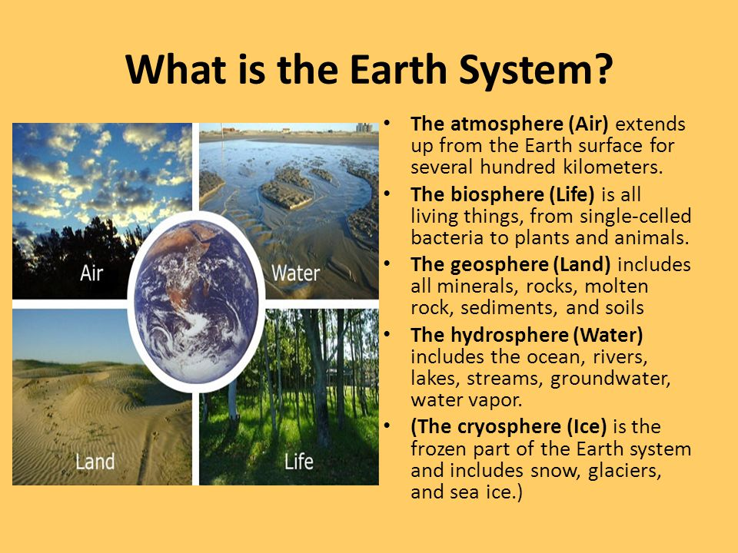
Introduction to the Earth System
The climate system is a complex and non-linear system, a set of complex interactions between the atmosphere, oceans and land surfaces, resulting from their characteristic internal dynamics and external influences. The system is composed of five subsystems, or spheres, on Earth, each one interacting with the other subsystems.

Slide 6
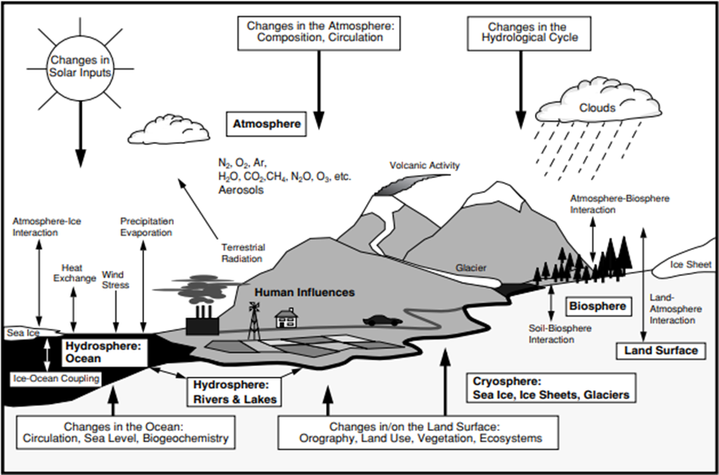
Introduction to the Earth System
The climate system is an interactive system forced or influenced by various external forcing mechanisms, the most important of which is the Sun. Also, the direct effect of human activities on the climate system is considered an external force.

Slide 7
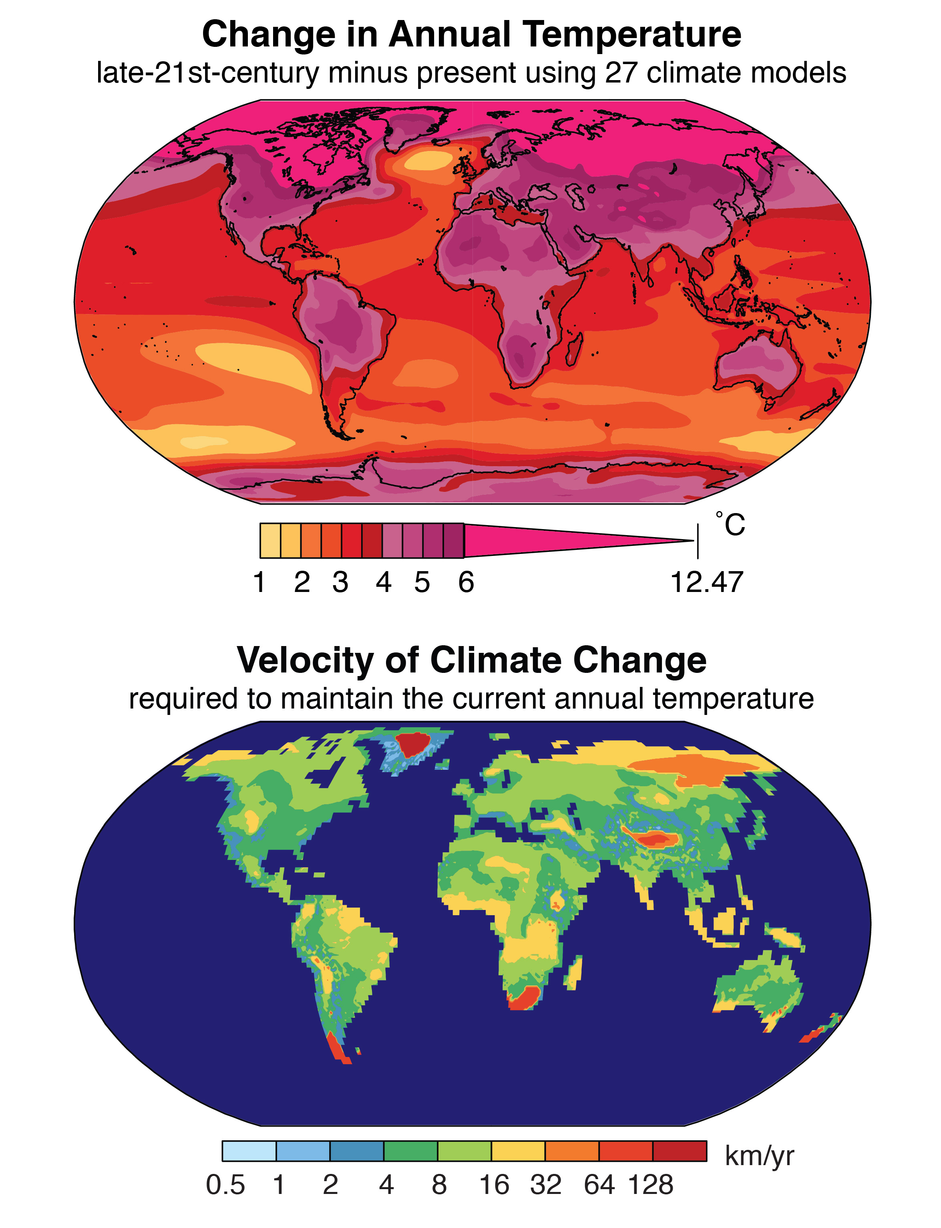
Basic mechanisms of climate change
Climate change is present throughout Earth’s history. As the planet changes through continental drift and the oceans change their size, sea currents are modified, and areas turn from warm into cold to warm again. These events happen within a millennial time span. Presently climate change occurs much faster and is one of the most complex issues involving several dimensions, from science to economics, society, and politics
Top: The change in annual temperature projected for the late 21st century using simulations from 27 global climate models. The change is calculated as the 2081-2100 mean minus the 1986-2005 mean. Bottom: The velocity of climate change required to maintain the current annual temperature should the late-21st-century climate change occur. The velocity is calculated for each location by identifying the closest location in the future climate that has the same annual temperature as the starting location has in the present climate. Credit: Noah Diffenbaugh

Slide 8
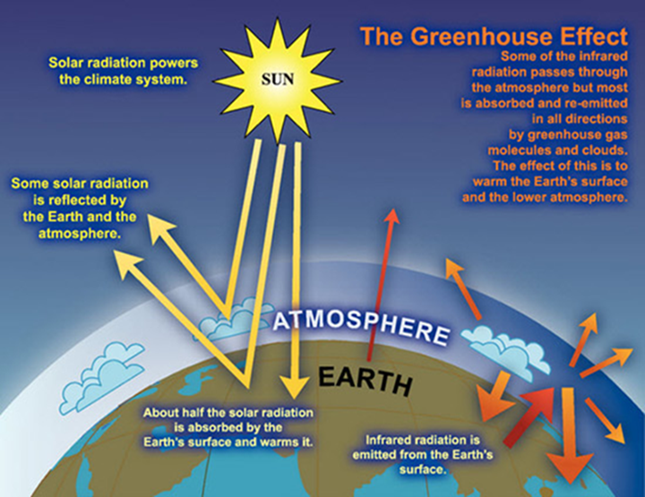
The Greenhouse Effect
The Earth’s dry atmosphere is composed mainly of nitrogen (N2, 78.1% volume mixing ratio), oxygen (O2, 20.9% volume mixing ratio), and argon (Ar, 0.93% volume mixing ratio.
Other gases, such as carbon dioxide (CO2), methane (CH4), nitrous oxide (N2O), and the halocarbons such as the chlorofluorocarbons, absorb and emit infrared radiation. These so-called greenhouse gases, with a total volume mixing ratio in the dry air of less than 0.1% by volume, play an essential role in the Earth’s energy budget.
The atmosphere also contains water vapor (H2O), which is also a natural greenhouse gas. Its volume is typically in the order of 1%.
These greenhouse gases absorb the infrared radiation emitted by the Earth and tend to raise the temperature near the Earth’s surface.

Slide 9
Human Influence on Greenhouse Gases
Human activities have led directly to increases in greenhouse gas concentrations and therefore an enhanced greenhouse effect, causing warming on the Earth’s surface. In the period 2011-2020, the global temperature was 1.1°C higher than the reference period (1850-1900).
The current trend in gas emissions makes it very likely that warming will exceed 1.5°C this century and makes it more difficult to limit warming below 2°C. In the worst-case scenario, an average temperature increases of 4.4°C is assumed at the end of the century.
The 2007 (IPCC) Fourth Assessment’s Report (AR4) emphasized the clear link between human-caused greenhouse gases and observed climate changes.
The 2014 IPCC Assessment (AR5) strengthens this link even further, observing that "Human influence has been detected in warming of the atmosphere and the ocean, in changes in the global water cycle, in reductions in snow and ice, in global mean sea level rise, and in changes in some climate extremes. This evidence for human influence has grown since AR4. It is extremely likely (95-100% certainty) that human influence has been the dominant cause of the observed warming since the mid-20th century” (IPCC 2013, Summary for Policymakers)

Slide 10
Climate models and predictive tools: Introduction to climate models and their role in understanding climate change
Climate models
Climate models are systems of differential equations based on the basic laws of physics, fluid motion, and chemistry.
Climate models are mathematical representations of the climate system, expressed as computer codes and run-on powerful computers.
One source of confidence in models comes from the fact that model fundamentals are based on established physical laws, such as the conservation of mass, energy, and momentum, along with a wealth of observations.
A second source of confidence comes from the ability of models to simulate important aspects of the current climate.
Models are routinely and extensively assessed by comparing their simulations with observations of the atmosphere, ocean, cryosphere, and land surface.

Slide 11
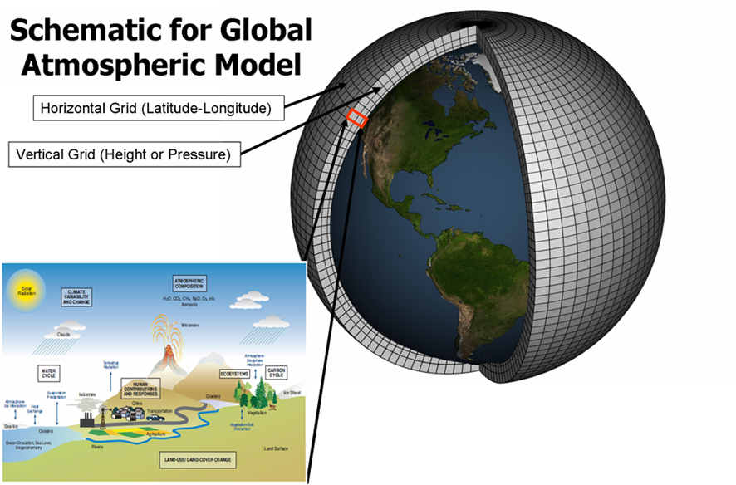
Climate models
Usually, models consist on overlapping a 3d grid over the designated area that can include the entire planet, apply the equations and observe and evaluate the results.
Atmospheric models are based on data obtained for at least 30 years on winds, temperature, radiation, relative humidity, and surface hydrology and calculate the equations using this information within each grid and evaluate interactions with neighboring points to produce a concept for the past climate and propose future climate.
Schematic for global atmospheric Model

Slide 12
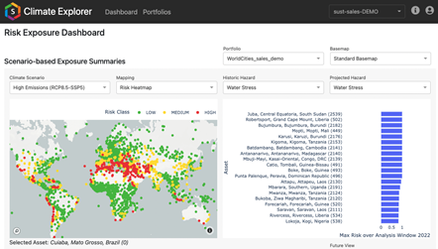
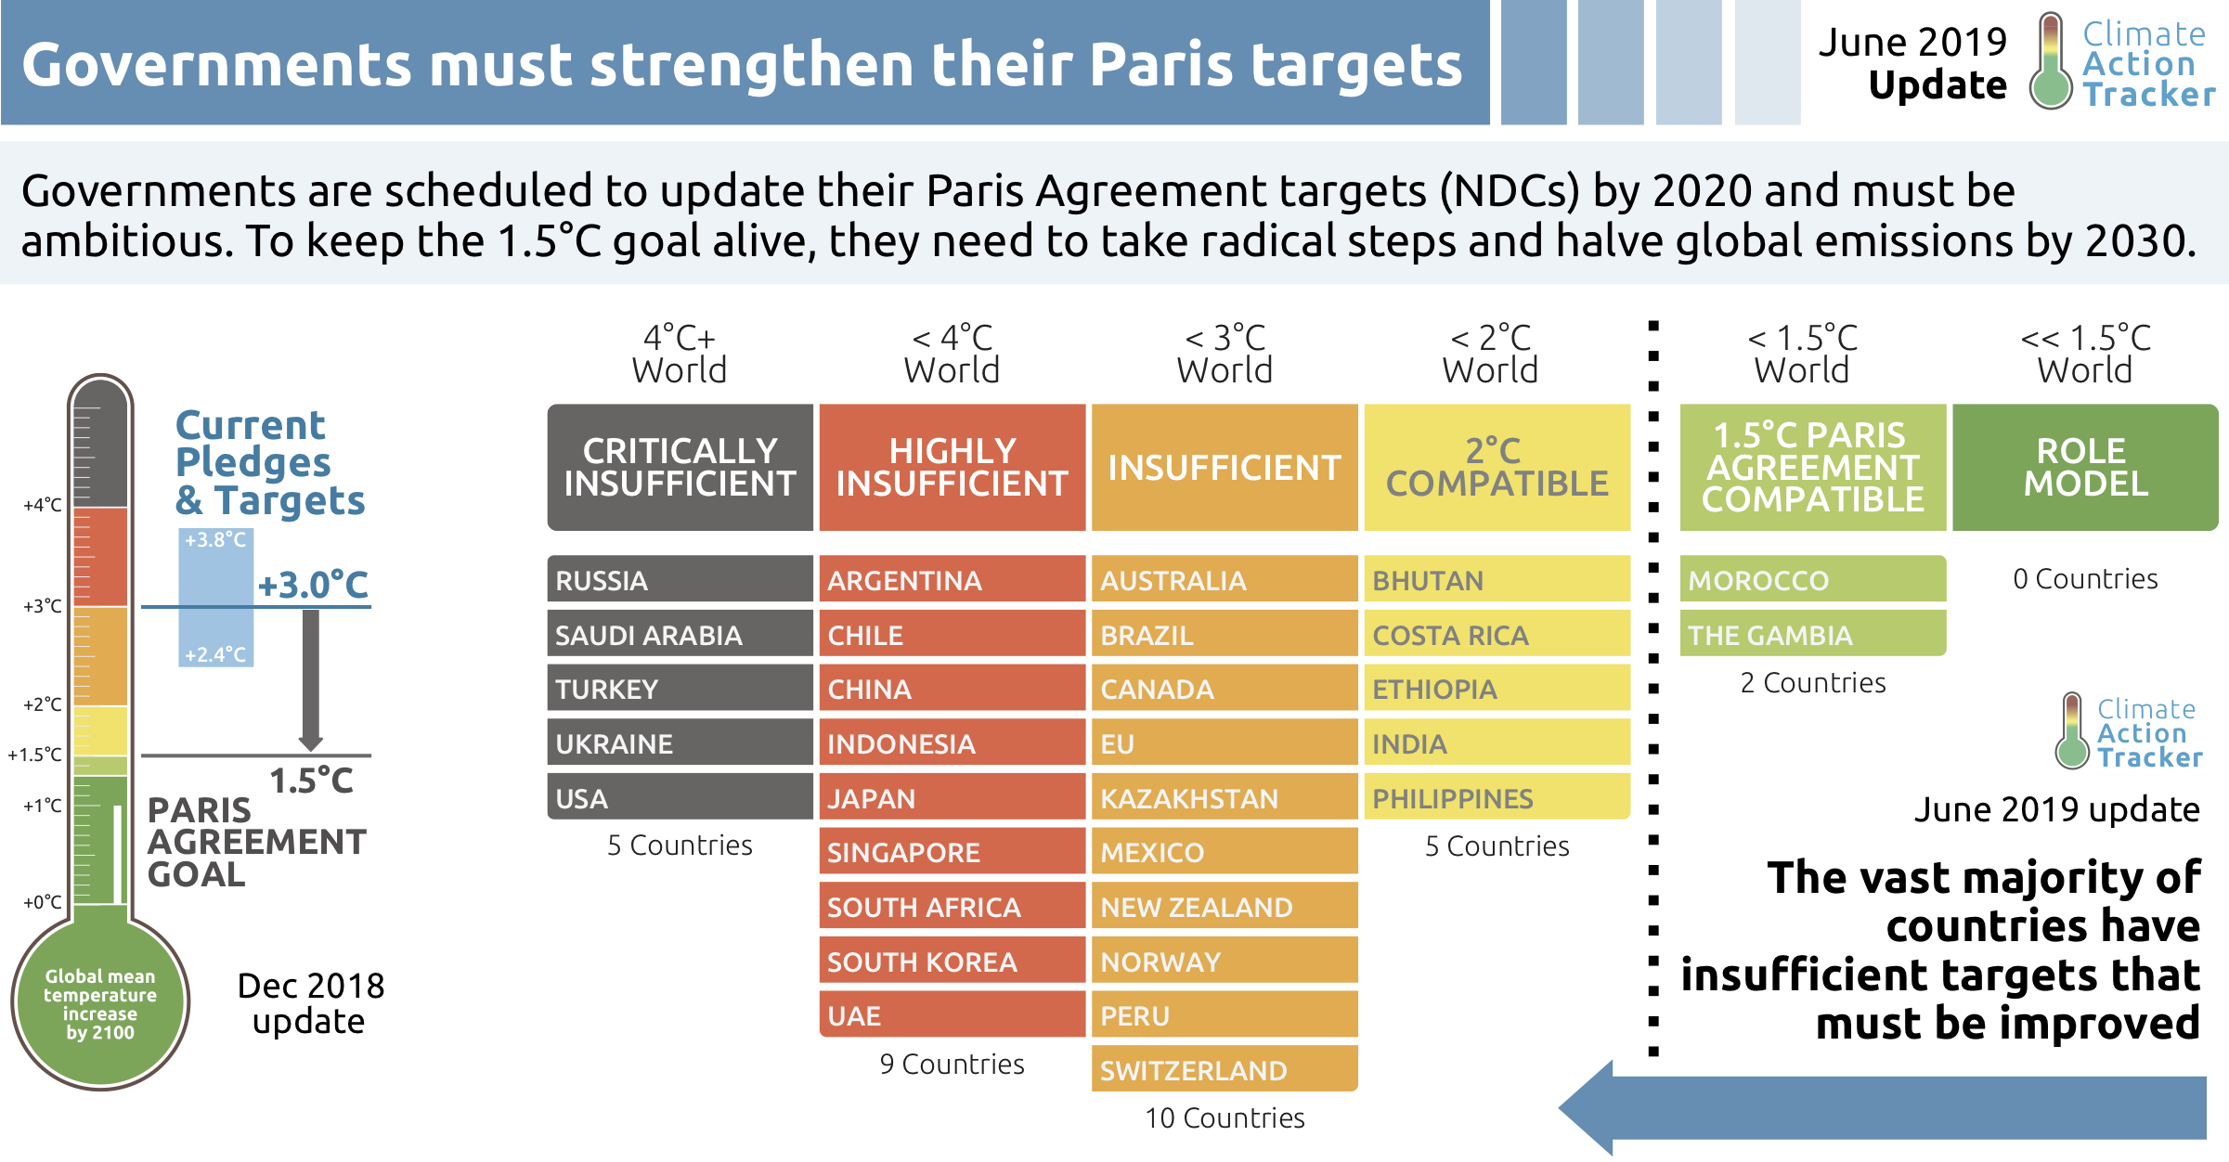
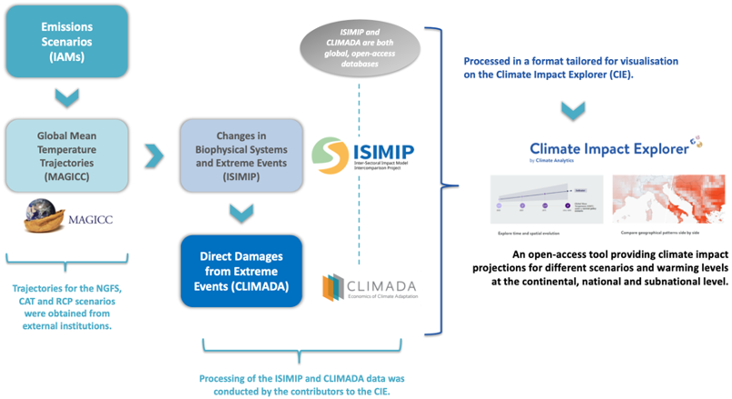
Predictive tools
Example of predictive tools:
Climate risk dashboard: The Climate risk dashboard (BETA) allows you to explore future impacts from climate change as the world warms.
Climate Action Tracker: The Climate Action Tracker is an independent scientific analysis that tracks government climate action and measures it against the globally agreed Paris Agreement aim of "holding warming well below 2°C, and pursuing efforts to limit warming to 1.5°C."
Climate impact explorer: This tool shows how the severity of climate change impacts will increase over time in regions, countries and provinces at different levels of warming, starting with 1.5°C, the limit in the Paris Agreement. It also allows access to the underlying data.

Slide 13
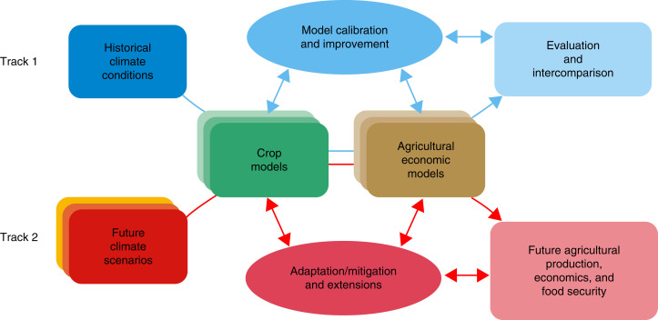
Climate models in agriculture
Agriculture is sensitive to weather variation, with special emphasis on temperature and rainfall.
The variations observed in recent weather propose a higher frequency of the occurrence of extreme events with potential damaging effects in agriculture.
Models based on crop-climate statistics, or agroecological zone indicators derived from climate and soil information combined with simple soil water budget estimates.
These approaches are useful to assess large scale trends in crop-climate relationships but cannot capture non-linear responses and tipping-points and the representation of farming management practices is limited in these approaches
Crop simulation Model, na overview

Slide 14
Subunit 2: Climate models and predictive tools: Introduction to climate models and their role in understanding climate change

Slide 15
How climate change is and will affect agriculture
Most agriculture practices are intrinsically connected with weather and climate conditions. The effects of climate change on agriculture will depend on the rate and severity of the change, as well as the degree to which farmers and ranchers can adapt.
As climate changes, it impacts agriculture due to alterations of variables such as:
carbon dioxide concentrations,
average temperature,
precipitation frost timing,
frequency/timing of extreme weather events.
These parameters affect crops specifically, for instance:
CO2 levels affect plant photosynthesis and respiration,
average and extreme temperatures influence crop development,
combined factors like higher temperatures and uneven rainfall increase water stress for crops,
indirect effects such as pests and diseases might promote additional crop damage.

Slide 16
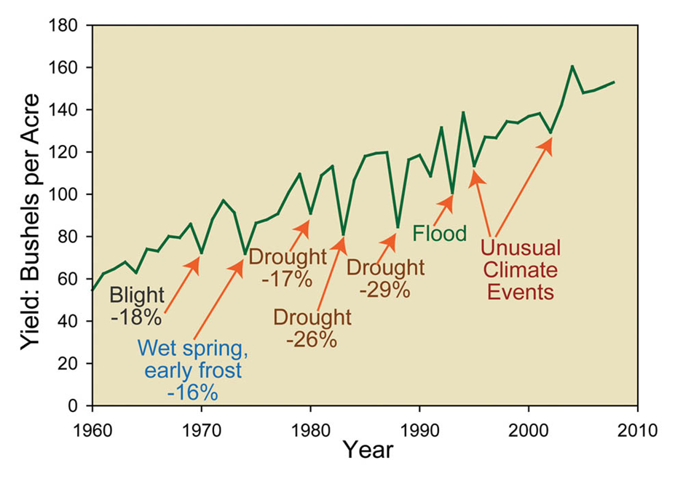
Changes in Agricultural Productivity
As climate changes, conditions for optimal agriculture will vary, affecting productivity differently depending on the region and the crop.
Farmers will have to adjust their practices to enhance their productivity according to their specificities.

Slide 17
Impacts to Agricultural Workers and Livestock
Heat and humidity can affect the health and productivity of animals raised for meat, milk, and eggs. Furthermore, livestock will be exposed to direct stress from heat and indirect from reduced quality of their food supply.
Agricultural workers also face climate-related health risks such as exposures to heat and other extreme weather, more pesticide exposure due to expanded pest’s presence, disease-carrying pests like mosquitos and ticks, and degraded air quality.
Climate change threatens to reverse the progress made so far in the fight against hunger and malnutrition, as highlighted by the IPCC AR5. Specifically, climate change increases and intensifies risks to food security for the most vulnerable countries and populations. Four out of the eight key risks induced by climate change identified by IPCC AR5 have direct consequences for food security:
Loss of rural livelihoods and income,
Loss of marine and coastal ecosystems, and livelihoods,
Loss of terrestrial and inland water ecosystems, and livelihoods,
Food insecurity and breakdown of food systems.

Slide 18
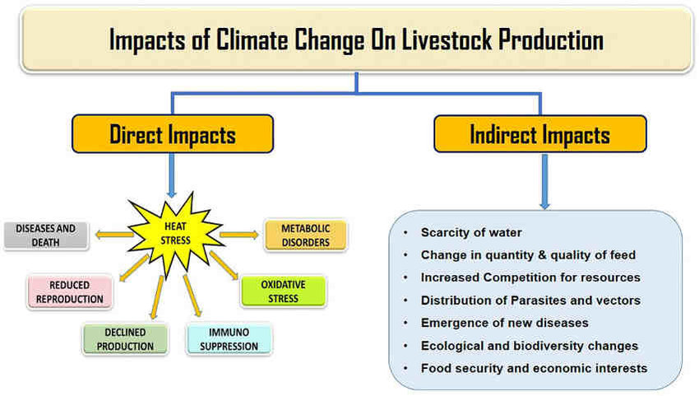
Impacts to Agricultural Workers and Livestock

Slide 19
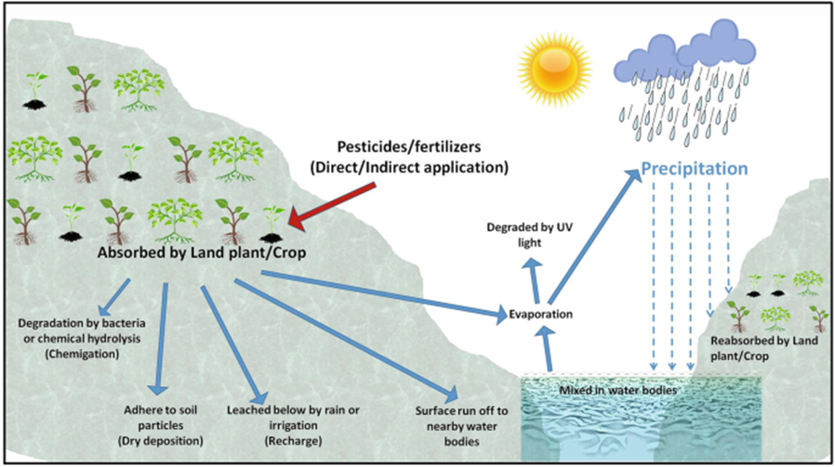
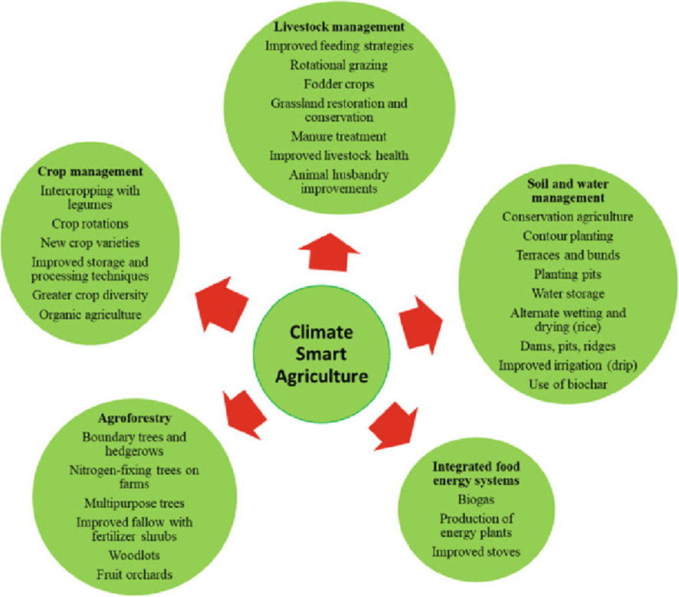
What can be done
It is crucial to engage students, key players, and policy makers in climate change discussions. Therefore, it is important to have time allocated to the discussion of the impacts of climate change on agriculture while at the same time considering what adjustments may be doable for farmers and ranchers. With that respect, a few suggestions may be:
Planting a pollinator-attracting garden with native species, which will help bees and butterflies thrive;
Incorporate research into the production, namely concerning by improving pollination and reducing pesticide use;
Incorporate climate-smart farming methods to adjust crop management;

Slide 20
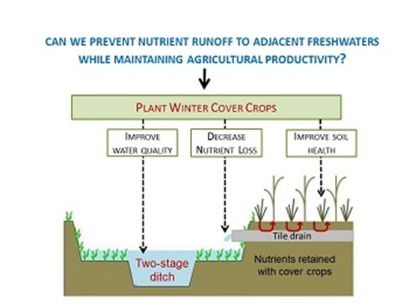
What can be done
It is crucial to engage students, key players, and policy makers in climate change discussions. Therefore, it is important to have time allocated to the discussion of the impacts of climate change on agriculture while at the same time considering what adjustments may be doable for farmers and ranchers. With that respect, a few suggestions may be:
Recover methane or reduce emissions from livestock producers;
Improve application of fertilizers to avoid runoff;
Improve of crop resistance.

Slide 21
Subunit 3: Mitigation, adaptation and carbon dioxide removal strategies

Slide 22

Mitigating climate change means reducing the flow of heat-trapping greenhouse gases into the atmosphere:
reducing the use of the sources of these gases (for example, the burning of fossil fuels for electricity, heat, or transport), or/and
enhancing the “sinks” that accumulate and store these gases (such as the oceans, forests, and soil).
The goal of mitigation is to avoid significant human interference with Earth’s climate, “stabilize greenhouse gas levels in a timeframe sufficient to allow ecosystems to adapt naturally to climate change, ensure that food production is not threatened, and to enable economic development to proceed in a sustainable manner”.

Slide 23
Mitigation
The measures adopted by the EU in different sectors to mitigate the Greenhouse effect, with the Green Deal, 2020, aiming at turning the European Union (EU) climate neutral in 2050 (https://commission.europa.eu/strategy-and-policy/priorities-2019-2024/european-green-deal_en ), encompass all responsible sectors:
Power stations and industry: a first important step to cut emissions was the implementation of the first Emissions Trading System (ETS) also called “carbon market”.
Industry emissions cut in 62% by 2030.
Transport: proposal to reach zero CO₂ emissions from new cars and vans in the EU by 2035, and adopted the revised proposal to phase out free allowances for aviation by 2026 and promote the use of sustainable aviation fuels.
Deforestation and land use: take advantage of the CO₂ absorption power of forests to fight climate change. The new rules will increase EU carbon sinks in 15% by 2030. Agriculture has a positive and important role to play in climate change mitigation: the crops, hedgerows, and trees found on farmland sequester carbon from the atmosphere through photosynthesis, while properly managed soils provide carbon storage.

Slide 24

Import from countries with lower climate ambitions: impose a carbon price on imports from carbon-intensive industries outside the EU with the objective of fighting relocation of industries to countries with less ambitious climate targets.
Boosting renewable energies and energy efficiency: The share of renewables in the EU’s final energy consumption should increase to 42.5% by 2030, whilst individual countries should aim for 45%.
In addition, the EU expects a 40% reduction in final energy consumption and 42.5% in primary energy consumption by 2030.
It is expected the creation of a sustainable and circular economy based on renewable energy share and energy efficiency by 2050.
The transition to a carbon-neutral EU by 2050 under the Green Deal means reconsidering the entire life cycle of products as well as promoting sustainable consumption and the circular economy. This should lead to a reduction in the consumption of resources, less waste and fewer greenhouse gas emissions.

Slide 25
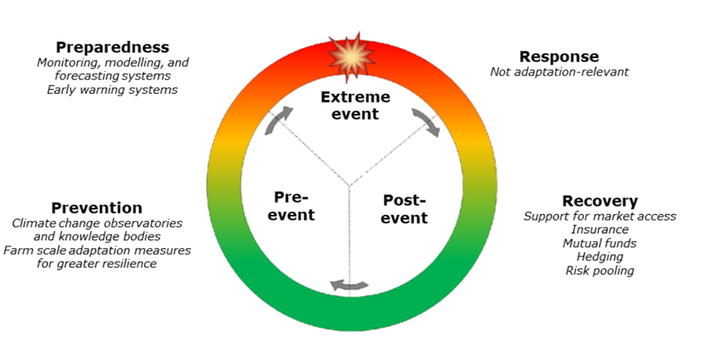
Adaptation – adapting to life in a changing climate
There are many solutions available for the sector to increase its adaptive capacity as regards adverse climate events and make agriculture more climate-resilient (European Commission, 2017). While no definitive typology of adaptation options exists, several classifications are possible based on the scale at which they are managed or implemented, the type of product they can be applied to, the nature of the option, the climate risk addressed, and the time scale necessary for its implementation, among others.
To describe the timing of the implementation of “top-down” adaptation options, the disaster risk management cycle is a useful parallel.

Slide 26
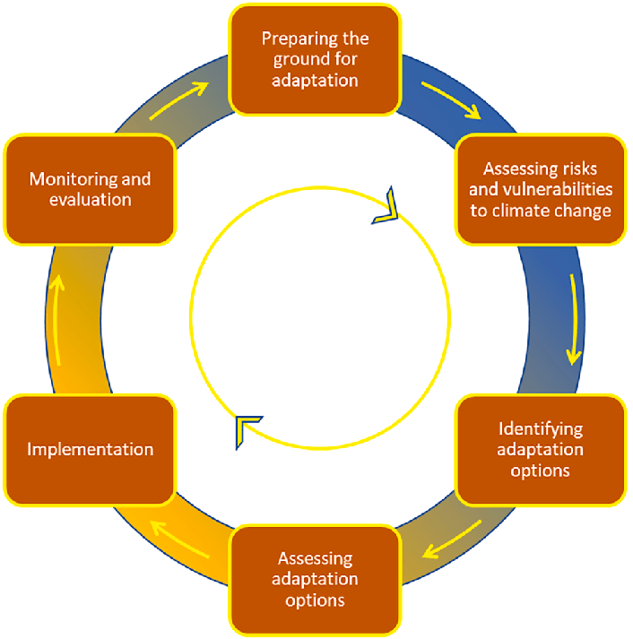
Adaptation – adapting to life in a changing climate
The 6-phase adaptation management cycle -the emphasis of information needs changes over time from mainly climate risk data (blue) towards socio-economic information on solutions (orange). Different project hubs are in different phases, but cannot easily be positioned in the cycle because often more than one stage is addressed simultaneously and during the planning process earlier phases are revisited. Colors added by the authors to the cycle as it is commonly used in Europe

Slide 27
Carbon dioxide removal (CDR)
Enhanced greenhouse gases and average temperature are affecting climate, biota and societies and reducing emissions will not be sufficient to maintain the temperature increase under 1.5 ⁰ C. Therefore, it is imperative to investigate strategies that, if safe to the environment, should be implemented urgently. CDR or simply carbon removal, is a process in which carbon dioxide gas (CO2) is removed from the atmosphere by deliberate human activities and durably stored in geological, terrestrial, or ocean reservoirs, or in products.
CDR methods include:
Afforestation/ reforestation;
Soil carbon sequestration in croplands and grasslands;
Peatland and coastal wetland restoration;
Agroforestry, improved forest management;
Biochar carbon removal (BCR);
Direct air carbon capture and storage (DACCS), bioenergy with carbon capture and storage (BECCS);
Enhanced weathering (alkalinity enhancement);
'Blue carbon management' in coastal wetlands (restoration of vegetated coastal ecosystems; an ocean-based biological CDR method which encompasses mangroves, salt marshes and seagrass beds);
Ocean fertilization, ocean alkalinity enhancement that amplifies the Oceanic carbon cycle.

Slide 28
Subunit 4: Climate policies and international agreements.

Slide 29
Climate policies and international agreements
The European Green Deal, approved in 2020 a set of policy initiatives by the European Commission (EC) whose overall objective is to make the European Union (EU) climate neutral by 2050, but also to limit the adverse effects of climate change, move towards a clean and circular economy, reverse biodiversity loss and reduce pollution.
Overview of global and regional climate policies
Countries have debated how to combat climate change since the early 1990s.
These negotiations have produced several important accords, including the Kyoto Protocol (1997) and the Paris Agreement (2015).
The Agreement includes commitments from all 195 countries to reduce their emissions and work together to adapt to the impacts of climate change and calls on countries to strengthen their commitments over time, expressing their views during the annual UN climate conferences known as the Conference of the Parties (COPs).
Major sources of international climate change law include the Paris Agreement, the Kyoto Protocol, the United Nations Framework Convention on Climate Change (UNFCCC), the first global treaty to explicitly address climate change, and the decisions made by the UNFCCC in implementing these treaties.

Slide 30
Conclusion
The Climate system is a complex and non-linear system, a set of complex interactions between the atmosphere, oceans and land surfaces, resulting from their characteristic internal dynamics and external influences. Taking this fact into account, many of the actions that humanity has taken have caused major changes in this fragile balance. This means that once this unbalanced system causes serious consequences on the planet, and consequently problems at the level of life on Earth.
Although it is almost impossible to reverse the process, there are ways to reduce the consequences of these changes. To achieve this, it is necessary to adapt all of humanity at all levels.
One of the sectors that suffers greatly from the effects of climate change is Agriculture. This sector, despite contributing a lot to the state we are in, can also contribute a lot to a regression (or at least to not worsening) the situation.
This can be achieved through changes in the agricultural practices used as well as what they produce.
There have been many agreements signed by various countries in order to reduce pollution and its consequences. However, sufficient awareness has not yet been achieved by governments, businesspeople, or the population in general.
However, with training like these, we are led to believe that future generations can improve the current situation.

Slide 31


