Slide 2
Course: HEI Module: Agricultural sustainability, management of natural resources and climate action Learning Unit: Water, Energy, and Food (WEF) Nexus security, Drip Irrigation, and Desalination
Author: UAZORES

Slide 3
Introduction
This LU aims to develop good management of existing water, as well as identify how to use all possible sources of water available for agriculture and human consumption. At the same time, how to use remnant water used in agriculture for possible uses, will be also achieved.
After the completion of the LU students should be able to have the following learning outcomes:
Knowledge
Identify different sources of water
Identify uses of water.
Skills
Ability to reuse water from different origins
Water control and monitorization.
Competences
Better sensibility to water uses and waste
Better understanding of the notion of the value of water and its quality.

Slide 4
Subunit 1: Water, energy and food security. General information
The importance of water should not be considered in isolation, but from an integral perspective, that is, considering its interrelationship with the climate and biophysical and socioeconomic systems.
Water, energy, and food systems are closely interlinked. These interlinkages intensify as the demand for resources increases with population growth and changing consumption patterns.

Slide 5
Water, energy and food security. General information
Energy: Long-term energy scenarios have become an essential tool for policy makers to guide the clean energy transition. Energy scenarios produced are varied, leading to an abundance of insights and technology combinations. Comparison studies have emerged to help understand the convergences and divergences between various scenarios, providing trade-offs for decision makers and identifying key insights for policy makers.
Water: The World Water Council has engaged in an important initiative that reviews and looks at the future of our water resources: “World Water Scenarios”. This initiative seeks to create a number of different scenarios to create clearer visibility on the future of water resources by 2050 and the related policy decisions that would be required for each.
Food: FAO’s efforts to support evidence-based decision-making processes, provides solid qualitative and quantitative analysis and sheds light on possible strategic options to achieve the Sustainable Development Goals of eradicating hunger, improving nutrition and ensuring economic, social and environmental sustainability of food and agricultural systems.

Slide 6
Uses and relations
Water, Food and Energy nexus

Slide 7
Subunit 2: Hydrologic Cycle

Slide 8
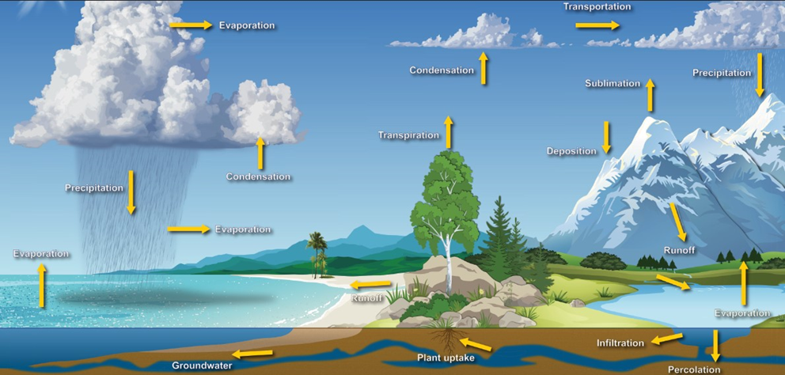
The water cycle
The water cycle is driven by the sun. The water cycle shows the continuous movement of water within the Earth and atmosphere. It is a complex system that includes many different processes. Liquid water evaporates into water vapor, condenses to form clouds, and precipitates back to earth in the form of rain, hail and snow.

Slide 9
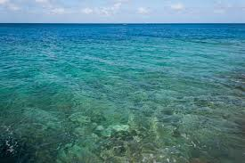
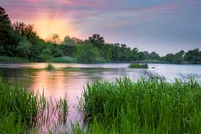
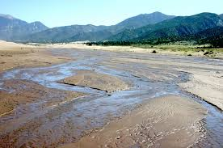
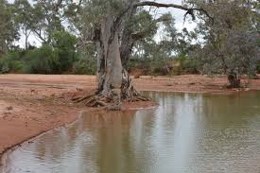
Types of water
Marine water
Surface Waters:
A - Perennial (A stream that has flowing water year-round during a typical year)
B - Intermittent (A stream that has flowing water during certain times of the year, when groundwater provides water for stream flow)
C - Ephemeral (A stream that has flowing water only during or for a short duration after precipitation events in a typical year)
A B C
Groundwater
Aquifers
Marine Water

Slide 10
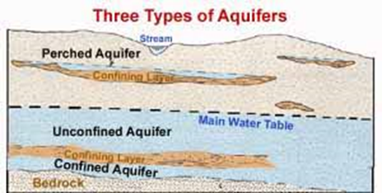
Types of Aquifers
There are different types of aquifers:
Confined Aquifer: A confined aquifer is a part of a rock bed or sand covered by a clay confining layer and prevents the groundwater from moving from one aquifer to another. The water in confined aquifers can have high pressure due to the overlying confining layer.
Unconfined Aquifer: An unconfined aquifer is a section of rock bed or sand not covered by a confining layer. An unconfined aquifer is always shallow in-depth, and its top consists of the water table. It acts like a sponge where the water level fluctuates depending on the outflow and inflow of water.
Perched Aquifer: Perched aquifer is a type of aquifer that occurs over unsaturated rock formations. These aquifers develop as a result of discontinuous impermeable layers of rock or sand.

Slide 11
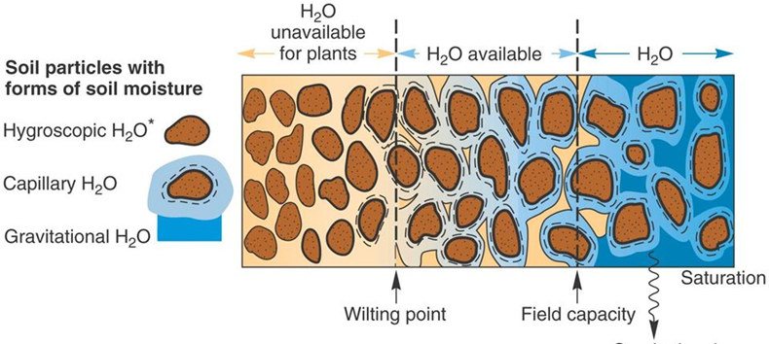
Considering the interaction of water molecules with soil, soil water can be classified into three main types:
Gravitational water - This is a free-flowing kind of water that is only weakly held in the soil.
Capillary water - It is the water that is contained within the soil’s micropores, or more specifically, within the soil pore spaces.
Hygroscopic Water - This type of water creates a fine layer over water particles, and it is often not readily available to plants due to its low availability.

Slide 12
Other classification of types of water:
Chemically Combined Water - Water is present in the chemical compounds found in the soil particles because they are water-soluble. Chemically mixed water is the term used to describe this. The plants are likewise unable to use this resource.
Atmospheric Humidity - Because of the presence of hygroscopic hairs and spongy velamen tissues, the epiphytes’ hanging roots are able to collect moisture from the surrounding air.

Slide 13
Subunit 3: Supply water systems
The method of collecting and storing rainwater for later use, rather than allowing it to run off is called rainwater harvesting. The raw water after collected must be stored, in a place which is suitable to obtain water with quality and quantity, so that after treatment, legal provisions are complied with, depending on the purpose for which it is intended. Available water resources and surrounding ecosystems must be respected.

Slide 14
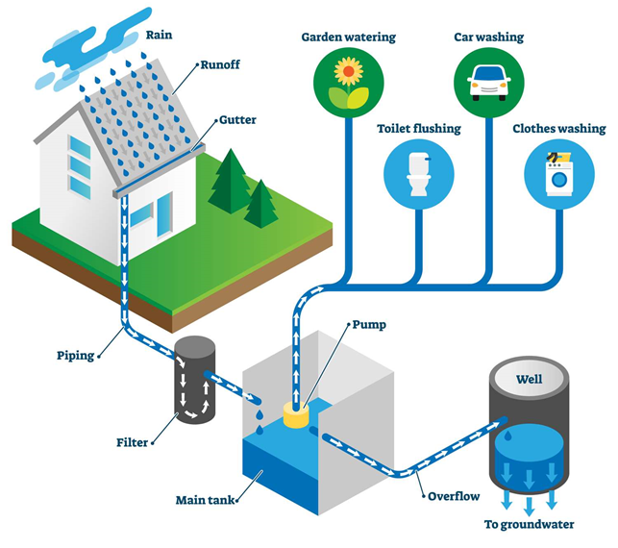
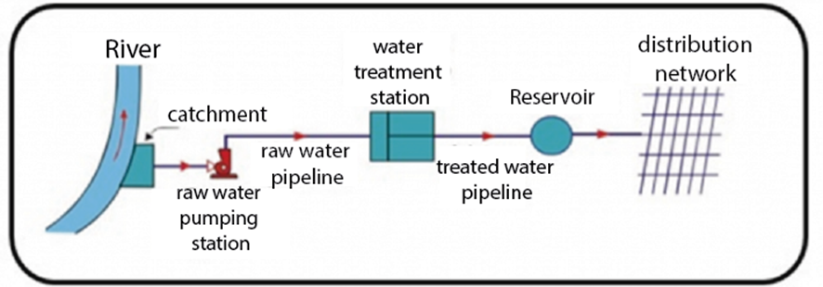
Origins of the water storage:
Surface water: the collection must be carried out upstream of the polluting sources and the population to be supplied, normally located in the central part of the watercourse, and close to the surface
Rainwater harvesting: is collecting the run-off from a structure or other impervious surface
Example of storage from surface water
Example of storage of rainwater

Slide 15
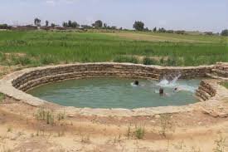
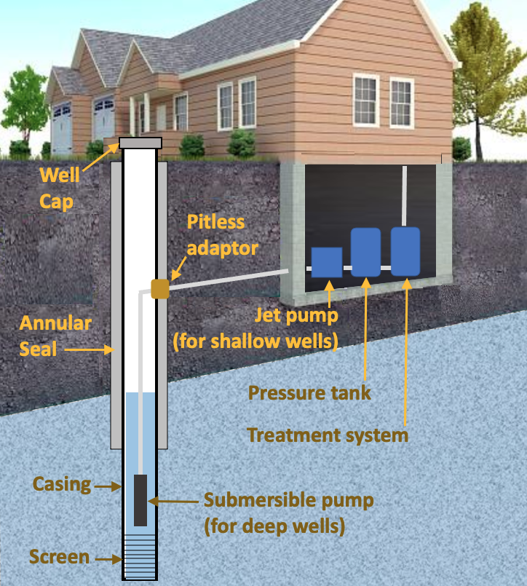
Origin of the water storage (continuation)
Underground water: Water capture through mine galleries can be made from unproductive land with a high density of fractures, fissures, veins and other geological features.
Borehole: element drilled into the ground where the depth is greater than the largest surface dimension and whose objective is to reach underground water reserves.
Well: similar to tower capture. The difference lies in the fact that the well does not require a walkway and that water is admitted not through window-type openings, but through pipes.

Slide 16
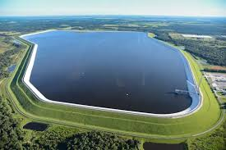
Water storage
Reservoirs: Reservoirs are the tanks which are used to store water for various purposes. The larger the reservoir size, the greater the reliability and the higher the cost.
Types of water Reservoirs:
Clean Water Reservoir: reservoirs that stores water that has been treated and clear,
Service Reservoir: are used to provide storage to meet fluctuation in demand of water.
Dams: enlarged body of water created using a dam or lock. It is a structure built across a river or lake outlet to hold back water and raise its level. Unlike lakes, which form by natural processes, these reservoirs are created by humans to provide water and hydroelectricity.

Slide 18
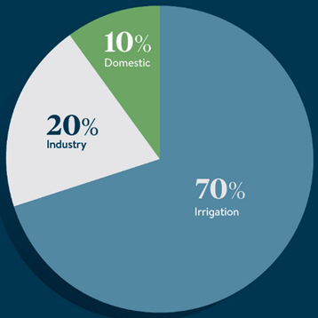
Water uses
Water can be used for direct and indirect purposes. Direct purposes include bathing, drinking, and cooking, while examples of indirect purposes are the use of water in processing wood to make paper and in producing steel for automobiles.
Estimated global freshwater use

Slide 19
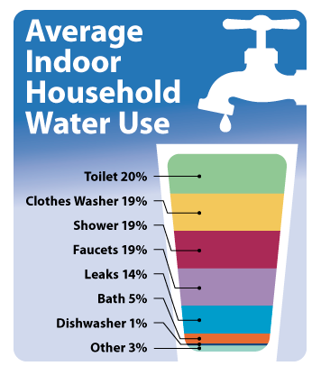
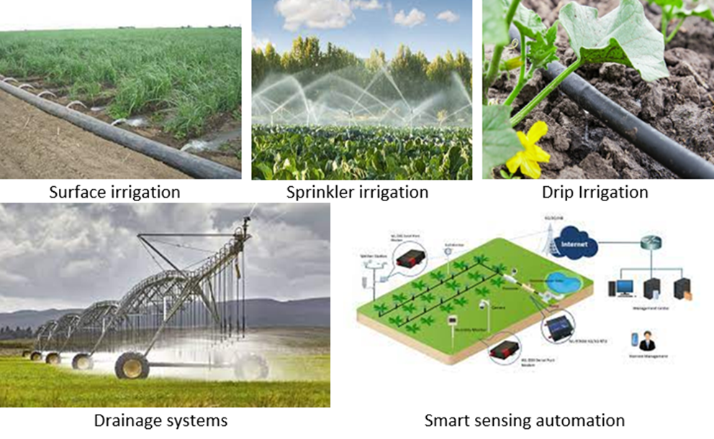
Water uses
Drinking /household water
Irrigation water

Slide 20
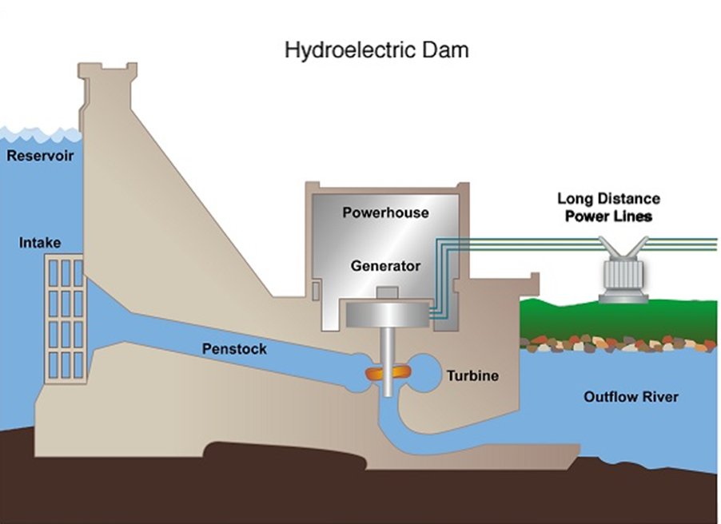
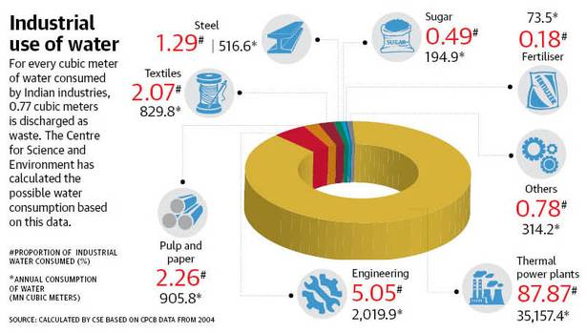
Water uses
Industrial uses
Energy production

Slide 21
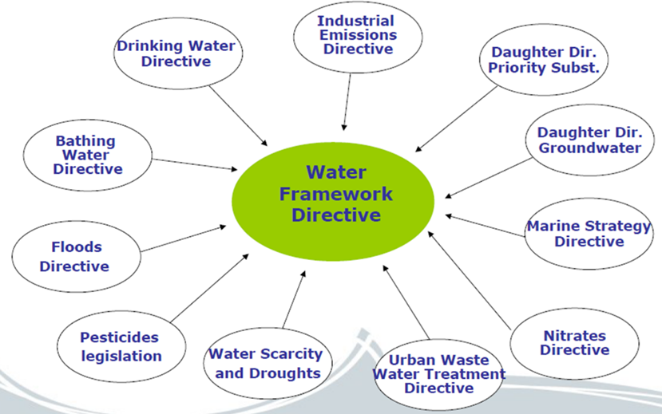
Water Management
Quality and Quantity: Quality parameters are related to the set of physical, chemical, biological and microbiological parameters that allow evaluating the suitability of water for a given purpose. Water can be of good quality for a certain purpose and poor quality for another, depending on its characteristics and the requirements for its specific use.
Water Framework Directive (WFD): is the primary legislation and it is supported by two so-called daughter directives on the quality and quantity of groundwater and on the quality of surface water.
Scheme of one management frame for all water-related legislation

Slide 22
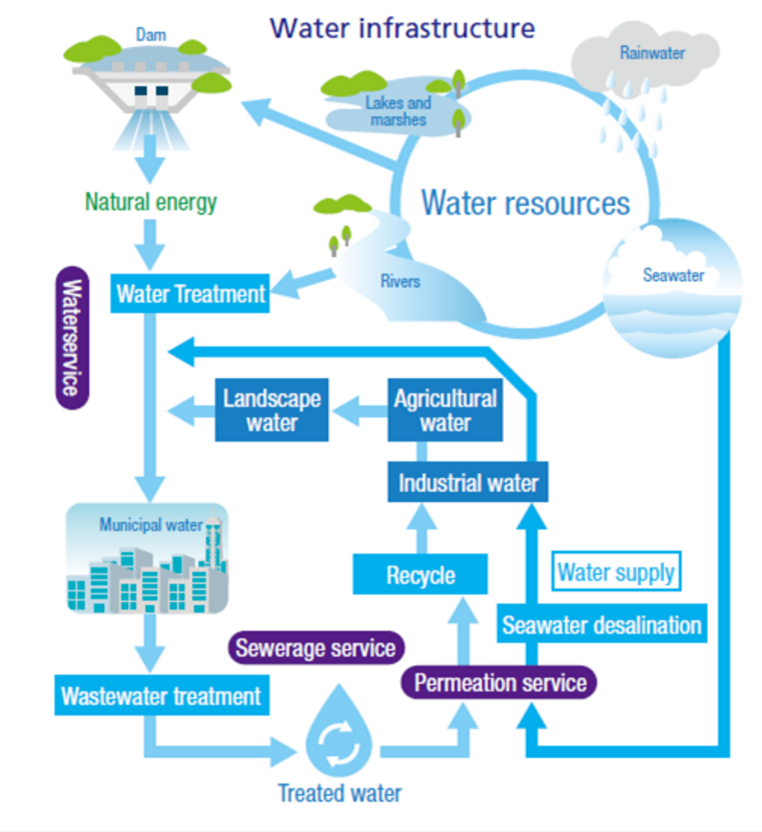
Water Management
Control and monitorization: Monitoring proposes an overall methodological approach to monitoring for the implementation of the WFD. Because of the diversity of catchment pressures, water-body types, biological communities and hydromorphological and physico-chemical characteristics within the European Union, the appropriate implementation of programmes of measures in accordance with the requirements of the directive will vary between Member States and river basins.

Slide 23
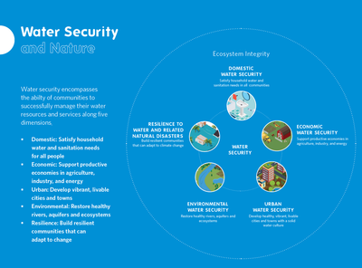
Water Management
Protection and security: The Water Framework Directive establishes a planning framework to, among other things, support the achievement of the standards and objectives for Protected Areas established under Community legislation. To ensure monitoring programmes are as efficient and as effective as possible, it would be appropriate to ensure that the quantitative status and the chemical status monitoring programmes described above complement, and are integrated with, the programmes established for Protected Areas so that the groundwater monitoring networks are as far as possible multi-purpose.

Slide 24
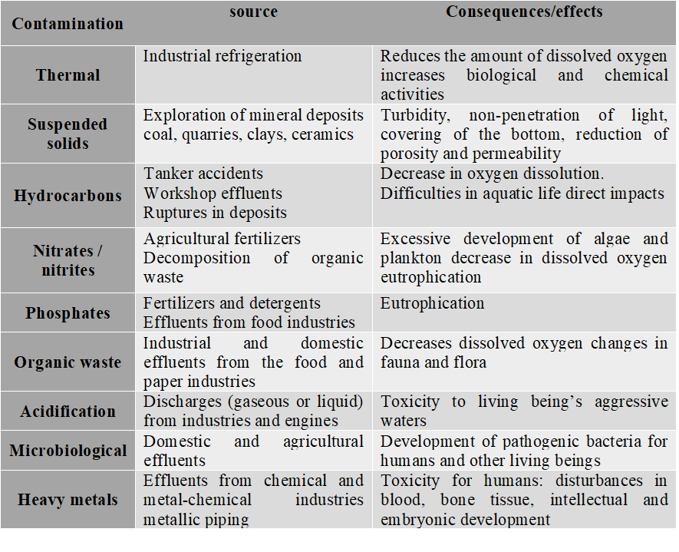
Water Management
Examples of types of contamination, their possible source and consequences.

Slide 25
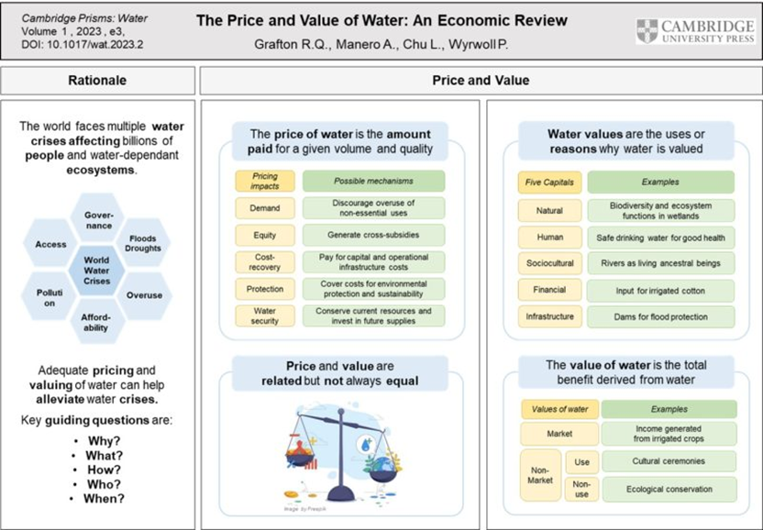
Water Management
Costs and values: If we could assess the value of water, what would we base it on?
Could a country from third world apply the price for their true value of water?

Slide 26
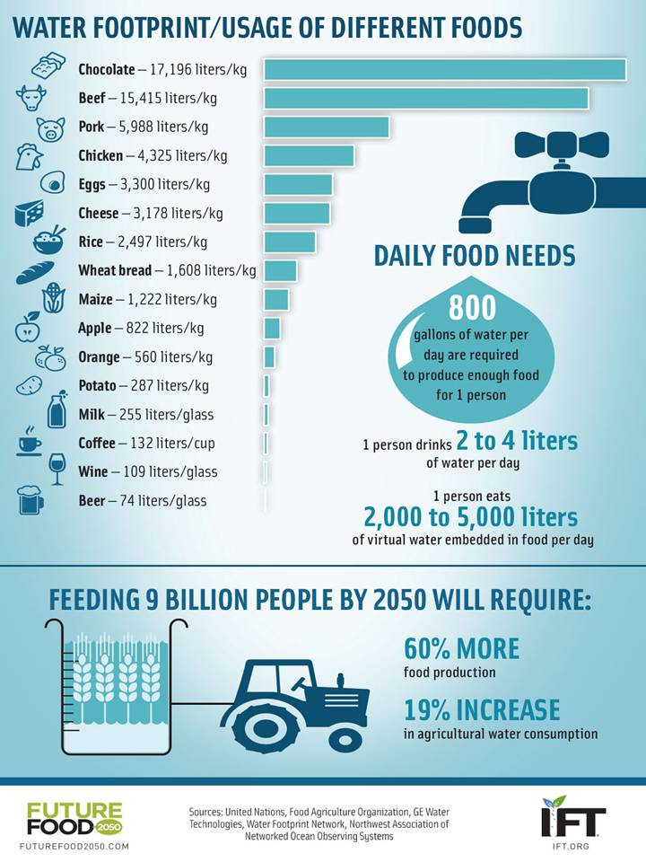
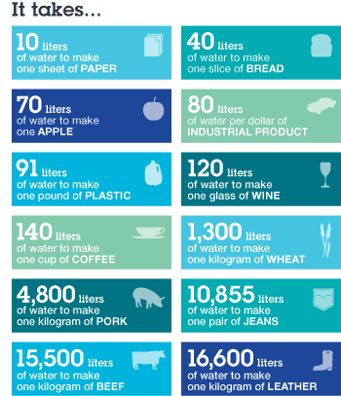
Water Management
Water footprint: The water footprint measures the amount of water used to produce each of the goods and services we use.

Slide 27
Subunit 6: Other sources of water
There are other ways to obtain fresh water, in addition to those mentioned in chapter 3.
Some of the examples of this are: Desalination, Water reuse and recycling.

Slide 28
Other sources of water
Desalination: is the process of removing dissolved salts from seawater and other waters by various methods.
The most common desalination processes are distillation and reverse osmosis.
Desalination using reverse osmosis technology to separate water molecules from seawater

Slide 29
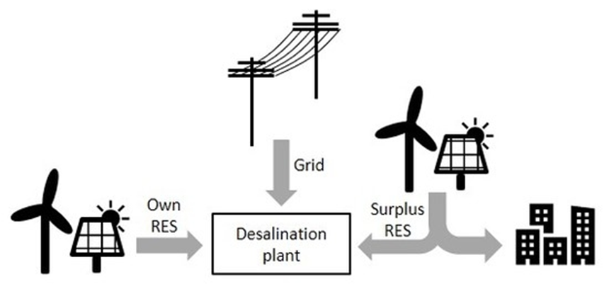
Other sources of water
Desalination systems can utilise in a more economically efficient way the available renewable energy sources (RES) potential
Graphical abstract of a RES driven desalination

Slide 30
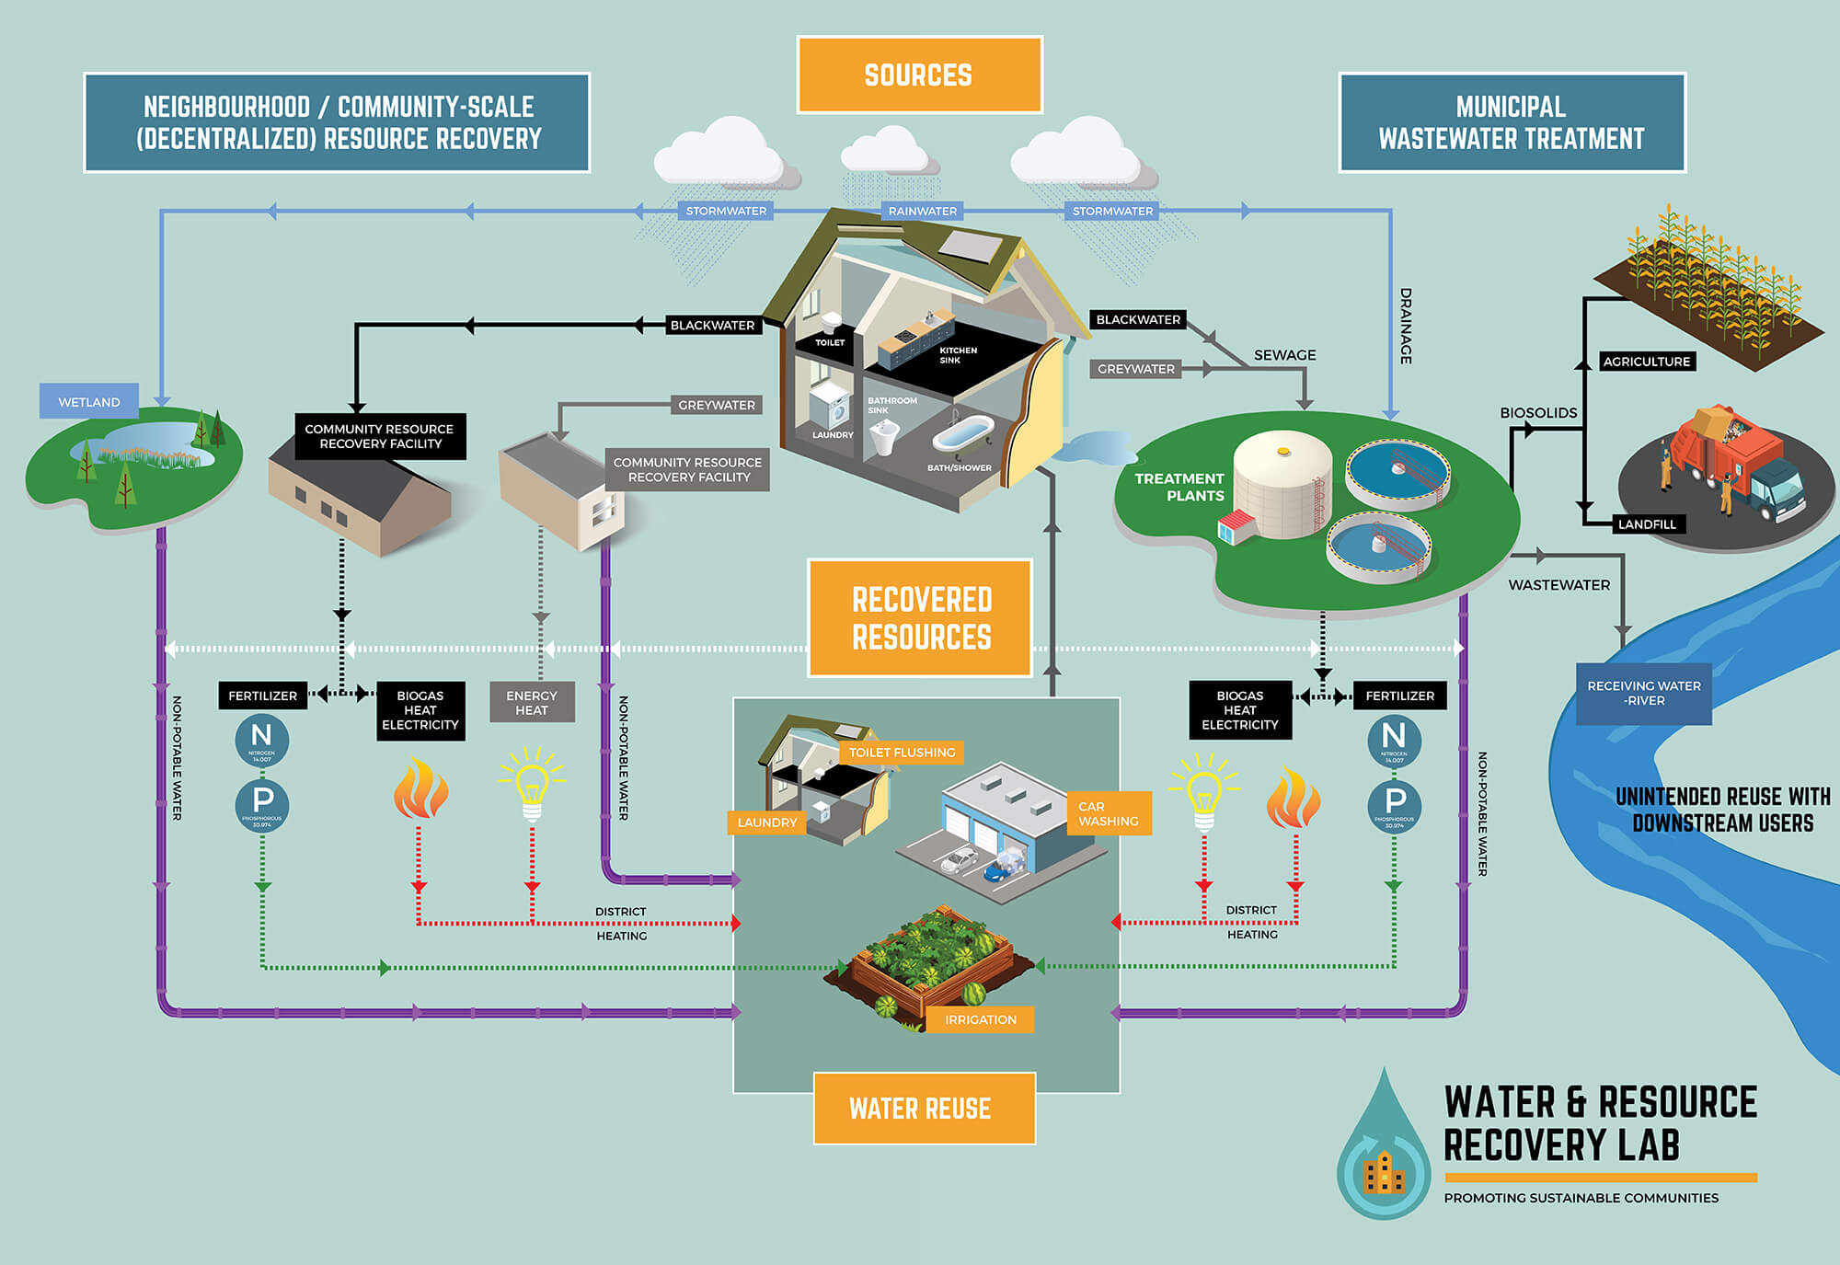
Other sources of water
Water reuse refers to the process whereby wastewater is reclaimed from a variety of sources and treated to a standard appropriate for a second purpose. Any type of wastewater (domestic, municipal, or industrial) can be considered for reuse and, depending on its quality, can be deployed for several different secondary purposes.
Water recycling is reusing treated wastewater for beneficial purposes such as agricultural and landscape irrigation, industrial processes, toilet flushing, and replenishing a ground water basin.

Slide 31
Conclusion
The Water, Energy, and Food (WEF) Nexus is an approach that aims to ensure access to water, energy, and food for all by strengthening synergies and reducing trade-offs among these sectors. The WEF Nexus is a critical concept in the context of sustainable development, as it recognizes the interdependence of these three resources and the need for integrated management.
Although over the last 20 years, 6 billion people gained access to improved drinking water, still there is a high childhood mortality rates linked to clean water scarcity, and in total, there is about 829,000 deaths due to unsafe water.
Considering all this, it is important to not only value and preserve all the accessible fresh water we still have, by using techniques and management, whether agricultural or industrial, that allow a reduction in water use.
At the same time the reuse of wastewater and desalination of ocean water are two important methods for ensuring a sustainable supply of freshwater. By adopting these sustainable practices, we can ensure that freshwater resources are used efficiently and equitably, while minimizing negative environmental impacts.
In this LU, information was provided on various ways in which water can be found on planet Earth, but also information that can help to make a more rational and ecological use of water.

