Slide 2
Course: (HEI-B1)
Module: (Digital technologies and artificial intelligence)
Learning Unit: (Precision technologies and Big Data)
Authors: (CERTH)

Slide 3
Precision agriculture and big data for productivity and efficiency
Foundations of Data Science
Data science is a multidisciplinary field that extracts valuable insights and knowledge from structured and unstructured data. In the context of agriculture, data science plays a pivotal role in transforming traditional farming practices into precision and data-driven approaches.
Agriculture, once reliant on experience and intuition, is now embracing the power of data to optimize operations, increase productivity, and address sustainability challenges.
In the digital era, where technology is seamlessly integrated into every aspect of our lives, agriculture has not remained untouched.
Digital technologies in agriculture encompass a wide array of tools, including sensors, drones, satellites, and automated machinery. These technologies generate vast amounts of data, laying the foundation for data science to unlock meaningful patterns, correlations, and predictions.

Slide 4
Precision agriculture and big data for productivity and efficiency
Technologies in agriculture
New improved machinery for agriculture use
Precision agriculture applications
Automation in agriculture

Slide 5
Precision agriculture and big data for productivity and efficiency
What is Precision Agriculture?
Precision Agriculture combines the latest developments in Information Technology together with a good knowledge of agricultural sciences (agricultural engineering, plant production, soil science, climatology, economics) to help producers to better understand their farms with to better manage their farms:
- It allows its application to small fields and large farms
- It provides an integrated system for selective plant and farm management

Slide 6
Precision agriculture and big data for productivity and efficiency
What drives the adoption of Precision Agriculture?
•Increased efficiency farm management ,better understanding of variability
•Economy and environment driven which will help to better economic outcome
•Reduced environmental impact
•Combination with protocols/standards
•Special payments
•Traceability system
How to achieve?
Key tools are:
1.Production mapping
2.Global Positioning Systems (GPS)
3.Direct data acquisition techniques on the go; EMI, ADP)
4.Variable dose technology inputs
5.Intelligent sensors
6.Remote sensing
7.Geographic Information System Information (GIS)

Slide 7
Precision agriculture and big data for productivity and efficiency
Goals of Precision Agriculture:
1.Maximizing profit
Determination of input needs (fertiliser, phytochemicals, water) for each piece of the field
Waste is avoided and the plants use as much as possible of what is available what we offer them
Production is increased and quality is optimised
Maximising the productivity of the land to meet needs for to meet the food needs of an ever-increasing population
2. Environmental Protection
Agricultural activity is directly linked to the environment.
The exploitation of natural resources (water, soil, etc.) and energy
If phytochemicals are used inappropriately, they end up in rivers and lakes, resulting in pollution of the water used for irrigation in subsequent periods
Excessive amounts of fertilisers degrade soils and cause financial damage to the producer

Slide 8
Precision agriculture and big data for productivity and efficiency
3. Ensuring food sufficiency
•The population of the earth is constantly increasing
•To cover the needs in the coming years to come, agriculture systems should be more productive

Slide 9
Precision agriculture and big data for productivity and efficiency
Challenges faced by agriculture:
Production costs continue to rise while prices fall, or remain stable.
The tight margins resulting from intense competition with foreign markets and the minimal support programmes granted, require increased efficiency to achieve sustainability.
Farmers are among the least educated segments of the population relative to other parts of the population.
Τhe rural population is characterised by conservatism and difficulty acceptance of new technologies, while at the same time there is an ageing of the rural population in all developed countries.
Agriculture must enter the information age by offering modern tools for the technologically familiar and 'demanding' new generation.

Slide 10
Precision agriculture and big data for productivity and efficiency
Europe’s Agriculture Sector:
ICT in agriculture, its adaptation and development are not always positive, since they suffer from the lack of young people in agriculture. Furthermore, countries having a small-scale farmer framework face a severe barrier in the investment capability for automation. Internet access availability is very often considered a big issue that hampers ICT usage in agriculture.
Precision Agriculture in Greece:
In Greece and in the European South in general there is a delay in the implementation of these systems. This is attributed to the prevailing conditions in which they are characterized:
Small farms.
Farmers who are attached to traditional methods production and product subsidies.
By farmers with a low level of education.
Lack of developed technology to apply the methods precision farming methods for crops in the European South, especially for fruit and vegetables.

Slide 11
Precision agriculture and big data for productivity and efficiency
Precision Agriculture Adoption-PAA
Precision Agriculture refers to the application of new agricultural practices (based in particular on GPS), with the aim of increasing or maintaining production rates, using fewer inputs of any kind (agrochemicals, water, energy), improving profit margins and at the same time increasing sustainability. However, the simplest definition of PGA was given by (Gebbers & Adamchuk, 2010) as "the application of the right application, in the right place at the right time“.
Precision Agriculture technologies can be defined as a farming system that responds to three key challenges:
1. Sustainable increase in agricultural productivity and incomes - food security and economic growth.
2. Adaptation and building resilience to climate change - climate change adaptation.
3. Reducing and/or eliminating greenhouse gas emissions - mitigating the impacts of climate change

Slide 12
Introduction to earth observation in Agriculture
GPS a tool for Agriculture
GPS is a worldwide radio-navigation system formed from a constellation of twenty-four satellites and five ground stations. The GPS provides continuous three-dimensional positioning twenty-four hours a day to military and civilian users throughout the world.
The Global Positioning System is divided into three major components:
1.The control segment, the space segment, and the user segment. The control segment is the sole responsibility of the DoD, who undertakes the construction, launching, maintenance, and constant monitoring of all GPS satellites.
2.The space segment consists of the constellation of Earth-orbiting satellites.
3.The user segment consists of all Earth-based GPS receivers.

Slide 13
Introduction to earth observation in Agriculture
GIS a software for Agriculture:
A GIS (Geographic Information System) is a structure constituted by a powerful set of instruments and technologies committed to acquire, store, manage, transform, analyze and visualize georeferenced spatial data, where every document or event referred to a particular portion of Earth’s surface is an example of georeferenced information.
A GIS is the base technical tool to analyze the condition of a portion of soil, to manage the related activities, to plan the following actions. Some basic concepts: cartography (cadastral maps), ortho images, data layers.
GIS software manages different kinds of inputs, to represent different aspects of the area of interest. Geographic data is information about the earth’s surface and the objects found on it. There are various sources of digital data: maps, aerial photographs, satellite images, existing analog tables, and GPS receivers.
The most common methods of capturing data from various sources include digitizing, map scanning, satellite data, field data collection and others. In particular, earth resources satellites have become a source of huge amounts of data for GIS applications and generally they can be directly imported into the software.

Slide 14
Introduction to earth observation in Agriculture
How does it work?
To determine the position through the system, it is necessary to use a receiver. Various factors affect the quality and accuracy of the signal of a receiver. Determine the position of a point in 5 steps (Blewitt, 1997):
1. Trilateration
2. Measurement of the distance to the satellites.
3. Synchronization of receiver - satellite clocks.
4. Finding the position of the satellites.
5. Correction of signal delays.
What can GIS application do?
It can combine spatial and non-spatial spatial information.
•Draw maps, display on maps the spatial distribution of various phenomena (e.g. Population per block)
•Add, delete and modify existing spatial and non-spatial data.
•Combine and correlate data from different levels of information.
•Perform simple and complex spatial analyses and spatial correlations

Slide 15
Introduction to earth observation in Agriculture
Advantages of using GIS:
They draw maps quickly and cheaply.
Design maps for any special needs of the user.
Make map design possible even when there are no qualified personnel.
Allow experimentation with different graphical representations of the same data.
Facilitate the design of up-to-date maps when the data is already in digital format.
Facilitate statistical analysis of data when needed for map design.
They minimize the use of traditional printed maps as a means of storing data and thus reduce the impact of data classification and generalization on data quality.
Design maps in which the processes of data generalization and selection are precisely defined and systematically executed.
Draw maps that are difficult to draw by hand, e.g. three-dimensional maps.

Slide 16
Introduction to earth observation in Agriculture
What Data can we import in a GIS?
Spatial data (in the form of maps, aerial photographs, satellite images)
Descriptive data (in the form of field observations, questionnaire data)
The above data are imported via terminals (descriptive data), digitized, scanned, magnetic media.
Geographical-Spatial Information:
Vector format (vector) The basic building block is the arc defined by the coordinates (x, y) of two points (start and end).
Mosaic or Mosaic-type or raster format (raster) The basic building block is the cell of known-fixed dimensions. It is usually a square or hexagon whose center coordinates are squared.

Slide 17
Introduction to earth observation in Agriculture
Spatial Data can be:
1.Points, is the simplest method of representation in the form of a point and refers to those entities that have (at the given scale) no dimension in space
2. Lines is the method of displaying in the form of a line segment and is represented using two pairs of coordinates of those points that define the beginning and end of the line segment. (e.g. isosceles curves).
3.Polygons is the method of displaying in the form of polygons which consist of continuous linear data. (e.g. forest).

Slide 18
Introduction to earth observation in Agriculture
Advantages of Vector Data:
Data are presented in their original form without generalization.
Vector maps are aesthetically better and resemble traditional analogue maps.
Most analogue maps are in vector format therefore no data conversion is required.
The exact spatial location of the data is preserved.
Can easily change scale and cartographic projection so that it is easier to combine vector files from different sources.
Vector representations are compatible with relational DB models, are easier to update and maintain vector files.
Vector representations have much greater spatial resolution capabilities especially with respect to networks e.g. roads, rivers, railways.

Slide 19
Introduction to earth observation in Agriculture
Disadvantages of Vector Data:
The position of each point must be recorded exactly.
For successful analysis the vector data must be converted into a topological structure. This requires difficult processing and detailed data cleaning. Because the topology is static any update or correction of the vector data requires rebuilding the topology
Spatial processing algorithms are complex and require difficult processing. This often limits the processing of large volumes of data.
Continuous data such as elevation data cannot be represented in vector form.
Spatial analysis within polygons is not possible.

Slide 20
Introduction to earth observation in Agriculture
Advantages of Raster Data:
The spatial position of each cell is determined by its position in the grid. Therefore, only the coordinates of the starting point of the matrix are stored.
Due to the storage of the data in tabular form the data analysis is easy and fast.
The nature of plexigraphic maps, single variable maps, are ideal for mathematical modelling and quantitative analysis.
The plexigraphic structure handles discrete data, e.g. such as forest stands, as well as continuous data, e.g. elevation, and facilitates the combination of the two types of data.

Slide 21
Introduction to earth observation in Agriculture
Disadvantages of Raster Data:
•The size of the cell determines the spatial resolution of the data.
•The visualisation of linear features is extremely difficult and depends on the size of the cell.
•The processing of parametric data is time consuming if we have a large volume of data. Plexigraphic maps store the value of a single parameter for a region.
•In addition to the increase in processing time, problems in data integrity may arise due to the choice of cell size when plotting vector maps.
•Most gridded maps do not meet the high quality of maps required by cartography.

Slide 22
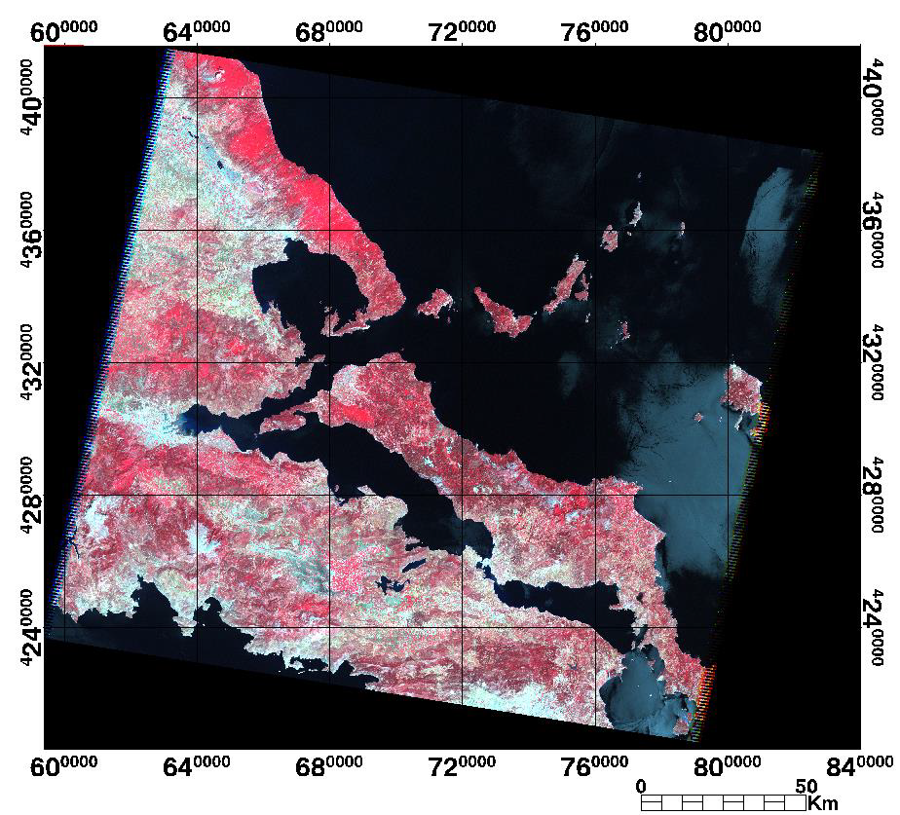
Introduction to earth observation in Agriculture
Spatial Data Collection:
Spatial data can also be collected from remote sensors on satellites such as Landsat, NORA, Advanced Very High Resolution Radiometer (AVHRR) and SPOT HRV (High Resolution Visible Range Instrument), which has unbiased interpretation and is very accurate. Also, from aerial photographs for digital terrain modelling, data collection methods vary from manual to fully automated.

Slide 23
Introduction to earth observation in Agriculture
Spatial Data Quality
A key success factor of Geographical Information System. It is determined by many factors including:
accuracy
precision
bias
scale.
spatial resolution.
generalization
compatibility.
Applicability
Integrity.

Slide 24
Introduction to earth observation in Agriculture
Sources of data errors. (Burrough, 1986)
Α. Obvious errors:
the age of the data
the cartographic coverage of the area
the scale of the map; (d) the density of observations
the relevance of the available data for the specific application
the format
the availability of the data
the cost.
Β. Errors arising from the initial measurements:
The accuracy of the location
The accuracy of the parametric data describing the spatial data
The variation of the data
C. Processing errors:
Numerical errors
Topological analysis errors
Classification and generalisation errors
Digitisation and georeferencing errors

Slide 25
Introduction to earth observation in Agriculture
Raster data are created during the scanning process using automatic scanners, which are divided into raster scanners and vector scanners. Digitisation using a digitiser, digitising on screen, stereophotogrammetry and COGO data are used to produce digital vector maps.
Flatbed scanners
Wide format scanners

Slide 26
Introduction to earth observation in Agriculture
Digitisation process
The coordinates of the points on the surface of the digitizer are sent to the computer using a magnetic pencil or a simple device called a "mouse" or "puck". More precisely, a "puck" is used which consists of a plastic disc with a crystal opening that has a crosshair. The coordinates of the point are digitized by placing the crosshair directly on the point and pressing a button on the guide.

Slide 27
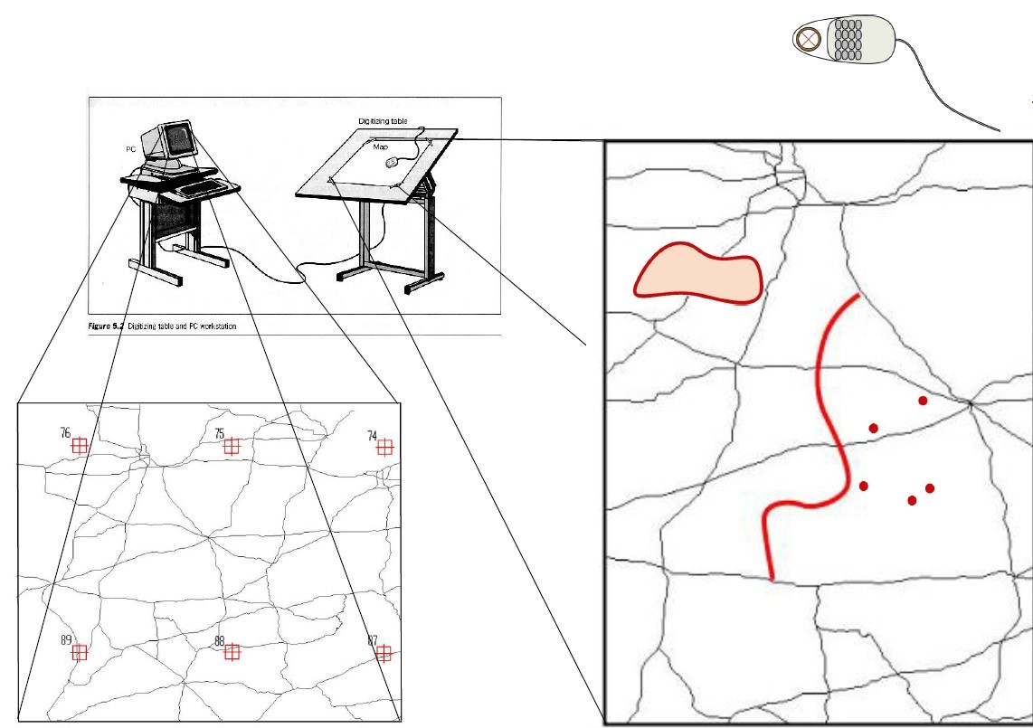
Introduction to earth observation in Agriculture
Problems during digitisation
Digitizer option, Digitization
Procedure:
1) Hooking up the map
2)defining the map extent
3)introduction of fixed points
4)definition of digitisation tolerances
5)digitisation of geographical features
continuous stream digitization, point-to-point digitization

Slide 28
Introduction to earth observation in Agriculture
A GPS receiver:
Locates at least 4 satellites
Calculates the distance from each satellite
It uses this information to calculate its position by applying the principle of triplicity (trilateration).
The accuracy of the GPS system ranges between 1-10 meters. This is why systems have been created to improve the accuracy of the signal to an accuracy of even one centimeter. The best known are D-GPS and RTK – GPS.

Slide 29
Introduction to earth observation in Agriculture
D-GPS
DGPS differential system, type of GPS which uses a signal from ground-based receivers to correct the error that there is.
This signal comes from ground-based stations whose position is known and by taking the signal from the satellites make the correction and they transmit the error.
System accuracy between 30cm-1m.
There are similar systems which use satellites to transmit error correction instead of ground stations, with the best known of EGNOS (Europe), WAAS (USA), SDMC (Russia), and for agricultural Starfire (John Deere) (USA), SDMC (Russia), SDMC (USA), USA (Russia), SDMC (USA), SDMC (Russia), and for agricultural applications Starfire (John Deere).

Slide 30
Introduction to earth observation in Agriculture
Real Time Kinetic GPS- RTK GPS
Positioning technique where a ground station provides the correction in real time with an accuracy even and 1cm.
It consists of a fixed station at the field boundary (reference receiver), which receives a signal from rom the satellites and transmits a signal to the GPS receiver which moves in the in the field
The receiver, in addition to the data of the station, the receiver receives the data its own measurements and combines them, with This results in a great deal of accuracy in positioning.

Slide 31
Introduction to earth observation in Agriculture
Remote sensing data resources:
Ground sensors
Aerial photos
Satellite photos

Slide 32
Introduction to earth observation in Agriculture
A drone can:
Can cover large areas quickly.
No physical presence in the field is required.
Can perform data collection at any time.
Not affected by cloud cover.
High quality images, flights are often less than 100 meters altitude.
Satellite data:
For satellite data, although has achieved very high resolution (i.e., 10x10 m2 / pixel, for open data), problems such as cloud cover and frequency visitation. Passive sensors measure the reflected energy.
Such sensors are Sentinel 2 from ESA and Landsat 8 from NASA. The sensors of this type have the most applications in agriculture, as measuring spectral reflectance.

Slide 33
Introduction to earth observation in Agriculture
Satellite Vs UAVs:
There is historical data from previous periods always available.
Images of sufficient accuracy for most agricultural applications are open data and therefore free of charge.
They do not require skilled personnel to perform collection data collection.

Slide 34
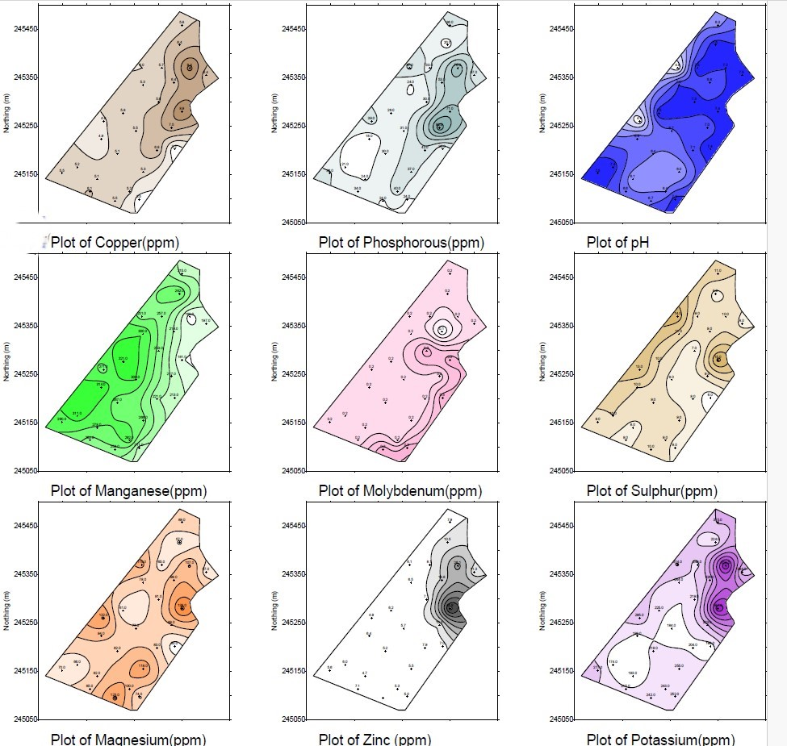
Introduction to earth observation in Agriculture
Maps as management tools:
Production maps really show results:
After the harvest historically
Quantification of spatial and temporal variability
Crops, soil, weeds and 'empirical’ maps, during the growing season
Show spatial variability.

Slide 35
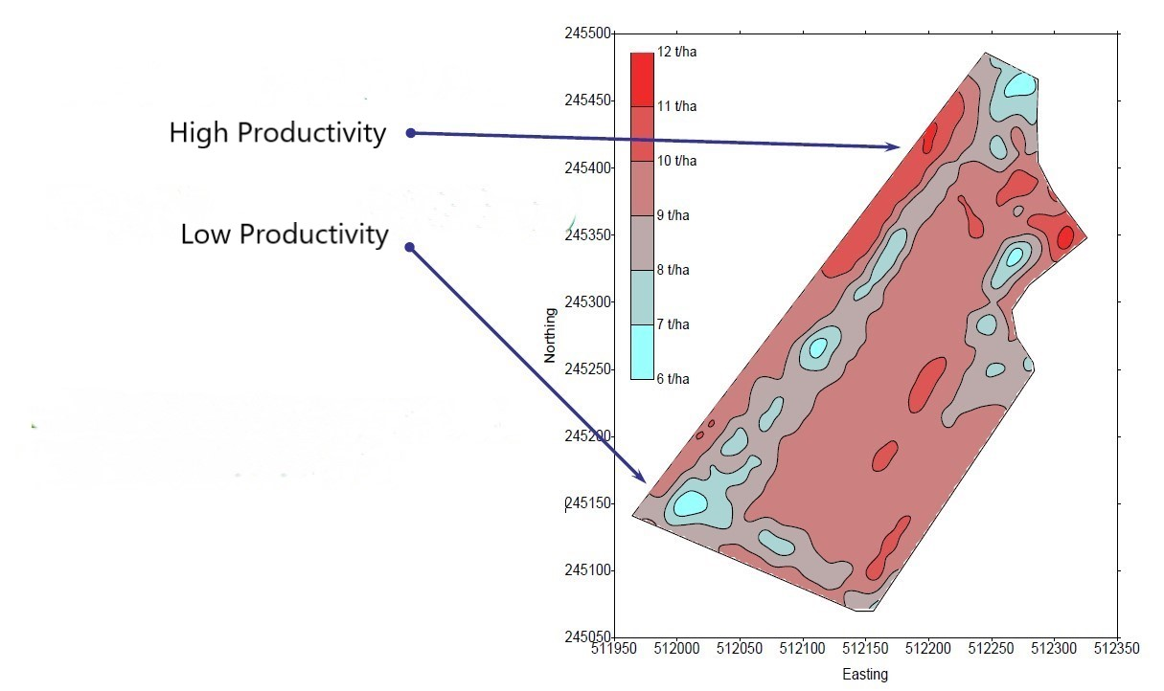
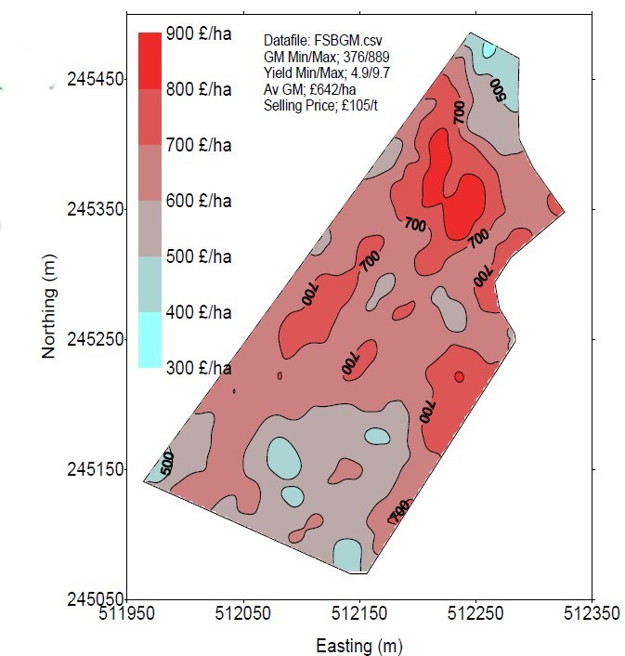
Introduction to earth observation in Agriculture
What are the causes of variability?
Every possible combination environment cultivation
Requires practical and agronomic analysis.
Geostatistics is used for the analysis of data.
The principle is done with a software GIS (Spatial variability control, Control of temporal variability)
Understanding variation:
Spatial trends (Removal of temporal effects, Shows areas with continuous low and high production)
Temporal trends (Shows areas that do not change with over the years and those that change)

Slide 36
Introduction to earth observation in Agriculture
Use of Sensors:
What is electrical conductivity?
The most important part of measuring soil parameters.
Electrical conductivity is defined as the ability of a solution to excite the electricity (cation exchange capacity) of the soil.
The mapping of electrical conductivity using sensors in real time (real time), can be used to create management zones, which considered the basis of precision agriculture and its applications.
It increases as the salt content in the soil increases.
However, the concentration (%) of salts in a solution also depends on the amount of water (soil moisture).
If to the complex of soil moisture and salts we add the effect of the conductivity of the soil as a material, then we conclude that the electrical conductivity of the soil as a material conductivity is a combination of salt concentration, soil moisture and soil structure.

Slide 37
Introduction to earth observation in Agriculture
Electrical Conductivity and Soil characteristics:
Identified mainly by its texture soil texture, temperature, and porosity of the soil.
The soil temperature, as it increases, influences the conductivity of the soil.
One source of salinity is the application of fertilizer on the soil.
The soils, depending on the indication of electrical conductivity, are classified into strongly saline, moderately saline, slightly saline, minimal and none.

Slide 38
Introduction to earth observation in Agriculture
Knowing the electrical conductivity, we can get an estimate of the course:
Concentration of salts, analogous course with electrical conductivity.
Soil porosity, proportional to electrical conductivity.
Soil temperature, a course proportional to electrical conductivity.
Soil texture, course proportional to clay concentration versus electrical conductivity.
Organic matter, indirect estimate based on the course of e.g., porosity or elements such as Ca.
Soil acidity (pH), course proportional or inversely proportional to electrical conductivity depending on the concentration of ions.
Cation exchange capacity, proportional to electrical conductivity.
Water content in soil, proportional to electrical conductivity, as water is a good conductor of electricity.

Slide 39
Introduction to earth observation in Agriculture
Applications of electrical conductivity to Precision Agriculture:
1. Targeted Sampling: In precision agriculture it is preferable that samples are categorized by a size when we collect them, because this way we can better categorize them.
2. Calculation of the rooting depth: to place the seed in the ideal position to determine the optimum depth and correct dosage.
3. Construction of drainage systems and adjustment of irrigation methods and duration.
4. Variability in herbicide doses: chemical doses vary in variations in chemical dosage vary with different organic matter and soil texture values
5. Variable fertilizer dose applications: correlations with electrical conditions, organic matter, soil texture, soil texture, and other factors..
6. Soil salinity and ways to manage it in an appropriate way.
7. Correlation with potential soil pollution.
8. Prediction and adapted management of areas with soils susceptible to the phenomenon compaction of soil and the creation of impermeable horizons.

Slide 40
Introduction to earth observation in Agriculture
Electrical conductivity mapping:
As the properties of the soil vary, so does the electrical conductivity in space.
An electrical conductivity mapping system consists of:
A system for measuring electrical conductivity (contact or non-contact)
A velocity recording system (whether or not contact or contactless)
Position recording system - GPS (whether contact or contactless)
Data storage system - GPS (contact or contactless)

Slide 41
Introduction to earth observation in Agriculture
Ground Sensors:
Sensors that collect data at ground level are called proximal sensors.
These types of sensors obviously offer the highest quality of data accuracy, but the acquisition of data is several times more difficult more time-consuming and require a physical presence in the field.
They are usually used as verification data.
Stable Sensors:
Fixed sensors are used to record a fixed sensor a specific parameter throughout the growing season. They are installed in the fields and left there for years with little or no maintenance, if possible, no maintenance. This means that they will remain exposed in the field during heavy rainfall and for prolonged periods of sunlight, which should withstand.
Rain sensor, anemometer for measuring the speed and wind direction, air temperature sensor, air humidity sensor.

Slide 42
Introduction to earth observation in Agriculture

Slide 43
Introduction to earth observation in Agriculture
Production mapping:
The process of recording the variability of the production of a field is called mapping the yield mapping.
The field is divided into smaller sections and in these sections the yield is measured.
Each section is plotted with coordinates, resulting in a file containing coordinates and the corresponding production.
Product of this process is the production of maps (maps production maps), showing the production of each part of the field.

Slide 44
Introduction to earth observation in Agriculture

Slide 45
Introduction to earth observation in Agriculture
What are application maps?
Application maps are electronic maps of the field that define areas - zones of the field and the application rate in each area. Application maps may be based on data from previous measurements and analyses, such as:
1. Soil type and other soil data, such as soil colour, soil structure, field topography (elevation maps), apparent electrical conductivity.
2. Maps of the field with the nutrient content resulting from soil analyses on a grid of points or directed.
3. Sensors that measure soil characteristics such as soil moisture, or spectral analysis of reflected light or resistance to tillage.
4. Remote sensing images or maps showing indicators of plantation or even soil germination during the growing season.
5. Maps with observations made by the farmer or the farmer's advisor in the previous growing season or in previous years (e.g., areas with weeds, areas where the crop does not grow well).
6. Maps of the previous year's or years' production and therefore, items removed from the soil by the crop or other items such as plant debris, tree branches, etc.; and
7. Any other information that can be collected and linked to the field areas.

Slide 46
Introduction to earth observation in Agriculture
Application maps for fertilizer:
One practice is to analyse soil samples for e.g., the main elements nitrogen, potassium and phosphorus. We can then define the amount of the element required for a target production.
A second practice is to do foliar diagnostics (leaf analysis during the growing season) and where a deficit occurs, add the element. This is a more laborious task, as the sampling must be done at the right time and the data must be analyzed very quickly.
A third possibility is to follow a policy of replacing the nutrients removed by the crop with its production (here we should add that the nutrients removed from the field are also removed with the crop residues when they are harvested).

Slide 47
Introduction to earth observation in Agriculture

Slide 48
Introduction to earth observation in Agriculture
Systems with sensors that directly control/adjust the application machines.
The idea is to find an element that can be measured directly and based on this, with the corresponding software, to determine the correct amount to apply to meet the needs of the plants. The sensor makes the measurement and a series of electronic circuits and software convert the signal produced by the measured property into a command to change the machine setting.
Many vegetation indicators have been developed to assess the condition of a plantation. These indices, such as NDVI express the vigour of the plantation.
By measuring the NDVI, the fertilizer applicator automatically adjusts the fertilizer rate, which is especially appealing to farmers who don't have to do anything other than calibrate the system. The system stops fertilizer application to the headers automatically, which gives it another significant fertilizer-saving advantage. Figure 7.8 shows the nitrogen uptake curve in durum wheat based on phenological stages and fertilizer application in Greek conditions based on average production

Slide 49
Introduction to earth observation in Agriculture
Application to fertiliser inputs
Fertilisers are currently applied by various methods. Mainly by mechanical or pneumatic fertiliser spreaders, by spraying machines and with irrigation water. For application by machinery there are devices that can vary the dose either by application maps or by sensors that are operated during movement in the field

Slide 50
Introduction to earth observation in Agriculture

Slide 51
Applied cases in Agriculture
Application to sprayers
There are two categories of applications. Those based on maps that are generated and those that define the zones that will be treated differently. The sprayer, when it reaches the coordinates of the map it finds using GPS and needs to change the setting, changes it automatically.
A second possibility is to have a sensor that during the movement of the sprayer can measure some property and directly change the setting of the sprayer. Such sensors are those that detect the presence of green plants and only spray there.

Slide 52
Applied cases in Agriculture
Application to seed drills:
In conventional seed drills, the metering mechanisms (those that determine the seed density) are driven by the ground wheel and their adjustment is independent of the tractor speed. The adjustment is changed by changing gears or toothed wheels, which cannot be done when the machine is moving in the field. Seed drills have been developed in which the drive to the metering mechanisms is given by electric motors
The ground wheel gives the drive to the machine and a controller sets the speed of the metering mechanism to adjust the seeding density. The adjustment is changed by varying the ratio of the electric motor drive with a signal given either by the operator by changing a knob, or by an application map that defines areas where more or less seed will be placed.

Slide 53
Conclusion
Societies in developed countries have become sensitive to environmental protection issues.
Agriculture is by definition the steward of the environment of a large part of each country and contributes to the preservation of both the environment and the rural landscape. Agriculture uses many natural resources to produce food and raw materials for society.
Many of these are limited and agriculture must help to conserve them. In some areas, many of these resources are limited and must be used to support them.
PA started to develop in the early 1990s. Although ideas and efforts were present in earlier years, substantial development began with the availability of GPS; initial hopes for rapid diffusion and adoption were not realized and in many areas of the world (including our country) adoption is very limited to non-existent.
The new technology must be reliable, well-built, free from breakdowns, widely applicable, user-friendly, can be purchased in places with lower initial costs and technical support for any problems is assured. An important promotional element is for farmers to be able to see the technology applied in demonstration fields or farms. Younger farmers adapt and accept new technologies more easily.

Slide 54
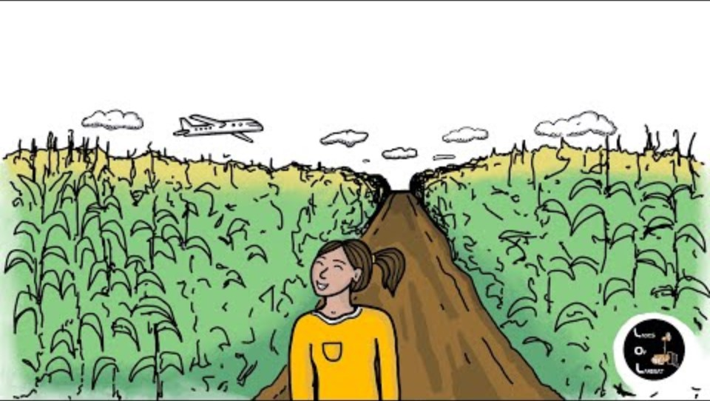
Case studies
USGS: Earth Observation User Case study: Using Landsat to Map Agricultural Yields and Irrigation Use

Slide 55
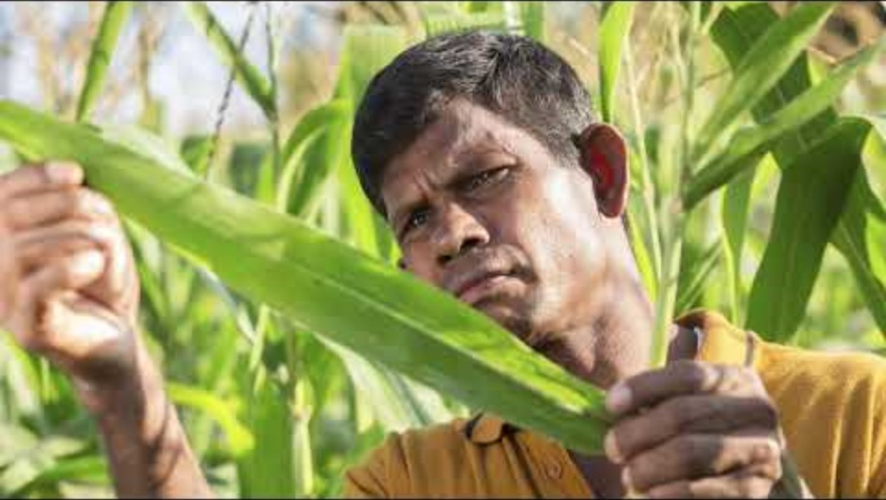
Modern Farming Solutions
Food and Agriculture Organization of the United Nations (FAO),

Slide 56
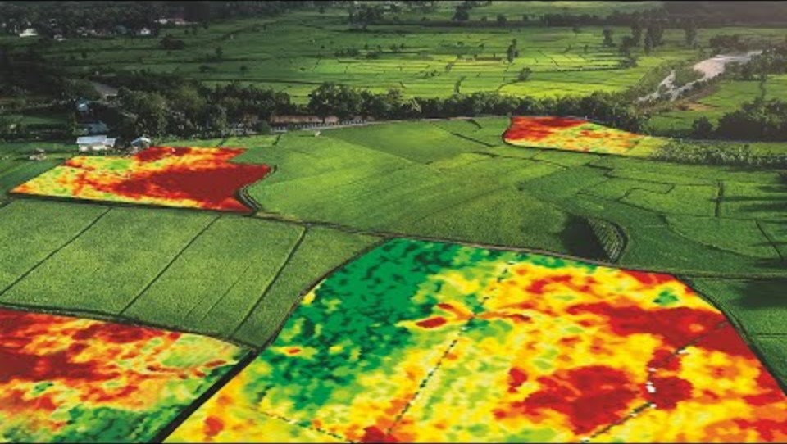
Case studies
Geospatial World: Application of Remote Sensing in Precision Farming. Technological advancements in precision agriculture have made it possible for farmers to improve their productivity effortlessly

Slide 57


