Slide 2
Course: HEI Module: Digital technologies and artificial intelligence Learning Unit: Remote Sensing and Farming
Authors: UAZORES

Slide 3
Introduction:
This LU covers fundamental concepts in remote sensing, including system components, with various elements such as, atmosphere, vegetation, soil, rocks, water, and cartography. It also explores image characteristics like structure, resolution, and processing techniques. Orbitals of satellites, sensors, and specific satellites such as Landsat, SPOT, IRS, and Envisat, along with applications in the fields of environment, agriculture, and forests also belong to the main aims.
After the completion of the LU you should be able to have the following learning outcomes:
Knowledge
• Identify the advantage of a remote sensing system in farming
• Identify applications of specific satellites in farming
Skills
• Ability to use remote sensing systems in agriculture
• Understand image characteristics
Competences
• Ability to identify and understand the system of remote sensing
• Ability to apply remote sensing in the fields of environment, agriculture, and forests.

Slide 4
Sub Unit 1: Introduction to remote sensing: an overview of remote sensing principles and their applications in agriculture, covering the fundamentals concepts and techniques used for data analysis and interpretation in the field of remote sensing

Slide 5
Remote sensing process:
A - Source of Illumination;
B - Radiation and the Atmosphere;
C - Target;
D – Sensor;
E - Transmission, Reception, and Processing;
F - Interpretation and Analysis;
G – Application

Slide 6
Interaction of the radiation with the atmosphere:

Slide 7
Interaction of the radiation with the atmosphere:
Different objects and surfaces, like water, soil, or plants, return energy in different electromagnetic bands in different quantities. What factors actually impact this? Here are the main ones:
properties of the object: chemical and physical composition, the kind of material, and surface roughness;
properties of the radiation: the radiant intensity, incidence angle, and wavelength.
remote sensing spectral signature.

Slide 8
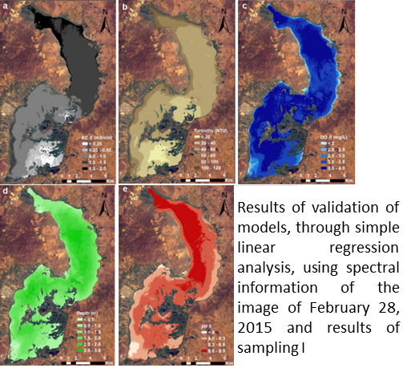
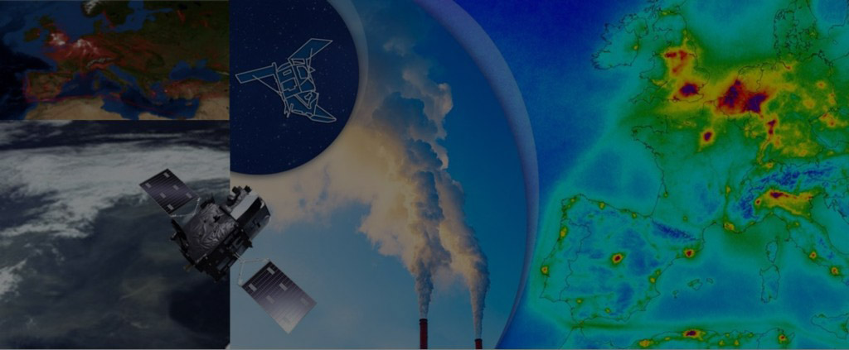
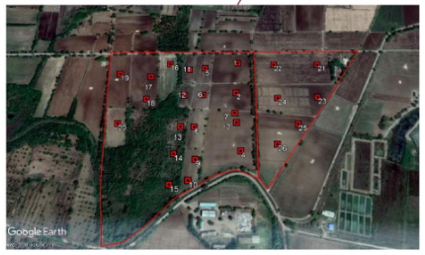
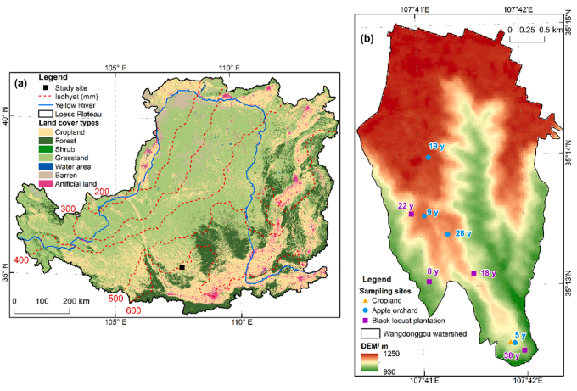
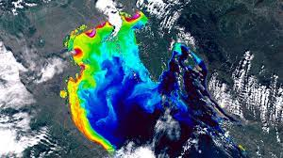
Remote sensing applications:
Atmosphere composition
Soil composition
Water quality
Flood Control
Evaluate the vegetation that covers the soil

Slide 9
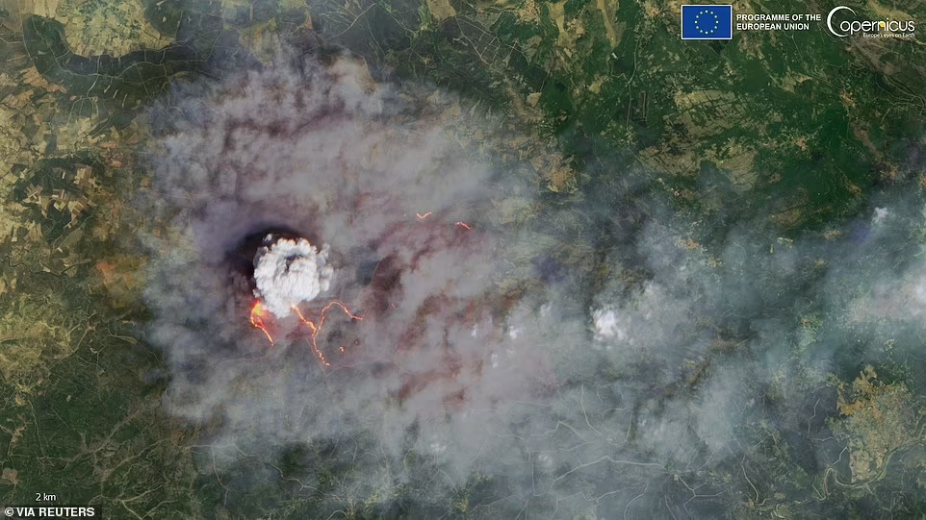
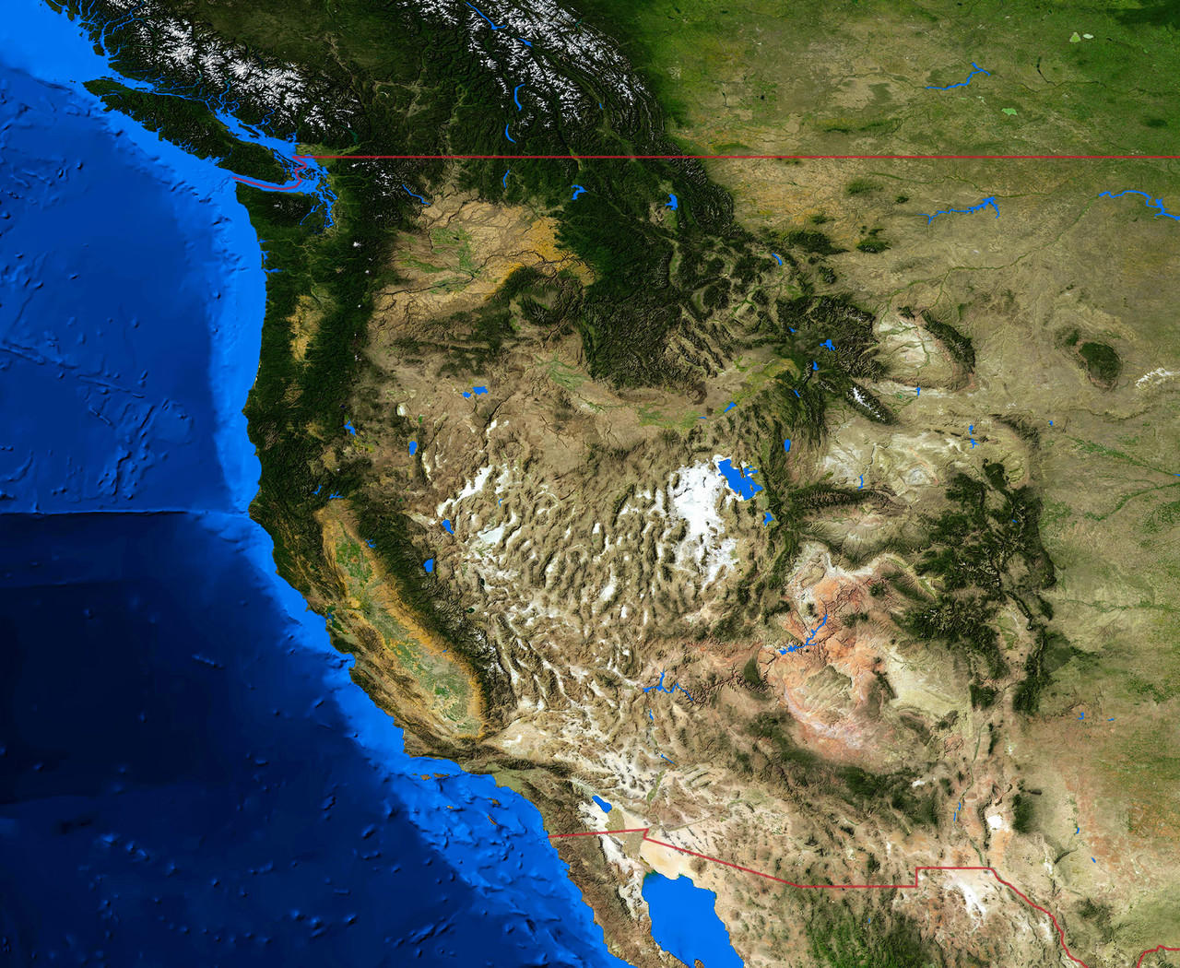
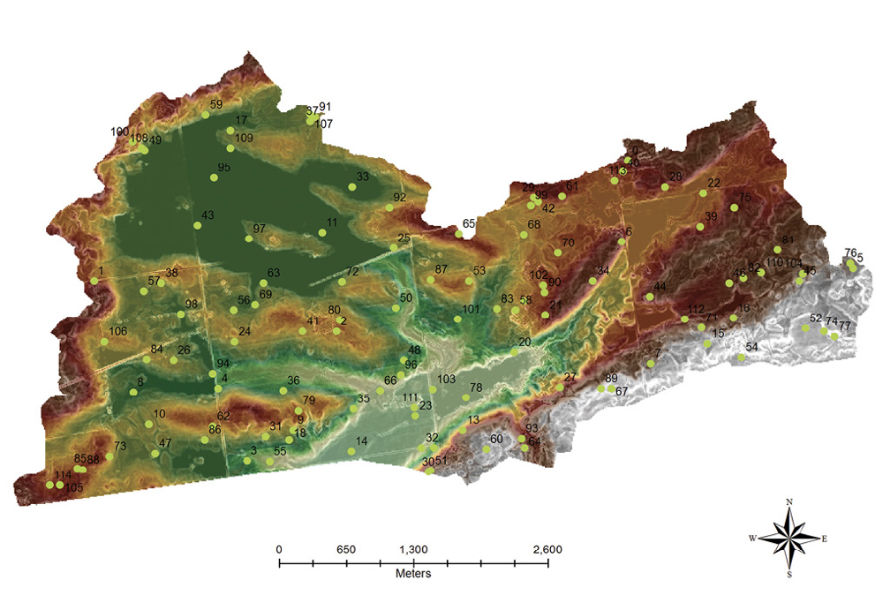
Remote sensing applications:
Control and surveillance of wildfires
Topography and geology
Soil type and topography

Slide 10
Sub Unit 2: Image characteristics

Slide 11
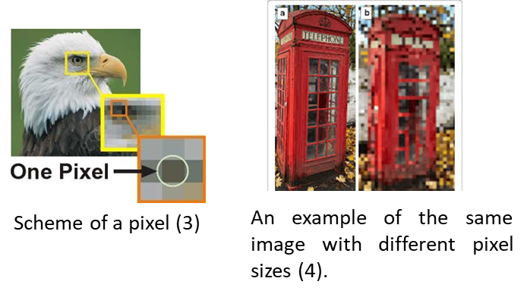
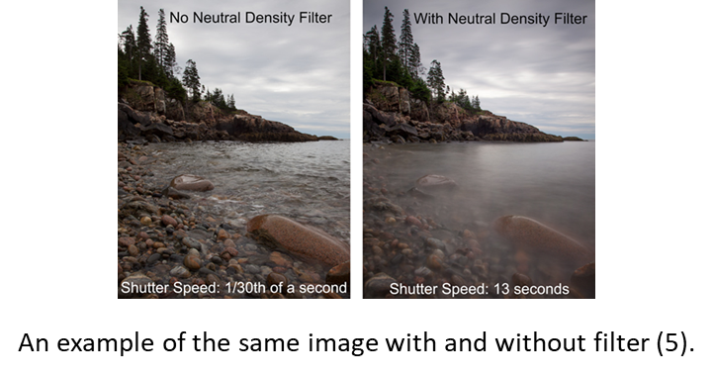
Characteristics and components must be considered when collecting data through Remote Sensing
Pixel: A pixel is part of a sensor that collects photons
so they can be converted into photoelectrons.

Slide 12
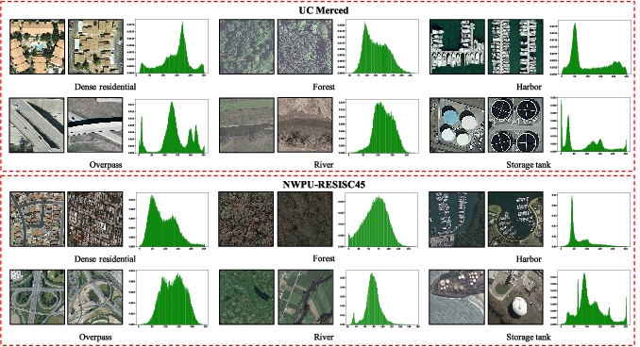
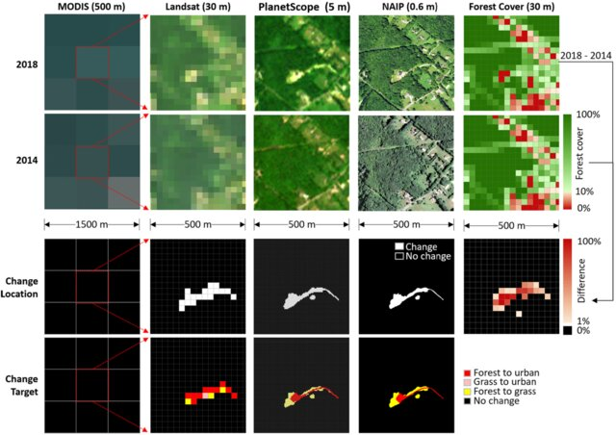
Characteristics and components must be considered when collecting data through Remote Sensing (continuation)
Spectral difference between two different remote sensing image datasets.
The impacts of spatial resolution on mapping change location and change target between 2014 and 2018.
Spectral: Spectral resolution describes the ability of a sensor to define fine wavelength intervals.
Spatial: Spatial resolution is the projection of a detector element or a slit onto the ground.

Slide 13
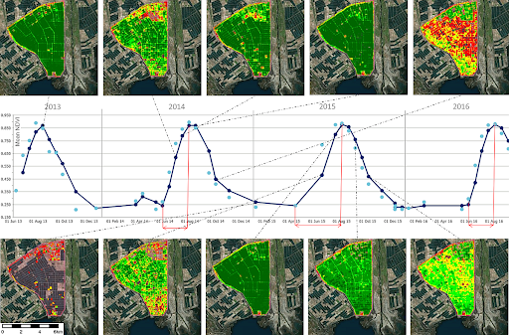
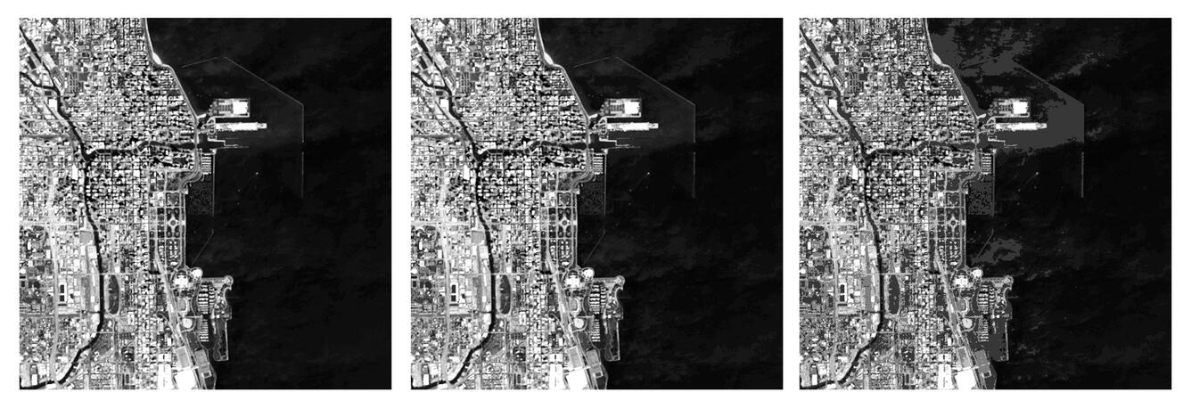
Characteristics and components must be considered when collecting data through Remote Sensing (continuation)
Examples of different radiometric resolutions over Chicago, Illinois. The left image is 16-bit radiometric resolution (65,536 discrete shades of grey), the center image is an 8-bit radiometric resolution (256 discrete shades of grey), the right image is 4-bit radiometric resolution (16 discrete shades of grey).
Temporal: Temporal resolution is defined as the amount of time needed to revisit and acquire data for the exact same location.
Radiometric: Radiometric resolution relates to how much information is perceived by a satellite’s sensor. The higher the radiometric resolution, the more shades of grey the user sees.

Slide 14
Subunit 3: Orbitals of satellites

Slide 15
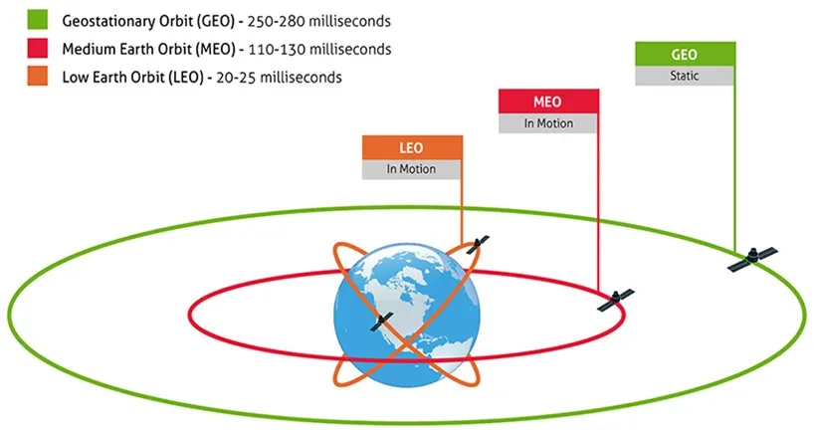
Types of orbits:
Satellite orbits are classified as high and low orbits, polar orbits (when the orbital plane contains the spin axis of the earth), equatorial orbits (the orbital plane coincides with the equatorial plane of the earth), and pro-grade and retrograde or bits (the direction of satellite motion is either eastward or westward).

Slide 16
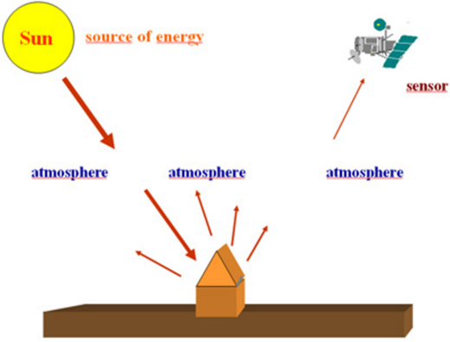
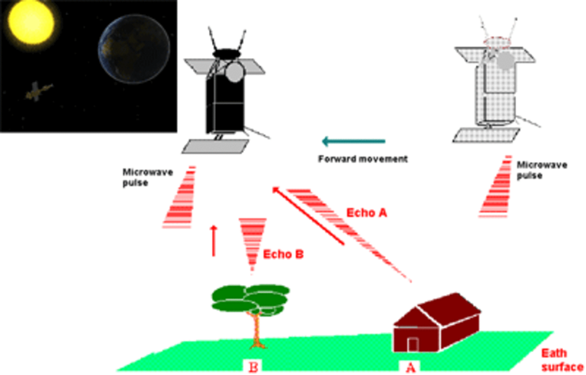
Types of sensors:
Passive sensors depend on solar illumination
Ex. Laser Altimeter, LiDAR, RADAR,
Scatterometer, Sounder
Active sensors emit their own radiation to illuminate objects and
measure the energy reflected back to the sensor. Ex: Landsat OLI/TIRS,
Terra MODIS, GPM

Slide 17
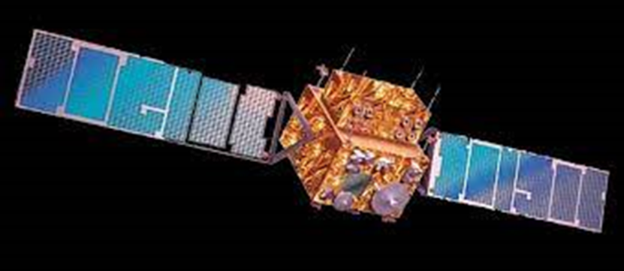
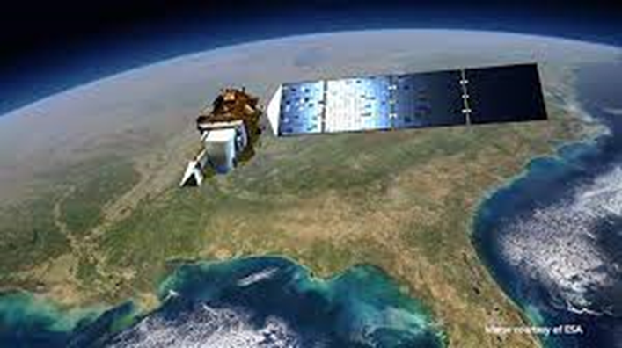
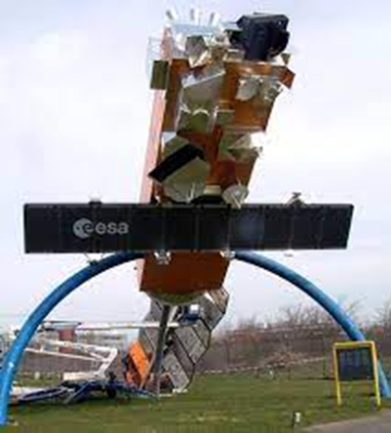
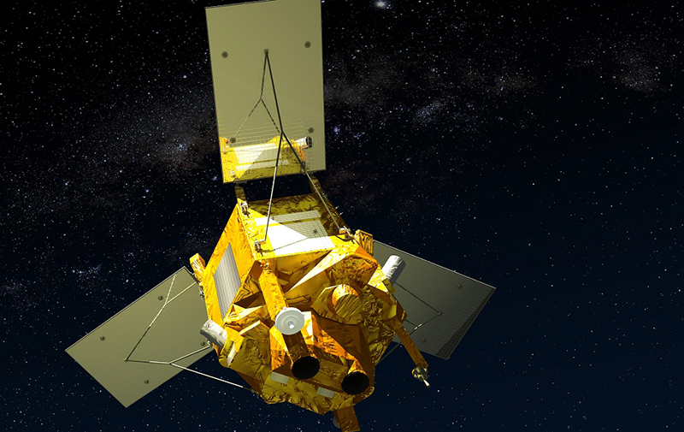
The most commonly used satellites in remoting sensing are:
IRS
Landsat
Envisat
SPOT

Slide 18
Subunit 4: Applications

Slide 19
Applications:
Many are the applications of the remote sensing, among others: Environment; Agriculture and Forests (as it was mentioned in subunit 1).
Particularly for Agriculture remote sensing are more and more used.

Slide 20
Applications in Agriculture:
Observing and Monitoring Crops: A critical role of remote sensing in agriculture is monitoring the health of crops.
Farming soil: For precision agriculture, monitoring the soil is essential.
Monitoring Water Conditions: Remote sensing in precision farming has successfully provided accurate and timely information like water bodies, irrigated cropland, crop and soil water status, and various scales.
Predicting Weather Conditions: This application of remote sensing in precision farming has provided spatial coverage to predict upcoming weather conditions successfully.
Observing Air Quality: Remote sensing in plant protection has allowed us to determine air conditions in specific locations.
Precision Farming: Precision farming and crop mapping using remote sensing aim to increase the yield of the crops and minimize strain on the natural environment.
Monitoring and Predicting Climate Changes: The remote sensing concept and application in agriculture has provided many advances when it comes to an understanding of climatic changes by quantifying the temporal states of the oceans, land, and atmosphere.

Slide 21
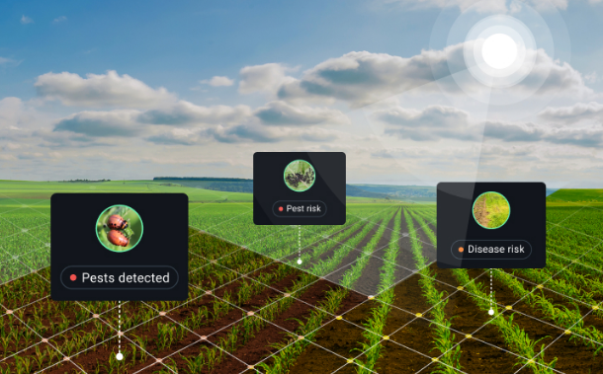
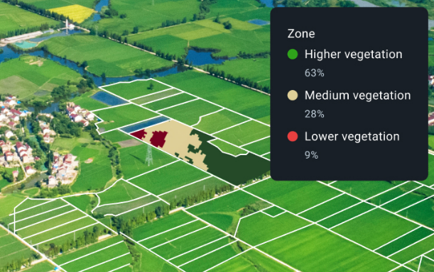
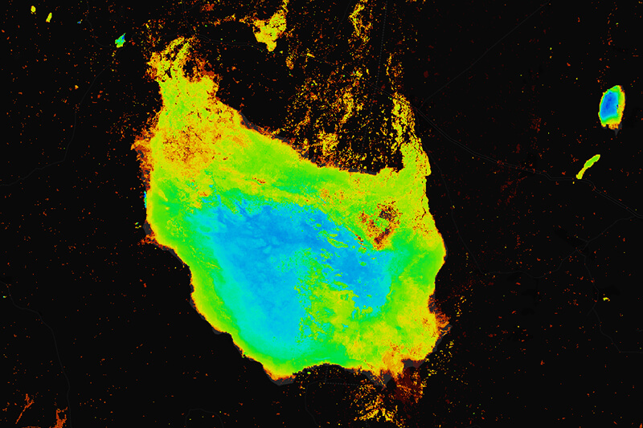
Remote sensing applications in agriculture:
Vegetation that covers the soil
Detection and control of pests and diseases
Water control (Monitoring a Lake)

Slide 22
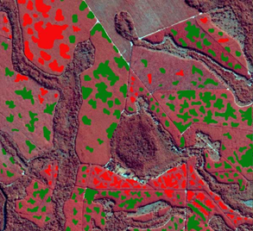
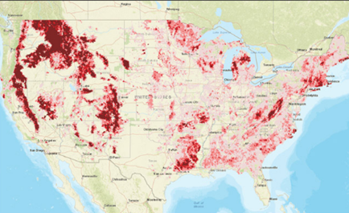
Remote sensing applications in agriculture:
Determination of harvest time

Slide 23
Conclusion:
Remote sensing is a technology used to gather information about objects and the environment without direct physical contact. It utilizes various instruments, such as cameras, sensors, and scanners, to capture data from a distance.
This technology has been increasingly used in various areas. From topography, to the assessment and prevention of natural disasters. Another very important application is in agriculture, in this case, it can be used from the choose of the crops to be produced, monitoring their development (protection against infestations, water balance) to even determining their harvest.
These techniques, since they use remote methods, do not cause any interference with the object to be studied.
Space-based remote sensing has revolutionized our understanding of the universe and our own planet. With advancements in technology, scientists can now gather unprecedented amounts of data and imagery from space-based sensors. From monitoring weather patterns to studying land cover changes, the applications of remote sensing are vast and continually expanding.
Through satellites and other instruments orbiting the Earth, we can observe the intricate details of distant galaxies, discover new celestial objects, and gain insights into the mysteries of the cosmos. Moreover, remote sensing enables us to monitor Earth’s natural resources, track environmental changes, and study the impacts of human activities on the planet.

