Slide 2
Course: (HEI-B3)
Module: (Digital technologies and artificial intelligence)
Learning Unit: (Integration of digital technologies for effective farm management)
Authors: (CERTH)

Slide 3
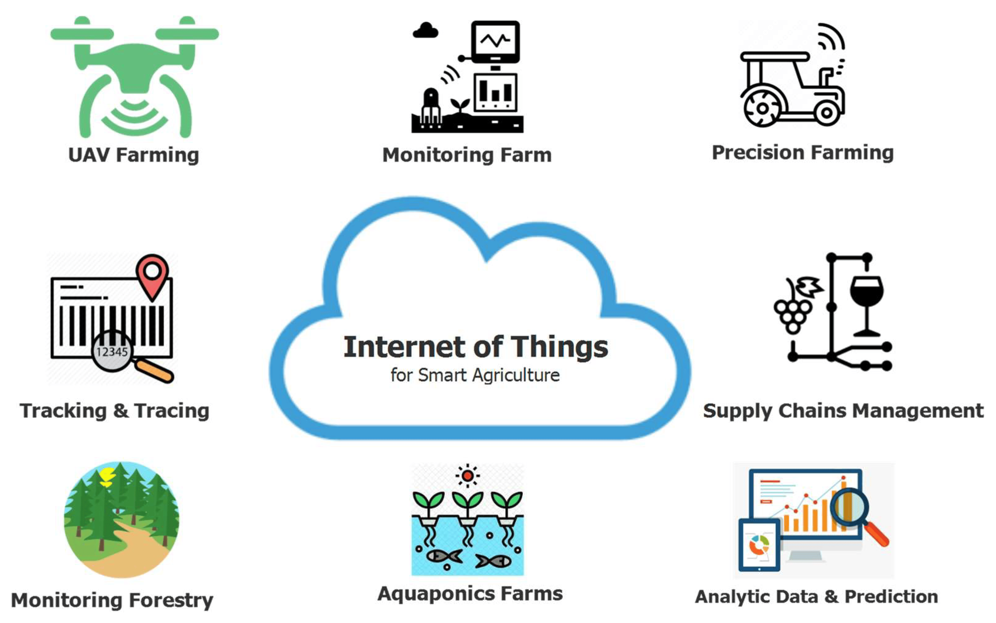
Introduction to smart farming
Internet of Things (IoT)
The internet of Things (IoT) is the present and future of every field impacting everyone’s life by making everything intelligent. It is a network of different devices which make a self-configuring network.
The aim is to propose a technology which can generate messages on different platforms to notify farmers

Slide 4
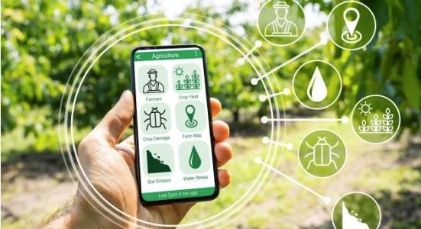
Introduction to smart farming
Digital Agriculture
A rapidly evolving field that uses technology to enhance agricultural practices, aiming to increase the efficiency, productivity, and sustainability of food production systems.
Digital Agriculture involves incorporating digital technology and data-driven methodologies into farming practices. This can involve everything from GPS guidance for machinery and satellite imagery for field analysis, to robotics for labour-intensive tasks and predictive analytics for assessing crop health and yield potential.

Slide 5
Introduction to smart farming
Areas of AI Application in Agriculture area
Crop, soil, and livestock monitoring: AI systems can support farmers in monitoring the condition of their crops, soil, and livestock and provide timely recommendations on particular actions and decisions
Detection of pests and diseases: AI systems can examine digital images taken by drones, agricultural robots, or farmers using a simple smart phone camera to detect pests and give concrete advice to agricultural workers on how to prevent their spread, treat affected plants or mitigate the damage caused
Weather and temperature forecasting: AI algorithms are able to assist with local weather and temperature forecasting using historical data and measurements made by local weather stations and field sensors.

Slide 6
Introduction to smart farming
Predictive analytics: By analyzing various field data and/or examining plant images, AI can generate accurate predictions about yields, and potentially, the quality of product.
Autonomous agricultural robots and farm equipment: AI systems can be deployed on robotic platforms to direct and control their work performing assistive tasks, such as targeted irrigation, application of fertilizers and pesticides, collection of fruits and transporting equipment around a farm among others.
AI technologies rely on automated systems, use of robots and drones and increased implementation of data generation through sensors and aerial images for crops and land use through deep learning technology.
It is important that farmers are equipped with up-to-date training to ensure technologies are used and continue to improve.
Smart farming is a modern farming managemental concept with IoT technology to increase the productivity in agriculture. With the use of smart farming, farmers can effectively use fertilizers and other resources to increase the quality and quantity of their crops

Slide 7
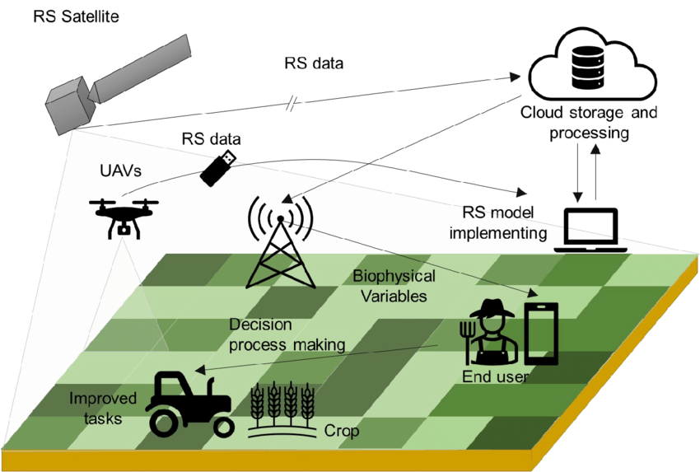
Monitoring Systems
Remote sensing
Τhe technique of obtaining information about objects on the Earth's surface through the analysis of data collected by special instruments that do not have physical contact with the objects.
Remote sensing is collecting information about an object without direct contact with the object through the use of electromagnetic radiation.
It refers to the use of satellite or aerial imagery, drones, and sensors to collect data on various aspects of crop health, soil conditions, and environmental factors.
The goal of using remote sensing in the field of agriculture is to look at crops from the sky in order to make better decisions.

Slide 8
Monitoring Systems
How does it work?
Electromagnetic radiation (EMR) is the basic amount of energy that has the ability to produce work and is measured in joules.
Radiation can transmit energy from one body to another without the intervention of an intermediate carrier and by traversing millions of kilometers in a vacuum medium. The method of transferring energy by radiation is also exploited by remote sensing, which is carried out from a body to the receiver (a suitable sensory instrument) that receives the signal.
The entire range of electrical radiation is the electromagnetic spectrum (EMS-Electromagnetic Spectrum). The spectrum is divided into spectral bands, which in turn are made up of small groups of continuous spectral lines. These spectral channels are the ultraviolet (UV), visible, infrared (IR) and microwave, of which the visible is most clearly defined by human vision.

Slide 9
Monitoring Systems
The UV channel lies between X-rays and visible light in the electromagnetic spectrum, with wavelengths from 0.01 to 0.40 μm and is divided into far UV (0.01-0.20 μm), middle UV (0.20-0.30 μm) and near UV (0.30-0.40 μm).
The visible channel, with a wavelength of 0,40 to 0,70 μm, has limits determined by human vision.
The white color of light comes from a mixture of six colors, which are violet, blue, green, yellow, orange and red. But the basic colors of visible light are blue (0.40-0.50 μm), green (0.50-0.60 μm) and red (0.60-0.70 μm), and from which, with a suitable combination, all the others are derived.

Slide 10
Monitoring Systems
Spectral Channels:
Ultraviolet, UV
Visible
Infrared, IR (The IR channel ranges from the red of the visible channel, up to microwaves, with wavelengths from 0.70 μm to 1000 μm. It is divided into near (near IR, 0.70-1.50 μm), intermediate (middle IR, 1.50-5.60 μm) and far (far IR, 5.60-1000 μm). Infrared is also divided into reflected (reflected IR, from 0.70-3.00 μm) and thermal (thermal IR, from about 3.00 to 1000 μm or 0.1 cm).
Microwave (The microwave channel is positioned between infrared and radio waves, with wavelengths from 0.1 cm to 1 m. This includes the longest wavelengths used in remote sensing. Microwave radiation has the ability to penetrate clouds and various surface objects depending on the wavelength used.)

Slide 11
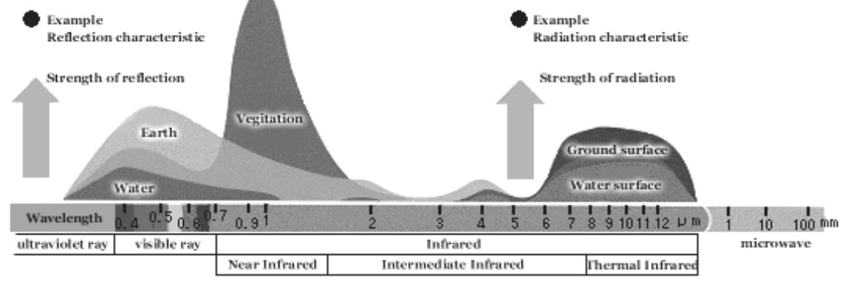
Monitoring System

Slide 12
Monitoring Systems
The physical characteristics and composition of each object affect the percentage of solar radiation reflected at different wavelengths in its own characteristic way. The amount and spectral distribution of the reflected and emitted radiation from an object is used as a means of identifying that object. This property is referred to as the spectral signature or spectral response of the object and is recorded by the sensors of satellites orbiting the Earth.
In this way, the reflection and emission behaviour (energy in the form of radiation) of the various objects on the Earth's surface is recorded and analysed, in order to facilitate the selection of the appropriate receivers and spectral bands that will better help in the detection of the objects of interest and their properties of interest.
The term 'remote sensors' includes all instruments for the remote detection and measurement of reflected or emitted radiation, as well as reflected acoustic waves from objects beneath the water masses, in the case of sonar. Sensors can be divided into two broad categories, which are recording (e.g., the spectrograph) and imaging sensors.

Slide 13
Monitoring Systems
Most remote sensing applications require information from different spectral regions (multispectral/multispectral-multiband), acquired by different sensors (multisensor) or a single sensor operating simultaneously in different spectral regions (multispectral or multiband sensor).
The imaging sensors can be classified:
according to the sensing processes (e.g., photographic or TV imaging),
according to their spectral range or mode of operation (e.g., active or passive imagers)
The imaging sensors according to (Lillesand, T. M., Kiefer, R. W., & Chipman, 2001) are classified as optical or passive and microwave or active.

Slide 14
Monitoring System
Advantages and Disadvantages of remote sensing systems
1) Visual systems (this includes cameras and scanners)
Advantages
•No complex editing software required.
•Require simple geometric corrections.
•They are characterized by the possibility of high spatial resolution.
•Have a wide instantaneous field of view.
Disadvantages
•Dependent on weather conditions and solar brightness
•Display spectral resolution limitation determined by the films.
•Have limited image reception.
•Allow very little possibility of image enhancement.
•Have a high loss of information when converted to digital format after scanning.

Slide 15
Monitoring Systems
Scanners: these are instruments that produce images in different spectral channels simultaneously, scanning the Earth's surface. They cover the visible and infrared spectrum.
Advantages
They have unlimited data download.
They show high spectral resolution.
Display high resolution.
Disadvantages
They exhibit geometric distortion due to the use of mechanical scanners which, although small, cannot be considered negligible.
They present problems related to the radiometric gradient. They are dependent on weather conditions and solar brightness.

Slide 16
Monitoring Systems
2)Radar: Mostly active recording systems covering the microwave spectrum.
Advantages
Not dependent on weather conditions and solar brightness of the Earth's environment (operate day and night with partial or total cloud cover)
They can use several spectral bands although most systems are limited to one band.
Disadvantages
It takes a lot of time and complex software to process the data.
Require significant geometric corrections where the use of DEMs (Digital Elevation Models) is necessary.
They have reduced data reception.
Do not provide multi-spectral data (with the exception of experimental flights and space shuttles).

Slide 17
Modern Farming Methods
1️. Crop Monitoring
What is it: Continuous observation of crop health and growth stages using remote sensing data and imagery.
Benefits for farmers: Timely identification of issues, efficient crop management, and increased yield.
Benefits for the environment: Targeted interventions reduce resource waste and minimize negative environmental impacts.
Market solutions: CropX, Taranis, Farmers Edge, SatSure, Orbital Insight.
2. Soil Moisture Monitoring
What is it: Measurement of soil water content using remote sensing techniques and sensors.
Benefits for farmers: Optimal irrigation scheduling, reduced water waste, and improved crop health.
Benefits for the environment: Conserved water resources and reduced runoff pollution. ▪Market solutions: Sentek, AquaSpy, Irrometer, METER Group, Arable Labs.

Slide 18
Modern Farming Methods
3. Nutrient Management
What is it: Assessment of soil nutrient levels using remote sensing data to inform precise fertilizer application.
Benefits for farmers: Improved crop yield, reduced fertilizer costs, and optimized resource use
Benefits for the environment: Minimized nutrient runoff and reduced environmental pollution. Market solutions: Yara, AgroCares, Cropnuts, TerrAvion, Agrology
4️. Weed Detection
What is it: Identification and mapping of weeds in agricultural fields using remote sensing imagery.
Benefits for farmers: Targeted weed control, reduced herbicide costs, and increased crop yield.
Benefits for the environment: Decreased herbicide use and minimized impact on non-target species.
Market solutions: Blue River Technology, ecoRobotix, Green Atlas, Bilberry, AgEagle.

Slide 19
Modern Farming Methods
5️. Yield Estimation
What is it: Prediction of crop yield using remote sensing data and advanced analytics.
Benefits for farmers: Improved decision-making, supply chain management, and market planning.
Benefits for the environment: Enhanced resource management and waste reduction.
Market solutions: Descartes Labs, Geosys, Agrivi, OneSoil, Gro In

Slide 20
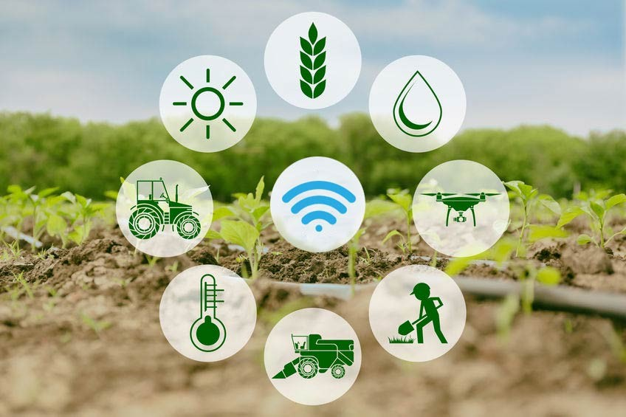
Modern Farming Solutions
Crop monitoring solutions:
European farmers are also embracing crop monitoring technologies, driven by strong innovation ecosystems and supportive policies. Countries like the Netherlands, Germany, Switzerland and the United Kingdom are leading the way in crop monitoring adoption.
What for?
1. Cattle Counting and Monitoring
2. Drones for Farm Security
3. Herding Cattle with Drones
4. Drones for pasture monitoring
WHY?
Automated cattle counting with drones saves time and is more accurate.

Slide 21
Modern Farming Solutions
Increased Dependence on Fertilizers: to compensate for the loss of soil fertility, farmers may become increasingly reliant on synthetic fertilizers, which can lead to further soil degradation, groundwater contamination, and increased costs.
Environmental Impacts: soil degradation can result in increased erosion, loss of biodiversity, and contributes to climate change through the release of stored carbon.
Food Security: in the long term, a decline in soil health can threaten food security by reducing the land's productive capacity

Slide 22
Modern Farming Solutions
Soil Health Digital/Precision Agriculture solutions
To mitigate the effects of this issue several digital and precision agriculture solutions can be adopted:
Soil Sensors: these devices are placed in the field to provide real-time data on soil moisture, temperature, and nutrient content. This information can guide farmers to apply water, fertilizers, and other inputs only when and where they are needed, reducing excessive use and soil degradation.
Precision Fertilizer Application: GPS-guided equipment can apply fertilizers with high precision, reducing over-application and ensuring nutrients are delivered where they are most needed. This can improve soil health and reduce nutrient runoff into nearby waterways.
Cover Cropping and Crop Rotation Decision Support Tools: these digital tools help farmers to plan and manage crop rotations and cover cropping, which can improve soil health and reduce the need for synthetic fertilizers. They use data on local conditions, crop characteristics, and other factors to provide recommendations.
Remote Sensing Technologies: satellite or drone-based imagery can provide a larger-scale view of the farm and reveal patterns and issues such as soil erosion or nutrient deficiency that might not be visible at ground level.

Slide 23
Modern Farming Solutions
Robotics in Agriculture
The idea of robotics in agriculture, the use of self-propelled machines in agricultural environments, is not so new.
In recent years, efforts have focused on creating smaller vehicles that, with the right intelligence, can work in an un-structured or semi-structured environment, such as that of agriculture.
These machines will be able to exhibit rational behaviour when they have to operate under identifiable conditions.
These vehicles can help to carry out complex and repetitive tasks, regardless of weather conditions. Automatic detection and automatic control (on-the-go) for each task is also important and systems like these are feasible, but most are too slow, and therefore not economically viable, and as a result have to be operated using a manned tractor.
The software and the technical and mechanical equipment to create these machines are already available, but what is needed is an integrated technical intelligence system adapted to the agricultural context.

Slide 24
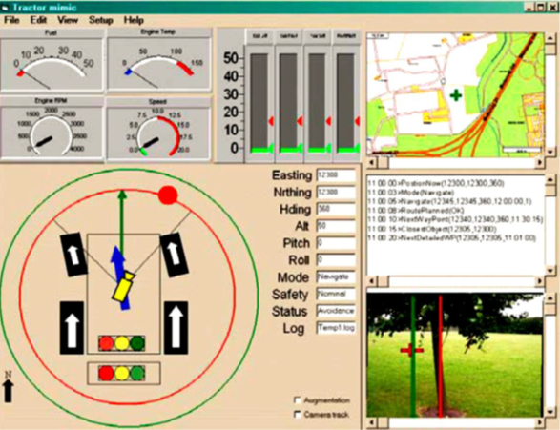
Modern Farming Solutions
Modern agriculture uses large amounts of energy. The energy consumed is a sum of the energy spent on applying inputs (fertilizers, chemicals and fuel) by tractors. The new trend is to create vehicles that are small in size, less energy-intensive, able to work under a variety of conditions and safe. Thus, by using smaller vehicles we have lower energy consumption and clearly safer vehicles.
Software simulation of the use of a self-driving vehicle

Slide 25
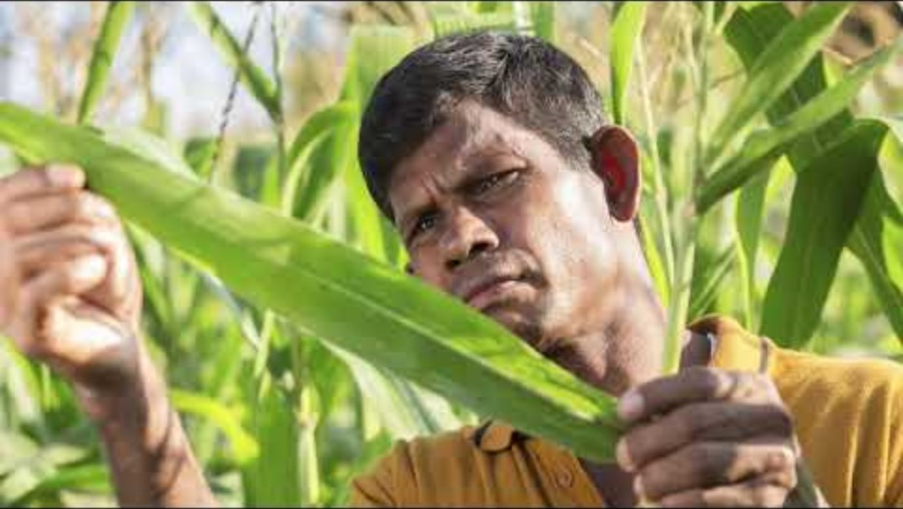
Modern Farming Solutions
Food and Agriculture Organization of the United Nations (FAO),

Slide 26
Case studies
Precision farming as mentioned started to be implemented in the early 1990s with pioneering countries such as the USA, the UK and others.
The first applications were in cereals with production mapping and, already by the end of the decade, applications were extended to most major crops and applications to crops such as vineyards began.
The application of Precision Agriculture started relatively late in Greece as well as in many Southern European countries.
Small farms.
Farmers who adhere to traditional production methods.
By farmers attached to product subsidies.
For crops in the European South, especially fruit and vegetables, there is no developed technology for the application of precision farming methods.

Slide 27
Case Studies
Applications in Cotton:
The first application of production mapping was on a fifty-acre field in Karditsa in 2001.
From all the measurements, but also from others in other areas of Thessaly, it turned out that there was significant variability in production, even in small fields which was the basis for an efficient application of GA.
In the fifty-acre parcel there was extensive application of precision agriculture technologies, and more data will be provided on this.

Slide 28
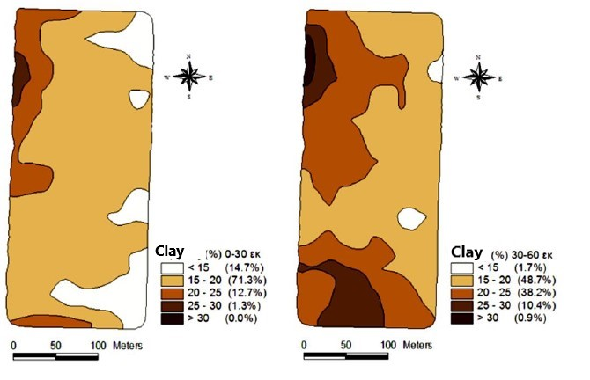
Case studies
The sensor was set to record values every 2’s at an average speed of 2 m/s, covered 4 m2 each production cell and gives the first maps, it processes the data to give us the maps in Figure 1, for four years.
The dark green color is the section with the highest yields, while the light color, yellow and red show the lowest yields. It is typical that the highest yield varies from year to year. While in the first two years in the northern and more clayey soil or rather the part with the least percentage of sand (Figure 6 and 7) gave the highest production, in the next two years the data changed, in the third and fourth year the data were practically reversed.

Slide 29
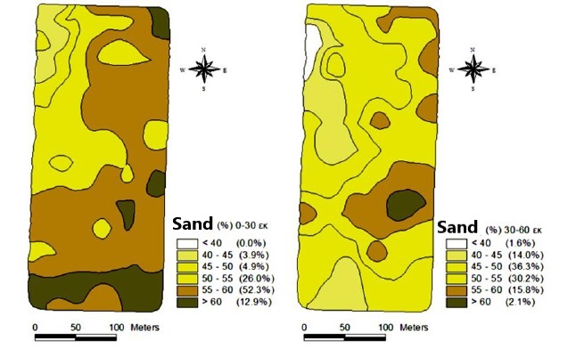
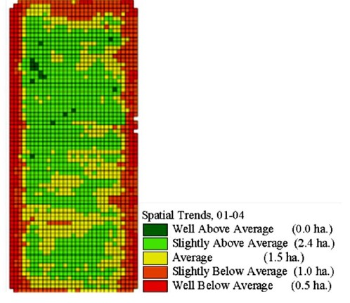
Case studies

Slide 30
Case Studies
The application in the field of Karditsa included measurements of electrical conductivity using a VERIS 3000 sensor, measurements in different fields and correlation of the calibration coefficient with varieties, as well as measurements of the variability of the quality characteristics of the production.

Slide 31
Case studies
Example for AI application for farmers
Plantix:provides instant information specific to individual growers and the crops they raise.
The main feature is to help the farmer automatically detect plant damage that occurs during cultivation.
The identification process determines plant diseases, pests and nutrient deficiencies and comes with necessary crop management advice including symptoms and triggers and the biological and chemical control measures to alleviate yield loss. The user uploads a picture of the plant damage which is further processed with the help of deep neural networks (DNN) using artificial intelligence (AI) and machine learning algorithms to identify the disease within seconds. : https://plantix.net/en/

Slide 32
Case studies
Connecterra
Uses sensors, cloud computing, and AI for monitoring the behaviour of cows to identify signs of disorders.
The solution has been successfully used in Netherlands. This is an example of using AI in livestock, which is an important sector of agriculture.
The raw data set was built up using a sensor around the neck of the cow, based on an accelerometer, an electromechanical device used to measure acceleration forces. Based on the labelled data, a supervised model was trained to identify the behavior patterns from the sensor data. By constantly training the models, it is possible to understand what the sensor data mean.

Slide 33
Case studies
XAG smart agriculture systems
XAG has developed a smart agriculture solution that integrates the use of unmanned aerial system (UAS) robots, automated steering system and management software as catalysts to unleash the huge potential of AI technology.
It starts with leveraging the survey UAS and IoT system to capture digital field maps, crop images and environmental data in the prescribed areas, followed by the analysis of XAG artificial intelligence (XAI) to gain an overall insight into farmland conditions
The three major processes of farm management–perception, decision-making and execution – are seamlessly linked together on the XAG SAS, where AI plays the role of data analyst to assist farmers

Slide 34
Case studies
Perception: building digital farming infrastructure to enable AI applications
XAG’s survey UAS photograph high-definition digital field maps which cover the entire farmland. This is building up a centimeter-level agricultural navigation network that enables standardized LBS (location-based service) of drones, robots and autopilot systems in farming areas.
While drones fly in the sky to capture an overall farm image, the solar powered XIoT™ system continuously takes high resolution pictures of a specific crop variety and collects ground soil/ weather data.
These digital field maps and farm data are automatically transmitted to and neatly displayed in the SAS system, with each land plot as uniquely numbered metadata. Farm owners do not need to put workers into the fields to scout the crops or geotag their locations.

Slide 35
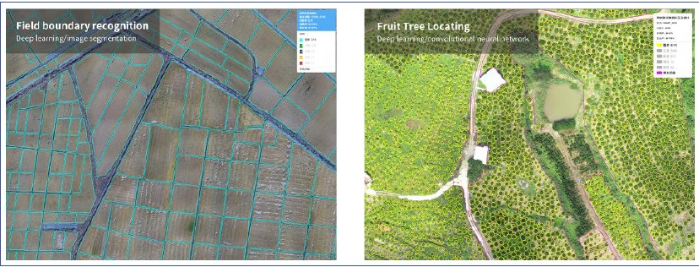
Case studies
Decision-making: XAI provides data analytics and timely diagnosis:
XAG artificial intelligence (XAI) is an AI cloud computing platform developed to achieve field insight and crop growth objectives.
SAS system provides a series of XAI-powered apps to assist farm owners in measuring the growth of various crops in different land plots, identifying abnormal conditions such as pests and weeds and evaluating the efficacy of fertilization and crop protection management.

Slide 36
Case studies
Optimising seedling population
During the seedling stage of crop growth, the number of healthy individual plants per unit ground area is considered a simple, yet essential factor that links to plant density and influences final crop yield.
An optimum seedling population must be obtained to achieve desirable crop production.
On the digital field maps, XAI is successfully programmed to identify the shape of each individual plant and calculate the seedling population of each land plot. It directly reveals whether the seedling population falls within the optimum level, so that land managers can make timely decisions on appropriate cultivation measures.
Crop growth modelling
The SAS system records the height of each individual plant and overall distribution levels to indicate which part of the cotton plant is growing too fast.
Land managers and farmers can easily plan how to adjust the speed of crop growth through chemical regulation, fertiliser application or irrigation.
An optimum plant height helps the cotton grow into the ideal shape and structure, resulting in a higher number of bolls and increased yield.

Slide 37
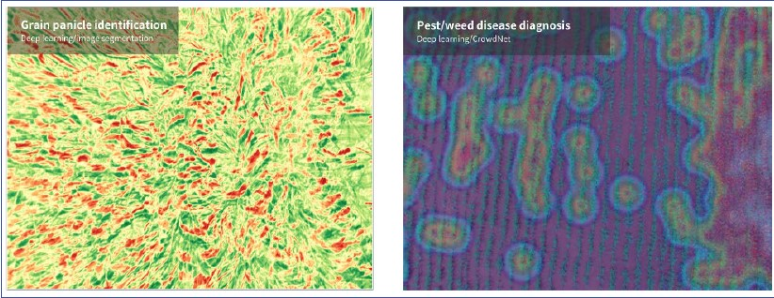
Case studies
  Anomaly detection of crop diseases
  When installing with the multi spectrum camera, the XMission survey UAS also takes remote sensing farm images that capture spectral variations to reflect the state of crop health.
  Abnormal changes, such as the presence of harmful pests, invasive weeds, or other crop diseases, can be accurately identified on the digital field maps using the normalised difference vegetation index (NDVI).
  Sparse vegetation coverage can also be recognised to provide locations and treatment areas for rehabilitation of degraded land. Based on these NDVI results, XAI generates AI prescription maps to instruct farm owners on the proper use of seeds, fertilisers, or pesticides.

Slide 38
Case studies
Yield estimation
Other AI applications of the SAS system include estimating grain yields of rice, wheat and maize through panicle counts during the ripening stage.
The panicle number is an agronomic determinant of final crop yield. It is traditionally obtained by sending field workers to manually count panicles of the sampling plants one by one on selected land plots, an inefficient, laborious method which falls short of accuracy.
To resolve this, deep learning models are developed to train XAI to identify the locations of individual panicles and then calculate their total number with remote-sensing images. Having a more precise estimate of crop yield, farm owners can make practical plans for future market transactions to improve their profitability.

Slide 39
Case studies
Execution: AI prescription map to guide precision farming operations
Field images with the application of XAI, the XAG SAS system helps farmers alleviate their physical burden and make smart decisions on best farm practices
These smart decisions are accurately executed by XAG agricultural drones and robots developed to replace manual labor and traditional large ground equipment.
With the guidance of AI prescription maps, drone swarms can navigate themselves on their pre-programmed flight route with centimeter level accuracy, while releasing the correct amounts of seeds, fertilizers, or pesticides precisely onto the target

Slide 40
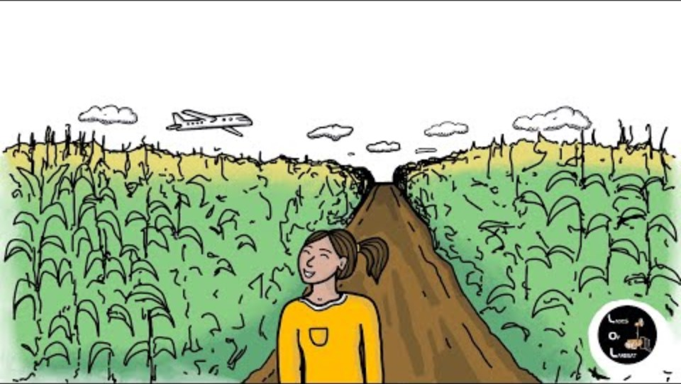
Case studies
USGS: Earth Observation User Case study: Using Landsat to Map Agricultural Yields and Irrigation Use

Slide 41
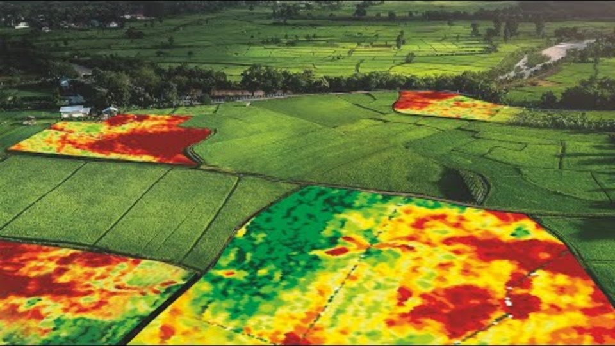
Case studies
Geospatial World: Application of Remote Sensing in Precision Farming. Technological advancements in precision agriculture have made it possible for farmers to improve their productivity effortlessly

Slide 42
Conclusion
All the above technologies that we described are contributing to increasing agricultural productivity. Accurate farm management, correct application of inputs at the right time and in the right quantities can make a significant contribution to increasing yields and achieving the 70% target.
It is obvious that the precise application of inputs in terms of quantity and timing can increase yields.
Navigation technologies can reduce ground compaction and help increase yields.
Vehicle traffic control systems for many years have helped to limit compaction, but also to improve the accuracy of routes by reducing gaps or overlaps in the application of inputs.
Precision agriculture is therefore a weapon in the hands of farmers to achieve better yields and meet society's expectations.

Slide 43


