Slide 2
Course: (HEI‐B4)
Module: (Digital Technologies and Artificial Intelligence )
Learning Unit: (Automation Technologies)
Authors: (CERTH-iBO)

Slide 3
Introduction to Automation technologies in agriculture
Agricultural automation is one of the potential significant contributors to improving productivity and reducing consumption and adverse impacts
Effective use of automation helps maximize agricultural production by better using inputs, reduces overall waste and can improve the quality of the produced agricultural products
The most significant developments occurred during the 20th century with the introduction of tractors
The first farm tractor powered by an internal combustion engine was built by Hart Parr Company

Slide 4
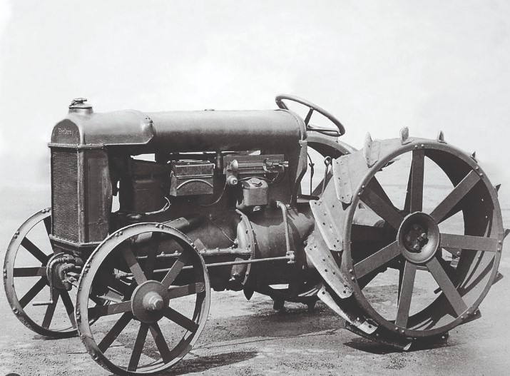
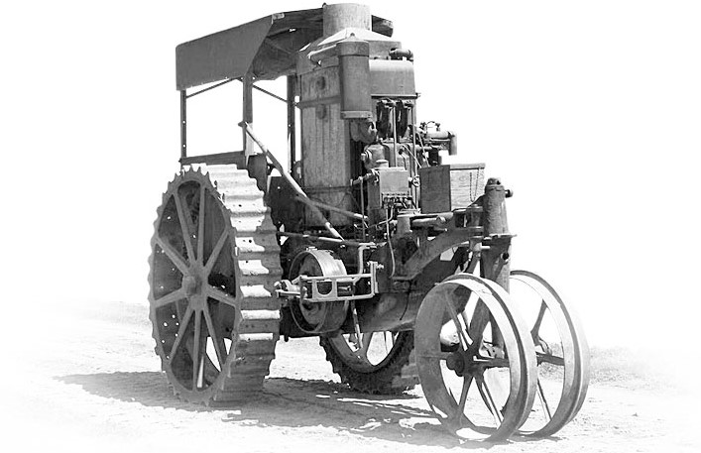
Introduction to Automation technologies in agriculture
Henry Ford & Son Corporation (1917)
Hart Parr Company Tractor (1900’s)

Slide 5
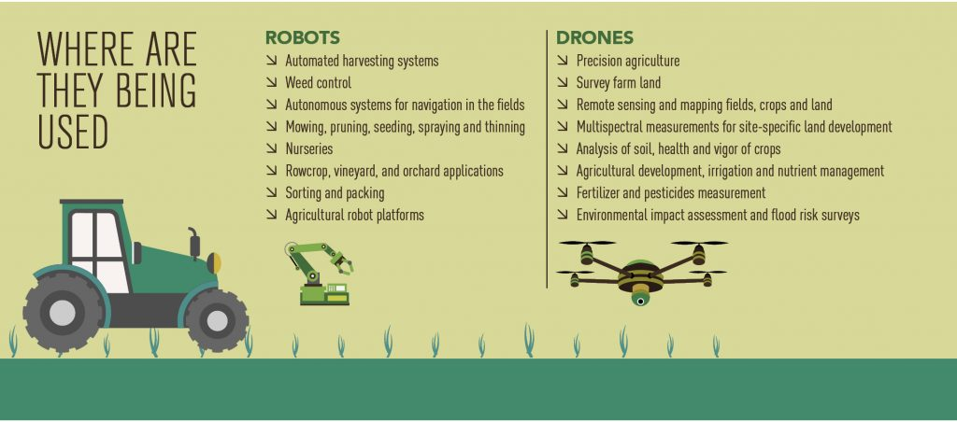
Introduction to Automation technologies in agriculture
Agriculture automation is the process of using various technological equipment to enhance and automate agricultural businesses
This farming technology is intended to alleviate the labor-intensive and time-consuming agricultural operations that farmers all over the world face
Automated tractors, GPS, drones, robotics, and software as a way to transform the current agriculture industry.

Slide 6
Introduction to Automation technologies in agriculture
The integration of cutting-edge innovations promises to reshape traditional farming practices, ushering in an era of unparalleled efficiency, sustainability, and resilience
Advancements in automation technology are poised to address some of the most pressing challenges facing agriculture in the 21st century
Robotics continues to play a pivotal role, with increasingly sophisticated machines designed to perform intricate tasks
The Internet of Things (IoT) is weaving a seamless web of connectivity across the agricultural landscape.
Smart sensors, drones, and interconnected devices offer real-time monitoring and control, enabling farmers to respond promptly to changing conditions and ensure the optimal growth of crops

Slide 7
Systems, Microcontrollers (Arduino, Raspberry), PID controller, sensor technologies, resistor wiring diagram
This subunit covers agricultural automation by dissecting core components
Automation with RELAY
Automation with PLC
Navigate through the intricacies of microcontrollers like Arduino,Raspberry Pi, unravel the principles of PID controllers
Decode sensor technologies, and grasp the practical aspects of resistor wiring diagrams

Slide 8
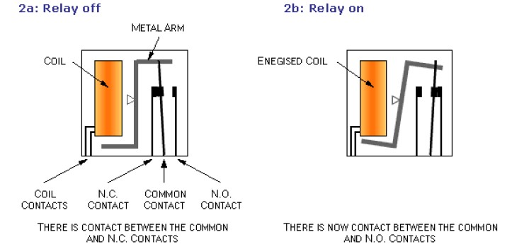
Automation with RELAY
Switches where the change of state is made (mechanically) and remains.
Push-Button switches, where their change of status is made (mechanically) and remains if it is pressed.
Relays are switching devices containing:
1) An excitation coil that is (usually) excited with a continuous voltage, e.g.5V, 24V, etc. or alternating voltage e.g., 220V.
2) One or more switches (relay contacts). As with simple switches, relays are represented by always shown in the rest position (closed position – unoperated contacts can be designed in different ways as shown below, but the common contact is the moving contact arm with brushes and will move when the relay is activated.
The parts and the mechanical function of the relay

Slide 9
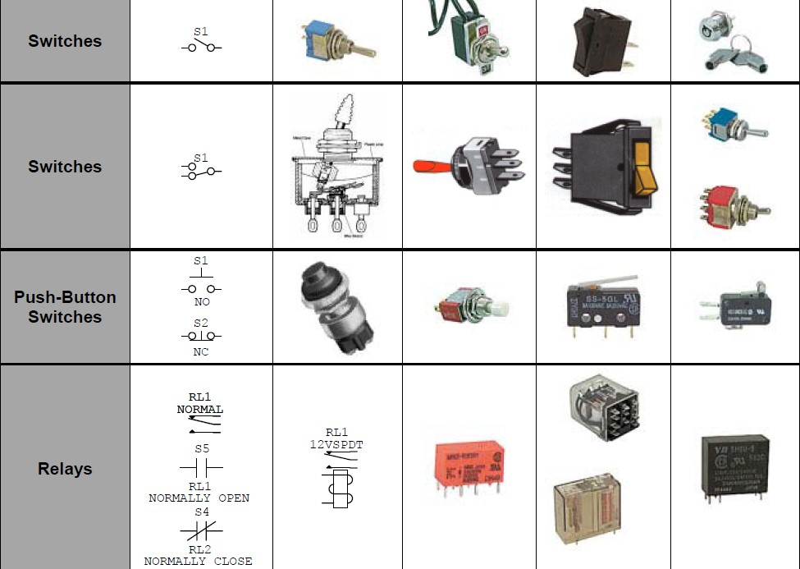
Automation with RELAY
Switch Symbols

Slide 10
Automation with PLC
Programmable Logic Controllers (PLC) or Logic Controllers, are controllers that can be programmed, and they belong to the family of computers (special use).
A PLC:
Monitors inputs (Switches, sensors, etc.)
Makes decisions based on its program
Controls outputs (lamps, pumps, motors, etc.),
to automate a process or a machine or mechanize a mechanical operation. They are useful in commercial and industrial applications.
PLCs can implement and execute the same and even more complex tasks automation than (traditional) automation and controls that were done with relays, cables, pins, etc

Slide 11
Automation with PLC
Structure of the PLC - Program flow
Each PLC has basically the same structure as described below. The differences between different types of PLC are subject to convenience and features needed in each application. Their structure includes:
Computer implementation (CPU, memories CPUs (memory, RAM/ROM, etc.)
Input lines (analogue or digital inputs)
Output lines (with relay or relay implementation transistors)
LED indicators (input/output status).
Communication port (for programming and/or cooperation with other PLCs or modules)

Slide 12
Where do we find RELAYS in agriculture?
Irrigation Control: Relays are used to control pumps, valves, and solenoids in irrigation systems.
Temperature Control: In greenhouses and climate-controlled environments, relays are employed to manage heaters, fans, and cooling systems
Lighting Control: In indoor farming or controlled environment agriculture, relays can be used to control artificial lighting systems, ensuring that crops receive the right amount and type of light for photosynthesis
Livestock Feeding and Watering: Relays can be used to automate the operation of feeders and waterers for livestock, ensuring that animals receive adequate nutrition and hydration
Security and Access Control: Relays are sometimes used for controlling access to agricultural facilities, such as gates and security systems, to enhance farm security.

Slide 13
Where do we find PLCs in Agriculture?
Automated Machinery Control: PLCs are often employed to control and automate various agricultural machinery, including tractors, seeders, harvesters, and sorting equipment
Data Collection and Monitoring: PLCs collect data from sensors, such as soil moisture sensors, weather stations, and humidity sensors, to monitor and control environmental conditions
Irrigation Management: PLCs can manage complex irrigation systems, adjusting water flow rates, timing, and distribution based on real-time sensor data
Feed and Livestock Management: In livestock farming, PLCs can automate feed distribution, monitor animal health through sensors, and control ventilation systems to ensure optimal conditions
Process Control: PLCs play a crucial role in food processing facilities associated with agriculture. They manage various stages of food processing, ensuring quality and consistency

Slide 14
What’s a PID controller?
PID controller is a series compensator, which is integrated, in whole or in part, into the straight branch of the closed loop system loop and appropriately adjusts the signal that activates the system under control, taking into account the deviation (error) of the input (usually the desired specification for the output) from the actual output of the system.
A PID controller includes 3 main terms:
The Proportional term (Proportional or P term)
The Integral or I term,
The Differential term (Derivative or D term)

Slide 15
Agricultural Automation Systems:
Many agricultural automation systems, like many automation systems in most industries, perform the following actions:
Obtain and process information.
Make a decision.
Perform some actions.
The automation system needs information to make appropriate decisions before it takes actions. If the automation system has incorrect information, it will make faulty decisions and will take incorrect actions. The information required by many agricultural automation systems can often be one of three types. These types are setpoints, agricultural variables, and automation system variables. Setpoints are desired outputs, conditions, or relationships supplied to the automation system from the outside.

Slide 16
Controllers
Controllers can be classified by the number of states of the output of the controller. Generally, the more states of the output, the more complicated and costly the controller will be. They will be initially classified here into on–off, discrete-output, and continuous controller categories. On–off control is the simplest control. Consider, for example, a simple heating system.
Controllers can be mathematically analysed to predict and understand performance and to enable improvements. The classical control theory was developed in the middle of the twentieth century to analyse automation systems.
Controllers must take all the sensor signals and resolve them into coherent and reliable information. The signals received may vary widely for such characteristics as signal level, frequency content, and noise. The controller front ends must properly process the signals to obtain reliable information. But the most important task of the controller is to decide the proper action.

Slide 17
Microcomputers in Agriculture
Set of mechanisms/devices in the environment that perform a specific action or activity and interact. As we can see, from the field of agriculture, it is not possible to end the contribution of computer systems as these have become indispensable in every branch of human activity.
System requirements:
•In many cases, all you need is a computer that could programme to simply take data from the environment (e.g., changes in temperature, distance, lighting, button presses) ...
•then, after processing, give commands for actions such as switching on a lamp (unit lighting), the movement of a mechanism (e.g., a ventilation unit or a fence mechanism), the generation of a sound (siren for emergency notification).
•The possibility of remote notification of what is happening or to delegate actions is very welcome.
•The small size and resistance to extreme environmental conditions (e.g., temperature, humidity, radiation) and the small energy consumption is a priority.

Slide 18
Computing Systems: Arduino & Raspberry Pi
The Arduino has digital inputs/outputs and analog inputs. The latter are particularly useful as they can be used to digitize useful data (angle, distance, temperature, brightness, etc.)
Raspberry is much more powerful than the Arduino, has ports GPIO, USB, Ethernet (in newer versions also Wi-Fi, Bluetooth) and is an ideal environment for developing applications in an environment Linux application, and now supports popular educational environments such as MIT Scratch or python and is becoming increasingly popular.
Raspberry Pi Arduino Uno

Slide 19
Applications in Agriculture
Automation in field crop production
Pressure sensors (Impact Force Sensor). These sensors measure the force exerted by the flow of the seed at some point in the product transfer tube. This force is proportional to the flow of the seed.
Plate Displacement Sensor. These sensors are similar to the above sensors except that they measure with a potentiometer the displacement exerted by the seed flow as it strikes a point on the product transfer tube. This displacement is proportional to the flow of the seed.
Radiometric System. The intensity of the radiation measured by the detector is the maximum intensity when no seed is passing through the transport tube. As the seed passes through the transfer tube, the intensity of the radiation detected decreases.
Load cell system. In this system the weight of the seed is measured by a load cell as it passes through the seed feed screw of the harvester.

Slide 20
Applications in Agriculture
Volume Measurement System. Another category of yield measurement sensors measures the volume of seed passing through the seed cleaning system.
Seed moisture sensors. The seed moisture sensor is usually placed in the seed cleaning system near the production sensors
Speed measurement sensors. These sensors are installed on the wheels of the harvester and measure its speed.
Harvester position sensor. This sensor controls the flow and storage of data.
Central unit with display. The central unit is the key element of the system. During the operation of the system, it collects and stores the outputs from the sensors and at the same time displays them on the screen.

Slide 21
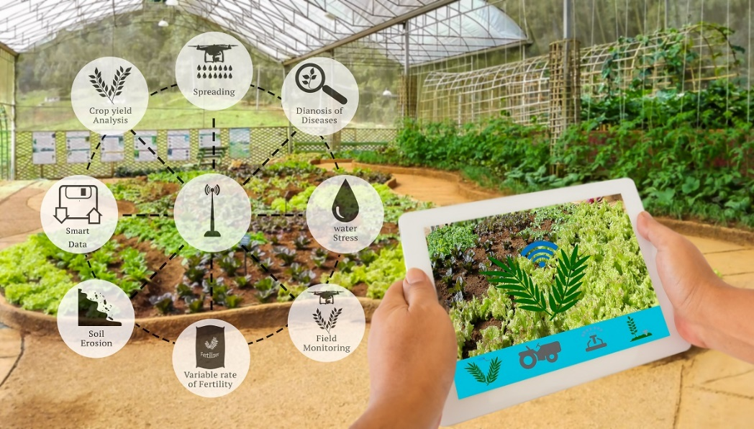
Sensors in Agriculture
Estimating production at each point or part of the field requires the measurement, recording and analysis of certain data.
The flow of products into the machine
The area harvested by the machine in the unit of time (e.g., m²/s)
The position of the machine in the field made using GPS
All data must undergo initial processing in a Central Processing Unit (CPU) and stored in a memory for transfer to a PC for further processing
The system may also have data to measure quality attributes of the production.
Sensors used in Agriculture

Slide 22
Production mapping systems in harvesting systems machines
A series of sensors that measure the flow of the seed and its moisture in the machine:
The stalk (straw) together with the ear (seed and anemides) are cut by the knife of the machine and pushed to the tub and from there with the screw to the elevator and fed to the drum - counter-drum where threshing begins.
There, in the drum-antidrum system, the grains are ginned, i.e., they are separated and allowed to fall on an inclined plane before being passed through the sieves.
The straw, together with a small part of the seed, is led to the horses or blowers where the seed is separated and led to the inclined plane and then to the sieves, while the straw is led out of the machine into the field.
Notes:
Did you know?
The first production mapping with sensors mounted on harvesters started in the early 1990s. The first applications were on harvesters and were implemented in fields in the UK. The first applications demonstrated the high variability of production and the usefulness of applying precision agriculture. Sensors for many other crops started to be produced in the late 1990s, e.g., for cotton, potatoes, beets, industrial tomatoes, but also applications in tree crops and horticulture.

Slide 23
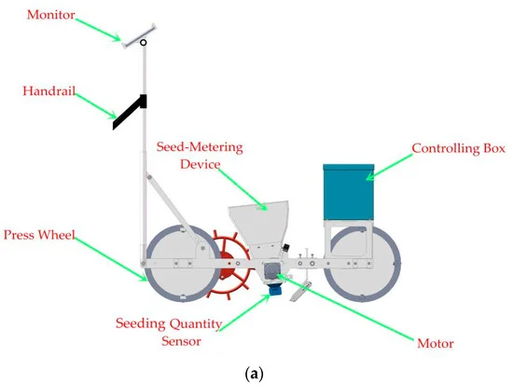
Production mapping systems in harvesting systems machines
2) Sensors for measuring the flow of the seed in a harvesting machine.
Sensors can be divided into several categories based on how the flow is estimated, such as sensors that measure the volume of material, sensors that measure weight, sensors that use the impact of the seed on surfaces and indirect methods.
These sensors should have the following characteristics:
Easy calibration and if possible independent of grain type,
Satisfactory measurement accuracy,
Not prevent the machine from operating normally, even if it is damaged,
Easy to fit to the machine and easily adaptable to different machines.
Seeding quantity sensor

Slide 24
Production mapping systems in harvesting systems machines
Seed flow measurement system in TH/A with volume measurement, showing the mode of operation with the seed height sensor
Claas Quantimeter system that measures seed flow
3) Methods of measuring the volume of the seed
With rotating volumetric wheel (Claydon sensor)
These systems either use a container with a known volume that when filled causes a movement that can be recorded or use beams of light that are interrupted by the seed and are related to its volume.

Slide 25
Production mapping systems in harvesting systems machines
Measurement of the volume of the seed in the seed container. This system has an array of light emitters and a receiver array located opposite each other. As the container is filled with seed, the beams are interrupted, and no potential difference is produced. Therefore, each interruption corresponds to a volume of filling of the container and thus the output is measured over the time interval of the successive interruptions of the beams.
Measurement of the volume of the seed in the "buckets" of the grain elevator The system works by beams of light that are interrupted by the volume of the seed on the elements of the grain elevator, thus estimating the volume of the seed and therefore the production. The system faces problems as the shape of the volume is altered by changes in the inclination of the machine and also by the different moisture content of the seed.

Slide 26
Production mapping systems in harvesting systems machines
Estimation of the filling of the screw conveyor of the seed to the store. This system again relies on light beams on the seed transfer screw in the hopper, which give the filling of the screw that correlates with the flow of seed into the machine

Slide 27
Production mapping systems in harvesting systems machines
3) Methods of measuring seed weight
System with force cells weighing the seed container. The entire seed container is supported by four force cells that continuously weigh the seed and take out differences in measurements at regular intervals. In this way, the quantity of seed (kg) in a unit of time is estimated.
With containers that are emptied when the seed reaches a weight. These systems have two containers into which the grain flows. At the beginning, one container is fed and, when full, is moved so that the grain flows into the other container, while the original container is emptied either by rotation or by retraction of the bottom. This system interferes with the flow of seed after the elevator and does not cause any substantial change to the machine. A problem arises, however, if the containers become blocked.

Slide 28
Production mapping systems in harvesting systems machines
With modification of the weighbridge and addition of a horizontal section to be weighed. The system requires a change of the grain elevator to which a horizontal section is added, which is weighed with a force cell. The weight measured is related to the flow of the seed. The change requires significant changes to the TH/A that make the system unusable.
With hinged connection of the hose/transfer screw. In this system, a screw conveyor is inserted into the system, e.g., in the warehouse, which is hinged and weighed by a load cell. The difference in weight per unit time gives us the flow of the seed into the machine. And this system requires interventions in the machine that make it difficult to implement

Slide 29
Production mapping systems in harvesting systems machines
5)Systems measuring the force or pressure from the flow of the seed.
Systems for measuring the impact force of a seed against a plate
System with baffle in the seed flow
With flexible seed flow hose

Slide 30
Production mapping systems in harvesting systems machines
6) Indirect measurement systems
By measuring the dielectric constant
Measurement of gamma radiation absorption
System with measurement of the tension in the chain or in the belt of the elevator

Slide 31
Harvesting machine

Slide 32
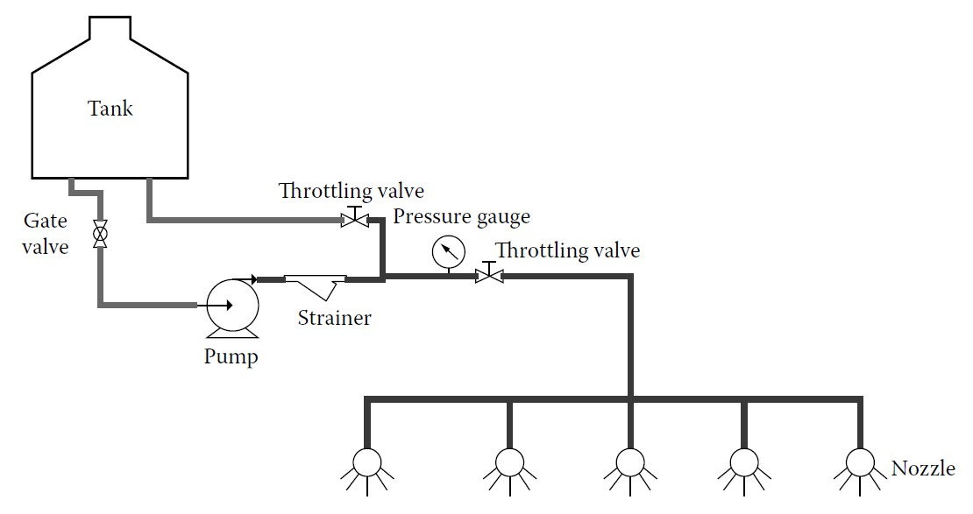
Automation of pesticide application systems
These conventional systems were designed to broadcast chemicals without any mechanism to vary application rate on the go to optimize chemical use. In such systems, the nozzle delivery rate was fixed through the adjustment of regulating or throttle valves.
Another important concern that should be addressed in the design of any pesticide application system is the impact on the health and safety of the person who operates the equipment that applies the pesticides onto the fields
The fundamental goal of automation in chemical application technology is to improve the precision and uniformity of chemical application while increasing biological efficacy and reducing environmental impact. The purpose is to achieve safe, economical, and efficient pesticide applications

Slide 33
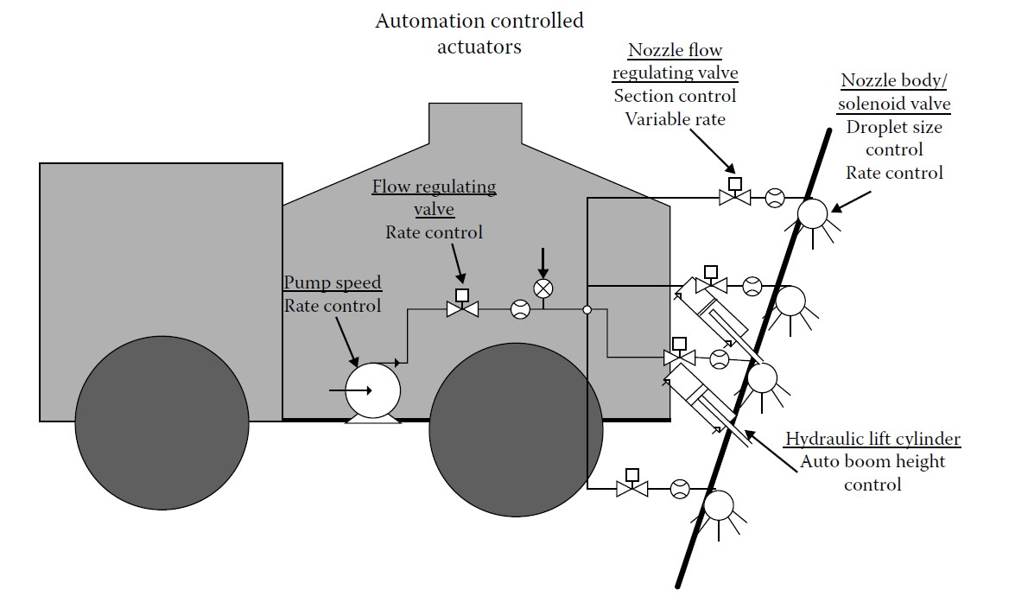
Automation of pesticide application systems
Many different types of controllers are used in chemical application systems to optimize system performance that helps achieve this overall goal. Generally, various control mechanisms being used by a state-of-the-art chemical application system can be classified into four groups:
rate control
nozzle/droplet control
section control
boom/tower control.

Slide 34
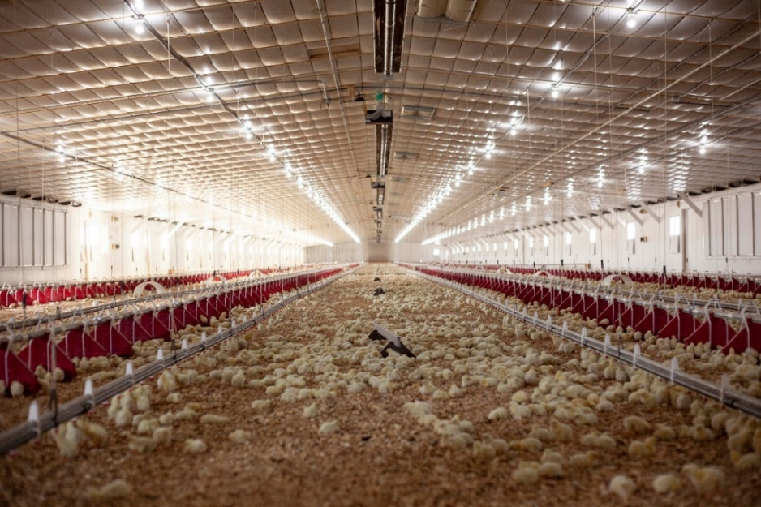
Automation in animal housing production
Modern structures for livestock and poultry house large numbers of animals—for example, animal numbers per building are typically about 1200, 25,000, and 250,000 for swine, broilers, and laying hens, respectively.
1) Environmental Control Systems: A key feature of environment control, whether via natural, mechanical, or hybrid control systems, is the provision of a more uniform environment near the thermoneutral zone for the animals. This is the range of environmental conditions (temperature, humidity, air velocity) for which animals are most comfortable and for which they expend the least amount of energy for maintenance requirements
2) Lighting Systems: Providing and controlling light intensity and simulated day length is critical because light is closely tied to reproductive and hormonal responses of animals. The simplest automated lighting systems use a 24-h timer that controls lighting circuits to provide the desired amount of “day” and “night.

Slide 35
Automation in animal housing production
3) Feed and water distribution systems
In-house feed distribution systems have largely been automated in commercial swine and poultry operations but remain a manually managed operation for most cattle. Swine and meat poultry feed distribution systems are practically identical in operation and differ only in the design of the feed access through and distribution auger placement. Feed is drawn from on-site feed bins external to the building

Slide 36
Automation irrigation systems and soil management
Soil moisture and temperature sensors with wireless sensor networks
Wireless network technology has emerged in recent years and seems to have a lot to offer in the agricultural sector.
The systems are installed in perennial plantations primarily, but also in annual plantations, and collect real-time data on various key parameters related to plant condition, soil, etc. These sensors are a useful tool enabling the producer to manage crop interventions in the various parts of the field in a timely and appropriate manner.

Slide 37
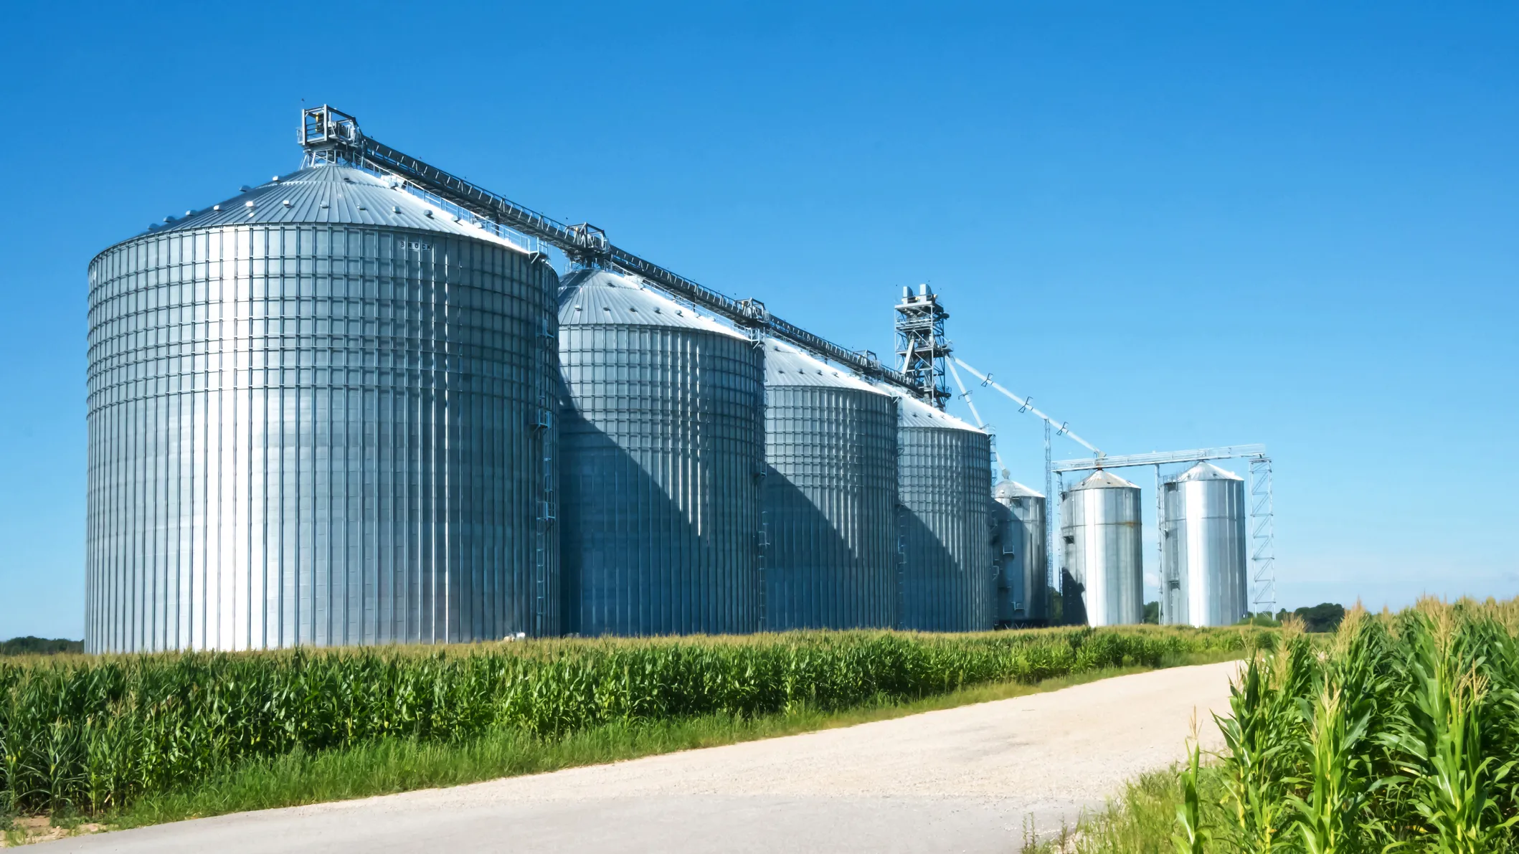
Post harvest automation
Automation of grain processing
Grain elevator: A grain elevator is an agricultural structure that processes and stores grains such as rice, wheat, corn, and beans.
Automatic Rice Quality Inspection System: An inspector usually evaluates visually the components of the rice as an official inspection when brown rice is shipped after hulling.
Dryers: There are several types of grain dryers: fixed-bed dryer, fluidized-bed dryer, and circulated-grain dryer.
Storage in Silos: After cleaning, rough rice is stored in a silo. During silo storage, aeration through the silo is automatically carried out when the temperature of fresh outside air is below –5°C in winter.
Module: Digital Technologies and Artificial Intelligence / Learning Unit: Automation Technologies / Subunit: 3rd

Slide 38
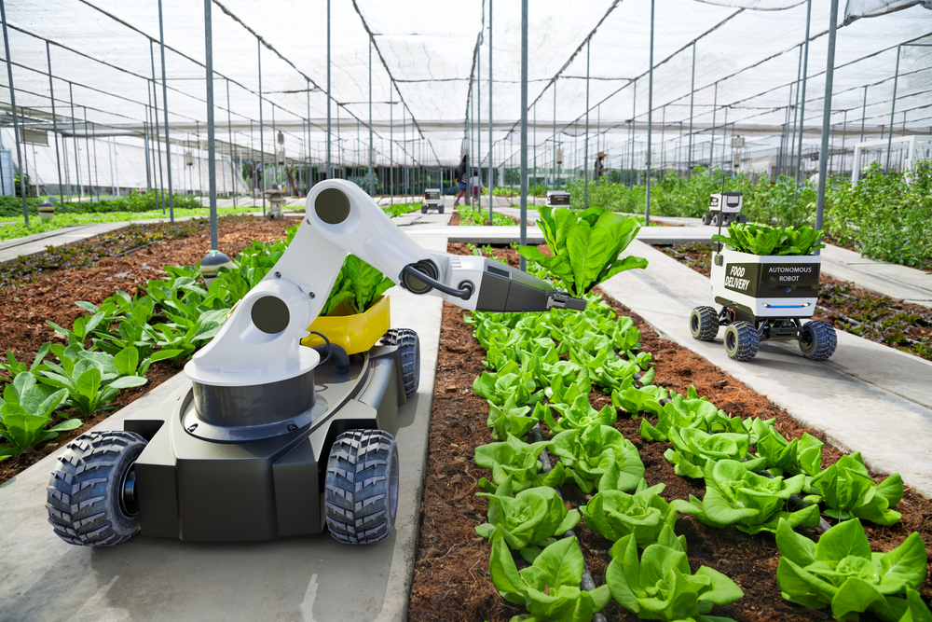
Post harvest automation
Hulling Systems: A hulling system consists of a roll type huller and a paddy separator. There are two rubber rollers rotating in opposite directions and at different revolving speeds in the huller
Grading Robot: Peaches, pears, and apples are not suitable for conveyors and handing systems because they are easily damaged on the system, a grading robot system which automatically provides fruit from containers and inspects all sides of the fruit, was developed.
Sensors of Inspection Systems: In the grading systems, imaging technologies and NIR technologies are essential in performing external and internal inspection.

Slide 39
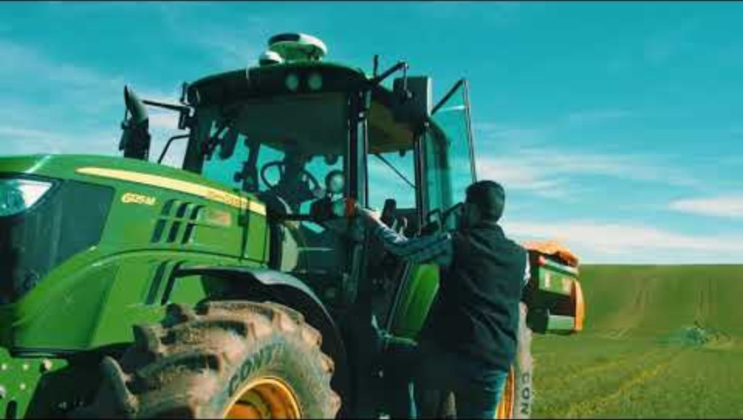
Applications in Agriculture
Augmenta System for machine vision. The Augmenta System uses state-of-the-art machine vision technology to analyze fields in real time to determine crop health and control Variable Rate operations such as nitrogen fertilizer, harvest-aid defoliant and plant growth regulator (PGR) applications. Watch this extended version to understand how it works

Slide 40
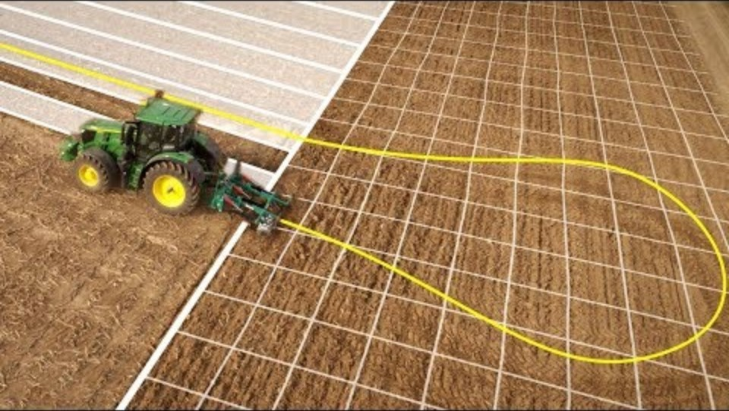
Applications in Agriculture
John Deere, AutoTrac Automation. AutoTrac Turn Automation on 6R to 9R Series John Deere Tractors automatically controls the entire headland turn and manages all tractor and implement functions with ease and precision. See how you can reduce headland skips and overlaps as well as costs for fertiliser, chemicals and fuel.

Slide 41
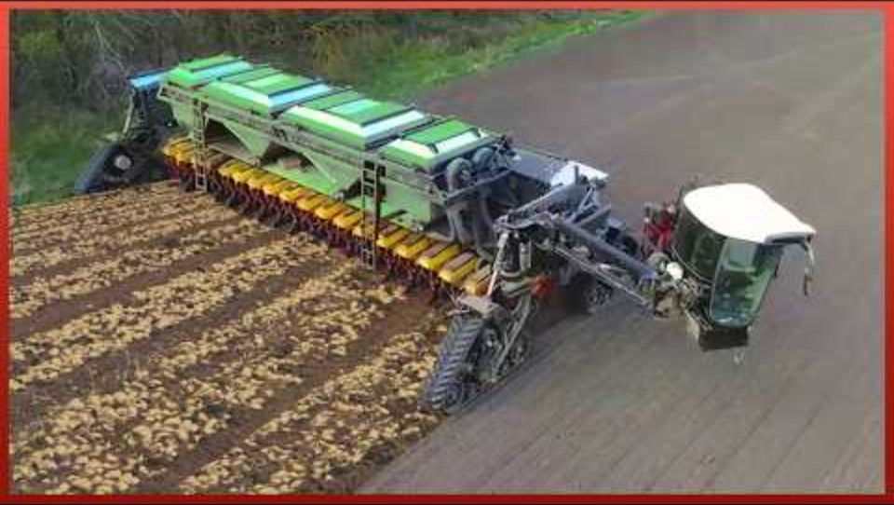
Applications in Agriculture
Quantum Tech, Automated machines, they provide an increase in production and ease the job of agricultures, making it less physical and time-consuming. Here we bring you a review of the best agriculture machines we have found. Watch it and tell us what you think.

Slide 42


