Slide 2
Course: HEI
Module: Bio-economy, circular economy and bio-based products
Learning Unit: Circular Economy
Authors: UOP

Slide 3
CONTENTS
1. Background and concept of the Circular Economy
2. Linear Economy versus Circular Economy
3. Principles, Dimensions, Benefits and Challenges of Circular Economy
4. Strategic Action Plan for Circular Economy and Product Sustainability
5. System Thinking and Circular Economy
6. Applying Circularity to Agriculture
7. Agroecology and Regenerative Practices
8. Circular Farming Technologies
9. Circular Business Models
10. Resource Reduction and Waste Management
11. Agricultural Production of Bio-based Resources

Slide 4
1. Background and concept of the Circular Economy

Slide 5
1.1. Background
The United Nations 2022 report predicts significant population growth:
  8.5 billion by 2030
  9.7 billion by 2050
Annual world extraction of raw materials:
  Increased from 27.1 billion tonnes in 1970 to 92.1 billion tonnes in 2017
  Average annual growth rate of 2.6%
Per capita demand for materials expected to rise:
  From 7.4 tonnes in 1970 to 12.2 tonnes in 2022

Slide 6
1.1. Background
50% of global greenhouse gas emissions attributed to:
  Mining, raw materials processing, and food production
  Responsible for over 90% of biodiversity loss and water scarcity
Greenhouse gas emissions on the rise:
  Significant increase since 1990
  Primary gases: carbon dioxide from fossil fuels and industry, methane
Despite EU commitments, greenhouse gas levels continue to rise:
  Earth's greenhouse gas levels are increasing despite reduction goals
Need for the circular economy:
  Addressing environmental pressures
  Creating a more sustainable future through resource management

Slide 7
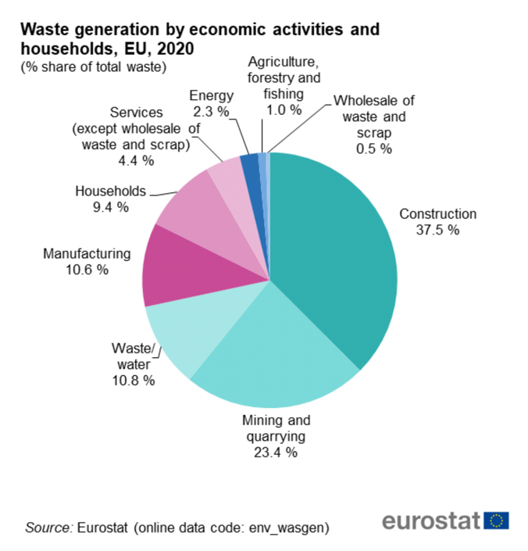
1.1. Background
Did you know that in 2020, Europe generated 2,151 million tonnes of waste from all sectors and households?
On a per capita basis, each person produced 4,8 tonnes of waste!

Slide 8
1.2. Definition of Circular Economy
The circular economy promotes a system of making and using goods that values sharing, reusing, repairing, updating and recycling materials and items to extend their functional life.
In essence, it focuses on minimising waste. When products are no longer usable, they are recycled so that their materials remain in the economy and are continually reused, adding value each time.

Slide 9
1.2. Definition of Circular Economy
The European Parliament (2016) defines circular economy as:
“an economic model based inter alia on sharing, leasing, reuse, repair, refurbishment and recycling, in an (almost) closed loop, which aims to retain the highest utility and value of products, components and materials at all times”.
This approach begins at the fundamental level of product design, which is based on durability, upgradability and recyclability. Products are encouraged to be used repeatedly and refurbished during their lifecycle. However, there is a major concern with them once they stop functioning, and this concerns recycling and resource recovery.

Slide 10
Additional Information
If you want to learn more on the Circular Economy, please watch this video in the following link
https://www.youtube.com/watch?v=zCRKvDyyHmI
If you want to learn more on the Waste Statistics please read this article in the following link
https://ec.europa.eu/eurostat/statistics-explained/SEPDF/cache/1183.pdf

Slide 11
2. Linear Economy versus Circular Economy

Slide 12
2.1. Linear Economy
Over the past 150 years, industrial progress has largely followed a linear economic model.
Known as the take-make-waste system:
  Resources used to produce items that become waste
  Products follow a linear path from raw materials to discarded waste
Benefits of the linear model:
  Enabled mass production and economic growth
  Lifted people out of poverty and fueled population growth

Slide 13
2.1. Linear Economy
Downsides of the linear model:
  Environmental degradation
  Waste of precious materials
Poor resource and land management across sectors like agriculture, construction, and transport exacerbate negative impacts.
The circular economy concept:
  Originating in 1966
  Explored by various intellectual currents
  Aims to eliminate waste and keep resources in use through regeneration and recycling

Slide 14
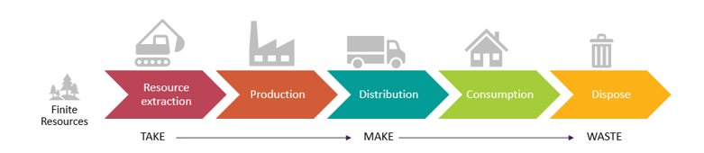
2.1. Linear Economy
The linear Model
SOURCE: WAUTELET, 2018

Slide 15
2.2. Circular Economy
The circular and linear models differ in their approach to creating and sustaining value. While a linear economy operates on a "take-make-waste" sequence, where raw materials are harvested, turned into products and eventually discarded, its value creation depends on producing and marketing the maximum number of products.
The approach of Circular Economy focuses on optimising resource use, favouring sustainable inputs, extending product life to maximise value, and recycling by-products and waste into new materials or products.

Slide 16
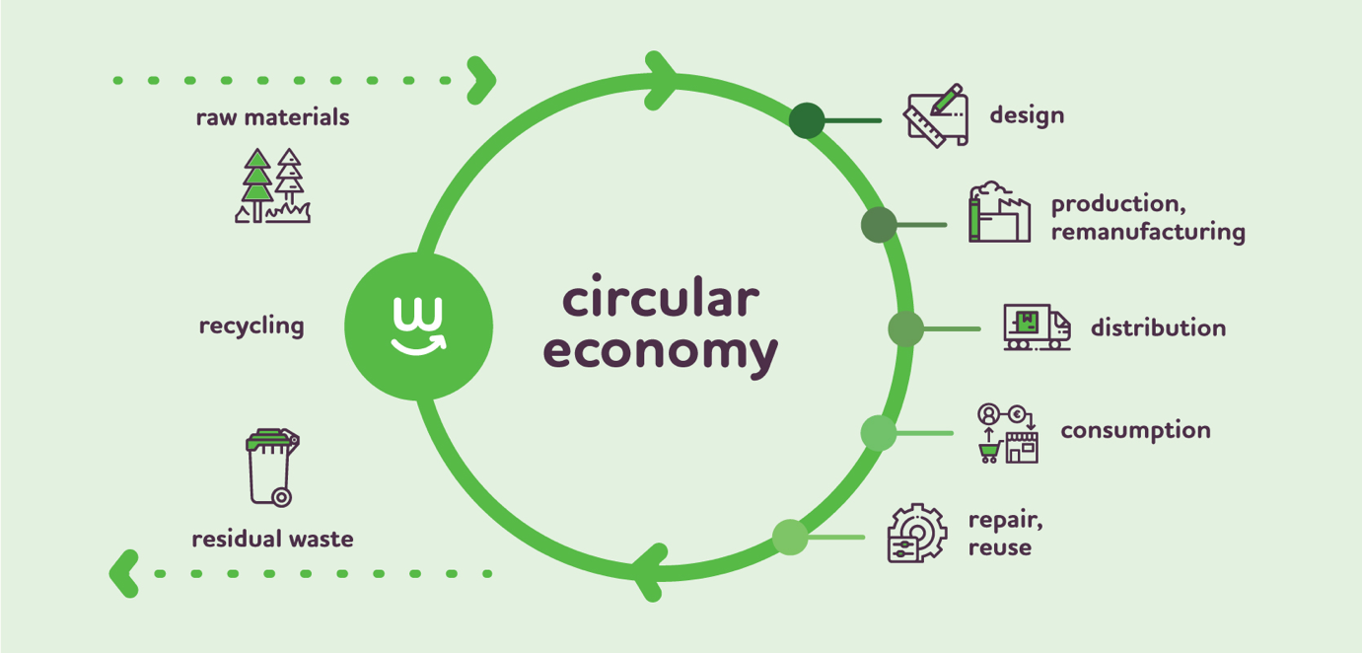
2.2. Circular Economy
Circular Economy Model
SOURCE: WWW.EUPOLITICALREPORT.EU

Slide 17
2.2. Circular Economy
Products should be:
Durable
Upgradeable
Repairable
Dismantlable
Manufacturing process:
Encourages redesign using secondary raw materials and renewable energy sources
Distribution and end-of-life:
Priority on reusing and repairing products
Collected for recycling to recover valuable materials

Slide 18
2.2. Circular Economy
The circular economy consists of two cycles:
  Biological cycle: Flow of biological products decomposable by living organisms, yielding biogas, bioplastics, compost, etc.
  Technical cycle: Flow of materials made up of petroleum derivatives, metals, and other non-decomposable raw materials
Importance of the technical cycle:
  Products must remain functional through sharing, maintenance, reuse, refurbishment, redesign, and recycling before reaching the end of their life cycle.

Slide 19
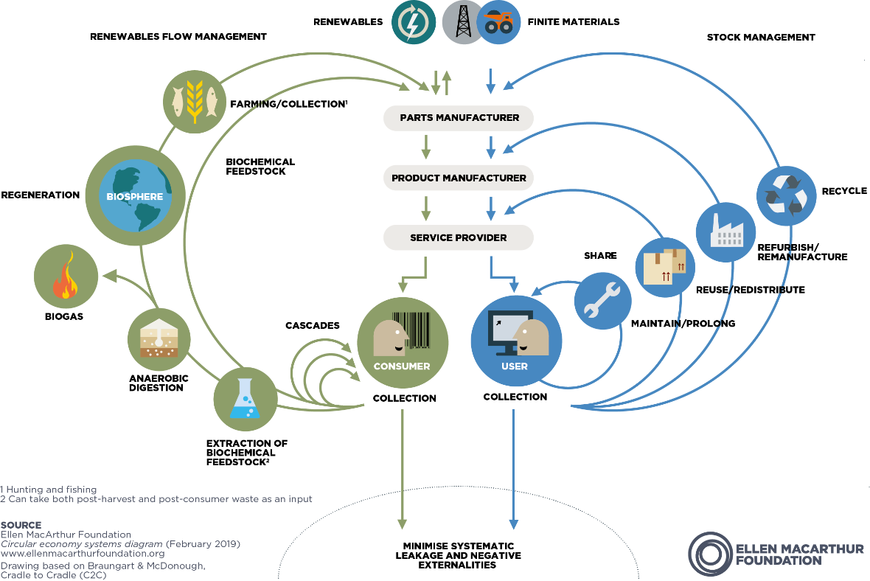
2.2. Circular Economy
Circular Economy System diagram
SOURCE: ELLENMACARTHURFOUNDATION.ORG

Slide 20
Additional Information
If you want to learn more on the Linear vs Circular Economy please watch the video in the following link
https://www.youtube.com/watch?v=__0Spwj8DkM
If you want to learn more on the Shift from Linear to Circular Economy please read the article in the following link
https://www.linkedin.com/pulse/shift-from-linear-circular-economy-road-sustainable-caroline/

Slide 21
3. Principles, Dimensions, Benefits and Challenges of Circular Economy

Slide 22
3.1. Principles of Circular Economy
Understanding Circular Economy Principles
Lack of unified definition or understanding in the academic world
Research explores facets like waste management, product development, value chains, eco-design, recycling, and secondary resource use
Evolution from theoretical concepts to actionable principles

Slide 23
3.1. Principles of Circular Economy
Evolution of Circular Economy Principles
Ellen MacArthur Foundation emphasizes material cycles linked to 3Rs: reduce, reuse, recycle
Advocates circularity adoption for resource-efficient consumption and waste management
Academic discourse post-2011 focuses on 3Rs, driving practical CE adoption

Slide 24
3.1. Principles of Circular Economy
Expanded Circular Economy Principles
Beyond foundational 3Rs, additional principles emerge: redeploy, remanufacture, redesign, repurpose
Proposed classification includes fourth R for reverse logistics
Strategic hierarchy of ten "R's" ranks circular strategies, reflecting ambition level

Slide 25
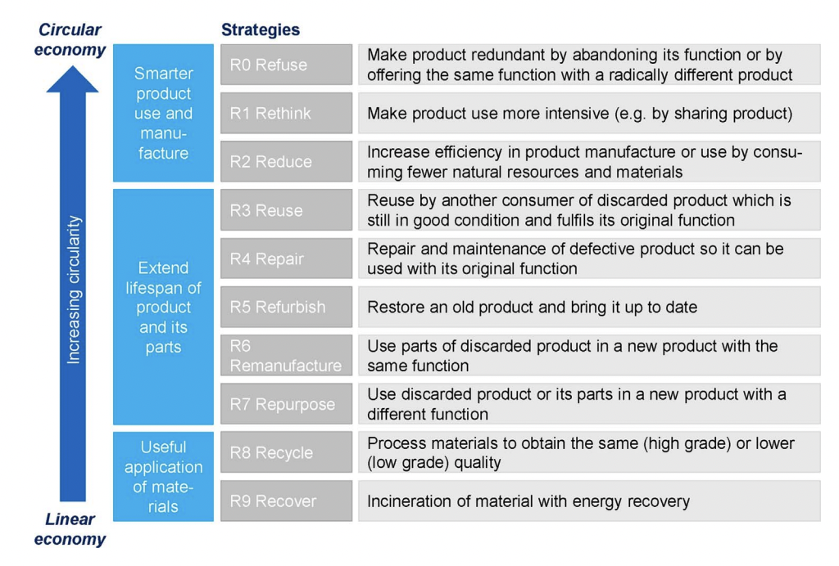
3.1. Principles of Circular Economy
The 9R Framework
SOURCE: KIRCHHERR ET AL, 2017

Slide 26
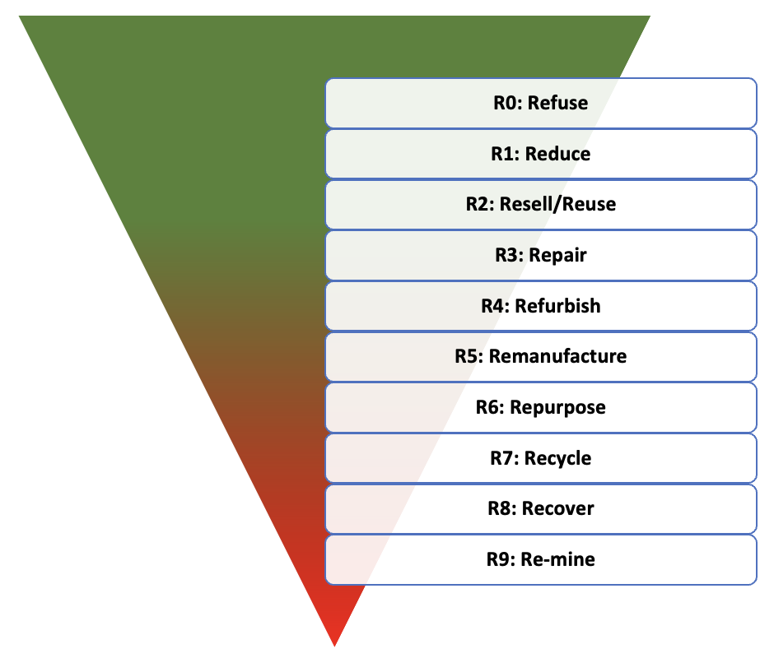
3.1. Principles of Circular Economy
The strategic hierarchy of the ten (10) "R's"
SOURCE: DELOITTE, 2021

Slide 27
3.1. Principles of Circular Economy
Fundamentals of Circular Economy Principles
"R" principles, regardless of number, form fundamental basis for CE understanding
3R principles receive significant scientific attention and offer clear structure
Reike et al. (2018) list 38R principles, Mhatre et al. (2021) extend to 45 CE principles, and Uvarova et al. (2023) examine 60 CE principles
Strategies, practices, operations, concepts, and approaches aim to transition to circular economy with common goal

Slide 28
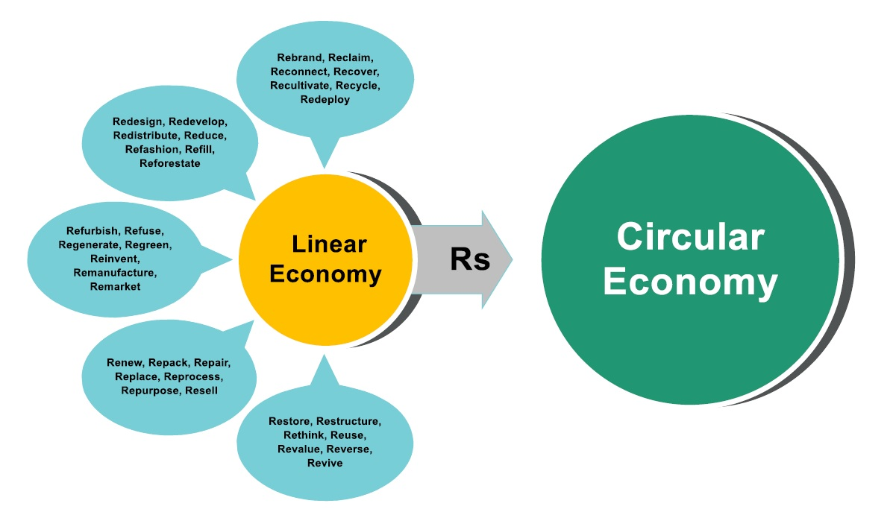
3.1. Principles of Circular Economy
Transition to a circular economy
SOURCE: TSIRONIS ET AL, 2022

Slide 29
3.2. Advantages of Circular Economy
Adopting a circular approach offers myriad benefits, including reduced environmental impact, increased security of material supply, business innovation and the creation of new jobs. However, it's not without its challenges, such as financing the transition, cultivating new skills, influencing consumer behavior, and developing supportive policies.

Slide 30
3.2.1.Preserving the environment
Adoption of circular economy slows resource depletion, minimises environmental degradation, and halts biodiversity loss.
Significant reduction in greenhouse gas emissions achieved through reuse and recycling.
Designing sustainable products reduces energy and resource consumption, influencing over 80% of product's environmental impact.
Long-lasting, upgradeable, fixable products reduce waste generation.
Addressing packaging waste crucial; Europeans generate nearly 180 kg of packaging waste annually, aiming to minimize and restructure unnecessary packaging.

Slide 31
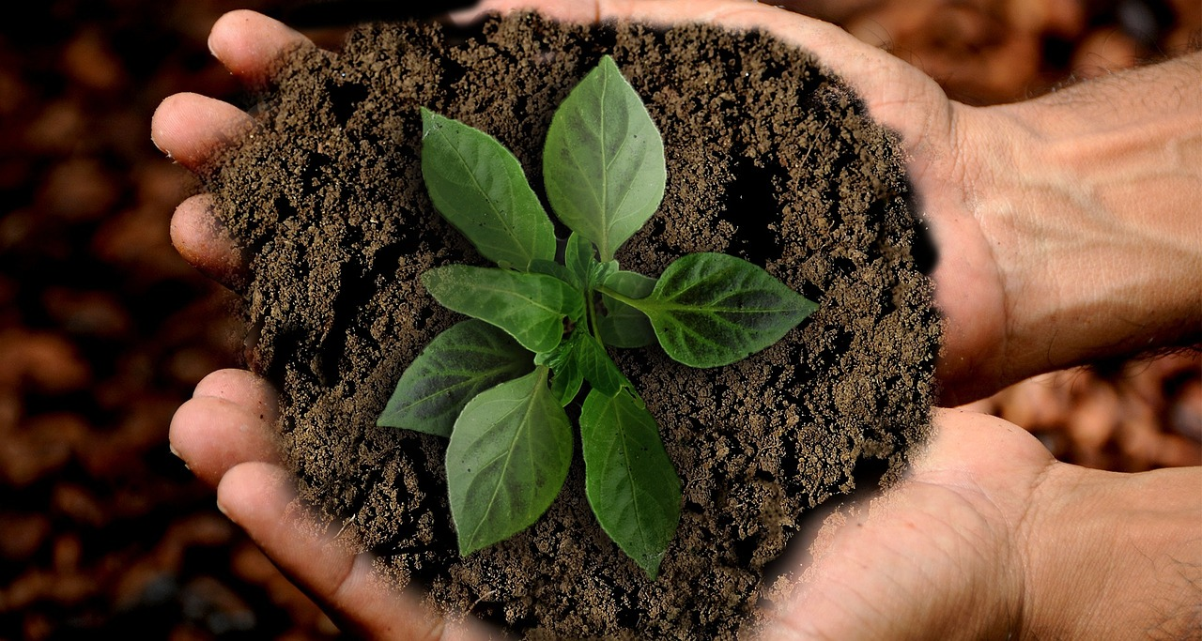
3.2.2.Minimising dependence on raw materials
Growing world population increases demand for raw materials.
Many essential raw materials are in limited supply.
EU depends on imports for raw material needs, importing around 50% of its raw materials.
Trade in raw materials between EU and other countries has tripled since 2002.
Despite export growth, EU remains a net importer, with a deficit of €35.5 billion in 2021.
Recycling mitigates supply risks like price volatility, limited availability, and import dependency, crucial for green technologies.

Slide 32
3.2.3.Economic and consumer benefits
Moving to a circular model can improve competitiveness, spur innovation, increase economic progress and create employment opportunities. Redesigning materials for a circular approach can drive innovation in several sectors of the economy.
Furthermore, consumers will benefit from longer-lasting and more creative products, improving their living standards and leading to greater financial savings.

Slide 33
Additional Information
If you want to learn more on importance and benefits of the Circular Economy, please read this article in the following link
https://www.europarl.europa.eu/news/en/headlines/economy/20151201STO05603/circular-economy-definition-importance-and-benefits
If you want to learn more on the Circular Economy Principles for Achieving Net Zero in the Built Environment, please watch this video in the following link
https://www.youtube.com/watch?v=rWFkLa-QI0s&t=29s

Slide 34
4. Action Plan for Circular Economy and Product Sustainability

Slide 35
4.1. Strategic action plan
Introduction to the Circular Economy Action Plan
The initial Circular Economy Action Plan launched in December 2015
Contained 54 measures addressing product life cycles, waste management, and secondary raw materials
Revised legislative proposal on waste included in the plan

Slide 36
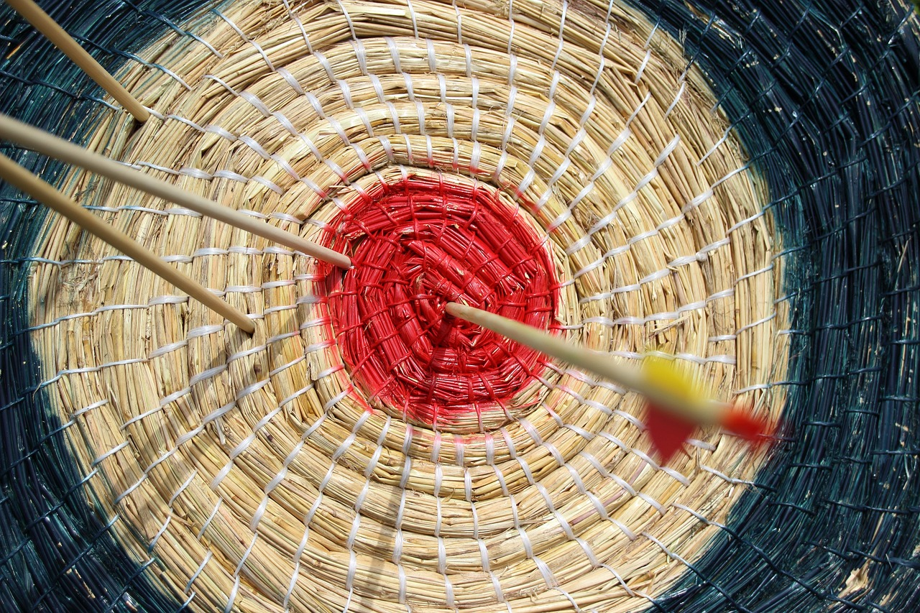
4.1. Strategic action plan
European Commission Initiatives (January 2018)
Creation of a monitoring structure
Report on key raw materials
Circular economy approach to plastics management
Study on legal interplay between chemicals, goods, and waste

Slide 37
4.1. Strategic action plan
Legislative Developments (2018-2019)
Updated waste legislation entered into force in July 2018
Final circular economy package ratified by the Commission in March 2019
Inclusion of recycled nutrients in fertiliser production required by revised fertiliser regulation

Slide 38
4.1. Strategic action plan
Directive on Single-Use Plastics (2019)
Introduced in June 2019
Advocates circular approach emphasizing sustainable, non-toxic, and reusable products
Aims to reduce waste generation

Slide 39
4.1. Strategic action plan
New Circular Economy Action Plan (March 2020)
Adopted on March 11, 2020, as part of the EU's Industrial Strategy
Measures include promoting sustainable products, preventing waste generation, and converting waste into high-quality secondary resources
Focus on sectors with high resource use and potential for circular economy implementation
Global guidance on circular economy to be provided, progress monitored for societal transition to circular economy model

Slide 40
Additional Information
If you want to learn more on Europe’s Circular Economy action plan, please read this article in the following link
https://environment.ec.europa.eu/strategy/circular-economy-action-plan_en#:~:text=The%20EU's%20new%20circular%20action,new%20agenda%20for%20sustainable%20growth
If you want to learn more on EU’s Sustainable Products Initiative please watch this video in the following link
https://www.youtube.com/watch?v=BQs8MJLuxMw

Slide 41
5. System Thinking and Circular Economy

Slide 42
5.1. Systems Thinking
Globalization and technological advancements fuel the emergence and expansion of complex systems
Interconnection of countries through global trade and economic networks
Advances in technology, such as the Internet and GPS, contribute to the complexity of interconnected systems
Interactions between systems lead to diverse and often unpredictable outcomes

Slide 43

5.1. Systems Thinking
A system is an ensemble of regularly interacting or interdependent entities that together form a cohesive unit.
Systems thinking involves abstract cognition that includes:
Recognising different points of view
Navigating ambiguity in system boundaries
Understanding the multiple operational contexts of the system
Identifying relationships within and across systems
Understanding complex system dynamics
Accurately anticipate the consequences of system changes

Slide 44
5.1. Systems Thinking
Did you know that using systems thinking provides a broader perspective on problem-solving, presenting diverse options?
It also makes us realize that only solutions come with consequences on other system parts. This awareness helps us predict and potentially harness the impacts of our choices. Furthermore, systems thinking is instrumental in crafting narratives that explain how systems operate.

Slide 45
5.1. Systems Thinking
Ideal scenarios for using systems thinking include:
Significant issues.
Recurring, not isolated, problems.
Familiar issues with a traceable history.
Problems that have been previously addressed without success.

Slide 46
5.1. Systems Thinking
Advancing Systems Thinking for Problem Solving
Sidestep the blame game and spark curiosity by asking, "What aren't we getting about this problem?"
Analyze the issue using the iceberg framework: events, patterns, and structures
Consider varied perspectives to gain unique insights from different stakeholders
Advancing in systems thinking leads to intricate modelling methods and shifts in problem-solving perspectives
Various models and strategies promote systems thinking for sustainability, focusing on minimizing resource and energy use while sometimes overlooking social, political, and economic aspects

Slide 47
Additional Information
If you want to learn more on the Systems Thinking, please watch the video in the following link
https://www.youtube.com/watch?v=GPW0j2Bo_eY
If you want to learn more on the importance of system-thinking and circularity, please watch the video in the following link
https://www.youtube.com/watch?v=OvX3BMT6P-k&t=4s

Slide 48
6. Applying Circularity to Agriculture

Slide 49
6.1. Circular food system
Impact of the Global Food System
The global food system contributes to nearly 25% of all human-caused greenhouse gas emissions
It leads to deforestation, biodiversity loss, and water pollution
Occupies almost half of the world's non-ice, non-desert land

Slide 50
6.1. Circular food system
Challenges and Concerns
Concerns range from farm size and profitability to animal welfare and health risks
Many recognize the Earth's physical limits as the ultimate constraint on human economic endeavor
Critical challenge: Ensure an adequate supply of nutritious food without depleting resources or damaging ecosystems

Slide 51
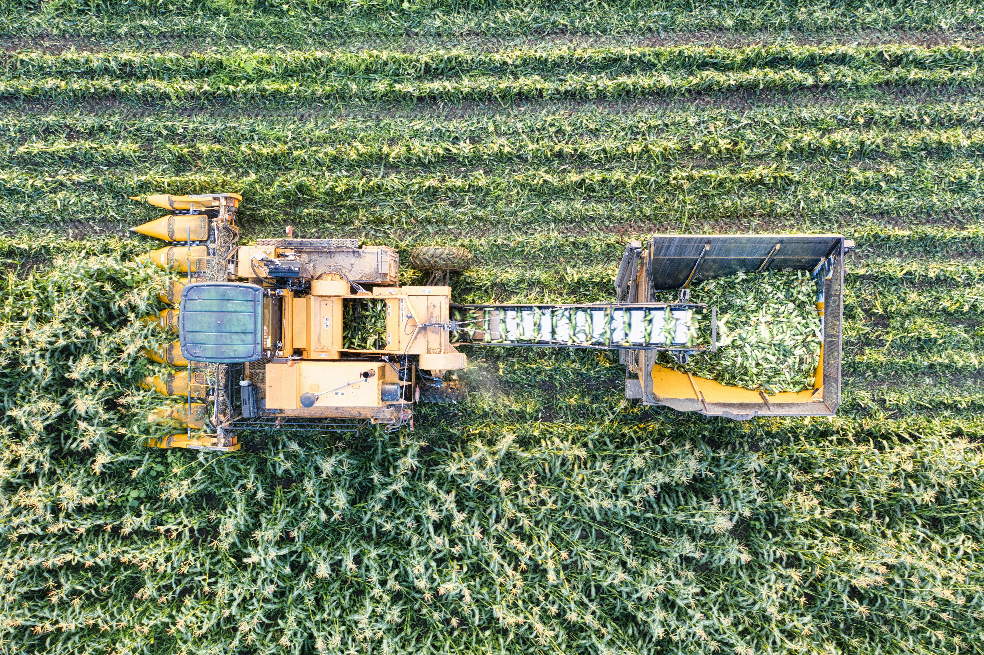
6.1. Circular food system
Circular Food System Approach
Adopting a circular food system involves reducing the use of non-renewable resources and promoting regenerative resources
Prioritize minimizing food loss and waste for human consumption
Reintroduce food waste into the food system through soil enrichment or animal feed, promoting sustainability

Slide 52
6.1. Circular food system
Did you know that…
MEAT AND DAIRY PRODUCTION USED 83% OF THE WORLD’S AGRICULTURAL LAND.
- POORE & NEMECEK 2018

Slide 53
6.1. Circular food system
Sustainable Food Production Practices
Ruminants like cows and sheep convert grass into meat, milk, and manure, recycling nutrients otherwise wasted.
Utilizing animal and human waste improves soil fertility sustainably.
Diversifying food sources to include seaweed and shellfish over traditional fish like salmon or cod promotes sustainability.
Plant-based feeds or waste-fed insects offer sustainable alternatives to fishmeal for livestock.

Slide 54
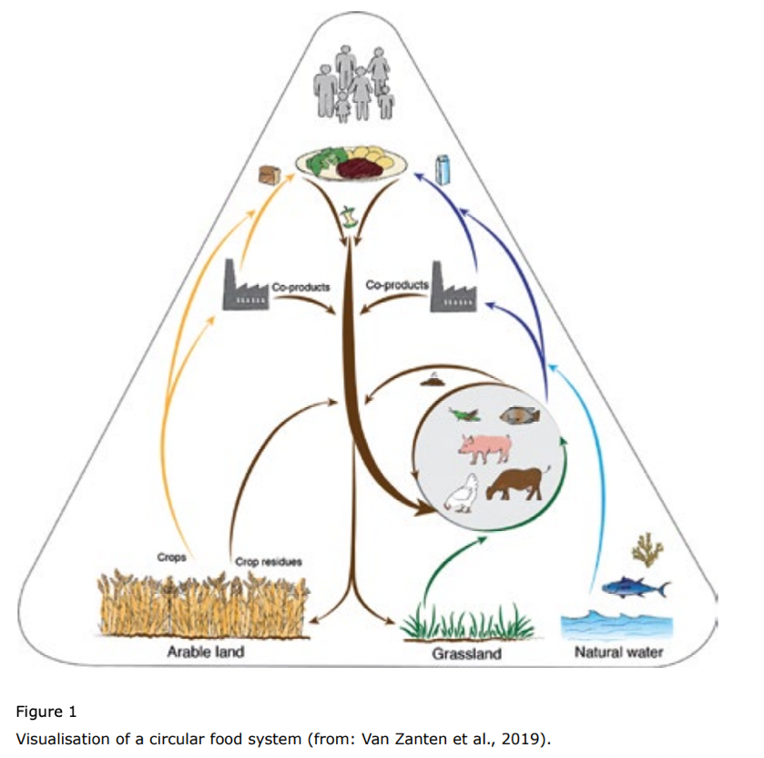
6.1. Circular food system
Circular food system
SOURCE: VAN ZANTEN ET AL, 2019

Slide 55
6.2. Three fundamentals for circular food production
Three fundamentals for circular food production
Using plant biomass as the primary source of food for humans
Reintegrate by-products of food production into the system
Using animals

Slide 56
6.2.1.Using plant biomass as the primary source of food for humans
Enhancing Crop Yields in Circular Food Systems
Photosynthesis forms the basis of food production, converting carbon for consumption.
Factors such as climate, genetics, water availability, and pests influence crop growth and yields.
Potential yield represents maximum crop production under ideal conditions, with the difference from actual yield termed as the yield gap.
Increasing crop yields involves improving genetic potential and closing yield gaps through better management.
Adopting a circular food system requires valuing crops beyond weight, considering nutritional and functional value to minimize unused by-products.
Diverse cropping systems enhance ecological production, optimizing crop quality and quantity while benefiting soils, animals, and the broader bioeconomy.

Slide 57
6.2.2.Reintegrate by-products of food production into the system
Our food system yields various by-products, including crop residues, food waste, and excreta.
Proposed resource hierarchy:
  Soil Improvement: Utilize by-products to enhance soil quality, fertility, and erosion control, vital for sustainable agriculture.
  Animal and Insect Feed: Feed animals or insects with suitable by-products, promoting efficient land use.
  Bioenergy and Fertilizers: Employ anaerobic digestion to produce biogas and digestate for energy and nutrient-rich fertilizers.
  Carbon Sequestration: Incorporate by-products into soil to sequester carbon, mitigating greenhouse gas emissions.

Slide 58
6.2.3.Using animals
Animals serve a vital function in our food system by transforming biomass humans cannot consume directly into valuable food and other by-products.
Efficient recyclers, animals convert inedible materials like crop residues, food industry by-products, unavoidable food waste, and grass into nutritious food and fertilizer.
Utilizing "low-cost feed sources" for animals, such as crop residues and food industry by-products, is more sustainable than using edible resources like grains.
Animals contribute to the circularity of the food system by converting otherwise wasted resources into valuable products, enhancing overall sustainability.

Slide 59
Additional Information
If you want to learn more on the Circular Agriculture, please read this article in the following link
https://www.un.org/development/desa/dpad/publication/un-desa-policy-brief-105-circular-agriculture-for-sustainable-rural-development/
If you want to learn more on the Circular Agri-food System, please watch this video in the following link
https://www.youtube.com/watch?v=TfC3UtbfHLE

Slide 60
7. Agroecology and Regenerative Practices

Slide 61
7.1. Agroecology
Origins and Evolution of Agroecology
Agroecology traces its roots back to the traditional food systems of indigenous peoples, embodying deep connections with ecosystems, traditions, and cultural heritage.
The term "agroecology" emerged in the early 20th century, initially focusing on aspects like pest control and soil biology, before expanding to include crop management, soil health, and agricultural meteorology by the 1950s.
In the 1960s, scholars like Wolfgang Tischler contributed to the development of agroecology as an independent academic discipline, exploring the interactions among plants, animals, soils, and climate within agroecosystems.

Slide 62
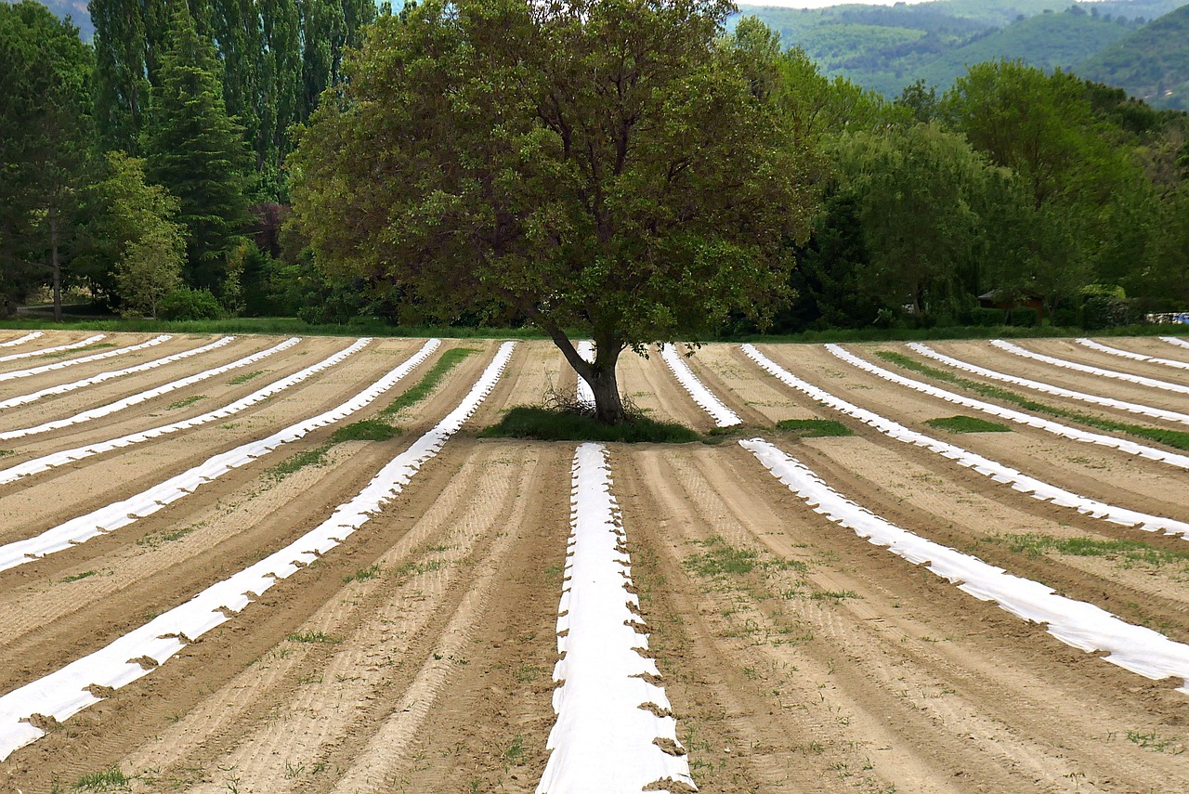
7.1. Agroecology
Growth and Expansion of Agroecology
The 1990s witnessed significant growth in agroecology both as a scientific discipline and a grassroots movement, spurred by increasing environmental awareness.
During this period, universities in Europe and the US began offering agroecology programs, while NGOs like Brazil's AS-PTA emerged to facilitate collaboration between agroecologists and farmers.
By the 2000s, agroecology evolved beyond agriculture to encompass the entire food system, integrating environmental, economic, and social dimensions and promoting sustainable practices from production to consumption.

Slide 63
7.1. Agroecology
Diverse Perspectives and Guiding Principles
Despite its growth, the definition of agroecology remains a subject of debate, with some viewing it purely as a technical field and others emphasizing its political and transformative potential.
The FAO's '10 elements of agroecology' and the UN Committee on World Food Security's 13 guiding principles underscore the multifaceted nature of agroecology, advocating for a holistic approach that combines traditional knowledge with science to drive profound changes in food systems for sustainability and social equity.

Slide 64
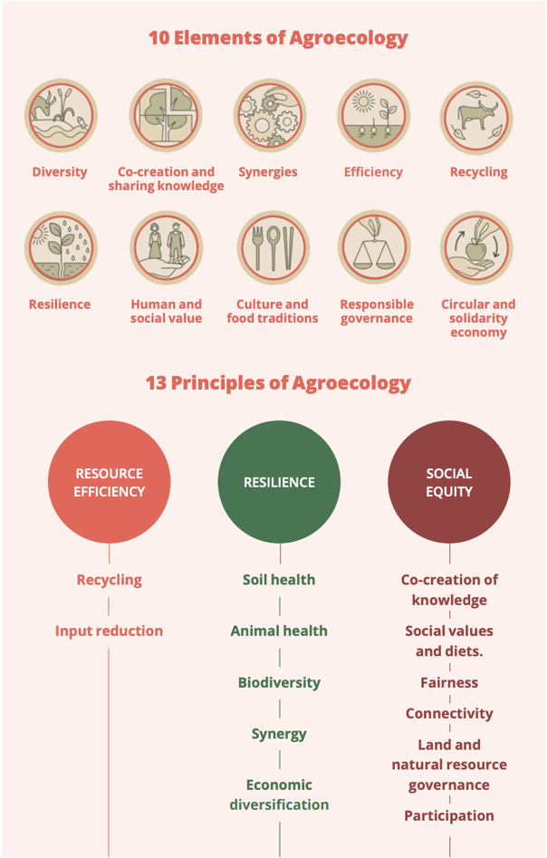
7.1. Agroecology
Elements and principles of agroecology
SOURCE: IDS & IPES-FOOD, 2022

Slide 65
7.1. Agroecology
The 13 guiding principles of agroecology align with the 10 elements, reflecting its evolution from a method for changing unsustainable food production to a comprehensive approach.
Today, agroecology integrates scientific knowledge with practical application, backed by a social movement advocating for a complete overhaul of food systems.
This transformation prioritizes environmental sustainability and distributive justice, garnering formal recognition in international food governance with the support of a diverse yet unified group of experts.

Slide 66
7.2. Regenerative agriculture
Roots and Principles of Regenerative Agriculture
Regenerative agriculture traces back to the organic movement of the 1960s in the USA, influenced by Rachel Carson's Silent Spring.
The Rodale Institute coined the term 'regenerative organic' in the early 1980s, emphasizing the natural rejuvenation capacity of ecosystems and biodiversity.
Richard Harwood outlined three core principles: linkages within farming systems, maintaining biological equilibrium, and nurturing constructive mutualism while minimizing damages.

Slide 67
7.2. Regenerative agriculture
Recognition and Advocacy
Regenerative agriculture, despite similarities to agroecology, lacked recognition until recent years.
A 2012 study highlighted its potential to address carbon emissions and resource scarcity, drawing attention to the environmental benefits of regenerative practices.
Organizations like the Rodale Institute and Regeneration International, founded in 2017, advocate for a global shift towards regenerative practices to combat climate change, hunger, and socio-economic issues.

Slide 68
7.2. Regenerative agriculture
While regenerative agriculture gains international traction, large agrifood corporations shape the discourse.
They invest in regenerative approaches but often prioritize environmental concerns like soil health and carbon emissions over social justice and equity.
Some corporate versions of regenerative agriculture may focus solely on offsetting emissions without addressing broader social issues, highlighting the need for a holistic approach.

Slide 69
Additional Information
If you want to learn more on the Regenerative Agriculture, please read this article in the following link
https://www.weforum.org/agenda/2022/10/what-is-regenerative-agriculture/#:~:text=Regenerative%20agriculture%20focuses%20on%20improving,well%20as%20reducing%20soil%20erosion.
If you want to learn more on the Regenerative Agriculture, please watch this video in the following link
https://www.youtube.com/watch?v=yp1i8_JFsao

Slide 70
8. Circular Farming Technologies

Slide 71
8.1. Meeting the challenges of sustainable food production
Sustainable agricultural practices must address the needs of a growing population.
On-farm technologies facilitate various sustainable production models: climate-smart agriculture, sustainable intensification, and agroecological production.
Investments in agricultural technologies, both large and small-scale, can increase yields and minimize ecological impacts.
Governments worldwide are encouraging on-farm investment to enhance productivity, sustainability, and farmer incomes.
Recent debates highlight the shift towards food circularity to improve sustainability.
Governments in regions like the EU, China, and Latin America are investing in technologies promoting on-farm circularity to boost production, sustainability, and meet international climate agreements.

Slide 72
8.1. Meeting the challenges of sustainable food production
Did you know that many farmers are often reluctant or need help to finance on-farm improvements?
This reluctance may be due to a number of factors, including risk aversion, resource constraints, lack of credit or failure to recognise the advantages. However, certain technologies can provide multiple benefits, including climate adaptation, resilience and income enhancement.

Slide 73
8.2. Benefits of specific circular technologies
Technologies for Reducing GHG Emissions and Eutrophication Potential in Livestock Farming
Implemented technologies include sand filter systems, solid waste separation, biodigesters, milking machines, and wastewater reuse.
Significant reductions in annual CO2eq and eutrophication potential were observed with the adoption of these technologies.
However, the construction or rehabilitation of septic tanks resulted in a significant increase in CO2eq emissions compared to scenarios with no manure management.
Some technologies showed consistent effectiveness regardless of herd size, while others were influenced by herd size.
Waste management pools were identified as a major contributor to GHG emissions, with significant emissions per cow despite reducing eutrophication potential.

Slide 74
Additional Information
If you want to learn more on the Smart Farming Systems, please read this article in the following link
https://www.mdpi.com/2673-4591/9/1/10
If you want to learn more on a farm which does not use soil, please watch this video in the following link
https://www.youtube.com/watch?v=WiOhsLFvmJU

Slide 75
9. Circular Business Models

Slide 76
9.1. Business Model
Understanding Business Models
A business model outlines a company's strategy for profitability, including products or services, target market, and expected expenses.
Both start-ups and existing businesses benefit from solid business models: attracting investors, guiding teams, and staying ahead of trends.
Successful companies adapt their business models to meet evolving market demands and investor expectations.

Slide 77
9.1. Business Model
The Business Model Canvas (BMC)
The Business Model Canvas (BMC) is a popular tool for strategic management and entrepreneurship, providing a visual representation of essential business elements.
It focuses on external (customer-related) and internal aspects, converging on the value proposition.
Reasons to use BMC: snapshot of business idea, insight into feasibility, customer assessment, and ensuring consistent vision.
The BMC comprises nine building blocks: Value Proposition, Customer Segments, Customer Relationships, Channels, Key Activities, Key Resources, Key Partners, Cost Structure, and Revenue Streams.

Slide 78
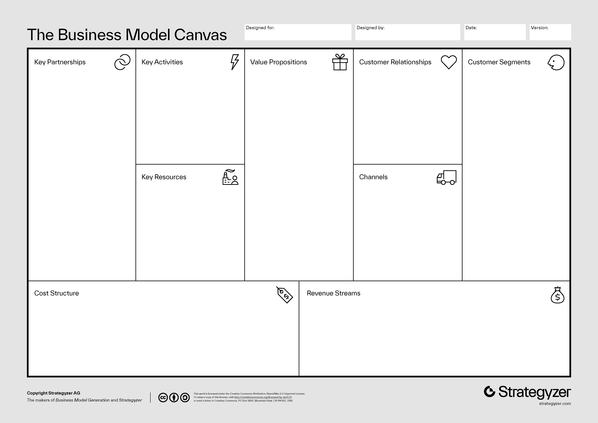
9.1. Business Model
Business model canvas
SOURCE: OSTERWALDER AND PIGNEUR (2010)

Slide 79
9.2. Circular Business Models
Introduction to Circular Economy Strategies
Circular economy strategies offer innovative approaches to production and consumption, aiming for a more sustainable and resource-efficient economy.
These strategies minimize the use of natural resources and waste generation, using existing materials and products for reduced environmental impact.
Despite their potential benefits, circular strategies currently represent a small fraction of sector output, primarily due to limited market reach.

Slide 80
9.2. Circular Business Models
Factors Influencing Circular Economy Adoption
The adoption of circular strategies varies, influenced by factors such as technological advances, consumer preferences, and government policies.
Some circular models, like recycling and repair, have seen stable growth, while others have expanded due to new technologies or changing business challenges.
Government policies can support circular economy uptake by addressing challenges like inaccurate resource valuation, operational costs, trade regulations, and biases favoring existing practices.

Slide 81
9.3. Essential Features of Circular Business Strategies
Five primary business strategies for a circular economy are:
Circular Supply Strategies: These replace standard inputs from fresh resources with bio-based, renewable, or reclaimed materials, reducing the need for new resource extraction.
Resource Recovery Strategies: These transform waste into secondary raw materials, preventing waste disposal and reducing the demand for fresh resources.
Product Life Extension Strategies: By prolonging product usability, these strategies decelerate the flow of materials in the economy, diminishing resource extraction and waste creation.
Sharing Strategies: By promoting the use of underutilized products, these strategies curb the demand for new items and the materials within them.
Product Service System Strategies: These emphasize marketing services over products, enhancing green product design incentives and encouraging resource conservation.

Slide 82
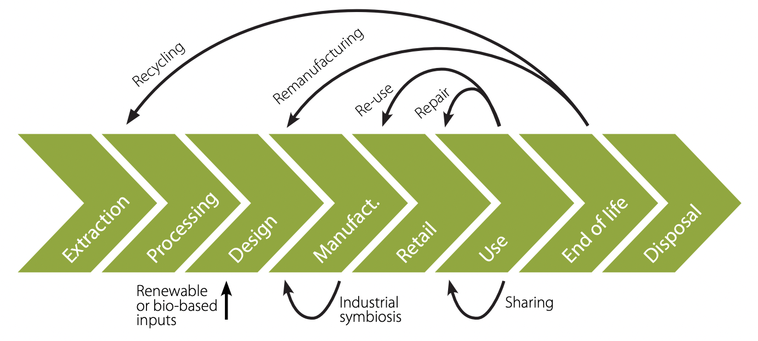
9.3. Essential Features of Circular Business Strategies
Circular business models operate in different parts of the value chain
SOURCE: OECD, 2018

Slide 83
Additional Information
If you want to learn more on the Circular Economy Business Models, please read this article in the following link
https://www.weforum.org/agenda/2022/01/5-circular-economy-business-models-competitive-advantage/
If you want to learn more on the Circular Economy Business Models, please read this article in the following link
https://www.boardofinnovation.com/circular-economy-business-models-explained/#:~:text=Circular%20business%20model%20definition,minimizing%20ecological%20and%20social%20costs

Slide 84
10. Resource Reduction and Waste Management

Slide 85
10.1. Resource Reduction and Waste Management
Overview of Waste Management
Waste management involves various processes such as collection, transportation, treatment, recycling, and disposal of waste materials.
Objectives include minimizing waste, reusing materials, returning organic waste to the environment, and adapting to changes in waste composition.
Practices differ between developing and industrialized nations, necessitating consideration of local factors like waste types, societal perspectives, and resource constraints.

Slide 86
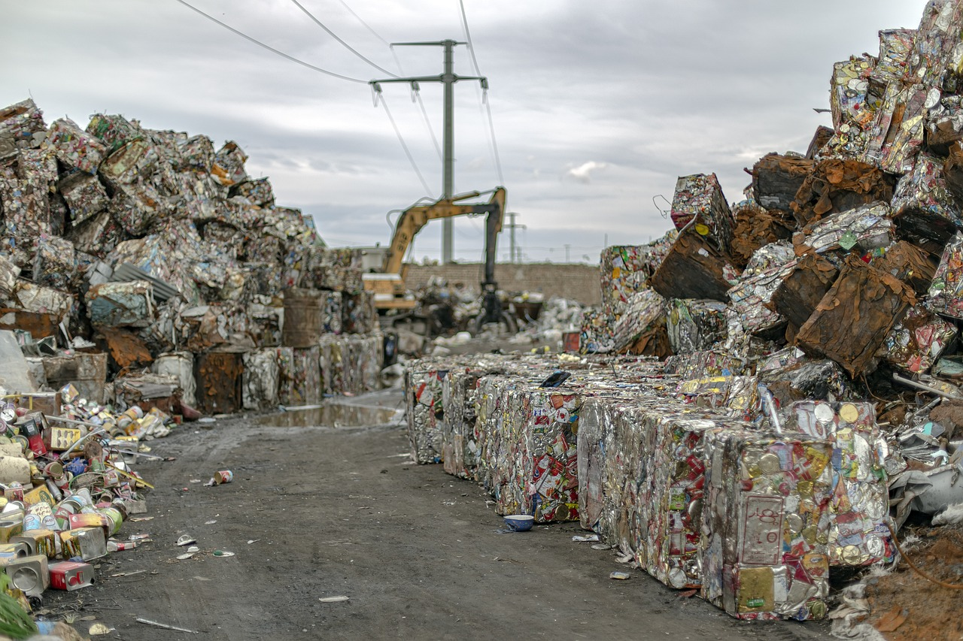
10.1. Resource Reduction and Waste Management
Components of a Waste Management System
A waste management system encompasses actions related to trash collection, treatment, disposal, and recycling.
The system includes four main segments: waste generation, collection and transportation, treatment, and final disposal.
Modern waste management prioritizes high recycling rates and cleanly segregated waste sources to minimize environmental impact and maximize resource recovery.

Slide 87
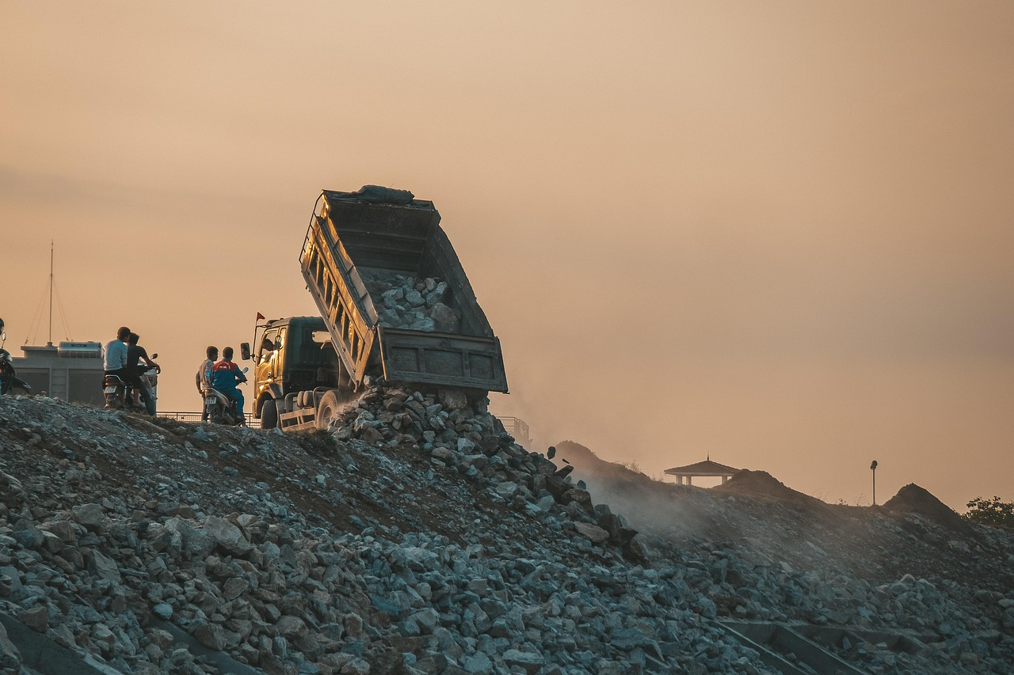
10.1. Resource Reduction and Waste Management
Strategies for Waste Management
Waste management strategies can be categorized into four main approaches:
  Waste reduction or prevention
  Waste recycling
  Thermal treatment with energy capture
  Landfill disposal
Priority is given to waste minimization, followed by recycling to retrieve materials for alternate uses.
Disposal methods are ranked based on environmental impact, with a hierarchy including reduce, reuse, recycle, compost, incinerate, and landfill.
Effective waste management requires understanding the volume, nature, and origins of waste, with unavoidable waste handled by licensed contractors for off-site processing.
The waste hierarchy prioritizes practices to maximize product benefits while minimizing waste generation, emphasizing sustainable utilization.

Slide 88
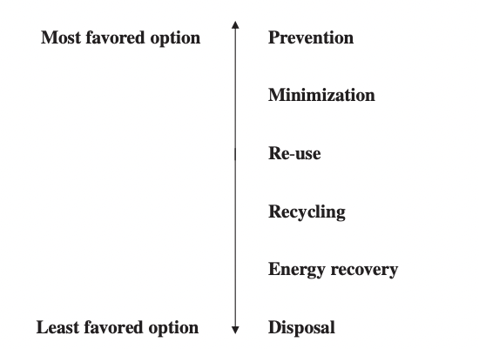
10.1. Resource Reduction and Waste Management
Waste management hierarchy
SOURCE: DEMIRBAS, 2011

Slide 89
Additional Information
If you want to learn more on the Waste Management in Europe, please listen this podcast in the following link
https://www.youtube.com/watch?v=pE7a4N9GDKk
If you want to learn more on a case about zero-waste packaging, please watch this video in the following link
https://www.youtube.com/watch?v=PvAd7t33fdo

Slide 90
11. Agricultural Production of Bio-based Resources

Slide 91
11.1. Bio-based Products
  Definition
  Bio-based products are goods made from sustainable raw materials sourced from the food or agricultural sector.
  The EU Commission defines them as products made wholly or partly from biological sources, excluding fossil sources.
  In the US, bio-based products are defined by the Farm Security and Rural Investment Act of 2002 as articles derived from biological or renewable agricultural materials.
Promotion and Regulation:
  The US Department of Agriculture launched the BioPreferred program in 2002 to encourage the use of bio-based products.
  Examples include agricultural sprays, compost enhancers, and pest control products.

Slide 92
11.1. Bio-based Products
Global Shift:
  The transition to bio-based products reflects economic, policy, and trade dynamics in agriculture.
  Advancements in conversion processes and technologies drive this shift, converting traditional agricultural inputs into chemicals, energy, and other innovative products.
Information Access:
  Stakeholders require access to comprehensive technical databases to navigate the diverse classes of bioproducts effectively.
  Initiatives like NASULGC emphasize the importance of such resources in facilitating informed decision-making.

Slide 93
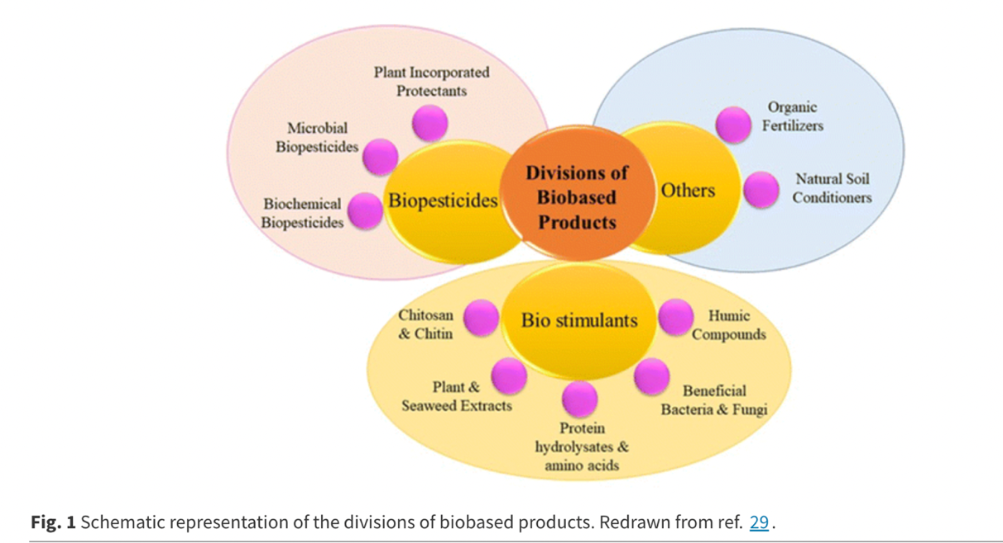
11.1. Bio-based Products
Schematic representation of the divisions of biobased products
SOURCE: PRIYA ET AL, 2023

Slide 94
11.1. Bio-based Products
Biomaterials:
  Derived from various biomass sources, including plants, marine resources, and animal residuals.
  Processing of these resources yields biomaterials, requiring knowledge of feedstock composition for effective production.
Energy Fuels:
  Biomass serves as a renewable energy source, including plants, agricultural waste, and forestry by-products.
  Biofuels like ethanol, methanol, and biodiesel are produced from biomass using biochemical or thermochemical conversion processes.
Biochemicals:
  Renewable chemicals derived from biomass offer eco-friendly alternatives to petroleum-based chemicals.
  Examples include bioalcohols and bio-derived acids, utilized in pharmaceuticals, cosmetics, and food industries.
  These alternatives are often more sustainable, cost-effective, and biodegradable compared to non-renewable counterparts.

Slide 95
11.2. The emergence of bio-products in agriculture
Types of Bio-Products:
  Biopesticides: Utilize biological agents to control pests and diseases.
  Biostimulants: Stimulate plant growth using substances like hormones or enzymes.
  Biofertilisers: Provide nutrients from organic sources, such as compost or fishmeal, to enhance crop protection, improvement, and nutrition.
Applications:
  Widely adopted across industries from cosmetics to fuels due to their eco-friendly nature and efficacy.
  Serve vital roles in integrated pest management, facilitating interspecies communication and promoting sustainable agricultural practices.

Slide 96
Additional Information
If you want to learn more on Bio-based Products, please read this article in the following link
https://single-market-economy.ec.europa.eu/sectors/biotechnology/bio-based-products_en#:~:text=Bio%2Dbased%20products%20are%20wholly,and%20paper%2C%20textiles%2C%20etc
If you want to learn more on Bio-based Plastics from Agricultural Waste, please watch this video in the following link
https://www.youtube.com/watch?v=ioHQNIrsojU

Slide 97
