Slide 2
Course: (HEI-C2)
Module: Bio-economy, circular economy and bio-based products
Learning Unit: The concept of biorefinery
Authors: UNIFI & MDU

Slide 3
Summary
The concept of biorefinery
Pathways of biorefinery
Case studies and world-case examples
Challenges for future development

Slide 4
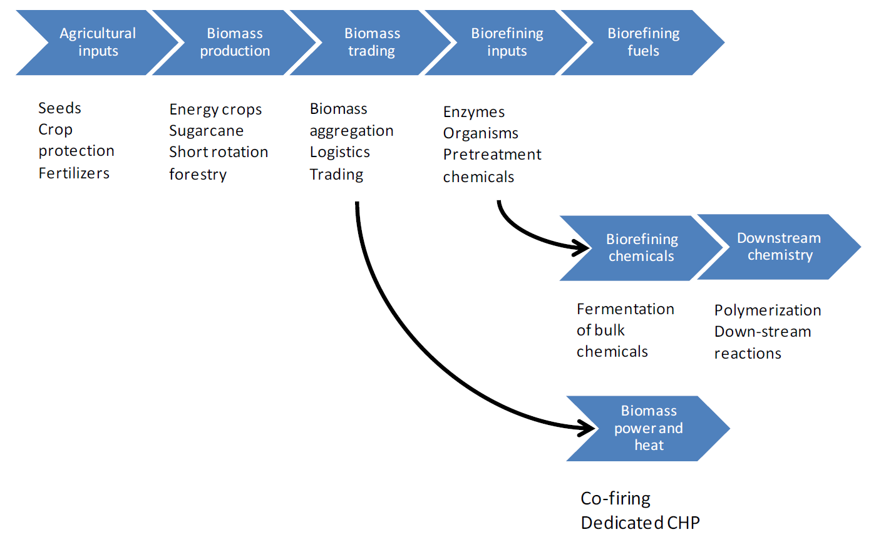
Biorefinery: definition
IEA Bioenergy Task 42 Biorefinery Definition
“Biorefinery is the sustainable processing of biomass into a spectrum of marketable Products (food, feed. materials, chemicals) and Energy (fuels, power, heat)”
An example of a Bio-based products value chain which is a general illustration of an agriculture feedstock based biorefinery that is built around biochemical conversion technologies.

Slide 5
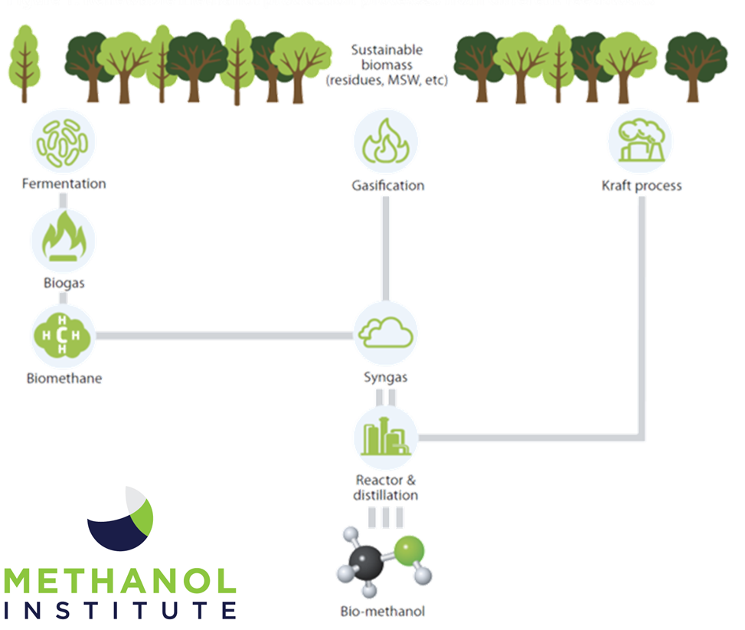
Biorefineries: products
Key building blocks in chemical industry include methanol, ethylene, propylene, butadiene, benzene, toluene, and xylene. While these are primarily used for polymers and plastics, they also serve as the basis for numerous fine and specialty chemicals.
Bio-based counterparts are the products of biorefineries, and they have the potential to replace fossil-based materials, but cost considerations are crucial.
Bio-based products must match or outperform their petrochemical equivalents at a competitive cost with a lower environmental impact. Integrated biorefinery processes, akin to oil refineries, are seen as a more efficient approach, producing bio-based products alongside secondary energy carriers. This integration, including food or feed production, aligns with the vision of a sustainable, bio-based economy.

Slide 6
Biorefineries generations
First Generation, primarily focused on the conversion of food crops, such as corn or sugarcane, into biofuels like ethanol. The feedstocks are typically edible portions of plants.
Second Generation, utilize non-food biomass, such as agricultural residues (e.g., corn stover, wheat straw), forestry residues, or energy crops, to produce a broader range of bio-based products.
Third Generation, often associated with the use of algae as a feedstock for biofuel production. Algae can be grown in various environments, including wastewater, and can produce lipids suitable for biodiesel.
Fourth Generation or Integrated Biorefineries combine multiple conversion processes to produce a variety of products from different feedstocks. These facilities aim for maximal resource utilization and economic viability.

Slide 7
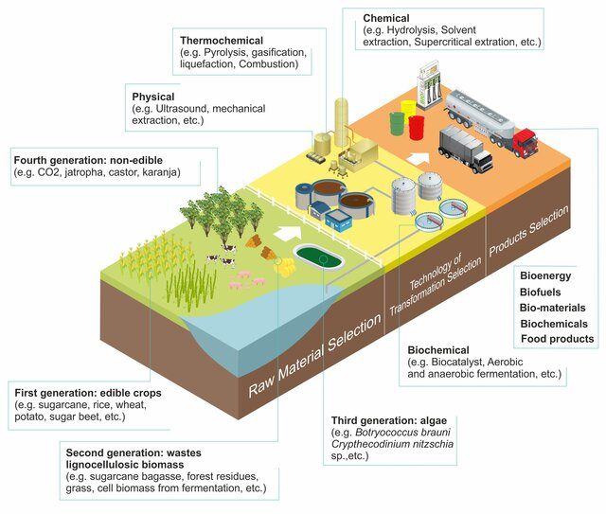
Biorefineries generations
There is a direct relationship between the raw materials used, the products obtained and the technologies implemented in a biorefinery. However, a biorefinery can be classified into different types based on the raw materials used and the scale of production. In terms of raw materials, i.e. feedstocks, a biorefinery can be classified into first, second, third and fourth generation biorefinery.
The availability of biomass is linked to geographical, political, social and, most importantly, economic and logistical aspects. In this sense, biomass has been categorised into generations in order to clarify the factors associated with each feedstock. For example, the use of first-generation feedstocks can threaten food security by increasing the cost of edible crops and creating competition for water and land.
Source: Botero et Al., DOI: 10.18331/BRJ2017.4.3.6

Slide 8
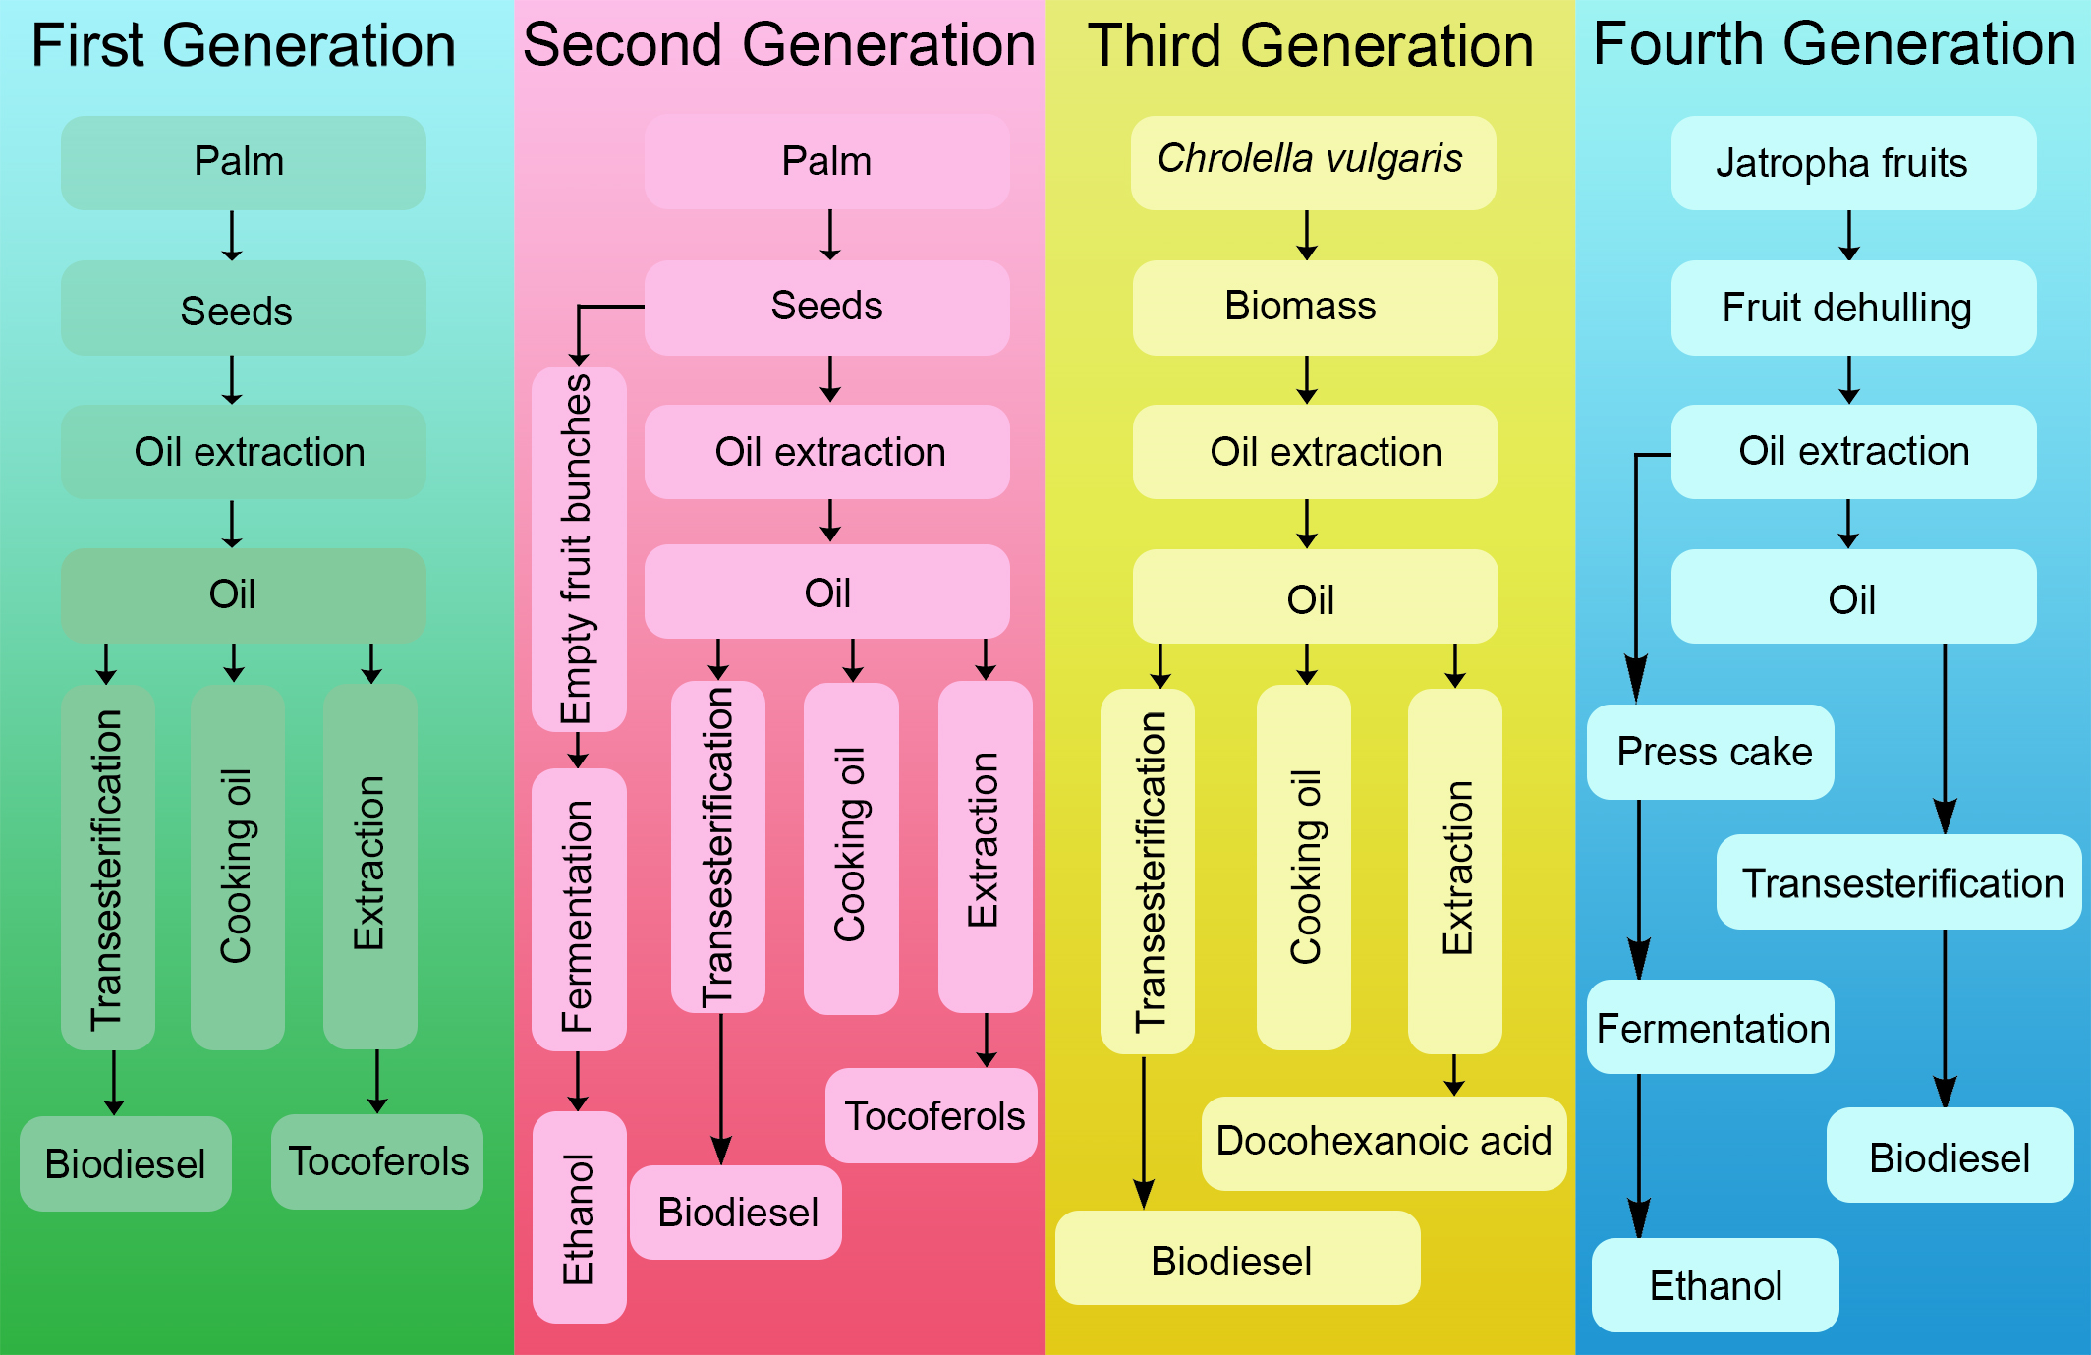
Biorefineries Generations: an example
2nd Gen
The figure presents the simplified scheme of the production of Biodiesel under different generations of biorefinery.
In the second-generation example, the wastes of the first-generation production (i.e., empty fruit bunches) become the feedstock for the second-generation Ethanol production.
For the 4th Generation, Jatropha fruits are considered, these being a non-edible product.
1st Gen
Source: Botero et Al., DOI: 10.18331/BRJ2017.4.3.6

Slide 9


Biorefineries: key drivers
Transportation sector
Sustainability
The main driver for the development and implementation of biorefinery processes today is the transportation sector. Significant amounts of renewable fuels are necessary in the short and midterm to meet policy regulations both in- and outside Europe.
One of the main drivers for the establishment of biorefineries is the call for sustainability. Biorefinery development can be designed for environmental, social and economic sustainability impacting the full product value chain.

Slide 10
Biomass value Pyramid
Biomass cascading
Health & Lifestyle
pharma, fine chemicals, cosmetics
Alimentation
food and feed final consumption
Added Value
Volume
Chemistry & Materials
commodities and bulk chemicals, fertilisers
Energy
transport fuel, electricity, heat

Slide 11
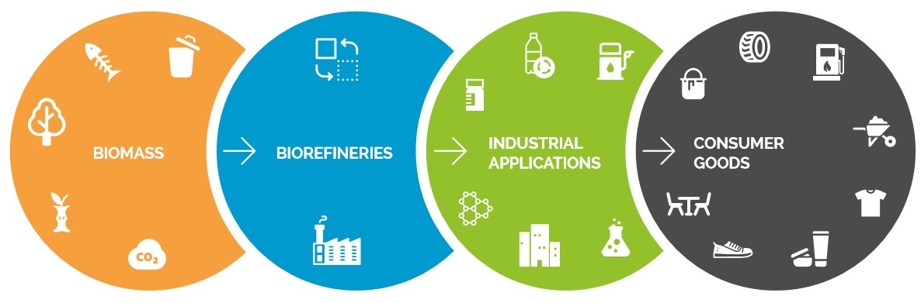
Bio-Based industries value chain
Waste streams Municipal organic waste By-products & side-streams Forestry side-streams Dedicated agricultural crops and residues Aquatic biomass Food processing residues Process and wastewater CO₂ | (Pre-) treatment Transformation | Bioplastics Building blocks Biopolymers Surfactants Active ingredients Biomaterials Biolubricants | Biofuels Textiles Packaging Solvents Furniture Personal care Construction materials Pharmaceuticals Clothing Car components
Picture Credits: biopilots4u.eu

Slide 12
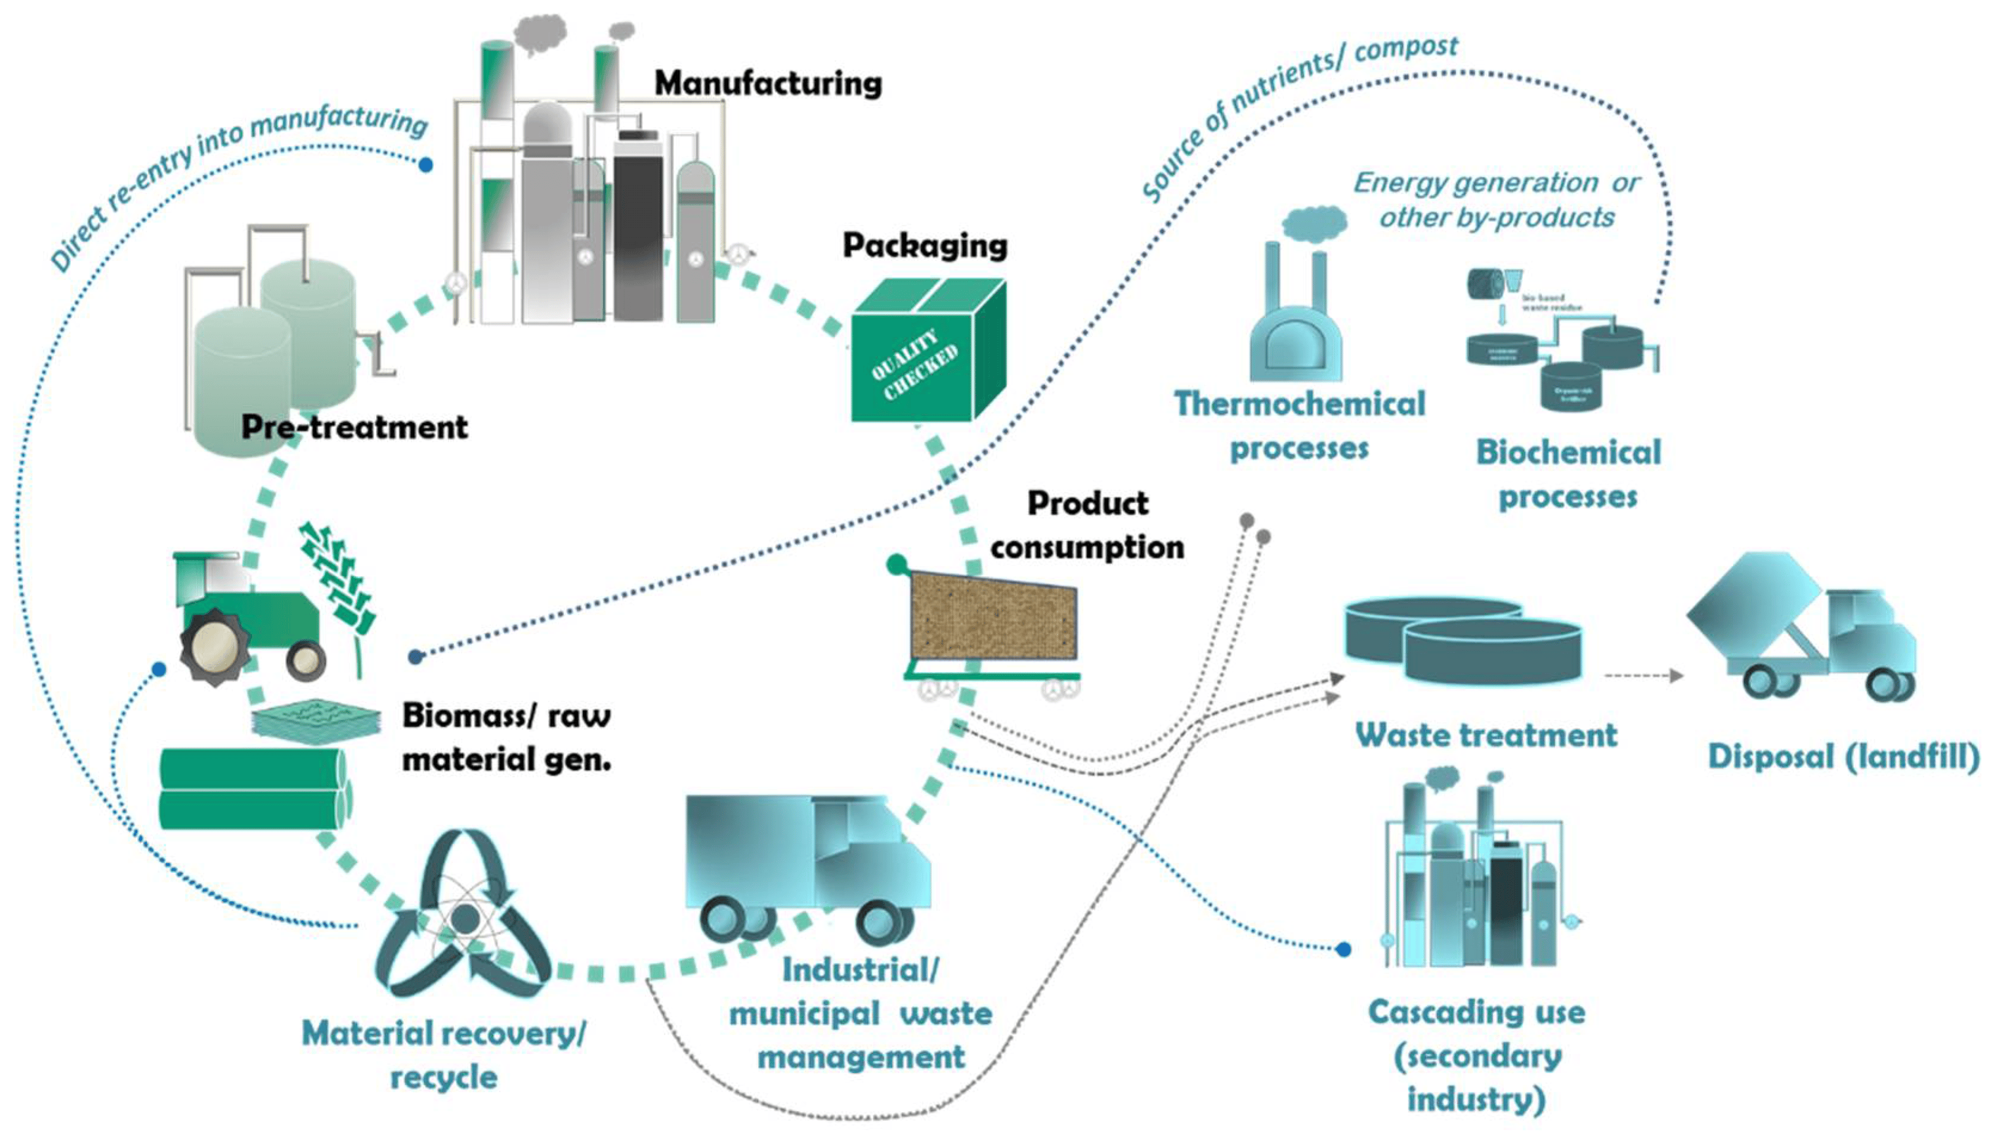
A bio-based value chain
Value chains, especially those focusing on secondary resources, aim to convert organic material into valuable products, including high-value chemicals, by-products, and renewable energy. Integrated biorefineries, capable of transforming waste into various high-value products, include a pre-treatment plant to prepare feedstock for subsequent transformation and refining technologies within the supply chain, before packaging and distribution.
Source: doi.org/10.3390/su10061695

Slide 13
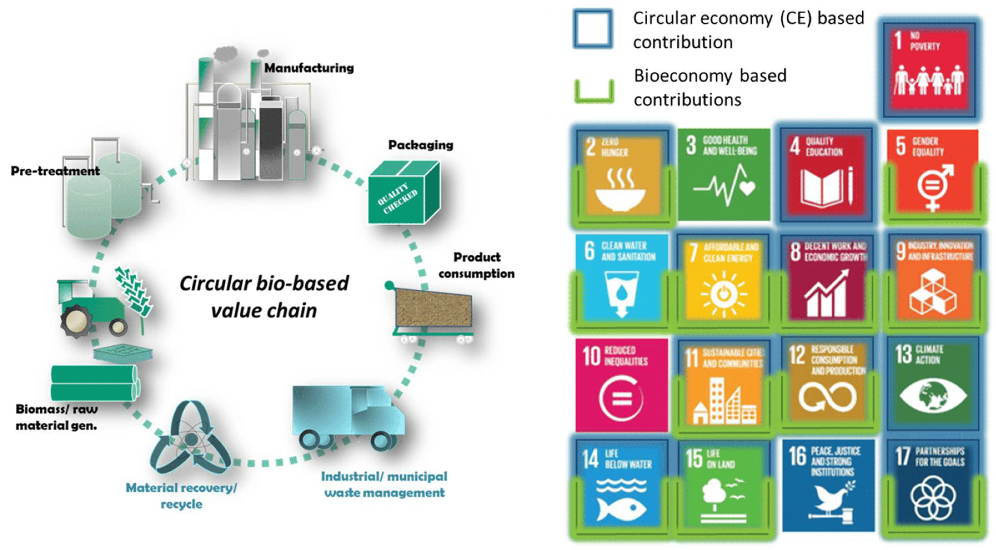
Circular Bio-Based value chain and UN’s SDGs
In terms of current targets for sustainable growth, bioeconomy, in combination with circular economy, has the potential to directly contribute to 11 out of the 17 UN’s Sustainability Development Goals (SDGs)
Source: doi.org/10.3390/su10061695

Slide 14
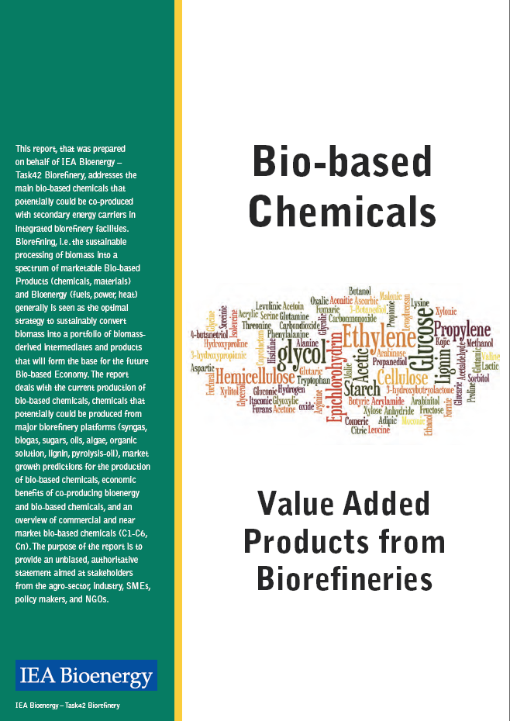
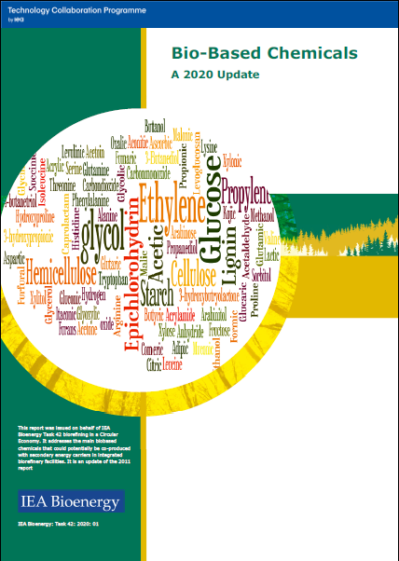
Green Chemistry
Bio-based products: chemicals and materials, pre-norm CEN/BT/WG 209: “biobased product = product wholly or partly bio-based (=derived from biomass)”, include all kind of bio-based chemicals, bio-based plastics and additives – biodegradable and durable, bio-composites like wood plastics composites and natural fibres reinforced plastics and insulation material, and also the traditional products of the timber industry.
Bio-based products are used in construction & insulation, packaging, automotive and consumer goods.
https://task42.ieabioenergy.com/publications/bio-based-chemicals-a-2020-update/

Slide 15
Green Chemistry: the beginning
In 1998, Paul Anastas and John C. Warner published the twelve Green Chemistry principles. The principles cover the following concepts:
the design of processes to maximize the amount of raw material that ends up in the product;
the use of renewable material feedstocks and energy sources;
the use of safe, environmentally benign substances, including solvents, whenever possible;
the design of energy efficient processes;
avoiding the production of waste, which is viewed as the ideal form of waste management.

Slide 16
Green Chemistry: 12 principles
Prevention. Preventing waste is better than treating or cleaning up waste after it is created.
Atom economy. Synthetic methods should try to maximize the incorporation of all materials used in the process into the final product. This means that less waste will be generated as a result.
Less hazardous chemical syntheses. Synthetic methods should avoid using or generating substances toxic to humans and/or the environment.
Designing safer chemicals. Chemical products should be designed to achieve their desired function while being as non-toxic as possible.
Safer solvents and auxiliaries. Auxiliary substances should be avoided wherever possible, and as non-hazardous as possible when they must be used.
Design for energy efficiency. Energy requirements should be minimized, and processes should be conducted at ambient temperature and pressure whenever possible.
Use of renewable feedstocks. Whenever it is practical to do so, renewable feedstocks or raw materials are preferable to non-renewable ones.
Reduce derivatives. Unnecessary generation of derivatives—such as the use of protecting groups—should be minimized or avoided if possible; such steps require additional reagents and may generate additional waste.
Catalysis. Catalytic reagents that can be used in small quantities to repeat a reaction are superior to stoichiometric reagents (ones that are consumed in a reaction).
Design for degradation. Chemical products should be designed so that they do not pollute the environment; when their function is complete, they should break down into non-harmful products.
Real-time analysis for pollution prevention. Analytical methodologies need to be further developed to permit real-time, in-process monitoring and control before hazardous substances form.
Inherently safer chemistry for accident prevention. Whenever possible, the substances in a process, and the forms of those substances, should be chosen to minimize risks such as explosions, fires, and accidental releases.

Slide 17
Pathways of biorefinery: Phase I to Phase III
Phase I
Phase II
Phase III
1 Raw Material
1 Process
1 Product
1 Raw Material
1 Process + Value added Processes
More than 1 Product
Several Raw Materials
Several Processes
Several Products
In phase III bioreﬁneries, there are four additional subgroups that are commonly mentioned:
Whole crop bioreﬁnery: Raw crops such as wheat or corn are used as a unique feedstock material to produce value-added products such as chemical building blocks, pharmaceutical products, textiles, plastics, lubricants, and biofuels.
Green bioreﬁnery: Natural-wet biomass such as cereals or grass are processed and transformed into marketable chemicals and fuels.
Lignocellulosic bioreﬁnery: Lignocellulosic biomass is converted into value-added products such as bio-oil, biochar, or other bio-based chemicals.
Two-platform concept bioreﬁnery: Both thermochemical and biochemical conversions take place in an integrated design to produce valuable products and fuels.

Slide 18
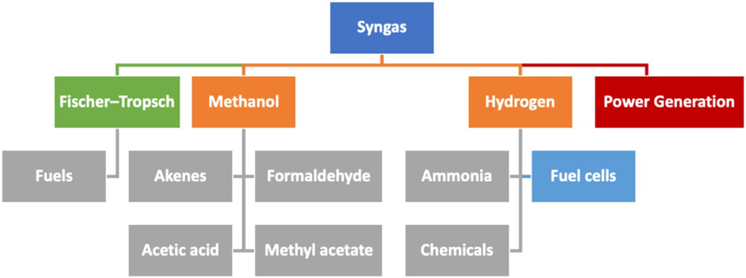
Pathways of biorefinery
Schematic representation of the possible routes for valorizing syngas
Source: Calvo-Flores et Al., 2022
DOI: 10.3389/fchem.2022.973417

Slide 19
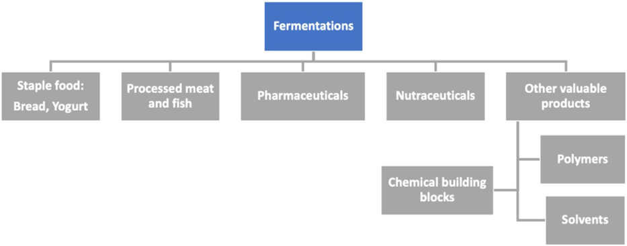
Pathways of biorefinery
Schematic representation of the main areas in which fermentation processes are traditionally used.
Source: Calvo-Flores et Al., 2022
DOI: 10.3389/fchem.2022.973417

Slide 20
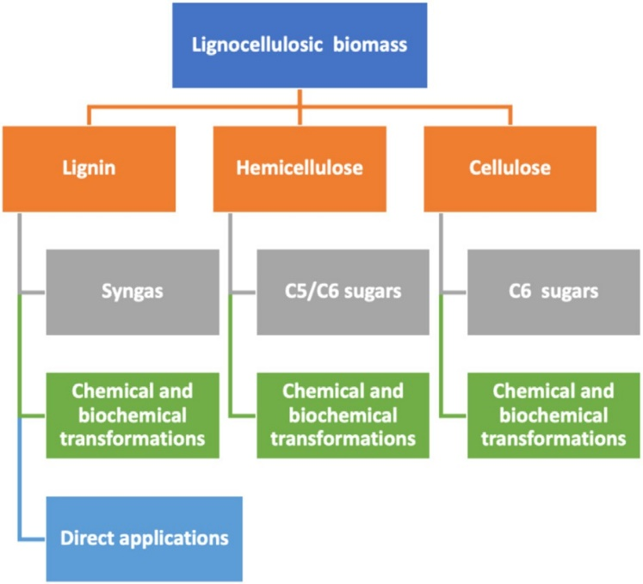
Pathways of biorefinery
Schematic representation of the possible routes for valorising lignocellulosic biomass
Source: Calvo-Flores et Al., 2022
DOI: 10.3389/fchem.2022.973417

Slide 21
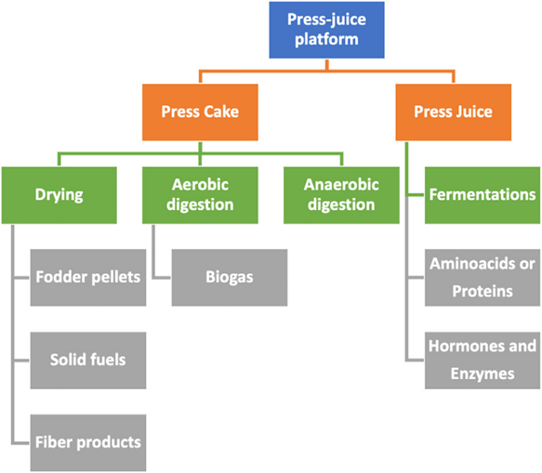
Pathways of biorefinery
Schematic representation of the possible routes in the pressjuice. It includes the main intermediates to produce valuable products, through different processes.
Source: Calvo-Flores et Al., 2022
DOI: 10.3389/fchem.2022.973417

Slide 22
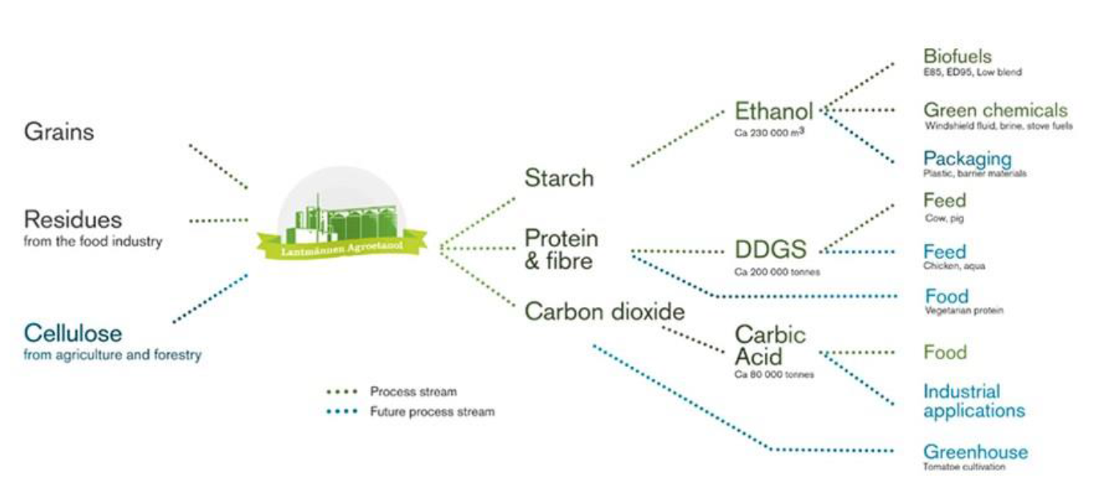
Case Study: Lantmännen Agroetanol
Lantmännen Agroetanol is the largest biorefinery in the Nordic region, it is a part of Lantmännen, an agricultural cooperative owned by 25,000 Swedish farmers.
The production facility in Norrköping started up in January 2001. In November 2008, a second production line was started.
The capacity today is about 230,000 m³ of ethanol and 200,000 tons of protein feed (DDGS).
In addition, 80,000 tonnes of carbon dioxide is delivered to the neighboring company AGA for carbonic acid production.

Slide 23

The Lantmännen biorefinery
The Ethanol biorefinery is located close to biomass-based CHP, ensuring deliveries of renewable electricity and process heat. Main feedstock are wheat and other grains, as well as starch-rich residues from the food industry. Products are Fuel ethanol and co-products in the form of protein-rich feed.
A further co-product here is the (biobased) carbon dioxide that is captured and sold as industrial raw material to customers in the food processing and packaging industry.
The Lantmännen biorefinery contributes to several SDGs: delivering a sustainable vehicle fuel (SDG 7), industrial development based on sustainable feedstocks (SDG 9), synergies between food-energy markets (SDG 12), and substantial life cycle GHG emission reductions through system improvements, co-production and CCU (SDG 13).

Slide 24


Case study: Mater-Bi
In 1992 Novamont started the commercial production of Mater-Bi, a bioplastic obtained processing starches, vegetable oils and combinations thereof.
Bioplastics have material characteristics and properties similar to those of traditional plastics, while being of vegetable origin, biodegradable and compostable according to European Standards.
www.novamont.com/eng/mater-bi

Slide 25

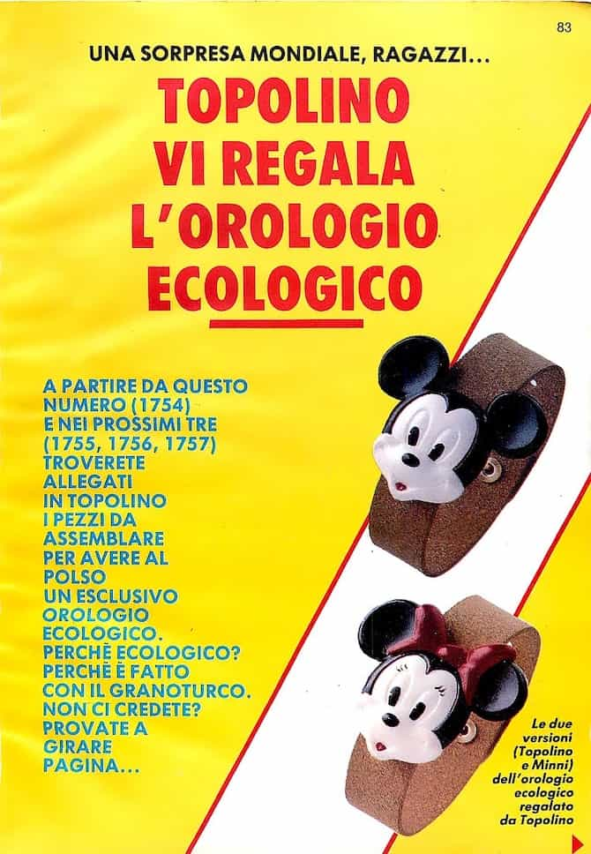


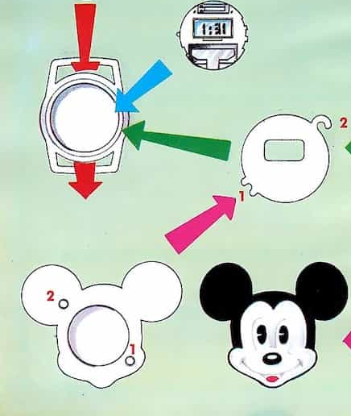
Did you know?
Bioplastic was already presented to the main public in 1989: a watch made of biodegradable plastic (made from maize) was attached as a gift to Mickey Mouse magazine in Italy (Topolino), followed in 1990 by a small camera.

Slide 26
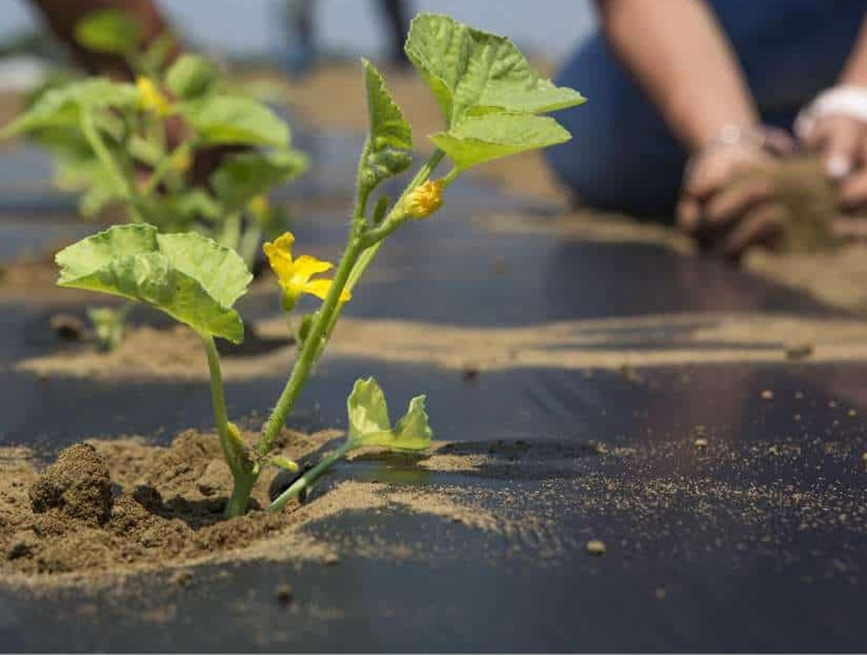
Case study: Mater-Bi mulch film
Mater-Bi mulch film is the first biodegradable and soil compostable mulch film guaranteeing excellent processing and agronomic performance in the field, combined with high environmental compatibility.
At the end of the crop cycle, mulching sheets do not have to be collected and disposed of, but incorporated into the soil where they biodegrade, turning into carbon dioxide, water and biomass.
agro.novamont.com/en/our-case-studies

Slide 27
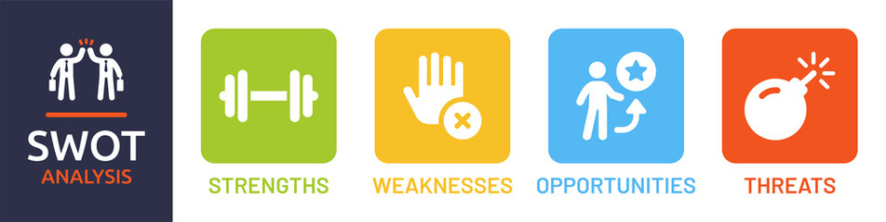
Biorefinery/Bioeconomy SWOT Analysis
Strenghts
Adding value to the use of biomass
Maximising biomass conversion efficiency minimising raw material requirements
Production of a spectrum of bio-based products (food, feed, materials, chemicals) and bioenergy (fuels, power and/or heat) feeding entire bioeconomy
Strong knowledge infrastructure available to tackle technical and non-technical issues
Biorefinery is not new, it builds on agriculture, food and forestry industries
Stronger focus on drop-in chemicals facilitating market penetration

Slide 28
Biorefinery/Bioeconomy SWOT Analysis
Weaknesses
Broad undefined and unclassified area
Involvement of stakeholders for different market sectors (agriculture, forestry, energy, chemical) over full biomass value chain necessary
Most promising biorefinery processes/concepts not clear
Most promising biomass value chains, including current/future market volumes/prices, not clear
Studying and concept development instead of real market implementation
Variability of quality and energy density of biomass

Slide 29
Biorefinery/Bioeconomy SWOT Analysis
Opportunities
Biorefineries can make a significant contribution to sustainable development
Challenging national and global policy goals, international focus on sustainable use of biomass for the production of bioenergy
International consensus on the fact that biomass availability is limited meaning that raw materials should be used as efficiently as possible – i.e. development of multi-purpose biorefineries in a framework of scarce raw materials and energy
International development of a portfolio of biorefinery concepts, including technical processes
Strengthening of the economic position of various market sectors (e.g. agriculture, forestry, chemical and energy)
Strong demand from brand owners for biobased chemicals

Slide 30
Biorefinery/Bioeconomy SWOT Analysis
Threats
Economic change and volatility in fossil fuel prices
Fast implementation of other renewable energy technologies feeding the market requests
Bio-based products and bioenergy are assessed to a higher standard than traditional products (no level playing field)
Availability and contractibility of raw materials (e.g. climate change, policies, logistics)
(High) investment capital for pilot and demo initiatives difficult to find, and undepreciated existing industrial infrastructure
Changing governmental policies
Questioning of food/feed/fuels (indirect land use competition) and sustainability of biomass production
Goals of end users often focused on single product

Slide 31
Conclusions
Biomass is becoming a crucial source for carbon materials as the economy shifts away from coal and crude oil.
The bio-based economy is growing in complexity due to factors like higher crude oil prices, environmental concerns, corporate commitments, and policy changes.
Biorefineries are producing fuels, chemical building blocks, polymers, and solvents from biomass, with expectations of further growth.
Biorefineries are not yet displacing fossil refinery technologies but aim to integrate with existing infrastructure.
Integrated biorefinery processes that produce bio-based products and energy carriers are seen as the most efficient strategy for biomass valorization.
Challenges include making biomass transformations economically feasible and developing new processing technologies, catalysts, and chemical reactions.
Achieving carbon-neutral industrial processes through renewable energy consumption requires collaboration among stakeholders and integration with other sectors and technologies.

Slide 32


