Slide 2
Course: (HEI-C3) Module: Bio-economy, circular economy and bio-based products Learning Unit: Bioenergy and energy crops
Authors: (UNIFI)

Slide 3
Introduction
In an era defined by growing environmental concerns and an urgent demand for sustainable energy solutions, bioenergy stands out as a promising answer at the intersection of renewable energy and agriculture. Bioenergy encompasses a range of energy forms derived from organic materials, predominantly biological resources like plants and biomass, aimed at producing power and heat. A fundamental element in bioenergy production revolves around the cultivation of dedicated energy crops. These crops are intentionally grown for the sole purpose of generating energy in various forms, including electricity, heat, and biofuels. The cultivation of energy crops plays a pivotal role in the bioenergy sector, providing an eco-friendly and economically viable alternative to traditional fossil fuels.

Slide 4
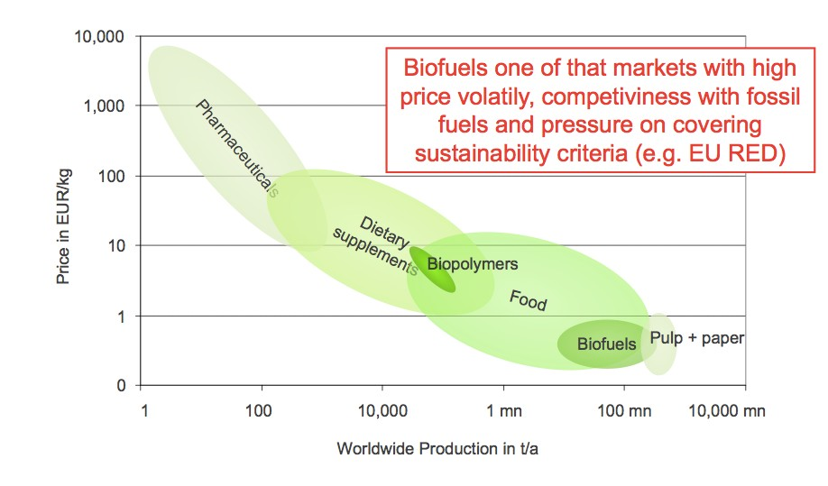
BIOFUELS

Slide 5
IMP

Slide 6
IMP

Slide 8
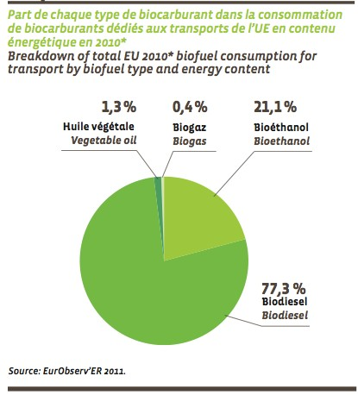
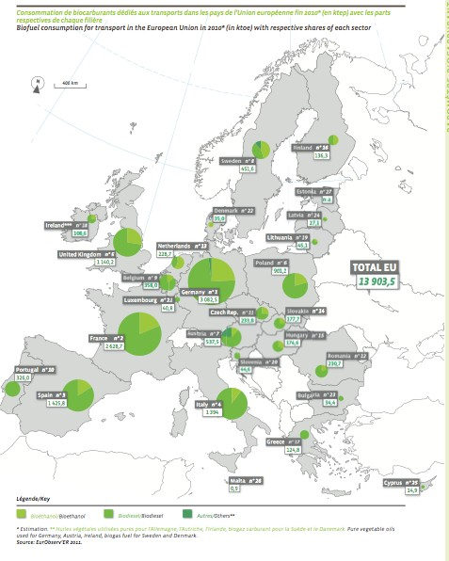

Slide 10
IMP

Slide 11
BIOETHANOL
Plant-based ethanol can be obtained through the cultivation of wheat and sugar beet from which sugar is extracted. The fermentation of the latter and subsequent distillation produces ethanol. This can be used as an additive up to 5% directly in unleaded gasoline or transformed into ETBE (Ethyl Tertiary-Butyl Ester) by reaction with isobutylene, and blended up to 15% with unleaded gasoline. There are also modified cars on the market that can be powered by bioethanol-gasoline blends with both pure components (FLEXFUEL CARS) MTBE (Methyl Tertiary-Butyl Ester) is a derivative of Methanol extracted from dedicated sugar crops and is similar to ETBE.

Slide 12
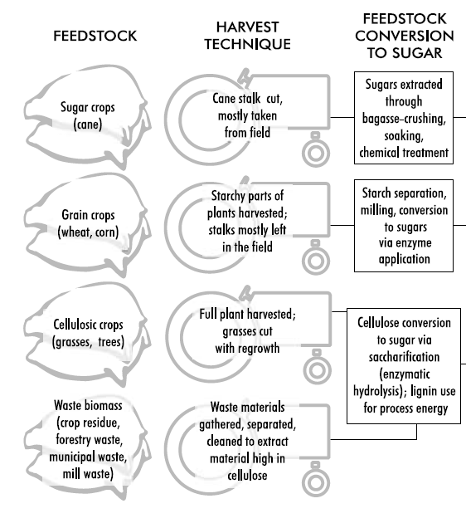
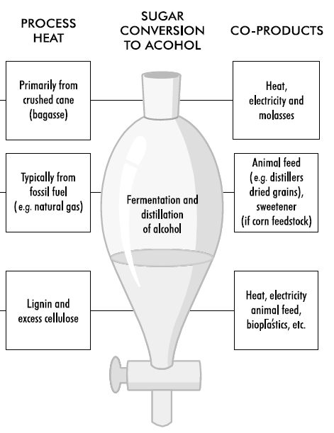
BIOETHANOL-PRODUCTION
IMP

Slide 13
BIOETHANOL-PRODUCTION
Ethanol can be produced from any biological feedstock that contains appreciable amounts of sugar or materials that can be converted into sugar such as starch or cellulose.
Sugar beets and sugar cane are obvious examples of feedstock that contain sugar.
Corn, wheat and other cereals contain starch (in their kernels) that can relatively easily be converted into sugar.
Similarly, trees and grasses are largely made up of cellulose and hemicellulose, which can also be converted to sugar, though with more difficulty than conversion of starch.

Slide 14
BIOETHANOL-PRODUCTION
Ethanol is generally produced from the fermentation of sugar by enzymes produced from yeast.
Traditional fermentation processes rely on yeasts that convert six-carbon sugars (mainly glucose) to ethanol.
Because starch is much easier than cellulose to convert to glucose, nearly all ethanol in northern countries is made from widely-available grains.
The organisms and enzymes for starch conversion and glucose fermentation on a commercial scale are readily available.
Cellulose is usually converted to five- and six-carbon sugars, which requires special organisms for complete fermentation.

Slide 15
Sugar-to-Ethanol Production
The least complicated way to produce ethanol is to use biomass that contains six- carbon sugars that can be fermented directly to ethanol.
Sugar cane and sugar beets contain substantial amounts of sugar, and some countries in the EU (e.g. France) rely on sugar beet to produce ethanol.
In Brazil and in most tropical countries that produce alcohol, sugar cane is the most common feedstock used to produce ethanol.
The costs of ethanol production from sugar cane in warm countries are among the lowest for any biofuels.

Slide 16
The Sugar-to-Ethanol Production
Process
In producing ethanol from sugar crops, the crops must first be processed to remove the sugar (such as through crushing, soaking and chemical treatment).
The sugar is then fermented to alcohol using yeasts and other microbes.
A final step distils (purifies) the ethanol to the desired concentration and usually removes all water to produce “anhydrous ethanol” that can be blended with gasoline.
In the sugar cane process, the crushed stalk of the plant, the “bagasse”, consisting of cellulose and lignin, can be used for process energy in the manufacture of ethanol.

Slide 17
The Sugar-to-Ethanol Production
IMP
Process

Slide 18
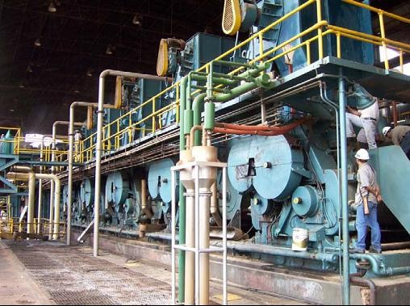
The Sugar-to-Ethanol Production
Process
Sugar mill for bioethanol production from sugar cane in Brazil

Slide 19
Grain-to-Ethanol Production
In many countries, most fuel ethanol is produced from the starch component of grain crops (primarily corn and wheat in the US and wheat and barley in Europe – though sugar beets are also used in Europe).
In conventional grain to-ethanol processes, only the starchy part of the crop plant is used. When corn is used as a feedstock, only the corn kernels are used; for wheat, it is the whole wheat kernel.
These starchy products represent a fairly small percentage of the total plant mass, leaving considerable fibrous remains (e.g. the seed husks and stalks of these plants).
Current research on cellulosic ethanol production is focused on utilising these waste cellulosic materials to create fermentable sugars – ultimately leading to more efficient production of ethanol than from using just the sugars and starches directly available.

Slide 20
The Grain-to-Ethanol Production
Process
The grain-to-ethanol production process starts by separating, cleaning and milling (grinding up) the starchy feedstock.
Milling can be “wet” or “dry”, depending on whether the grain is soaked and broken down further either before the starch is converted to sugar (wet) or during the conversion process (dry).

Slide 21
The Grain-to-Ethanol Production
Process
In both cases, the starch is converted to sugar, typically using a high-temperature enzyme process.
From this point on, the process is similar to that for sugar crops, where sugars are fermented to alcohol using yeasts and other microbes.
A final step distils (purifies) the ethanol to the desired concentration and removes water.
The grain to- ethanol process also yields several co-products, such as protein-rich animal feed (e.g. distillers dry grain soluble, or DDGS) and in some cases sweetener, although this varies depending on the specific feedstock and process used.

Slide 22
The Grain-to-Ethanol Production
IMP
Process

Slide 23
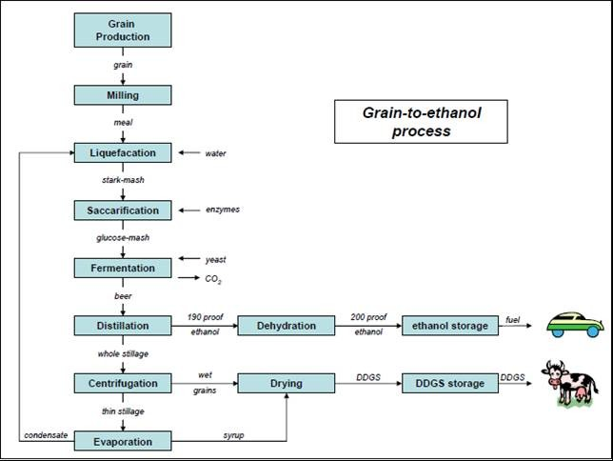
The Grain-to-Ethanol Production
Process

Slide 24
1° Generation Ethanol Production
From sugar cultures in water at T=70-80 °C
WET: 1-2 days in 0.1/0.2% H2SO4 aqueous solution; squeezing; separation of starch, oils and proteins pH=5.5-6.2 with Na(OH) at 70°C addition of α-amylase and CaCl2
From starchy crops
DRY: grain squeezed without pre-treatment; lower costs; increased production of bioethanol; No oils and proteins.
From sugary juice:Quarrying: - mechanical: with mills or presses
the stems are always soaked in H2O at 50-70 °C
by diffusion centrifugation

Slide 25
1° Generation Ethanol Production
^{C}6^{H}12^{O}6
C₂H₅OH + 2CO₂
Saccharomyces cerevisiae
29°C < T < 35 °C
450 g of yeast per 1000 l of sugary juice
Rendimenti:
1 kg di starch = 0,568 kg di CH3CH2OH1 kg of sucrose = 0.538 kg of CH3CH2OH10% of yeasts do not survive

Slide 26
1° Generation Ethanol Production
The main points in the dry bioethanol production process are: Grinding: The base material passes through a mill that grinds it into a fine powder, called a paste. Liquefaction. The paste is mixed with water and α-amylase, then passed through the stove where the starch is liquefied. Heat is applied at this stage to allow liquefaction. The stoves are used with a high temperature phase (120-150 degrees centigrade) and a lower temperature retention period (95 degrees centigrade). High temperatures reduce the levels of bacteria in the water mixture.

Slide 27
1° Generation Ethanol Production
Saccharification: The aqueous mixture that comes out of the cooking stove is cooled and the secondary enzyme (glucoamylase) is added to convert the liquefied starch into fermentable sugars (dextrose). Fermentation: Yeast is added to the mash to ferment the sugars to ethanol and carbon dioxide. Using a continuous process, the fermentation mixture passes through several fermenters until it is fully fermented and left to rest in a final bath. In a batch process, the fermentation mixture remains in a fermenter for about 48 hours before the distillation process begins.

Slide 28
1° Generation Ethanol Production
5. Distillation. The fermented mixture, now called beer, contains about 10% alcohol plus all non-fermentable solids from yeast and grain. The mixture is pumped to a continuous, multi-column distillation system in which alcohol is extracted from solids and water. The alcohol leaves the top of the final column with a purity of about 96% and the residue is transferred from the base of the column to the co-product.

Slide 29
1° Generation Ethanol Production
Disidratazione. Alcohol from the top of the column passes through a dehydration system where the remaining water will be removed. Most plants use molecular sieves to block the last amount of water in ethanol. The product of alcohol at this stage is called anhydrous ethanol (pure, without water).
Denaturazione. Ethanol that will be used for fuel must be denatured, or made inedible, with a small amount of gasoline(2-5%).

Slide 30
1° Generation Ethanol Production
8. Byproducts. There are two main by-products generated in ethanol production: wheat and carbon dioxide from distillers. Distillers' grain, whether used wet or dry, is a highly nutritious feed for livestock.

Slide 31
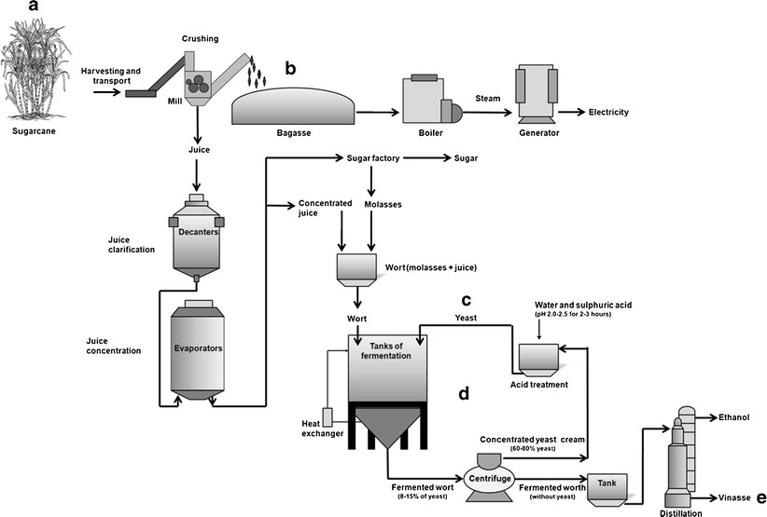
1° Generation Ethanol Production
Figure: Simplified illustration showing bioethanol production and the main scientific challenges. a Introduction of new feedstocks. b Production of second generation bioethanol from bagasse. c Selection of new yeast strains more adapted to stressing conditions of industrial fermentations. d Bacterial and yeast contamination in the fermentation process with cell recycling. e Reduction of vinasse volume
(Source: Amorim, et al.,2011)

Slide 32
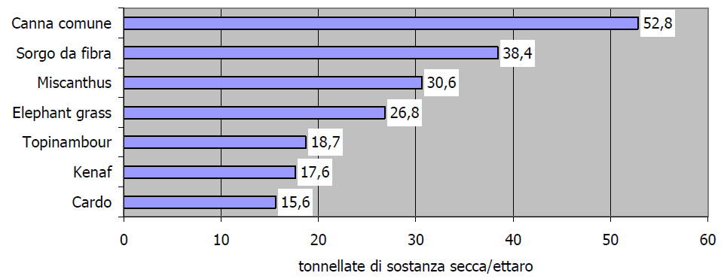
1° Generation Ethanol Production THE SUPPLY CHAIN

Slide 33
Cellulosic Biomass-to-Ethanol
Production
Most plant matter is not sugar or starch, but cellulose, hemicellulose and lignin. The green part of a plant is composed nearly entirely of these three substances.
Cellulose and hemicellulose can be converted into alcohol by first converting them into sugar (lignin cannot).
The process, however, is more complicated than converting starch into sugars and then to alcohol.

Slide 34
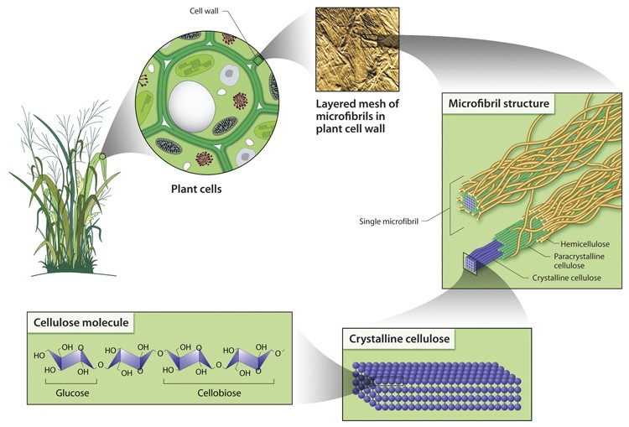
Cell-Biomass-to-Ethanol Prod

Slide 35
Cellulosic Biomass-to-Ethanol
IMP
Production
There are several potentially important benefits from developing a viable and commercial cellulosic ethanol process:
Access to a much wider array of potential feedstock (including waste cellulosic materials and dedicated cellulosic crops such as grasses and trees), opening the door to much greater ethanol production levels.
Greater avoidance of conflicts with land use for food and feed production.
A much greater displacement of fossil energy per litre of fuel, due to nearly completely biomass-powered systems.
Much lower net well-to-wheels greenhouse gas emissions than with grain to- ethanol processes powered primarily by fossil energy.

Slide 36
Cellulosic Biomass-to-Ethanol
Production: FEEDSTOCKS
A large variety of feedstock is available for producing ethanol from cellulosic biomass.
Agricultural wastes (including those resulting from conventional ethanol production), forest residue, municipal solid wastes (MSW), wastes from pulp/paper processes and energy crops.
Agricultural wastes available for ethanol conversion include crop residues such as wheat straw, corn stover (leaves, stalks and cobs), rice straw and bagasse (sugar cane waste).
Forestry wastes include underutilised wood and logging residues; rough, rotten and salvable dead wood; and excess saplings and small trees.

Slide 37
Cellulosic Biomass-to-Ethanol
IMP
Production - FEEDSTOCKS
MSW contains some cellulosic materials, such as paper and cardboard.
Energy crops, developed and grown specifically for fuel, include fast-growing trees, shrubs, and grasses such as hybrid poplars, willows and switchgrass.
The cellulosic components of these materials can range anywhere from 30% to 70%. The remainder is lignin, which cannot be converted to sugar, but can be used as a process fuel in converting cellulose to alcohol, or can be converted to liquid fuel through gasification and gas-to liquids conversion.

Slide 38
Cellulosic Biomass-to-Ethanol
IMP
Production
To convert cellulose to ethanol, two key steps must occur.
First, the cellulose and hemicellulose portions of the biomass must be broken down into sugars through a process called saccharification. The yielded sugars, however, are a complex mixture of five- and six-carbon sugars that provide a greater challenge for complete fermentation into ethanol.
Second, these sugars must be fermented to make ethanol, as they are in grain- to-ethanol processes.
The first step is a major challenge, and a variety of thermal, chemical and biological processes are being developed to carry out this saccharification step in an efficient and low-cost manner.

Slide 39
Cellulosic Biomass-to-Ethanol
IMP
Production
To convert cellulose to ethanol, two key steps must occur.
First, the cellulose and hemicellulose portions of the biomass must be broken down into sugars through a process called saccharification. The yielded sugars, however, are a complex mixture of five- and six-carbon sugars that provide a greater challenge for complete fermentation into ethanol.
Second, these sugars must be fermented to make ethanol, as they are in grain-to- ethanol processes.
The first step is a major challenge, and a variety of thermal, chemical and biological processes are being developed to carry out this saccharification step in an efficient and low-cost manner.

Slide 40
Cellulosic Biomass-to-Ethanol
Production
One important difference between cellulosic and conventional (grain and sugar crop) ethanol production is the choice of fuel to drive the conversion process.
In current grain-to-ethanol production processes in North America and Europe, virtually all process energy is provided by fossil inputs, such as natural gas used to power boilers and fermentation systems.
For cellulose-to-ethanol conversion, nearly all process energy is provided by biomass, in particular the unused cellulosic and lignin parts of the plant being processed.
In short, it has been easier and less expensive to continue relying on fossil energy inputs to drive the conversion process, even though this emits far more greenhouse gases than conversion relying on bioenergy as the process fuel.

Slide 41
Cell Biomass-to-Ethanol Process
The first step in converting biomass to ethanol is pre-treatment, involving cleaning and breakdown of materials. A combination of physical and chemical (e.g. acid hydrolysis) processes is typically applied, which allows separation of the biomass into its cellulose, hemicellulose and lignin components. Some hemicellulose can be converted to sugars in this step, and the lignin removed.

Slide 42
Cell Biomass-to-Ethanol Process
Next, the remaining cellulose is hydrolysed into sugars, the major saccharification step.
Common methods are dilute and concentrated acid hydrolysis, which are expensive and appear to be reaching their limits in terms of yields.
Therefore, considerable research is being invested in the development of biological enzymes that can break down cellulose and hemicellulose.
The first application of enzymes to wood hydrolysis in an ethanol process was to simply replace the cellulose acid hydrolysis step with a cellulose enzyme hydrolysis step. This is called separate hydrolysis and fermentation (SHF).

Slide 43
Cell Biomass-to-Ethanol Process
An important process modification made for the enzymatic hydrolysis of biomass was the introduction of simultaneous saccharification and fermentation (SSF), which has recently been improved to include the co-fermentation of multiple sugar substrates.
In the SSF process, cellulose, enzymes and fermenting microbes are combined, reducing the required number of vessels and improving efficiency.
As sugars are produced, the fermentative organisms convert them to ethanol (Sreenath et al., 2001).

Slide 44
Cell Biomass-to-Ethanol Process
Finally, researchers are now looking at the possibility of producing all required enzymes within the reactor vessel, thus using the same “microbial community” to produce both the enzymes that help break down cellulose to sugars and to ferment the sugars to ethanol.
This “consolidated bioprocessing” (CBP) is seen by many as the logical end point in the evolution of biomass conversion technology, with excellent potential for improved efficiency and cost reduction (Hamelinck et al., 2003).

Slide 45
Cell Biomass-to-Ethanol Process

Slide 46
2° Generation Ethanol Production
Idrolisi acida:
2 ore in solution con 10% H₂SO₄: Hydrolysis of hemicellulose
lignin + cellulose in 30% acid solution 70%: Breakdown of the crystal structure of cellulose
suspension: in H₂O a 100°C for 2 h
solution: neutralized with Na(OH)
Hydrate formation of
Chalk
EFFICIENCY:
hemicellulose = 90 – 96 %
cellulose = 79 – 90 %
lignin = Solid Process Residue

Slide 47
2° Generation Ethanol Production
- Steam explosion e Enzymatic hydrolysis:
Steam explosion: Biomass heated with high-pressure steam: P = 20-25 bar, T = 210 – 290 °C, for a few minutes sudden decompression up to 1 atm
BREAKDOWN OF HEMICELLULOLYTIC SUGARS (xylose, arabinose, mannose, galactose) Solid part: (lignin + cellulose) to be hydrolyzed Liquid part: ready for fermentation
IEnzymatic drolysis: cellulase enzymes break down cellulose polymer chains A pre-treatment is of fundamental importance to have yields of up to 90%

Slide 48
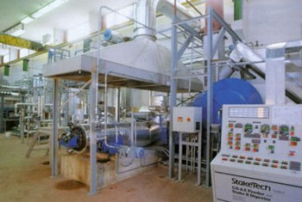
2° Generation Ethanol Production

Slide 49
BIOETHANOL DISTILLATION AND
DEHYDRATION
Ethanol produced by fermentation results in a solution of ethanol in water. For ethanol to be used as fuel, water must be removed.
The oldest method therefore is distillation, but the purity is limited to 95-96 % due to the formation of a low-boiling water-ethanol azeotrope. An azeotrope is a liquid mixture of two or more substances that retains the same composition in the vapor state as in the liquid state when distilled or partially evaporated under a certain pressure. It means that the composition of this liquid at its azeotropic composition can not be changed by simple boiling.

Slide 50
BIOETHANOL DISTILLATION AND
DEHYDRATION
Thus it is not possible to obtain ethanol of higher purity of 96 % by distilling any more dilute solution.
But for blending with gasoline, ethanol purities of 99.5 to 99.9% are required, depending on temperature, to avoid separation. Currently, the most widely used purification method is a physical absorption process using molecular sieves.

Slide 51
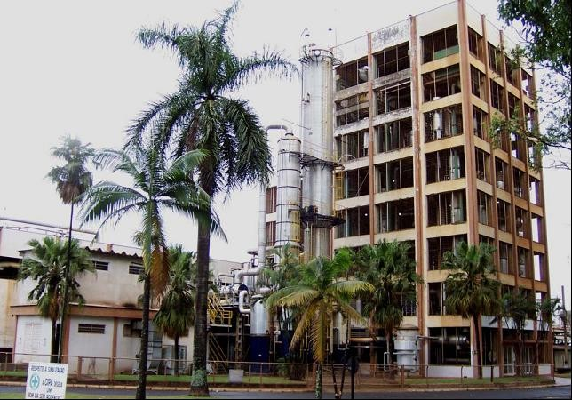
BIOETHANOL DISTILLATION AND
DEHYDRATION
Distillery for bioethanol production from sugarcane in Brazil

Slide 52
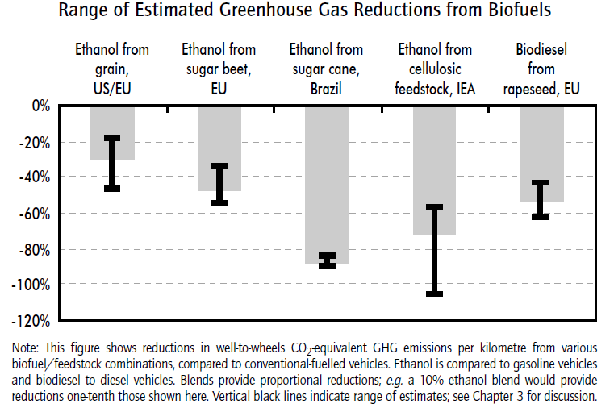
BIOETHANOL

Slide 53
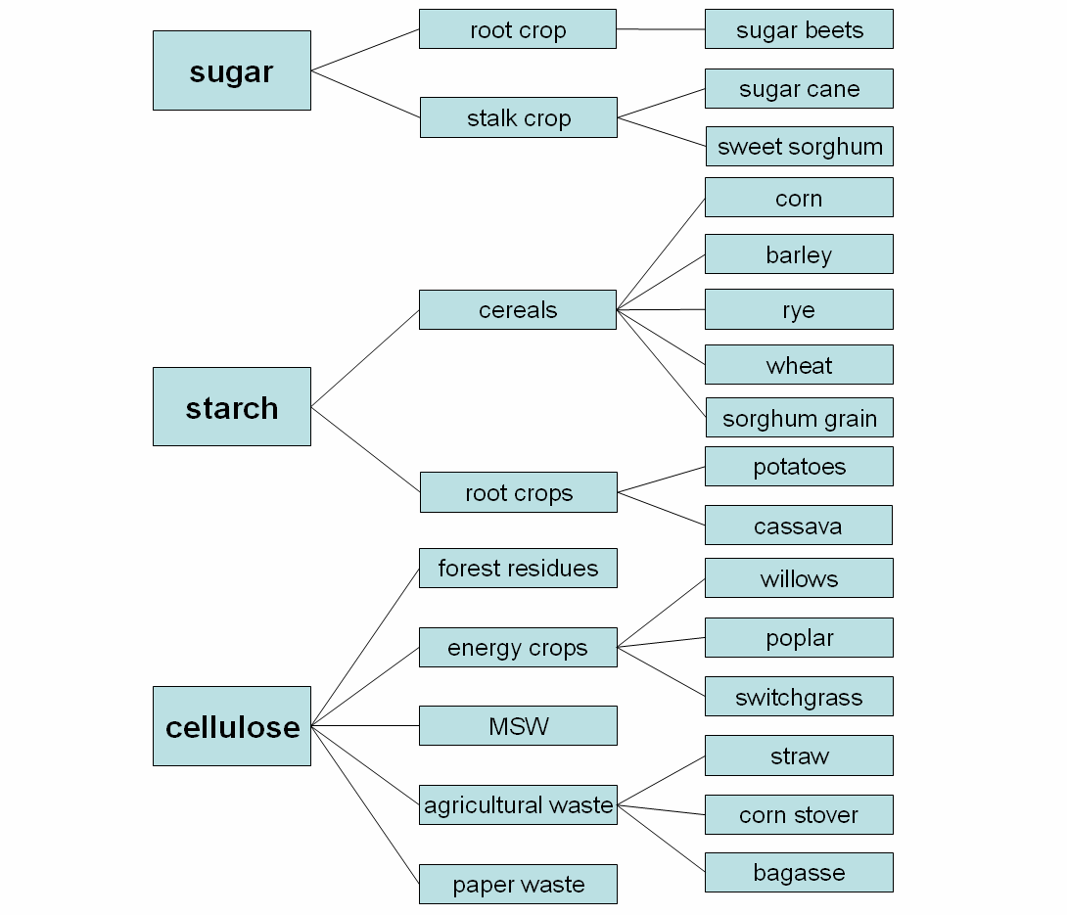
FEEDSTOCKS

Slide 54
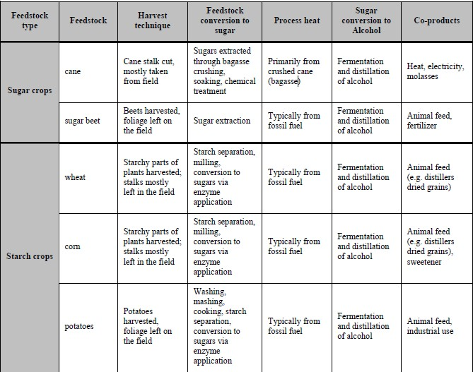
FEEDSTOCKS

Slide 55
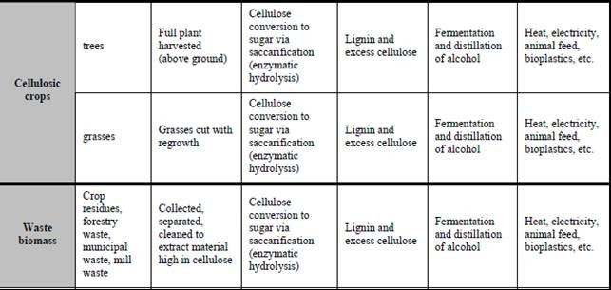
FEEDSTOCKS

Slide 56
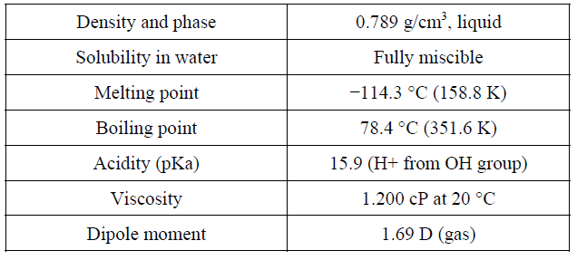
BIOETHANOL - PROPERTIES
Ethanol, also known as “ethyl alcohol” or “grade alcohol”, is a flammable, colorless chemical compound, one of the alcohols that is most often found in alcoholic beverages.
Its molecular formula is C₂H₆O, variously represented as EtOH, C₂H₅OH or as its empirical formula C₂H₆O. The most important properties of ethanol are shown in Table

Slide 57
BIOETHANOL - PROPERTIES
Parameters of bioethanol in comparison with petrol
Ethanol has many favorable properties. For example the octane number of ethanol is higher than the octane number of conventional petrol. The octane number influences the antiknocking property of the fuel. The anti knocking number (AKI) and the research octane number (RON) of pure ethanol is 116 and 129 compared to ordinary petrol with 86/87 AKI and 91/92 RON. A high octane number stands for an antiknocking fuel. Knocking describes uncontrolled combustion which puts heavy mechanical and thermal loads on the engine.

Slide 58
BIOETHANOL - PROPERTIES
On the other hand, the energy yield of ethanol is about one third lower than petrol. One liter of ethanol substitutes only about 0.65 liters of petrol. This is due to the different caloric values of petrol and ethanol. The energy content of petrol is 32.5 MJ/l and 21.2 MJ/l of ethanol.

Slide 59
BIOETHANOL - PROPERTIES
Another property of ethanol is its low vapor pressure. When stored as a pure fuel (or even as an E-85 blend), it has a lower vapor pressure than gasoline, and thus will have fewer evaporative emissions. In colder climates, the low vapor pressure of pure ethanol can cause cold start problems. Therefore in cold climates ethanol is blended with gasoline (E85). In contrast, lower-level blends of ethanol in gasoline, tend to raise the vapor pressure of the base gasoline to which ethanol is added. When ethanol is blended up to about 40 percent with gasoline, the two fuels combined have higher evaporative emissions than either does on its own (WWI 2006 p. 192).

Slide 60
BIOETHANOL - PROPERTIES
This example shows that different blends of ethanol and petrol have different properties. Depending on the situation and the desired fuel, ethanol is therefore blended with gasoline at any ratio. Common ethanol blends are E5, E10, E20, E25, E70, E85, E95, and E100, which contain 5%, 10%, 20%, 25%, 70%, 85%, 95%, and
100% ethanol, respectively. Also other varying quantities are possible. In the European Union, so-called flexible-fuel vehicles (FFV) are currently entering the market. They can run with an ethanol proportionof any mixture up to 85 %.

Slide 61
BIOETHANOL - PROPERTIES
Ethanol is also increasingly used as an oxygenate additive for standard petrol, as a replacement for methyl tertiary butyl ether (MTBE). MTBE is usually mixed with petrol as an additive to improve the octane number. Because MTBE has toxic properties and is responsible for considerable groundwater and soil contamination, MTBE is more and morefrequently replaced by ETBE (ethyl tertiary butyl ether). ETBE is produced from bioethanol and may be mixed in maximum quantities of 15 percent with petrol.

Slide 62
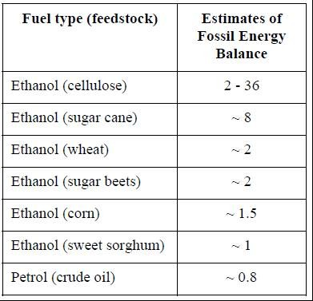
BIOETHANOL -ENERGY BALANCE
Estimated fossil energy balances of selected fuel types from several studies
The best energy balances a r e r e c e i v e d f o r bioethanol from sugar cane. It is only exceeded by ethanol made from cellulosic feedstock, but the technology is not yet in commercial operation. Significantly, all types of bioethanol not only have better energy balances than fossil petrol, but ev en ha ve en er gy balances larger than one.

Slide 63
BIOETHANOL – GHG EMISSIONS
the GHG balance for bioethanol is highly variable and includes emissions of cultivation, transport, conversion process and distribution. Further, the GHG reduction potential depends on type of feedstock, agricultural practices, site productivity, conversion technology, and finally on the whole design of the study.
Detailed studies, indicating GHG reductions by using neat or blended bioethanol show reductions of up to 96 % for anhydrous bioethanol in Brazil.
The total life-cycle GHG emissions reductions associated with the ethanol industry in Brazil are equivalent to 46.6 million tons annually. These are approximately 20 % of Brazil’s annual fossil fuel emissions.

Slide 64
BIOETHANOL – GHG EMISSIONS
This is due to high site productivity in Brazil and its favourable climate for sugar cane, which is highly productive and only needs low inputs of fertilizer. Additionally almost all conversion plants use bagasse for process energy which also reduces GHG emissions.
Well-to-wheel CO2 emissions of sugar cane-ethanol are estimated to be, on average 0.20 kg per liter of fuel used, versus 2.82 kg for gasoline
In contrast, ethanol from corn shows very small GHG reductions within all potential feedstock options, Using commercial processes, the use of ethanol derived from grains, brings a 20% to 40% reduction in well-to- wheels CO2-equivalent GHG emissions, compared to gasoline.

Slide 65
BIOETHANOL
Biomass required to produce 100 litres or 1 tonnes:
 | 100 l_{ETOH} | 1 t ETOH
Grain | 289 kg | 3,636 kg
Sugar beet | 992 kg | 12,500 kg
Patata | 794 kg | 10,000 kg
Crop | Expected bioethanol yield (lt/ha/y)
Grain | 1,800 – 2,500
Corn | up to 3,800
Sugar cane | up to 5,600
Sugar beet | up to 7,000
Lignocellulosic biomass | up to 9,000
 | lETOH | t ETOH
Grain | 2,424 | 1.92
Sugar beet | 6,650 | 5.28
Potato | 4,410 | 3.50
Production of biofuel per hectare:
Energy balance➔Various sources, conflicting results (depending on initial resource and technologies)
Altre emissioni – Considerando miscele (blending) al 5-7 %
➔ - 15 / - 40 % CO
➔ - 2 / - 7 % Unburned hydrocarbons
➔ Significant reduction in particulate emissions
➔ + 4 / + 10 % NOx
➔ Aldeidi e Chetoni

Slide 66
Conclusion
Bioenergy and energy crops offer crucial solutions for addressing climate change and transitioning to sustainable energy. By cultivating energy crops for biofuel production, we proactively diversify energy sources and reduce reliance on finite fossil fuels. Bioenergy, in the form of bioethanol and biodiesel, provides a cleaner alternative, mitigating greenhouse gas emissions. Sustainability depends on balancing environmental, social, and economic factors, emphasizing responsible land use, biodiversity preservation, and community engagement. Technological innovations and adherence to rigorous standards enhance bioenergy system efficiency. Challenges like land competition with food crops necessitate ongoing research and a nuanced approach to balancing energy needs, food security, and environmental conservation. Certification plays a key role in guiding responsible practices. Despite challenges, continued investment in research, education, and collaboration is essential for unlocking the full potential of bioenergy, contributing to a resilient, sustainable, and greener energy future..

