Slide 2
Course: HEI Module: Controlled Environment Agriculture (CEA) Learning Unit: Introduction to Controlled Environment Agriculture (CEA: principles, techniques and innovations
Authors: UOP

Slide 3
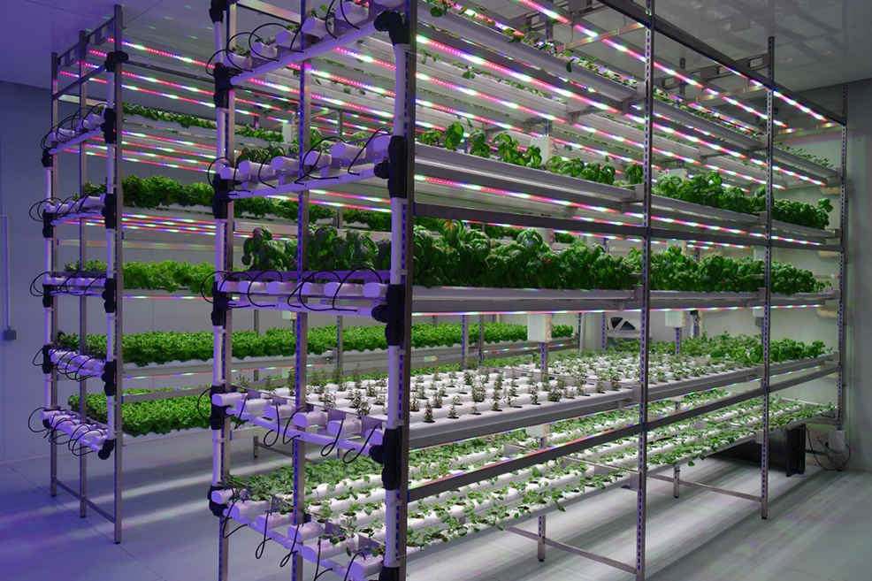
Definition of Controlled Environment Agriculture (CEA)
CEA allows growers to precisely control and manipulate environmental conditions to create an ideal growth environment for plants
Indoor and vertical farming can be established in urban areas, reducing the need for long-distance food transportation and providing locally grown produce to urban populations.
CEA employs soilless growing techniques like hydroponics (growing plants in nutrient-rich water) and aquaponics (combining aquaculture and hydroponics).
By optimizing environmental factors and reducing water and nutrient waste, it can use significantly less water and land compared to traditional agriculture.

Slide 4
Types of plants cultivated
Leafy greens such as lettuce, spinach, kale, swiss chard etc: Leafy greens are popular choices for CEA because they have relatively short growth cycles, thrive in controlled conditions, and are in high demand year-round.
Herbs such as basil, cilantro, parsley, mint etc. Herbs are also well-suited for controlled environments due to their compact growth habits and high market value.
Microgreens and sprouts. Microgreens are young, edible greens harvested at an early stage, making them ideal for CEA. Popular choices include arugula, radishes, and broccoli sprouts
Tomatoes, cucumbers and bell pepers, which can be grown hydroponically or aeroponically in controlled environments, allowing for precise control over nutrient levels and climate conditions
Strawberries grown hydroponically are increasingly popular in CEA due to their year-round availability and consistent quality
Mushrooms, in various types, such as oyster and shiitake, can be grown in controlled environments with precise temperature and humidity control
Specialty crops, depending on market demand and specific environmental conditions, specialty crops like exotic fruits, edible flowers, or specialty vegetables can be considered as potential alternatives.

Slide 5
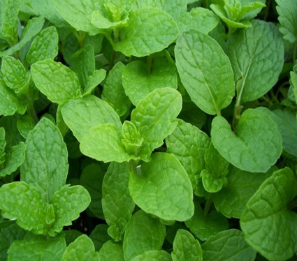
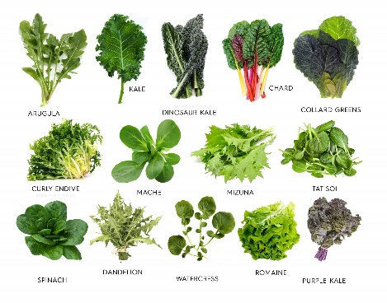
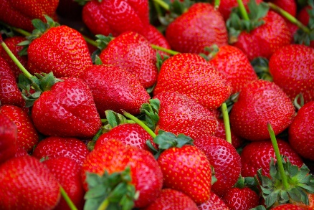
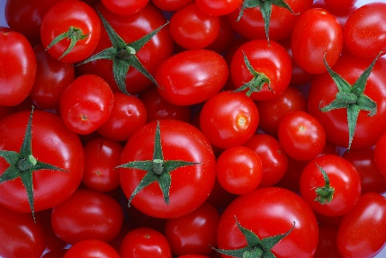
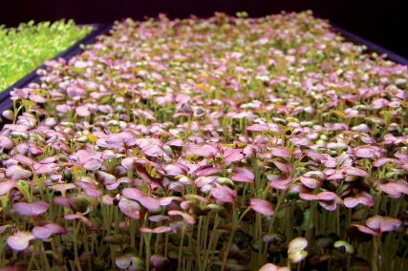
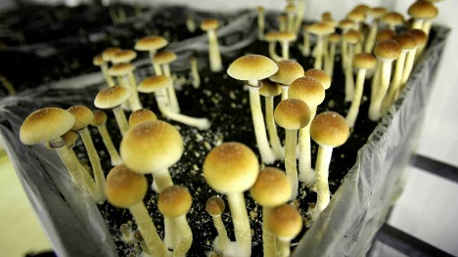

Slide 6
Advantages of CEA
Year-Round Production: CEA allows for year-round crop production, irrespective of external weather conditions. This can lead to a more consistent and reliable supply of fresh produce.
Optimized Growing Conditions: CEA provides precise control over environmental factors like temperature, humidity, light, and CO₂ levels. This enables growers to create optimal conditions for plant growth, resulting in faster growth rates and increased yields.
Resource Efficiency: CEA systems often use less water and space compared to traditional farming methods. Controlled irrigation and recycling systems can significantly reduce water usage, making it more sustainable in water-scarce regions.
Pest and Disease Control: The closed and controlled environment of CEA helps in preventing pest infestations and reducing the need for chemical pesticides. This can result in safer, pesticide-free produce.
Reduced Environmental Impact: By minimizing the need for large expanses of land and transportation, CEA can reduce the carbon footprint of agriculture, mitigating the impact of farming on the environment.
Higher Crop Yields: With optimized conditions and control over variables, CEA can achieve higher crop yields per unit of area compared to traditional farming methods.
Local Food Production: CEA can be set up in urban areas or regions with limited arable land, allowing for local food production. This can reduce the distance food needs to travel, leading to fresher produce and fewer emissions from transportation.
Crop Variety: CEA allows for the cultivation of a wide range of crops, including those that may not thrive in local climates. This can diversify food production and increase food security

Slide 7
Disadvantages of CEA
High Initial Costs: Setting up CEA systems can be expensive. The cost of infrastructure, technology, and energy requirements can be a barrier to entry for small-scale farmers.
Energy Consumption: Maintaining controlled environments requires a significant amount of energy, particularly for lighting and climate control. This can result in high operational costs and contribute to greenhouse gas emissions.
Complexity: CEA systems are technically complex, requiring knowledge and expertise in various fields such as agriculture, engineering, and automation. This complexity can be a challenge for inexperienced growers.
Limited Crop Diversity: While CEA can grow a variety of crops, it may not be as suitable for large, sprawling crops like corn or wheat. This limits the types of crops that can be economically grown using CEA.
Dependence on Technology: CEA systems rely heavily on technology, making them vulnerable to equipment failures, power outages, or software glitches. A breakdown in any part of the system can lead to crop loss.
Environmental Impact of Energy Use: The high energy consumption in CEA can offset some of the environmental benefits, especially if the energy source is not renewable.
Scale Limitations: CEA is often more suitable for smaller-scale, high-value crops. It may not be as economically viable for large-scale commodity crops.

Slide 8
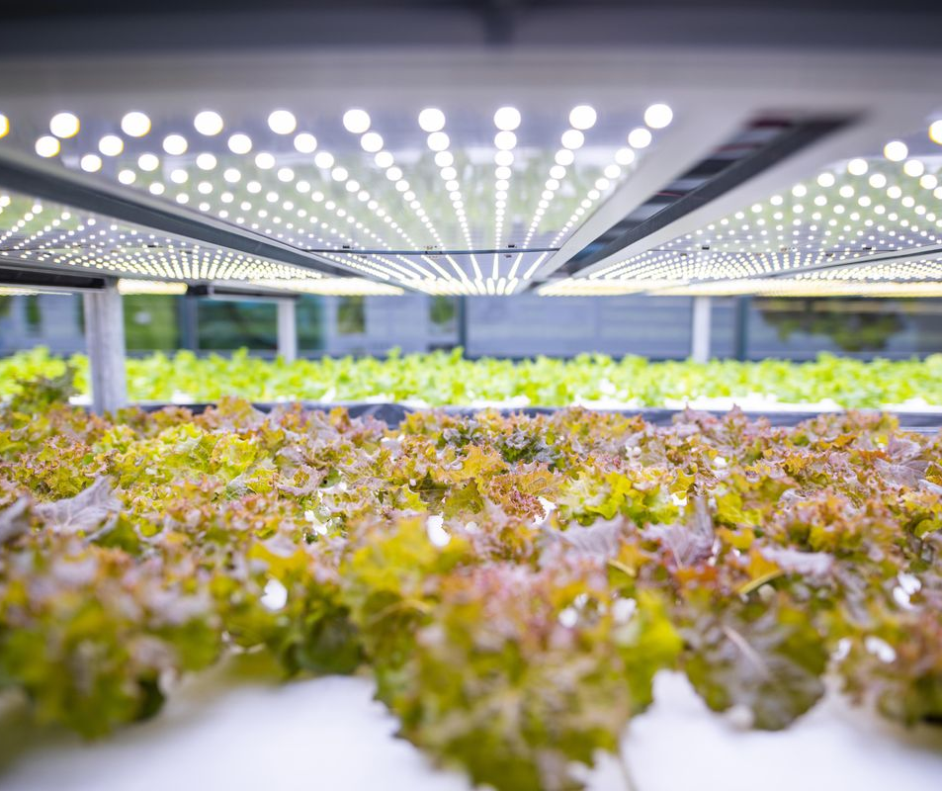
Key factors affecting growth
Light: Water: Adequate water is essential for plant growth. Water is not only a component of photosynthesis but also helps transport nutrients throughout the plant. Too little water (drought) or too much water (waterlogging) can be detrimental to plant health.
Temperature:
Nutrients:
Soil/Substrate Quality:
Air Circulation:
Humidity:
Pests and Diseases:

Slide 9
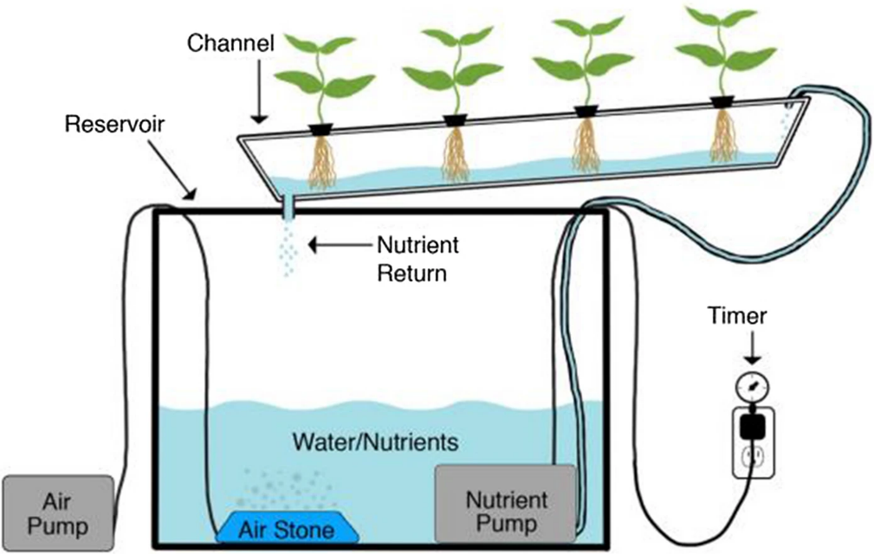
Environmental Control System (ECS)
The Environmental Control System (ECS) is a critical component in controlled environment agriculture (CEA) systems
Climate Control
Lighting Control
CO₂ Control
Air Circulation
Nutrient and Water Delivery
Environmental Monitoring
Data Logging and Analysis
Control Logic and Automation
Energy Efficiency
Remote Monitoring and Control

Slide 10
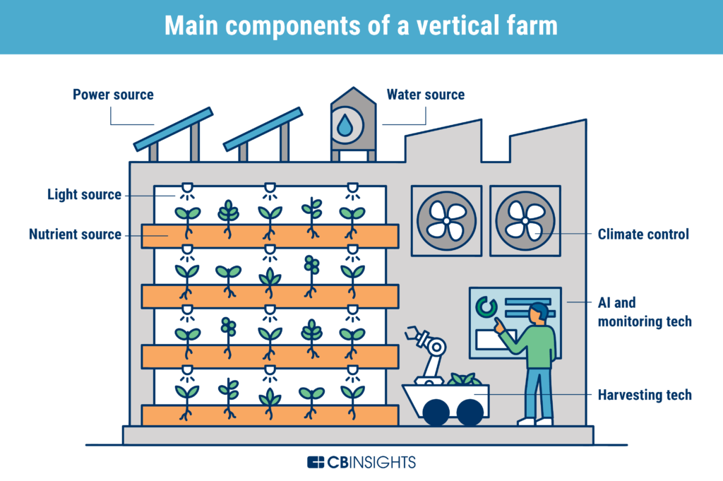

Slide 11
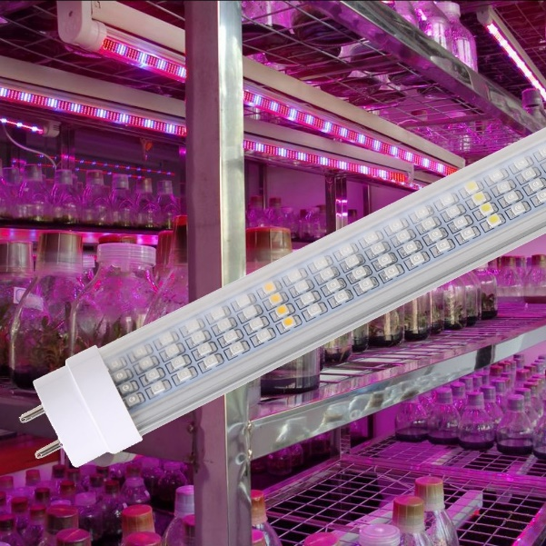
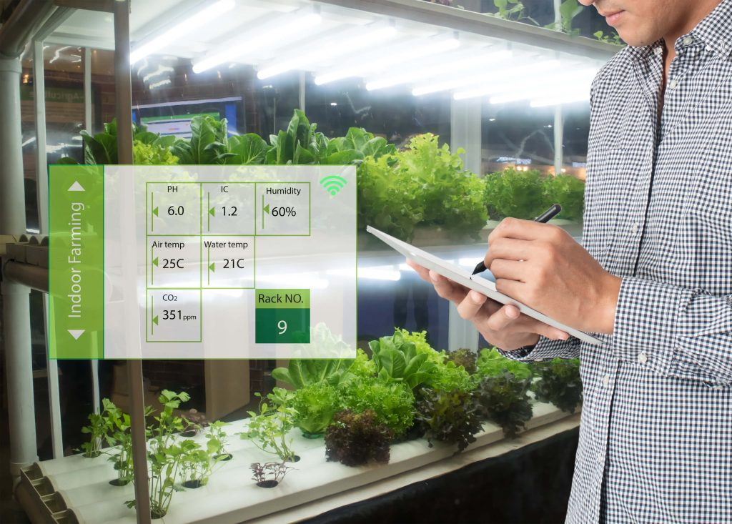
Technologies used in CEA
Climate Control Systems
Hydroponic systems
LED Grow Lights
Environmental Sensors
Automated Irrigation Systems
Biological Pest Control
Cultivation Trays and Vertical Farming Systems

Slide 12
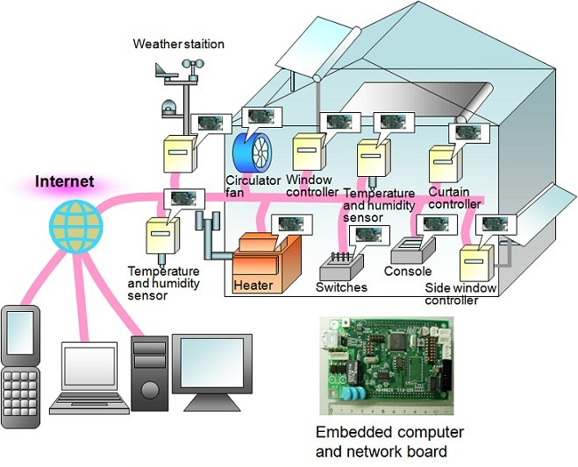
CO₂ Enrichment
Data Analytics and Monitoring
Climate Computer and Control Systems
Nutrient Delivery Systems
Building Structures
Smartphone Apps and Remote Monitoring
Renewable Energy

Slide 13
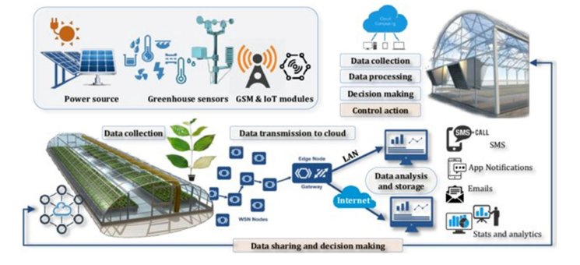
The role of the Internet of things (IOT)
The role of Internet-of-Things (IoT) in precision agriculture and smart greenhouses has been reinforced by recent R&D projects, growing commercialization of IoT infrastructure, and related technologies such as satellites, artificial intelligence, sensors, actuators, uncrewed aerial vehicles, big data analytics, intelligent machines, and radio-frequency identification devices

Slide 14
The current Market of CEA
The market for Controlled Environment Agriculture (CEA) has been experiencing significant growth and innovation the past 20 years. Global CEA market is projected to grow from USD 70.5 Billion in 2021 and is estimated to reach USD 270.2 Billion by 2032, registering a compound annual growth rate (CAGR) of 18.9% between 2022 and 2032 (KD Market Insights report, 2022). The CEA market involves the cultivation of crops in a closed or partially closed environment, where environmental factors such as temperature, humidity, and light are carefully controlled.

Slide 15
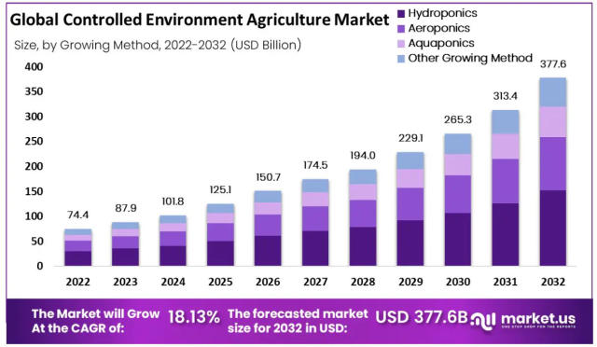
Market trends
Rising Global Demands for food
Growing Demand for Sustainable Agriculture
Loss of Agricultural Land
Innovations in Indoor Farming and new Technologies
Precision Agriculture

Slide 16
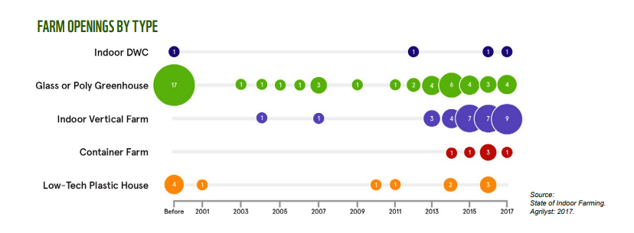

Slide 17
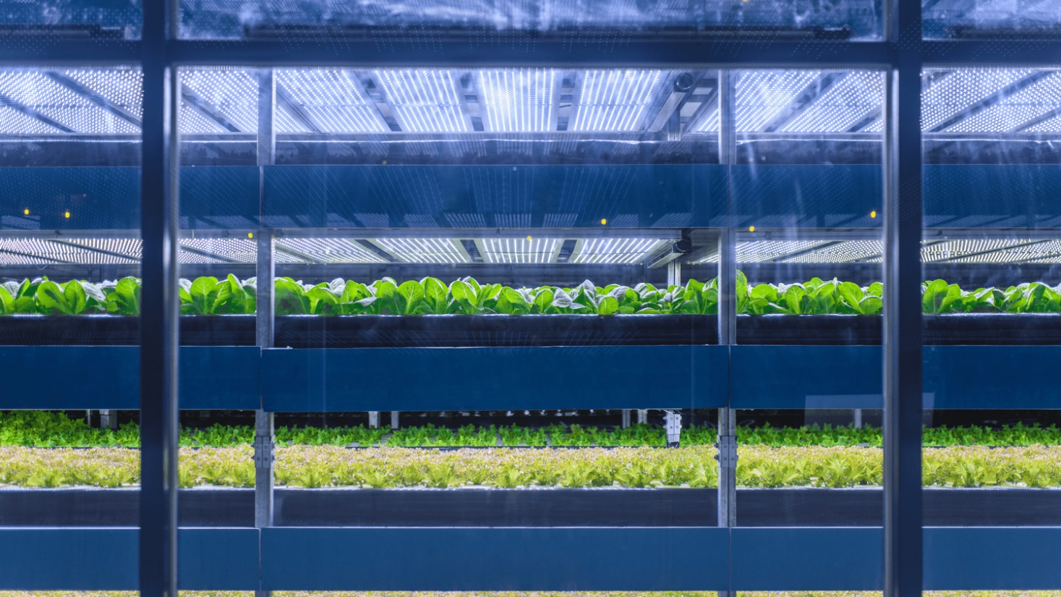
Energy use in CEA
The controlled environment agriculture (CEA) industry is highly sensitive to the price of energy, especially electricity and natural gas.
CEA is a catch-all name for methods of growing crops indoors while controlling elements of the environment such as irrigation, temperature, humidity or light.
Despite CEA’s higher output of produce, and reduced resource, pesticide and land use, a common and understandable critique is that artificially controlling the climate and often replacing sunlight with LEDs requires a substantial amount of energy.

Slide 18
The Spread Ltd. Company success story
Spread was founded in 2006 in Kyoto, Japan. Kyoto is a traditional producer of high-quality vegetables and the “Kyoto-vegetable” brand is famous throughout Japan. The Plant Factory was built in Kameoka City, Kyoto near the flourishing agricultural area.
From factory operations to sales, Spread is expanding its vegetable production and sales business while carrying out all technological development in-house. Lettuce under the brand Vegetus, is delivered to approx. 2000 domestic supermarkets every day and has the largest sales area of any Plant factory growing lettuce
Spread produces aprox. 21000 heads of frilled, pleated, sunny and romaine lettuce every day. Supermarkets are the main buyer, accounting for the 90% of the sales. The remaining 10% of the sales comes from bulk deliveries made to restaurants, delis and airlines.
Established in 2007; 4780 m2, total floor area = 2868m2, Height = 15,94 m
Cultivation area in building 1 = 10800 m2 (900m2 x 12 tiers) and building 2 = 14400 m2 (900m2 x 16 tiers). Electricity supply = 1750 kW, Water source= ground water, 16 tons / day. Cultivation system = deep flow hydroponics.

