Slide 2
Course: HEI
Module: Controlled environment agriculture
Learning Unit:Entrepreneurship in Vertical Farming: Business Models, Financial Planning and Marketing Strategies
Hailong Li
Mälardalen University
Sweden

Slide 3
Content
General information
Learning outcomes
Introduction to business models
Basics of economic analysis
Marketing strategies
How to start vertical farming
Case studies of urban farming

Slide 4
General information
Working hours:
  Face to Face: 24 hrs
  Online learning (asynchronous): 20 hrs
  WBL (through study visits and/or workshops): 16 hrs
ECTS: 3
Aim:
  to introduce the basics of entrepreneurship in the urban farming industry. Through real-world case studies, learners will understand and apply these concepts in the context of an urban farming startup.
Teaching methods:
  Lectures + self-reading
Examination:
  Self-assessment activities (quizzes, multiple choice, true-false), reflection questions

Slide 5
Learning outcomes
Knowledge
  Describe business models utilized in urban farming.
  Explain fundamental elements of economic analysis.
  Identify essential marketing strategies suitable for promoting an urban farming business.
Skills
  Comprehend and interpret essential marketing strategies suitable for promoting an urban farming business.
  Develop the skills necessary to draft a simple business plan for an urban farming startup.
  Formulate a basic marketing strategy using tools and resources specific to the urban farming industry.
Competences
  Apply knowledge and skills to participate effectively in a startup urban farming business.
  Exhibit competence in making basic financial decisions based on the understanding of financial planning principles.
  Demonstrate the ability to contribute to the marketing efforts of a urban farming venture.

Slide 6
Introduction to business models
Ref: Osterwalder, A., Pigneur, Y. (2010). Business Model Generation: A Handbook for Visionaries, Game Changers, and Challengers. John Wiley & Sons, Inc., Hoboken, New Jersey.

Slide 7
What is a business model
A business model describes the rationale of how an organization or network of organizations creates, delivers, and captures value (Osterwalder & Pigneur, 2010). In general, a business model explains four things (Kriss & Murphy, 2021):
  What product or service a company will sell.
  How it intends to market that product or service.
  What kind of expenses the company will face.
  How the company expects to turn a profit.

Slide 8
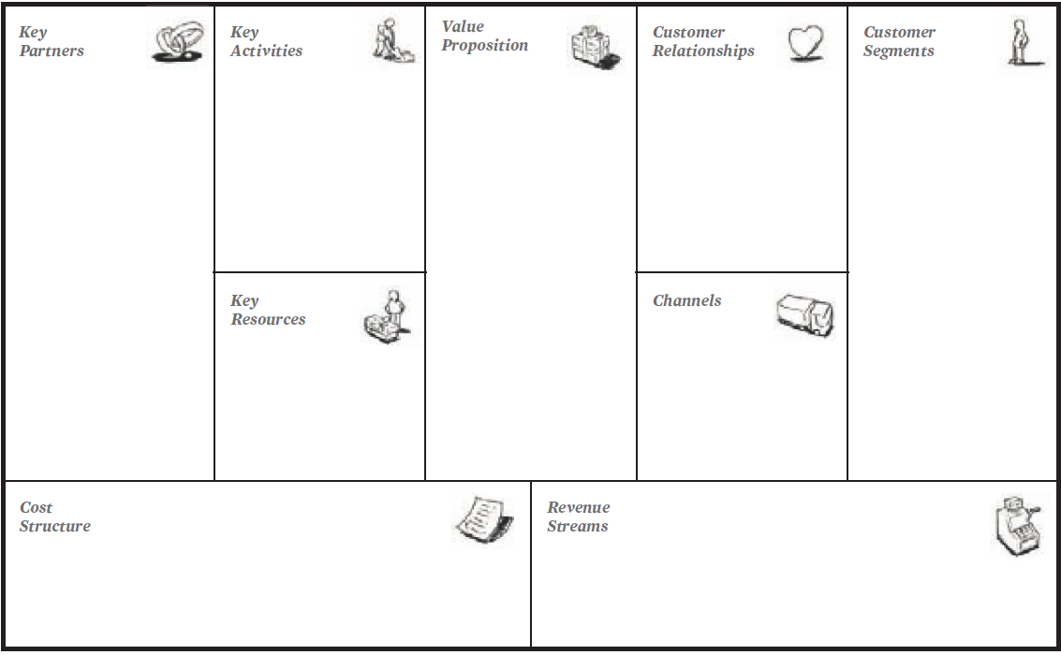
Business model - Canvas
The Business Model Canvas is a strategic management tool that helps entrepreneurs and businesses to visually map out their business model. It includes nine key building blocks, as shown in the righ.

Slide 9
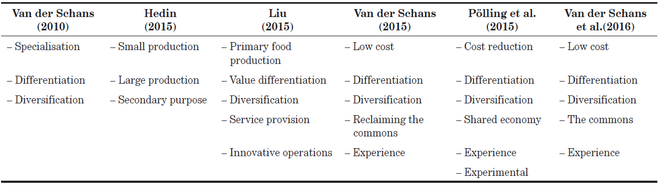
Business models for urban farming
the well-established business models mainly include ‘low-cost specialisation’, ‘differentiation’, and ‘diversification’. Examples can be found the in the course materials
Pölling et al., 2017

Slide 10
Basics of economic analysis
Ref: Turton, R., Bailie, R. C., Whiting, W. B., Shaeiwitz, J. A. (2008). Analysis, Synthesis, and Design of Chemical Processes. Pearson Education, Inc. Third Edition

Slide 11
Key concepts
Investment: An investment is an agreement between two parties, whereby one party, the investor, provides money, P (Principal or Present Value), to a second party, the producer, with the expectation that the producer will return money, F (Future Value), to the investor at some future specified date, where F > P. The amount of money earned from the investment is E=F-P.
Interest: Money paid regularly at a particular rate for the use of money lent, or for delaying the repayment of a debt. Two types of interest are used when calculating the future value of an investment.
  simple interest calculations, the amount of interest paid is based solely on the initial investment. Interest paid in any year = P*i_{s}. For an investment period of n years, the total interest paid = P*i_{s}*n. Total value of investment in n years: F_{n} = P + P*i_{s}*n.
  compound interest, an interest rate of i is also applied to the interest earned. Thus, for compound interest it can be written: F_{n}=P(1 + i)^{n}. If interest rates changing with time: F_{n}=P(1 + i₁) (1 + i₂) (1 + i₃)… (1 + i_{n})

Slide 12
Key concepts
Cash Flow Diagrams (CFD) Cash flow diagrams are visual representations of revenue and spending over a period of time.
  Discrete Cash Flow Diagram
  Cumulative Cash Flow Diagram
For example: a company invested 0,5M, 0,75M and 0,9M USD at the end of years 1, 2, and 3, respectively to build a plant. The lifetime of the plant is 10 years and the annualincome was 0,4M USD except the 1st year of operation, which was 0,3M USD. The discrete CFD is shown on the right
the cumulative CFD keeps a running total of the cash flows occurring in a project. For the same plant shown in the previous example, the cumulative CFD becomes

Slide 13
Key concepts
Inflation: Inflation measures how much more expensive a set of goods and services has become over a certain period, usually a year (IMF). Inflation is the rate of increase in prices over a given period of time.
Depreciation of Capital Investment: a reduction in the value of an asset with the passage of time, due in particular to wear and tear. There are a number of methods that accountants can use to depreciate capital assets. They include straight-line, declining balance, double-declining balance, sum-of-the-years' digits, and unit of production.
Taxation: Taxation is the imposition of compulsory levies on individuals or entities by governments in almost every country of the world.
Capital cost: Capital cost pertains to the costs associated with construction of a new process/plant or modifications to an existing process/plant. The capital cost must take into consideration many costs other than the purchased cost of the equipment.
Manufacturing costs: Manufacturing costs cover the costs associated with the day-to-day operation.

Slide 14
Marketing strategies

Slide 15
Market development strategies
Key strategies
  pricing - you could implement competitive price structures with offers and discounts or, to command a higher price, provide a product with more value than the competitor’s.
  distribution - you could develop new channels to reach target customers, eg sell online if you currently only have a 'brick and mortar' shop
  branding - you could create a new brand for products aiming to reach a target market or a specific customer segment.
  promotion - you could consider tailoring promotional messages to entice customers with offers, vouchers, loyalty schemes, etc
  sales - you could target a different demographic segment or type of customer to create new leads and opportunities.
  product development - you could alter an existing product or develop a new one for the untapped market

Slide 16
Some popular strategies
Geographic expansion
Upselling to existing customers
Attracting non-users
Attracting competitors’ customers
New Customer Segments
Product Modification
Strategic Alliances
New Sales Channels

Slide 17
How to start a vertical farming business
Ref: ISIFARMER. (n.d.). How to start vertical farming: a complete guide to build a vertical farming business. https://isifarmer.com/learn/how-to-start-vertical-farming

Slide 18
before set-up a vertical farm
Steps:
  Determine your goals
  Research supply and demand
  Regulations and permits
  Choose a location
  Choose your crops
  Choose the vertical farming equipment
  Time to calculate the costs
  Secure funding
  Set-up your farm

Slide 19
after set-up a vertical farm
Steps:
  Monitor plant growth
  Harvest and sell your products
  Analyze your data
  Continuously improve

Slide 20
Case studies of urban/vertical farming

Slide 21
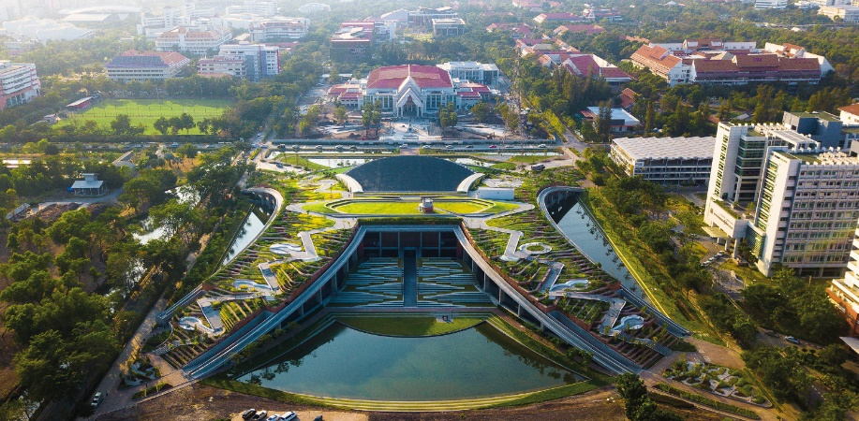
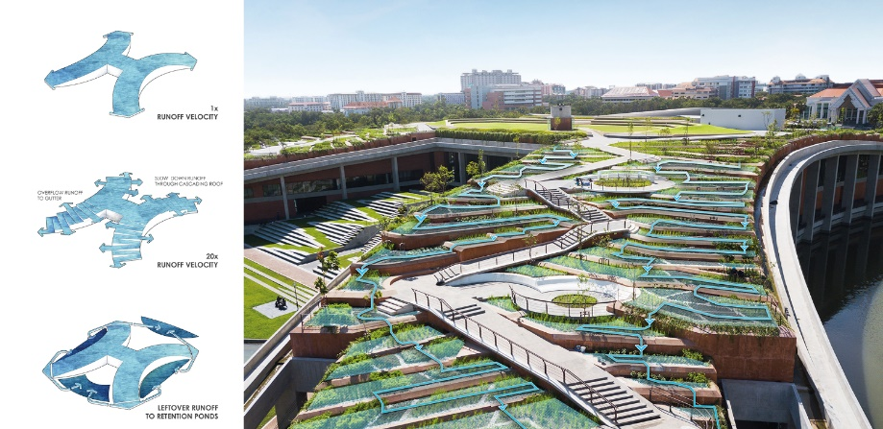
Thammasat University Urban Rooftop Farm (Greenroofs)
Designed by LANDPROCESS, the $31 million TURF incorporates sustainable food production, renewable energy, organic waste, water management and public space within its 22,000 square meters.
TURF grows more than 40 edible species, including rice, indigenous vegetables and herbs, and fruit trees.
The roof is equipped with solar panels, capable of producing up to 500,000 watts per hour to irrigate the urban farm from the retaining ponds and power the building beneath it.

Slide 22
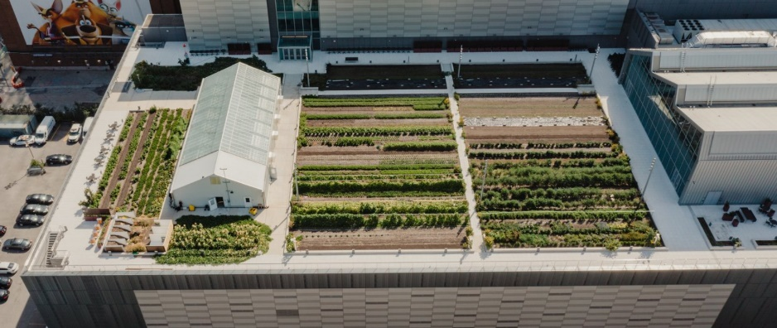
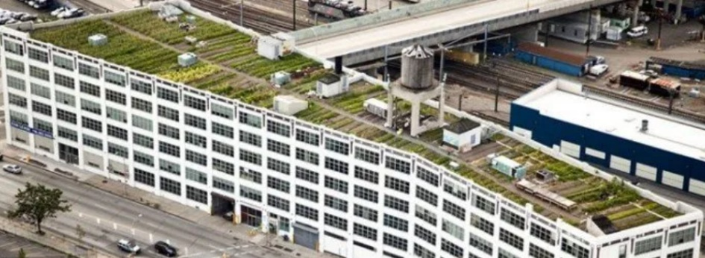
Brooklyn Grange Rooftop Farm (BROOKLYN GRANGE)
The farm's start-up budget was estimated to be $165,000 to get the farm up and running, later increased to $200,000 because the first farm site was over 4,000 square feet.
More than 30 types of organic fruits and vegetables are grown on the Brooklyn farm, with tomatoes being the dominant crop, and others such as peppers, kale, beets, cabbage, herbs, carrots, radishes, beans, and more. The farm produces about 50,000 pounds of organic food each year, which is commonly used to host visitors, sell, and serve CSA members and restaurants.
selling crops only accounts for 1/3 of their income, and the other two important profit channels are organising events and providing green roof design and construction services

Slide 23
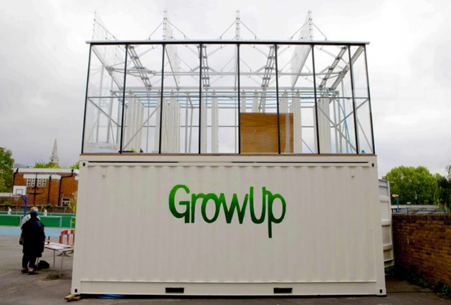
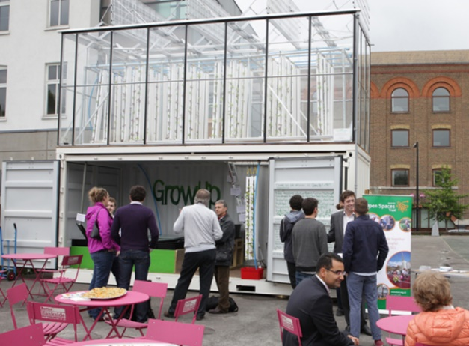
GrowUp’s Aquaponic Urban Farm (Designboom)
After successfully raising over £16,000 through a Kickstarter campaign, the team constructed their GrowUp Box from a reused shipping container that was modified to include a rooftop greenhouse.
With a footprint of only 14 square meters, the GrowUp Box can produce around 100 kilograms of fish and 400 kilograms of lettuce per year.
Part of a hybrid technology system called aquaponics in which methods of cultivating plants in water are synthesized with the practice of raising aquatic animals, the module is fitted with a rooftop greenhouse fed by the nutrient-rich wastewater from tilapia-filled fish tanks.

Slide 24
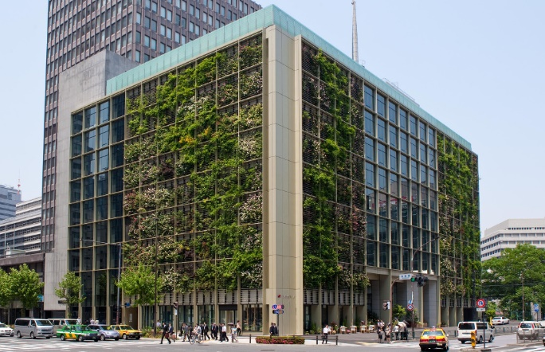
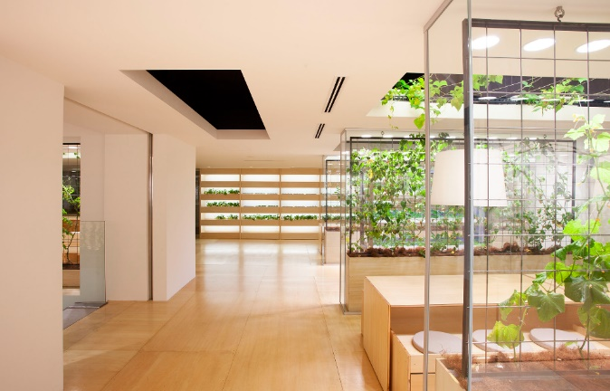
Pasona Urban Farm (Buczynski, 2013)
Throughout the office, vines, trees, plantar boxes and garden beds are a permanent fixture.
An intelligent climate control system monitors humidity, temperature and breeze to balance human comfort during office hours and crop growth after hours, maximising crop yield and annual harvest growth.
As crops harvested in Pasona headquarters are served within the building cafeterias, it highlights the ‘zero food’ mileage concept of a sustainable food distribution system that reduces energy and transportation costs.
Externally, a double-skin green façade features seasonal flowers and orange trees planted in shallow balconies, creating a living green wall and a dynamic identity to the public.

Slide 25
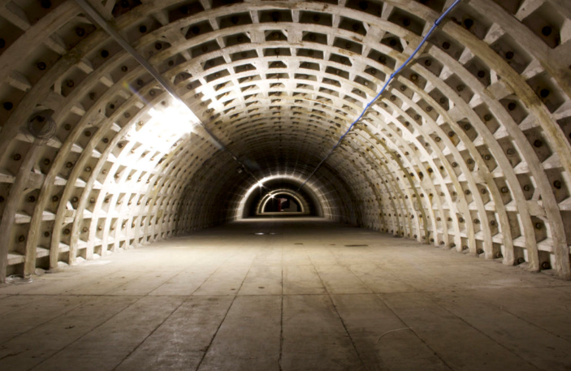
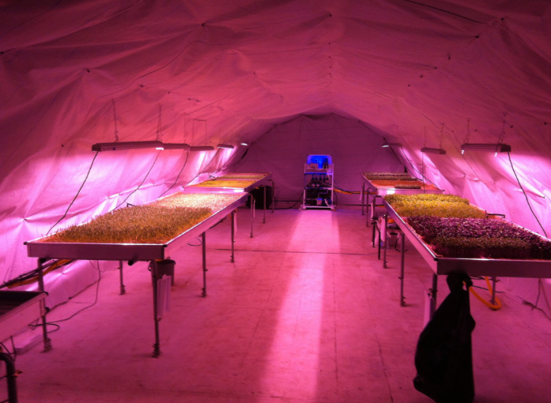
Growing Underground (Walsh, 2021)
the world’s first subterranean farm uses the latest hydroponic technology and LED lighting powered by renewable energy to produce fresh vegetables.
using 70% less water than your typical farming operation. They utilize a closed-loop ebb and flow system where water with nutrients floods the beds of sprouts a few times a day and then is recycled through a reservoir and reused. The plants float in a substrate made from recycled wool carpeting. Lights sit above the plants and are turned on and off to simulate daylight and night time.
By 2022, Growing Underground hopes to be producing over 60 tonnes of produce per year from a 528m2 area. That’s enough to meet the yearly lettuce consumption of 10,000 adults. The farm grows 12 times more per unit area than a traditional greenhouse grows in the UK but it also consumes four times more energy per unit area.

Slide 26
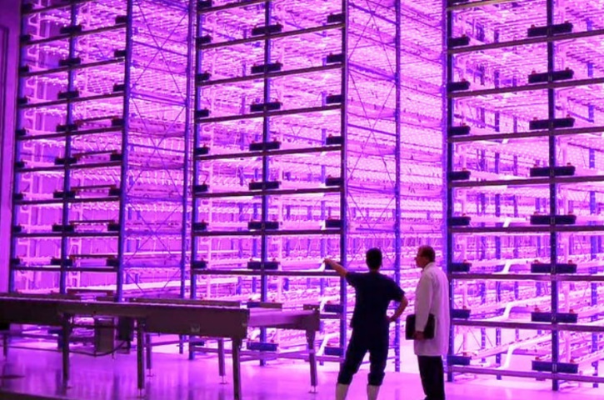
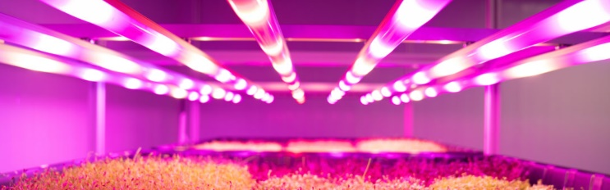
Pink Farm (Verticalfarm Daily)
Pink Farm has 750 square meters available for indoor production of all types of greens, such as lettuce, arugula, chard, spinach, basil, microgreens, among others.
The Pink Farms’ vertical farm produces about three tons per month and up to 130 times more food per square meter of soil. According to Maia, it generates savings of 95% of water and 60% of fertilizers per kilo produced. Bonus: the food is pesticide-free.
Their team works on how to automate specific crops on a large scale in a controlled environment. They have developed a sealed growing system in which there is no air exchange between the growing environment and the external environment.

Slide 27
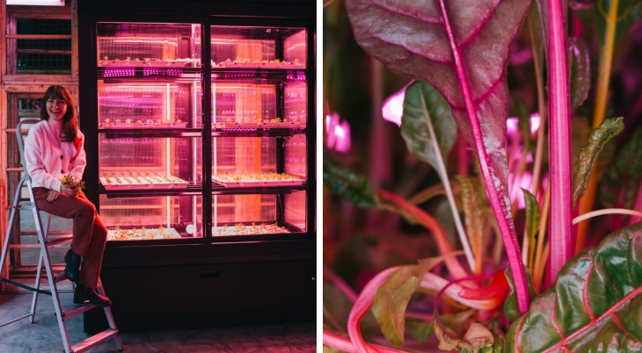
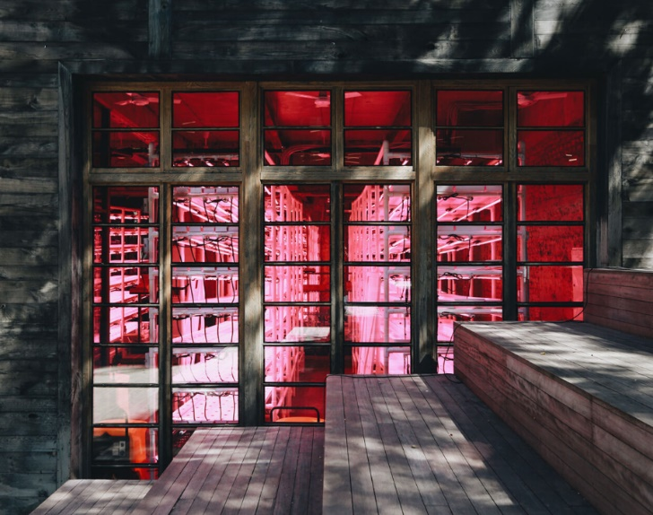
SpaceFarms (SpaceFarms)
SpaceFarms applies 75% less water than traditional farming.
Modular Farm Spots. The first prototype holds two square meters and can regularly produce 15-20 kg of crops per month, regardless of the season, year-round. Crops are grown without pesticides or herbicides with minimal human labor and low utility expenses
Using Precise Heating, Ventilation, and Air Conditioning (HVAC Systems), they have full control over the environment where the micro and leafy greens grow. By managing CO2 emission, water recycling, nutrient intake, temperature and humidity sensors, lighting brightness, and intensity, they create perfect conditions for nurturing fresh, 100% pesticides free, high-quality produce.

Slide 28


