Slide 2
Course: HEI-D4 Module: Controlled Environmental Agriculture Learning Unit:Challenges and Solutions
Author: MDU

Slide 3
Summary
Introduction to Control Environmental Agriculture (CEA)
Methods for Indoor Agriculture
Challenges and Opportunities of CEAs
Environmental Control Systems and its components
Sustainability in CEAs
Case Studies
Conclusions

Slide 4
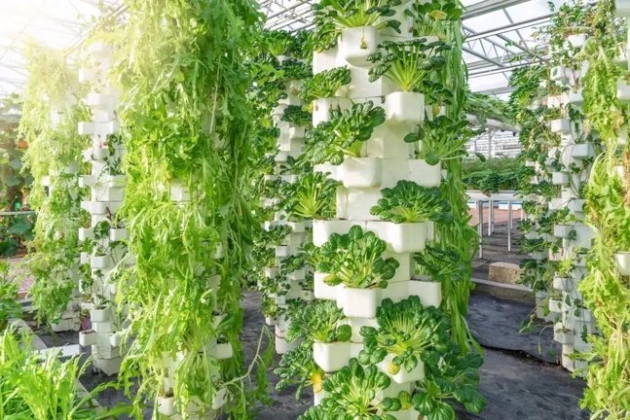
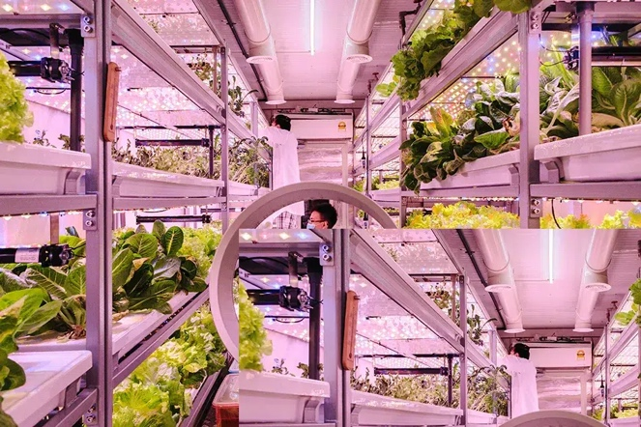
Introduction to Control Environmental Agriculture
Controle environmental agriculture (CEA)
Growing crops indoors in closed environments
Precise control over environmental factors like
Crops grow in structures instead of in the groud
Allows a wide variety of plant species to achieve growth rates year-round
Constant monitoring and manipulation of environmental factors enrure ideal conditions for growth
Examples of vertical farming in controlled environment agriculture in greenhouses (top) and climate-controlled rooms (bottom) (Source: Earth.org, 2022)

Slide 5
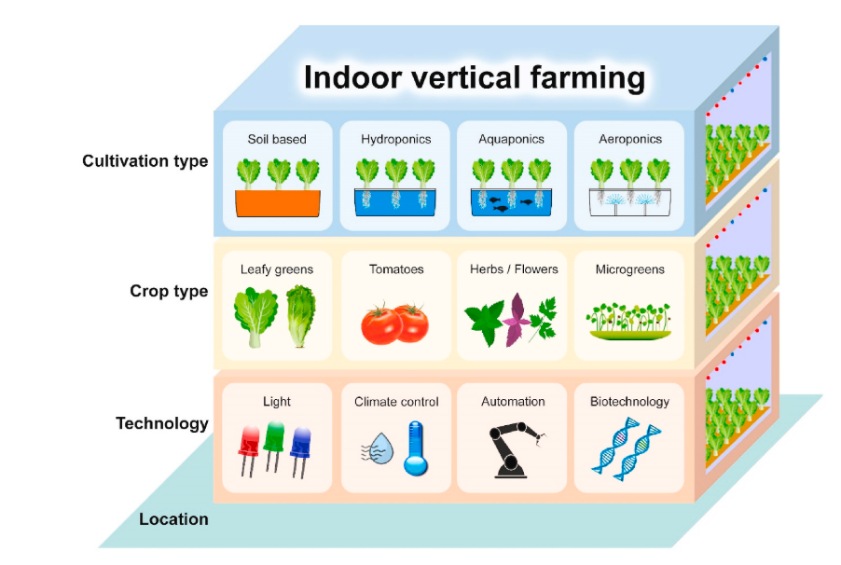
Introduction to Control Environmental Agriculture
There are four main farming methods for indoor agriculture:
Soil-based
Hydroponics
Aquaponics and
Aeroponics
Different types of indoor vertical farming for food production in a controlled environment (Source: Wong et al. 2020).

Slide 6
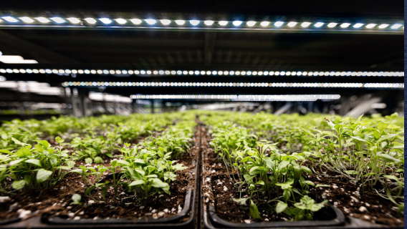
Methods for indoor agriculture
Soil-based
Soil is the primary source of essencial nutrients for plants
Plants cultivated in trays with soil
Advantages:
Effective moisture retention
Natural aeration
Soil can be reused for multiple crop cycles with proper fertilization
Challenges
Requires expertise in
Soil type
Fertilization
Pest control
Soil-based indoor agriculture (Source: economic Allience 2022)

Slide 7
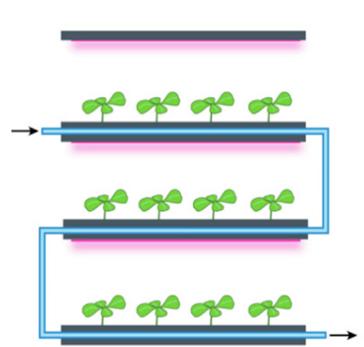
Methods for indoor agriculture
Hydroponics
Cultivation of plants in nutrient-enrich water
Plants are not supported by soil but by inert growing media like cocopeat
Nutrient-rich water circulate through the root system
Close-loop process minimize waste
Advantages:
Reduced water loss through evaporation, conserving water
Precise control of nutrients delivery
Healthier plants and higher crop yields
Schematic representation of a hydroponic systems in vertical farms (Source: Saad et al., 2021 )

Slide 8
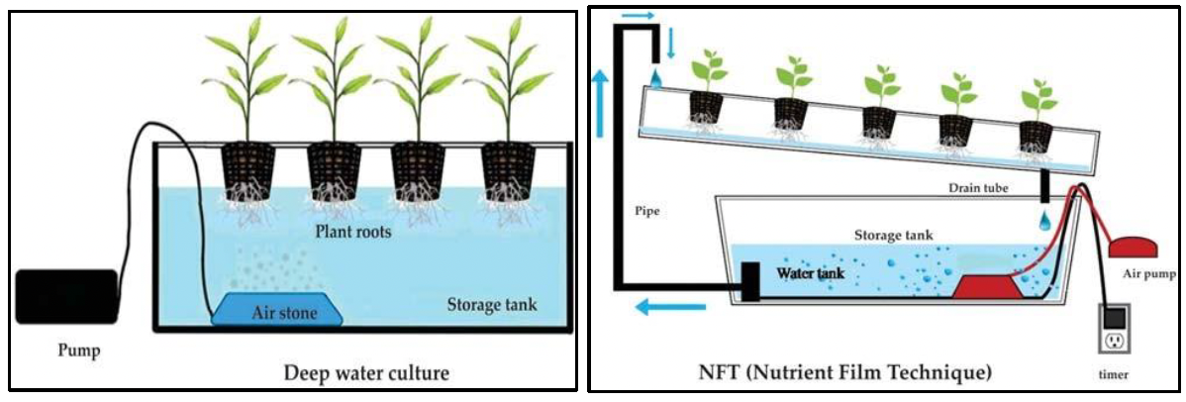
Methods for indoor agriculture - Hydroponics
Diagram of various structures of hydroponic systems (Source: Salim Mir et at. 2022 )

Slide 9
Methods for indoor agriculture
Aquaculture and Aquaponics
Cultivation of plants in nutrient-enrich water
Plants are not supported by soil but by inert growing media like cocopeat
Nutrient-rich water circulate through the root system
Close-loop process minimize waste
Advantages:
Reduced water loss through evaporation, conserving water
Precise control of nutrients delivery
Healthier plants and higher crop yields

Slide 10
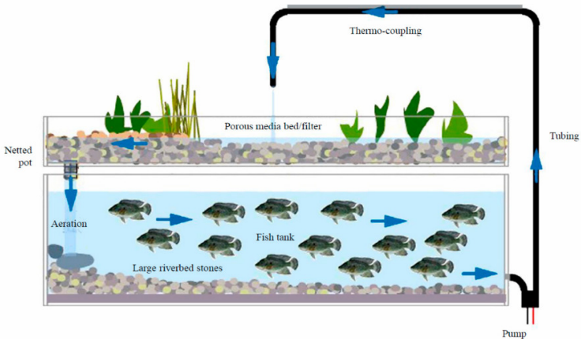
Methods for indoor agriculture - Aquaponics
Schematic representation of a model of aquaponics (Source: Barui et al., 2021)

Slide 11
Methods for indoor agriculture
Aquaculture
Cultivating aquatic organisms under controlled conditions
Includes fish, crustaceans, and aquatic photosynthetic organisms
Aquaponics
Cultivation method fostering a symbiotic relationship between fish and plants
Symbiosis achiever through fertigation (fertilization and irrigation)
Nutrient-rich waste from fish tank enriches hydroponic production beds
Process
Nurient-rich water undergoes filtration and converion of toxic ammonia into nutrient-rich nitrate
Plants absorb nutrients and purify wastewater before returning to fish tank
Plants consume fishe´s CO₂
Water in fish tanks absorbs heat

Slide 12
Challenges and Opportunities of CEA
 | Opportunities | Challenges
Energy Savings | Efficient light control Creative energu-scaving solutions | Increased energy costs Air conditioning requirements
Water demand | Reduction in water demand Recycling and purification techniques Conversion of wasetewater into drinking water | Logistical challenges in water transport
Productivity per unit area | Year-round, multi-cropproduction Increased crop yield | Limitations on plant varieties suitable for vertical farming Difficulty in quantifying space efficiency
Recycling of organic waste | Effective harnessing of nutrients and organic waste from wastewater
Healthy food provison | Fresh and locally produced foods Products unaffected by polluted soils or irrigated water | Social acceptance
Environmental opportunities and challenges of vertical farming(Source: Kalantari et al. 2018)

Slide 13
Challenges and Opportunities of CEA
 | Opportunities | Challenges
Initial costs | Proper site selection to maximise return on investment | High initial costs
Energy costs | Implementation of strategies to reduce costs: (i) utilizing building waste and (ii) integration into building energy system | High energy costs mainly due to artificial lighting
Economic growth and food prices | Integration into urban economies Transformation of urban spaces into agricultural centers | Initial labour shortage Lack of economic analysis
Economic l opportunities and challenges of vertical farming(Source: Kalantari et al. 2018 and. Barui et al. 2021)

Slide 14
Environmental Control SYstems
Efficient food production systems with minimal environmental impact are crucial for sustainable practices and circular economy.
CEA utilizes environmental control systems to automatically adapt growing conditions. Mimicking natural habitats for
Year-round cultivation
Fast growth
High yields
Reduced resource consumption
Promote sustainable and circular food production

Slide 15
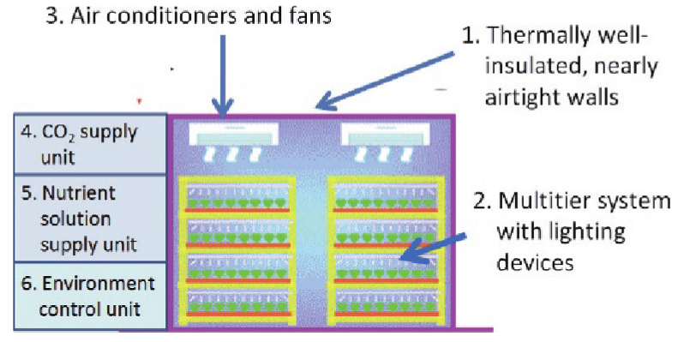
Components of Environmental Control Systems
Light control Systems
Light cannot be optimize by itself
Delicate balance between light, temperature and humidity for otimal growth
Interconnected effects requires a control system that can optimize all the three parameters
LED lights offer tunable spectra
Schematic representation of the six principal components of a CEA (Source: Kozai et al. 2015)

Slide 16
Components of Environmental Control Systems
Air quality
Proper ventilation and air circulation to prevent mold and ensure uniform temperature and humidity
Efficient ventilation systemsand CO2 enrichment promotes photosynthesis
Irrigation System
Effective control prevent crop infectionand minimizes water and nutrient wastage
Key factors:
electrical conductivity
pH
Dissolved oxygen levels
Nutrient solution

Slide 17
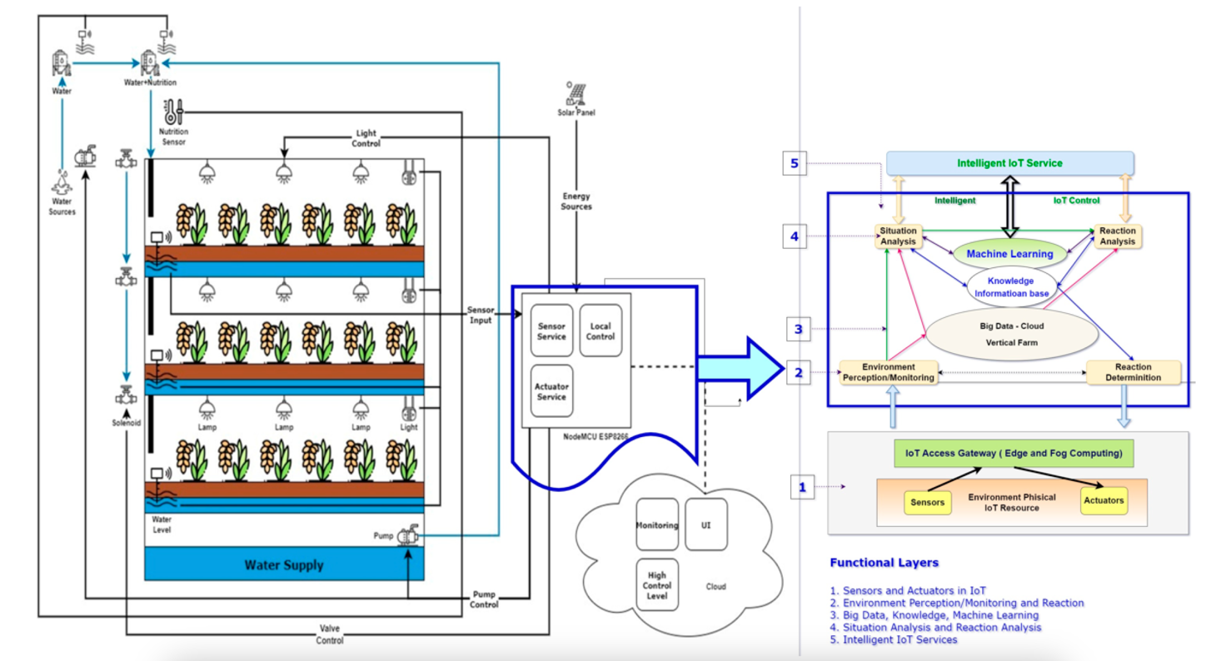
Smart Vertical Farming – integration of IoT
Schematic representation of a conceptiual architecture of Smart Vertical farming (Source: Siregar et al. 2022)

Slide 18
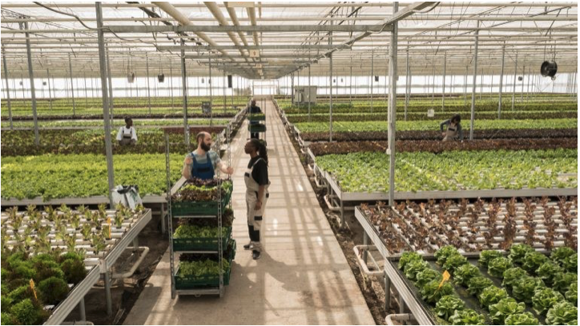
Sustainability in CEA
While CEA may not solve all environmental issues, it offers significant potential as a viable alternative to conventional agriculture
CEA offers a sustainable solution to modern food prodction challenges
saves resources, in particular water
Efficient irrigation systems
Operates year-round
Maximizes space efficiency
Reduces needs for long-distance transportation (minimization of food waste)
Contributes to circular economy
Recycling materials
Harnessing rainwater
Producing energy
(Source: LinkedIn.com)

Slide 19
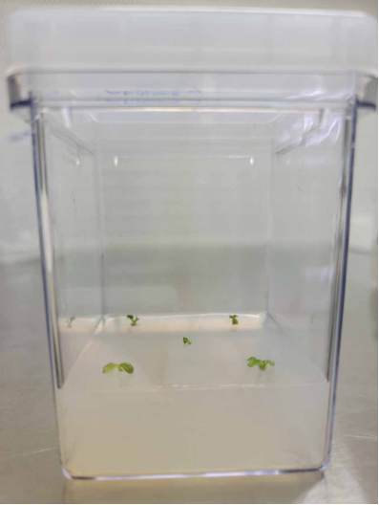
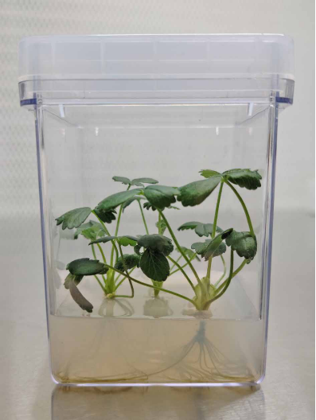
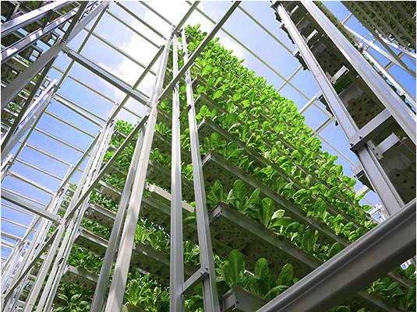
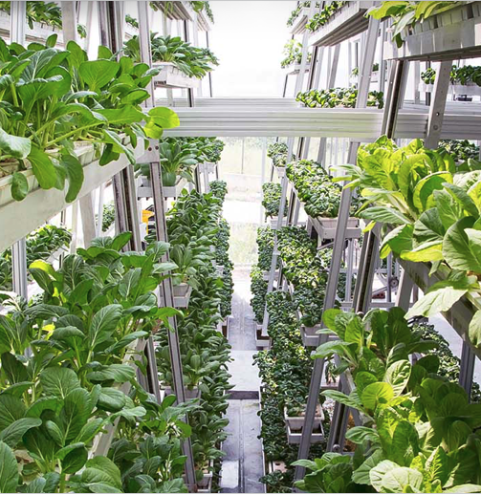
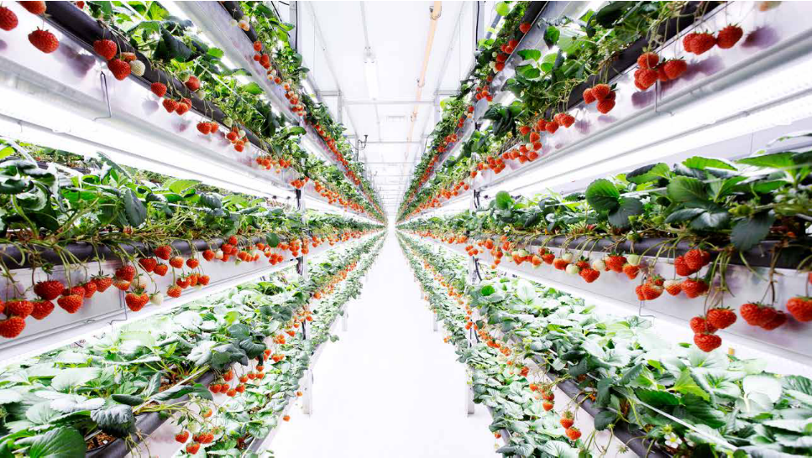
Case Studies
Aerofarms
Nordic Harvest (lasgest vertical farm in Europe)
Sky Green (Singapore)
Oishii farm (pioneer company)

Slide 20
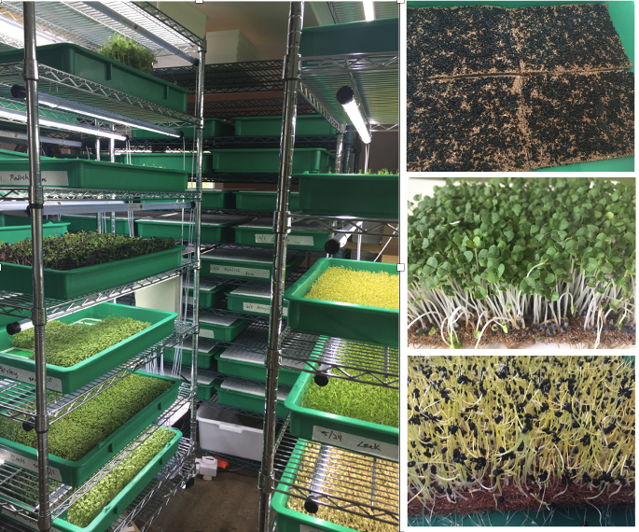
Case Studies
Gotham Greens
Green Spirits Farms
The Plant

Slide 21
Conclusions
Significant advancement in sustainable agriculture have been achieved through innovative yechniques loke hydroponics, aquaculture and aeroponics
Indoor farming options increasingly adopted by companies and growers, offering alternative ways to produce plant goods in urban areas
Environmental control systems crucial for indoor farming, enabling optimaöl conditions for plant growth by optimizing temperature, humidity, light and nutrient delivery
Initial setup costs and energy requirements can be substantial, but technology advancements and ongoing research are making methods more efficient and cost-effectiveI
Indoor farming offers solutions to challenges associated with conventional farming

