Slide 2
Course: HE Module: Horizontal Skills Learning Unit: Soft Skills
Authors: (CESIE & OTC)

Slide 3
Content
Interpersonal and effective communication
What is effective communication?
Verbal and non-verbal communication
Effective speaking and active listening
Barriers to communication

Slide 4
Interpersonal and effective communication
INTERPERSONAL COMMUNICATION
EFFECTIVE COMMUNICATION
exchange of information, ideas, thoughts, and feelings between individuals
the ability to convey a message in a clear, concise, and impactful manner
Definition
the context of personal relationships, whether they are professional or personal in nature
both interpersonal and broader organizational or public communication contexts
Scope
the successful transmission of information or ideas, ensuring that the message is delivered and received as intended
building relationships and maintaining the quality of interactions
Focus

Slide 5
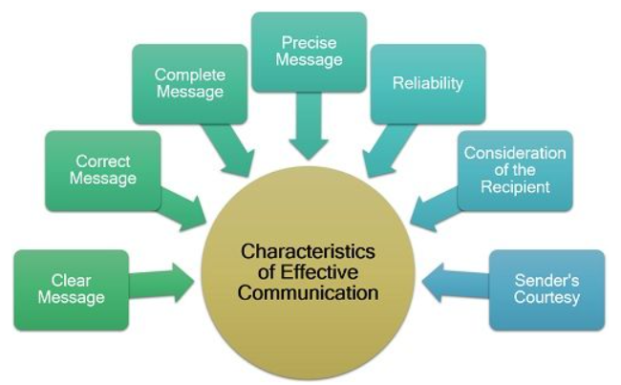
What is effective communication?
The process of conveying information or ideas in a way that is understood, and the intended message is successfully delivered and received.
Crucial skill in both personal and professional contexts.
It encompasses the nuanced interplay of language, tone, body language, and context.
ULTIMATE GOAL
To convey a message with precision and to elicit the desired response or action from the receiver.
(Source: theinvestorsbook)

Slide 6
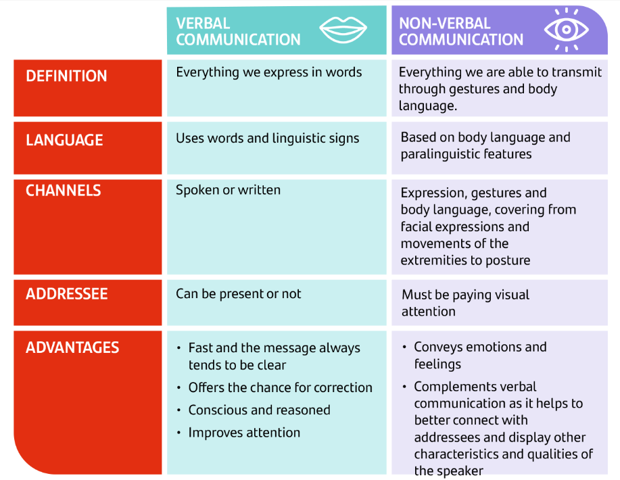
Verbal and non-verbal communication
Two distinct yet intertwined forms of human interaction that collectively shape our ability to convey messages, emotions, and intentions effectively.
Verbal Communication is the use of spoken or written words to convey messages. It's the linguistic component of communication, encompassing not only the words themselves but also their structure, tone, and context.
Non-verbal Communication, on the other hand, encompasses all forms of communication without the use of words. It includes body language, facial expressions, eye contact and even silence.
(Source: Santander)

Slide 7
Main differences between verbal and non-verbal communication
Basis | Verbal Communication | Non-verbal Communication
Use of words | Use of oral or written words | Other than oral or written words
Types | Oral and written | Facial expression, body movement and posture, gestures, eye contact, touch, space, but also visual, audio, audio-visual, etc
Understanding | Easy | Comparatively difficult
Structure | Well structured | Lacks in formal structure
Distortion of information | Less possible | Highly possible
Feedback | Less and delayed feedback | Gives a lot of feedback

Slide 8
Practical Activity #1
Group discussion
Think of a moment where you bargain with your boss for a promotion, or a decrease in prices to your supplier etc.
What was the first reaction of your boss, supplier etc?
What his/her body language signaled to you?
What was the final outcome ?(did you achieved what you initial asked for?)

Slide 9
Effective speaking and active listening
Speaking and listening are two fundamental components of human communication that enable individuals to exchange ideas, information, emotions, and experiences. These two complementary skills are essential for effective and meaningful interactions in both personal and professional contexts. Effective speakers are often effective listeners as well because they understand the importance of receiving feedback and adjusting their communication style accordingly.
(Source: thriveglobal)

Slide 10
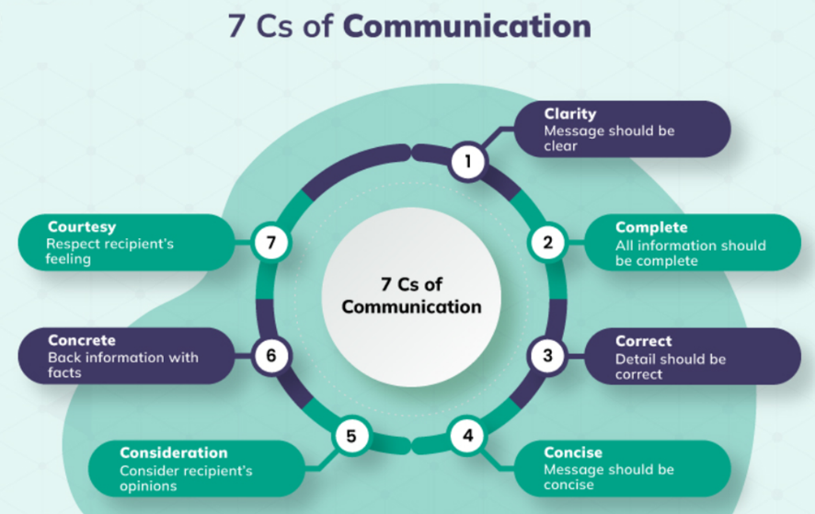
Effective speaking
The act of conveying thoughts, ideas, and messages through spoken words.
To be an effective speaker, however, the mere use of the language is not enough. Effective speaking, in fact, involves a higher level of skill and mastery in conveying messages, engaging an audience, and achieving desired outcomes.
It is characterized by clarity, coherence, and the ability to engage and connect with the audience using various strategies and techniques.
It entails the use of both Verbal and Non-verbal communication
The 7 Cs for effective communication (Source: Crowjack)

Slide 11
Active listening
The skill of actively receiving, processing, and interpreting spoken or non-verbal messages from others.
Dynamic and intentional form of listening that goes beyond merely hearing words and sounds.
It involves engaging with the speaker in a way that demonstrates attentiveness, empathy, and a genuine interest in understanding their message and perspective.
Main active listening skills (Source: Firstpracticemanagement)

Slide 12
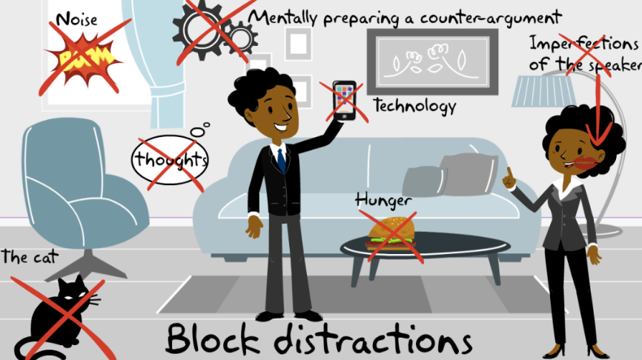
Active listening
Active listeners give the speaker their full attention, minimizing distractions, such as putting away electronic devices and maintaining eye contact.
They use non-verbal cues (Example: nodding to show they are following the conversation or smiling to convey warmth and encouragement) to signal their engagement and use verbal affirmations (Example: "I see," "I understand," or "Tell me more") to acknowledge the speaker's message and emotions.
(Source: autonomousLearner)

Slide 13
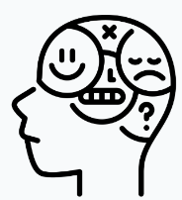
Barriers to communication
They are obstacles that impede the effective exchange of information, ideas, or emotions between individuals or groups:
Physical barriers: external factors that hinder effective communication. These barriers can be related to the environment, distance, noise, or even technological limitations.
Example: Imagine you're in a large conference room with a group of colleagues for an important meeting. The room has poor acoustics, and there's construction noise from outside. The physical barrier in this context is the noisy environment, making it challenging to hear and understand what others are saying.
Psychological barriers are related to individuals' mental states, including emotions, biases, preconceptions, and cognitive limitations that hinder their ability to listen and communicate effectively.
Example: Suppose you're a manager conducting performance evaluations. You have a negative perception of one of your team members based on a past mistake. During the evaluation, your preconceived bias against them affects your ability to objectively assess their performance, resulting in a less constructive conversation.

Slide 14
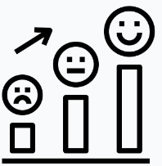
Barriers to communication
They are obstacles that impede the effective exchange of information, ideas, or emotions between individuals or groups:
Emotional barriers involve intense emotions, such as anger, fear, or stress, that can disrupt communication by clouding judgment, triggering defensive responses, or preventing effective expression of thoughts and feelings.
Example: Imagine a couple engaged in an emotional argument. One partner is furious due to a perceived slight, and the other is overwhelmed with guilt. These intense emotions can make it difficult for either person to express themselves calmly and rationally, hindering effective communication.
Psychological barriers are related to individuals' mental states, including emotions, biases, preconceptions, and cognitive limitations that hinder their ability to listen and communicate effectively.
Example: Suppose you're a manager conducting performance evaluations. You have a negative perception of one of your team members based on a past mistake. During the evaluation, your preconceived bias against them affects your ability to objectively assess their performance, resulting in a less constructive conversation.

Slide 15
Practical Activity #2
Role Playing
One of the learners is partner A and another one is partner B.
Partner A (speaker) will share something with partner B related to his/her job that is passionate about
Partner B (listener) will do everything impossible to ignore the speaker.
Take 90 seconds to do so
What were the feelings of both partners?
Then change the roles, partner B will be the speaker and partner A will be the listener.
The listener should listen to the story of the speaker like it is the most wonderful amazing thing he/she have ever heard in his/her job
Take 90 seconds to do so What are your thoughts and feelings at the second time?

Slide 18
Content
Critical components of Leadership in Agriculture
The role of emotional intelligence (EQ)
Different leadership styles

Slide 19
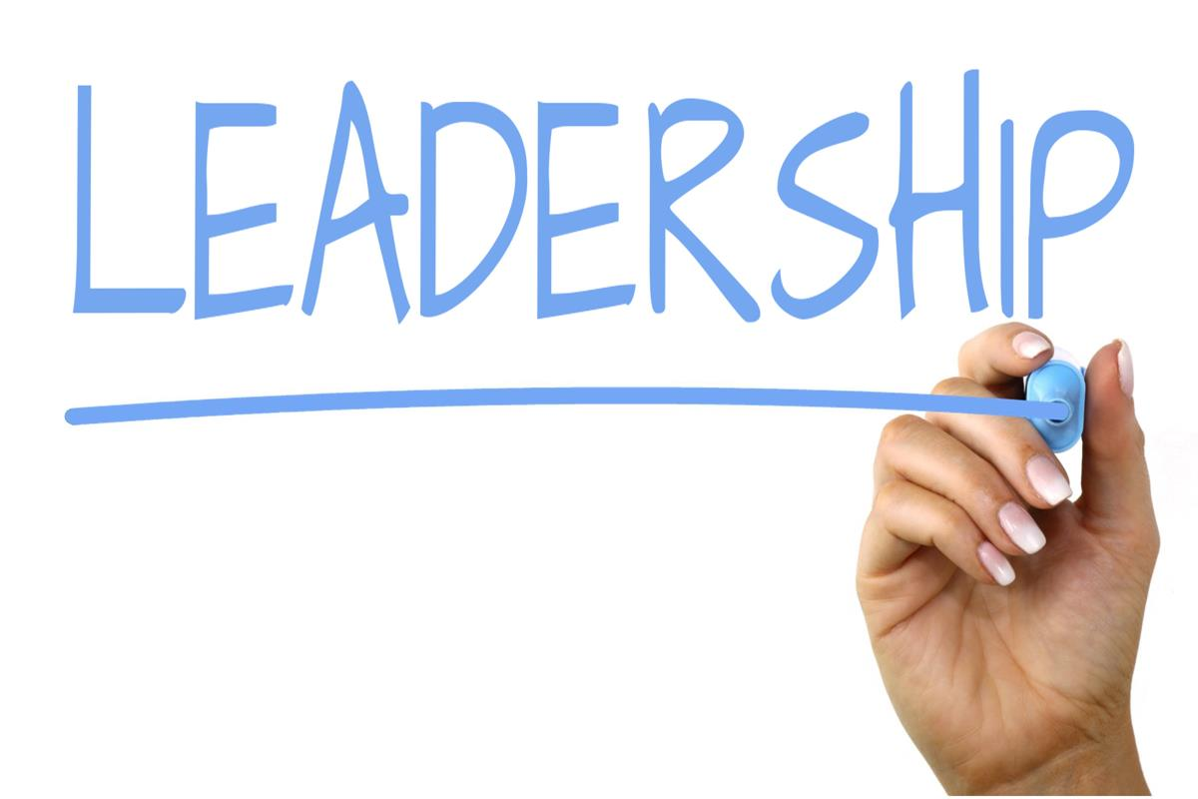
Leadership in agriculture
Leadership in agriculture involves understanding the complexity of the bioeconomy, environmental sustainability and socioeconomic factors that influence rural communities.
It requires:
Innovation
Adaptability
Ability to manage technological advances
Ability to promote sustainable practices
Within the agricultural context Leaders are supposed to respond to environmental challenges and market fluctuations
This Photo by Unknown Author is licensed under CC BY-SA

Slide 20
The role of Emotional Intelligence to Leadership
Emotional Intelligence is defined as the ability to perceive, understand, manage and use emotions effectively in oneself and others (Mayer & Salovey, 1997).
Εmotional awareness can have a significant impact on
Team dynamics,
Decision making, and
Community relations.
Emotional Intelligence Source

Slide 21
The Four pillars of Emotional Intelligence
Self awareness in Leadership
Self-awareness involves understanding one's emotions, strengths, weaknesses, values, and impact on others. It is particularly vital in the agricultural sector, where leaders must navigate complex, often unpredictable environments.
Self-Regulation and Motivation
Self-regulation refers to the ability to control or redirect disruptive emotions and impulses, while motivation involves being driven to achieve results for the sake of achieving results
Empathy in Agricultural Leadership
Empathy involves understanding and sharing the feelings of others, a skill that is essential for effective communication, team building, and conflict resolution in the agricultural sector.
Social Skills for effective communication
Social skills in leadership include effective communication, team building, conflict resolution, and the ability to inspire and influence others

Slide 22
Key characteristics of effective leader in general
Advocates the vision of the organisation, has strategic thinking, recognizes the importance and pursues financial sustainability, works to defend the interests and achieve the objectives of the organisation
Engages in continuous empowerment and encouragement of human resources, which aims at active participation of all, continuous improvement of the organization's operations and the products/services produced.
Has an intuitive approach which is particularly useful in times of uncertainty and insecurity.
Has an understanding of the strengths and weaknesses of each individual and/or team and/or the organisation he/she leads.
Possesses values consistent with those of the organisation, including respect for all members of the organisation, regardless of their position, and promotes the principle of trust and honesty.
Motivates, inspires and contributes to the personal development of the organization’s staff

Slide 23
Key skills of effective leader in general
Has analytical skills, can analyse a situation in depth, identify causes and effects
Possesses human (or alternatively soft) skills, which contribute to understanding human behaviour and the ability to guide, and improve behaviour within the organisation
Understands the wider social enterprise environment, promotes innovation and has creative thinking skills.
Distinguished for his/her self-awareness, adaptability and ambition.
Has interpersonal communication and collaboration skills

Slide 24
Practical Activity #3
Think of two managers/ leaders/ supervisors/ Agribusiness owners in your working environment, who represent two different “schools of leadership”. The first one represents a leader with high levels of EQ and the second one, a strong personality with high levels of IQ but clearly perceived low levels of EQ.
What were the relationships of each one with their subordinates and /or various key stakeholders? What was the climate in the working environment? Were their workers motivated and committed? After answering the abovementioned questions, please reflect the extent to which EQ or its absence in leadership signifies the Agribusiness’s success.

Slide 25
Leadership styles
The Leadership styles followed in a business affects its course in time, success, and effectiveness by enhancing employees’ involvement, improving levels of innovation, creating higher revenues, and contributing positively to its financial performance
In the farming context, the leadership styles to be analyzed are the following:.
Transactional leadership style:
It focuses on the exchange between leaders and followers, often involving a system of rewards and penalties. This style can be effective in structured environments such as agricultural organizations with clear goals and tasks.
This style involves setting clear expectations, establishing goals, and rewarding or correcting behaviour as necessary. Transactional leaders focus on contingent rewards and corrective actions to ensure that followers meet established standards and goals.
Source

Slide 26
Leadership styles
2. Transformational style:
It involves inspiring and motivating followers to achieve more than originally intended. This style is especially relevant in agriculture, where leaders often must drive innovation and change.
Leaders who practice this style often exhibit charisma, vision, intellectual stimulation, and individualized consideration to empower their followers to exceed expectations and transform their attitudes and perspectives.
source
3. Servant Leadership:
It emphasizes the leader's role as a servant first, prioritizing the needs of others, including employees and community members. This approach can be particularly effective in community-oriented agricultural settings.
It involves serving others with empathy, humility, and a commitment to their well-being and development. The key idea is that by prioritizing the needs of their team members, leaders can foster a supportive environment that encourages personal and professional growth.
Source

Slide 27
Practical Activity #4
Group Discussion
Taking into account your experience with an agribusiness, as well as its specific characteristics (number of employees, region of establishment, network of stakeholders etc) describe which of the previous mentioned leadership styles could be appropriate for this business.

Slide 29
Content
Teamwork and Collaboration skills
Their role in business success
Effective teams and their characteristics
Setting common goals
Conflict resolution

Slide 30
Teamwork and Collaboration skills
Set of abilities and attributes that enable individuals to work effectively with others to achieve common goals and solve problems.
Important skills in both personal and professional contexts.
Teamwork combines the individual efforts of all team members to achieve a goal, is usually overseen by a team leader and those within a team are delegated individual tasks to contribute towards the team’s end goal.
Collaboration implies that people complete a project collectively, work together as equals - usually without a leader - to come up with ideas or make decisions together to achieve a goal.

Slide 31
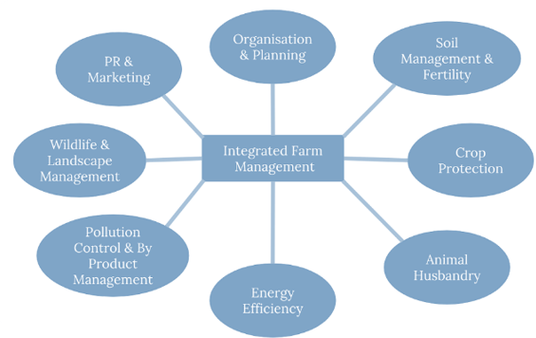
Their role in business success
“Two heads are better than one" couldn't be more relevant! Teamwork and collaboration have in fact emerged as the cornerstone of success for businesses.
In businesses like farms that consist of individuals with varying skill sets, experiences, and knowledge, Teamwork creates a platform where this diversity can be harnessed for the greater good.
The five steps of the negotiation analysis (Source: Penn State University)

Slide 32
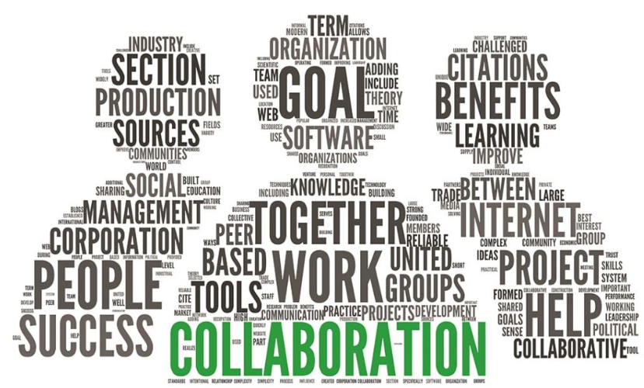
Their role in business success
When minds from different backgrounds converge, new ideas blossom and innovative solutions to key problems emerge, eventually enhancing creativity and innovation.
In farming, where factors like unpredictable weather patterns and market fluctuations can make or break a season, collaboration is the key respond to crises, pool resources during tough times, and strategize for long-term resilience.
The five steps of the negotiation analysis (Source: mbiseattle)

Slide 33
Effective teams and their characteristics
Building effective teams is not just a desirable trait but a fundamental necessity for achieving success.
They require a thoughtful approach that considers both individual qualities and the dynamics of group collaboration, while providing a framework for harnessing the diverse talents, skills, and experiences of individuals to collectively achieve goals that would be unattainable for a single person.
To this aim, it is necessary to define clear and specific goals as well as to assign roles and responsibilities based on individual strengths and expertise, always considering the opportunity to form teams with members who bring diverse skills, backgrounds and perspectives.
T
E
A
M
TOGETHER
EVERYONE
ACHIEVES
MORE

Slide 34
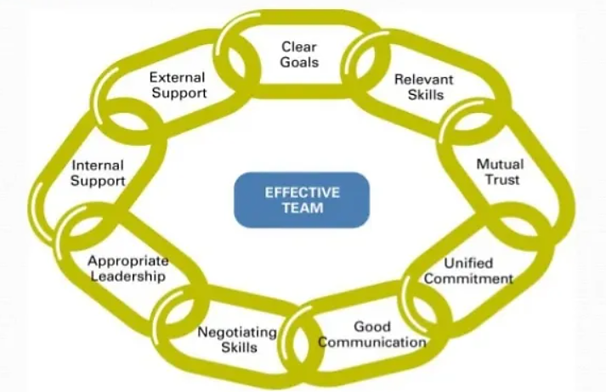
Effective teams and their characteristics
The fundamental characteristics of effective teams are:
The fundamental characteristics of effective teams (Source: CareerCliff)

Slide 35
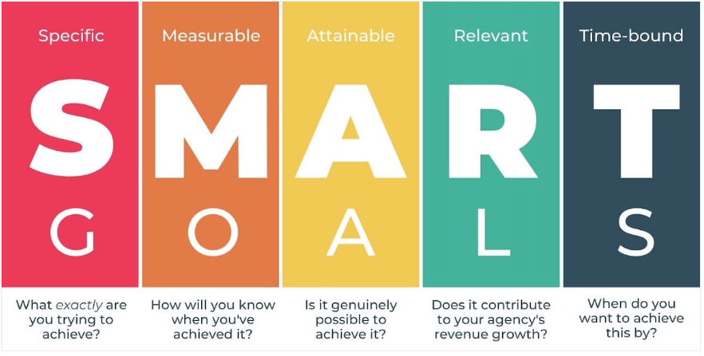
Effective teams and their characteristics
A fundamental aspect of team success, as it provides a shared direction and purpose for all team members:
It aligns the diverse talents, experiences, and energies of individuals within a team, transforming a group of people into a cohesive unit, working together in harmony towards a single destination.
The fundamental characteristics of effective teams (Source: coachcounselcare)

Slide 36
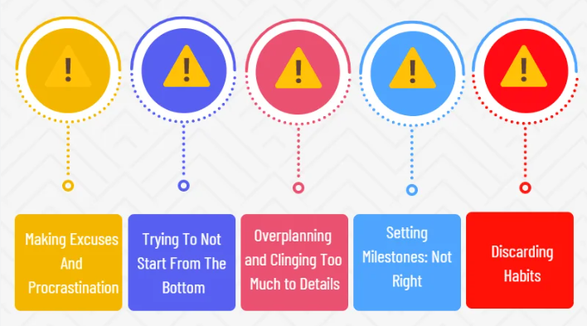
Effective teams and their characteristics
However, there is always the possibility to make mistakes when trying to set common goals. The most common ones are:
The most common mistakes when setting common goals (Source: Projectcubicle)

Slide 37
Practical Activity #5
Group Activity
Team working and collaboration skills
Module: Horizontal skills / Learning Unit: Soft skills / Sub-Unit: Teamworking and collaboration skills

Slide 38
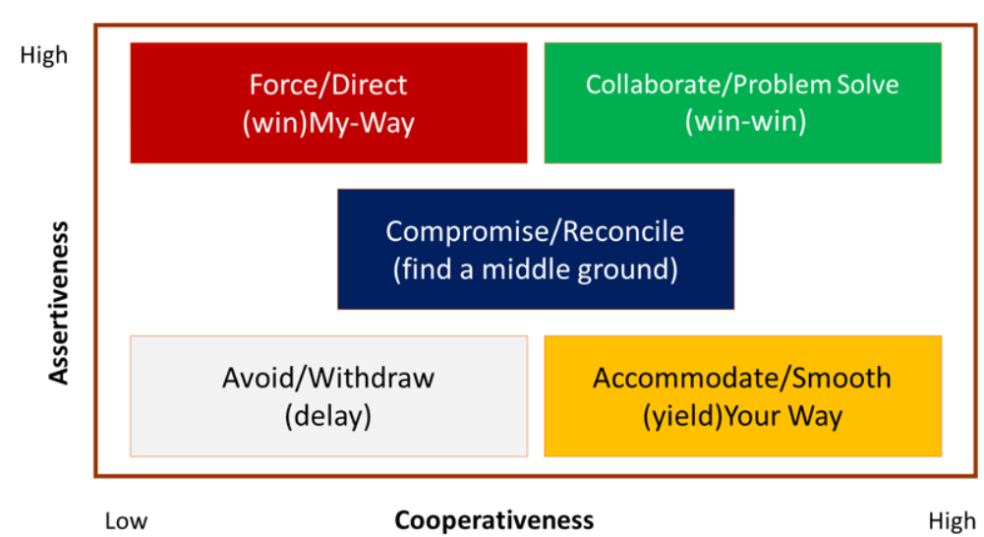
Conflict resolution
Critical aspect of teamwork, as it addresses inevitable disagreements and tensions that arise when individuals with different perspectives, backgrounds, and priorities collaborate.
It is not the presence of conflict that defines the fate of a team; rather, it is the way those conflicts are handled and resolved that truly matters
There are 5 different approaches to conflict resolution:
Avoiding
Competing
Collaborating
Accommodating
Compromising
The fundamental characteristics of effective teams (Source: cmbankng)

Slide 39
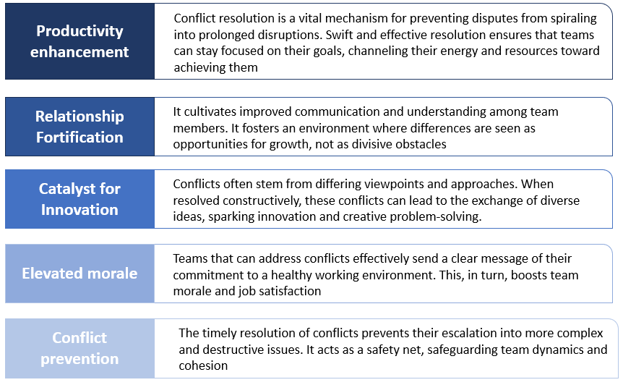
Conflict resolution
If properly managed, conflict resolution can lead to multiple benefits:
The fundamental characteristics of effective teams (Source: Own elaboration)

Slide 40
Practical Activity #6
Group Discussion
Remember a time when you were in the middle of a conflict at work. How did the manager behave? What were the steps that he undertook so as to resolve the situation? Was it effective? If not, what he/she should have done differently? Please elaborate.

Slide 41
Content
Introduction to Agile Thinking
The pillars of an agile mindset

Slide 42
Introduction to Agile Thinking
Agile thinking is a mindset and approach to problem-solving that emphasizes adaptability, collaboration, and responsiveness to change. It involves the capacity to liberate oneself from traditional decision-making and problem-solving habits. Instead, it relies on more impactful mindsets like creativity, collaboration, and a scientific approach to analysis.
Benefits for cultivating Agile thinking:
Adapt to changing conditions.
Optimize their decision making.
Better understand the customers’ and the market’s needs
Better collaborate with each other by sharing experiences and knowhow.
Promote Innovation and experimentation.
Seek for their continuous development
source

Slide 43
Characteristics of an Agile mindset
People with agile mindset:
Are adaptive to change
See obstacles as opportunities for innovation
View challenges as a process to grow through
Are constantly on the lookout to improve efficiency and effectiveness as well as simplify processes
Are continuously curious, therefore enjoy learning and aren’t afraid of asking questions
Are outcome orientated, thereby exercising discipline and consequently are not easily distracted once focused on a task
Are resourceful
Are empathetic and respectful
Are able to see things from different perspectives within a single context
Value collaboration

Slide 44
Key pillars of an Agile mindset
Creativity
Proficient creative thinking skills involving strategic planning, envisioning, and forecasting to cultivate novel perspectives and distinctive insights
Adaptability
The ability to adapt and flourish in dynamic business landscapes
Collaboration
Effective collaboration skills enabling the identification of risks and engagement in in-depth problem-solving
Critical Thinking
Outstanding critical thinking capabilities encompassing inquiry, analysis, clarification, and verification to question assumptions and unveil overlooked aspects

Slide 45
Practical Activity #7
Group Discussion
Please watch the following video and answer to the questions.
How to Use Lateral Thinking & Generate Brilliant Ideas
Do you consider yourself as a lateral thinker?
Describe a situation where you had to think out of the box.
Did it work? Please elaborate.

Slide 46
Content
Accountability
Ethical behaviour and communication
Responsible Leadership

Slide 47
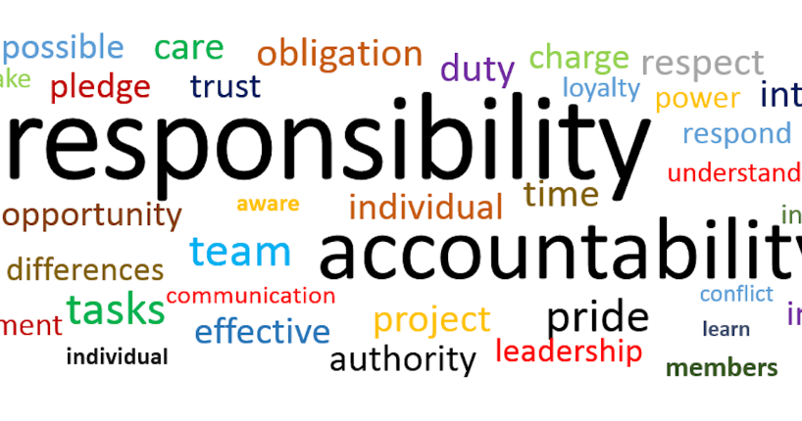
Accountability
“the responsibility and answerability of individuals, organizations, or institutions for their actions, decisions, and outcomes” (Sergeeva, 2021)
Accountability vs responsibility
focuses on the results / outcomes of an action vs remains simply on the completion of tasks
This Photo by Unknown Author is licensed under CC BY-ND

Slide 48
5 key principles of Accountability
Clear understanding of role
Answerability
Active participation and compliance
Ability to make reasonable decisions
Ability to handle criticism

Slide 49
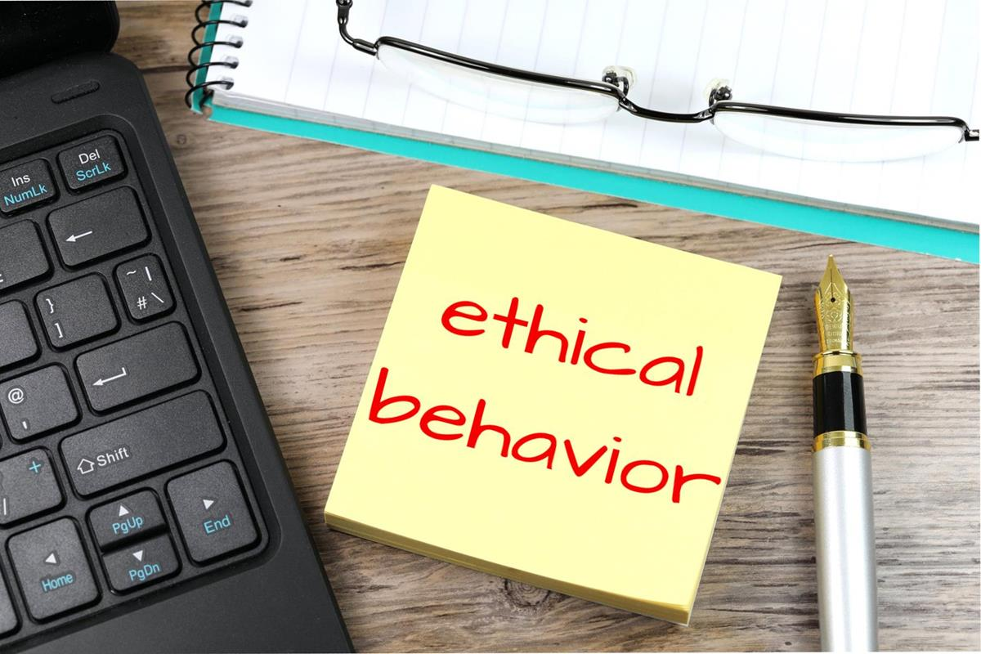
Ethical Behaviour
“a set of rules or principles that defines right and wrong conduct” (Robbins et al, 2012)
Ethical behaviour refers to actions and conduct that align with accepted principles and standards of morality, integrity, and fairness (Peek, 2023).
honesty, transparency, loyalty, responsibility and respect
This Photo by Unknown Author is licensed under CC BY-SA

Slide 50
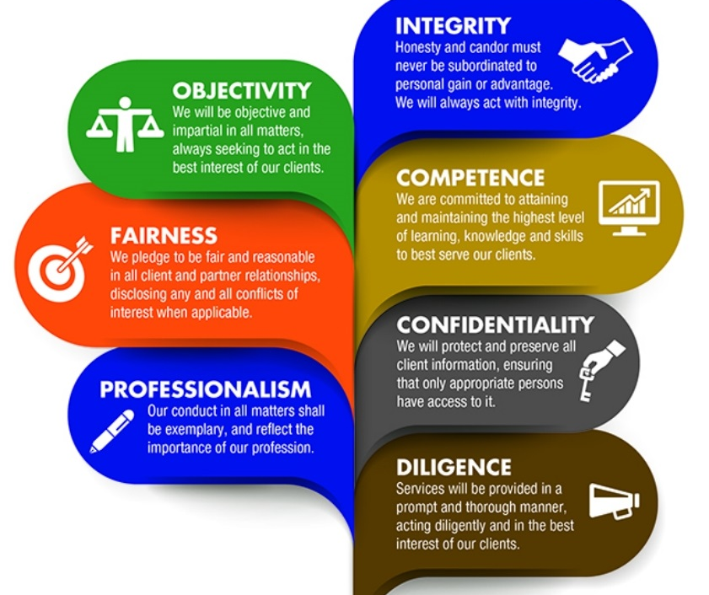
Code of ethics
It is “a guide of principles designed to help professionals conduct business honestly and with integrity” (Hayes, 2023). Within this document the vision, the principles and values of the organization are determined, while common issues related to ethics are analyzed such as employer-employee relations, discrimination, environmental issues, social responsibility
source

Slide 51
Ethical Communication
Ethical Communication Principles
Be truthful and honest
Active Listening
Speak non-judgmentally
Speak from your own experience
Consider the receiver’s preferred communication channel
Strive to understand
Avoid a negative tone
Do not interrupt others
Respect privacy and confidentiality
Accept responsibility
“a discipline of analyzing what is right and wrong in the realm of communication” (Kvalnes, 2023)”
source

Slide 52
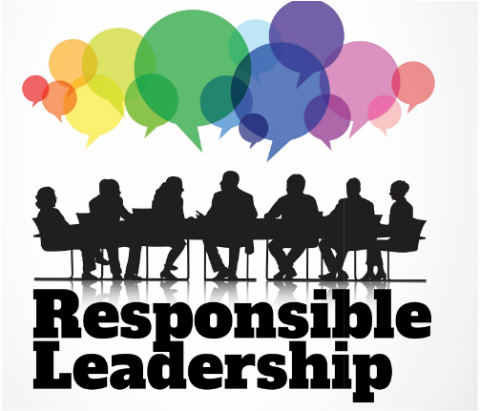
Responsible Leadership
“embodies an approach to leadership that gives precedence to ethical decision-making, sustainability, and social responsibility (Sahar et al., 2023).
The primary objective of responsible leaders is to generate enduring value not only for their organizations but also for society as a whole
It focuses on sustainable values and fostering positive changes, both environmentally and socially
source

Slide 53
Key elements of Responsible Leadership
Ethical decision-making that adheres to high ethical standards and is fully aligned with principles as honesty, integrity, and fairness
Sustainability minimizing the environmental impact of organizations, promoting resource efficiency, and contributing to the well-being of future generations
Stakeholder Engagement where responsible leaders seek to understand and address the diverse needs and concerns of various stakeholders
Transparency & Accountability entails open communication with stakeholders and taking responsibility for the leaders’ actions, both successes, and failures
Corporate Social Responsibility which actively contributes to social and environmental causes beyond the core business activities

Slide 54
Practical Activity #8
Group Discussion
Please provide examples of social responsibility within the agricultural sector.

Slide 55
Practical Activity #9
Group Exercise
Separate in teams of 5 persons. Each team should have a specific subject to discuss with regard to ethical dilemmas. Possible subjects are the following:
Find a method to minimize the time that you as farmers need for cultivating vegetables
Provide solutions for minimizing the costs of the fertilizers
Provide solutions for selling the goods produced during the previous period.
After deciding the subject that the team will undertake, write down as many solutions as you can regarding the subject. Then discuss which of them are ethical and which are not and the terms upon which you counter this ethicality. At the end, each team will present its results and discuss the provided solutions with the rest of the teams.

Slide 56
Content
Professional Development
Self-awareness and Self management

Slide 57
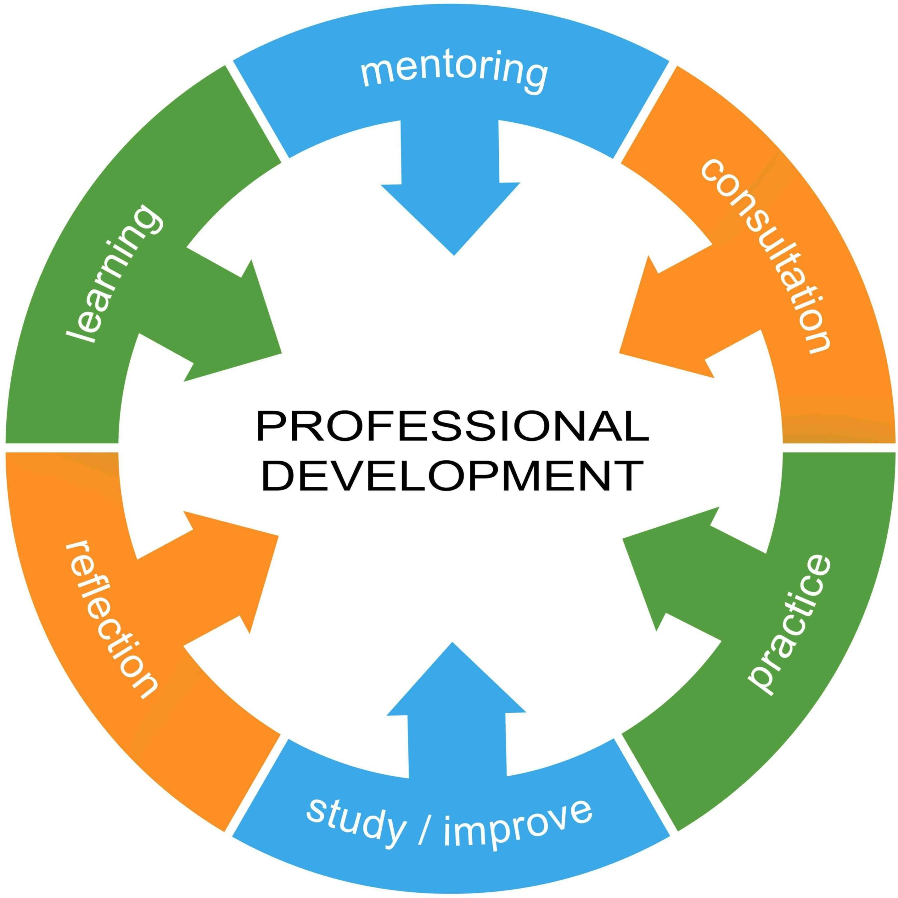
The role of Professional Development
"the process of improving and increasing capabilities of staff through access to education and training opportunities in the workplace, through outside organizations, or through watching others perform the job."
It encompasses a wide range of activities, including:
workshops,
seminars,
conferences,
formal education,
mentoring,
networking, and
self-directed learning
This Photo by Unknown Author is licensed under CC BY-NC-ND

Slide 58
Why farmers should pursue their professional development (1/2)
Technological Advancements: The field of agriculture is continuously evolving with the introduction of new technologies, precision farming techniques, and sustainable practices
Adaptation to Changing Conditions: Agricultural professionals often face challenges such as climate variability, market fluctuations, and regulatory changes
Sustainable Practices: With a growing emphasis on sustainability in agriculture, professional development provides insights into environmentally friendly practices, resource management, and sustainable farming techniques
Market Dynamics: Understanding market trends, consumer preferences, and global trade dynamics is essential for professionals in agriculture

Slide 59
Why farmers should pursue their professional development (2/2)
Networking and Collaboration: Professional development events provide opportunities for networking and collaboration
Policy and Regulation Compliance: Professionals in agriculture need to stay informed about changes in policies and regulations that impact their work.
Improved Productivity and Efficiency: Continuous learning and skill enhancement contribute to improved productivity and efficiency in agricultural operations.

Slide 60
Self- awareness and Self- management
Self- awareness
“the ability to focus on yourself and how your actions, thoughts or feelings align or do not align with your internal patterns. If you have high self-awareness, you can objectively evaluate yourself, manage your emotions, align your behavior with your values, and correctly understand how others perceive you.” (Duval & Wicklund, 1972)
It is distinguished in internal and external self- awareness
Self – management
“an individual's ability to take responsibility for and control over his/her own actions, behaviors, and decisions”(Munro, 2016).
It is a multidimensional skill set (including time management, emotional regulation, and goal setting, personal accountability, continuous improvement) that contributes to overall effectiveness and well-being.
Both constitute the key personal qualities that one should possess in order to take ownership of his/her own personal development.

