Slide 2
Course: HE Module: Horizontal Skills Learning Unit: Green Skills
Authors: CESIE & OTC

Slide 3
Content
The concept of Sustainability and its three pillars
Green Economy
Circular Economy
Bioeconomy

Slide 4
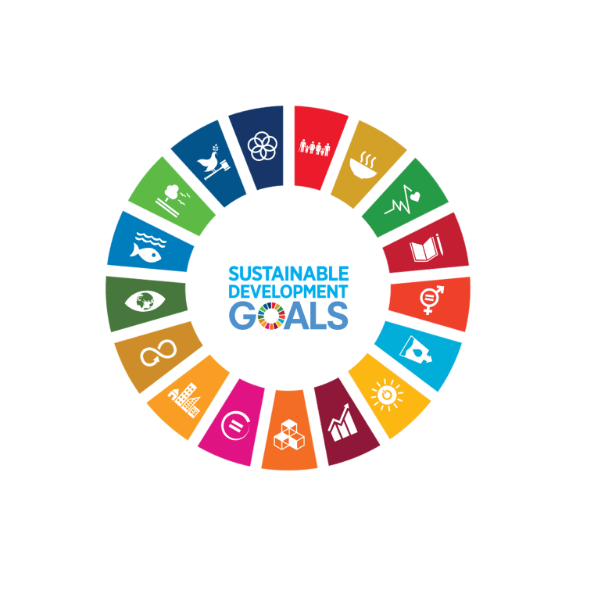
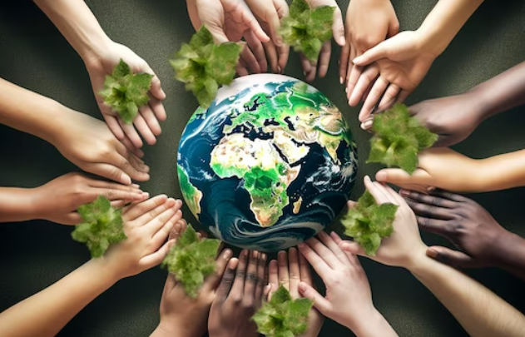
The concept of Sustainability
It is the practice of using resources in a way that preserves the environment, supports societal well-being, and ensures economic viability.
It is a concept which is global in scope, timeless, reflects an ongoing process and includes a moral responsibility for equity and justice.
One framework for incorporating sustainability into daily actions is the 2030 United Nations Agenda and its 17 Sustainable Development Goals (SDGs) set out to achieve a greener, more prosperous, and more equitable world by 2030.

Slide 5
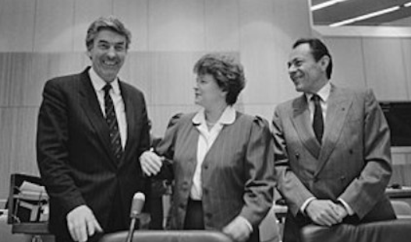
The concept of Sustainability
“Meeting the needs of the present without compromising the ability of future generations to meet their own needs”
The Brundtland Commission (1987)
(Source: IISD, 2017)

Slide 6
The three pillars of Sustainability
Although sustainability is linked to the environmental movement, the notion that it is only focused on the environment is a misconception. Sustainability is in fact based on three dimensions:
Environmental Sustainability focuses on preserving the planet's natural systems and resources, ensuring they are not depleted or irreparably damaged by human activities.
Social Sustainability focuses on creating equitable, just, and inclusive societies where all individuals have access to basic needs, rights, and opportunities for personal growth and well-being.
Economic Sustainability is the ability of human communities around the world to maintain their independence and have access to the resources required to meet their needs, meaning that secure sources of livelihood are available to everyone.

Slide 7
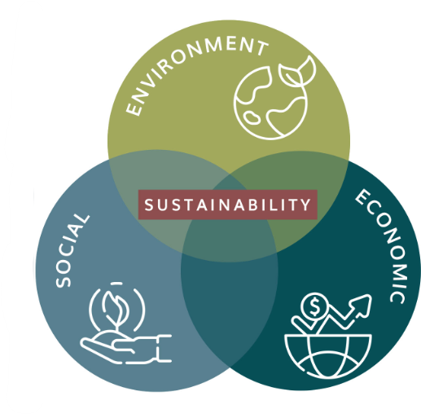
The three pillars of Sustainability: examples
Organic farming practices emphasize environmental sustainability by minimizing the use of synthetic pesticides and fertilizers. Instead, they focus on natural methods of pest control and soil enrichment.
Community-Supported Agriculture (CSA) programs connect local farmers with consumers in their community. People buy "shares" of the farm's produce in advance and receive regular deliveries of fresh, seasonal produce.
Sustainable farming practices contribute to economic sustainability by using technology and data to optimize resource use, reducing costs for farmers or improving soil health, eventually leading to higher yields over time and economic benefits.

Slide 8
Green Economy
It is an economic system that aims to achieve sustainable development by promoting activities and industries that reduce environmental risks and minimize resource depletion.
From policymakers crafting visionary legislation to businesses adopting sustainable practices and individuals making conscious choices in their daily lives, everyone has a stake in the transition to a Green Economy.
Besides sustainability, it is founded on a set of guiding principles that drive its vision and implementation.

Slide 9
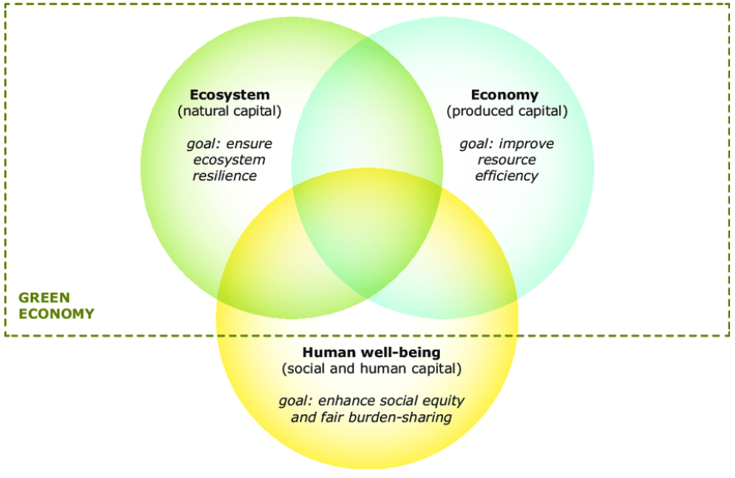
Green Economy: the three guiding principles
(Source: EEA, 2018)

Slide 10
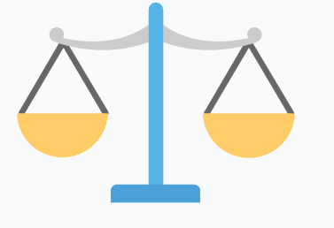
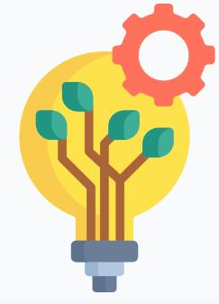
Green Economy
Equity: the fair distribution of benefits, resources, and opportunities among all members of society. It underscores the importance of ensuring that vulnerable and marginalized populations have access to resources, opportunities, and protections.
Example: policies might be designed to ensure that clean and affordable energy is accessible to all, regardless of income.
Efficiency: the optimal utilization of resources to minimize waste and environmental impact while saving costs. In a Green Economy, industries and businesses are encouraged to adopt resource-efficient practices and technologies.
Example: Industries might implement processes that reduce energy consumption, lower water usage, and minimize material waste. Efficiency not only conserves resources but also often leads to cost savings and increased competitiveness.
Innovation: the development and adoption of new technologies, processes, and ideas that contribute to environmental sustainability based on finding solutions to complex challenges.
Example: Innovative green technologies such as advanced solar panels, energy-efficient appliances, and electric vehicles are vital for reducing greenhouse gas emissions and promoting sustainable practices.

Slide 11
Practical Activity #1
Group Discussion
In your opinion, what distinguishes a green economy from a traditional, non-sustainable economy?

Slide 12
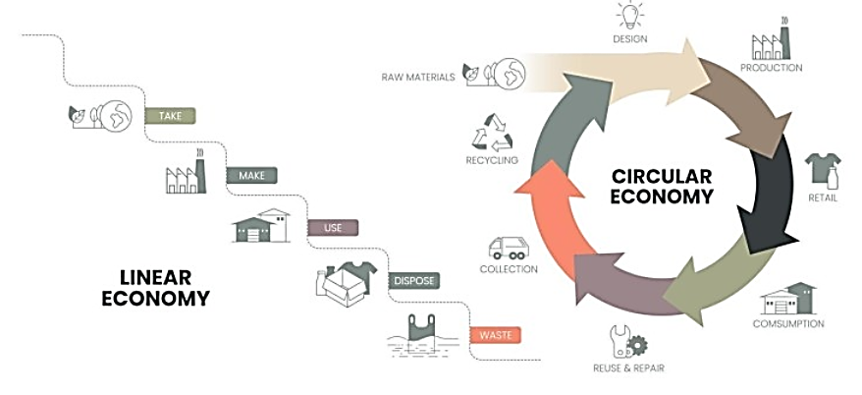
Circular Economy
It is an economic system designed to minimize waste and make the most of resources.
Unlike the traditional linear economy, which follows a "take, make, dispose" pattern, a circular economy aims to keep products, components, and materials at their highest utility and value for as long as possible, reducing waste and environmental impact.
(Source: Caroline Macdonald, 2022)

Slide 13
Circular Economy
Design for Sustainability: creating products, systems, and services with a clear understanding of their environmental and social impacts from the outset, considering the entire lifecycle of a product.
Example: sustainable packaging designs, such as using reusable or biodegradable materials.
Preserve and Extend Product Life: instead of opting for discarding a product at the slightest malfunction or trend shift, reducing the frequency of replacements and waste, conserving resources and reduces waste.
Example: second-hand markets allow used products to find new homes and uses.

Slide 14
Circular Economy
Rethink Waste as a Resource: shifting from a linear "end of life" concept to a valuable input for new products, processes, or energy generation, extracting value from materials and products at the end of their initial use cycle and closing the loop on material flows, reduce landfilling and maximize resource recovery.
Example: food waste is collected and processed through anaerobic digestion to produce biogas, a renewable energy source.
Promote Sustainable Consumption: encouraging individuals and businesses to make informed choices that reduce resource consumption, minimize waste, and prioritize long-term well-being over short-term gains.
Example: some innovative farms are adopting zero-waste principles, where they aim to utilize every part of the plants or animals by respectively composting crop residues and utilizing animal byproducts.

Slide 15
Practical Activity #2
Group Discussions
Please provide examples of circular economy practices in your daily life or within your organization

Slide 16
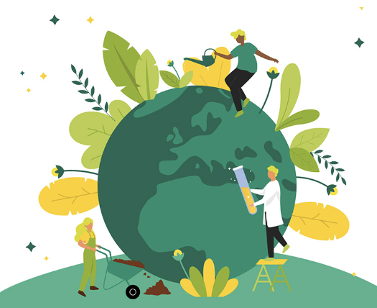
Bioeconomy
It is an economic system where biological resources, processes, and principles are used to provide sustainable solutions to pressing global challenges through their conversion into valuable products.
It applies to various sectors, such as agriculture and forestry, biotechnology and pharmaceuticals, food and beverage, energy as well as waste management.
The benefits of a Sustainable and Circular Bioeconomy are:

Slide 17
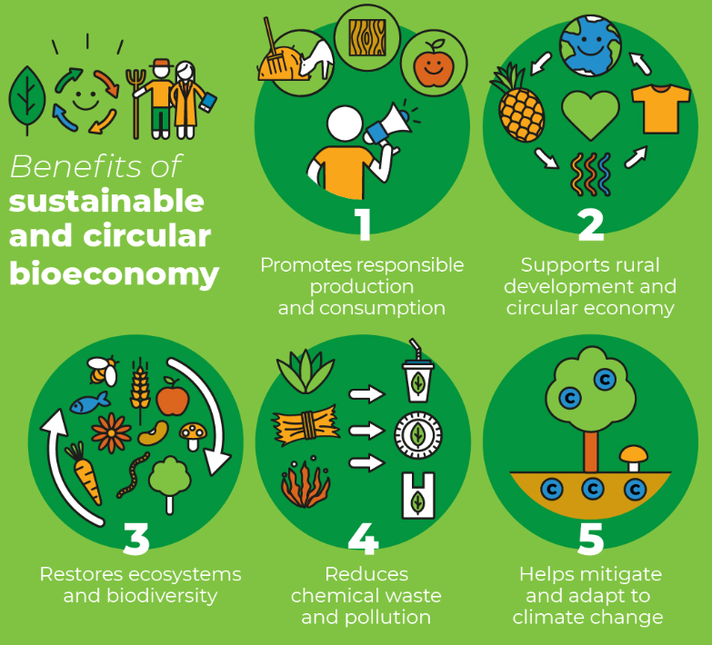
(Source: FAO, 2022)

Slide 18
Bioeconomy: guiding principles
The principles of the Bioeconomy are the foundational guidelines that guide the sustainable and responsible use of biological resources and processes for economic, social, and environmental benefits:
Sustainability
Principle: The bioeconomy must prioritize the long-term sustainability of biological resources and ecosystems.
Explanation: Sustainability ensures that biological resources are available for current and future generations. This involves practices that minimize resource depletion, protect biodiversity, reduce environmental impacts, and promote ecological resilience.
Circularity
Principle: The bioeconomy encourages a circular approach, where biological materials and products are reused, recycled, or regenerated to minimize waste and maximize resource efficiency.
Explanation: Circular economy principles emphasize the reduction of waste and the efficient use of resources. In the bioeconomy context, this means designing products and processes that allow for the recovery and reutilization of biological materials, thereby reducing the strain on natural ecosystems and minimizing the generation of waste.

Slide 19
Bioeconomy: guiding principles
Innovation and Technology
Principle: The bioeconomy relies on cutting-edge innovation and technology to harness biological resources efficiently and sustainably.
Explanation: Innovation and technology are vital components of the bioeconomy. Advances in biotechnology, genetic engineering, precision agriculture, and sustainable forestry practices enable the responsible utilization of biological resources while minimizing negative environmental impacts.
Diversity and Resilience
Principle: The bioeconomy recognizes the value of biodiversity and seeks to promote diverse biological resources and ecosystems for greater resilience.
Explanation: Biodiversity is critical for ecosystem stability and resilience. The bioeconomy principle of diversity encourages the protection and responsible management of various biological species, genotypes, and ecosystems to enhance their adaptability to changing conditions, such as climate change or disease outbreaks.

Slide 20
Bioeconomy: guiding principles
Ethical Considerations
Principle: Bioeconomy activities should be conducted with ethical considerations, respecting human rights, cultural values, and the welfare of all species.
Explanation: This principle underscores the importance of ensuring that bioeconomy practices are conducted with a strong ethical framework. It involves obtaining free and informed consent from communities, protecting indigenous knowledge, and upholding social and environmental ethics.
Economic Viability
Principle: The bioeconomy should be economically viable, promoting economic growth and job creation while delivering sustainable benefits.
Explanation: Economic viability is essential to ensure that the bioeconomy contributes to economic development. Sustainable bio-based industries should generate profits, create employment opportunities, and stimulate economic growth while adhering to environmental and social responsibility.

Slide 21
Bioeconomy: guiding principles
Global Collaboration
Principle: Bioeconomy efforts should encourage international collaboration, knowledge sharing, and the equitable distribution of benefits.
Explanation: The bioeconomy is a global endeavor. Collaboration between nations, organizations, and stakeholders is crucial to address global challenges like climate change, food security, and resource scarcity. This principle emphasizes sharing knowledge, technology, and benefits to achieve common goals.
Responsible Governance
Principle: Effective governance and regulation are essential to ensure that bioeconomy activities are conducted responsibly and ethically.
Explanation: Governments and regulatory bodies play a critical role in establishing and enforcing policies, standards, and guidelines that promote responsible bioeconomy practices. This ensures that the principles of sustainability, ethics, and economic viability are upheld.

Slide 22
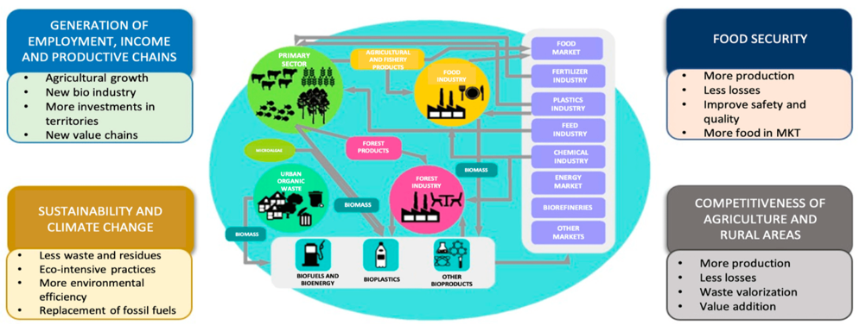
Sectors and networks of the bioeconomy
(Source: Trigo, E. et al., 2023)

Slide 23
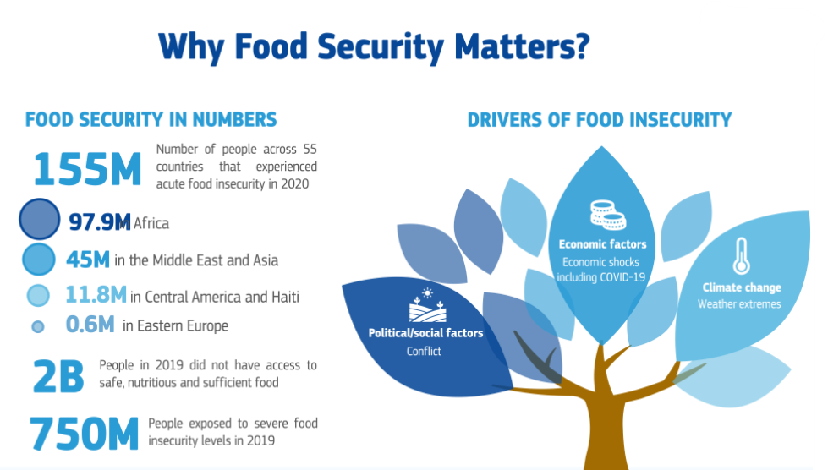
The bioeconomy and food security
(Source: European Commission, 2021)

Slide 24
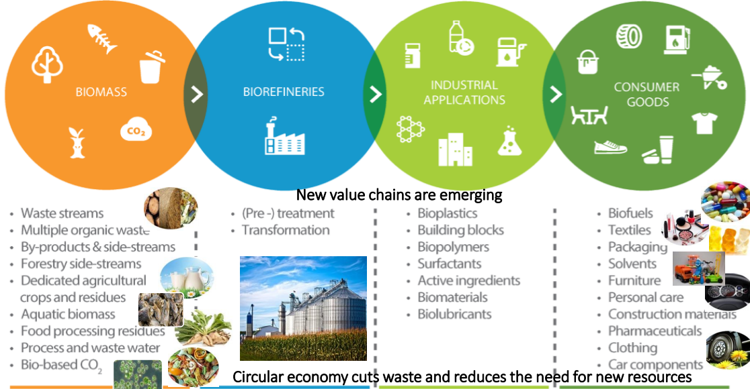
The bioeconomy and value addition
(Source: European Commission, 2019)

Slide 25
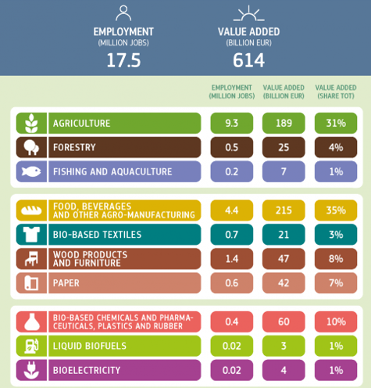
The bioeconomy and job creation in the EU
(Source: EU Science Hub, 2020)

Slide 26
Practical Activity #3
Group Activity
Split in teams of 4. Each team based on one of the key principles of Bioeconomy will try to identify examples with practices that are fully aligned with it. Discuss your findings with your peers.

Slide 29
Content
UN 2030 Agenda and the Sustainable Development Goals (SDGs)
Relation between the SDGs and the bioeconomy and farming context
EU Green New Deal
Farm to Fork strategy

Slide 30
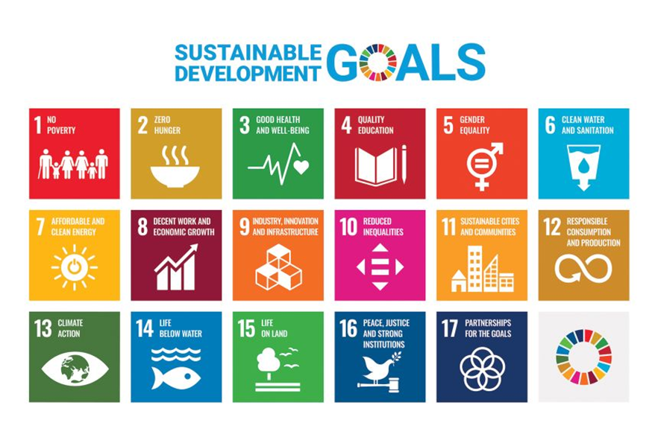
UN 2030 Agenda and the SDGs
Comprehensive global framework adopted by all 193 United Nations member states in September 2015, at its core has 17 goals (SDGs).
MDGs vs. SDGs
The principle of “leave no one behind”
The 3 pillars of sustainability
Holistic approach to interconnected challenges
Example: improving access to education (SDG 4) can lead to better health outcomes (SDG 3) and reduced inequalities (SDG 10)
(Source: United Nations, 2023)

Slide 31
Agriculture
Crucial role of Food & Agriculture in achieving multiple SDGs due to their economic, social, and environmental impacts.
Promoting food security and sustainable agriculture while addressing the environmental and social challenges associated with food production
can lead to a
more equitable, sustainable, and prosperous world for all.

Slide 32
Agriculture
(Source: FAO, 2020)

Slide 33
The SDGs and the bioeconomy and farming context
Sustainable Development Goal (SDG) | Relevance of bioeconomy and farming
SDG 2: Zero Hunger | Sustainable farming practices can increase food production while reducing environmental impacts
SDG 8: Decent Work and Economic Growth | Sustainable farming practices and the development of bio-based industries can create jobs, stimulate economic growth, and improve livelihoods
SDG 12: Responsible Consumption and Production | Sustainable farming and bio-based industries promote responsible resource management
SDG 13: Climate Action | Sustainable farming practices and the use of bioenergy from agricultural residues can reduce GHG emissions and enhance carbon sequestration
SDG 14: Life Below Water | Aquaculture and sustainable fisheries can help reduce pressure on wild fish stocks, contributing to the conservation of marine ecosystems
SDG 14: Life on Land | Agroforestry and organic farming, can help protect biodiversity, prevent land degradation, and promote the sustainable management of forests

Slide 34
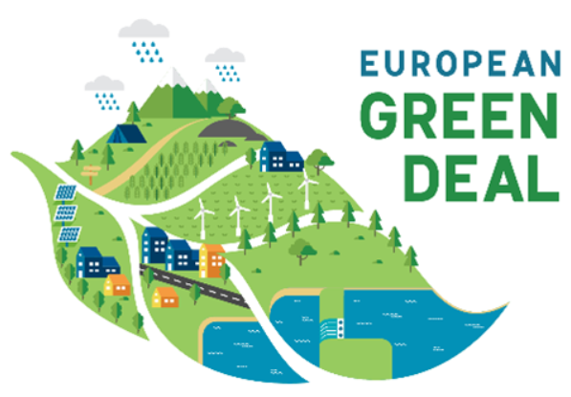
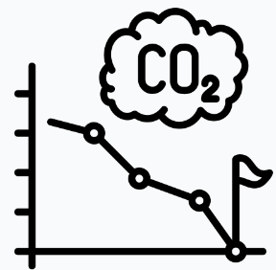
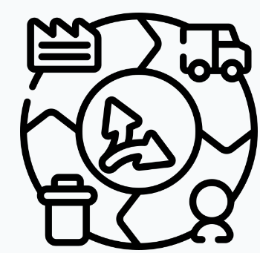
The European Green Deal
Ambitious policy initiative introduced by the European Commission in December 2019 to ignite a fundamental shift in the EU's approach to economic growth, sustainability, and climate change.
Three main objectives:
Climate neutrality by 2050
Sustainable and Circular economy
Biodiversity and Ecosystem protection
(Source: Copernicus, 2023)

Slide 35
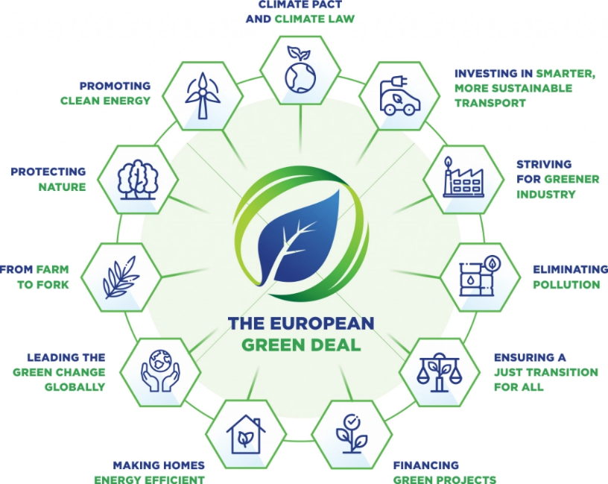
The European Green Deal: multiple goals
(Source: Euinasean, 2021)

Slide 36
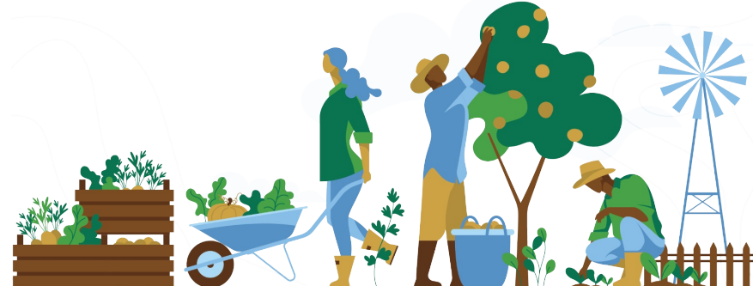
Farm to Fork strategy
Key component of the EU Green Deal's effort to create a more sustainable and resilient food system within the European Union.
It seeks to address environmental challenges, improve public health, and support a fair transition for farmers and consumers toward a more sustainable and healthy food future.
(Source: FAO, 2022)

Slide 37
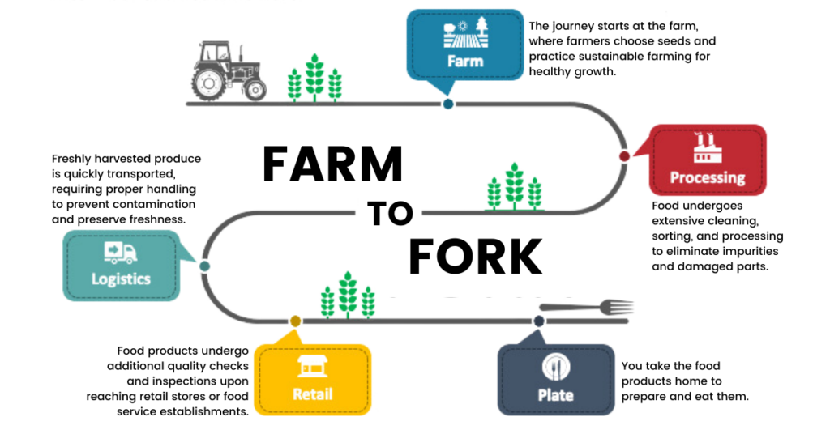
The ‘’Farm to Fork journey’’
(Source: Collidu, 2022)

Slide 38
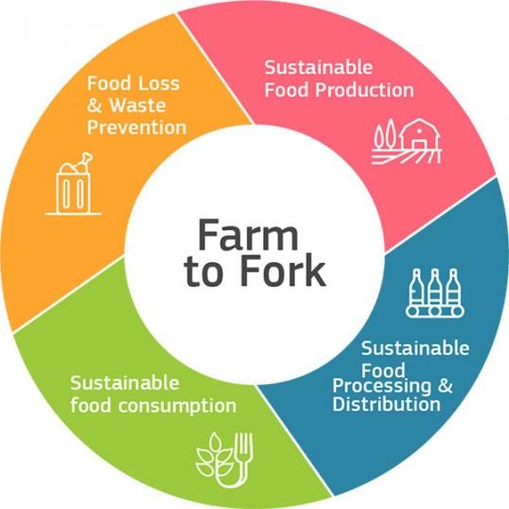
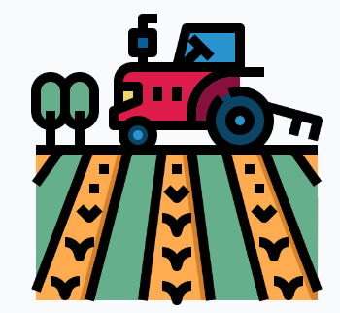
The 4 pillars of the strategy
The strategy is based on four pillars designed to address various aspects of the food system, from production to consumption:
Sustainable Food Production
Sustainable Food Processing & Distribution
Sustainable Food Consumption
Food Loss & Waste Prevention
(Source: European Commission, 2022)

Slide 39
Practical Activity # 4
Can you identify any specific benefits or challenges that the Farm to Fork strategy has brought to the broader agricultural community?

Slide 42
Content
Environmental Management
Environmental Impact Assessment and Life Cycle Assessment
Green Innovation and Bioeconomy
Future trends in Environmental Management

Slide 43
Environmental Management
Set of practices and methods that aim to ensure the sustainability of our food production systems
Involves a systematic and proactive approach to using natural resources efficiently while minimizing negative impacts on the environment
Addresses environmental challenges that agriculture pose

Slide 44
Environmental Impact Assessment
a systematic tool for evaluating and understanding the environmental consequences of agricultural activities.
it helps identify, assess, and mitigate the environmental risks associated with farming practices.

Slide 45
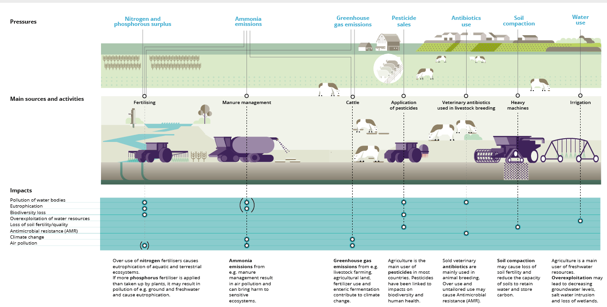

Slide 46
Life Cycle Assessment
a holistic tool that assesses the environmental impacts of a product or process throughout its entire life cycle, from production to disposal
It enables us to consider the full spectrum of environmental consequences

Slide 47
Green Innovation and Bioeconomy
Green Innovation could be defined as the services, products, and processes that do not harm or reduce the degradation of an eco-friendly environment and enhance natural resources.
Enables reshaping agricultural landscapes towards more ecologically sound and economically viable solutions

Slide 48
Critical points of Green Innovation
mitigates the adverse effects of traditional farming practices on the environment
fosters economic resilience
offers renewable alternatives to traditional fossil fuels, curbing greenhouse gas emissions and shrinking the carbon footprint of agricultural operations

Slide 49
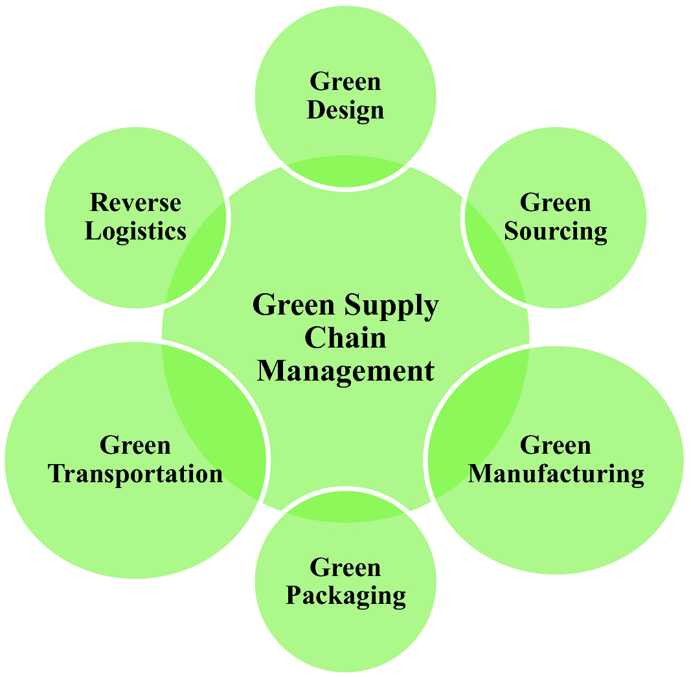
Future Trends
Green Supply Chain Management

Slide 50
Practical Activity #5
Group Discussion
Can you provide examples of Corporate Social Responsibility ?
Can you identify the benefits for the environment if organizations adopt the Corporate Social Responsibility model?

Slide 53
Content
Waste management, Energy efficiency and savings and waste water
Life cycle thinking
Key elements for ensuring compliance with environmental legislation

Slide 54
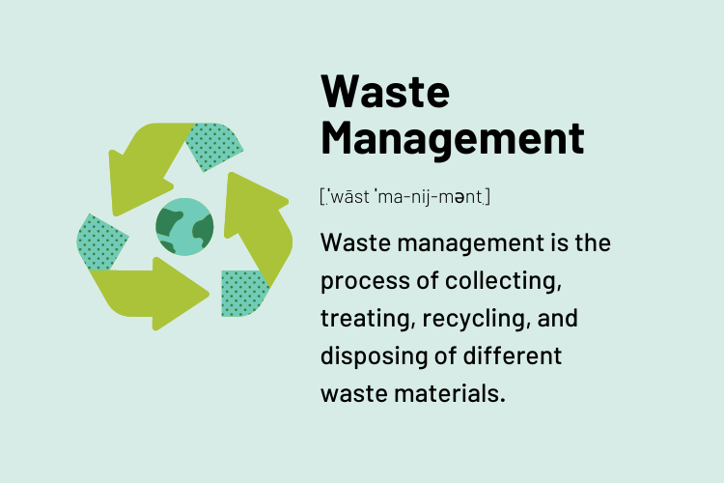
Waste management
Focuses on preserving the value and properties of waste materials by delivering high quality, secondary, raw materials to the economy.
(source)

Slide 55
Connected concepts
Energy Efficiency:
a method, which aims at accomplishing a task with the less possible use of energy, in order to eliminate energy waste
Food and water management:
in 2019 households produced globally 596 million tones food waste, whilst in 2017, the average water consumption of households in Europe was estimated at 147 litres/day per person with the daily minimum to be estimated at 50 litres/day per person

Slide 56
Farm Waste Management
involves a series of practices and strategies to reduce, reuse, and recycle agricultural waste.
Optimize the potential benefits of organic waste.
Minimize the harmful impact of agricultural waste on the environment.

Slide 57
Benefits of Farm Waste Management
Benefits
Prioritizing the use of reusable materials
Encouraging composting and recycling
Recycling of organic waste and saving water
Less greenhouse gas emissions
Saving costs and increasing efficiency
Helps compliance with environmental regulations
Optimizes farm operations,

Slide 58
Practical Activity #6
Group Discussion
Can you provide examples of agricultural waste categories?
How they could be handled so as to be less harmful for the environment?

Slide 59
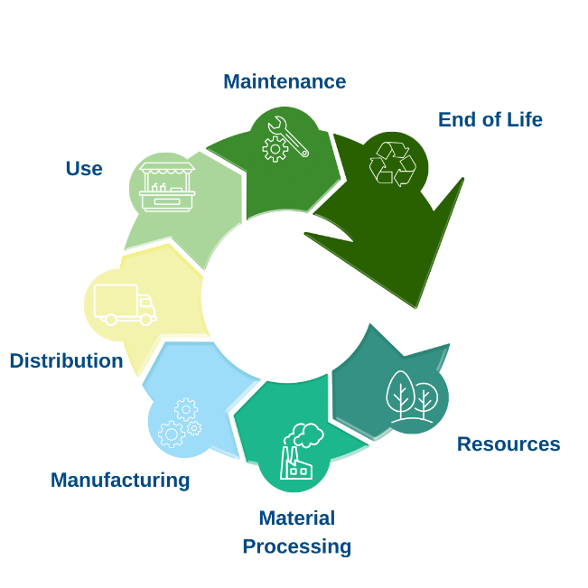
Life Cycle Thinking
a way of thinking of the environmental, economic, and social impacts of a product throughout its entire life cycle.

Slide 60
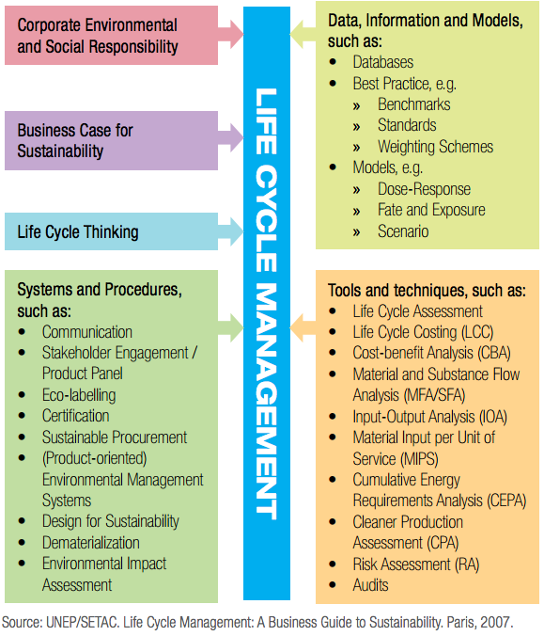
Life Cycle Management

Slide 61
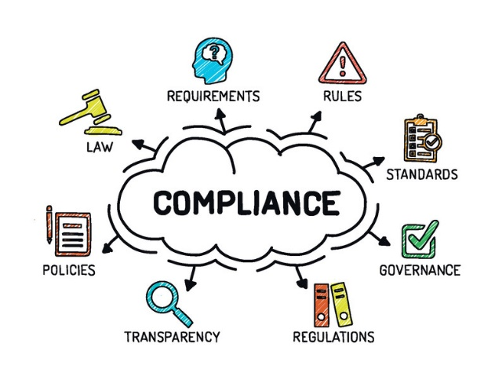
Key elements of compliance
a critical aspect of sustainable business practices, requiring organizations to adhere to legal frameworks that govern environmental protection and conservation
describes all the ways in which public authorities promote, monitor, and enforce compliance with the relevant environmental regulations
Involves adopting proactive measures to exceed regulatory expectations and contribute to broader environmental goals.

Slide 62
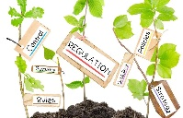
Levels of compliance
Preventive level: helping businesses and other duty-holders to comply through means such as awareness-raising, guidance, and helpdesks.
Diagnostic level: monitoring and assessing non-compliance and providing evidence for enforcement. It covers inspections, investigations, examination of complaints.
Corrective level: stopping and punishing those who disregard the rules, encouraging compliance. It covers, amongst other things, official warnings, cease-and-desist orders, administrative or criminal proceedings.
(source)

Slide 63
Key Principles of Compliance
Proportionality
Consistency
Targeting
Transparency
Credibility

Slide 65
Content
The environmental impact of human activities: the “Anthropocene”
The interdipendence between agriculture and climate change
Environmental footprint
The Earth Overshoot Day

Slide 66
The ‘’Anthropocene’’
It is the era we found ourselves in where human activities have become the dominant force shaping the Earth's environment.
Related issues are:
CLIMATE CHANGE
BIODIVERSITY LOSS
POLLUTION
LAND-USE CHANGES
RESOURCE DEPLETION
significant and accelerating rise in global temperatures
unprecedented rate at which species are disappearing
introduction of harmful materials (GHG, plastics,
toxic waste, etc.) into the environment
have led to deforestation, soil degradation, and the transformation of once-pristine landscapes
unsustainable extraction of freshwater, minerals, and fisheries taking a toll on Earth's finite resources

Slide 67
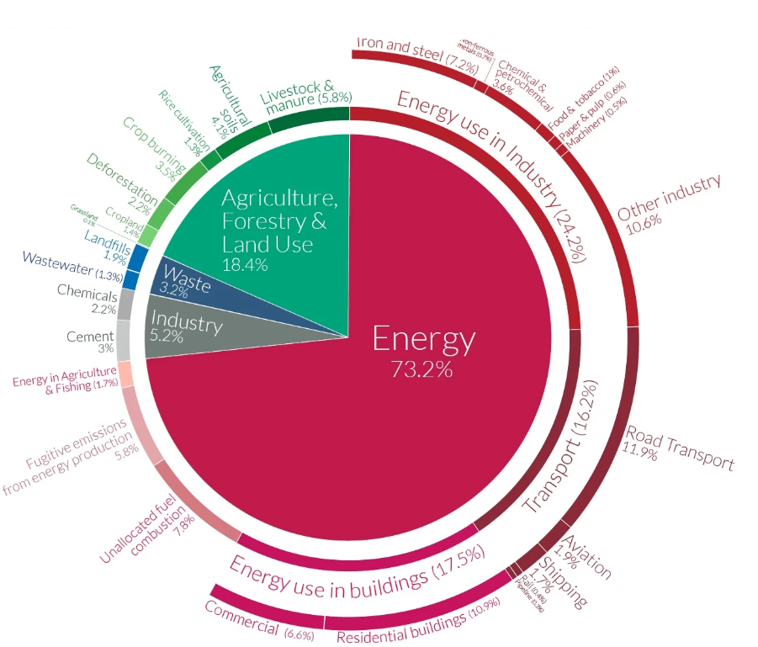
Sectors contributing to climate change
(Source: OurWorldInData, 2021)

Slide 68
The role of agriculture in an ever-changing climate
Agriculture plays a complex and multifaceted role, being both a threat and a potential solution to climate change.
Agriculture as a threat
SOURCE OF GHG EMISSIONS: Besides the energy required to carry out agricultural activities, livestock and manure are the main contributors of methane (enetic fermentation) and nitous oxide (manure management and the use of synthetic fertilizers).
MAIN DRIVER OF DEFORESTATION: Every year the world loses around 5 million hectares of forest. 95% of this occurs in the tropics. At least three-quarters of this is driven by agriculture – clearing forests to grow crops, raise livestock and produce products.

Slide 69
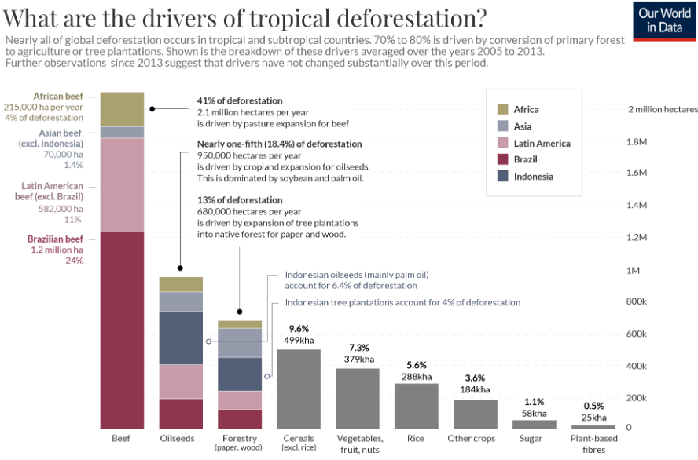
(Source: OurWorldInData, 2021)

Slide 70
The role of agriculture in an ever-changing climate
Agriculture as a potential solution
SEQUESTER CO2 EMISSIONS: agriculture has the potential to sequester carbon dioxide from the atmosphere through various practices. These include reforestation, afforestation (planting trees on previously non-forested land), and agroforestry (integrating trees into agricultural systems). These practices can act as carbon sinks, helping to offset emissions.
ALTERNTIVE SOURCE OF ENERGY: Agriculture can also contribute to renewable energy production, such as bioenergy. Biofuels derived from crops or agricultural residues, along with biogas from manure, can replace fossil fuels and reduce emissions.

Slide 71
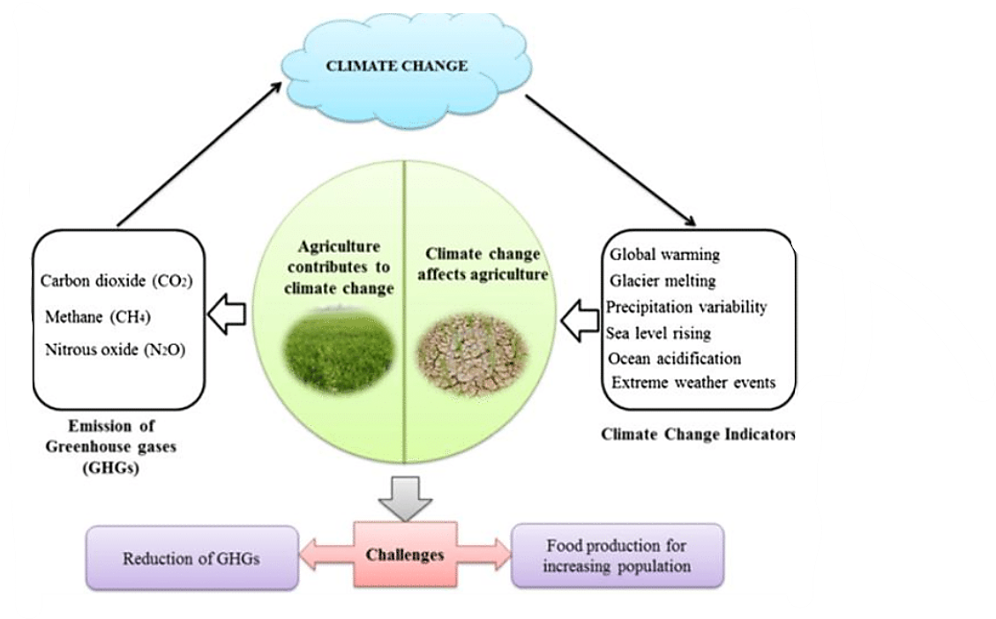
The role of agriculture in an ever-changing climate
(Source: Rogelj et al., 2010)

Slide 72
Environmental footprint
There are several tools and methodologies used to calculate the impact of human activity on the environment, developed in response to growing concerns about sustainability and environmental degradation.
1
ECOLOGICAL FOOTPRINT
It measures the total environmental impact of an individual, community, organization, or even a country in terms of the natural resources and ecosystems required to support their lifestyle or activities.
METHOD: quantification of human demand on Earth's ecosystems by measuring the area of biologically productive land and water needed to produce the resources a population consumes and absorb its waste, all converted into a common unit (global hectares or acres).

Slide 73
Environmental footprint
There are several tools and methodologies used to calculate the impact of human activity on the environment, developed in response to growing concerns about sustainability and environmental degradation.
2
CARBON FOOTPRINT
It measures the amount of greenhouse gas emissions, primarily carbon dioxide (CO2), that are produced directly or indirectly as a result of an individual's, organization's or entity's activities.
METHOD: quantification of the impact in terms of the global warming potential caused by greenhouse gas emissions released in the atmosphere, using the common unit of carbon dioxide equivalents (CO2e).

Slide 74
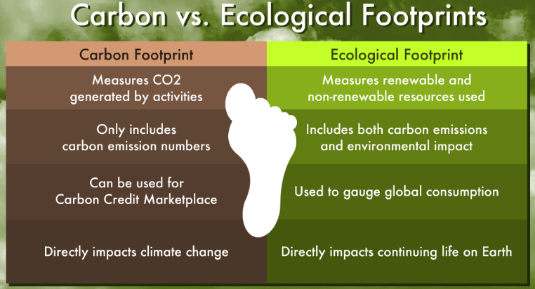
Main differences between ecological and carbon footprints
(Source: 8BillionTrees, 2023)

Slide 75
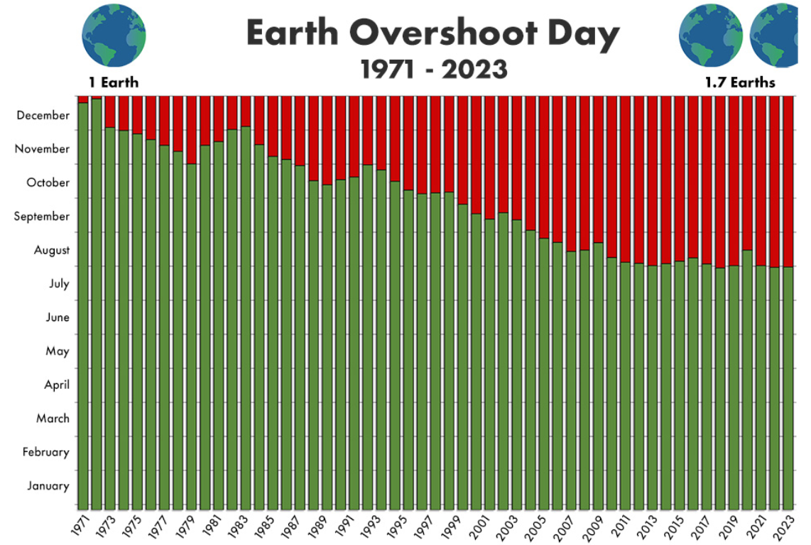
The Earth Overshoot Day
Date when humanity has used up the planet's ecological resources and services for a particular year.
It is the point in the calendar year when our collective demand for resources and the production of waste, primarily carbon dioxide emissions, exceed what Earth can naturally regenerate and absorb in that year.
After this date, we are essentially living on ecological "credit”, depleting natural resources faster than they can be replenished.
Source: EconomiaCircolare, 2023)

Slide 76
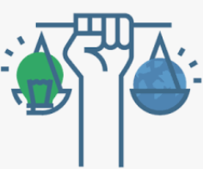
The three pillars of Sustainability: Examples
The calculation of Earth Overshoot Day is based on a variety of factors, including:
Global Ecological Footprint, which measures humanity's demand on nature by assessing factors such as food production, energy consumption, timber harvesting, and carbon emissions.
Biocapacity representing Earth's capacity to regenerate resources and absorb waste, taking into account factors like forested land, fisheries, and agricultural land.
The date of Earth Overshoot Day varies from year to year.
For the year 2023, the Earth Overshoot Day has been on the 2nd of August.

Slide 77
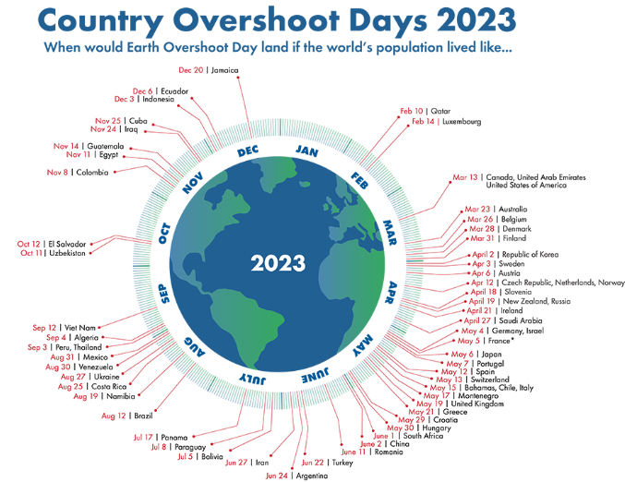
(Source: GlobalFootprintNetwork, 2023)

Slide 78
Practical Activity #7
Group Discussion
Please indicate any internal policies or programs that your organization has that aim at reducing its carbon footprint

Slide 81
Content
The system Thinking Approach

Slide 82
Systems Thinking
a holistic approach aiming at the understanding of a system, by studying the relations and interactions between the elements that compose this system.
a problem-solving method, which takes into consideration all the factors that are involved in a system and breaks down a big problem down into its component parts, figuring out how each part affects the whole

Slide 83
Fundamentals of Systems Thinking
Looking at the big picture
Taking a wider perspective
Having multiple perspectives
Examining inter-relationships within the system
Looking for root causes and solutions
Preventing consequences
Challenging and exploring new opportunities

Slide 84
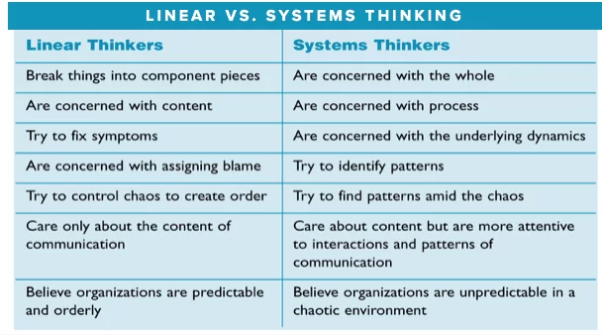

Slide 85
Practical Activity #8
Group Activity
Slpit in teams of 4. Each team should try to provide examples of an issue that an agribusiness may face identifying potential solutions:
As Linear Thinker
As Systemic Thinker
Present your findings to your peers and discuss the results.

