Slide 2
Course: VET-A1 Module: Agricultural sustainability, management of natural resources and climate action Learning Unit:Renewable energy solutions for agriculture
Author: UNIFI

Slide 3
Summary
Introduction
Solar Energy for farmers
Biomass to Energy
Other RES based solutions for agriculture

Slide 4
Introduction Changes in GDP and energy demand 2000-2014
For the world as a whole, GDP growth is pushing energy consumption higher.
Overall, for every one percentage point rise in non-OECD economic growth over the period 2000-2014, energy demand increased by around 0.7%.

Slide 5
World Consumption
In 2022, the world needed an amount of energy equivalent to that contained in 14430 million barrels of oil. Renewables’ (excluding hydroelectricity) share of primary energy consumption reached 7.5%, while Fossil fuel consumption as a percentage of primary energy remained steady at 82%.
Greenhouse gas (GHG) emissions resulting from the provision of energy services from fossils (coal, oil, and gas) have contributed significantly to the historic increase in atmospheric GHG concentrations.

Slide 6
Lowering GHG emissions
There are multiple options for lowering GHG emissions from the energy system while still satisfying the global demand for energy services. Renewable Energies are one of these.
Renewable energy includes all forms of energy produced from renewable sources in a sustainable manner, including bioenergy, geothermal energy, hydropower, ocean energy, solar energy and wind energy. (IRENA).

Slide 7
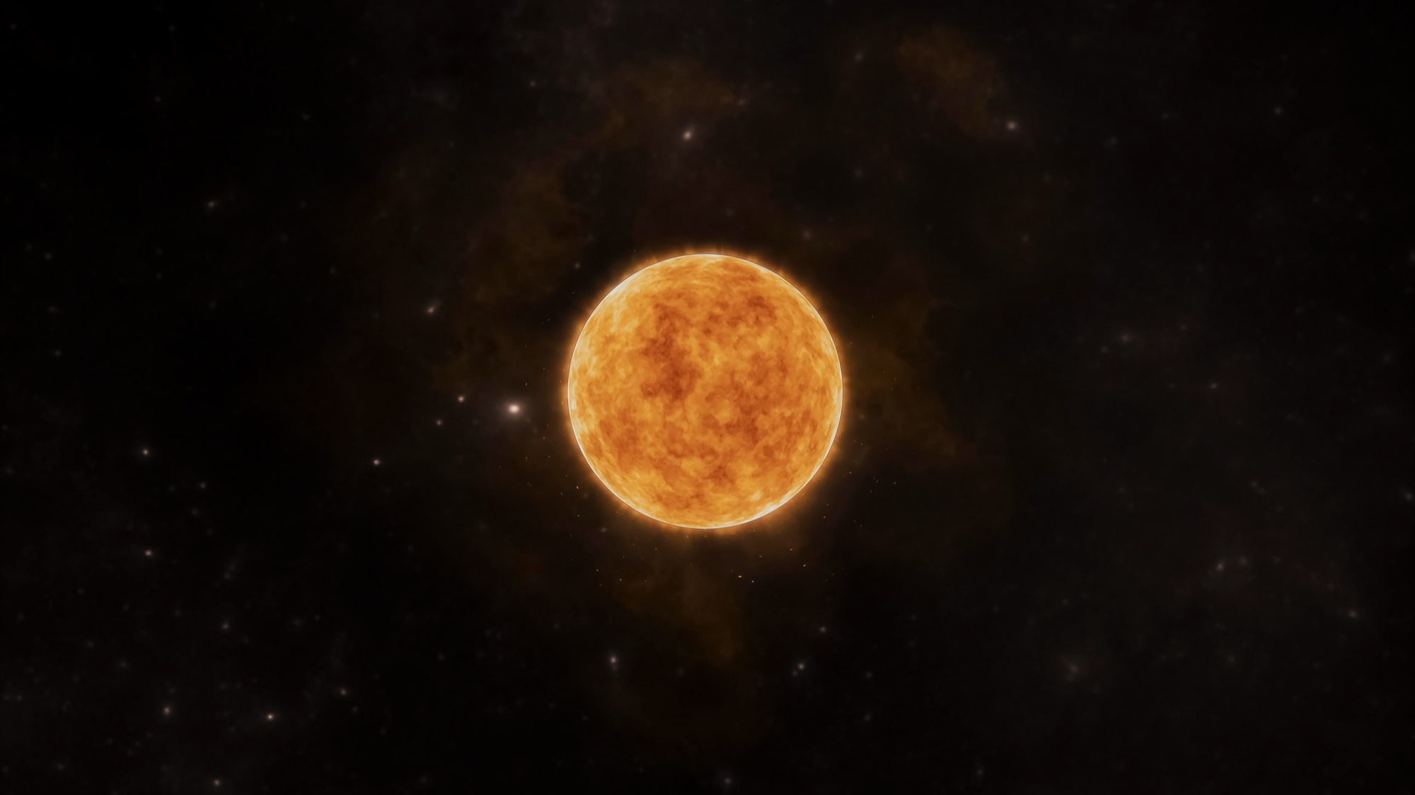
Solar Energy
Solar Heat
Converting the sun’s radiant energy to heat comes from the past and has today evolved into a well-developed technology.
The basic principle of solar thermal collection is that when solar radiation strikes a surface, a part of it is absorbed, thereby increasing the temperature of the surface.
Photovoltaic (PV) conversion
Direct conversion of sunlight into electricity with no intervening heat engine.
Conversion of solar radiation into electrical energy by means of solar cells developed since early 1960’s as a part of satellite and space-travel technology.
PV devices: stand-alone systems to give outputs from microwatts to megawatts.
Sun emits about 175~178 Billions MW
Irradiance, an instantaneous quantity often identified as the intensity of sunlight, is the measure of the power density of sunlight. It is usually measured in W/m².
The irradiance received from the sun at the top of the atmosphere (AKA solar constant for the earth) is approximately equal to 1367 W/m².
After passing through the atmosphere the irradiance is reduced to approximately 1000 W/m² (on average).
Solar energy has a share of more than 99.9 % of all the energy converted on earth.
Image by freepik

Slide 8
Solar Thermal Energy
Harnessing the sun's radiant energy and converting it into heat has evolved from the past into a sophisticated technology today.
In solar thermal collection, when solar radiation hits a surface, it absorbs a portion, raising the surface temperature.
The effectiveness of a solar collector depends on absorption efficiency and minimizing thermal and reradiation losses to the surroundings, as well as efficiently extracting energy for practical use.

Slide 9
Domestic Solar Heat System
A traditional solar thermal system operates following three main actions:
“Harvesting” of the solar radiation with the panels (1)
Transfer of heat to a storage system/boiler (2) with natural or forced circulation,
The control system (3) manages the distribution of the heat to the utilisation (4), such as heating or domestic hot water.
Picture Credits: buildersontario.com

Slide 10
Domestic Solar PV System
The solar panel (1) is mounted on the roof.
An inverter (2) converts the electricity produced by the system from DC (Direct Current) energy into AC (Alternating Current).
An electric panel (3) is connected to the AC system of the home.
A power meter (4) accounts for how much energy is exchanged and balanced between the system users (5) either in DC or AC and the grid (6).

Slide 11
The concept of Agri-Photovoltaics (APV)
Under the regulated shadow of the APV system (1) crops (2) grow with less water needs, animals (3) may find shadow, and tractors (4) can operate without interfering with the PV structures and panels (5).
Electricity can be either self-consumed (6), sold following Power Purchase Agreements with local residentials and industrial estates (7), or it can be fed into the power grid (8).

Slide 12
Agri-Photovoltaics: a Win-Win solution
Category I (DIN SPEC 91434):
Overhead PV with vertical clearance > 2.1 m
Farming under the APV system
A_{L} Cultivatable agricultural areas
A_{N} Uncultivatable agricultural areas
h₁ Clearance height below 2.1 m
h₂ Clearance height above 2.1 m
1 Examples of PV modules
2 Mounting structure
3 Examples of crops
Credits: Fraunhofer ISE

Slide 13
Agri-Photovoltaics: a Win-Win solution
Category II (DIN SPEC 91434) Variant 1:
Interspace PV with vertical clearance < 2.1 m
Farming between the rows of APV systems
A_{L} Cultivatable agricultural areas
A_{N} Uncultivatable agricultural areas
h₁ Clearance height below 2.1 m
h₂ Clearance height above 2.1 m
1 Examples of PV modules
2 Mounting structure
3 Examples of crops
Credits: Fraunhofer ISE

Slide 14
Agri-Photovoltaics: a Win-Win solution
Category II (DIN SPEC 91434) Variant 2:
Interspace PV with vertical clearance < 2.1 m
Farming between the rows of APV systems
A_{L} Cultivatable agricultural areas
A_{N} Uncultivatable agricultural areas
h₁ Clearance height below 2.1 m
h₂ Clearance height above 2.1 m
1 Examples of PV modules
2 Mounting structure
3 Examples of crops
Credits: Fraunhofer ISE

Slide 15
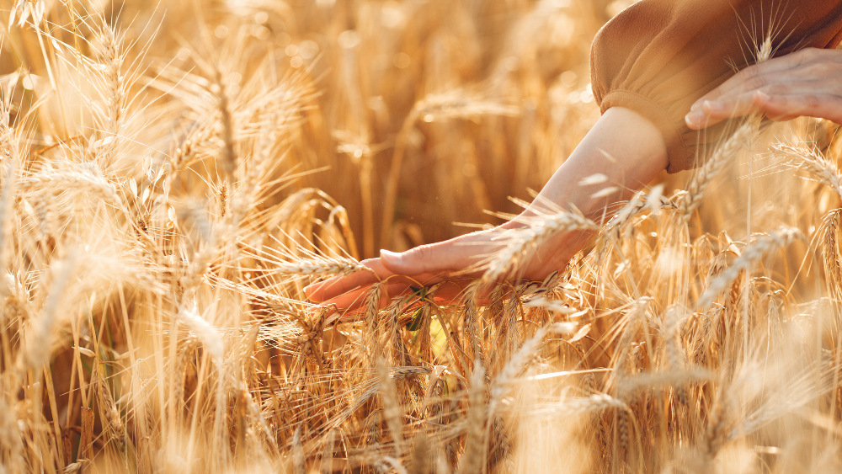
Biomass
Biomass to energy used by humanity form the discover of fire use for cooking, heating and later metallurgy
The term biomass includes all the organic materials coming from vegetables and animals (marine or soil origin) with the exclusion of the fossils, able to be used for energy production purposes
Biomass is solar energy fixed in organic material through photosynthesis
Picture Credits: prostooleh on Freepik

Slide 16
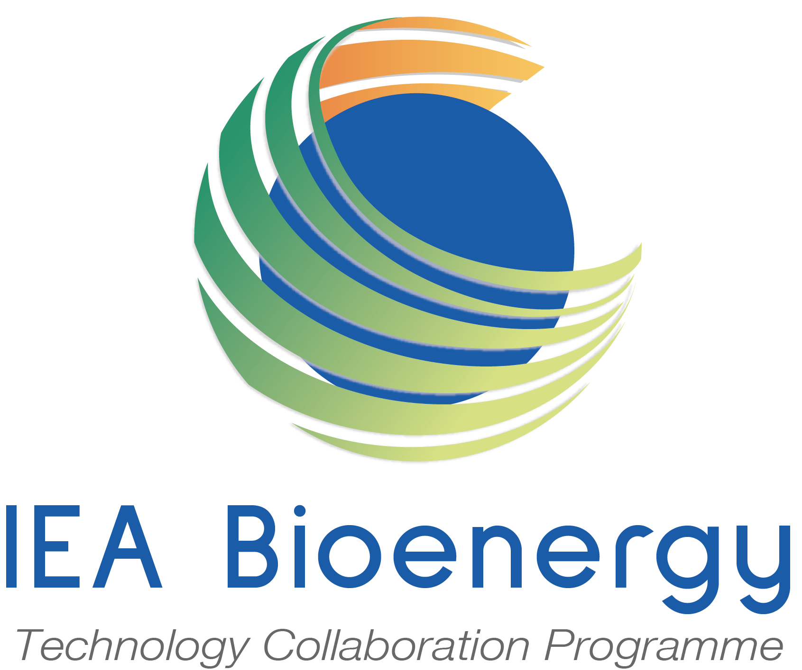
Multiple sources of biomass
Source: IEA ETP 2017

Slide 17
Biomass: CO₂ “neutral”
As biomass (forests, crops etc.) grow, CO₂ is removed from the atmosphere via photosynthesis, converted into organic carbon and stored into the biomass.
Trees and crops release the stored carbon when they die, decay or are combusted.
As the biomass releases carbon as CO₂, the carbon cycle is completed. The carbon in biomass will return to the atmosphere regardless of whether it is burned for energy, allowed to biodegrade or lost in a forest fire.
Overall, the flow of forest CO₂ is carbon positive when forests are sustainably managed, and the forest system remains a net sink of CO₂ from the atmosphere.

Slide 18
Overview of bioenergy pathways
Source: IEA Bioenergy Roadmap, 2017

Slide 19
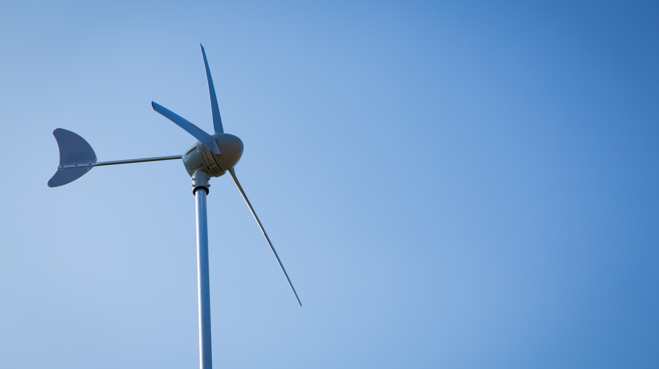
Small wind generation for rural areas
Small Wind Turbines (SWTs) offer decentralized power solutions, providing energy independence and resilience, especially in areas with limited access to centralized electricity grids. While large wind farms cater to utility-scale electricity generation, SWTs continue to serve localized needs and specific applications, contributing to sustainable energy access and rural development worldwide. Some examples of applications are:
Households and Rural Areas.
Hybrid Energy Systems.
Direct Energy Services.
Rural Development.
Picture Credits: jannoon028 on Freepik

Slide 20
Micro and pico hydro power
Micro and pico hydro power are a feasible option for generating off-grid electricity in remote areas with accessible flowing water.
These systems provide reliable power, reducing reliance on distant grids. Economically, they offer a cost-effective alternative for local electricity generation in challenging, remote regions where grid extension is impractical.
Additionally, strategic reservoir or small dam designs can serve dual purposes as energy storage and irrigation reservoirs.
Picture Credits: Intechopen

Slide 21
Conclusions
Agriculture and renewable energy have been closely linked since ancient times.
Before the industrial era, most energy was produced by burning biomass.
Despite the advent of the fossil fuel era, biomass remains an important source of energy in developing countries.
The agricultural sector has new opportunities to contribute to reducing carbon dioxide emissions throughout the production chain due to the environmental challenges posed by carbon dioxide emissions following industrialisation.
This can be achieved not only through the traditional use of biomass but also through advanced renewable energy technologies such as solar photovoltaic and wind power, as well as the digital revolution, which supports better and more efficient farming practices.

