Slide 2
Course: VET Module: Agricultural sustainability, management of natural resources and climate action Learning Unit: Water, Energy, and Food (WEF) Nexus security, Drip Irrigation, and Desalination
Author: UAZORES

Slide 3
Introduction
This LU aims to develop good management of existing water, as well as identify how to use all possible sources of water available for agriculture. At the same time, how to use remnant water used in agriculture for possible uses, will be also achieved.After the completion of the LU students should be able to have the following learning outcomes:
Knowledge
Identify different sources of water,
Identify uses of water.
Skills
Ability to reuse water from different origins,
Water control and monitorization.
Competences
Better sensibility to water uses and waste,
Better understanding of the notion of the value of water and its quality.

Slide 4
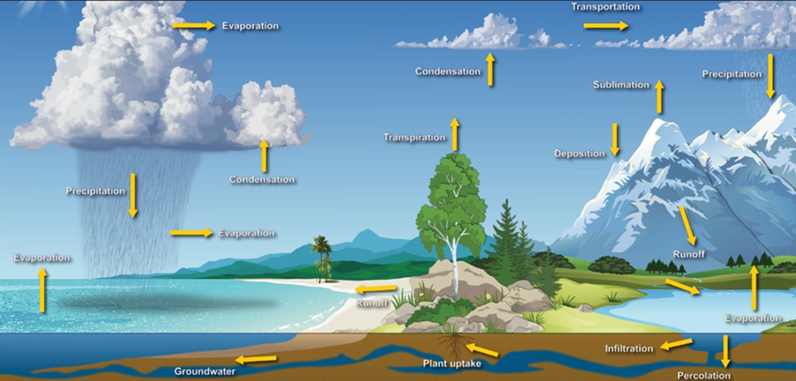
Subunit 1: Water basic concepts
The water cycle: is how water moves from the land into the atmosphere, and then back to the land and ocean. It consists of three parts: evaporation, condensation, and precipitation. The water cycle is driven by the sun. The water cycle shows the continuous movement of water within the Earth and atmosphere.

Slide 5
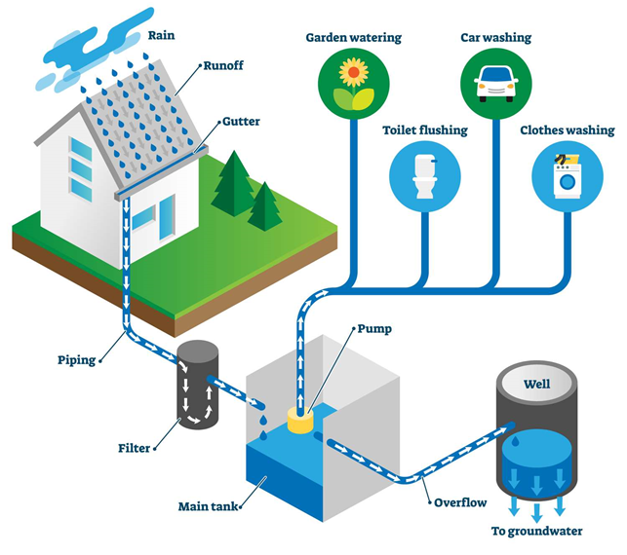
Subunit 2: Supply water systems
Catchments: The method of collecting and storing rainwater for later use. The raw water after collected must be stored, in a place which is suitable to obtain water with quality and quantity, so that after treatment, legal provisions are complied with, depending on the purpose for which it is intended.
Rain catchment: Rainwater harvesting is collecting the run-off from a structure or other impervious surface in order to store it for later use. Traditionally, this involves harvesting the rain from a roof.

Slide 6
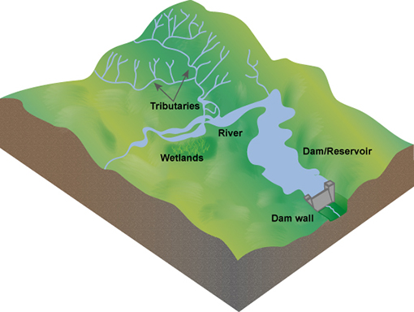
Catchments
River catchments: The term “river catchment” is used to refer to any lower-lying region in which water collects from the higher areas above it. Catchments are generally centered around a body of water, such as a stream, river or lake, into which they drain the water they collect from above.

Slide 7
Catchments (continuation)
Spring: is a place where water moving underground finds an opening to the land surface and emerges, sometimes as just a trickle, maybe only after a rain, and sometimes in a continuous.

Slide 8
Catchments (continuation)
Wells and boreholes
Borehole: element drilled into the ground where the depth is greater than the largest surface dimension and whose objective is to reach underground water reserves.
Well: similar to tower capture. The difference lies in the fact that the well does not require a walkway and that water is admitted not through window-type openings, but through pipes.

Slide 9
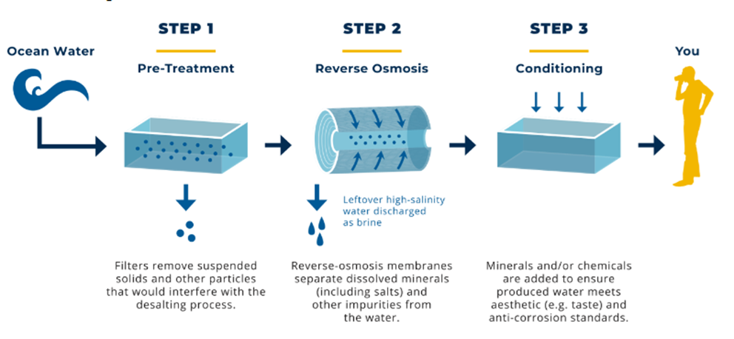
Catchments (continuation)
Other sources of water:
Desalination: is the process of removing dissolved salts from seawater and other waters by various methods.
The most common desalination processes are distillation and reverse osmosis.
Desalination using reverse osmosis technology to separate water molecules from seawater.

Slide 10
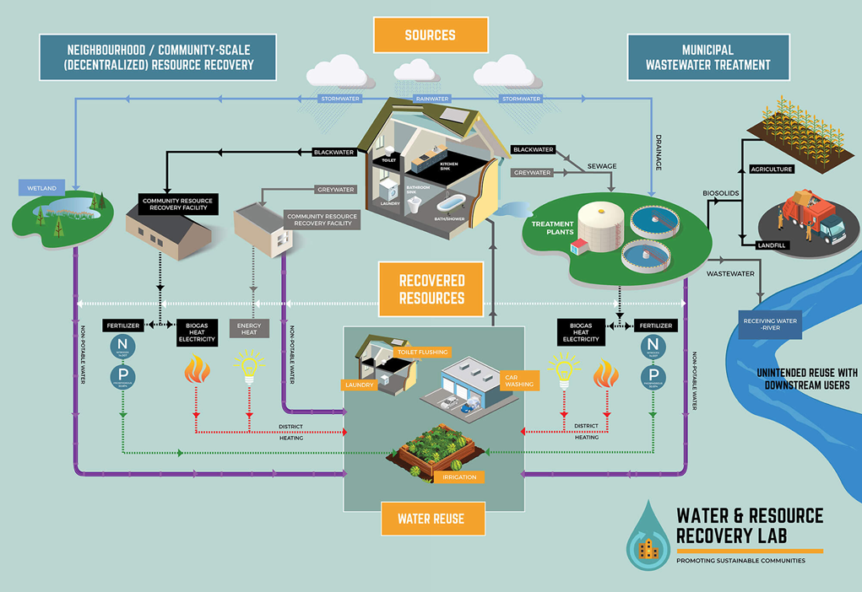
Catchments (continuation)
Other sources of water:
Water reuse refers to the process whereby wastewater is reclaimed from a variety of sources and treated to a standard appropriate for a second purpose. Any type of wastewater (domestic, municipal, or industrial) can be considered for reuse and, depending on its quality, can be deployed for several different secondary purposes.
Water recycling is reusing treated wastewater for beneficial purposes such as agricultural and landscape irrigation, industrial processes, toilet flushing, and replenishing a ground water basin.

Slide 11
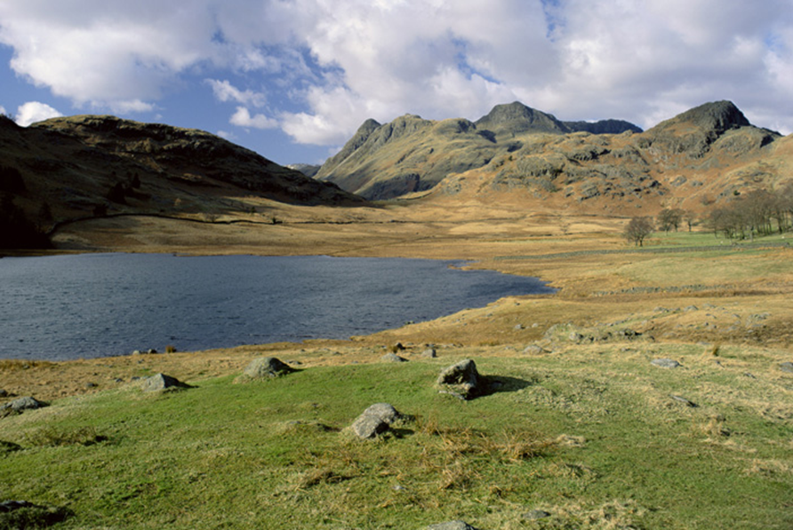
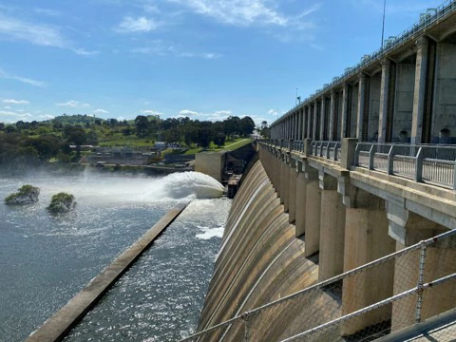
Catchments (continuation)
Reservoirs: Reservoirs are the tanks which are used to store water for various purposes. The larger the reservoir size, the greater the reliability and the higher the cost.
Lakes: are large bodies of standing water, either formed naturally or man-made for amenity purposes.
Dams: enlarged body of water created using a dam or lock. It is a structure built across a river or lake outlet to hold back water and raise its level. Unlike lakes, which form by natural processes, these reservoirs are created by humans to provide water and hydroelectricity.

Slide 12
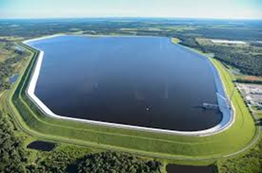
Catchments (continuation)
Artificial: An artificial reservoir is manmade reservoir where water is stored. Most reservoirs are formed by constructing dams across rivers. A reservoir can also be formed from a natural lake whose outlet has been dammed to control the water level. The dam controls the amount of water that flows out of the reservoir.

Slide 13
Archimedes screw

Slide 14
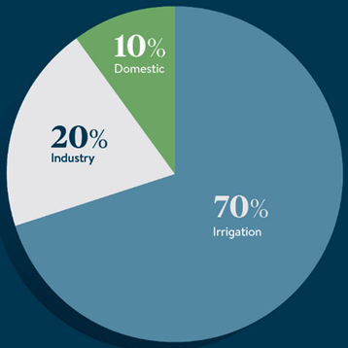
Subunit 3: Water uses
Water can be used for direct and indirect purposes. Direct purposes include bathing, drinking, and cooking, while examples of indirect purposes are the use of water in processing wood to make paper and in producing steel for automobiles.
Estimated global freshwater use

Slide 15
Water uses

Slide 16
Industrial uses
Energy production

Slide 17
Subunit 4: Water Management
Quality and Quantity: Quality parameters are related to the set of physical, chemical, biological and microbiological parameters that allow evaluating the suitability of water for a given purpose. Water can be of good quality for a certain purpose and poor quality for another, depending on its characteristics and the requirements for its specific use.
Demands vs available equilibrium: It is important for drought indices to have a term for water demand (evaporation or evapotranspiration (ET)) as well as water supply (precipitation). Water supply is easy to measure - it is just precipitation, maybe with some component that looks at soil moisture. Water demand is harder to calculate and is frequently based on temperature. Warmer temperatures generally result in more ET and greater water demand, increasing the risk of drought.

Slide 18
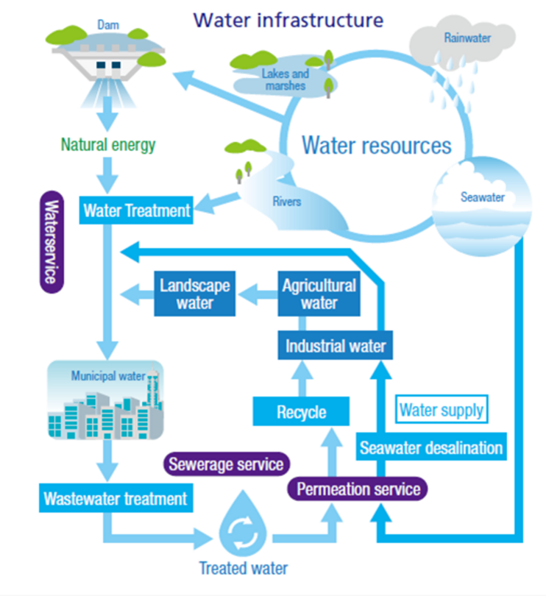
Water Management (continuation)
Control and monitorization: Monitoring proposes an overall methodological approach to monitoring for the implementation of the WFD. Because of the diversity of catchment pressures, water-body types, biological communities and hydromorphological and physico-chemical characteristics within the European Union, the appropriate implementation of programmes of measures in accordance with the requirements of the directive will vary between Member States and river basins.

Slide 19
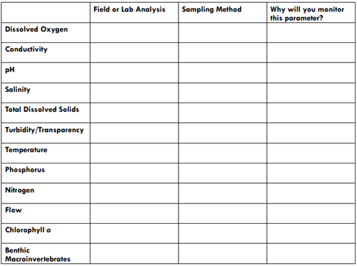
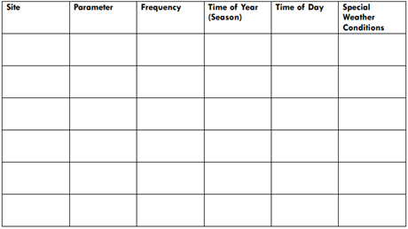
Water Management (continuation)
Monitorization networks: Water monitoring can be defined as repeated (with a defined frequency) analysis of water quality in permanent points, data processing and prognosis of trends to support actions focused on interception and remediation of adverse anthropogenic impact on the aquatic environment. There are several companies that monitor water quality, according to the parameters required by each country and for each use.
Control plans and reports: Reports and plans for water quality control are very dependent on the purpose for which the water is intended. Many parameters are evaluated in the water, most common are: pH, nitrogen, conductivity, total dissolved solids, among others. A report on water for human consumption has much more rigorous parameters than whether this water is intended for energy production or irrigation.
Example of a control plan included in a report
for a water quality monitorization

Slide 20
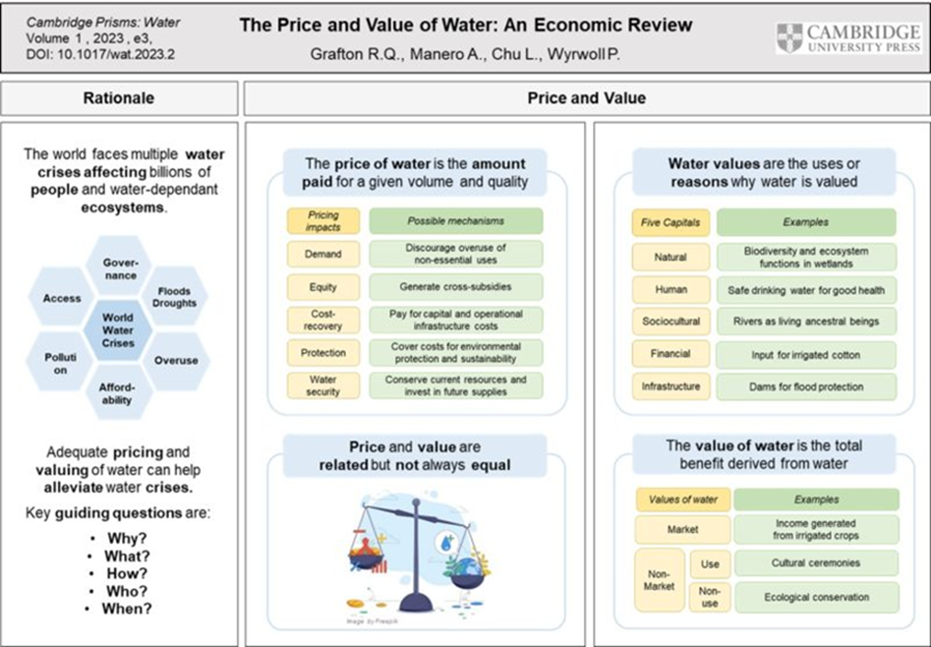
Water Management (continuation)
Costs and values: If we could assess the value of water, what would we base it on?
Could a country from third world apply the price for their true value of water?

Slide 21
Conclusion
The Water, Energy, and Food (WEF) Nexus is an approach that aims to ensure access to water, energy, and food for all by strengthening synergies and reducing trade-offs among these sectors. The WEF Nexus is a critical concept in the context of sustainable development, as it recognizes the interdependence of these three resources and the need for integrated management. Although over the last 20 years, 6 billion people gained access to improved drinking water, still there is a high childhood mortality rates linked to clean water scarcity, and in total, there is about 829,000 deaths due to unsafe water. Considering all this, it is important to not only value and preserve all the accessible fresh water we still have, by using techniques and management, whether agricultural or industrial, that allow a reduction in water use. At the same time the reuse of wastewater and desalination of ocean water are two important methods for ensuring a sustainable supply of freshwater. By adopting these sustainable practices, we can ensure that freshwater resources are used efficiently and equitably, while minimizing negative environmental impacts. In this LU, information was provided on various ways in which water can be found on planet Earth, but also information that can help to make a more rational and ecological use of water.

