Slide 2
Course: VET Module Agricultural sustainability, management of natural resources and climate action Learning Unit Agricultural reuse of organic residuals
Author: UNIFI

Slide 3
Introduction
The agricultural reuse of organic residuals represents a pioneering frontier in sustainable farming and environmental stewardship. It refers to the practice of recycling organic waste materials back into the agricultural system to enhance soil fertility, improve soil structure, and promote sustainable agricultural practices.
PROMOTION OF SUSTAINABLE AGRICULTURE AND…
Resource
efficiency
Soil health
and fertility
Waste reduction and recycling
Regulatory compliance
Cost
savings

Slide 4
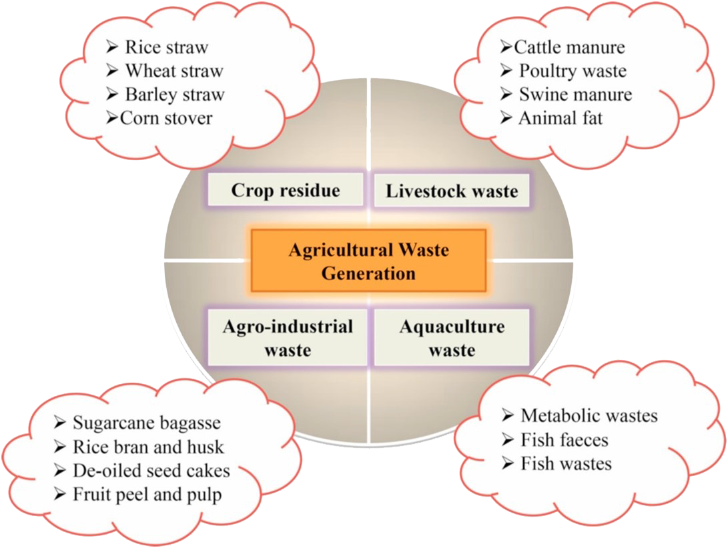
1
Typologies and characterization of agricultural residues
Organic residues that can be used agriculture are categorized based on their origin and composition
Crop residues
Livestock waste
Agro-industrial waste
Acquaculture waste

Slide 5
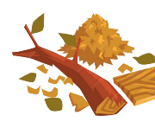
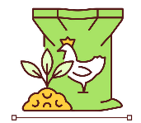
1
Crops residue: stems, leaves, and other plant parts left on the field after harvesting. Variable composition
Silage Residues: residues from the ensiling process used to preserve forage crops.
Poultry Litter: Mixture of chicken droppings and bedding material.
Manure: animal waste, often mixed with bedding material, generated on farms
Wastewater Sludge: from treatment of agricultural or food processing wastewater. Careful handling due to potential contaminants
Food Processing Residues: byproducts generated during food processing
Aquaculture Residues: Waste generated from aquaculture activities.
Wood Residues: residues from wood processing industries or tree pruning
8
2
N/C
7
C/N/P
N/P
3
C/N/P/K
6
4
5
Module: A / Learning Unit: 4 / Sub Unit: 1

Slide 6
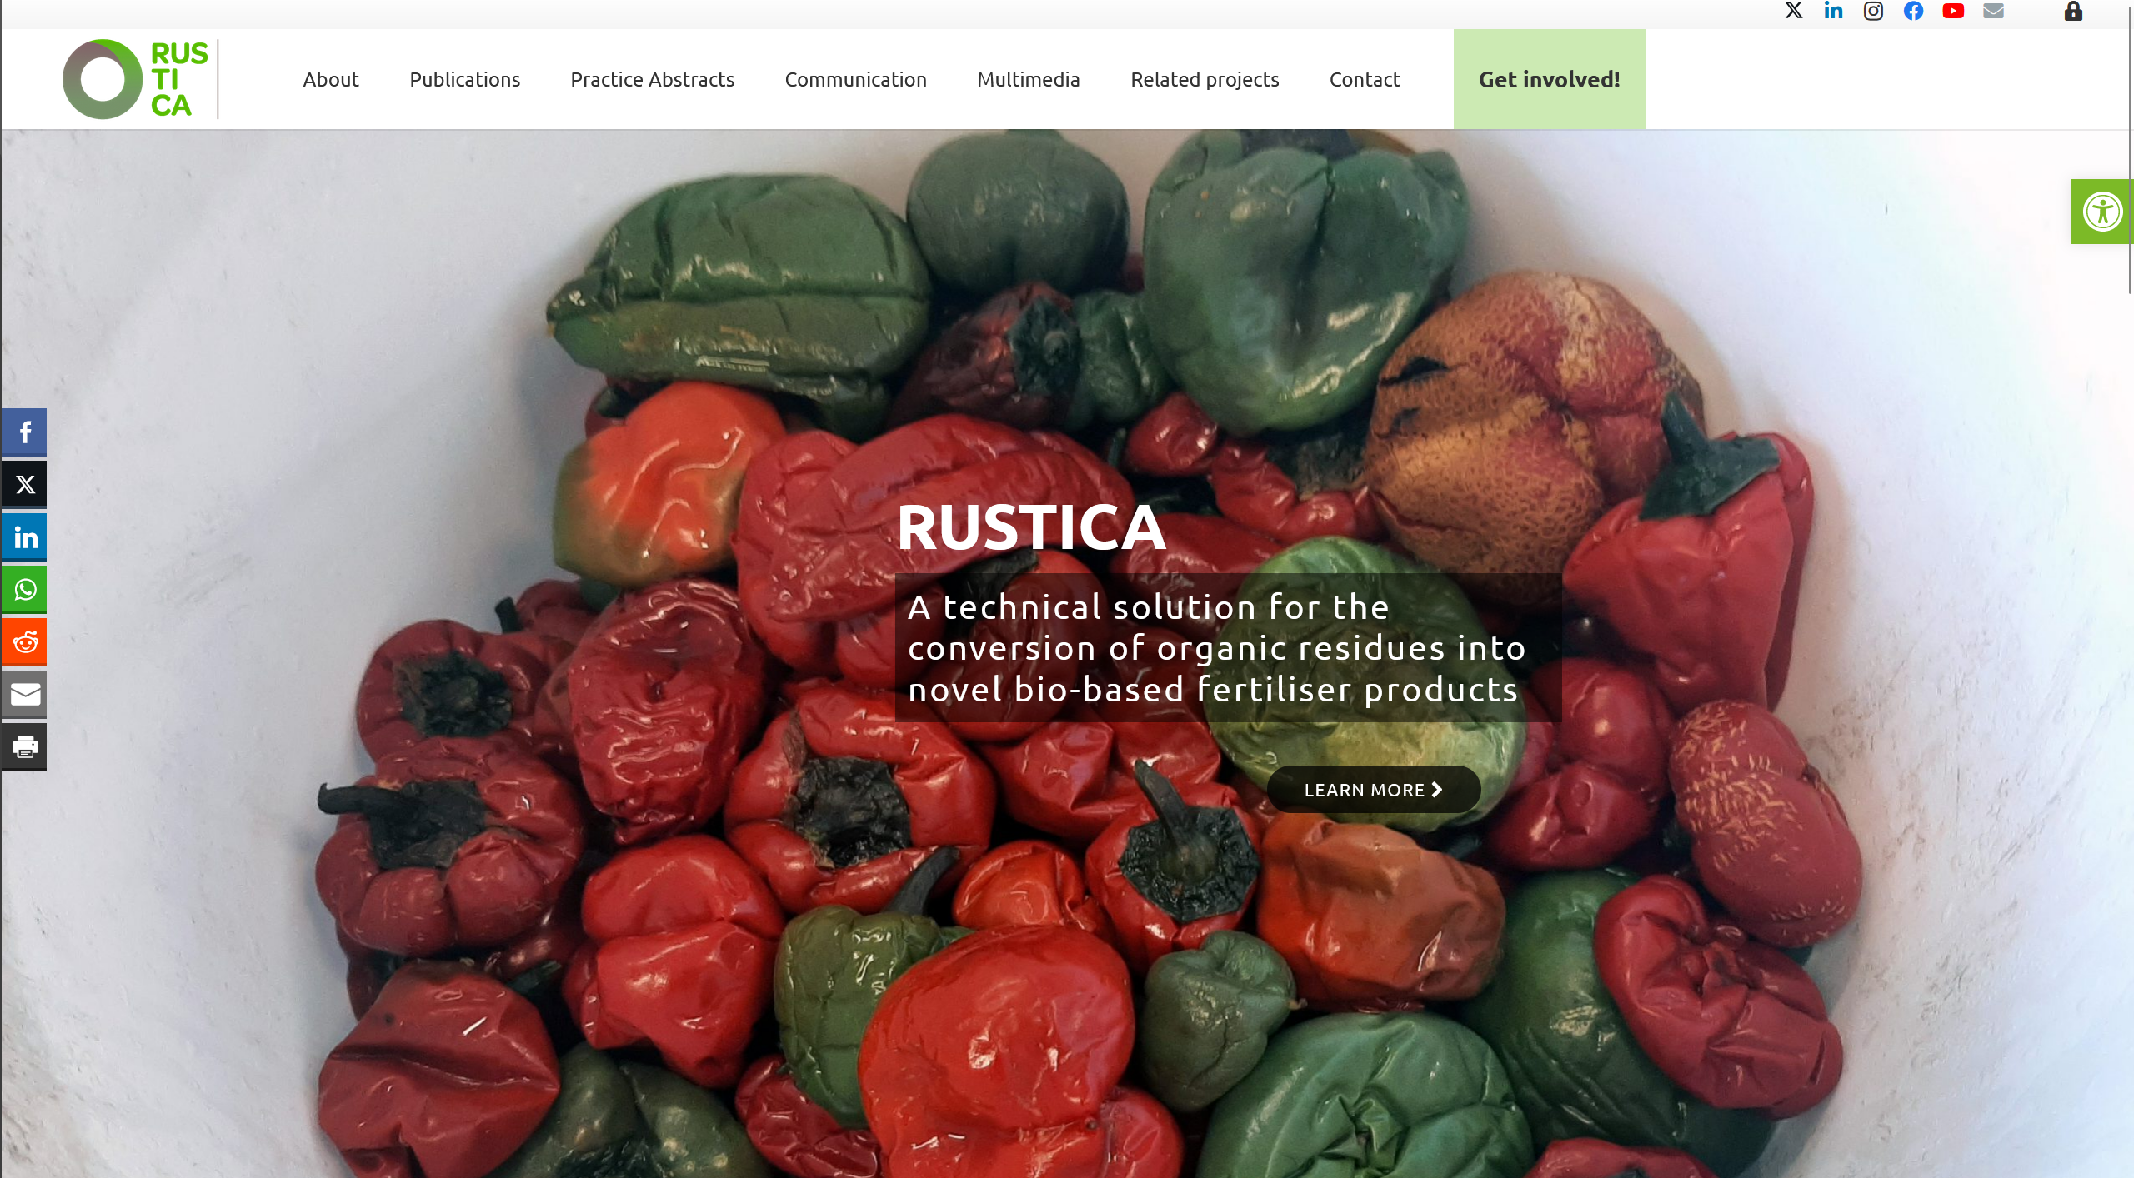
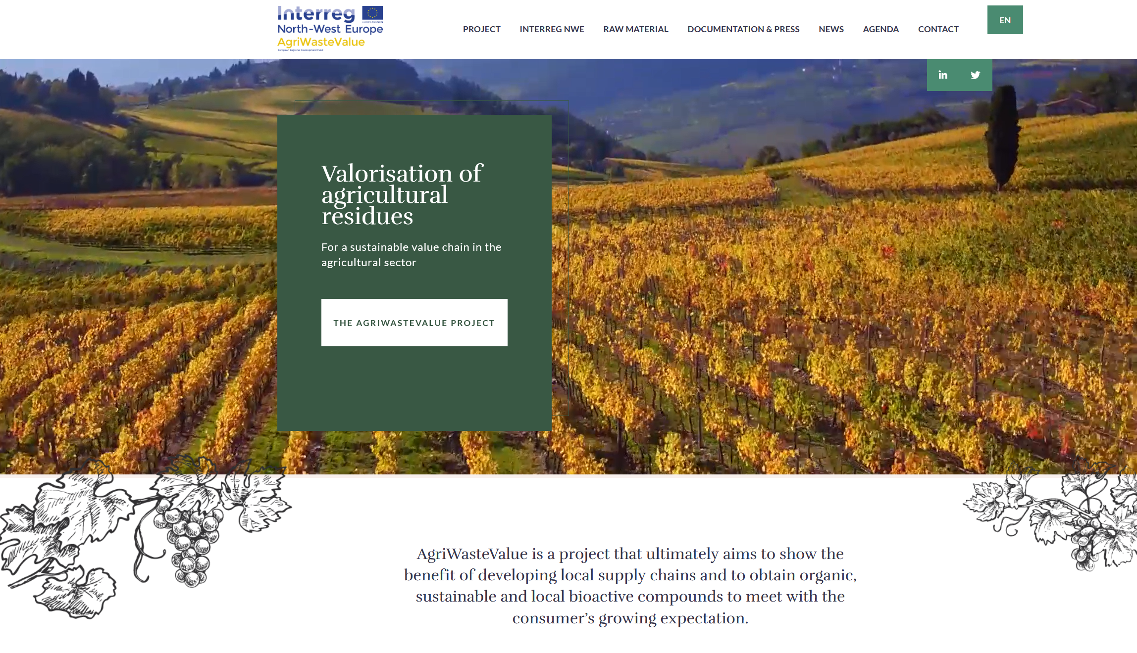
research and innovation
At present, there are many ongoing research and EU-funded projects investigating solutions and technologies aimed at recovering not only useful nutrients in agriculture, but also elements and molecules for use in other sectors.
EU Horizon 2020
Rustica project
Technical solution to convert organic residues from fruit and vegetable into novel bio-based HQ fertiliser products that address the needs of modern agriculture
Einterreg North-West Europe AgriWasteValue
To transform agricultural residues into bioactive compounds for industrial sectors as cosmetic and nutraceutical. Secondly into energy, chemical and agricultural fields
European NOMAD project
projectnomad.eu
There are experience and ongoing research on the use as a fertiliser of organic residues from bioenergy production processes.

Slide 7
2
Biochar as a solution for sustainable agriculture
Biochar is a type of charcoal produced through the pyrolysis process (organic materials are heated in a low-oxygen environment). The result is the degradation of the materials into a carbon-rich substance. Biochar production is often carried out using various biomass sources, including wood chips, crop residues and other waste organic materials.
KEY CHALLENGES
Energy
consumption
Trasportation & distribuition
Feedstock selection
Lack of standardization
Social/Ethical Concerns

Slide 8
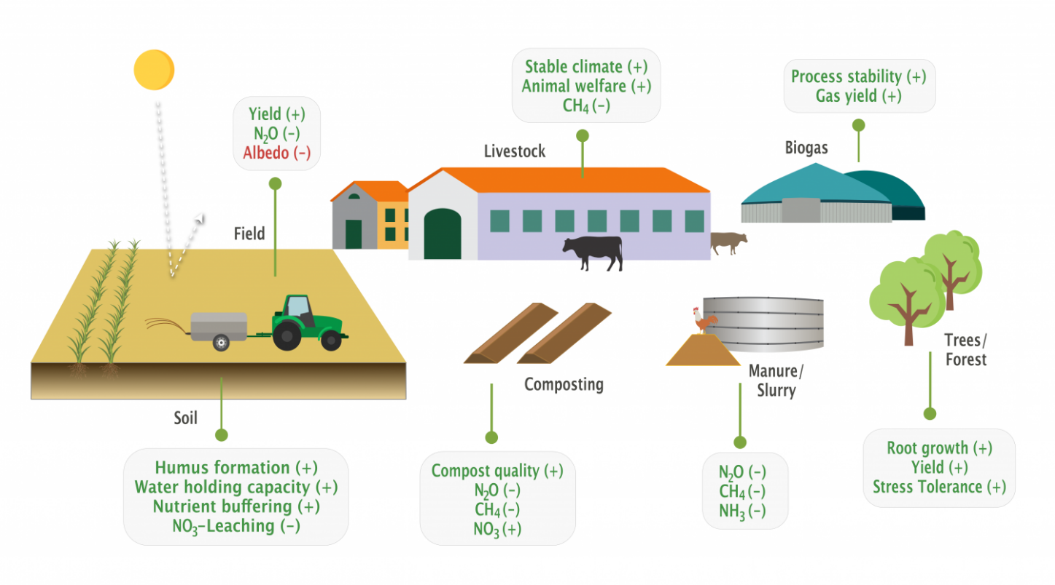
Biochar can be produced from various organic waste materials, providing a way to recycle and repurpose agricultural residues, forestry waste, and other biomass
what is biochar?
the biomass pyrolysis process
Benefits of biochar application in agriculture
(Source: European Biochar Industry Consortium)

Slide 9
management practices
safe handling and storage of biochar is essential to minimize potential risks and maximize its benefits
Biochar can generate dust, which may be harmful when inhaled. To minimize dust, moisten the biochar before handling or use wetting agens. This is also the best way to prevent your biochar from being lost to wind
Biochar is highly flammable, especially in fine particulate form. Keep fire extinguishers readily available and ensure that your storage area complies with fire safety regulations
Store biochar in a dry and well-ventilated area to prevent moisture absorption and the growth of moth or bacteria. Use sealed containers or bags to protect it from environmental contaminants.

Slide 10
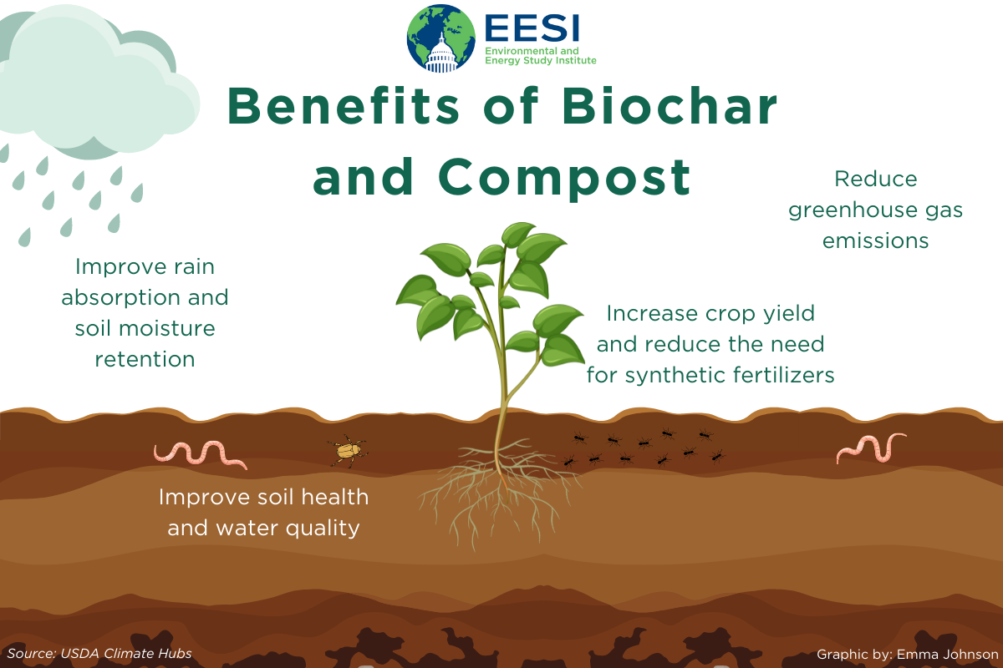
where and how to put biochar
biochar works synergistically with organic matter. Incorporating biochar alongside compost or other organic materials enhances nutrient retention and improves soil microbial activity. Biochar can be used not only as soil amendment but also for contaminants filtration and erosion reduction.
As soil amendment put biochar into the plant’s root zone incorporating the biochar into 4 to 6 inches of soil depth
With erosion reduction or contaminants filtration action place biochar where necessary (landscapes socks and filtration systems) e.g. where water is running off land, roots, roads or contaminated sites

Slide 11
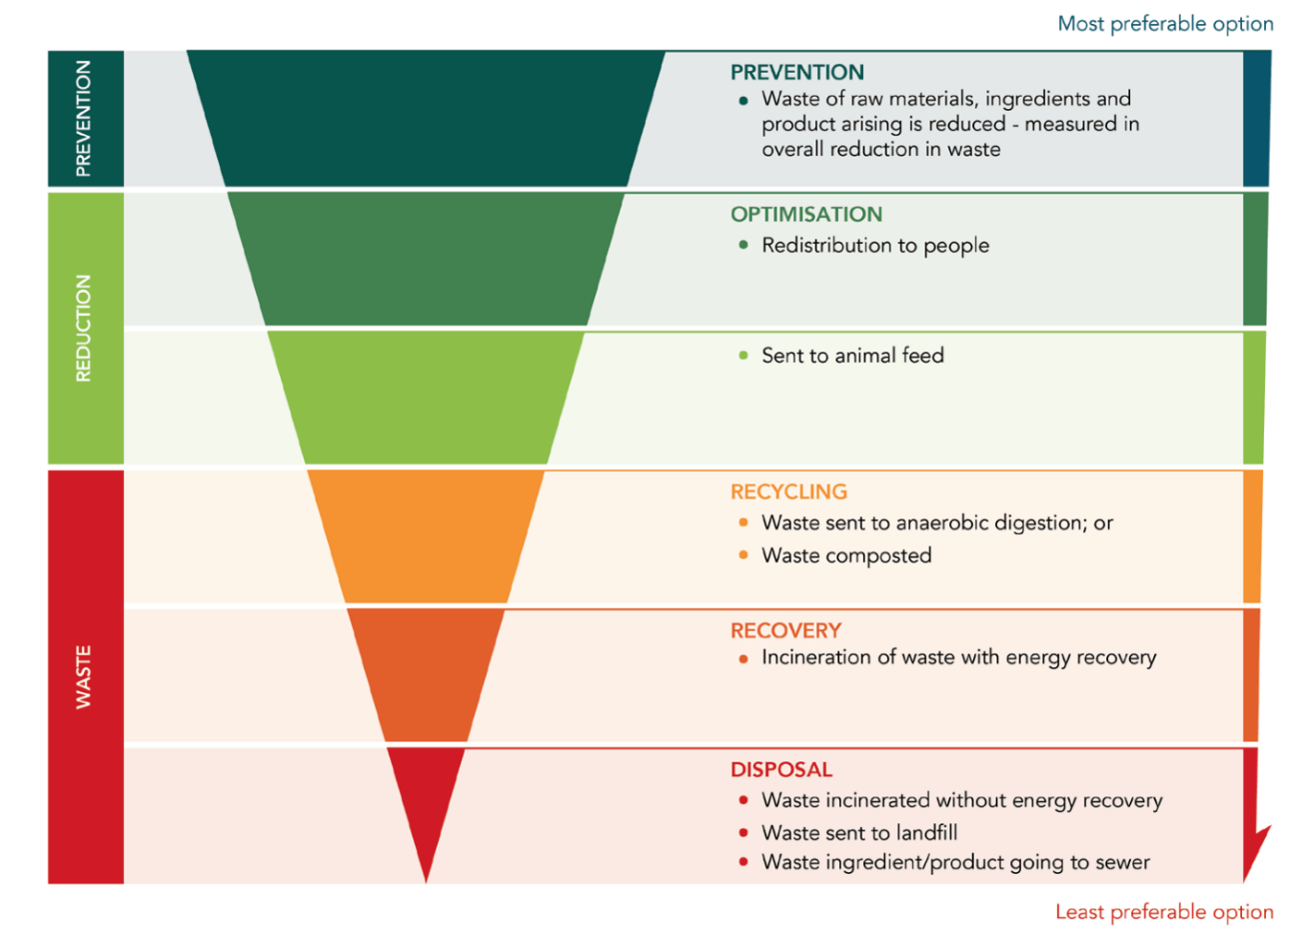
3
Organic residues management and logistic considerations
Effective residues management and logistics are essential components of modern agriculture and environmental stewardship. Planning, collection, and disposal are critical for both environmental sustainability and resource efficiency.
First step towards a more sustainable resolution of the waste is to adopt a sustainable production and consumption approach along the global food supply chain.
We can do a lot to improve the way how we can reuse materials before they can be considered as waste.
waste management hierarchy
Incineration of waste, even if with energy recover, should be considered as last option before the waste disposal.

Slide 12
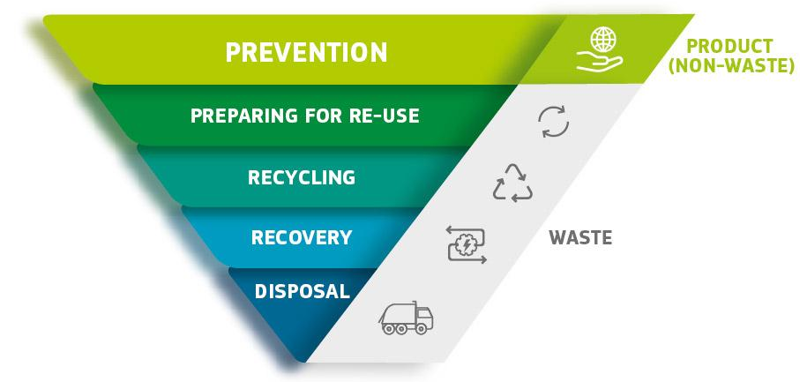
The EU Waste Framework Directive
The Waste Framework Directive sets the basic concepts and definitions related to waste management, including definitions of waste, recycling and recovery
by 2025, the preparing for re-use and the recycling of municipal waste shall be increased to a minimum of 55 %, 60% and 65% by weight by 2025, 2030 and 2035 respectively
the Waste Framework Directive provides additional labelling, record keeping, monitoring and control obligations from the "cradle to the grave"
by-products is a substance or object, resulting from a production process, the primary aim of which is not the production of that item. By-products can come from a wide range of sectors with different environmental impacts
End-of-waste criteria specify when certain waste ceases to be waste and becomes a product, or a secondary raw material
Directive 2008/98/EC

Slide 13
The hidden cost of the food we throw out and that can be reused as organic matter

Slide 14
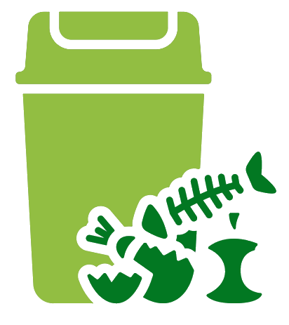
4
Processes and treatments for successful reuse
The processes and treatments designed for the successful reuse of various materials in agriculture represent a dynamic and innovative realm at the intersection of environmental sustainability, resource efficiency, and agricultural productivity
NUTRIENT RECOVERY
From the main 3 losses streams
Livestock manure
Sewage sludge
Food chain waste

Slide 15
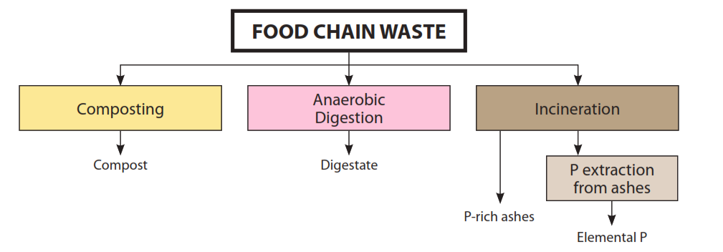
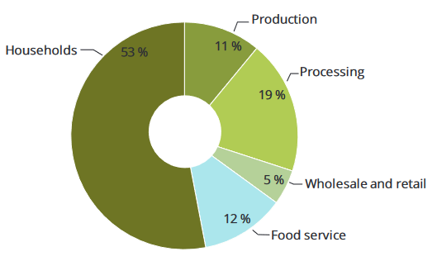
Food chain waste
In 2017, the EU-28 generated 249 million tonnes of municipal solid waste (Eurostat, 2019), of which about 34 % (86 Mt, around around 175 kg/capita/yr) was bio-waste.
Nutrients can be recovered from biodegradable waste through composting, anaerobic digestion and incineration. According to the European Commission, maximizing recovery and recycling could potentially substitute 10% of phosphate fertilisers with compost and reduce soil degradation by 3-7% due to the addition of organic matter.
Food waste generation by sector, EU, 2012 (EEA Report n.04/2020)

Slide 16
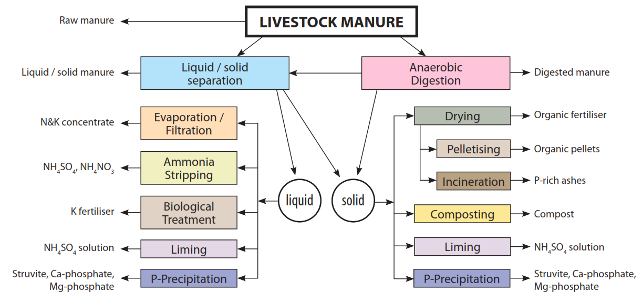
Livestock manure
Any excrement and/or urine of farmed animals other than farmed fish, with or without litter. The regulation establishes limitations on its handling, transport and traceability. Manure use on land is regulated by the Nitrates Directive (91/676/EEC), that establishes a threshold of 170 kg N/ha only in Nitrate Vulnerable Zones.
In general, nutrient recovery from manure implies dewatering, concentrating and converting manure into a stable product that can be easily stored, transported and applied.
Manure recovery processes use two types of substrates: raw manure or digested manure
Direct manure application on agricultural fields is often driven by the motive to dispose conveniently of material considered a nuisance rather than valued as a nutrient. The dosage may not always be based on calculations of crop nutrient demand…

Slide 17
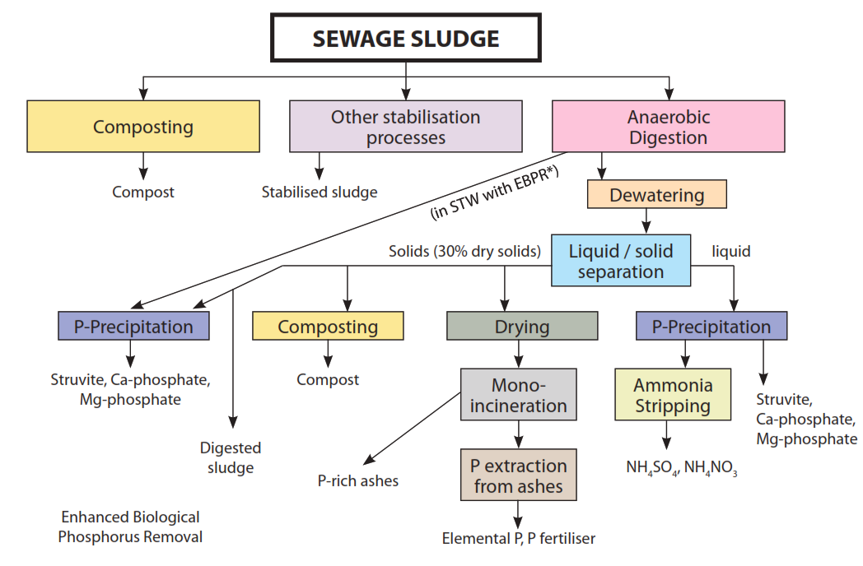
Sewage sludge
Sewage sludge is an organic substrate relatively rich in nutrients and trace elements. Sludge composition varies regionally and seasonally and there is little monitoring of the concentration and amounts of nutrients in sewage reaching Sewage Treatment Systems.
Anaerobic digestion is the most common treatment for sludge that is later applied to land. Anaerobic digestion stabilises the organic compounds in sludge and reduces the odour.
The biogas generated by the process can be used
internally in the plant or used to produce electricity.
Sludge is used in agriculture as a source of nutrients (N and P) for plants and also a way to replace organic matter back into the soil.
Sludge application to agricultural land is framed by the
directive on the use of sludge in agriculture (86/278/EEC).

Slide 18
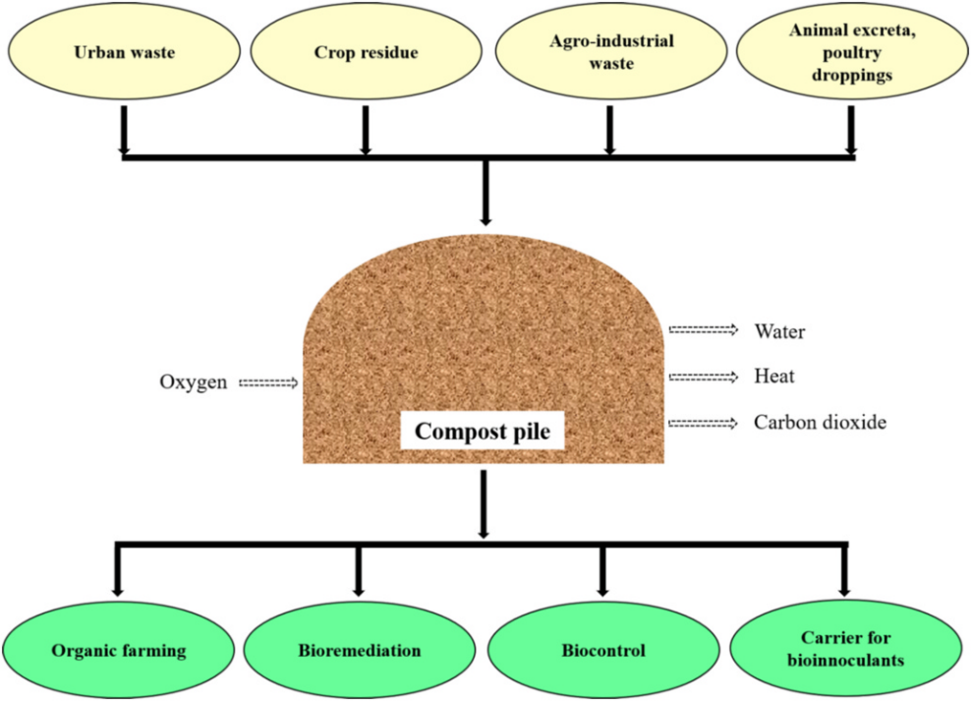
Composting
A natural biological process where microorganisms break down organic materials into a nutrient-rich soil conditioner. Organic waste, including kitchen scraps, yard waste, and crop residues, is mixed in proper proportions (carbon to nitrogen ratio), aerated, and regularly turned to promote decomposition.
The process can be enhanced introducing forced aeration (Aerated Static Pile (ASP) Composting) to increase oxygen supply and accelerate decomposition.
Organic waste is placed in a pile with aeration pipes, and a blower forces air through the pile. This method speeds up the composting process.

Slide 19
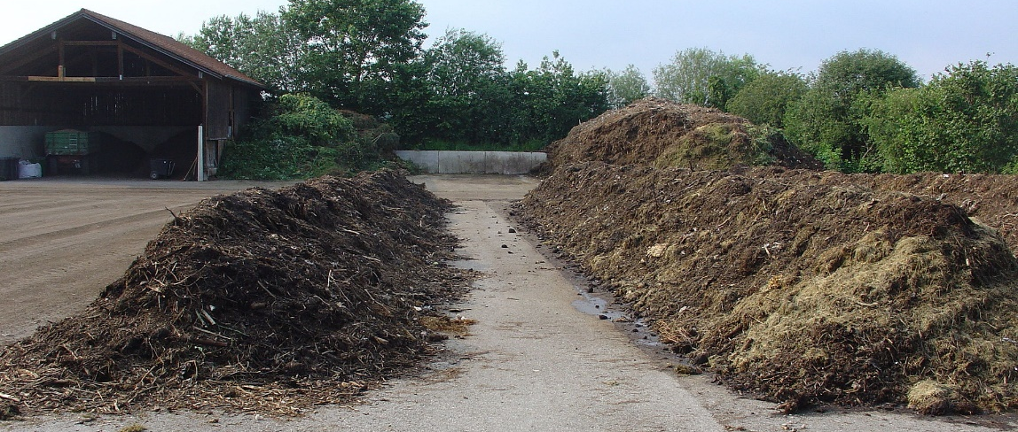
Composting
It is possible to recycle agricultural residues in organic farming by on-farm compost production
Correct starting mixture!
Temperature of the pile should be continuously controlled to evaluate the ending phase of the process (when the inside temperature approaches the external one).
The composting pile moisture should be checked weekly and kept between 40 and 70%.
Degraded land begins to bloom thanks to European composting projects
25% of all compost produced in the EU 27, CH, NO and UK is certified to the ECN’s quality insurance scheme. European Compost Network (ECN) is a European non-profit membership organisation promoting sustainable recycling practices in composting, anaerobic digestion, and other biological treatment processes of organic resources.

Slide 20
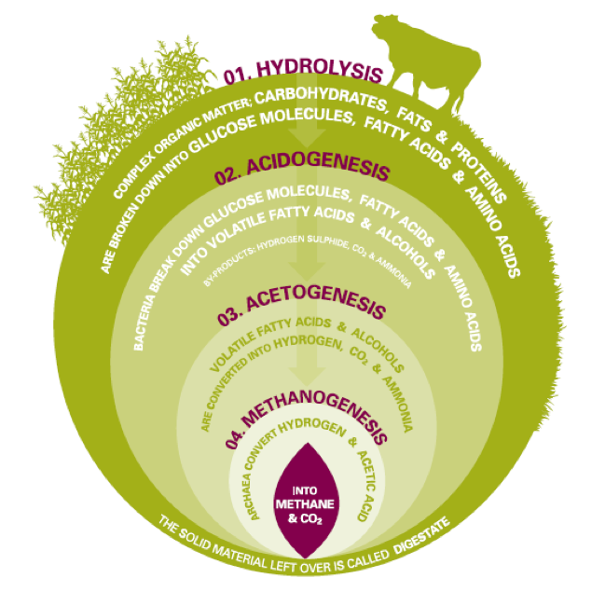
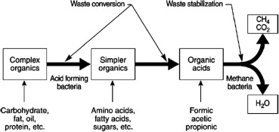
Anaerobic digestion
Process where microorganisms break down organic matter in the absence of oxygen, producing biogas (methane and carbon dioxide) and a nutrient-rich slurry. Manure, food waste, and wastewater solids are placed in a sealed, oxygen-free environment. The biogas generated can be used for energy, and the digested material (digestate) is a valuable fertilizer.
The biomass added to the digester is broken down into sugars, amino acids and fatty acids (hydrolysis), fermented to produce volatile fatty acids and alcohols (acidogenesis) followed by the conversion into hydrogen, carbon dioxide and ammonia and, finally methanogens produce biogas from acetic acid and hydrogen.
AD of food waste takes place at two optimum temperature ranges, 35-40°C (mesophilic) and 55-60°C (thermophilic
The four stages of the AD process

Slide 21
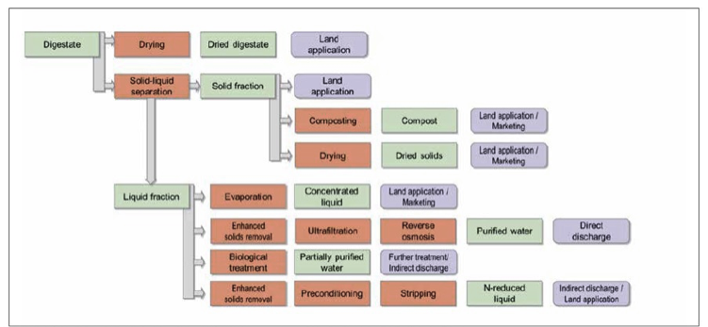
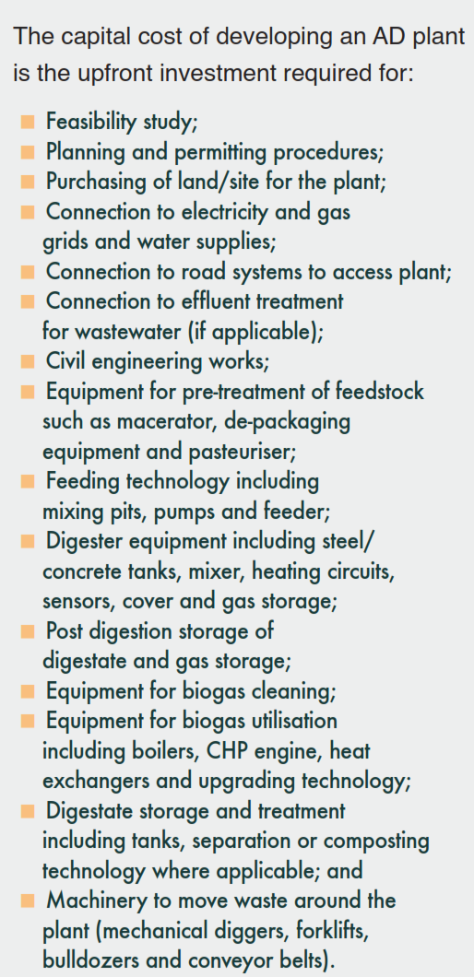
Anaerobic digestion
Digestate may be used whole or separated into solid and liquid parts. The solid fractions may be processed into compost and/or dried into dried solids for land application. The liquid fractions maybe concentrated into liquid fertiliser or partially treated and sent to a wastewater treatment facility or fully treated and discharged
Data source: 2018 World Biogas Association.

Slide 22
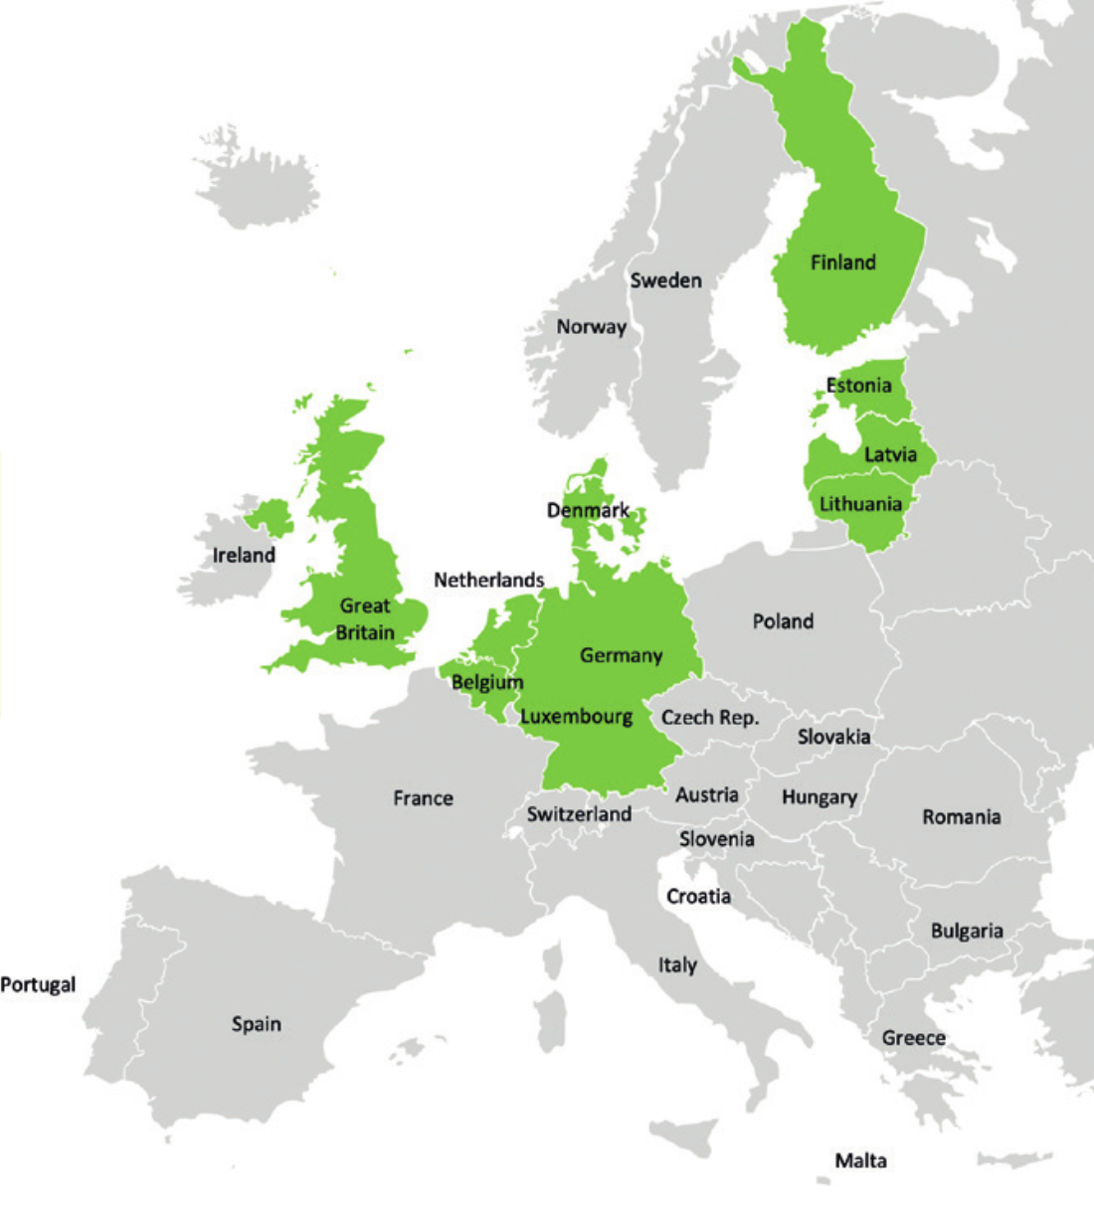
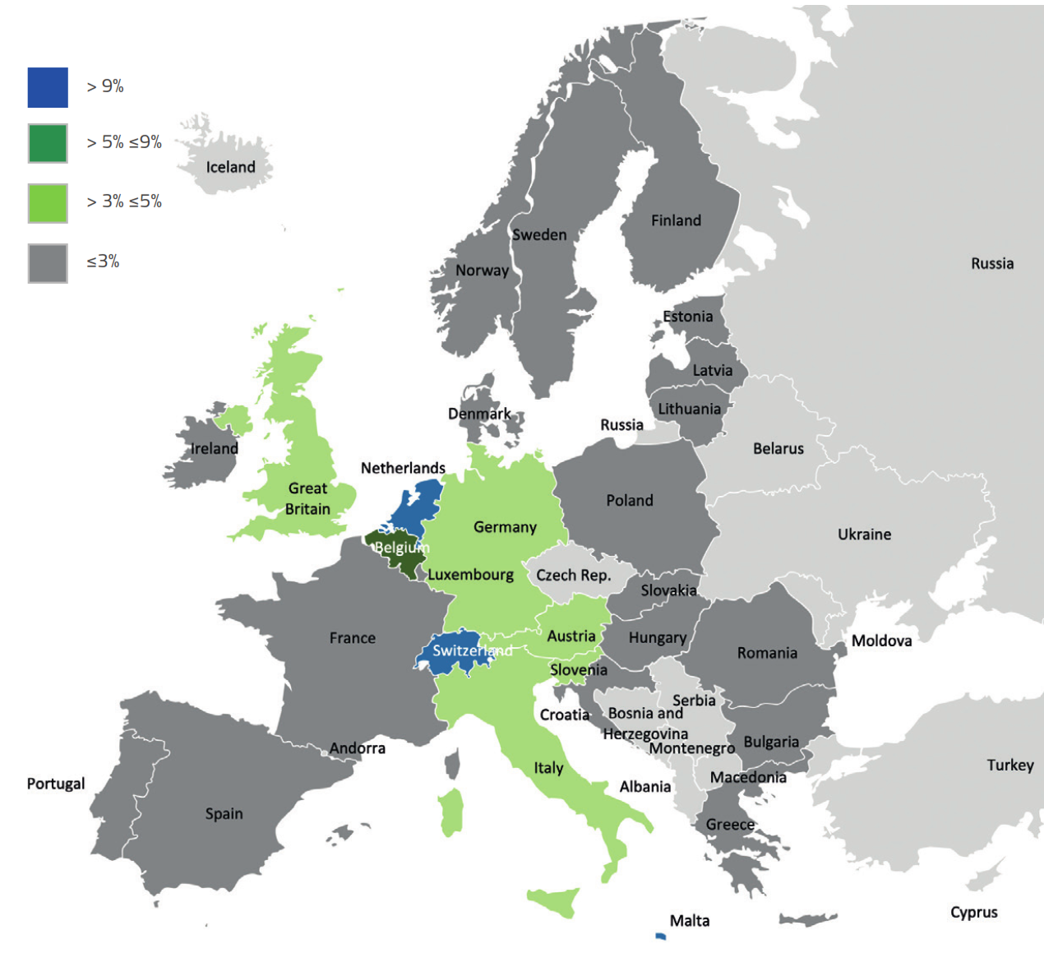
Carbon recycling & soil improvement
All European soils suffer from erosion. 2% of arable land and 16% of modaretely eroded agricultural land could benefit from compost application at 10 ton/ha
Countreis that currently (2022) produce more than enough compost to apply to all of their eroded agri-cultural soils (10 ton/ha per annum)
Most European countries don’t manufacture enough compost to apply to their eroded soils
The fraction of arable land could benefit from compost produced at currently estimated amount is very low
Data source: ECN rapport 2022.

Slide 23
5
Cost/benefit - from waste to opportunity
The cost and benefits associated with the reuse of organic waste can vary depending on factors such as the type of waste, the chosen reuse method, local regulations, and the specific goals of the reuse program
COSTS
Infrastructure Investment
establishing facilities initial investment in infrastructure, equipment, and technology
Transportation Costs
costs associated with vehicles, fuel, and labour
Operational Costs
labour, energy, maintenance, and monitoring
Regulatory Compliance
Meeting environmental regulations and standards may require additional investments in monitoring
Market Challenges
BENEFITS
Reduced Waste Disposal Costs
reduction of landfill disposal fees
Soil Improvement and Fertility
costs associated with vehicles, fuel, and labour
Energy Generation
Biogas for energy generation is an example
Economic Opportunities
Such as job creation in recycling facilities, the production of compost or bioenergy
Greenhouse Gas Reduction

Slide 24
Advantage & disadvantages
overview on advantages and disadvantages related to the different management strategies of organic waste
Animal feed
Residues| Maize, sugarcane, grain, sorghum,soybean, wheat, and vegetables
PROS |Nutrient source for animals, Waste reduction
CONS |Toxicity in feeds due to the toxins produced by the crop itself or applied to the crop (e.g., insecticides or herbicides) and produced by molds and fungi
Composting
Residues| Leaves, grass clippings, plant debris, food scraps
PROS |Organic fertilizer, solves environ-mental problems, kills pathogens, reduce germination of weeds and odour, reduces landfill waste
CONS |Cost for site preparation and equipment can be high, lengthy treatment period, issues such as odours and dust

Slide 25
Advantage & disadvantages
overview on advantages and disadvantages related to the main management strategies of organic waste
Mushroom
cultivation
Residues| Wheat straw, paddy straw, rice straw, rice bran, molasses, coffee straw, tea leaves, cotton straw, saw dust
PROS |Cost effective farming, practices to fight the malnutrition and environ-mental pollution caused by these wastes
CONS |Lack of available market and promotion in local level
Surface mulching
Residues| Bark chips, grass clippings, wheat or paddy straw, plant leaves, compost, rice hulls and sawdust
PROS |Prevents erosion, moderate soil temp. provide nutrients, kills pathogen and pests, increase water retention, ….
CONS | Keep the soil too moist on poorly drained soils (low oxygen), breeding spots for some pests, mulches (hay and straw) contain seeds which may become weeds

Slide 26
Advantage & disadvantages
overview on advantages and disadvantages related to the main management strategies of organic waste
Biofuel
Residues| Rice (bioethanol), wheat (bioethanol) and corn straw (bioethanol) as well as sugarcane bagasse (biofuel)
PROS | Renewable, reduced dependence on fossil fuels, waste reduction
CONS | Cost for setting up biomass energy plant is expensive
Paper & pulp industry
Residues| Wheat straw, cotton rags, cotton linters, softwood
PROS | Less environmental impact than raw material processing, prevention of deforestation, constant waste residue availability
CONS | Lack of available market and proper promotion in local level

Slide 27
6
European legislation on organic residuals reuse in agriculture
The European legislation on organic residuals reuse in agriculture is aimed at promoting sustainable agricultural practices and environmental protection. EU has a framework for waste management and recycling that includes organic residuals
Waste Framework Directive | (Directive 2008/98/EC) establishes principles and definitions related to waste, recycling, and recovery. It encourages the reuse of organic residuals where feasible
Circular Economy Action Plan | the European Green Deal and the Circular Economy Action Plan emphasize the importance of sustainable use and management of organic residuals in agriculture to reduce waste and promote resource efficiency
Specific regulations and guidelines may vary from one country to another within the EU. Local regulations can provide more detailed and region-specific guidance on the use of organic residuals in agriculture

Slide 28
EU regulation on fertilising products (Reg. UE 2019/1009)
Applied since 16 July 2022, the new rules are boosting the role of the Single Market, help reduce the environmental impact of fertilisers, limit their risk on human health as well as reduce Europe’s dependency on imported fertilisers
Easier for producers of organic fertilisers and from recovery chains to sell products with harmonised quality standards for all types of materials that can be marketed throughout the European Union
More choice for farmers, reduced risks for the environment and consumer health.
The case of organo-mineral fertilisers with 'low cadmium content' <20 mg/kg allows for improved soil protection and reduced health and environmental risks compared to mineral fertilisers with high cadmium content.
Promotion of the use of organic and biological fertilisers derived from the recovery of waste materials.
Establishment of EU-wide quality, safety and environmental criteria for 'EU' fertilisers
Full harmonisation of the internal market will eliminate all costs related to mutual recognition and/or divergence of national standards, as well as ensuring a uniform level of protection of human health and the environment

Slide 29
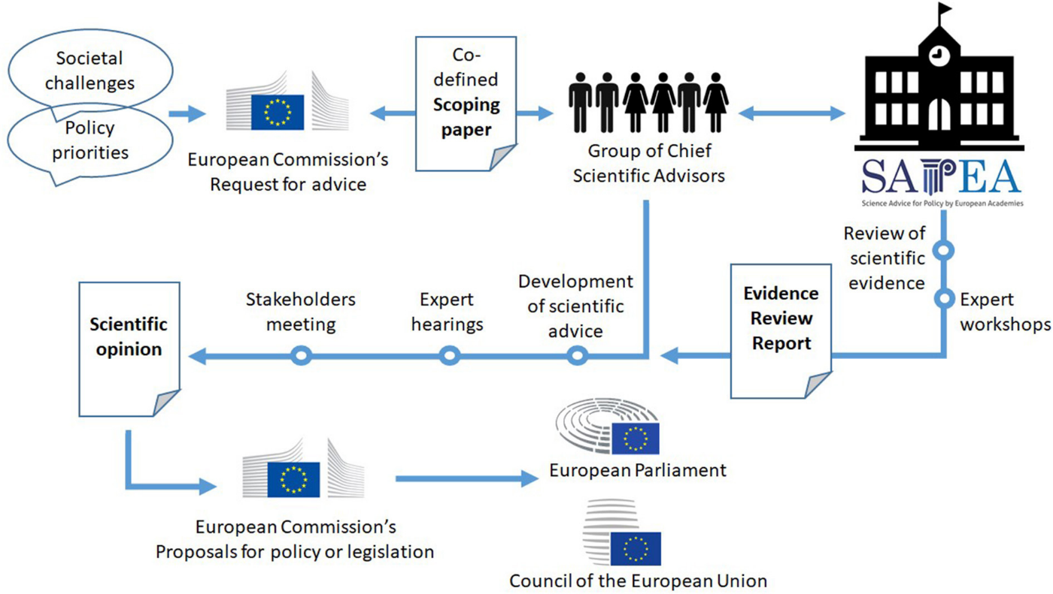
EU’s science-policymaking interactions
The European Commission’s Science Advice Mechanism (SAM) was created in 2016 to replace the Chief Scientiﬁc Advisor who was until then the sole scientiﬁc advisor, reporting directly to the President of the European Commission.
SAM is based on an expert Group of Chief Scientiﬁc Advisors nominated by the European Council

