Slide 2
Course: (VET-B1)
Module: (Digital Technologies and Artificial Intelligence)
Learning Unit: (Data Science and Precision Technologies)
Authors: (CERTH)

Slide 3
Introduction to data science, to sensors and other monitoring devices in agriculture
Foundations of Data Science
Data science is a multidisciplinary field that extracts valuable insights and knowledge from structured and unstructured data. In the context of agriculture, data science plays a pivotal role in transforming traditional farming practices into precision and data-driven approaches. Agriculture, once reliant on experience and intuition, is now embracing the power of data to optimize operations, increase productivity, and address sustainability challenges.
What is Digital Agriculture?
Also known as AgTech or smart farming, is a rapidly evolving field that uses technology to enhance agricultural practices, aiming to increase the efficiency, productivity, and sustainability of food production systems. Digital Agriculture involves incorporating digital technology and data-driven methodologies into farming practices.

Slide 4
Introduction to data science, to sensors and other monitoring devices in agriculture
Artificial Intelligence for Digital Agriculture
As AI systems learn, they are able to approach or sometimes exceed human performance in particular areas. From transcribing handwritten texts, to recognizing objects and patterns in images, to providing complex predictive analysis, AI can take on a share of many “clever” tasks (that are often resource-intensive) and complete them at a fraction of the time and effort required by a human, especially if coupled with other technologies.
Αn AI system can quickly identify areas that need water or fertilizers by analysing real images of farmland taken by drones, allowing for targeted use of these resources. Increasingly today AI is considered one of the most potent solutions to the many challenges the agricultural sector faces in low- and high-income countries

Slide 5
Introduction to data science, to sensors and other monitoring devices in agriculture
Areas of Application
Crop, soil, and livestock monitoring. AI systems can support farmers in monitoring the condition of their crops, soil, and livestock and provide timely recommendations on particular actions and decisions.
Detection of pests and diseases. AI systems can examine digital images taken by drones, agricultural robots, or farmers using a simple smart phone camera to detect pests and give concrete advice to agricultural workers on how to prevent their spread, treat affected plants or mitigate the damage caused.
Weather and temperature forecasting. AI algorithms are able to assist with local weather and temperature forecasting using historical data and measurements made by local weather stations and field sensors.

Slide 6
Introduction to data science, to sensors and other monitoring devices in agriculture
Predictive analytics. AI can generate accurate predictions about yields, and potentially, the quality of product. This can help farmers to project their revenues as well as make decisions on how much to sell and how much to save for personal consumption. AI systems can also be used to analyze consumption patterns to help predict demand for a particular agricultural product. These predictions can be communicated to producers to avoid any shortage or oversupply
Autonomous agricultural robots and farm equipment. AI systems can be deployed on robotic platforms to direct and control their work performing assistive tasks, such as targeted irrigation, application of fertilizers and pesticides, collection of fruits and transporting equipment around a farm among others.

Slide 7
Introduction to data science, to sensors and other monitoring devices in agriculture
AI technologies rely on automated systems, use of robots and drones and increased implementation of data generation through sensors and aerial images for crops and land use through deep learning technology.
In the coming years, the application of machine learning in various agricultural practices is expected to rise substantially provided several challenges to its widespread deployment are resolved, especially among developing country farmers. They include the prohibitive costs of the technologies, lack of standardization, lack of AI awareness among farmers and limited availability of historical data. While the agricultural sector is likely to see further adoption of AI, it is important that farmers are equipped with up-to-date training to ensure technologies are used and continue to improve.
Smart farming is a modern farming managemental concept with IoT technology to increase the productivity in agriculture. With the use of smart farming, farmers can effectively use fertilizers and other resources to increase the quality and quantity of their crops.

Slide 8
Introduction to data science, to sensors and other monitoring devices in agriculture
What is remote sensing?
The technique of obtaining information about objects on the Earth's surface through the analysis of data collected by special instruments that do not have physical contact with the objects. Thus, remote sensing can also be defined as the identification of an object from a distance (Avery & Berlin, 1992). It refers to the use of satellite or aerial imagery, drones, and sensors to collect data on various aspects of crop health, soil conditions, and environmental factors.
How does it work?
Electromagnetic radiation (EMR) is the basic amount of energy that has the ability to produce work and is measured in joules. Electromagnetic energy is known to be expressed as mechanical, chemical, electrical and thermal energy. Energy is transmitted by contact, transport and radiation. Of these three factors, only radiation is able to transmit energy from one body to another without the intervention of an intermediate carrier and by traversing millions of kilometers in a vacuum medium.

Slide 9
Introduction to data science, to sensors and other monitoring devices in agriculture
Monitoring Devices
1️. Crop Monitoring
What is it: Continuous observation of crop health and growth stages using remote sensing data and imagery.
Benefits for farmers: Timely identification of issues, efficient crop management, and increased yield.
Benefits for the environment: Targeted interventions reduce resource waste and minimize negative environmental impacts.
Market solutions: CropX, Taranis, Farmers Edge, SatSure, Orbital Insight.

Slide 10
Introduction to data science, to sensors and other monitoring devices in agriculture
2. Soil Moisture Monitoring
What is it: Measurement of soil water content using remote sensing techniques and sensors.
Benefits for farmers: Optimal irrigation scheduling, reduced water waste, and improved crop health.
Benefits for the environment: Conserved water resources and reduced runoff pollution.
Market solutions: Sentek, AquaSpy, Irrometer, METER Group, Arable Labs.

Slide 11
Introduction to data science, to sensors and other monitoring devices in agriculture
3. Nutrient Management
What is it: Assessment of soil nutrient levels using remote sensing data to inform precise fertilizer application.
Benefits for farmers: Improved crop yield, reduced fertilizer costs, and optimized resource use.
Benefits for the environment: Minimized nutrient runoff and reduced environmental pollution.
Market solutions: Yara, AgroCares, Cropnuts, TerrAvion, Agrology

Slide 12
Introduction to data science, to sensors and other monitoring devices in agriculture
4️. Weed Detection
What is it: Identification and mapping of weeds in agricultural fields using remote sensing imagery.
Benefits for farmers: Targeted weed control, reduced herbicide costs, and increased crop yield.
Benefits for the environment: Decreased herbicide use and minimized impact on non-target species.
Market solutions: Blue River Technology, ecoRobotix, Green Atlas, Bilberry, AgEagle.

Slide 13
Introduction to data science, to sensors and other monitoring devices in agriculture
Precision Agriculture solutions
To mitigate the effects of this issue several digital and precision agriculture solutions can be adopted:
Soil Sensors: these devices are placed in the field to provide real-time data on soil moisture, temperature, and nutrient content. This information can guide farmers to apply water, fertilizers, and other inputs only when and where they are needed, reducing excessive use and soil degradation.
Precision Fertilizer Application: GPS-guided equipment can apply fertilizers with high precision, reducing over-application and ensuring nutrients are delivered where they are most needed. This can improve soil health and reduce nutrient runoff into nearby waterways.

Slide 14
Introduction to data science, to sensors and other monitoring devices in agriculture
Cover Cropping and Crop Rotation Decision Support Tools: these digital tools help farmers to plan and manage crop rotations and cover cropping, which can improve soil health and reduce the need for synthetic fertilizers. They use data on local conditions, crop characteristics, and other factors to provide recommendations.
Remote Sensing Technologies: satellite or drone-based imagery can provide a larger-scale view of the farm and reveal patterns and issues such as soil erosion or nutrient deficiency that might not be visible at ground level.

Slide 15
Uses of Precision Technologies in agriculture
Mapping of production in vineyards
One of the first applications in horticulture was the mapping of production in vineyards for winemaking where harvesting was done by machines. Two basic principles were used:
1. Placing force cells under the grape conveyor belts and weighing them as the machine moved (Figure 1). In machines with vibration-induced rack gathering buckets, the force cells are placed under the belt that moves the buckets and weigh the production.
2. Measuring the volume of grapes as they move on the conveyor belt (Figure 2). The measurement is done with ultrasound which estimates the volume of the grapes and then converts it to weight

Slide 16
Uses of Precision Technologies in agriculture
Applications in Cotton
The first application of production mapping was on a fifty-acre field in Karditsa in 2001. Since then and for the next four years, intensive measurements were carried out both in this field and in neighboring fields.
From all the measurements, but also from others in other areas of Thessaly, it turned out that there was significant variability in production, even in small fields which was the basis for an efficient application of Precision Agriculture.

Slide 17
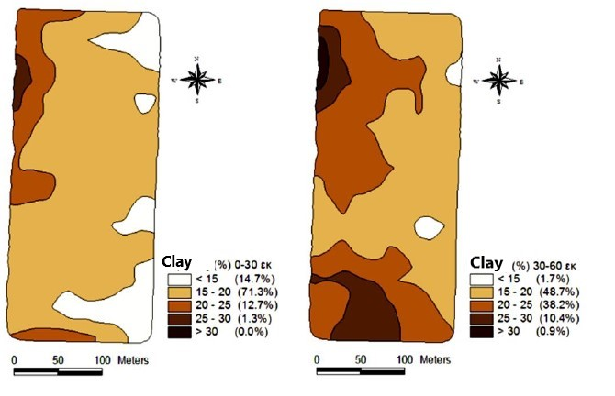
Uses of Precision Technologies in agriculture
The application in the field of Karditsa included measurements of electrical conductivity using a VERIS 3000 sensor, measurements in different fields and correlation of the calibration coefficient with varieties, as well as measurements of the variability of the quality characteristics of the production.
Clay content of the soil

Slide 18
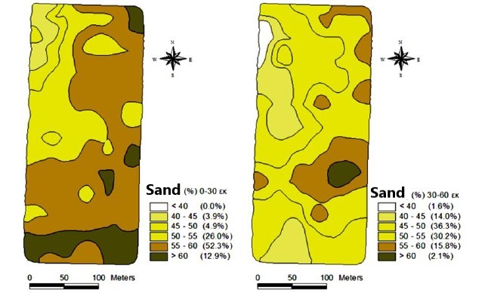
Uses of Precision Technologies in agriculture
Sand content of the soil

Slide 19
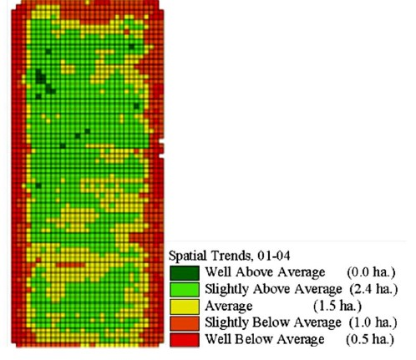
Uses of Precision Technologies in agriculture
Map of production trends from the four years of cotton production mapping

Slide 20
Uses of Precision Technologies in agriculture
Advanced Pest Detection Technologies
Cutting-edge technologies for pest detection, including drones, sensors, and artificial intelligence. Understand how these tools enable early pest identification, allowing for targeted and timely pesticide application.
Smart Traps: Smart traps are equipped with sensors that can detect specific pest pheromones or behaviors. These traps provide real-time data on pest activity, helping farmers monitor pest populations.
Automated Drones: Drones equipped with high-resolution cameras and sensors can cover large agricultural fields efficiently. These drones capture detailed images and data that are analyzed using machine learning algorithms.
Remote Sensing Satellites: Satellite imagery and remote sensing technologies provide a broad-scale view of agricultural landscapes. These satellites can detect changes in crop color, patterns, and health. Advanced analytics, including spectral analysis, help identify areas affected by pests.

Slide 21
Conclusion
All the above technologies that we described are contributing to increasing agricultural productivity. Accurate farm management, correct application of inputs at the right time and in the right quantities can make a significant contribution to increasing yields and achieving the 70% target.
In the near future, better standards with better predictions of weather conditions may contribute to higher yields. Navigation technologies can reduce ground compaction and help increase yields. Vehicle traffic control systems for many years have helped to limit compaction, but also to improve the accuracy of routes by reducing gaps or overlaps in the application of inputs.
Precision agriculture is therefore a weapon in the hands of farmers to achieve better yields and meet society's expectations. A second element is the saving of non-renewable resources. Agriculture is not a particularly large consumer, but it can contribute to saving resources. Technologies such as variable rate application of fertilisers and other chemicals contribute substantially to reducing energy consumption (nitrogen fertilisation) and limited phosphorus and potassium reserves.

Slide 22
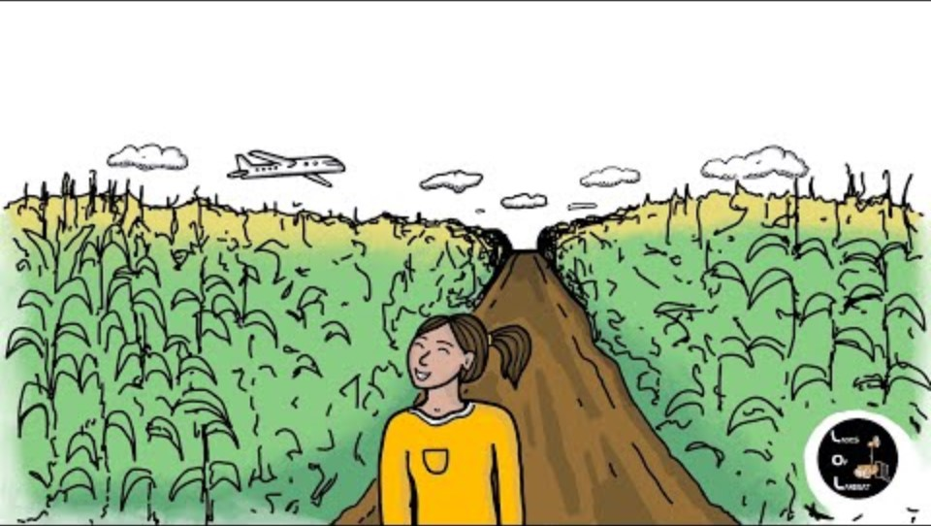
Case studies
USGS: Earth Observation User Case study: Using Landsat to Map Agricultural Yields and Irrigation Use

Slide 23
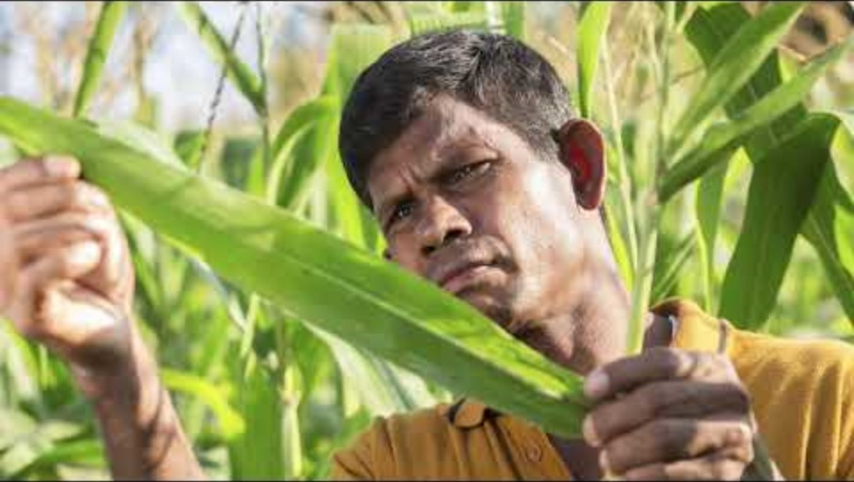
Modern Farming Solutions
Food and Agriculture Organization of the United Nations (FAO),

Slide 24
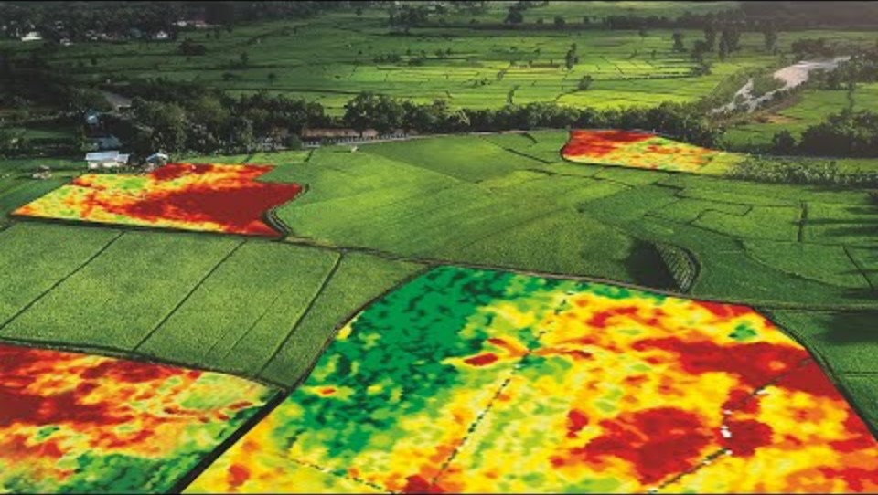
Case studies
Geospatial World: Application of Remote Sensing in Precision Farming. Technological advancements in precision agriculture have made it possible for farmers to improve their productivity effortlessly

Slide 25


