Slide 2
Course: VET Module: Digital technologies and artificial intelligence Learning Unit: Remote Sensing and Farming
Authors: UAZORES

Slide 3
Introduction
This LU aims at providing the students with the fundamental knowledge of remote sensing principles and their practical applications in agriculture and forestry, enabling them to utilize remote sensing techniques in monitorization and optimization practices.
After the completion of the LU you should be able to have the following learning outcomes:
Knowledge
Outline the principles of remote sensing and their applications in agriculture
Recognize and discuss acquired and processed data images
Identify challenges and limitations associated with using remote sensing techniques in agricultural contexts.
Skills and Competences
Apply image processing software and techniques in remote sensing data.
Analyse and interpret processed spatial data to assess indicators relevant to agricultural practices.
Collect and utilize relevant data from various sources, including satellite imagery, aerial photographs, and other relevant data sets, for monitoring and analysis purposes.

Slide 4
Sub Unit 1: Introduction to remote sensing: an overview of remote sensing principles and their applications in agriculture, covering the fundamentals concepts and techniques used for data analysis and interpretation in the field of remote sensing

Slide 5
Definition:
"Remote sensing (RS) is the science (and to some extent, art) of acquiring information about the Earth's surface without actually being in contact with it. This is done by sensing and recording reflected or emitted energy and processing, analysing, and applying that information."

Slide 6
PRINCIPLES OF REMOTE SENSING
RS system:
A - Source of Illumination;
B - Radiation and the Atmosphere;
Adapted from: https://civilpanda.com/remote-sensing-system/
C - Target;
D – Sensor;
E - Transmission, Reception, and Processing;
F - Interpretation and Analysis; G – Application.

Slide 7
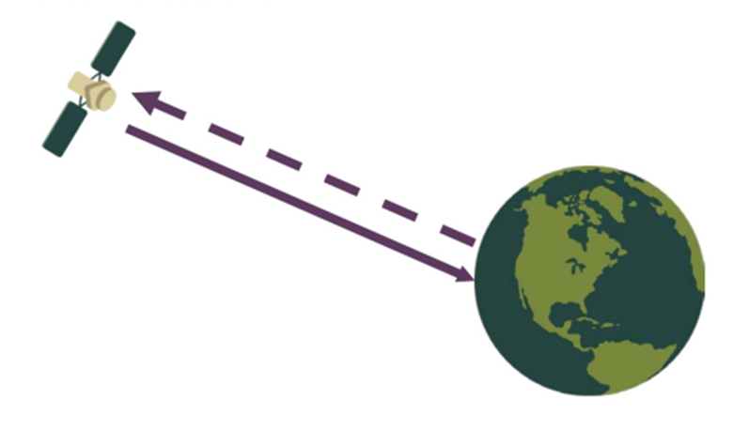
Types of sensor according to the energy source
Passive sensor
(Source: ARSET).
Active sensor
Source: ARSET
Active sensors provide their own energy source for illumination: Ex. Laser Altimeter, LiDAR, RADAR, Scatterometer, Sounder
Passive remote sensors measure radiant energy reflected or emitted by the Earth atmosphere system or changes in gravity from the Earth. Ex: Landsat OLI/TIRS, Terra MODIS, GPM.

Slide 8
Sub Unit 2:
Remote sensing data acquisition: Understanding the process of acquiring remote sensing data, including satellite and aerial images

Slide 9
Flow of simple remote sensing system

Slide 10
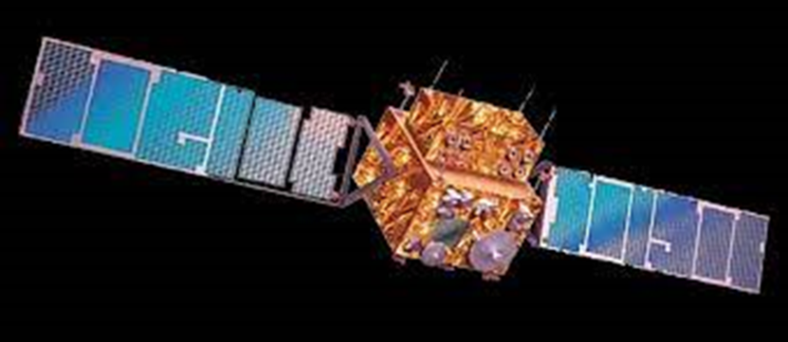
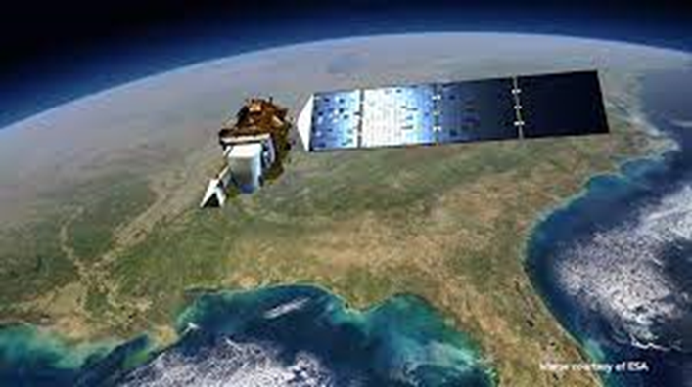
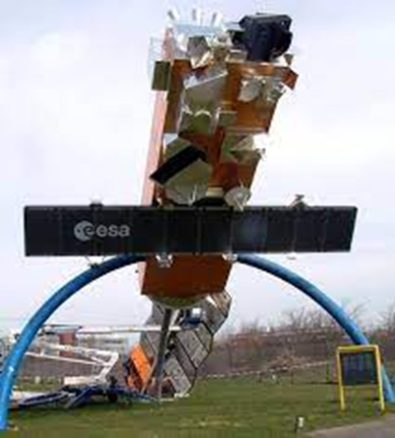
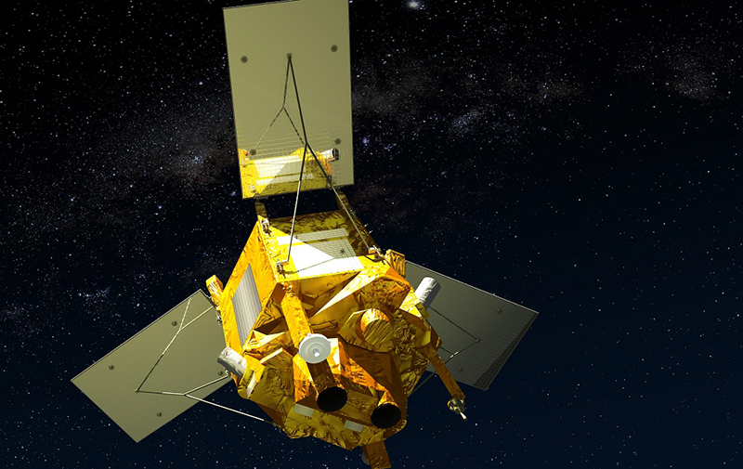
The most commonly used satellites in remoting sensing are:
IRS
Landsat
Envisat
SPOT

Slide 11
Set of characteristics and components that
must be considered when collecting data through RS
Pixel: A pixel is part of a sensor that collects photons so they can be converted into photoelectrons.
ND: ND stands for “Neutral Density” which means it blocks the light in a neutral way without changing the colour of the light.
Spectral: Spectral resolution describes the ability of a sensor to define fine wavelength intervals.
Spatial: Spatial resolution is the projection of a detector element or a slit onto the ground. In other words, scanner’s spatial resolution is the ground segment sensed at any instant. It is also called ground resolution element (GRE).
Temporal: Temporal resolution is defined as the amount of time needed to revisit and acquire data for the exact same location.
Radiometric: Radiometric resolution relates to how much information is perceived by a satellite’s sensor. The higher the radiometric resolution, the more shades of grey the user sees.

Slide 12
Sub Unit 3:
Introduction to data analysis and processing:
Introduction to image processing software and methods of spatial data analysis to extract meaningful information from remote sensing images

Slide 13
Important properties to consider while searching the RS data
Spatial resolution or pixel size
Date or time of the year/season
Cloud-cover
Wavelengths to measure different physical properties
Availability of historical data
Noise or artefacts in data

Slide 14
General technical pipeline of processing and analysis for RS big data

Slide 15
Aspects to consider when processing RS data
Geometric (spatial) - is an approach focused on precisely mapping every pixel in geographic space through techniques such as geometric rectification, orthorectification, terrain correction, and 3D reconstruction, with the initial crucial step being image registration—a process involving multimodal, multitemporal, and multiangle alignment, achieved through feature extraction, feature matching, and image warping.
Radiometric (spectral) - processing maps or corrects pixel values from one measured space to another, with or without reference data, including physical parameter inversion, absolute and relative radiometric correction, and radiometric normalization.
Cloud masking - In the pipeline of RS applications, cloud-covered regions are taken as invalid and cloud masking is an important step to delineate and extract cloud-free (valid) regions from RS images for the following analysis.
Data fusion – is the combination of multiple images (captured through various sensors under different parameter settings) to generate a single image which combines all the meaningful information from the individual images. Therefore, data fusion methods provide the composite (fused) image with complementary information.

Slide 16
Sub Unit 4:
Applications of remote sensing in agriculture:
explore case examples that demonstrate the potential applications of remote sensing in agriculture, specifically in the assessment of various indicators important to agricultural practices

Slide 17
Information provided by RS in Agricultural Practices
Observing and monitoring crops
Observing soil conditions
Monitoring water conditions
Predicting weather conditions
Observing air quality
Precision farming
Monitoring and predicting climate changes

Slide 18
Sub Unit 5:
Challenges and limitations of remote sensing applied to agriculture

Slide 19
Challenges and limitations of remote sensing applied to agriculture
Limited access to data: Limited access to high-quality data. Some RS data is only available for a fee, and it can be difficult for farmers to access and use this data.
Interpretation of data: The interpretation of RS data. The data can be complex, and farmers may not have the expertise to interpret it accurately.
Cloud cover: Cloud cover can be a major obstacle to obtaining clear RS data. Clouds can block the view of the Earth’s surface, making it difficult to obtain accurate data.
Technical limitations: Some RS technologies have technical limitations. For example, some sensors are not sensitive enough to detect certain types of vegetation or soil properties.

Slide 20
Conclusion
Remote sensing is a technology increasingly used in numerous fields. From topography, cartography, control of natural phenomena, and even monitoring of natural disasters. However, one of the uses that has been growing is in Agriculture. From choosing the use of the crop to be produced, based on climate and soil characteristics including controlling the crop itself from the phytosanitary aspect and its development to determining the ideal time for harvesting. However, this technique requires a large amount of equipment and know-how that is not available to everyone. In order for us to use it, we have to have access to information provided by satellites and which then has to be worked on so that it can be used by farmers.
On the other hand, the data obtained by RS allows it to be used by various professionals for different purposes. These data, once processed, can not only be used by farmers but also by meteorologists thus being able to prevent and warn of various natural disasters. In addition to being able to make a more detailed assessment of climate change.
Despite being a technique that has been used for many decades, it continues to evolve and improve, allowing for easier and better use. While in the beginning they used photographic cameras mounted on hot air balloons and even pigeons, now they use satellites and computer programs that allow visualization and analysis of the terrain. However, this improvement continues to occur both in terms of image quality and in terms of their processing to facilitate their use.

