Slide 2
Course: (VET-B3)
Module: (Digital Technologies and artificial intelligence)
Learning Unit: (Smart Farming Solutions)
Authors: (CERTH)

Slide 3
Introduction to Smart Farming
Smart farming, an integral component of the broader paradigm of precision agriculture, stands at the forefront of transformative innovations in the agricultural sector
The term "smart farming" includes the Internet of Things (IoT), artificial intelligence (AI), robotics, and data analytics, all converging to revolutionize traditional farming methodologies.
Smart farming is the application of information and data technologies for optimizing complex farming systems, and the focus of smart farming is not on precise measurement or determining differences within the field or between individual animals
The focus is rather on access to data and the application of these data and how the collected information can be used in a smart way.
These applications are divided into categories based on their purpose, including monitoring, tracking and traceability, and greenhouse production. In the agriculture sector, factors affecting the farming and production process can be monitored and collected, such as soil moisture, air humidity, temperature, pH level, etc (Quy et al., 2022).

Slide 4
Introduction to Smart Farming
Some of the issues facing agricultural production today include:
Managing and utilizing resources in the production while ensuring a sustainable natural environment;
Laborious operations under conditions not conducive to human productivity;
Advancement of technologies in other industries that threaten to attract labour force away from agriculture;
An increased demand for higher product quality;
The necessity to modernize agriculture using technology;
The trend towards organic farming and (7) to employ human intelligence and machine power in a sustainable and economical manner

Slide 5
Introduction to Smart Farming
The application of automation technology plays a role in all these issues: It can contribute to sustainability by providing field information through sensing, and to offer optimization tools.
Robots are being developed to replace manual labor in the harvesting of fruits and vegetables. Weeding robots can replace chemical herbicide application in organic farming.
Automation technology inherently addresses the issue of a dwindling labor force.
The capabilities of intelligence-enabled machines include:
1. Sensing and perception– obtaining the awareness of surroundings, i.e., gathering, processing, and interpretation of information about situations,
2. Reasoning and learning – conducting logical deduction, mathematical analysis, heuristic inference, and experiential adaptation used to derive conclusions, make decisions, and issue instructions,
3. Communication – coordinating and delivering information among various entities
4. Task planning and execution – effecting device operations for control activation and physical work. Commonly seen additional components are external sensing, transporting, and traveling devices (Kondō & Ting, 1998).

Slide 6
Introduction to Smart Farming
IoT technology and automation is efficient due to the given reasons. AI’s ability to perform intelligent tasks opens opportunities to improve current agricultural practices by:
providing support services previously deemed too resource-intensive, expensive, or unavailable (e.g., due to lack of skills and expertise among local professionals);
driving down current operational costs by saving time and labour performed by agriculture workers. Using an AI model, we are aiming to automate the following garden processes
● Minimizing human labour – Automation can help the minimization of human resource and human error.
● Quick Access – Crop and soil health can be remotely monitored through any device and at any region.
● Time Efficient – Automatic report generation and remote monitoring can save time and effort from farmers.
● Efficient Communication – Using Android and iOS app platform a community of farmers, students and enthusiasts can share their work and new methodologies for agricultural growth.
● Analytics – Wide range of analysis can be done including avg. rainfall, soil health gradient.

Slide 7
Introduction to Smart Farming
Increasingly today AI is considered one of the most potent solutions to the many challenges the agricultural sector faces in low- and high-income countries.
Following the healthcare, automotive, manufacturing and finance sectors, AI has entered the agriculture domain and is providing cutting edge technology with applications throughout the food system including production, distribution, consumption and harvest yield uncertainty.
AI-enabled technologies can help farmers improve crop yields, address the challenges of soil health and herbicide resistance and use resources more sustainably to reduce the agricultural sector’s greenhouse gas emissions. (FAO, 2021)

Slide 8
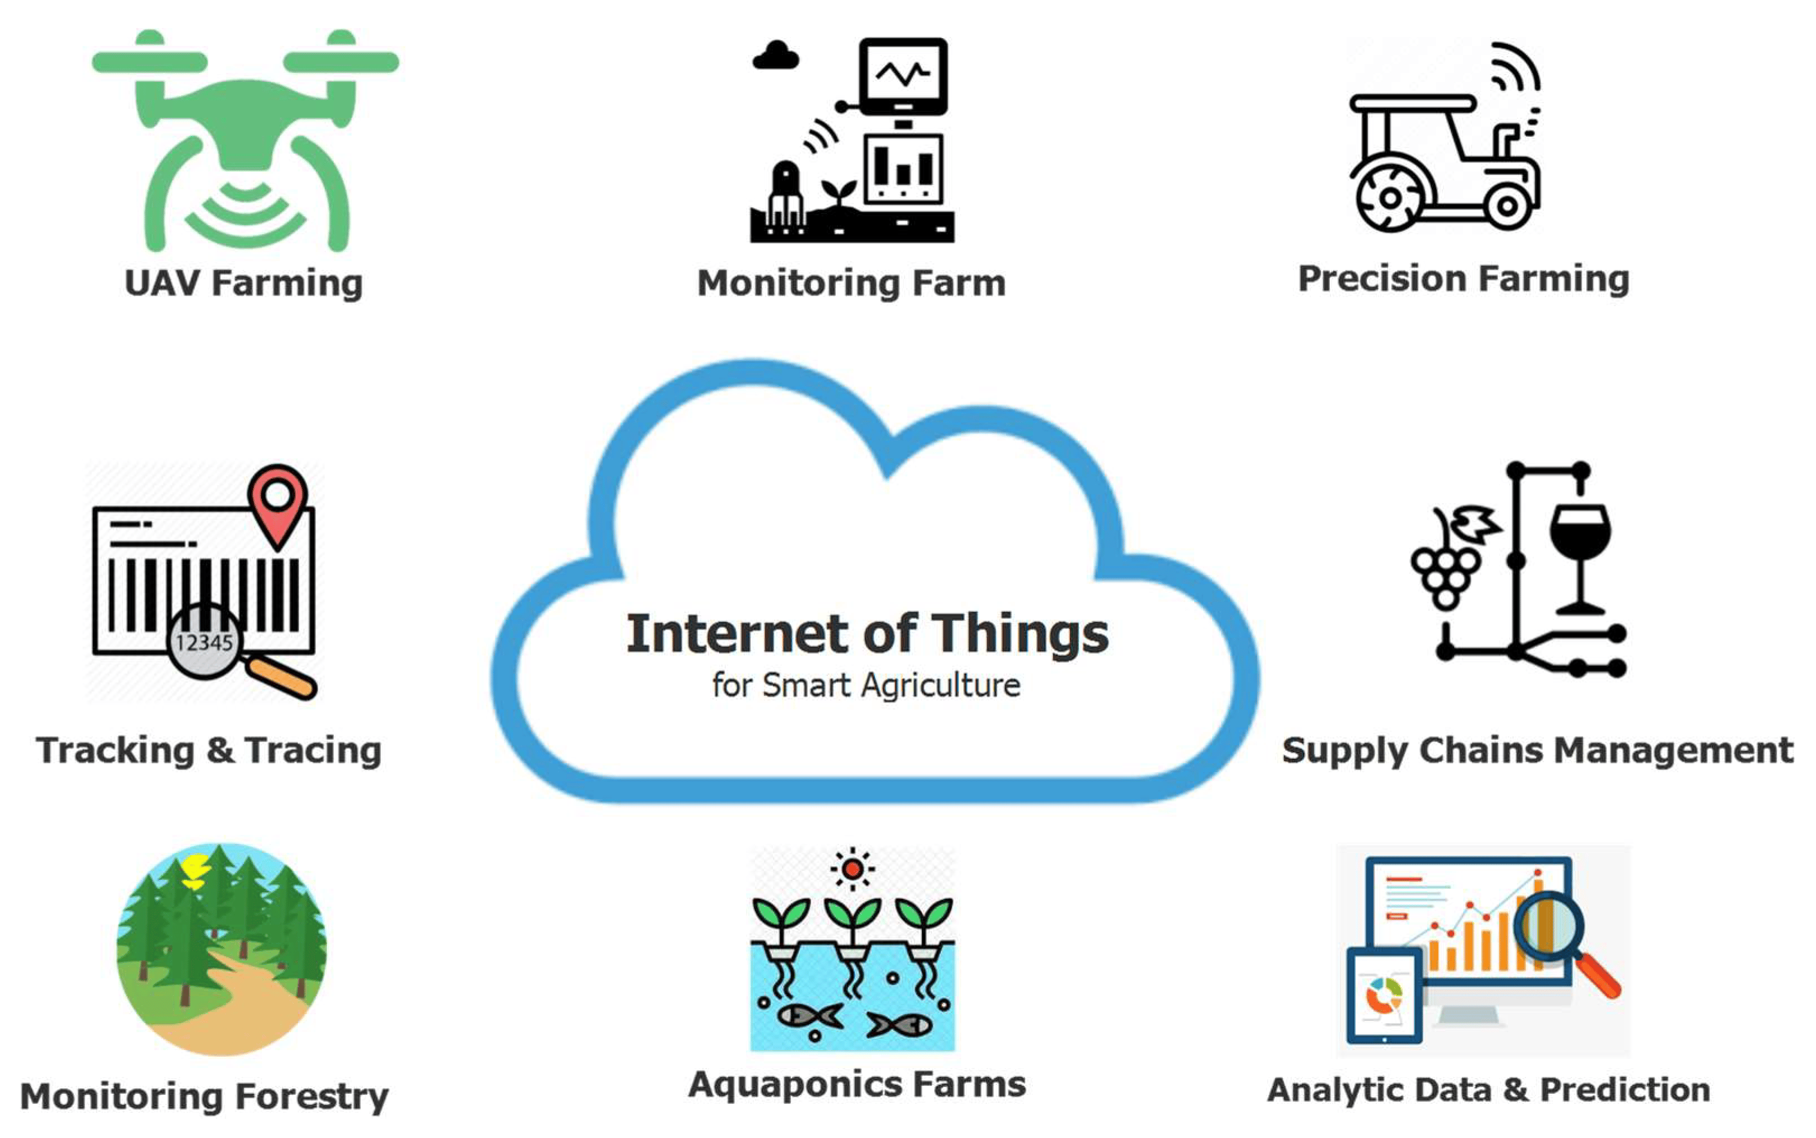
Introduction to smart farming
Internet of Things (IoT)
The internet of Things (IoT) is the present and future of every field impacting everyone’s life by making everything intelligent. It is a network of different devices which make a self-configuring network.
The aim is to propose a technology which can generate messages on different platforms to notify farmers

Slide 9
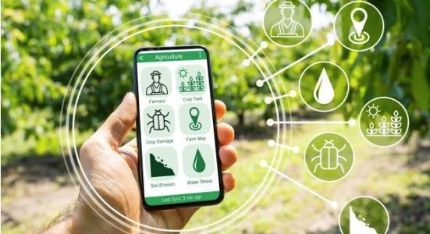
Introduction to smart farming
Digital Agriculture
A rapidly evolving field that uses technology to enhance agricultural practices, aiming to increase the efficiency, productivity, and sustainability of food production systems.
Digital Agriculture involves incorporating digital technology and data-driven methodologies into farming practices. This can involve everything from GPS guidance for machinery and satellite imagery for field analysis, to robotics for labour-intensive tasks and predictive analytics for assessing crop health and yield potential.

Slide 10
Monitoring Systems
Areas of AI Application in Agriculture area
Crop, soil, and livestock monitoring: AI systems can support farmers in monitoring the condition of their crops, soil, and livestock and provide timely recommendations on particular actions and decisions
Detection of pests and diseases: AI systems can examine digital images taken by drones, agricultural robots, or farmers using a simple smart phone camera to detect pests and give concrete advice to agricultural workers on how to prevent their spread, treat affected plants or mitigate the damage caused
Weather and temperature forecasting: AI algorithms are able to assist with local weather and temperature forecasting using historical data and measurements made by local weather stations and field sensors.

Slide 11
Monitoring Systems
Predictive analytics: By analyzing various field data and/or examining plant images, AI can generate accurate predictions about yields, and potentially, the quality of product.
Autonomous agricultural robots and farm equipment: AI systems can be deployed on robotic platforms to direct and control their work performing assistive tasks, such as targeted irrigation, application of fertilizers and pesticides, collection of fruits and transporting equipment around a farm among others.
AI technologies rely on automated systems, use of robots and drones and increased implementation of data generation through sensors and aerial images for crops and land use through deep learning technology.
It is important that farmers are equipped with up-to-date training to ensure technologies are used and continue to improve.
Smart farming is a modern farming managemental concept with IoT technology to increase the productivity in agriculture. With the use of smart farming, farmers can effectively use fertilizers and other resources to increase the quality and quantity of their crops

Slide 12
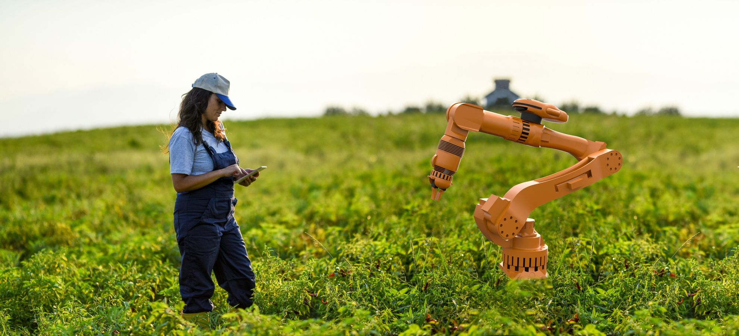
Monitoring Systems
Robotics in Agriculture
The idea of robotic agriculture, i.e., the use of self-propelled machinery in agricultural environments, is not so new. Many engineers had built self-propelled agricultural tractors in the past, an effort that was not successful as they were not able to meet the actual needs of the field.
Most of them operated with an industrial-type design, where conditions are known and vehicles move along predetermined routes, which cannot be applied to agricultural applications.
In recent years, the effort has focused on creating smaller vehicles, where with the right intelligence they can operate in a variable or semi-structured environment, such as that of agriculture. By intelligence we mean that these machines will be able to exhibit rational behaviour when they have to operate under identifiable conditions.

Slide 13
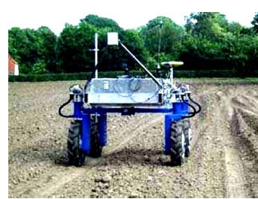
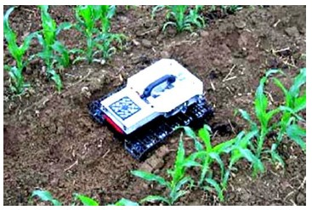
Monitoring Systems
Applications of robotics in Agriculture
Seed installation
Ploughing is one of the most important tasks in establishing a crop. It is essentially the preparation of the soil for growing the seed. Ploughing also allows us to incorporate the residue of the previous crop, as well as any weeds that may have grown. Ploughing a large area would be difficult and highly energy intensive using a small self-propelled vehicle, however another approach to soil tillage could be taken.
Seed care
One of the main actions of good management is the ability to collect valid and correct information from the crop development pathway, the phytomedicine. This process can be done by using an automated system which, using appropriate sensors (multispectral, hyperspectral, fluorescent cameras), can process information on the health and condition of the crop.

Slide 14
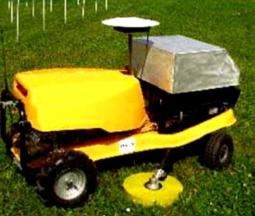
Monitoring Systems
Weed mapping
Is a process of recording the location of weeds and better the biomass density of different weeds growing within the crop area. Weed mapping can be done either by identifying and recording increased leaf area outside the seed rows, or by weed shape recognition according to a recognition template created for human face recognition, so that weeds are identified according to the outer contour of their foliage (active shape recognition). In addition, weed mapping can be done by colour recognition. The end result is a weed map which can be used for proper weed control only in the places where there is a sufficient population and not over the whole cultivated area, with significant benefits from the reduction of herbicides.

Slide 15
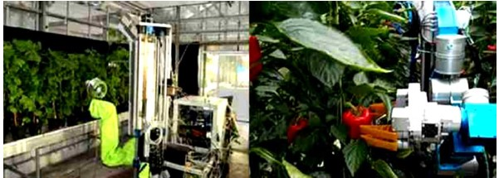
Monitoring Systems
Selective harvesting
By using sensors that sense the quality of the crop we can, for example, in a cereal crop, have the harvester sense the quality of the grain to be harvested and select which area is ready for harvesting and let the rest ripen. But the largest application of such robotic vehicles has been in selective harvesting of vegetables in greenhouses.

Slide 16
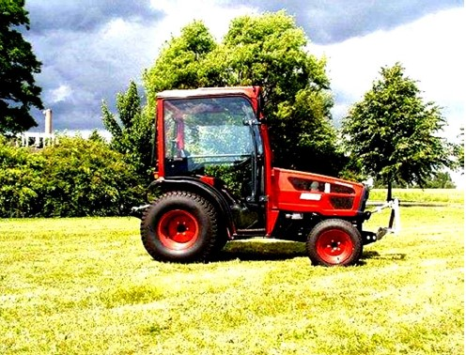
Monitoring Systems
Autonomous agricultural tractor (HAKO)
This system is based on crop management techniques of precision agriculture. Based on these techniques, the field is divided into sections of similar soil or plant properties in order to deal with spatial variability by varying inputs per section. The aim of modern systems, of which this is one, is to extend the farming techniques to a higher spatial resolution at the plant level and to treat them as separate units. These systems, intensive in terms of automation and information, aim to identify the needs of each individual plant and to adapt inputs to the needs of each of them.

Slide 17
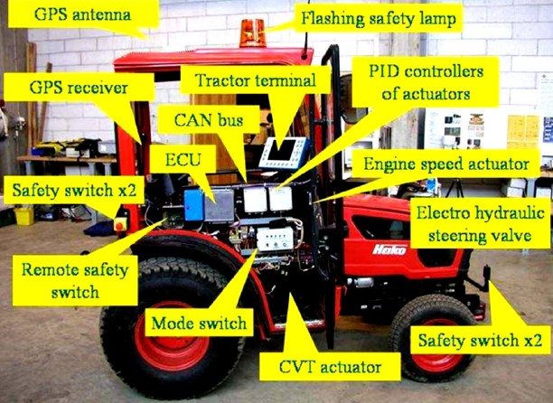
Monitoring Systems

Slide 18
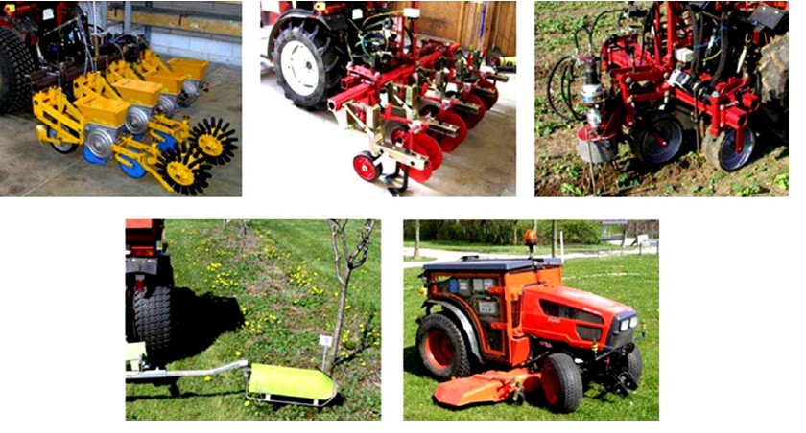
Monitoring Systems

Slide 19
Monitoring Systems
The main attachments used by the autonomous tractor for the respective field operations (Figure. 8) that the system can perform are precision seeding machines (between-row and on-row - grid seeding) with simultaneous recording of the seed grid, mechanical weed control machines between-row and on-row and spraying and grass cutting machines.
Precision Agriculture is a new method of farm management whereby inputs (pesticides, fertilizers, seed, irrigation water) and cultural practices are applied according to the needs of the soil and crops as they vary in space and time (Minasny, 2005). The main objectives of precision agriculture are:
•increasing crop yields,
•improving the quality of the products produced,
•the more efficient use of agrochemicals,
•the saving of energy,
•protecting soil and water from pollution

Slide 20
Modern Farming Methods
The technologies used by Precision Agriculture are related to all stages of production from sowing to harvesting and are as follows.
•GPS and GIS. They are systems that allow accurate mapping of fields and interpretation of field variability.
•Production mapping. Production mapping involves recording and collecting production data from specific locations in the field.
•Soil property mapping which records the fertility of fields.
•Soil electrical conductivity mapping. Today, one of the simplest and most cost-effective soil parameter measurements used in precision agriculture is that of apparent electrical conductivity (ECa). The apparent electrical conductivity of soil integrates a broader set of factors that affect the production of a crop. Electrical conductivity mapping can be easily done by attaching a conductivity measuring device to an accessory vehicle and adapting a geographic positioning system (GPS) receiver.

Slide 21
Monitoring Systems
•Remote sensing:
Collects information about an object without contact. The two most common methods of remote sensing are aerial photography and satellite imagery. Electromagnetic radiation is the basic element of remote sensing. When electromagnetic radiation comes into contact with an object, it can be reflected, absorbed or transmitted. Depending on the object to which the electromagnetic radiation strikes, different wavelengths of radiation react differently. By measuring the reflected radiation from plants, we can collect information about the water content of plant tissues, the nutritional status of plants and other plant characteristics.
•Variable Rate Application technology.
With this technology, inputs are applied to the field at different rates in different areas of the field depending on the needs of each area. There are two methods of variable rate technology: map-based and sensor-based. Map-based requires a prescription map and a GPS that determines the position in the field. As the machine applying the inputs moves across the field, it changes the dose based on the application map (the coordinates of the management zones). The sensor-based method requires neither a map nor a GPS. Sensors are mounted on the applicator and measure characteristics of the soil or crop as it moves across the field.

Slide 22
Monitoring Systems
1️. North America: Crop monitoring solutions are widely adopted in this region, particularly in the United States and Canada. Farmers are increasingly utilizing advanced technologies such as satellite imagery, drones, and data analytics to optimize crop health and yield.
2. Europe: European farmers are also embracing crop monitoring technologies, driven by strong innovative ecosystems and supportive policies. Countries like the Netherlands, Germany, Switzerland and the United Kingdom are leading the way in crop monitoring adoption.
3. Asia-Pacific: In this region, crop monitoring adoption varies significantly between countries. Countries like Australia, New Zealand, and Japan have high adoption rates, while other countries, especially those in Southeast Asia, face challenges such as limited access to technology and infrastructure.
4️. Latin America: Crop monitoring adoption in Latin America is growing, with Brazil and Argentina as frontrunners. Factors such as increasing demand for food, a growing middle class, and supportive government policies are driving the adoption of innovative crop monitoring technologies.
5️. Africa: Crop monitoring adoption in Africa is generally lower than in other regions, mainly due to infrastructure limitations, access to technology, and financial constraints. However, there is a growing interest in crop monitoring solutions, particularly mobile-based technologies that can empower smallholder farmers. As crop monitoring solutions continue to advance, there is an opportunity for more regions and countries to benefit from innovative solutions that can help optimize food production, reduce waste, and promote sustainability.

Slide 23
Monitoring Systems

Slide 24
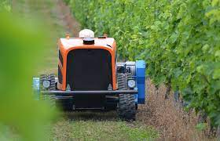
Case studies in Greece
Table grapes Spraying: (Technology: Ceol robot, retrofitted tractor, ASM model sprayer)
In the framework of the EU H2020 project Robs4Crops there is a pilot region of Greece, which focus on spraying table grape vineyards. Because table grapes are an important product, the quality needed is a difficult task for the producers. As a result, table grapes need up to 30 applications of pesticide and foliar fertilizer each growing season.

Slide 25
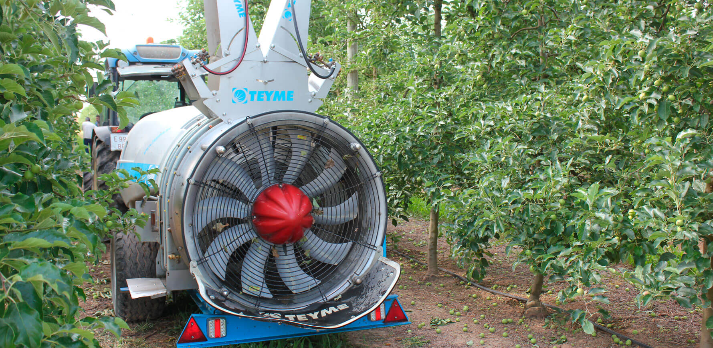
Case studies in Greece
Robs4Crops addresses those challenges by deploying the Ceol robot and a retrofitted tractor (autonomous) as carrying platforms of the lift-mounted ASM model sprayer from Teyme (600L tank Capacity). Combining both platforms on the same sprayer and pilot will help our experts draw useful conclusions regarding reversibility and dynamic behavior of both systems in the hilly terrain of the Greek pilot areas. (https://robs4crops.eu/ )

Slide 26
Case studies in Greece
Larissa Case study:
The plain of Larissa is one of the main cotton producing areas in Greece and in collaboration with the Farmers’ Cooperative of Thessaly (THESgi), cotton farming is supported by the smart farming services of gaiasense. In collaboration with the Farmers’ Cooperative of Thessaly THESgi, the services developed for cotton farming adapt to the particular soil and climatic conditions of the Larissa plain in order to provide solutions to problems faced by the producers.More specifically, the application focuses on optimization of combating the main pests and diseases of cotton in the area, such as the green worm and the pink bollworm, as well as the alternaria. At the same time, the smart irrigation service will contribute to the rationalization of the use of water for irrigation.
Augmenta field analyzer:
Augmenta Filed Analyzer auto calibrated through a variety of parameters recorded from Augmenta’s unique setup, so as to consistently produce a vegetation index (AUG Index) map of a field under variable conditions. This map is then used for the realization of a Variable Rate Application of Nitrogen fertilizer (N VRA). Augmenta N-VRA applies a recommended dose/rate of fertilizer in an intelligent way so as to minimize waste and maximize efficiency.

Slide 27
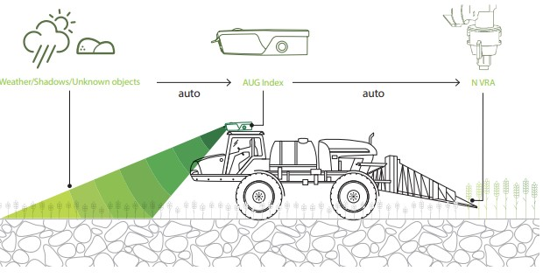
Monitoring Systems

Slide 28
Monitoring Systems
Case study of FarmB
FarmB.view is an information portal that provides you with your agricultural data in an aggregated and visualized form.
Fast, accurate and easy-to-read reporting for the entire system can provide important information regardless of production, crop mix and number of producers.
•Monitoring of production at a single point of information.
• Get fast, detailed and targeted reports for the entire system.
•Export important data.
•Navigate farms at a glance.
• Manage production systems, regardless of size, crop mix and operating structure.
•Overseeing teams and clients from the office.
•Applying data analysis to better make informed decisions.
•Obtaining personalized, analytical and visualized information.
•Leveraging data interoperability in conjunction with analytics tools.

Slide 29
Monitoring Systems
1)FarmB.eye is the focus point for all visual information collected by unmanned aerial vehicles (drones) using a wide range of sensors,
2)FarmB.sat is your "eye" from space, offering plot-level data from satellites,
3)FarmB.clima integrates available climatic data ranging from freely available meteorological data to sensor networks installed on your farm. farmB.clima utilizes the data to suggest sensor settings tailored to your needs.
4)FarmB.fleet extends the usability of the system to the field of agricultural machinery, data streams from machinery, crops, soil and other sources are merged into actionable information for agricultural advisors.
5) FarmB.insta allows real-time exchange of information between groups in the field and remote.
6) FarmB.prox allows the management of critical soil and crop data. It offers a complete set of services and applications for collecting processing and visualizing information.
7) FarmB.log is your farm work log, with extremely detailed information at plot level. Whether it's financial data, operational parameters or environmental performance, farmB.log provides all the necessary information and generates official reports for each key performance indicator.

Slide 30
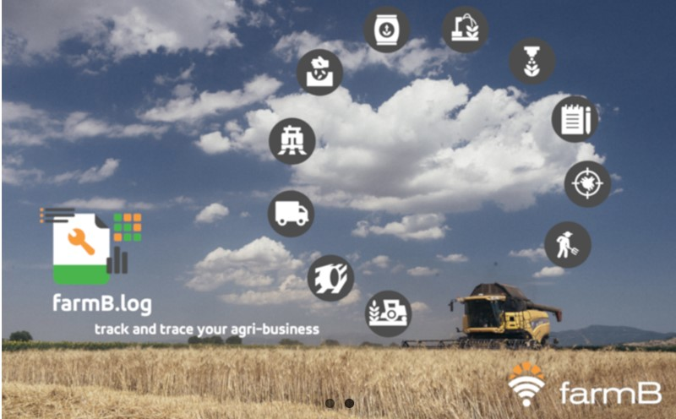
Monitoring Systems

Slide 31
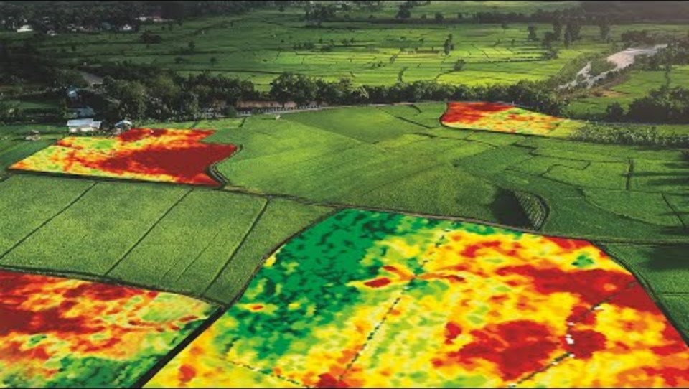
Additional Information
Geospatial World: Application of Remote Sensing in Precision Farming. Technological advancements in precision agriculture have made it possible for farmers to improve their productivity effortlessly.

Slide 32
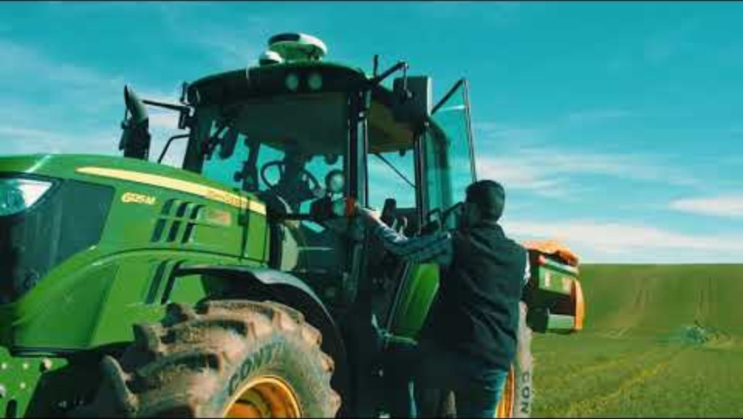
Additional Information
The Augmenta System uses state-of-the-art machine vision technology to analyze fields in real time to determine crop health and control Variable Rate operations such as nitrogen fertilizer, harvest-aid defoliant and plant growth regulator (PGR) applications

Slide 33
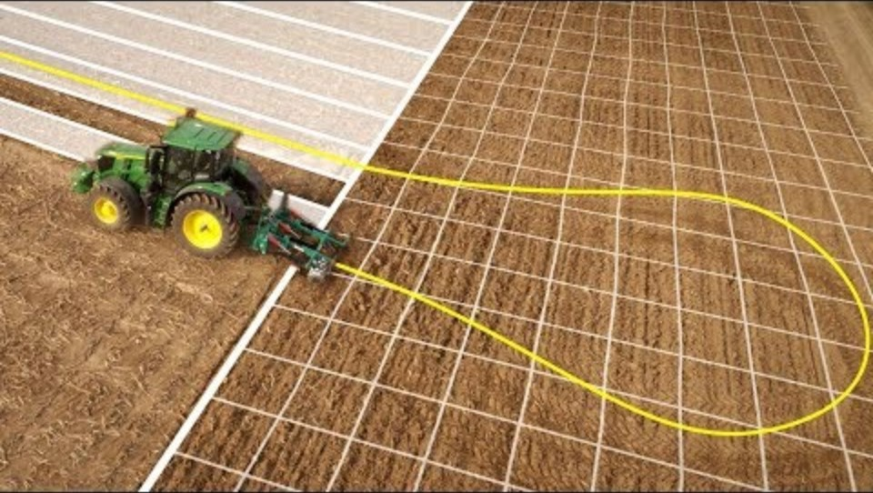
Additional Information
John Deere, AutoTrac Automation. AutoTrac Turn Automation on 6R to 9R Series John Deere Tractors automatically controls the entire headland turn and manages all tractor and implement functions with ease and precision

Slide 34
Conclusion
The advent of smart farming, characterized by the integration of technologies like GPS, presents an opportunity for sustainable agricultural practices. Despite its introduction in the 1990s, global adoption has been limited, prompting inquiries into the reasons behind this delay. Insights from farmers globally emphasize prerequisites for technology acceptance—scientific robustness, transparent communication of equipment limitations, positive evaluations, and the opportunity for trial periods.
Crucial factors for fostering adoption include ease of use, low initial costs, and reliable technology performance. In regions where significant research has been conducted, there is an opportunity for the state to play a pivotal role through targeted programs.
Supporting young farmers, promoting equipment access, and showcasing successful applications of technology in demonstration settings can catalyze the integration of smart farming practices and contribute to the overall development of the agricultural sector. It's imperative for political systems to move beyond rhetoric and actively engage in initiatives that facilitate the transformative potential of the primary sector for national development.

Slide 35


