Slide 2
Course: (VET-B4)
Module: (Digital Technologies and Artificial intelligence )
Learning Unit: (Automation Technologies)
Authors: (CERTH)

Slide 3
Introduction to Automation technologies in agriculture
Agricultural automation is one of the potential significant contributors to improving productivity and reducing consumption and adverse impacts
Effective use of automation helps maximize agricultural production by better using inputs, reduces overall waste and can improve the quality of the produced agricultural products
The most significant developments occurred during the 20th century with the introduction of tractors
The first farm tractor powered by an internal combustion engine was built by Hart Parr Company

Slide 4
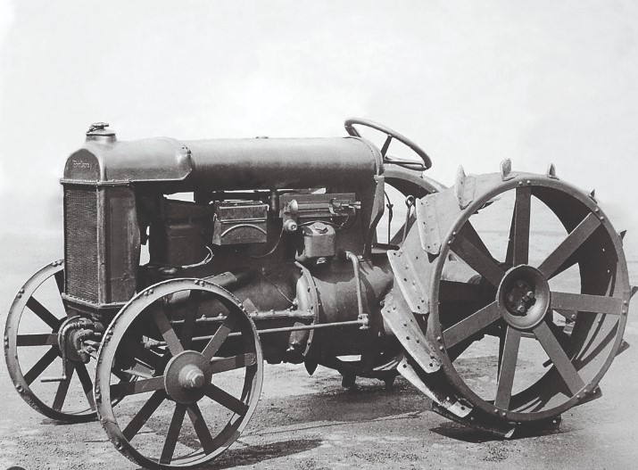
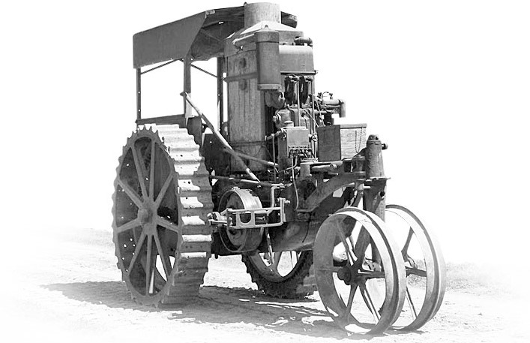
Introduction to Automation technologies in agriculture
Henry Ford & Son Corporation (1917)
Hart Parr Company Tractor (1900’s)

Slide 5
What are Automation Technologies in Agriculture?
Agriculture automation is the process of using various technological equipment to enhance and automate agricultural businesses
This farming technology is intended to alleviate the labor-intensive and time-consuming agricultural operations that farmers all over the world face
Automated tractors, GPS, drones, robotics, and software as a way to transform the current agriculture industry.

Slide 6
Agricultural Automation Systems:
Many agricultural automation systems, like many automation systems in most industries, perform the following actions:
Obtain and process information.
Make a decision.
Perform some actions.
The automation system needs information to make appropriate decisions before it takes actions. If the automation system has incorrect information, it will make faulty decisions and will take incorrect actions. The information required by many agricultural automation systems can often be one of three types. These types are setpoints, agricultural variables, and automation system variables. Setpoints are desired outputs, conditions, or relationships supplied to the automation system from the outside.
Module: Digital Technologies and Artificial intelligence / Learning Unit: Automation Technologies / Subunit: 2nd

Slide 7
What’s a PID controller?
PID controller is a series compensator, which is integrated, in whole or in part, into the straight branch of the closed loop system loop and appropriately adjusts the signal that activates the system under control, taking into account the deviation (error) of the input (usually the desired specification for the output) from the actual output of the system.
A PID controller includes 3 main terms:
The Proportional term (Proportional or P term)
The Integral or I term,
The Differential term (Derivative or D term)
Module: Digital Technologies and Artificial intelligence / Learning Unit: Automation Technologies / Subunit: 2nd

Slide 8
Controllers
Controllers can be classified by the number of states of the output of the controller. Generally, the more states of the output, the more complicated and costly the controller will be. They will be initially classified here into on–off, discrete-output, and continuous controller categories. On–off control is the simplest control. Consider, for example, a simple heating system.
Controllers can be mathematically analysed to predict and understand performance and to enable improvements. The classical control theory was developed in the middle of the twentieth century to analyse automation systems.
Controllers must take all the sensor signals and resolve them into coherent and reliable information. The signals received may vary widely for such characteristics as signal level, frequency content, and noise. The controller front ends must properly process the signals to obtain reliable information. But the most important task of the controller is to decide the proper action.
Module: Digital Technologies and Artificial intelligence / Learning Unit: Automation Technologies / Subunit: 2nd

Slide 9
Microcomputers in Agriculture
Set of mechanisms/devices in the environment that perform a specific action or activity and interact. As we can see, from the field of agriculture, it is not possible to end the contribution of computer systems as these have become indispensable in every branch of human activity.
System requirements:
•In many cases, all you need is a computer that could programme to simply take data from the environment (e.g., changes in temperature, distance, lighting, button presses) ...
•then, after processing, give commands for actions such as switching on a lamp (unit lighting), the movement of a mechanism (e.g., a ventilation unit or a fence mechanism), the generation of a sound (siren for emergency notification).
•The possibility of remote notification of what is happening or to delegate actions is very welcome.
•The small size and resistance to extreme environmental conditions (e.g., temperature, humidity, radiation) and the small energy consumption is a priority.
Module: Digital Technologies and Artificial intelligence / Learning Unit: Automation Technologies / Subunit: 2nd

Slide 10
Computing Systems: Arduino & Raspberry Pi
The Arduino has digital inputs/outputs and analog inputs. The latter are particularly useful as they can be used to digitize useful data (angle, distance, temperature, brightness, etc.)
Raspberry is much more powerful than the Arduino, has ports GPIO, USB, Ethernet (in newer versions also Wi-Fi, Bluetooth) and is an ideal environment for developing applications in an environment Linux application, and now supports popular educational environments such as MIT Scratch or python and is becoming increasingly popular.
Raspberry Pi Arduino Uno

Slide 11
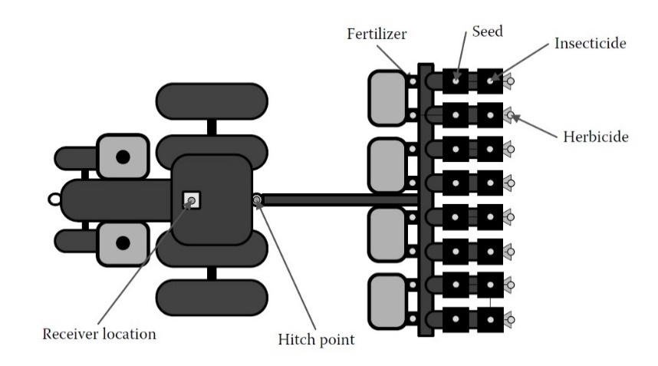
Applications in Agriculture
1)Automation in field crop production
Automated Guidance:In most cases, operators use automatic guidance to follow parallel paths through the field.
At the beginning of field operations, an A–B line is input into the control console, and the GPS coordinates are stored. As the operator continues to cover the field, the automatic guidance system can be engaged, and the equipment will attempt to follow parallel paths to cover the field based on steering sensor feedback and GPS data.

Slide 12
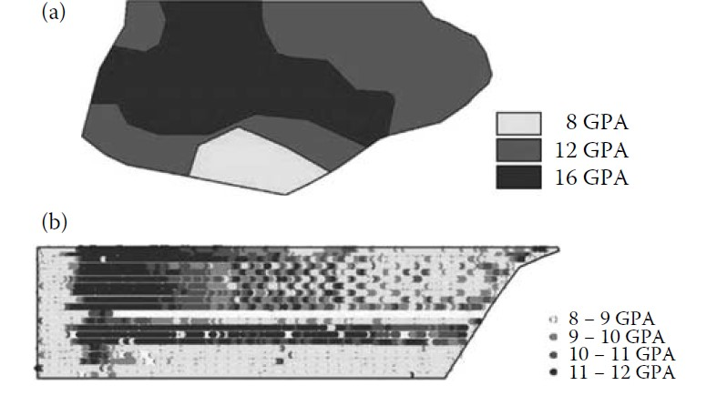
Applications in Agriculture
Variable rate technology (VRT):
Is the application of varying amounts of crop inputs per unit area of a field based on soil and plant needs.
It is a popular precision agriculture technology that improves application efficiency while decreasing costs. VRT can be map-based or sensor-based depending on the type of crop and field operation.

Slide 13
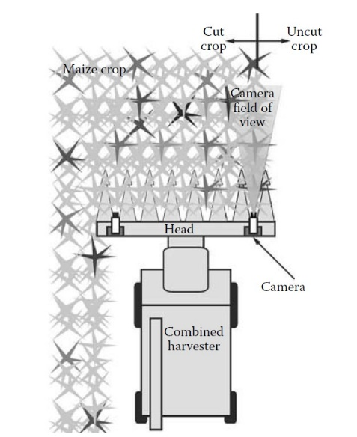
Applications in Agriculture
Harvest Automation:
Over the past two decades, yield monitors have been one of the most noteworthy developments in harvest technology. Manufacturers continue to improve these systems to provide yield and moisture measurements to the operator during harvesting operations as well as computer software for postprocessing. Many producers use automatic steering systems on harvesters to improve field efficiency.

Slide 14
Applications in Agriculture
Automation in Animal House production
Automated feeding stations gain popularity for dairy calves, allowing continuous feeding monitoring. Manure management systems, whether dry or liquid, leverage mechanized removal machinery to maintain interior air quality in various animal facilities.

Slide 15
Applications in Agriculture
Manure management systems:
Manure management is critical for interior air quality control.
Manure systems can be characterized as dry or semisolid systems such as litter and bedding used in broilers, turkeys, and dairy barns, and liquid or slurry systems found in swine and dairy operations.
Mechanized removal of manure ranges from manually operated skid-steer loaders, mechanized litter removal machinery in broiler and turkey operations

Slide 16
Applications in Agriculture
Automation in Pesticide application systems
Automated systems, such as fertilizer dispensers, adjust doses based on NDVI measurements, offering farmers a hands-free calibration advantage and significant fertilizer savings.
Module: Digital Technologies and Artificial intelligence / Learning Unit: Automation Technologies / Subunit: 3rd

Slide 17
Applications in Agriculture
Application in irrigation systems and soil management
Dive into irrigation systems, including drip and sprinkler irrigation, that contribute to water efficiency. Automation adjusts water levels based on soil data, creating application maps.
Control of nozzles, achieved through opening and closing at different frequencies, enhances precision in water application, reducing consumption and energy usage
Module: Digital Technologies and Artificial intelligence / Learning Unit: Automation Technologies / Subunit: 3rd

Slide 18
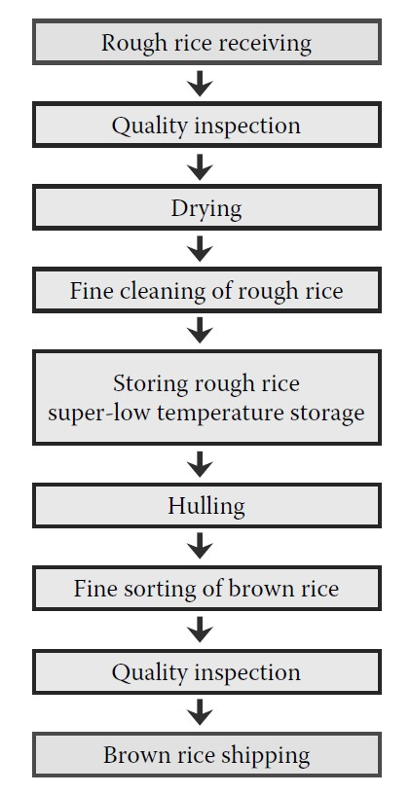
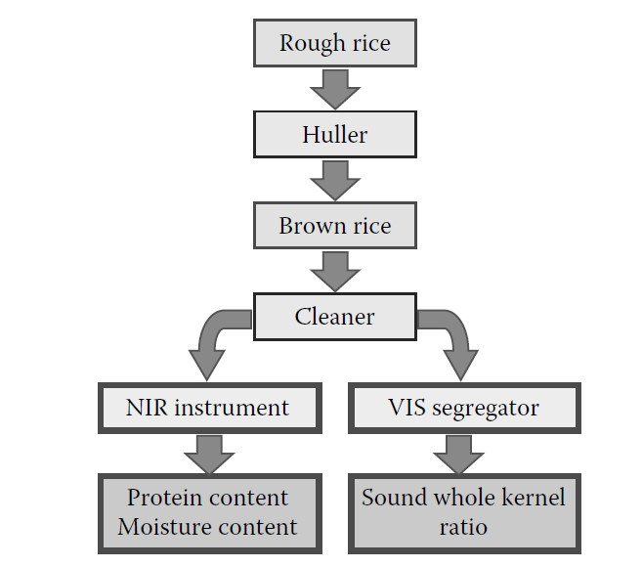
Applications in Agriculture
Applications in post-harvest automations
From current situations of automation in agriculture, post-harvesting operations are the most automated and computerized with near-infrared (NIR) and machine vision technologies among many agricultural operations because these operations offer suitable environments to introduce sensing systems, equipment, and PCs under structures.
Module: Digital Technologies and Artificial intelligence / Learning Unit: Automation Technologies / Subunit: 3rd

Slide 19
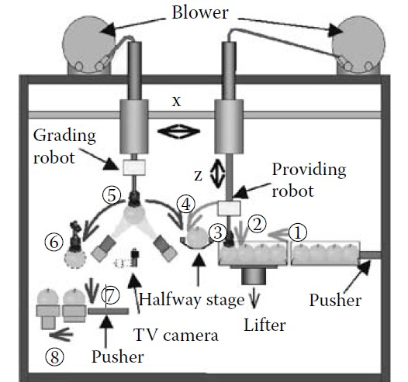
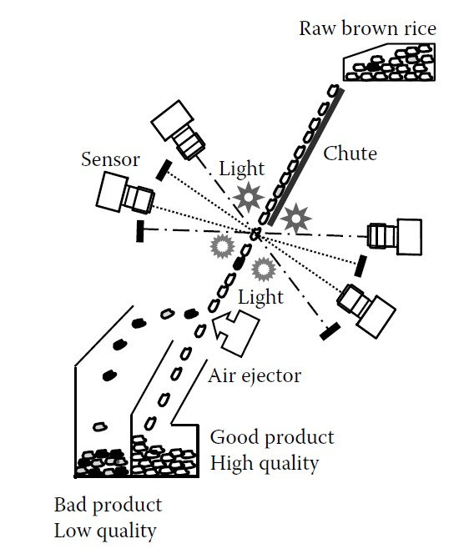
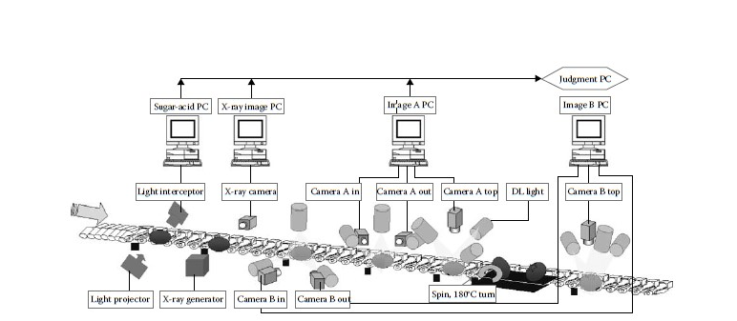
Applications in Agriculture
Sorting System
A grading robot system, which automatically provides fruit from containers and inspects all sides of the fruit, was developed (Kondo, 2003).
It has two Cartesian coordinate robots called the providing robot and the grading robot. The grading robot consists of a 3-DOF manipulator, 12 suction pads as end effectors, 12 colour TV cameras, and 28 lighting devices with polarizing filters, whereas the providing robot has similar manipulator and end effectors but has no machine vision. Twelve fruits are sucked up by a manipulator at a time and 12 bottom images of fruits are acquired during the time the manipulator is moving to carriers on a conveyor line
Module: Digital Technologies and Artificial intelligence / Learning Unit: Automation Technologies / Subunit: 3rd

Slide 20
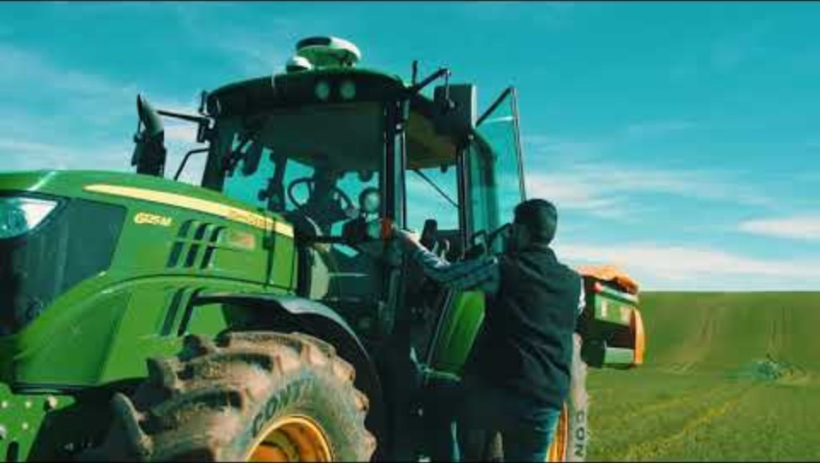
Applications in Agriculture
Augmenta System for machine vision. The Augmenta System uses state-of-the-art machine vision technology to analyze fields in real time to determine crop health and control Variable Rate operations such as nitrogen fertilizer, harvest-aid defoliant and plant growth regulator (PGR) applications. Watch this extended version to understand how it works

Slide 21
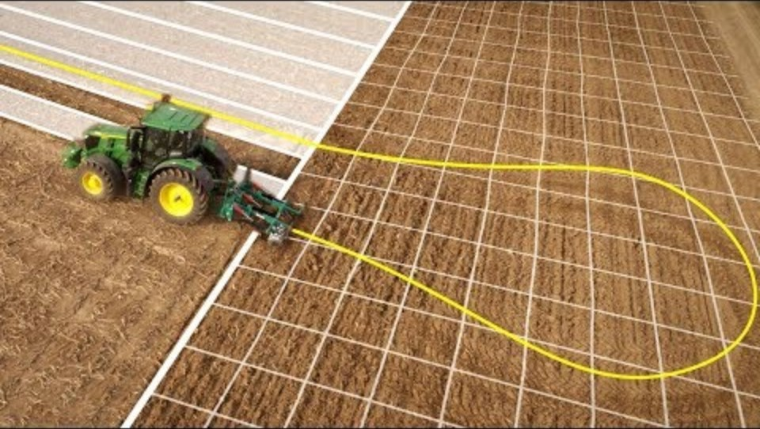
Applications in Agriculture
John Deere, AutoTrac Automation. AutoTrac Turn Automation on 6R to 9R Series John Deere Tractors automatically controls the entire headland turn and manages all tractor and implement functions with ease and precision. See how you can reduce headland skips and overlaps as well as costs for fertiliser, chemicals and fuel.
Module: Digital Technologies and Artificial intelligence / Learning Unit: Automation Technologies / Subunit: 3rd

Slide 22
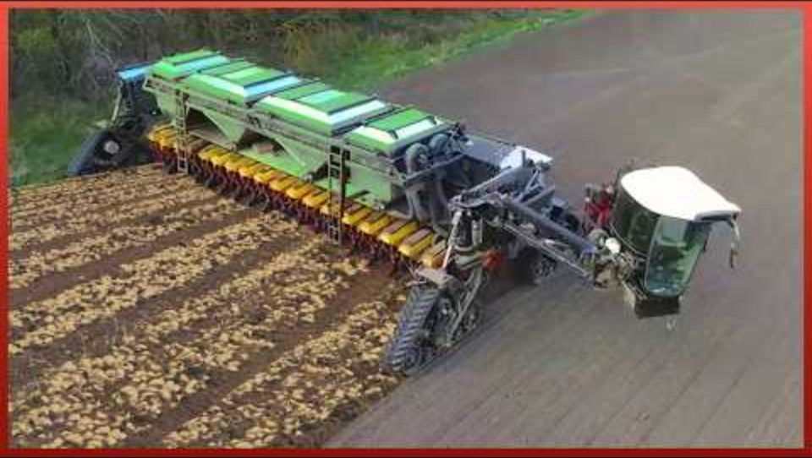
Applications in Agriculture
Quantum Tech, Automated machines, they provide an increase in production and ease the job of agricultures, making it less physical and time-consuming. Here we bring you a review of the best agriculture machines we have found. Watch it and tell us what you think.
Module: Digital Technologies and Artificial intelligence / Learning Unit: Automation Technologies / Subunit: 3rd

Slide 23
Conclusion
All the above technologies that we described are contributing to increasing agricultural productivity. Accurate farm management, correct application of inputs at the right time and in the right quantities can make a significant contribution to increasing yields and achieving the 70% target.
Rational application of inputs contributes significantly to environmental protection by reducing the addition of polluting chemicals.
They limit the deep infiltration of elements that pollute groundwater aquifers, but also limit the elements that are transported to groundwater aquifers by erosion.
It also limits greenhouse gas emissions from adding the desired elements at the exact time. Precise application of pesticides reduces environmental pollution. In general, Precision Agriculture is a powerful weapon in environmental protection.
Module: Digital Technologies and Artificial intelligence / Learning Unit: Automation Technologies / Subunit: 3rd

Slide 24


