Slide 2
Course: VET
Module: Bio-economy, circular economy and bio-based products
Learning Unit: Circular Economy
Authors: UOP

Slide 3
CONTENTS
1. Circular Economy – principles, dimensions, benefits and challenges
2. Resource Reduction and Waste Management
3. Agricultural Production of Bio-based Resources
4. Agroecology and Regenerative Practices
5. Circular Farming Technologies

Slide 4
1. Circular Economy – principles, dimensions, benefits and challenges

Slide 5
1.1. Introduction
The United Nations 2022 report predicts significant population growth:
  8.5 billion by 2030
  9.7 billion by 2050
Annual world extraction of raw materials:
  Increased from 27.1 billion tonnes in 1970 to 92.1 billion tonnes in 2017
  Average annual growth rate of 2.6%
Per capita demand for materials expected to rise:
  From 7.4 tonnes in 1970 to 12.2 tonnes in 2022

Slide 6
1.1. Introduction
50% of global greenhouse gas emissions attributed to:
  Mining, raw materials processing, and food production
  Responsible for over 90% of biodiversity loss and water scarcity
Greenhouse gas emissions on the rise:
  Significant increase since 1990
  Primary gases: carbon dioxide from fossil fuels and industry, methane
Despite EU commitments, greenhouse gas levels continue to rise:
  Earth's greenhouse gas levels are increasing despite reduction goals
Need for the circular economy:
  Addressing environmental pressures
  Creating a more sustainable future through resource management

Slide 7
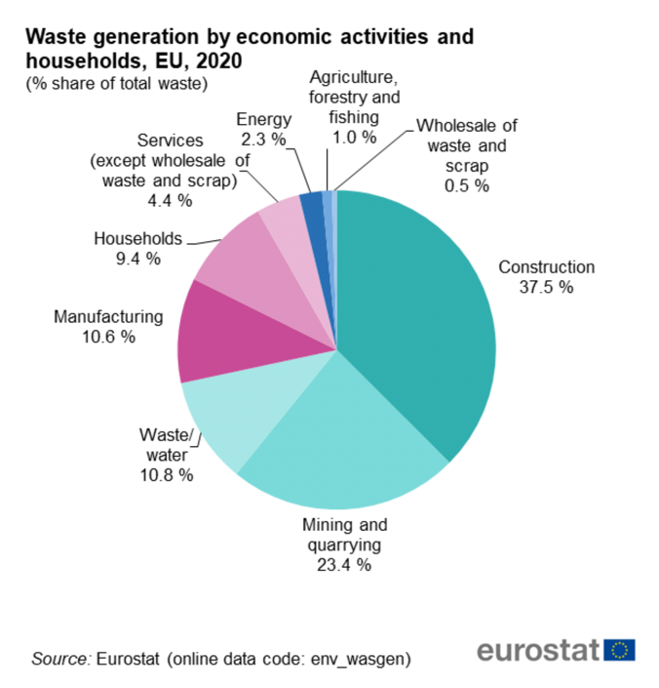
1.1. Introduction
Did you know that in 2020, Europe generated 2,151 million tonnes of waste from all sectors and households?
On a per capita basis, each person produced 4,8 tonnes of waste!

Slide 8
1.2. Circular Economy
The European Parliament (2016) defines circular economy as:
“an economic model based inter alia on sharing, leasing, reuse, repair, refurbishment and recycling, in an (almost) closed loop, which aims to retain the highest utility and value of products, components and materials at all times”.
This approach begins at the fundamental level of product design, which is based on durability, upgradability and recyclability. Products are encouraged to be used repeatedly and refurbished during their lifecycle. However, there is a major concern with them once they stop functioning, and this concerns recycling and resource recovery.

Slide 9
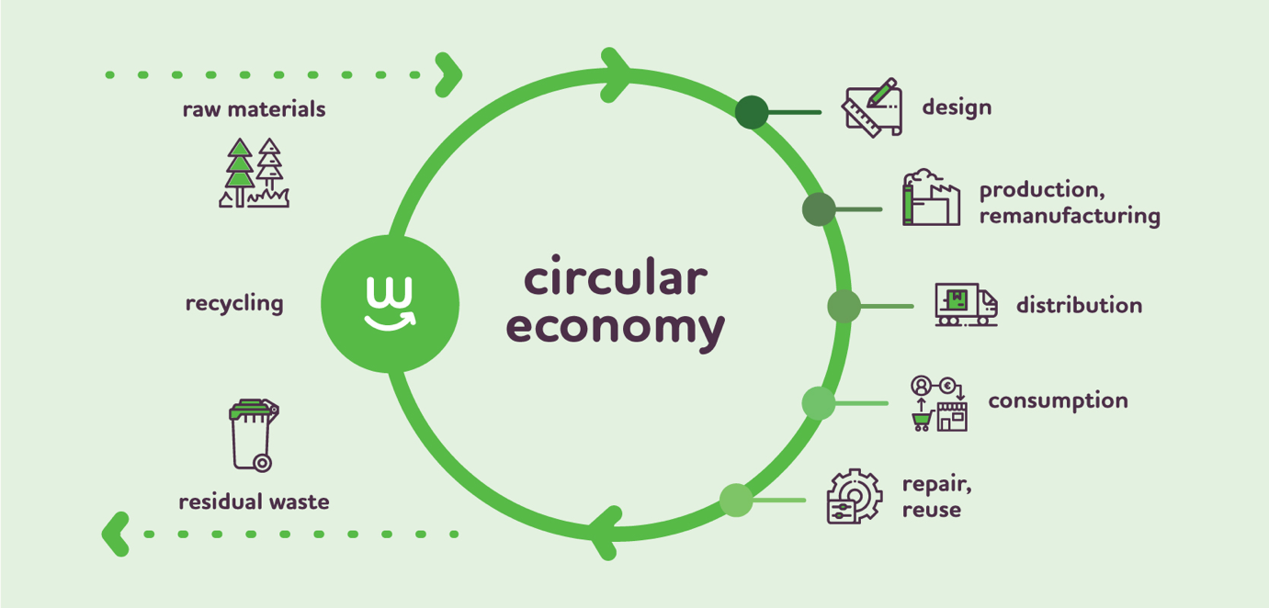
1.2. Circular Economy
Circular Economy Model
SOURCE: WWW.EUPOLITICALREPORT.EU

Slide 10
1.3. Linear vs Circular
Over the past 150 years, industrial progress has largely followed a linear economic model.
Known as the take-make-waste system:
  Resources used to produce items that become waste
  Products follow a linear path from raw materials to discarded waste
Benefits of the linear model:
  Enabled mass production and economic growth
  Lifted people out of poverty and fueled population growth

Slide 11
1.3. Linear vs Circular
The circular and linear models differ in their approach to creating and sustaining value. While a linear economy operates on a "take-make-waste" sequence, where raw materials are harvested, turned into products and eventually discarded, its value creation depends on producing and marketing the maximum number of products.
The approach of Circular Economy focuses on optimising resource use, favouring sustainable inputs, extending product life to maximise value, and recycling by-products and waste into new materials or products.

Slide 12
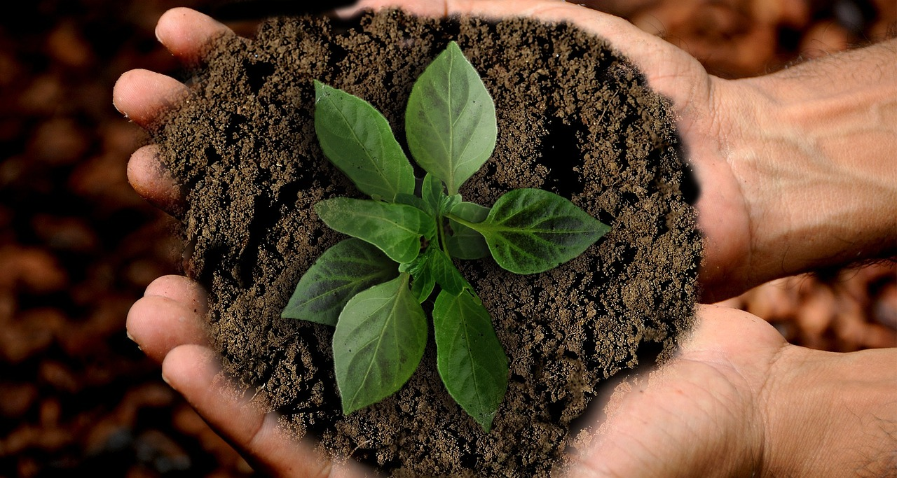
1.4. Circular Economy’s Benefits
Environmental Impact
Reducing Raw Materials Dependence
Economic and Consumer Benefits

Slide 13
Additional Information
If you want to learn more on the Circular Economy, please watch this video in the following link
https://www.youtube.com/watch?v=zCRKvDyyHmI
If you want to learn more on the Waste Statistics please read this article in the following link
https://ec.europa.eu/eurostat/statistics-explained/SEPDF/cache/1183.pdf

Slide 14
2. Resource Reduction and Waste Management

Slide 15
2.1. Resource Reduction and Waste Management
Overview of Waste Management
Waste management involves various processes such as collection, transportation, treatment, recycling, and disposal of waste materials.
Objectives include minimizing waste, reusing materials, returning organic waste to the environment, and adapting to changes in waste composition.
Practices differ between developing and industrialized nations, necessitating consideration of local factors like waste types, societal perspectives, and resource constraints.

Slide 16
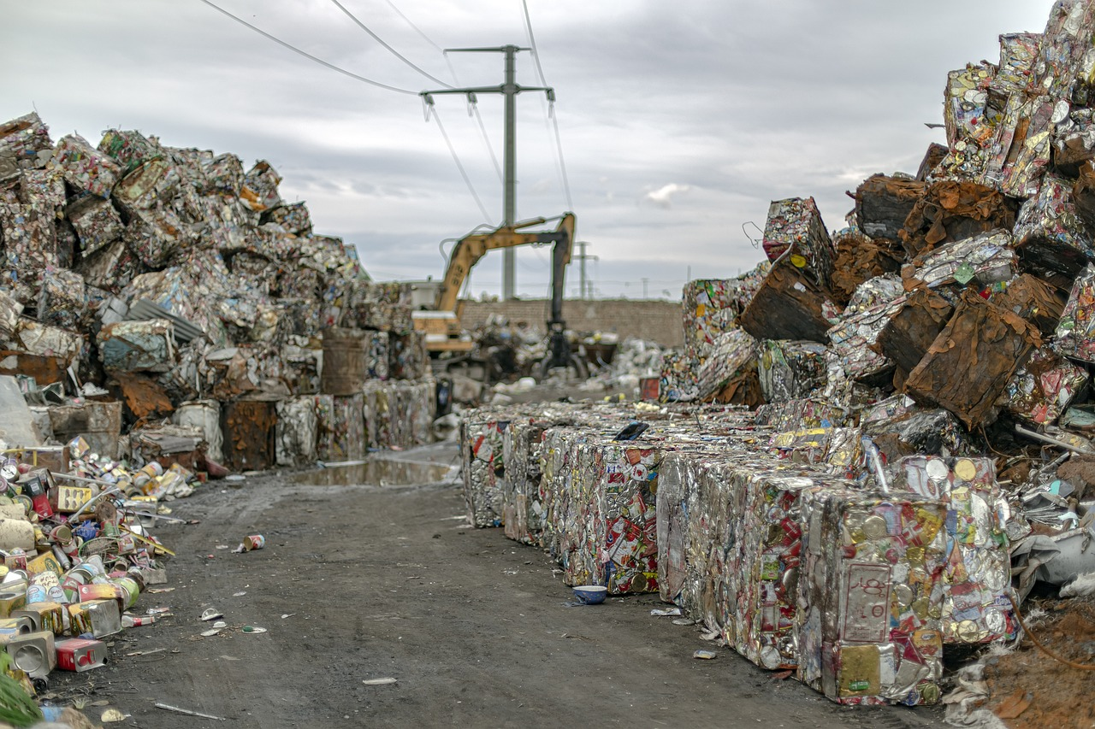
2.1. Resource Reduction and Waste Management
Components of a Waste Management System
A waste management system encompasses actions related to trash collection, treatment, disposal, and recycling.
The system includes four main segments: waste generation, collection and transportation, treatment, and final disposal.
Modern waste management prioritizes high recycling rates and cleanly segregated waste sources to minimize environmental impact and maximize resource recovery.

Slide 17
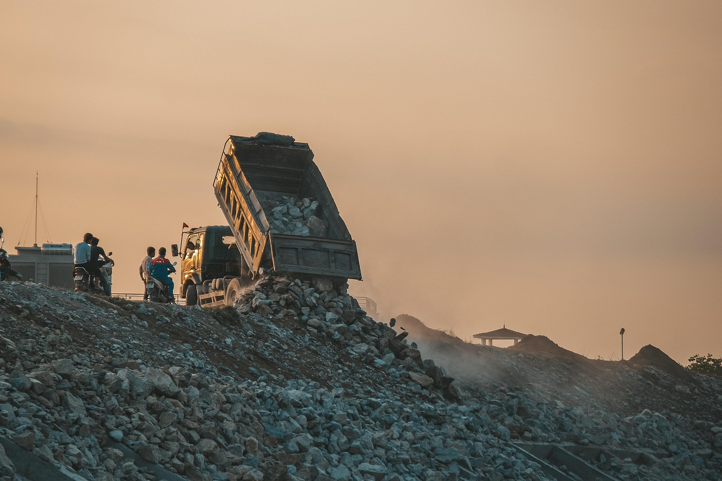
2.1. Resource Reduction and Waste Management
Strategies for Waste Management
Waste management strategies can be categorized into four main approaches:
  Waste reduction or prevention
  Waste recycling
  Thermal treatment with energy capture
  Landfill disposal
Priority is given to waste minimization, followed by recycling to retrieve materials for alternate uses.
Disposal methods are ranked based on environmental impact, with a hierarchy including reduce, reuse, recycle, compost, incinerate, and landfill.
Effective waste management requires understanding the volume, nature, and origins of waste, with unavoidable waste handled by licensed contractors for off-site processing.
The waste hierarchy prioritizes practices to maximize product benefits while minimizing waste generation, emphasizing sustainable utilization.

Slide 18
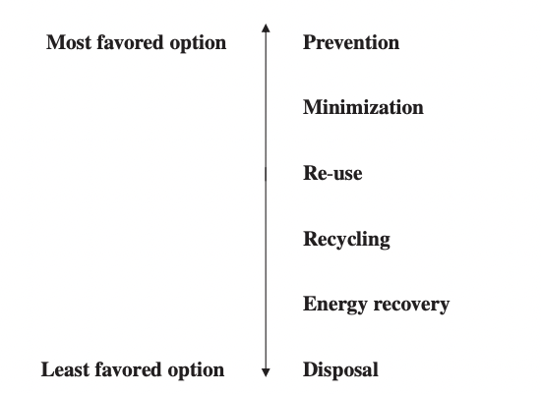
2.1. Resource Reduction and Waste Management
Waste management hierarchy
SOURCE: DEMIRBAS, 2011

Slide 19
Additional Information
If you want to learn more on the Waste Management in Europe, please listen this podcast in the following link
https://www.youtube.com/watch?v=pE7a4N9GDKk
If you want to learn more on a case about zero-waste packaging, please watch this video in the following link
https://www.youtube.com/watch?v=PvAd7t33fdo

Slide 20
3. Agricultural Production of Bio-based Resources

Slide 21
3.1. Bio-based Products
  Definition
  Bio-based products are goods made from sustainable raw materials sourced from the food or agricultural sector.
  The EU Commission defines them as products made wholly or partly from biological sources, excluding fossil sources.
  In the US, bio-based products are defined by the Farm Security and Rural Investment Act of 2002 as articles derived from biological or renewable agricultural materials.
Promotion and Regulation:
  The US Department of Agriculture launched the BioPreferred program in 2002 to encourage the use of bio-based products.
  Examples include agricultural sprays, compost enhancers, and pest control products.

Slide 22
3.1. Bio-based Products
Global Shift:
  The transition to bio-based products reflects economic, policy, and trade dynamics in agriculture.
  Advancements in conversion processes and technologies drive this shift, converting traditional agricultural inputs into chemicals, energy, and other innovative products.
Information Access:
  Stakeholders require access to comprehensive technical databases to navigate the diverse classes of bioproducts effectively.
  Initiatives like NASULGC emphasize the importance of such resources in facilitating informed decision-making.

Slide 23
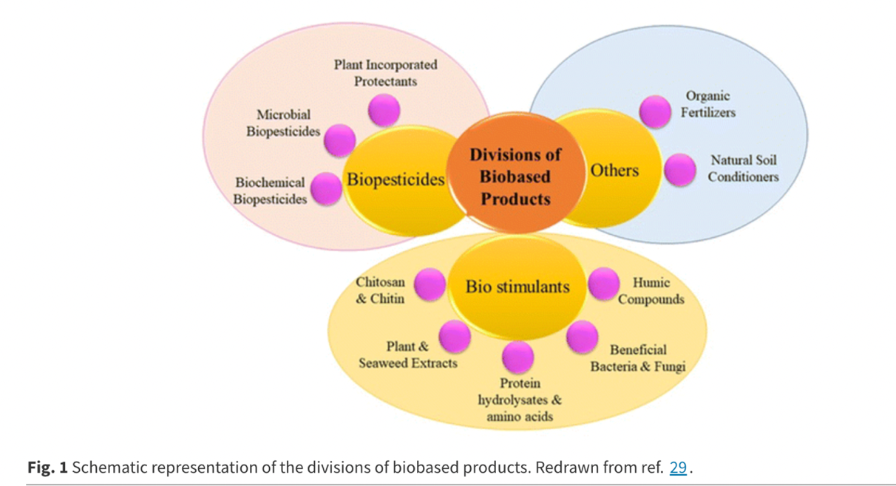
3.1. Bio-based Products
Schematic representation of the divisions of biobased products
SOURCE: PRIYA ET AL, 2023

Slide 24
3.1. Bio-based Products
Biomaterials:
  Derived from various biomass sources, including plants, marine resources, and animal residuals.
  Processing of these resources yields biomaterials, requiring knowledge of feedstock composition for effective production.
Energy Fuels:
  Biomass serves as a renewable energy source, including plants, agricultural waste, and forestry by-products.
  Biofuels like ethanol, methanol, and biodiesel are produced from biomass using biochemical or thermochemical conversion processes.
Biochemicals:
  Renewable chemicals derived from biomass offer eco-friendly alternatives to petroleum-based chemicals.
  Examples include bioalcohols and bio-derived acids, utilized in pharmaceuticals, cosmetics, and food industries.
  These alternatives are often more sustainable, cost-effective, and biodegradable compared to non-renewable counterparts.

Slide 25
3.2. The emergence of bio-products in agriculture
Types of Bio-Products:
  Biopesticides: Utilize biological agents to control pests and diseases.
  Biostimulants: Stimulate plant growth using substances like hormones or enzymes.
  Biofertilisers: Provide nutrients from organic sources, such as compost or fishmeal, to enhance crop protection, improvement, and nutrition.
Applications:
  Widely adopted across industries from cosmetics to fuels due to their eco-friendly nature and efficacy.
  Serve vital roles in integrated pest management, facilitating interspecies communication and promoting sustainable agricultural practices.

Slide 26
Additional Information
If you want to learn more on Bio-based Products, please read this article in the following link
https://single-market-economy.ec.europa.eu/sectors/biotechnology/bio-based-products_en#:~:text=Bio%2Dbased%20products%20are%20wholly,and%20paper%2C%20textiles%2C%20etc
If you want to learn more on Bio-based Plastics from Agricultural Waste, please watch this video in the following link
https://www.youtube.com/watch?v=ioHQNIrsojU

Slide 27
4. Agroecology and Regenerative Practices

Slide 28
4.1. Agroecology
Origins and Evolution of Agroecology
Agroecology traces its roots back to the traditional food systems of indigenous peoples, embodying deep connections with ecosystems, traditions, and cultural heritage.
The term "agroecology" emerged in the early 20th century, initially focusing on aspects like pest control and soil biology, before expanding to include crop management, soil health, and agricultural meteorology by the 1950s.
In the 1960s, scholars like Wolfgang Tischler contributed to the development of agroecology as an independent academic discipline, exploring the interactions among plants, animals, soils, and climate within agroecosystems.

Slide 29
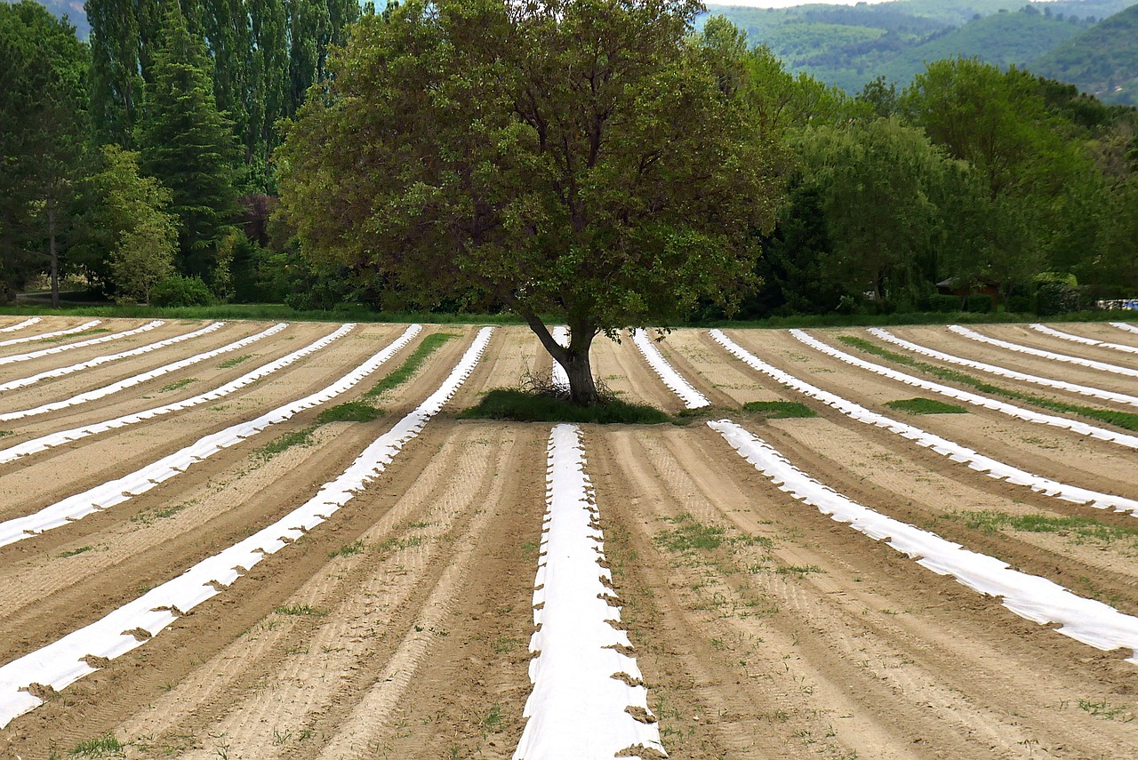
4.1. Agroecology
Growth and Expansion of Agroecology
The 1990s witnessed significant growth in agroecology both as a scientific discipline and a grassroots movement, spurred by increasing environmental awareness.
During this period, universities in Europe and the US began offering agroecology programs, while NGOs like Brazil's AS-PTA emerged to facilitate collaboration between agroecologists and farmers.
By the 2000s, agroecology evolved beyond agriculture to encompass the entire food system, integrating environmental, economic, and social dimensions and promoting sustainable practices from production to consumption.

Slide 30
4.1. Agroecology
Diverse Perspectives and Guiding Principles
Despite its growth, the definition of agroecology remains a subject of debate, with some viewing it purely as a technical field and others emphasizing its political and transformative potential.
The FAO's '10 elements of agroecology' and the UN Committee on World Food Security's 13 guiding principles underscore the multifaceted nature of agroecology, advocating for a holistic approach that combines traditional knowledge with science to drive profound changes in food systems for sustainability and social equity.

Slide 31
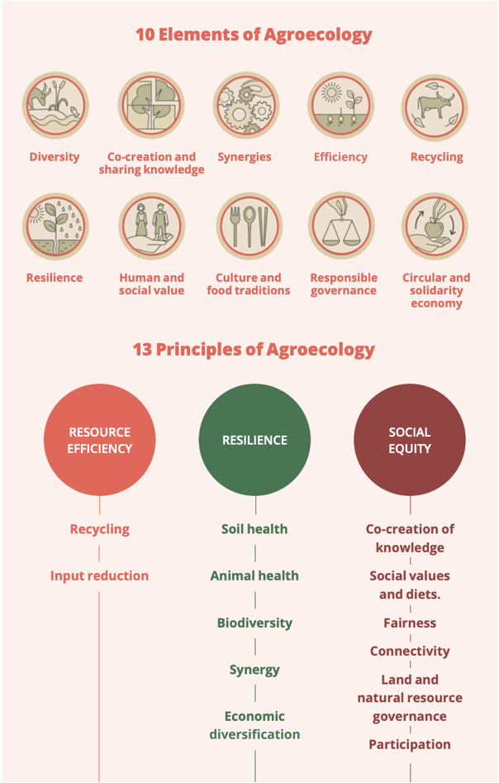
4.1. Agroecology
Elements and principles of agroecology
SOURCE: IDS & IPES-FOOD, 2022

Slide 32
4.1. Agroecology
The 13 guiding principles of agroecology align with the 10 elements, reflecting its evolution from a method for changing unsustainable food production to a comprehensive approach.
Today, agroecology integrates scientific knowledge with practical application, backed by a social movement advocating for a complete overhaul of food systems.
This transformation prioritizes environmental sustainability and distributive justice, garnering formal recognition in international food governance with the support of a diverse yet unified group of experts.

Slide 33
4.2. Regenerative agriculture
Roots and Principles of Regenerative Agriculture
Regenerative agriculture traces back to the organic movement of the 1960s in the USA, influenced by Rachel Carson's Silent Spring.
The Rodale Institute coined the term 'regenerative organic' in the early 1980s, emphasizing the natural rejuvenation capacity of ecosystems and biodiversity.
Richard Harwood outlined three core principles: linkages within farming systems, maintaining biological equilibrium, and nurturing constructive mutualism while minimizing damages.

Slide 34
4.2. Regenerative agriculture
While regenerative agriculture gains international traction, large agrifood corporations shape the discourse.
They invest in regenerative approaches but often prioritize environmental concerns like soil health and carbon emissions over social justice and equity.
Some corporate versions of regenerative agriculture may focus solely on offsetting emissions without addressing broader social issues, highlighting the need for a holistic approach.

Slide 35
Additional Information
If you want to learn more on the Regenerative Agriculture, please read this article in the following link
https://www.weforum.org/agenda/2022/10/what-is-regenerative-agriculture/#:~:text=Regenerative%20agriculture%20focuses%20on%20improving,well%20as%20reducing%20soil%20erosion.
If you want to learn more on the Regenerative Agriculture, please watch this video in the following link
https://www.youtube.com/watch?v=yp1i8_JFsao

Slide 36
5. Circular Farming Technologies

Slide 37
5.1. Circular Farming Technologies
Sustainable agricultural practices must address the needs of a growing population.
On-farm technologies facilitate various sustainable production models: climate-smart agriculture, sustainable intensification, and agroecological production.
Investments in agricultural technologies, both large and small-scale, can increase yields and minimize ecological impacts.
Governments worldwide are encouraging on-farm investment to enhance productivity, sustainability, and farmer incomes.
Recent debates highlight the shift towards food circularity to improve sustainability.
Governments in regions like the EU, China, and Latin America are investing in technologies promoting on-farm circularity to boost production, sustainability, and meet international climate agreements.

Slide 38
5.1. Circular Farming Technologies
Did you know that many farmers are often reluctant or need help to finance on-farm improvements?
This reluctance may be due to a number of factors, including risk aversion, resource constraints, lack of credit or failure to recognise the advantages. However, certain technologies can provide multiple benefits, including climate adaptation, resilience and income enhancement.

Slide 39
5.2. Benefits of specific circular technologies
Technologies for Reducing GHG Emissions and Eutrophication Potential in Livestock Farming
Implemented technologies include sand filter systems, solid waste separation, biodigesters, milking machines, and wastewater reuse.
Significant reductions in annual CO2eq and eutrophication potential were observed with the adoption of these technologies.
However, the construction or rehabilitation of septic tanks resulted in a significant increase in CO2eq emissions compared to scenarios with no manure management.
Some technologies showed consistent effectiveness regardless of herd size, while others were influenced by herd size.
Waste management pools were identified as a major contributor to GHG emissions, with significant emissions per cow despite reducing eutrophication potential.

Slide 40
Additional Information
If you want to learn more on the Smart Farming Systems, please read this article in the following link
https://www.mdpi.com/2673-4591/9/1/10
If you want to learn more on a farm which does not use soil, please watch this video in the following link
https://www.youtube.com/watch?v=WiOhsLFvmJU

Slide 41


