Slide 2
Course: (VET-C3) Module: Bio-economy, circular economy and bio-based products Learning Unit: Bioenergy and energy crops
Authors: (UNIFI)

Slide 3
Introduction
In an era defined by growing environmental concerns and an urgent demand for sustainable energy solutions, bioenergy stands out as a promising answer at the intersection of renewable energy and agriculture. Bioenergy encompasses a range of energy forms derived from organic materials, predominantly biological resources like plants and biomass, aimed at producing power and heat. A fundamental element in bioenergy production revolves around the cultivation of dedicated energy crops. These crops are intentionally grown for the sole purpose of generating energy in various forms, including electricity, heat, and biofuels. The cultivation of energy crops plays a pivotal role in the bioenergy sector, providing an eco-friendly and economically viable alternative to traditional fossil fuels.

Slide 4
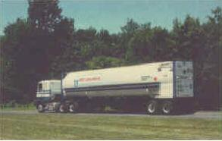
BIOFUELS: DEFINITION
THE TERM "BIOFUELS" REFERS TO A WHOLE SERIES OF FUELS OF VEGETABLE ORIGIN WHICH, PURE OR BLENDED, CAN BE USED IN ENGINES FOR ENERGY PRODUCTION AND FOR TRANSPORT.
THE CHARACTERISTIC OF BEING LIQUID, IN AMBIENT CONDITIONS, ALLOWS THEM TO BE EASILY INSERTED INTO THE EXISTING INFRASTRUCTURE, BOTH IN TERMS OF STORAGE AND DISTRIBUTION, AND FOR THEIR USE.

Slide 5
BENEFITS
AGRICOLTURE
Increased use of agricultural and forestry resources
Market diversification, greater competitiveness on the international scene
Higher income for the farmer, development of rural areas
ENVIRONMENT
Small/large-scale pollution reduction.
OCCUPATION
Job creation, particularly in rural areas
Esempi: 1 job / 550 m³ bioeth = 10 agric. Job /MWel attached + 2 Indust. Job/MWel product
STRATEGIC ASPECTS
Reduced dependence on imports (domestic reneweble fuel)

Slide 6
PROBLEMATIC ASPECTS
AGRICOLTURE
Allocation of part of the productive land to energy production (Set-aside)
ENVIRONMENT
Production of pollutants associated with each combustion process, in particular NOx
MARKETS
Speculative effects on the prices of certain foodstuffs: (grains, maize, etc.)

Slide 7
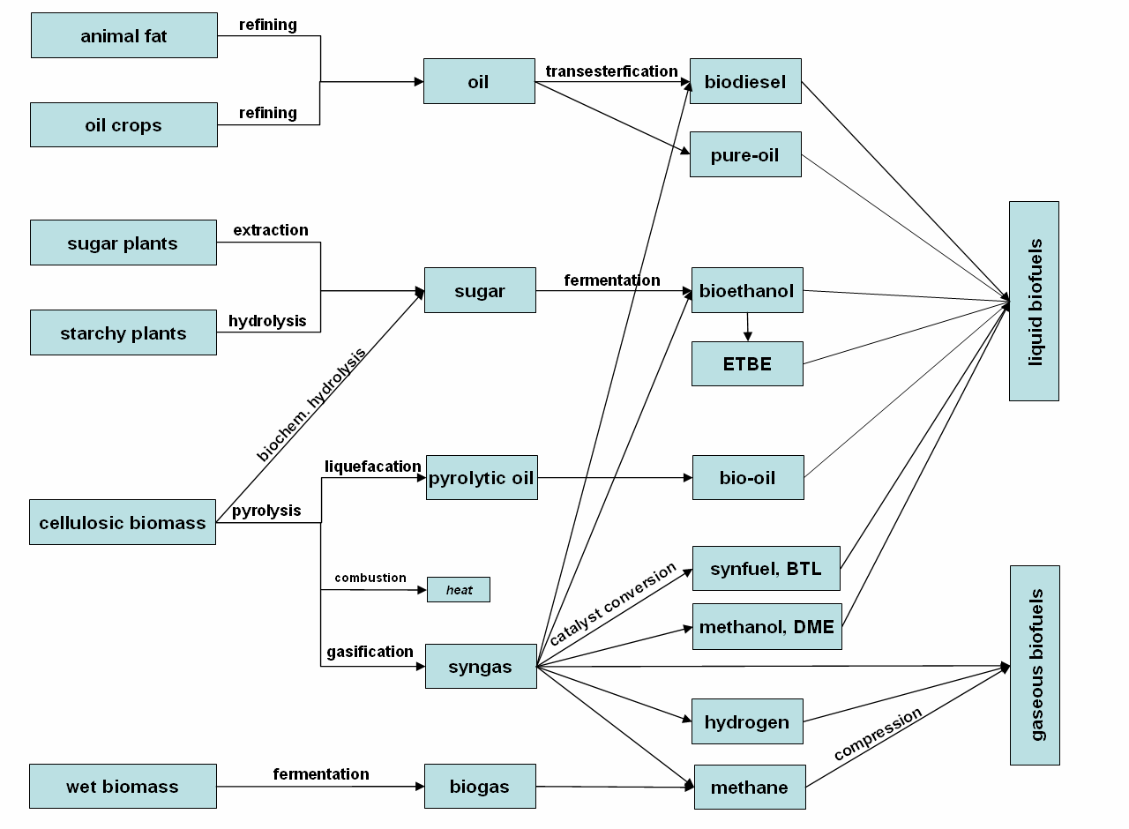
BIOFUELS PATHWAYS
Notes:
Feedstock sources can be divided into animal fats, oil crops, sugar plants, starchy plants, cellulosic biomass and wet biomass

Slide 8
PATWAYS DEI BIOCARBURANTI
FIRST GENERATION BIOFUELS
PPO, biodiesel, ETBE and bioethanol are FIRST GENERATION BIOFUELS since the conversion and engine technologies are widely developed and approved in practice. They offer the greatest short-term potentials of biofuels today. Although they differ in properties, technical requirements, economical aspects and potential, they can contribute to guarantee long-term mobility

Slide 9
PATWAYS DEI BIOCARBURANTI
SECOND GENERATION BIOFUELS are not yet commercial available since their conversion technologies have to be improved. They include e.g. BTL fuels and ethanol from lignocellulose. BtL fuels are a promising option for the future, but will not achieve relevance to the market before 2015. However, the boundaries first and second generation fuels are fluently and not exactly defined. Currently, the use of biomethane in the transport sector shifts from 2nd to 1st generation biofuel. First biomethane stations are built at the moment. Biomethane from biogas can be used in natural gas vehicles without any adjustments.

Slide 10
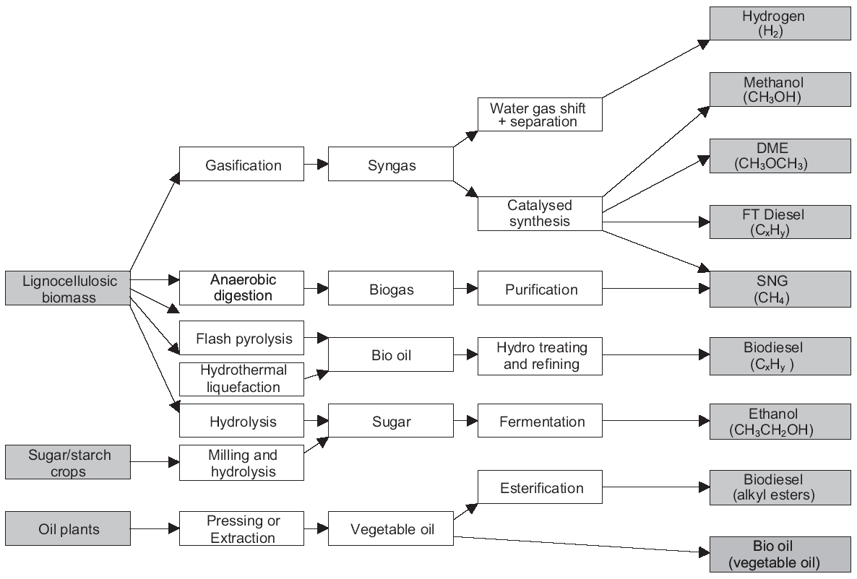
2ND GENERATION BIOFUELS
1ST GENERATION BIOFUELS
Fonte: Hamelinck et al, 2005

Slide 11
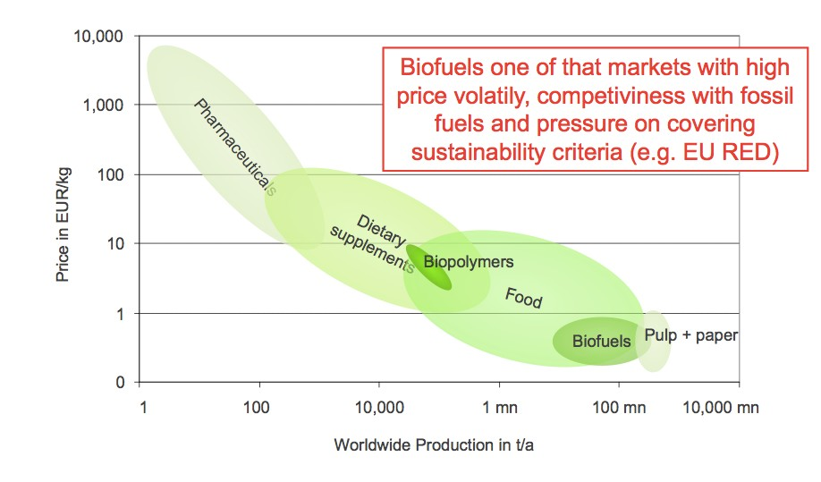
BIOFUELS

Slide 12
IMP

Slide 13
IMP

Slide 15
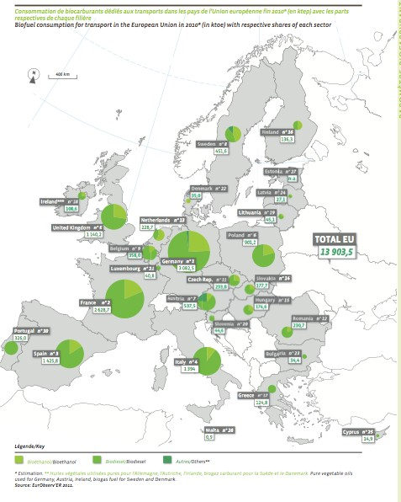
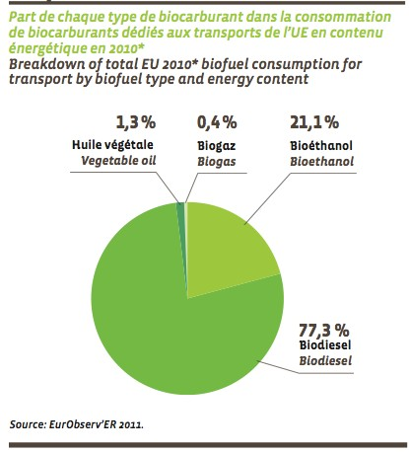

Slide 16
BIOETHANOL
Plant-based ethanol can be obtained through the cultivation of wheat and sugar beet from which sugar is extracted. The fermentation of the latter and subsequent distillation produces ethanol. This can be used as an additive up to 5% directly in unleaded gasoline or transformed into ETBE (Ethyl Tertiary-Butyl Ester) by reaction with isobutylene, and blended up to 15% with unleaded gasoline. There are also modified cars on the market that can be powered by bioethanol-gasoline blends with both pure components (FLEXFUEL CARS) MTBE (Methyl Tertiary-Butyl Ester) is a derivative of Methanol extracted from dedicated sugar crops and is similar to ETBE.

Slide 17
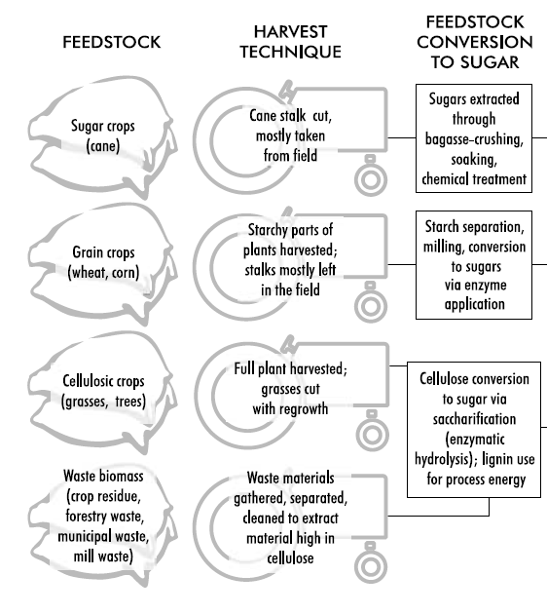
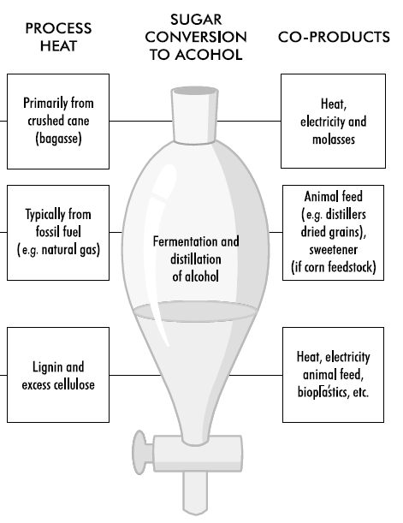
BIOETHANOL-PRODUCTION
IMP

Slide 19
IMP

Slide 20
BIOETHANOL-PRODUCTION
Ethanol can be produced from any biological feedstock that contains appreciable amounts of sugar or materials that can be converted into sugar such as starch or cellulose.
Sugar beets and sugar cane are obvious examples of feedstock that contain sugar.
Corn, wheat and other cereals contain starch (in their kernels) that can relatively easily be converted into sugar.
Similarly, trees and grasses are largely made up of cellulose and hemicellulose, which can also be converted to sugar, though with more difficulty than conversion of starch.

Slide 21
The Sugar-to-Ethanol Production
Process
In producing ethanol from sugar crops, the crops must first be processed to remove the sugar (such as through crushing, soaking and chemical treatment).
The sugar is then fermented to alcohol using yeasts and other microbes.
A final step distils (purifies) the ethanol to the desired concentration and usually removes all water to produce “anhydrous ethanol” that can be blended with gasoline.
In the sugar cane process, the crushed stalk of the plant, the “bagasse”, consisting of cellulose and lignin, can be used for process energy in the manufacture of ethanol.

Slide 22
The Sugar-to-Ethanol Production
IMP
Process

Slide 23
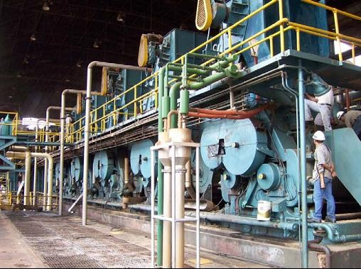
The Sugar-to-Ethanol Production
Process
Sugar mill for bioethanol production from sugar cane in Brazil

Slide 24
Grain-to-Ethanol Production
In many countries, most fuel ethanol is produced from the starch component of grain crops (primarily corn and wheat in the US and wheat and barley in Europe – though sugar beets are also used in Europe).
In conventional grain to-ethanol processes, only the starchy part of the crop plant is used. When corn is used as a feedstock, only the corn kernels are used; for wheat, it is the whole wheat kernel.
These starchy products represent a fairly small percentage of the total plant mass, leaving considerable fibrous remains (e.g. the seed husks and stalks of these plants).
Current research on cellulosic ethanol production is focused on utilising these waste cellulosic materials to create fermentable sugars – ultimately leading to more efficient production of ethanol than from using just the sugars and starches directly available.

Slide 25
The Grain-to-Ethanol Production
Process
The grain-to-ethanol production process starts by separating, cleaning and milling (grinding up) the starchy feedstock.
Milling can be “wet” or “dry”, depending on whether the grain is soaked and broken down further either before the starch is converted to sugar (wet) or during the conversion process (dry).

Slide 26
The Grain-to-Ethanol Production
Process
In both cases, the starch is converted to sugar, typically using a high-temperature enzyme process.
From this point on, the process is similar to that for sugar crops, where sugars are fermented to alcohol using yeasts and other microbes.
A final step distils (purifies) the ethanol to the desired concentration and removes water.
The grain to- ethanol process also yields several co-products, such as protein-rich animal feed (e.g. distillers dry grain soluble, or DDGS) and in some cases sweetener, although this varies depending on the specific feedstock and process used.

Slide 27
The Grain-to-Ethanol Production
IMP
Process

Slide 28
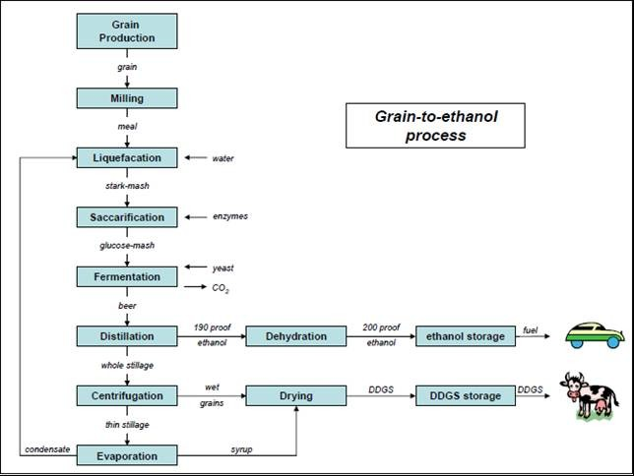
The Grain-to-Ethanol Production
Process

Slide 29
Cellulosic Biomass-to-Ethanol
Production
Most plant matter is not sugar or starch, but cellulose, hemicellulose and lignin. The green part of a plant is composed nearly entirely of these three substances.
Cellulose and hemicellulose can be converted into alcohol by first converting them into sugar (lignin cannot).
The process, however, is more complicated than converting starch into sugars and then to alcohol.

Slide 30
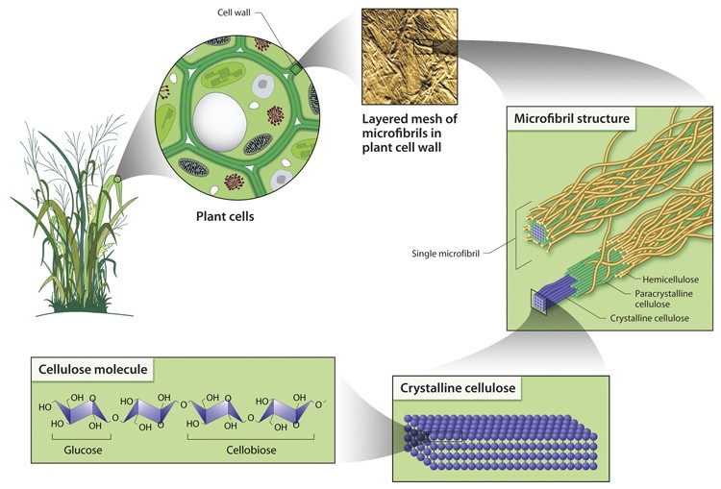
Cell-Biomass-to-Ethanol Prod

Slide 31
Cellulosic Biomass-to-Ethanol
IMP
Production
There are several potentially important benefits from developing a viable and commercial cellulosic ethanol process:
Access to a much wider array of potential feedstock (including waste cellulosic materials and dedicated cellulosic crops such as grasses and trees), opening the door to much greater ethanol production levels.
Greater avoidance of conflicts with land use for food and feed production.
A much greater displacement of fossil energy per litre of fuel, due to nearly completely biomass-powered systems.
Much lower net well-to-wheels greenhouse gas emissions than with grain to- ethanol processes powered primarily by fossil energy.

Slide 32
Cellulosic Biomass-to-Ethanol
Production: FEEDSTOCKS
A large variety of feedstock is available for producing ethanol from cellulosic biomass.
Agricultural wastes (including those resulting from conventional ethanol production), forest residue, municipal solid wastes (MSW), wastes from pulp/paper processes and energy crops.
Agricultural wastes available for ethanol conversion include crop residues such as wheat straw, corn stover (leaves, stalks and cobs), rice straw and bagasse (sugar cane waste).
Forestry wastes include underutilised wood and logging residues; rough, rotten and salvable dead wood; and excess saplings and small trees.

Slide 33
Cellulosic Biomass-to-Ethanol
IMP
Production - FEEDSTOCKS
MSW contains some cellulosic materials, such as paper and cardboard.
Energy crops, developed and grown specifically for fuel, include fast-growing trees, shrubs, and grasses such as hybrid poplars, willows and switchgrass.
The cellulosic components of these materials can range anywhere from 30% to 70%. The remainder is lignin, which cannot be converted to sugar, but can be used as a process fuel in converting cellulose to alcohol, or can be converted to liquid fuel through gasification and gas-to liquids conversion.

Slide 34
Cellulosic Biomass-to-Ethanol
IMP
Production
To convert cellulose to ethanol, two key steps must occur.
First, the cellulose and hemicellulose portions of the biomass must be broken down into sugars through a process called saccharification. The yielded sugars, however, are a complex mixture of five- and six-carbon sugars that provide a greater challenge for complete fermentation into ethanol.
Second, these sugars must be fermented to make ethanol, as they are in grain- to-ethanol processes.
The first step is a major challenge, and a variety of thermal, chemical and biological processes are being developed to carry out this saccharification step in an efficient and low-cost manner.

Slide 35
Cellulosic Biomass-to-Ethanol
IMP
Production
To convert cellulose to ethanol, two key steps must occur.
First, the cellulose and hemicellulose portions of the biomass must be broken down into sugars through a process called saccharification. The yielded sugars, however, are a complex mixture of five- and six-carbon sugars that provide a greater challenge for complete fermentation into ethanol.
Second, these sugars must be fermented to make ethanol, as they are in grain-to- ethanol processes.
The first step is a major challenge, and a variety of thermal, chemical and biological processes are being developed to carry out this saccharification step in an efficient and low-cost manner.

Slide 36
Cellulosic Biomass-to-Ethanol
Production
One important difference between cellulosic and conventional (grain and sugar crop) ethanol production is the choice of fuel to drive the conversion process.
In current grain-to-ethanol production processes in North America and Europe, virtually all process energy is provided by fossil inputs, such as natural gas used to power boilers and fermentation systems.
For cellulose-to-ethanol conversion, nearly all process energy is provided by biomass, in particular the unused cellulosic and lignin parts of the plant being processed.
In short, it has been easier and less expensive to continue relying on fossil energy inputs to drive the conversion process, even though this emits far more greenhouse gases than conversion relying on bioenergy as the process fuel.

Slide 37
Cell Biomass-to-Ethanol Process
The first step in converting biomass to ethanol is pre-treatment, involving cleaning and breakdown of materials. A combination of physical and chemical (e.g. acid hydrolysis) processes is typically applied, which allows separation of the biomass into its cellulose, hemicellulose and lignin components. Some hemicellulose can be converted to sugars in this step, and the lignin removed.

Slide 38
Cell Biomass-to-Ethanol Process
Next, the remaining cellulose is hydrolysed into sugars, the major saccharification step.
Common methods are dilute and concentrated acid hydrolysis, which are expensive and appear to be reaching their limits in terms of yields.
Therefore, considerable research is being invested in the development of biological enzymes that can break down cellulose and hemicellulose.
The first application of enzymes to wood hydrolysis in an ethanol process was to simply replace the cellulose acid hydrolysis step with a cellulose enzyme hydrolysis step. This is called separate hydrolysis and fermentation (SHF).

Slide 39
Cell Biomass-to-Ethanol Process
An important process modification made for the enzymatic hydrolysis of biomass was the introduction of simultaneous saccharification and fermentation (SSF), which has recently been improved to include the co-fermentation of multiple sugar substrates.
In the SSF process, cellulose, enzymes and fermenting microbes are combined, reducing the required number of vessels and improving efficiency.
As sugars are produced, the fermentative organisms convert them to ethanol (Sreenath et al., 2001).

Slide 40
Cell Biomass-to-Ethanol Process
Finally, researchers are now looking at the possibility of producing all required enzymes within the reactor vessel, thus using the same “microbial community” to produce both the enzymes that help break down cellulose to sugars and to ferment the sugars to ethanol.
This “consolidated bioprocessing” (CBP) is seen by many as the logical end point in the evolution of biomass conversion technology, with excellent potential for improved efficiency and cost reduction (Hamelinck et al., 2003).

Slide 41
Cell Biomass-to-Ethanol Process

Slide 42
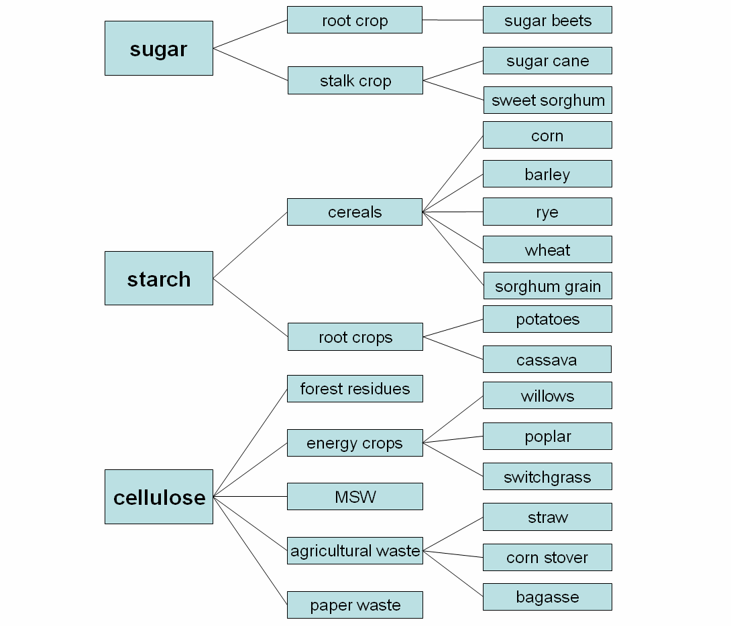
FEEDSTOCKS

Slide 43
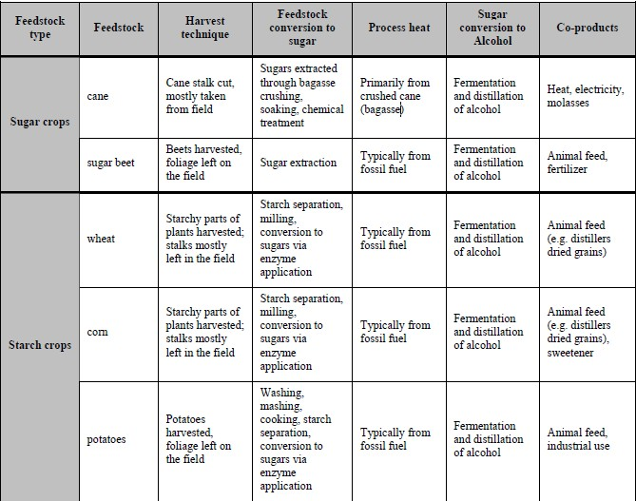
FEEDSTOCKS

Slide 44
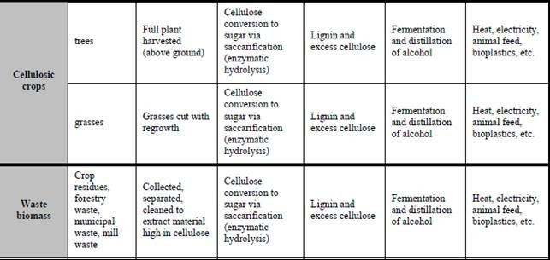
FEEDSTOCKS

Slide 45
Conclusion
Bioenergy and energy crops offer crucial solutions for addressing climate change and transitioning to sustainable energy. By cultivating energy crops for biofuel production, we proactively diversify energy sources and reduce reliance on finite fossil fuels. Bioenergy, in the form of bioethanol and biodiesel, provides a cleaner alternative, mitigating greenhouse gas emissions. Sustainability depends on balancing environmental, social, and economic factors, emphasizing responsible land use, biodiversity preservation, and community engagement. Technological innovations and adherence to rigorous standards enhance bioenergy system efficiency. Challenges like land competition with food crops necessitate ongoing research and a nuanced approach to balancing energy needs, food security, and environmental conservation. Certification plays a key role in guiding responsible practices. Despite challenges, continued investment in research, education, and collaboration is essential for unlocking the full potential of bioenergy, contributing to a resilient, sustainable, and greener energy future

