Slide 2
Course: VET Module: Bio-economy, circular economy and bio-based products Learning Unit: Introduction to bioeconomy - New value chains, Innovation and basic Economics in the Bioeconomy (C4)
Authors: Olympic Training & Consulting Ltd.

Slide 3
Introduction
The course learning outcomes, specific knowledge, skills and competences of an appropriate level, which the learners will acquire with the successful completion of the course are described:
Knowledge
Indicate the key concepts related to bioeconomy.
Make distinctions between conventional and bio based agribusinesses
Identify the bio-based value chains and recognise potential convergences between industries and processes
Discuss about the economic aspects of bioeconomy in the agribusiness sector
Outline current and future trends for bioeconomy innovation
Recognise strategic management as a tool for viable and efficient decision-making
Skills
contrast conventional and bio based agribusinesses
compare open innovation practices of bio based economy
discover value chain networks that are compatible to his/her activities
use tools that allow the calculation processing and analysis of economic aspects of bioeconomy
propose and develop service products in bioeconomy
Competences
adapt existing emerging technologies in the bio-based economy
administer existing bioeconomy strategies
review open innovation practices and develop own strategic plans

Slide 4
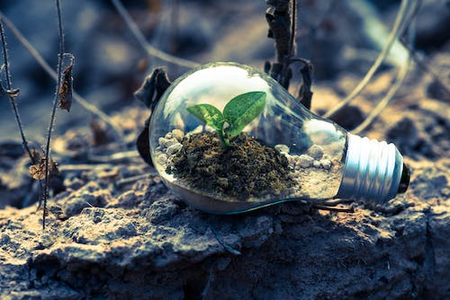
Overview of Bioeconomy
“Bioeconomy can be defined as those parts of the economy that use renewable biological resources from land and sea – such as crops, forests, fish, animals and microorganisms – to produce food, materials and energy” (EC 2020).
Module: Bio-economy, circular economy and bio-based products / Learning Unit: Introduction to bioeconomy - New value chains, Innovation and basic Economics in the Bioeconomy

Slide 5
Key elements of the bioeconomy in agribusiness
Biomass Utilization: Biomass, such as crop residues, agricultural waste, and forestry by-products, can be converted into various products, including biofuels, bio-based materials, and bioenergy. This creates opportunities for agribusinesses to diversify their revenue streams and reduce their carbon footprint.
Biotechnology and Genetic Engineering: Advances in biotechnology and genetic engineering have revolutionized agribusiness by enabling the development of genetically modified crops with improved traits, such as higher yields, disease resistance, and enhanced nutritional content.
Circular Economy: The bioeconomy encourages a circular approach where agricultural by-products and waste are utilized as feedstock for various value-added processes. This reduces waste and promotes resource efficiency.
Sustainable Agriculture: The bioeconomy emphasizes sustainable agricultural practices that prioritize environmental conservation, biodiversity protection, and responsible land management. This involves adopting techniques like precision agriculture, agroforestry, and organic farming.
Food and Nutraceuticals: The bioeconomy offers opportunities to develop new and healthier food products with enhanced nutritional value through biotechnological advancements.
Renewable Resources: Unlike fossil fuels, which are finite, the bioeconomy relies on renewable resources like plants and microorganisms, ensuring a more sustainable approach to resource utilization.
Policy and Regulations: Government policies and regulations play a crucial role in shaping the bioeconomy in agribusiness. Supportive policies, incentives, and research funding can accelerate the adoption of bio-based technologies and practices.
Module: Bio-economy, circular economy and bio-based products / Learning Unit: Introduction to bioeconomy - New value chains, Innovation and basic Economics in the Bioeconomy

Slide 6
Benefits
Sustainability: The bioeconomy emphasizes the use of renewable resources and the reduction of waste, leading to more sustainable agricultural practices. This can help mitigate the negative environmental impacts associated with conventional agriculture, such as soil degradation, water pollution, and greenhouse gas emissions.
Increased Productivity: Biotechnology allows for the development of genetically modified crops that are resistant to pests, diseases, and environmental stressors. These crops can lead to higher yields and better quality produce, addressing global food security concerns.
Circular Economy: The bioeconomy encourages the concept of a circular economy, where agricultural waste and byproducts are used as feedstocks for the production of biofuels, bioplastics, and other value-added products, reducing the reliance on finite fossil resources.
Diversification of Revenue Streams: Agribusinesses can explore new revenue streams by producing bio-based materials, chemicals, and fuels. This diversification can make them more resilient to market fluctuations in traditional commodity markets.
Rural Development: The bioeconomy can stimulate economic growth in rural areas by promoting the development of local bio-based industries, creating jobs, and revitalizing communities.
Innovation and Research: The bioeconomy fosters innovation through research and development in areas like precision agriculture, biotechnology, and synthetic biology, leading to continuous advancements in agribusiness practices.
Module: Bio-economy, circular economy and bio-based products / Learning Unit: Introduction to bioeconomy - New value chains, Innovation and basic Economics in the Bioeconomy

Slide 7
Challenges
Regulatory Hurdles: The use of genetically modified organisms (GMOs) and new biotechnological methods often faces regulatory challenges due to concerns about environmental safety, consumer health, and ethical considerations. Regulatory processes can be lengthy and complex, delaying the adoption of new technologies.
Ethical Concerns: Genetic modification and other biotechnological interventions can raise ethical questions related to the potential impact on biodiversity, ecosystem stability, and unintended consequences.
Market Acceptance: Consumer acceptance of bioengineered products and bio-based materials can be influenced by factors such as perceived health risks, labeling transparency, and cultural attitudes towards biotechnology.
Intellectual Property Issues: The development and commercialization of bio-based products may involve intellectual property disputes over patents and proprietary genetic resources.
Infrastructure and Investment: Transitioning to a bioeconomy requires significant investments in research, infrastructure, and technology adoption. Small and resource-constrained agribusinesses may struggle to access the necessary resources.
Complexity of Interactions: Biological systems are complex, and predicting the long-term effects of certain interventions can be challenging. There is a need for comprehensive risk assessments to avoid unintended consequences.
Resource Competition: In some cases, the use of biological resources for bio-based products can compete with traditional food production, potentially leading to conflicts over land use and resource allocation.
Module: Bio-economy, circular economy and bio-based products / Learning Unit: Introduction to bioeconomy - New value chains, Innovation and basic Economics in the Bioeconomy

Slide 8
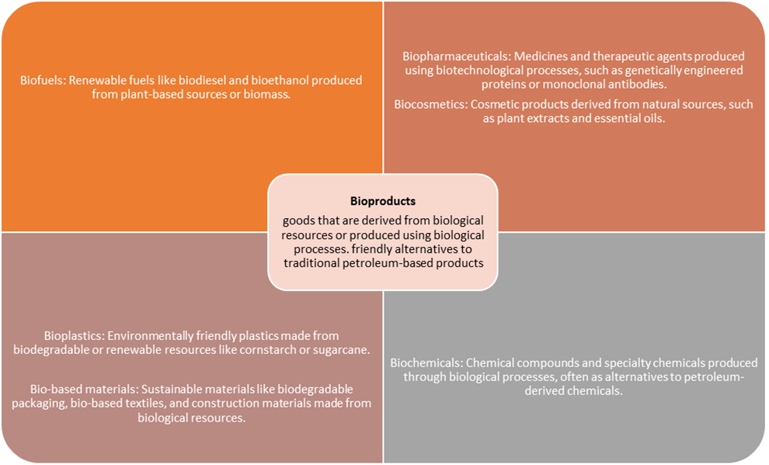
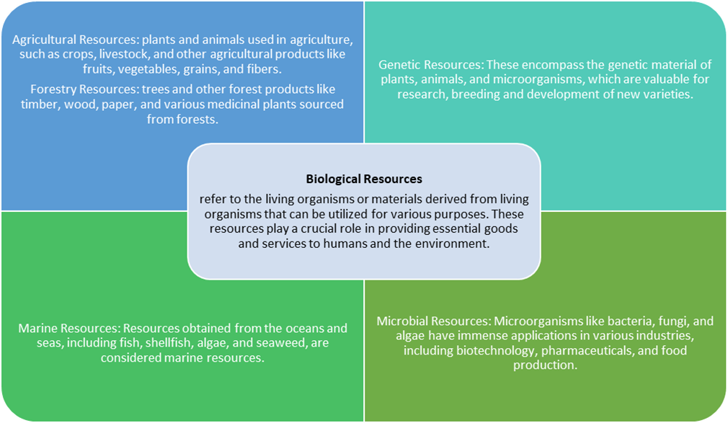
Bioproducts & Biological resources
Module: Bio-economy, circular economy and bio-based products / Learning Unit: Introduction to bioeconomy - New value chains, Innovation and basic Economics in the Bioeconomy

Slide 9
Bio-economy in Europe
Key EU initiatives and policies related to bioeconomy:
Bioeconomy Strategy and Action Plan (2018) The EU Bioeconomy Strategy also provides a strategic framework for shifting the economic resource base in Europe to a circular model that is grounded on renewable and bio-based materials. With a turnover of €2.3 trillion and accounting for 8.2% of the EU's workforce, the bioeconomy is already central to the success of the EU economy. Expansion of a sustainable European bioeconomy is projected to create 1 million new jobs by 2030, especially in coastal and rural areas. The 2018 update of the Bioeconomy Strategy aims to accelerate the deployment of a sustainable European bioeconomy so as to maximise its contribution towards the 2030 Agenda and its Sustainable Development Goals (SDGs), as well as the Paris Agreement.
European Green Deal (2019): The European Green Deal, launched in 2019, aims to make the EU climate-neutral by 2050. It emphasizes the importance of the bio-based industry and bio-economy in reducing greenhouse gas emissions and promoting sustainable growth.
Horizon Europe (2021-2027): The EU's research and innovation framework program, Horizon Europe, has allocated significant funding to support research and innovation in the bio-based industry. This funding facilitates the development of new technologies and processes to enhance the competitiveness of bio-based products.
Circular Economy Action Plan (March 2020): The Circular Economy Action Plan encourages the sustainable use of resources and promotes circular practices in various industries, including the bio-based sector. It emphasizes the importance of recycling and reusing bio-based products to minimize waste.
Circular Bio-based Europe Joint Undertaking (CBE JU): is a €2 billion partnership between the European Union and the Bio-based Industries Consortium (BIC) that funds projects advancing competitive circular bio-based industries in Europe. CBE JU is operating under the rules of Horizon Europe, the EU’s research and innovation programme, for the 2021-2031 period. The partnership is building on the success of its predecessor, the Bio-based Industries Joint Undertaking (BBI JU), while addressing the current challenges facing the industry.
Common Agricultural Policy (CAP): The CAP provides financial support and incentives to European farmers to adopt more sustainable agricultural practices, including the production of renewable biomass for the bio-based industry. Common Agricultural Policy (CAP) CAP Strategic Plans encourage the transition towards a smart, sustainable, competitive, resilient and diversified agricultural sector, while ensuring long-term food security. They also contribute to climate action, the protection of natural resources, the preservation and enhancement of biodiversity, as well as strengthen the socio-economic fabric of rural areas. Funds from the Common Agricultural Policy (CAP) complement Horizon Europe’s funding and action to ensure that research and innovation will be taken up by farmers, foresters and rural communities. Actions funded by the CAP under the agricultural European Innovation Partnership (EIP-AGRI) help building the bridge between innovation and end users. Also by country CAP 2023-27 – 28 CAP Strategic Plans at a glance
“Farm to Fork” Strategy (2020) This initiative aims to re-balance food systems, nature and biodiversity in Europe through much wider organic farming, among other priorities. This initiative highlights that making European food famous for its sustainability can give a competitive advantage and open new business opportunities for European farmers.
Module: Bio-economy, circular economy and bio-based products / Learning Unit: Introduction to bioeconomy - New value chains, Innovation and basic Economics in the Bioeconomy

Slide 10
Bio-based industry in Europe
The bio-based industry refers to the production of renewable biological resources, such as crops, forest biomass, and organic waste, to produce a wide range of products, including biofuels, bioplastics, bio-based chemicals, and bio-based materials. This industry aims to replace fossil-based products with sustainable alternatives, reducing greenhouse gas emissions and dependency on non-renewable resources. The European bio-based industry has been flourishing, supported by favorable policies, research and development initiatives, and public-private partnerships. Governments and the private sector have been investing in research and innovation to drive advancements in biotechnology and bio-refining processes. The bio-based industry also helps in promoting rural development by creating new economic opportunities in agricultural regions.
Bio-economy in Europe
The bio-economy encompasses all economic activities that use biological resources and processes to produce goods and services. It includes sectors such as agriculture, forestry, fisheries, food production, and the bio-based industry. The EU sees the bio-economy as a crucial element in achieving sustainable development goals, including mitigating climate change, fostering circular economy practices, and ensuring resource efficiency.
Agriculture plays a vital role in the European bio-economy. It provides the renewable resources necessary for bio-based products and fuels. Additionally, the bio-economy offers opportunities for farmers to diversify their income streams by engaging in bio-based activities and utilizing their agricultural by-products in value-added processes.
Module: Bio-economy, circular economy and bio-based products / Learning Unit: Introduction to bioeconomy - New value chains, Innovation and basic Economics in the Bioeconomy

Slide 11
Value chains
a set of interlinked activities that deliver products/services by adding value to bulk material (feedstock). In a bio-based value chain, the feedstocks tend to be biomass drawn from an existing primary production route (e.g., agriculture, forestry and livestock), or of a novel (e.g., microalgae) or secondary origin (e.g., sludge, industrial wastewater and household organic waste).
Module: Bio-economy, circular economy and bio-based products / Learning Unit: Introduction to bioeconomy - New value chains, Innovation and basic Economics in the Bioeconomy

Slide 12
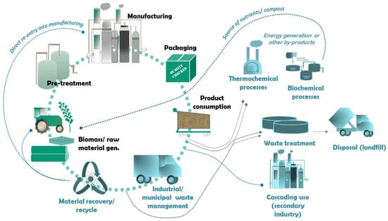
Value chains in bioeconomy
Within the bioeconomy, value chains play a crucial role in connecting different stages of production and processing to deliver products to the market. When it comes to farming in the context of the bioeconomy, value chains play an essential role in optimizing resource utilization, reducing waste, and creating more sustainable agricultural practices. The bio-based value chains have been identified as one of the most promising pathways to attaining a resource-efficient circular economy.
Module: Bio-economy, circular economy and bio-based products / Learning Unit: Introduction to bioeconomy - New value chains, Innovation and basic Economics in the Bioeconomy

Slide 13
Breakdown of the value chains in the bioeconomy farming sector:
Harvesting and Collection: Once crops are ready for harvesting or livestock is ready for processing, this stage involves the collection of agricultural products from farms and other sources.
Processing and Refining: In this stage, raw agricultural materials are processed and refined to create value-added products. This can include the production of biofuels, bio-based chemicals, biodegradable materials, and other bio-based products.
Distribution and Logistics: After processing, the bio-based products need to be distributed to various markets and consumers. Efficient logistics and transportation play a significant role in ensuring that products reach their intended destinations promptly.
Retail and Consumer Markets: This stage involves the sale of bio-based products to end consumers through various retail channels. The bioeconomy aims to offer sustainable and eco-friendly alternatives to traditional products.
Waste and By-Product Management: Sustainable bioeconomy value chains emphasize the efficient management of waste and by-products generated at different stages of production. These by-products can be utilized for other purposes, such as generating energy through biogas production or used as feedstock for other industries.
Research and Innovation: Constant research and innovation are vital for the bioeconomy farming sector to develop new and improved technologies, better crop varieties, and more sustainable farming practices.
Module: Bio-economy, circular economy and bio-based products / Learning Unit: Introduction to bioeconomy - New value chains, Innovation and basic Economics in the Bioeconomy

Slide 14
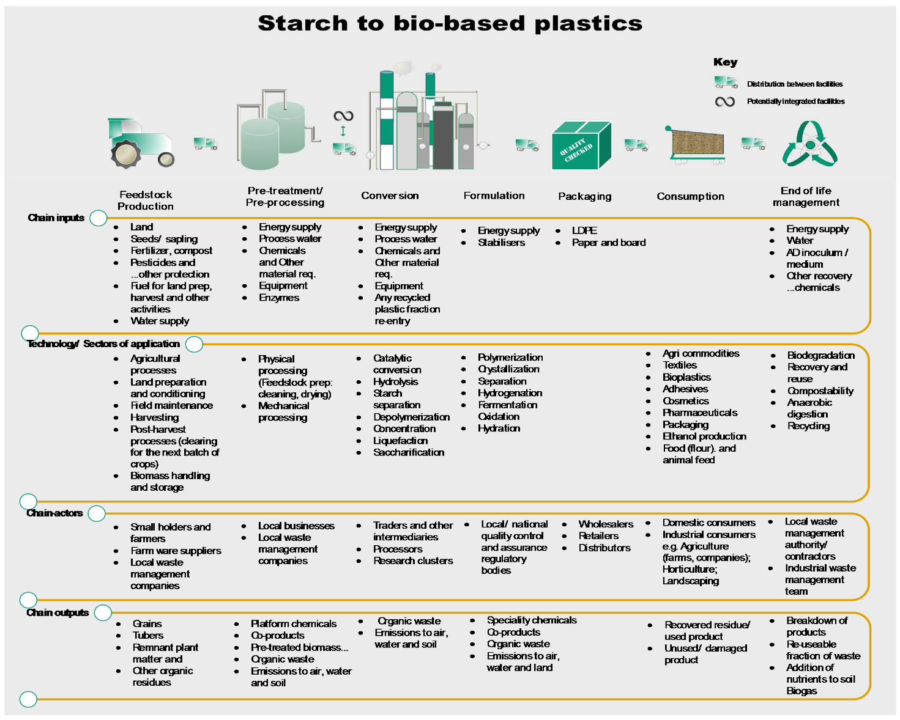
Value Chain Mapping
Value chain maps provide valuable insight into the integrated activities, actors and technology, in addition to the material flow, and are providing a foresight of the scope and qualitative performance potential (in socio-economic and environmental terms) within each of the life cycle stages.

Slide 15
Economic aspects of the bioeconomy
Diversification of Industries: The bioeconomy aims to foster the development of diverse industries based on bio-based resources. This includes sectors like bioenergy, biofuels, bioplastics, bio-based chemicals, bio-based materials, and more. By diversifying industries, it reduces dependency on finite fossil resources and fosters economic growth through innovation.
Sustainable Resource Management: The bioeconomy emphasizes sustainable management of biological resources, such as crops, forests, marine life, and waste materials. Sustainable practices ensure the resources are utilized in a manner that preserves their availability for future generations and prevents overexploitation.
Job Creation and Rural Development: The bioeconomy can play a significant role in creating job opportunities and promoting rural development. Activities such as sustainable agriculture, forestry, and bio-based industries can generate employment in rural areas, contributing to regional economic growth and reducing urban-rural disparities.
Circular Economy Approach: The bioeconomy embraces a circular economy model, where waste and by-products are utilized to create value-added products. This approach reduces waste generation, promotes recycling, and enhances resource efficiency, thereby reducing overall production costs.
Innovation and Research Investment: The bioeconomy relies heavily on research and innovation to develop new bio-based technologies and processes. Governments and private sectors often invest in research and development (R&D) to improve the efficiency and scalability of bio-based industries, fostering technological advancements.
Environmental Benefits: By relying on renewable biological resources, the bioeconomy has the potential to reduce greenhouse gas emissions and mitigate climate change. Replacing fossil-based products with bio-based alternatives can lower the carbon footprint and support environmental sustainability.
Market Opportunities and Trade: The bioeconomy opens up new market opportunities for bio-based products both domestically and internationally. As demand for sustainable and eco-friendly products increases, countries that are strong players in the bioeconomy can benefit from increased exports and trade.
Policy Support and Regulation: To promote the bioeconomy, governments often implement supportive policies and regulations. This may include financial incentives, tax benefits, renewable energy mandates, and sustainability standards to encourage the adoption of bio-based technologies.
Challenges and Risks: Despite the potential benefits, the bioeconomy faces challenges such as competition for land and resources, potential impacts on food security, and ensuring the sustainability of bio-based processes. Proper governance, regulation, and stakeholder engagement are crucial to address these challenges effectively.
Module: Bio-economy, circular economy and bio-based products / Learning Unit: Introduction to bioeconomy - New value chains, Innovation and basic Economics in the Bioeconomy

Slide 16
Tools related to economic aspects of bioeconomy
Input-Output Analysis: This technique helps to understand the interdependencies between different sectors of the economy. It can be used to estimate the economic impact of bioeconomy activities on various industries, employment, and value-added.
Life Cycle Assessment (LCA) Tools: LCA evaluates the environmental impacts associated with a product's life cycle. These tools can also incorporate economic aspects, helping to assess the cost-effectiveness of bio-based products compared to conventional alternatives.
Economic Models: There are various economic models that can simulate the effects of different policies, market conditions, and technological advancements on the bioeconomy. Examples include Computable General Equilibrium (CGE) models and agent-based models.
Bioeconomic Modeling Software: Some software tools are specifically designed for bioeconomic modeling. These tools can help analyze the interactions between ecological and economic systems. Examples include the Bioeconomy Impact Model (BIM) and BioEcon.
Cost-Benefit Analysis (CBA) Tools: CBA assesses the costs and benefits of a project or policy, including those related to the bioeconomy. These tools help decision-makers compare different options and determine the most economically viable choice.
Market Analysis Tools: Tools that provide insights into market trends, demand, and pricing for bio-based products can be essential for understanding the economic potential of the bioeconomy.
Financial Analysis Software: When assessing the economic aspects of bioeconomy projects, financial analysis tools can help calculate metrics like net present value (NPV), internal rate of return (IRR), and payback period.
Statistical Software: Software like R or Python with appropriate libraries can be used for statistical analysis of economic data related to the bioeconomy.
GIS (Geographic Information System) Tools: GIS can be used to analyze spatial data related to bioeconomy activities, such as land use, resource distribution, and transportation networks.
Databases and Data Repositories: Access to relevant economic data is crucial for analysis. Various databases provide economic and environmental data related to the bioeconomy, such as statistical offices, research institutions, and international organizations.
.
Module: Bio-economy, circular economy and bio-based products / Learning Unit: Introduction to bioeconomy - New value chains, Innovation and basic Economics in the Bioeconomy

Slide 17
Life Cycle Assessment (LCA)
LCA is a structured, comprehensive and internationally standardised method (ISO 2006) that aims to assess the potential environmental impacts associated with a product, a process or a system throughout its life cycle, from extraction of its raw materials to its end of life. Its objective is to:
quantify all relevant flows of raw materials consumed and pollutants emitted throughout the supply chain;
comprehensively assess the potential impacts on the environment and human health of the entire supply chain of a product, and identify hotspots of environmental impacts across the supply chain;
identify trade-offs between life-cycle stages, impact categories or regions that can lead to a shifting of environmental burdens.
LCA is implemented in four phases:
goal and scope definition;
life cycle inventory (LC I);
(3) life cycle impact assessment (LC IA); and
(4) interpretation of the results.
Module: Bio-economy, circular economy and bio-based products / Learning Unit: Introduction to bioeconomy - New value chains, Innovation and basic Economics in the Bioeconomy

Slide 18
Strategic management Plan
Implementing a sustainable bioeconomy plan may require changes to and improvements in many aspects of rural businesses. These can include where relevant:
improving existing supply and value chains, and developing new ones;
changing land management practices and systems to ensure that the farming and forestry sectors safeguard their soils and productive capacity in the face of the impacts of climate change;
changing the way natural resources are managed to ensure they will still be available for future generations to use;
providing environmental public goods including biodiversity and high nature value landscapes, as a resource for bioeconomy services;
adding value to existing products and creating new ones in a circular bioeconomy;
building the skills, knowledge and ability to make all this happen.
Module: Bio-economy, circular economy and bio-based products / Learning Unit: Introduction to bioeconomy - New value chains, Innovation and basic Economics in the Bioeconomy

Slide 19
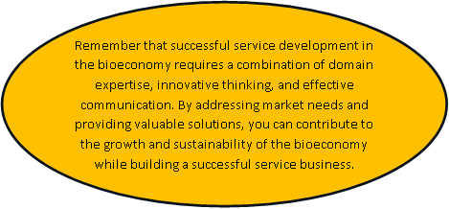
Simple steps on how to develop a service product within bioeconomy the bioeconomy
Identify Market Needs:
Research and identify specific gaps or challenges within the bioeconomy where your service could add value. This could involve areas such as sustainable agriculture, bio-based materials, renewable energy, waste management, or biotechnology.
Define Your Niche:
Determine your specialization within the bioeconomy. Are you focusing on data analysis for optimizing agricultural processes? Providing advisory services for bio-based product development? Defining a clear niche will help you tailor your offerings to meet specific market demands.
Understand the Bioeconomy Landscape:
Gain a deep understanding of the bioeconomy's current trends, technologies, and regulations. This knowledge will help you position your service effectively and ensure its relevance.
Develop Service Offerings:
Based on your niche and market research, outline the specific services you will offer.
Demonstrate Value:
Develop case studies or pilot projects that showcase the value your service brings to clients. Highlight how your service can lead to cost savings, increased efficiency, reduced environmental impact, or other benefits.
Marketing and Branding:
Create a strong brand identity that resonates with the bioeconomy's values of sustainability and innovation. Develop a compelling website, marketing materials, and online presence to reach your target audience.
Regulatory Compliance:
Ensure that your services are aligned with relevant regulations and standards within the bioeconomy. This is especially important if you are offering services related to biotechnology or bio-based products.
Pricing Strategy:
Determine your pricing model based on factors such as the complexity of services, market demand, and the value your service provides to clients.
Launch and Iterate:
Launch your service and gather feedback from initial clients. Use this feedback to continuously improve and refine your offerings based on real-world experiences.
Stay Updated:
Stay informed about the latest advancements and trends within the bioeconomy. As the field evolves, adapt your services to stay relevant and meet changing needs.

