Slide 2
Course: [VET]
Module: Controlled environment agriculture
LU: Basics of controlled environment agriculture
D1
Partner: UOP

Slide 3
Contents
1. Introduction to Controlled Environment Agriculture
2. Key Learning Outcomes
3. Subunit 1: Greenhouse Usefulness
4. Environmental Factors Influencing Plant Growth
5. Subunit 2: Lighting in Greenhouses
6. Subunit 3: Greenhouse Temperature Control
7. Subunit 4: Humidity and Air Quality Control
8. Subunit 5: CO2 Management in Greenhouses
9. Subunit 6: Greenhouses vs. Plant Factories
10. Conclusion

Slide 4
Introduction to Controlled Environment Agriculture
This Learning Unit (LU) aims to provide an overview of controlled environment agriculture, covering commonly used techniques, current market trends, and comprehensive knowledge and skills development.
Upon completion, learners will understand the environmental factors affecting plant growth, recognize construct elements of such farms, and differentiate between greenhouses and plant factories while mastering the technologies involved.

Slide 5
Key Learning Outcomes
Educational Objectives
Knowledge
Learners will name key environmental factors affecting plant growth, identify basic structural elements of controlled environment farms, recognize differences between greenhouses and plant factories, and understand the technologies used.
Skills
Identify and use necessary technologies and equipment to control the environment within greenhouses, manipulate environmental factors, and calculate energy needs.
Competences
Design and operate controlled environment farms and evaluate the cost of environmental control in greenhouses or plant factories.

Slide 6
Subunit 1: Greenhouse Usefulness
A greenhouse is a structure designed to maximize natural lighting essential for plant growth while protecting crops from adverse weather.
It enables the regulation of crucial plant growth factors such as radiation, heat, humidity, and CO₂.
The comparison with open field cultivation reveals advantages like protection from physical damage and more effective control over environmental conditions conducive to plant growth.

Slide 7
The Greenhouse Advantage
Purpose and Functionality
Greenhouses create a controlled environment to optimize plant growth by regulating temperature, humidity, light, and other factors to protect plants from adverse weather and enhance production.
Comparison with Open-Field Cultivation
Greenhouses prevent crop damage from weather, allow regulation of environmental factors in the plant crown and root, and provide effective protection from diseases due to their enclosed space.

Slide 8
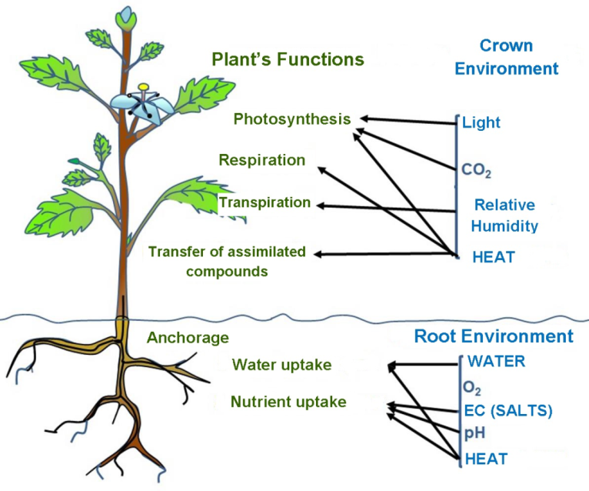
Environmental Factors Influencing Plant Growth
Factors Influencing Plant Growth in Greenhouses
Crown's Factors
Plant growth and yield in greenhouses rely on both crown’s factors (aerial part) such as radiation, heat, and root’s factors (below ground) such as water and nutrients.
Different layers of environment within the greenhouse like soil and aerial space influence these factors, with technologies allowing dynamic regulation of these conditions to maximize photosynthesis and plant health.
Above-ground plant functions are influenced by radiation, heat, humidity, and carbon dioxide levels.
Root's Factors
Root functions are impacted by water, oxygen, heat, inorganic nutrients, and pH levels.

Slide 9
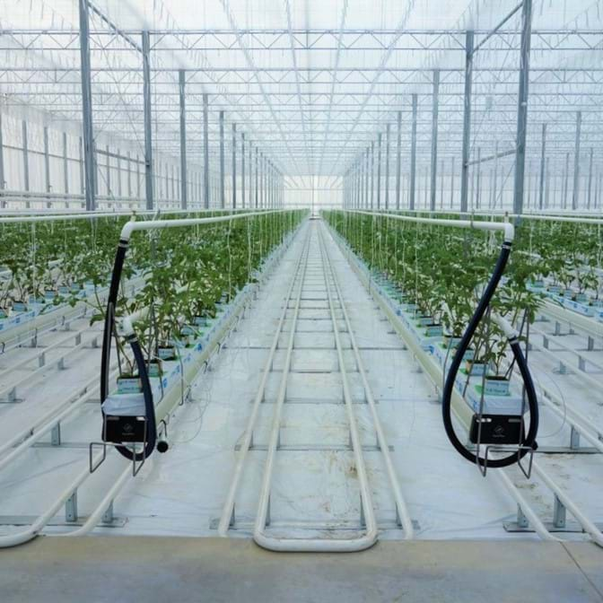
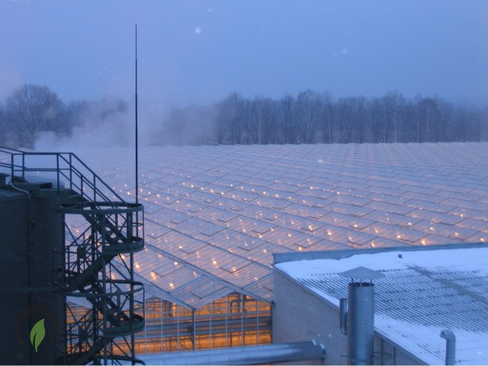
Subunit 2: Lighting in Greenhouses
Greenhouse lighting comprises mainly natural, and secondly artificial, supplemental sources. Natural solar radiation drives photosynthesis and heat within the structure.
However, artificial lighting like LEDs and other systems supplement natural light, especially during low daylight periods, aiding in plant growth by regulating the photoperiod and intensity of light needed for optimal plant production.

Slide 10
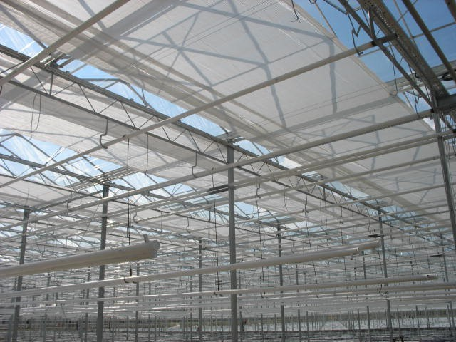
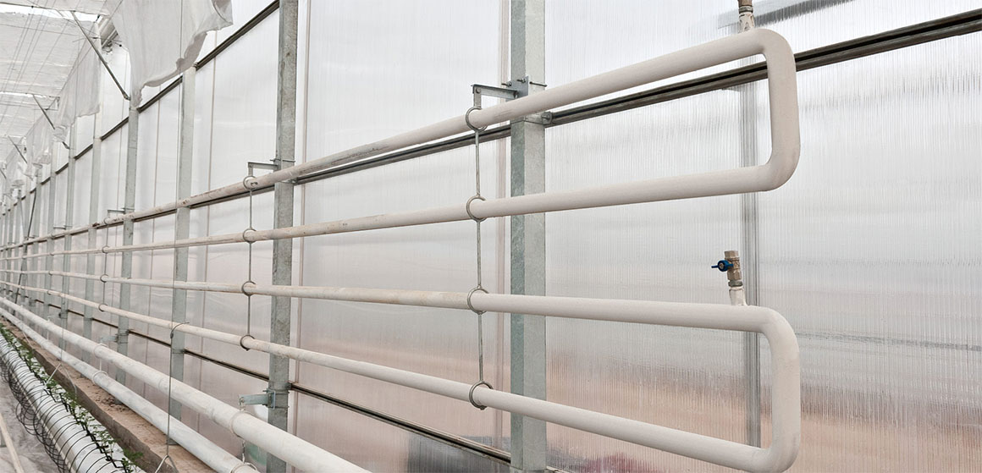
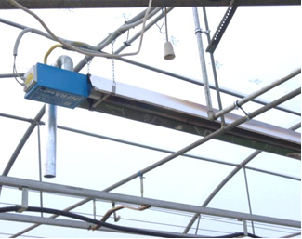
Subunit 3: Greenhouse Temperature Control
Temperature control in greenhouses is key to regulating plant growth environments.
Techniques involve using solar radiation for heat during the day and mitigating high temperatures with ventilation, cooling, and shading.
During cold days and nights, temperatures are managed through heating systems to maintain optimal conditions for optimal plant growth.

Slide 11
Subunit 4: Humidity and Air Quality Control
Maintaining ideal humidity levels inside the greenhouse requires innovative technologies such as ventilation, dehumidification, and heating systems to ensure optimal plant growth conditions and prevent disease. Techniques include exhaust fans, evaporative cooling, and dehumidified heat pumps, highlighting the integration of multiple environmental control measures to manage air quality and moisture.

Slide 12
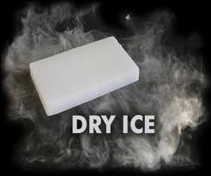
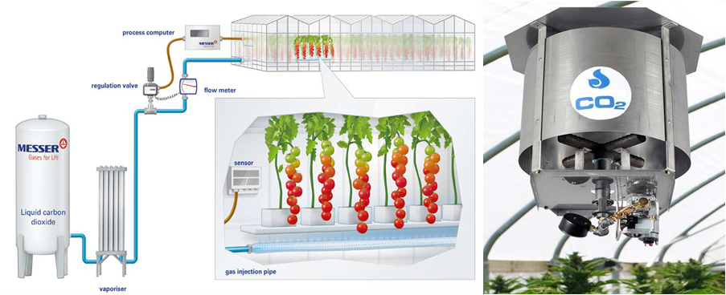
Subunit 5: CO₂ Management in Greenhouses
CO₂ supplementation is essential for enhancing photosynthesis, especially under controlled environment conditions where natural CO₂ levels might not be sufficient.
Methods of CO₂ supplementation include Dry ice, compressed CO2 tanks, CO₂ generators and natural processes like composting. These systems help maintain optimal CO₂ levels for plant growth and yield improvement.

Slide 13
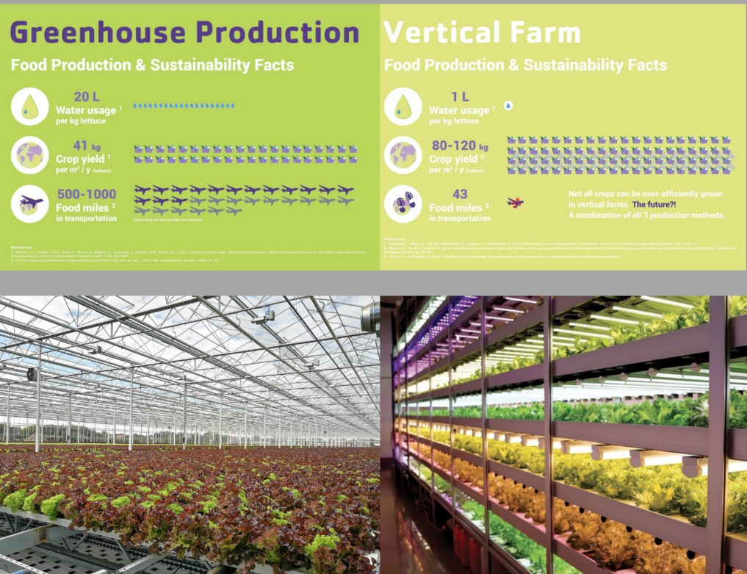
Subunit 6: Greenhouses vs. Plant Factories
Comparisons between greenhouse and vertical farming (plant factories) highlight differences in design, operation, and efficiency.
Greenhouses utilize natural light and have larger spatial requirements, suitable for less urban settings, while plant factories use artificial lighting in a vertically arranged setup, making them ideal for urban centers but with higher energy consumption.
(https://farmtechsociety.org/)

Slide 14
High Tech Greenhouses
Dynamic Regulation
Utilization of Scientific Knowledge
Modern greenhouses use central automation units for dynamic regulation of environmental factors, leading to energy savings, increased production, quality improvement, and reduced costs.
Integration of natural models with biological and economic models enhances greenhouse efficiency and economic benefits.

Slide 15
Conclusion
Controlled environment agriculture, including greenhouse crop production, addresses global food production challenges by extending growing seasons, optimizing resource use, and reducing dependency on geographical climate. However, the energy-intensive nature of greenhouses and the need for exceptional management of environmental controls underline the importance of sustainable practices to reduce operational costs and improve efficiency.

