Slide 2
Course: VET-D2 Module: Controlled Environmental Agriculture Learning Unit: Mastering vertical farming
Authors: Jan Skvaril, MDU

Slide 3
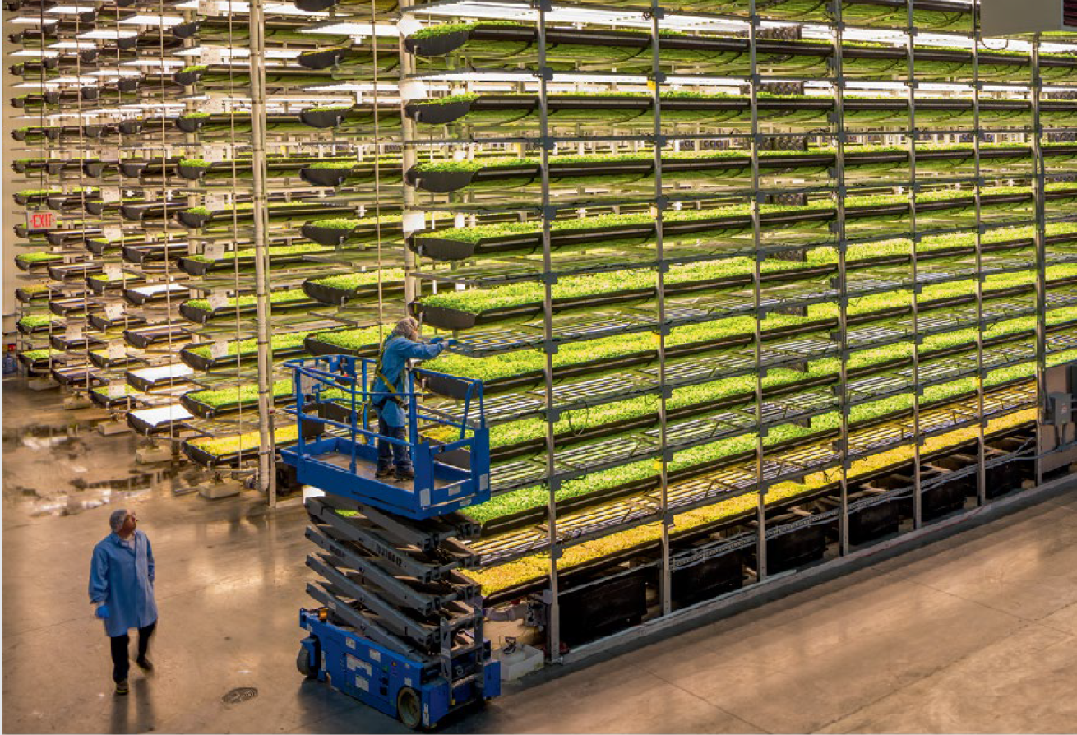
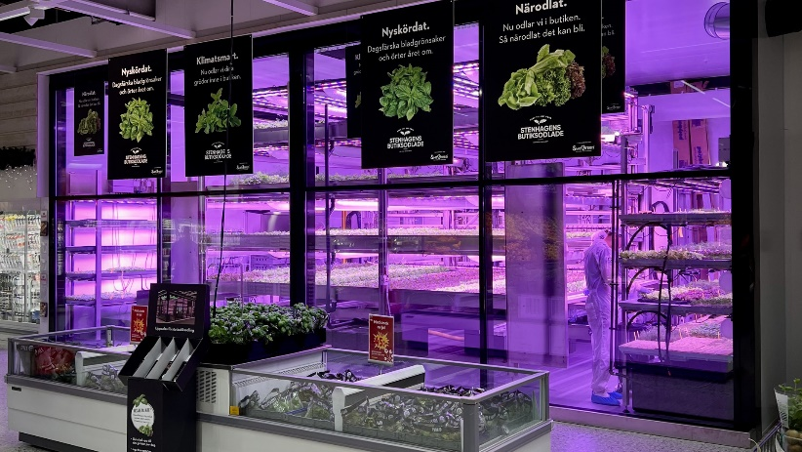
Introduction to vertical farming
Controlled environment agriculture (CEA):
CEA is a technology-based approach to crop production, optimizing plant growth through precise control of environmental factors such as temperature, humidity, light intensity, spectrum, and CO2 concentration.
Applicable in settings like greenhouses, indoor farming, and vertical farming, enabling year-round crop growth, higher yields, and efficient water use.
Vertical farming (VF):
Involves growing crops in vertically stacked layers, often within a controlled environment, utilizing soilless farming methods like hydroponics, aeroponics, or aquaponics.
Utilizes vertical space to significantly increase crop yield per square meter compared to traditional farming methods.
Example of a) Plant factory with artificial lighting (PFAL) - AeroFarms (van Delten et al., 2021), and b) Indoor vertical farm unit installed in large grocery store (Swegreen, Stockholm)

Slide 4
Introduction to vertical farming
Urban farming (UF):
The cultivation, processing, and distribution of food in or around urban areas, employing methods such as rooftop gardens, community gardens, and vertical farms.
Aims to bring food production closer to urban consumers and make efficient use of urban spaces for agricultural purposes.
Indoor farming (IF):
Growing plants or crops within indoor spaces using CEA, often with artificial lighting (like LEDs) and climate control systems to create optimal conditions.
Can range from small-scale home setups to large commercial operations.
Plant factories with artificial lighting (PFAL):
A type of indoor farming where crops are grown under artificial light (usually LEDs) in a fully controlled environment, allowing for consistent, year-round production.
Provides complete control over environmental factors, including light, temperature, humidity, CO2 levels, and nutrients.

Slide 5
Comparison between open-field farming (left) and controlled environment agriculture (right)
Comparison between open-field farming (left) and controlled environment agriculture (right) (van Delden et al., 2021)

Slide 6
Introduction to vertical farming
Relationships and combinations:
Vertical and urban farming: Vertical farming is a form of urban farming when implemented in city spaces, addressing urban space constraints and enhancing local food production.
Indoor and vertical farming: Indoor farming includes vertical farming if crops are grown in stacked layers indoors but can also involve single-layer setups.
Plant factories and indoor farming: PFALs represent a specialized, highly controlled form of indoor farming. While all PFALs are indoor farms, not all indoor farms qualify as PFALs due to varying degrees of environmental control and use of natural light.
Interconnections: These concepts are interconnected, allowing for combinations like controlled indoor vertical farms in urban areas, which merge aspects of CEA, vertical farming, urban farming, and indoor farming.

Slide 7
Introduction to vertical farming
Vertical farming overview
Innovative agricultural practice maximizing crop production in minimal space.
Utilizes stacked layers and artificial lighting within controlled environments.
Regulates essential factors like light, temperature, humidity, CO2, water, and nutrients for consistent, high-quality yields.
Employs sensors, imaging, and AI for automation, efficiency, and increased output.
Vertical farming models
Plant Factories with Artificial Lighting (PFALs): Large-scale operations in industrial zones.
Container Farms: Modified shipping containers with LED lighting and digital controls, offering mobility.
In-store Farms: Located in supermarkets, providing fresh produce directly to consumers.
Appliance Farms: Small-scale setups for homes or offices focusing on convenience.
Adaptive reuse of buildings, deep farms, balconies, and rooftops.

Slide 8
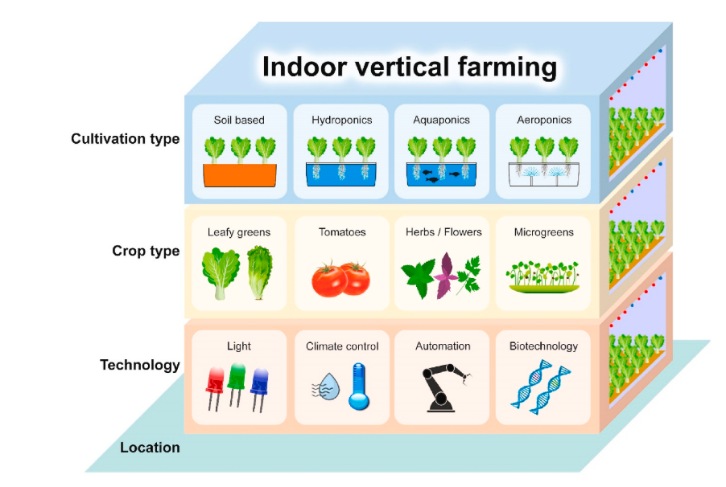
Introduction to vertical farming
Important aspects of indoor vertical farming
(Source: Wong et al. 2020).

Slide 9
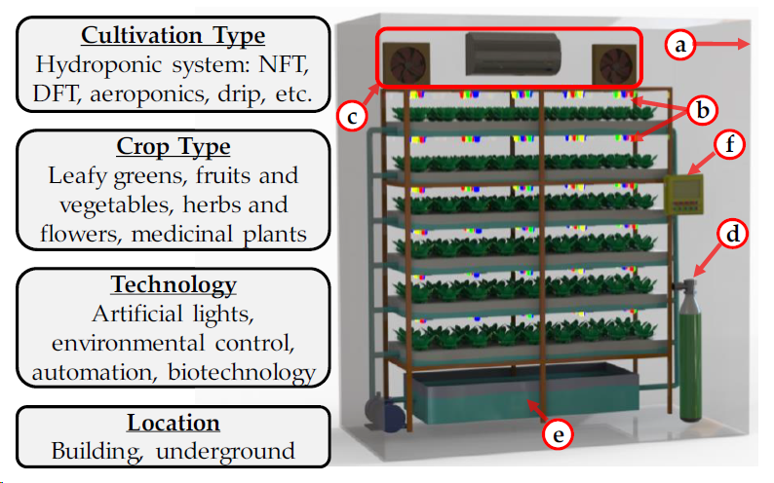
Configuration of vertical farm
Configuration of vertical farm a) thermally well-insulated and tightly sealed walls; (b)
multilevel structure with lighting equipment; (c) air conditioner with fan; (d) CO2 supply unit; (e)
hydroponic system (nutrient-solution supply unit); and (f) environmental control unit. (Kabir et al., 2023).

Slide 10
Introduction to vertical farming
Vertical farm structural design:
Stacked Horizontal Systems: Multiple tiers of growing areas.
Vertical Growth Surfaces: Includes green walls and cylindrical structures.
Key components of a typical vertical farm:
Airtight, insulated structure.
Multi-tier cultivation beds with lighting.
Air conditioning and fans for climate control.
CO₂ delivery and nutrient-solution supply systems.
Environmental management system.
Benefits and protocols of vertical farming:
Improves plant growth conditions, water efficiency, and reduces CO₂ emissions.
Requires strict hygiene protocols and advanced environmental monitoring technology.
Presents a sustainable and efficient method potentially revolutionizing agriculture.

Slide 11
Overview of indoor vertical farming techniques
Based on Controlled Environment Agriculture (CEA), utilizing both soil-based and soilless systems.
Predominantly hydroponics (51%), followed by aeroponics (20%), soil-based (13%), aquaponics (9%), and others (6%).
Soil based systems:
Involve movable soil trays for nutrient absorption.
Offer moisture retention and aeration, suitable for repeated crop cycles with proper fertilization.
Require expertise in management, fertilization, and pest control.
Hydroponics:
Plants grow in nutrient solutions without soil.
Systems include nutrient-film technique (NFT), deep water culture (DWC), and aeroponics, focused on efficient nutrient recirculation.
Reduces water evaporation and conserves resources, though sensitive to disruptions.

Slide 12
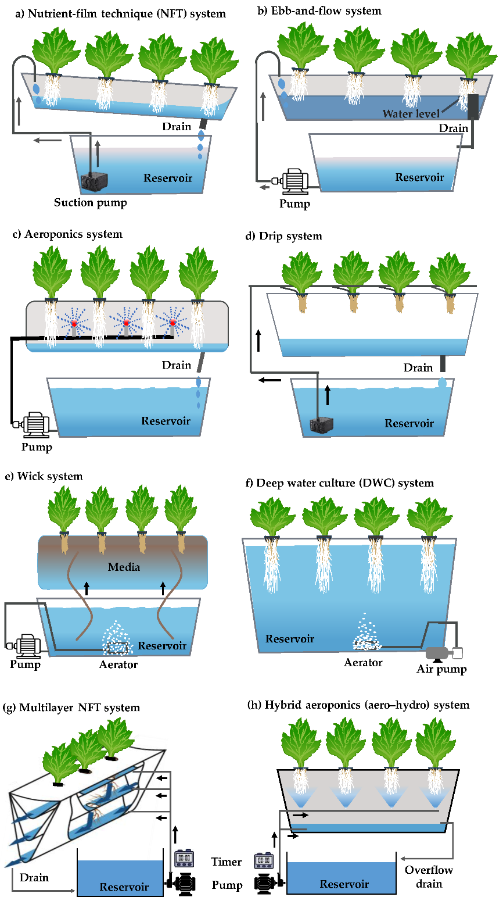
Hydroponic systems
Schematic diagram of hydroponic and aeroponic soilless systems (Kabir et al 2023).

Slide 13
Overview of indoor vertical farming techniques
Aeroponics
Combines aquaculture and hydroponics in a symbiotic system.
Fish waste provides nutrients for plants, integrating waste filtration and plant-based water purification.
Suitable for greens and herbs, conserves water, and increases yields, beneficial for food security in dry areas
Innovations in Hydroponics and Aeroponics:
Development of modified or hybrid systems like multilayer NFT and aero-hydro systems.
Introduction of revoponics, promoting high-density crop cultivation and optimized environmental conditions.
Advancements in hydroponic modules and systems integrating microalgae for sustainable food production and bioenergy.

Slide 14
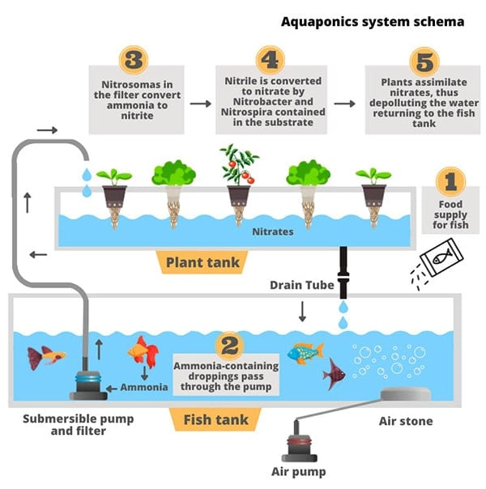
Overview of indoor vertical farming techniques
Aquaponics
Combines aquaculture and hydroponics in a symbiotic system.
Fish waste provides nutrients for plants, integrating waste filtration and plant-based water purification.
Suitable for greens and herbs, conserves water, and increases yields, beneficial for food security in dry areas.
Schematic diagram of aquaponics system
(Source: https://www.crowdfunder.co.uk )

Slide 15
Crop selection
Selection based on feasibility studies, operating costs, and market demand.
Preference for economically viable crops: leafy greens, herbs, berries, cherry tomatoes, cucumbers, and microgreens due to their rapid maturation, short stature, and specific light requirements.
Benefits include maximizing vertical space, greater plant density, and flexible crop rotation for disease and pest management.
Possibility to grow larger crops like tomatoes and peppers, and non-edibles like ornamental flowers, although with greater challenges.
Potential for broadening crop diversification, contributing to sustainable urban agriculture and reshaping food production strategies.

Slide 16
Technology and location for vertical farms
The success of VF systems hinges on efficient technology use, especially for water and temperature control, which varies by location.
Advancements in LED lighting, sensors, and automation enhance indoor farming efficiency and crop specificity.
Lighting: Crucial reliance on artificial LEDs for their efficiency, durability, and customizable spectra to meet crop growth requirements.
Monitoring and Control: Utilization of real-time sensors, big data, and IoT for precise condition monitoring and AI for optimal growth conditions.
Location: VF's adaptability allows implementation in diverse environments, including urban areas and harsh climates, offering year-round production.
Benefits include reduced transportation costs, lower fossil fuel consumption, and enhanced local employment opportunities..

Slide 17
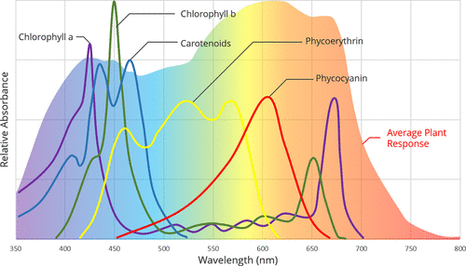
Role of light in plant growth and development
Photosynthesis and light spectrum
Light is crucial for photosynthesis, where plants convert CO2 and water into food using light, especially within the 400-700 nm Photosynthetically Active Radiation (PAR) range.
Different colors of light have specific effects on plant growth: blue light enhances leaf growth, red light boosts flowering and fruiting, while green light was thought to contribute minimally.
Advances in Light Spectrum Research
Recent studies show that green light, UV light, and near-infrared (NIR) light significantly impact plant growth and development.
The McCree curve highlights the importance of various light wavelengths, including green photons that penetrate deeper into leaves, aiding in photosynthesis.
The McCree curve is represented by a graph that is overlaid with the absorption curves of the associated pigments.
The McCree curve depicts the average photosynthetic response to each wavelength of light. (Neo et al., 2022)

Slide 18
Role of light in plant growth and development
Terminology
PAR: Spectrum range from 400 to 700 nm supporting photosynthesis.
PPF: Quantity of light emitted by a source, in moles of photons per second.
PPFD: Number of PAR photons landing on a surface per unit area per second.
PPE: Efficiency metric of PAR photons produced per second per energy consumed.
DLI: Total amount of PAR photons a plant receives over 24 hours, critical for understanding light requirements.
Spectral-selective Contribution to Plant Health
Light spectrum influences plant morphology, nutrient content, and well-being.
Indoor LED lighting allows for precise control over light spectra, affecting crop traits such as color and taste, and can enhance flavor and acceptability of indoor-grown produce.

Slide 19
Role of light in plant growth and development
Light Intensity and Duration:
The relationship between light intensity and photosynthesis is non-linear; photosynthesis increases with light intensity up to a point before plateauing.
Adjusting light exposure duration can promote growth without increasing intensity, with extended photoperiods leading to more biomass in some crops.
Conclusion
Understanding the complex effects of light wavelengths, intensities, and durations is crucial for optimal plant growth. Modern research and technology allow for precise control over these factors in both natural and controlled environments.

Slide 20
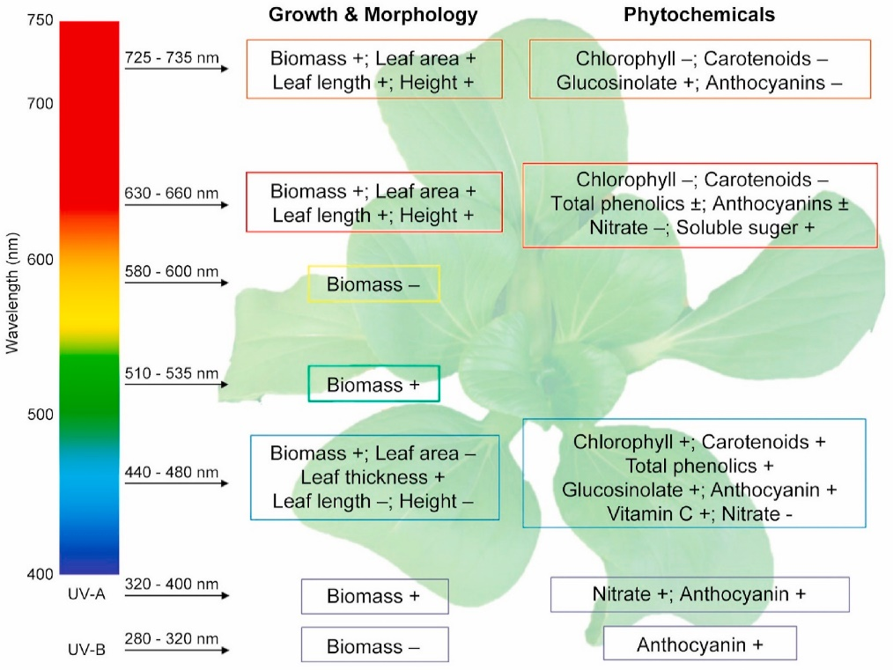
Light as environmental factor
Light, including UV, visible light, and infrared radiation, is vital for photosynthesis and plant growth, with the visible spectrum (400-700 nm) being most crucial.
Harnessing light for photosynthesis
Chlorophyll a and b in chloroplasts capture energy from PAR, facilitating light-dependent reactions to produce ATP, NADPH, and oxygen.
Plant responses to Light
Plants adapt to light intensity and spectrum changes, affecting photomorphogenesis, photoperiodism, and phototropism, crucial for survival.
Responses of leafy greens to different light quality. The effects of an increase in the specific wavelength ranges on growth and phytochemical contents in leafy greens are summarized. (Wong et al. 2020)

Slide 21
Light as environmental factor
Photosynthetic Pigments
Chlorophylls absorb light for photosynthesis, with accessory pigments like carotenoids broadening light absorption and protecting against excessive light.
Plant Photoreceptors and Light Perception:
Plants have specialized photoreceptors (UVR8, cryptochromes, phototropins, zeitlupes, phytochromes) for UV-B, blue/UV-A, and red/far-red light, regulating various growth processes.

Slide 22
Enhancing leafy greens quality with LED lighting
LED technology manipulates light spectra to improve growth, flavor, and nutrition in leafy greens, focusing on lettuce.
Challenges in LED Lighting Applications
Difficulties in finding optimal lighting recipes due to species/cultivar-specific responses and experimental variations.
Red and Blue Light Effects
Red light enhances leaf development and nutrient accumulation; blue light affects chlorophyll content, leaf thickness, and morphogenic responses.
Other Visible Wavelengths and Plant Growth
Green and yellow light's effects on photosynthesis and growth are less understood, needing further research.
Far-Red light influences photosynthesis and morphogenic signals, showing complex interactions with other spectra.

Slide 23
Enhancing leafy greens quality with LED lighting
Light quality and phytochemicals
LED lighting impacts secondary metabolite accumulation, affecting nutritional and taste qualities of leafy greens.
Postharvest preservation
Postharvest light treatment can maintain or enhance nutritional and sensory qualities, showcasing LED technology's utility beyond growth.
Conclusion
LED lighting offers precise control over environmental conditions for optimizing leafy greens' growth and nutritional value, with ongoing research aiming to maximize agricultural benefits.

Slide 24
Advances in grow lights for vertical farming
Shift towards LED technology due to its energy efficiency, light quality, and spectral tuning capabilities.
LEDs vs. traditional light sources
LEDs are preferred for their higher Photosynthetic Photon Flux Density (PPFD) and spectral tuning, improving plant growth and nutrient levels.
Outperform traditional sources like HPS and fluorescent lamps in energy efficiency and lifespan.
Advancements in LEDs include increased Photosynthetic Photon Efficacy (PPE) and full-spectrum capabilities mimicking sunlight.
Recent advances in LED technology
Continuous improvements in LED efficiency, tunable light spectrums, and innovations such as Osram's 6-channel LED module system for precise spectral control.
Developments aim to address challenges like light penetration and uniformity and reduce energy consumption.

Slide 25
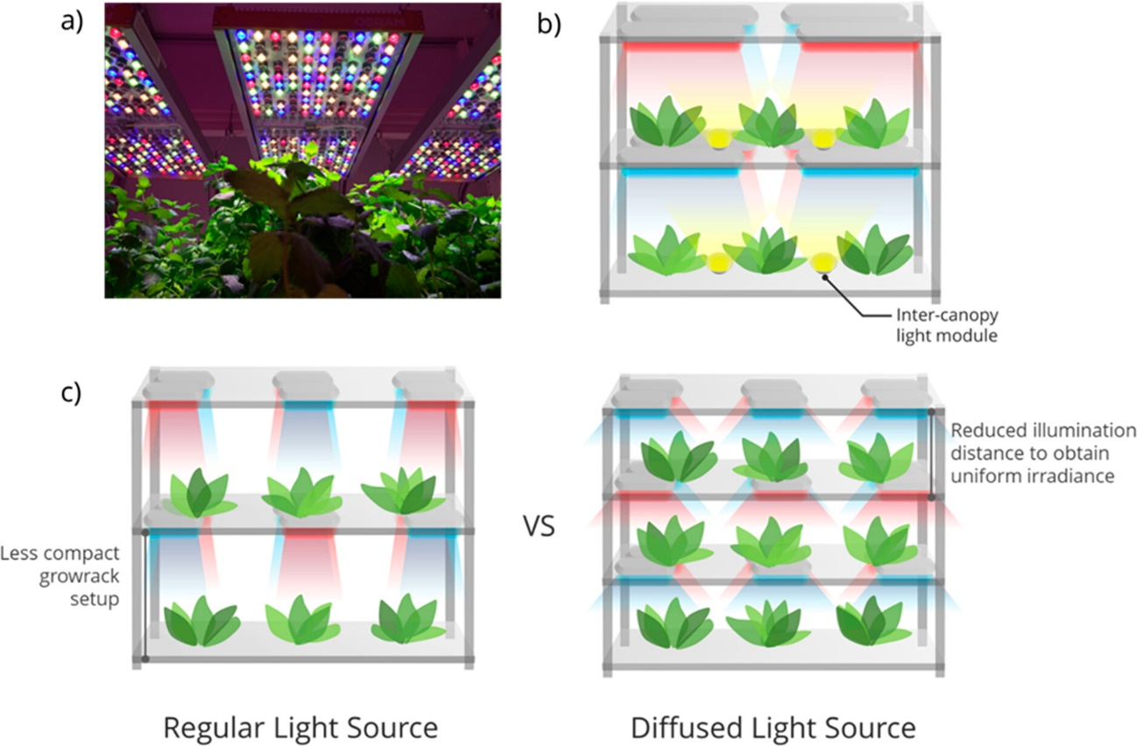
Advances in grow lights for vertical farming
OSRAM PHYTOFY RL LED system with 6 tunable color channels, operable wirelessly and independently. Permission from OSRAM (https://www.osram.com).
Phillips GreenPower LED module schematic, highlighting canopy illumination.
Illustrates uniform, diffused light's advantage for closer luminaire placement and increased vertical farm stacking capacity. (Neo et al., 2022)

Slide 26
Advances in grow lights for vertical farming
Advantages of LED Lights over sunlight
Spectral Control: Dynamic LED lighting allows tuning to match photosynthetic pigments, enabling growth in non-traditional locations.
Consistent Lighting: LEDs offer a constant light source, potentially enhancing growth cycles and yield.
Pest and Disease Management: Specific light spectrums can help reduce pest reproduction and disease spread.
Solar spectral shading
Breakthrough technology optimizing sunlight for plant growth, emphasizing red-light wavelengths with luminescent films.
Luminescent films enhance red spectrum of sunlight, increasing photosynthesis efficiency and crop yields.

Slide 27
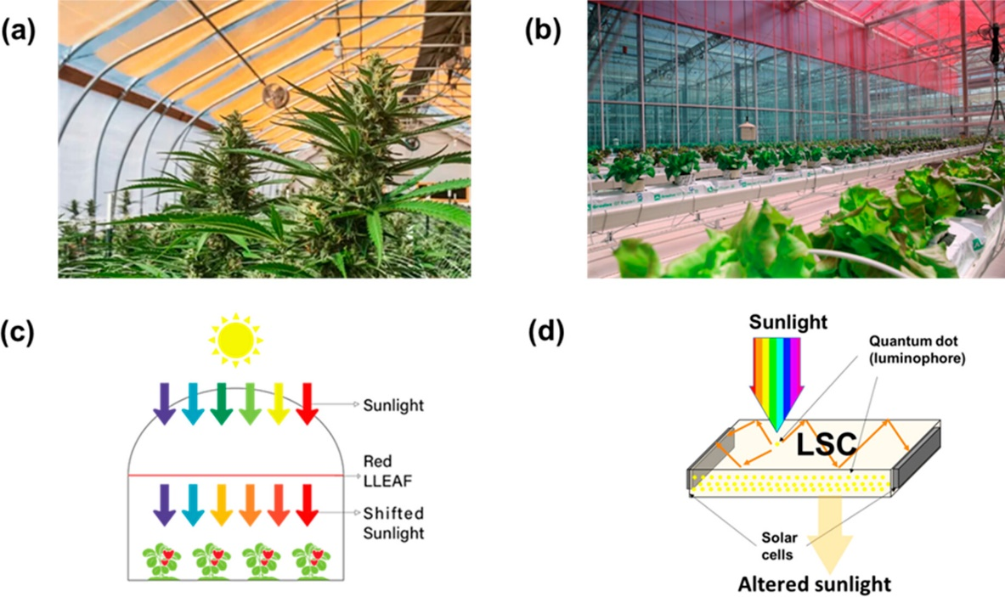
Advances in grow lights for vertical farming
Copper indium sulfide quantum dots film adjusts solar spectrum for more red wavelengths in greenhouses. Permission from Ubigro (https://ubigro.com).
Red dye films in greenhouses enhance leafy green growth.
Shows sunlight conversion to higher red content by green photon absorption. (b,c) Permission from http://www.lleaf.com.au/.
Luminescent solar concentrator (LSC) schematic: harnesses sunlight for electricity, tuning transmitted light's spectrum for optimal growth. (Neo et al., 2022)

Slide 28
Advances in grow lights for vertical farming
Light Redirection
Optical fibers and sunlight concentrators address excessive and insufficient light exposure, ensuring even light distribution across plant layers.
Optical Fiber Daylighting (OFD) Systems utilize sunlight collectors, optical fibers, and diffusers for efficient indoor light transmission.
Innovations in Agricultural Practices
Development of solar spectral shading technologies and light redirection techniques mark significant advancements, promising increased crop yields and sustainable vertical farming operations.

Slide 29
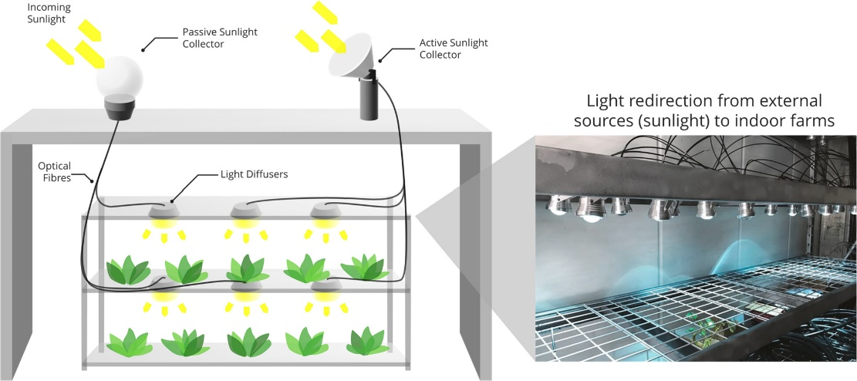
Advances in grow lights for vertical farming
Schematic shows the integration of passive/active sunlight collectors, optical fibers, and light diffusers. Inset image displays redirected light via optical fibers and diffusers on a grow rack. (Neo et al., 2022)

Slide 30
Advances in grow lights for vertical farming
Smart hybrid lighting systems
Transition to indoor farming has significantly increased electrical consumption, especially for artificial lighting in plant factories.
Smart hybrid systems blend natural and artificial light, aiming to cut down energy use and support urban electrical grids.
Implementation and challenges of smart hybrid lighting systems
Utilize sunlight and photovoltaic panels for energy, facing challenges in energy conversion efficiency and loss.
Adapt daylighting systems for agricultural use to meet the light intensity and spectra needed for photosynthesis.
Benefits of smart hybrid lighting systems
Automatic adjustment of artificial lighting based on real-time sunlight, reducing electricity use, cost, and environmental impact.
Natural light use promotes plant growth and can increase yields.

Slide 31
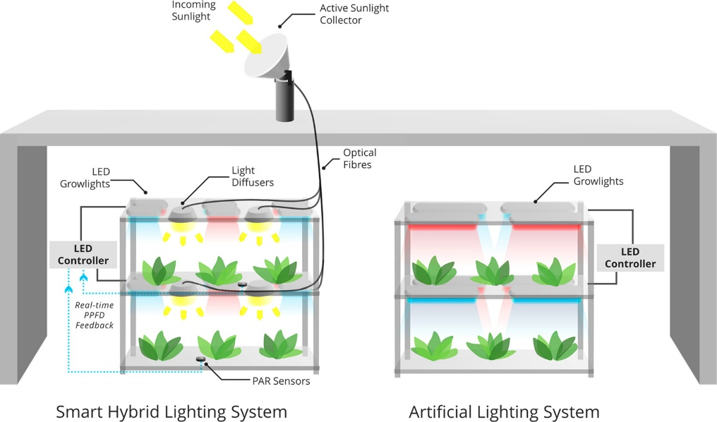
Advances in grow lights for vertical farming
Schematic compares a smart hybrid lighting system with a standalone artificial lighting system, highlighting the smart system's key feature: a sensor that monitors light intensity for plants, activating artificial lights when needed, fully automatically. (Neo et al., 2022)

Slide 32
Advances in grow lights for vertical farming
Economic and environmental impact of smart hybrid systems
Initial cost assessment against long-term savings and environmental benefits is necessary.
Hybrid systems, blending LED with sunlight, could offer up to 70% energy savings, providing a sustainable urban agriculture option.
Future outlook for LED lighting
Technological advancements in LED lighting have significantly benefited modern agriculture.
Despite the high energy consumption challenge, improvements in LED efficiency and design are reducing operational costs.
Alternatives like spectra shaping films and optical fiber-based systems offer environmentally friendly solutions but depend on economic viability.
Smart hybrid lighting, combining natural and artificial light, emerges as a sustainable solution promising substantial energy savings and consistent crop illumination.

Slide 33
Nutrient needs and provision in vertical farming
Nutrient Needs and Provision in Hydroponics
Goal: Efficiently provide essential nutrients, water, and oxygen to plants.
Nutrients are supplied through a well-designed formula, needing timely replenishment.
Essential Nutrients for Plant Growth
Seventeen essential nutrients are required, divided into macronutrients (N, P, K, Ca, Mg, S) and micronutrients (Cl, Fe, B, Mn, Na, Zn, Cu, Mo).
Hydrogen (H), oxygen (O), and carbon (C) are derived from water and CO₂.
Recent additions include silicon (Si) for stress resistance and nickel (Ni) as an enzyme activator, though Ni is often omitted from hydroponic formulas.

Slide 34
Nutrient needs and provision in vertical farming
Nutrient Solution Formula and Preparation
Influenced by crop type, growth stage, and conditions, requiring adjustments for light and temperature.
Use of consistent nutrient concentrations in controlled environments, measured by electrical conductivity (EC).
Customized solutions may be needed, with no universal formula. Commonly used formulas include Hoagland, Modified Sonneveld, Jack’s, and UA CEAC.
Preparation process
Nutrient mixes can be preblended or made from individual components for specific crop needs, using water-soluble, high-purity fertilizers.
Creating concentrated stock solutions, typically at 50x or 100x concentration, to avoid insoluble precipitates, often requires separation into two tanks for chemical stability.
Guidelines and formulas for solution preparation provided available in literature

Slide 35
Nutrient needs and provision in vertical farming
Nutrient Solution Uptake
Refilling practices vary with plant species and cultivars due to different nutrient and water uptake rates.
Short-cycle crops may not require solution adjustment within a cycle; long-cycle crops might need adjustments, especially when transitioning between growth stages.
Routine monitoring relies on EC and pH measurements due to the high cost and complexity of detailed nutrient profiling.
Group | Elements | Comment
I | NO₃, NH₄, P, K, Mn | Active update, fast removal
II | Mg, S, Fe, Zn, Cu, Mo, Cl | Intermediate uptake, intermediate removal
II | Ca, B | Passive uptake, slow removal
Uptake rates of essential elements (Niu et al., 2022)

Slide 36
Nutrient needs and provision in vertical farming
pH and Water Quality
Optimal pH range for hydroponic solutions is between 5.5 and 6.5, with regular adjustments needed for plant health.
Water temperature and aeration affect dissolved oxygen levels, critical for root respiration.
Water quality analysis is essential for preparing nutrient solutions, with strategies for managing ion accumulation in recirculating systems.
Nutrient Management System (NMS)
Essential elements require precise concentrations and ratios, with real-time monitoring challenging due to the cost and development stage of ion-specific sensors.
Systems often use electroconductivity (EC) and water level sensors for managing total ion concentration.
Closed-loop systems adjust based on feedback; open-loop systems, simpler and less expensive, lack feedback controls, posing challenges for variable nutrient requirements.

Slide 37
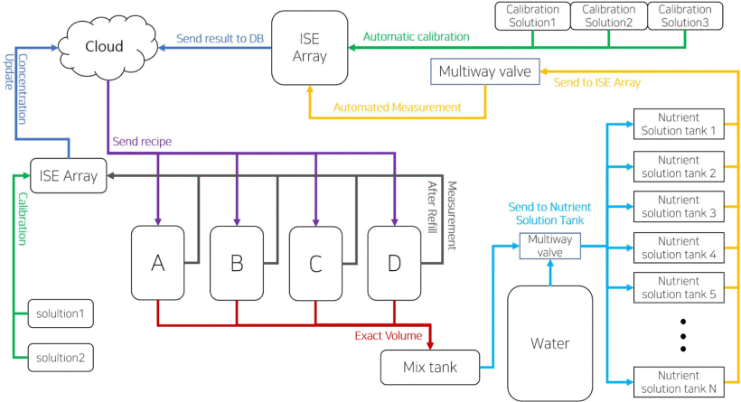
Nutrient needs and provision in vertical farming
Example of nutrient management system architecture (Ban et al., 2020)

Slide 38
Technology trends in vertical farming
Sensing Technology and Automation:
Key for effective environmental management, utilizing sensors and actuators to monitor and control conditions like temperature, humidity, light intensity, CO2 levels, nutrient concentration, and pH levels.
Nutrient Sensing Systems
Advances in ion-selective nutrient sensing and AI tools for real-time monitoring enhance precision in nutrient management.
Plant Monitoring and Control Systems
IoT technology enables continuous monitoring and control, with visual sensors, chlorophyll fluorescence sensors, and spectral sensors aiding in plant health assessment and environmental management.

Slide 39
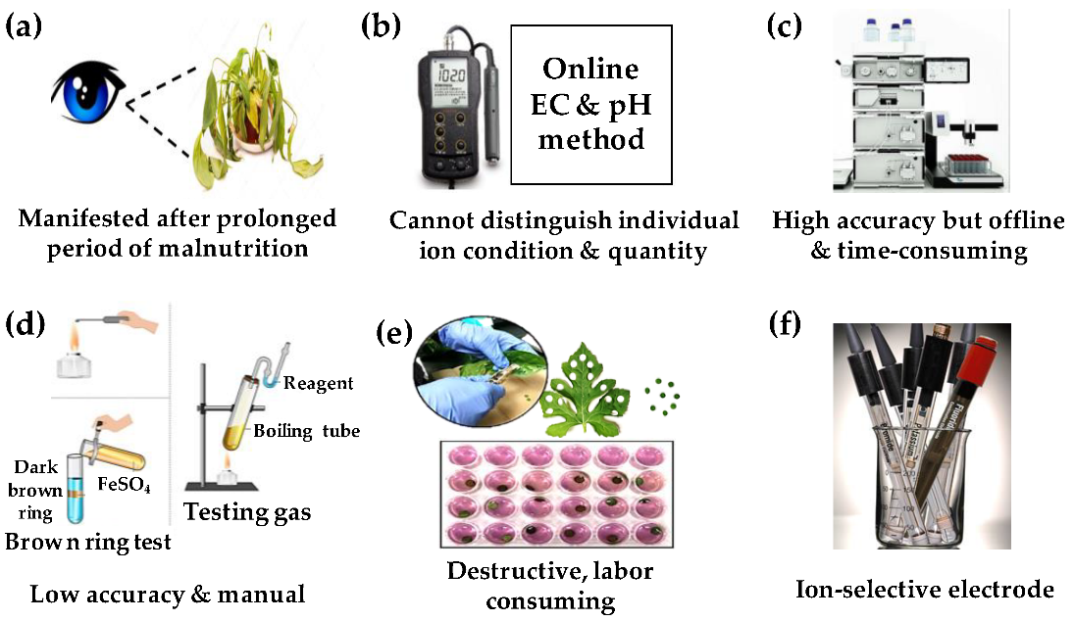
Technology trends in vertical farming
Hydroponic nutrient monitoring methods cover: (a) visual plant symptom assessment; (b) EC and pH evaluation; (c) ion chromatography; (d) salt testing; (e) leaf tissue analysis; and (f) ion-specific analysis with ion-selective electrodes. (Kabir et al. 2023).

Slide 40
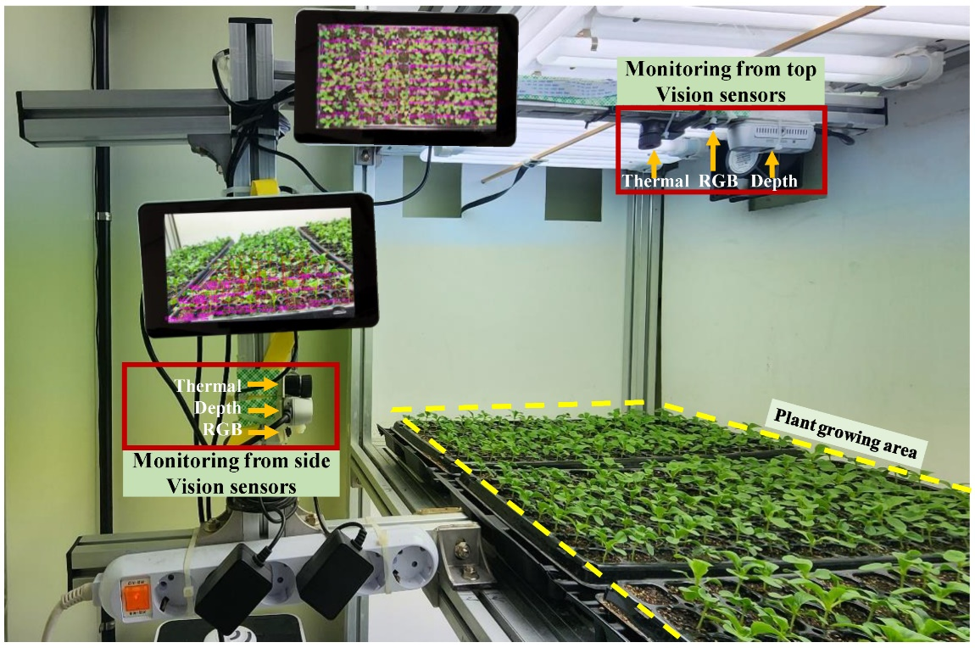
Technology trends in vertical farming
Real-time growth and stress detection in seedlings using AI and sensors for smart production at Chungnam National University's Agricultural Production Machinery and Precision Agriculture Lab, South Korea. (Kabir et al. 2023).

Slide 41
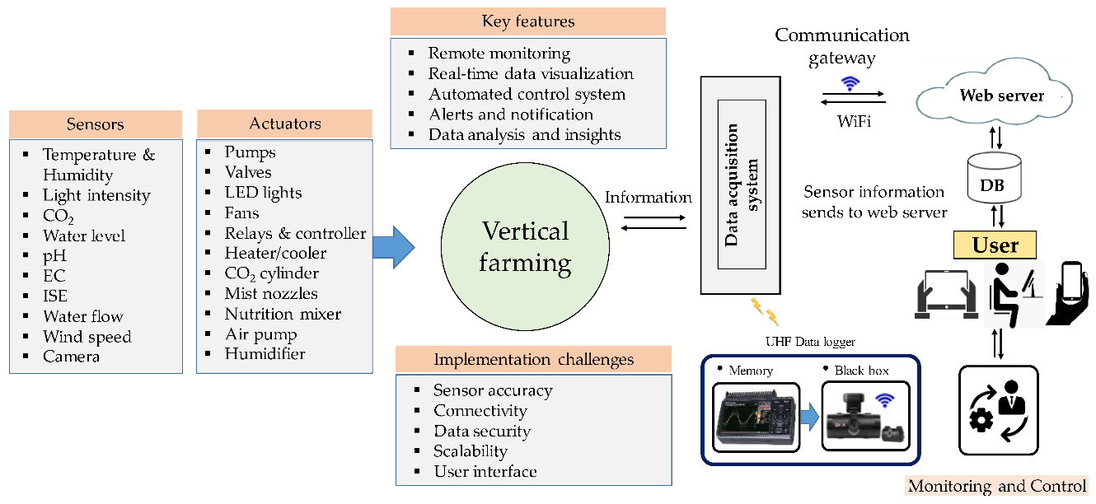
Technology trends in vertical farming
A schematic representation of IoT-based monitoring and control systems for vertical farms. (Kabir et al. 2023).

Slide 42
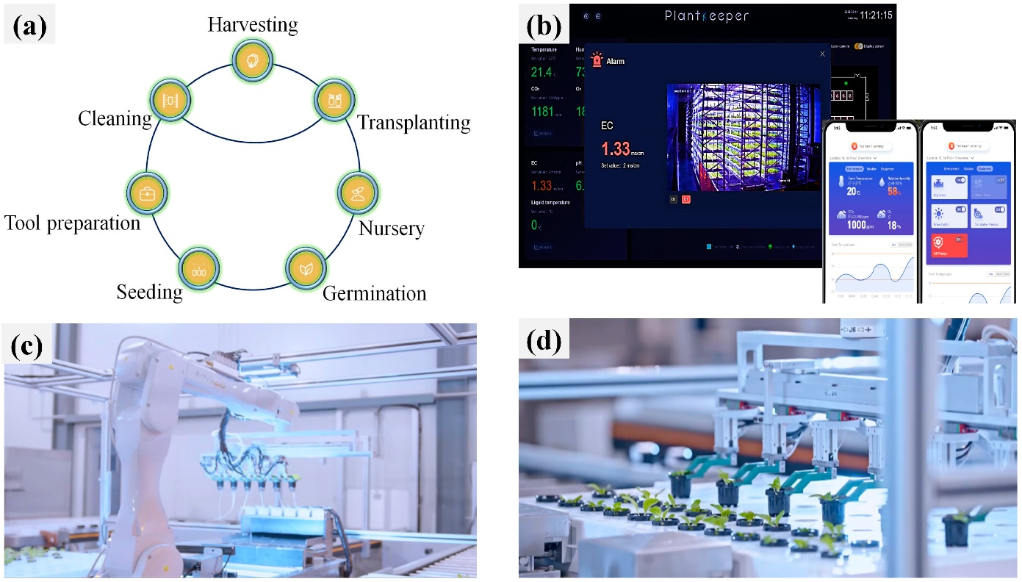
Technology trends in vertical farming
Unmanned vertical farming operations include
key processing steps,
the PlantKeeper wireless monitoring and control app menu, and
(c,d) automated production and management. (Kabir et al. 2023).

Slide 43
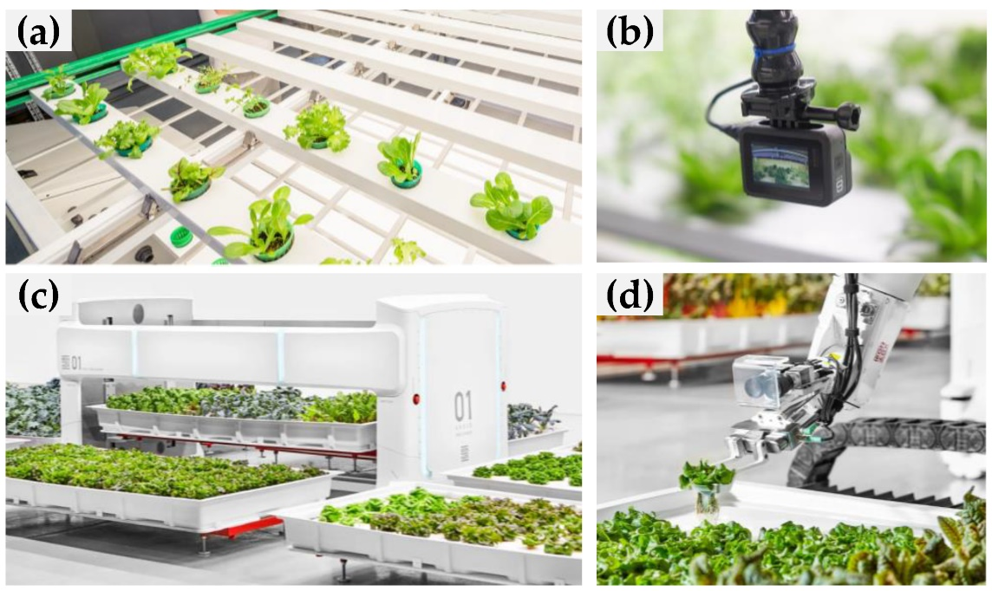
Technology trends in vertical farming
Unmanned operation in vertical farming: (a) automatic conveyor belt; (b) rack-mounted control camera; (c) 1000-pound robot, Angus; and (d) Iron Ox's harvesting robotic arm. (Kabir et al. 2023).

Slide 44
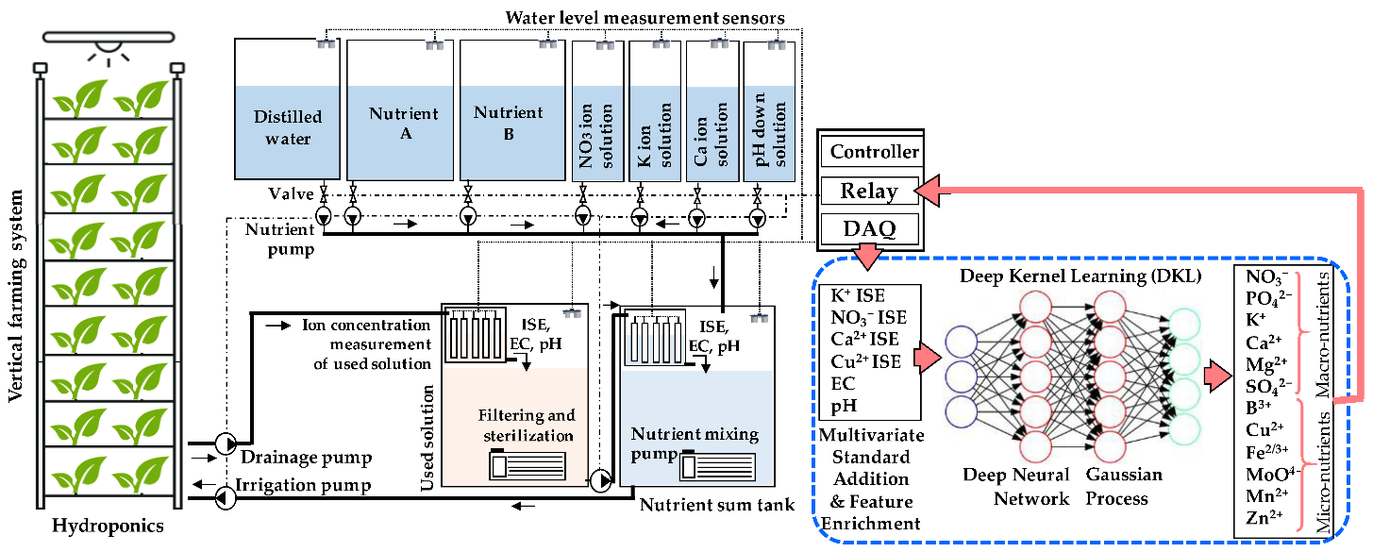
Technology trends in vertical farming
Combined application of several AI-based algorithms (MSAM, FE, DKL DNN, and GP) to determine multiple ions in hydroponic solutions. (Kabir et al. 2023).

Slide 45
Technology trends in vertical farming
Unmanned Vertical Farming Systems (UVFS)
Automation and robotics streamline operations, offering benefits like resource efficiency, year-round production, reduced environmental impact, and space optimization.
Automated Vertical Farming Systems
From seeding to harvesting, automation technologies reduce labor costs and improve safety and productivity.
Robotic Vertical Farming Systems
Robots perform tasks with precision, reducing labor costs and improving consistency in farming operations.
Vertical Farming with Drones
Drones enhance crop monitoring and management, offering aerial precision and data-driven insights for improved crop health and yield.

Slide 46
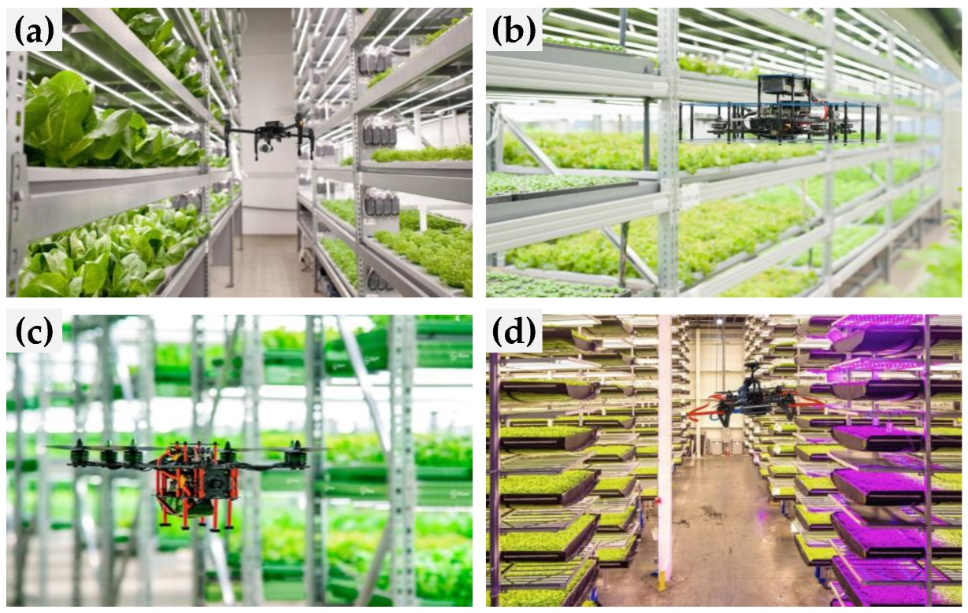
Technology trends in vertical farming
Use of UAVs/drones in vertical farming: (a,b) autonomous drone (iFarm, Abu Dhabi, UAE) (c) autonomous drone; (d) AI drones (Kabir et al. 2023).

Slide 47
Technology trends in vertical farming
Research Trends – Artificial Intelligence (AI)
AI optimizes environmental conditions and resource utilization, with applications in monitoring, optimization, and stress detection.
Deep learning models support tasks like leaf segmentation and stress classification, enhancing plant health analysis.
Issues include data management, algorithm diversity, privacy and security concerns, and the need for transparency and bias mitigation in AI applications.

Slide 48
Technology trends in vertical farming
Crop Production – challenged and future prospects
Offers opportunities for diverse crops in controlled environments.
Enables year-round production and explores novel crops and niche markets.
Challenges include limited crop diversity and the need for specialized cultivars.
Strategic breeding for compact growth and resource efficiency is crucial.
Environmental Sustainability – challenged and future prospects
Reduces pesticide use, conserves water and land, and minimizes food transport.
Initial and operational costs, and energy-intensive climate control pose challenges.
Optimizing system design and implementing circular systems are essential for sustainability.
Economic Sustainability – challenged and future prospects
Viable due to reduced transportation costs and climate resilience.
High electrical energy consumption is a significant economic challenge.
Renewable energy and advanced technologies could reduce costs and improve efficiency.

Slide 49
Technology trends in vertical farming
Food Security – challenged and future prospects
Addresses urbanization, climate change, and land degradation challenges.
Encourages urban self-sufficiency in food production.
Economic and spatial constraints require strategic solutions for ecosystem restoration and urban demands.
New technologies – opportunities and challenges
Integration of hydroponics, aeroponics, aquaponics with AI, sensors, and automation enhances efficiency and yields.
Complexities in system integration, uniform irrigation, and lighting management present significant challenges.
Advancing vertical farming as a sustainable solution requires overcoming these integration and management issues.

Slide 50
Conclusions
Vertical farming optimizes space and emphasizes sustainability in agriculture.
Utilizes LED lighting, precise nutrient management, and innovative technologies like automation and drones to enhance food production.
Offers significant reductions in water and land use, contributing to a lower carbon footprint.
Challenges include the high initial costs and ongoing energy demands.
Benefits encompass year-round production, minimal environmental impact, and reduced pressure on natural resources.
Integration of sensors, AI, and robotics is making vertical farming more feasible in urban environments.
Success depends on understanding local conditions and fostering supportive policy frameworks.
Represents a promising avenue for bolstering food security and sustainability, requiring collaboration across various sectors.

