Slide 2
Course: VET Module: Controlled environment agriculture Learning Unit: The business of urban farming: practical guidance
Hailong Li
Mälardalen University
Sweden

Slide 3
Content
General information
Learning outcomes
Understanding business models
Marketing strategies
Developing a basic business plan
Case studies of urban farming

Slide 4
General information
Working hours:
Face to Face: 8 hrs
Online learning (asynchronous): 6 hrs
WBL (through study visits and/or workshops): 6 hrs
ECTS: 1
Aim:
to introduce entrepreneurship in vertical farming, focusing on understanding business models and marketing strategies. Learners will explore basic business models and marketing techniques within the vertical farming industry through practical examples and case studies.
Teaching methods:
Lectures + self-reading
Examination:
Self-assessment activities (quizzes, multiple choice, true-false), reflection questions

Slide 5
Learning outcomes
Knowledge
Describe what a business model is and how it applies to vertical farming.
Discuss fundamentals of marketing strategies in the context of vertical farming.
Skills
Perform a simple business model related to vertical farming
Apply marketing techniques suitable for a vertical farming business
Competences
Criticize in business models of vertical farming.
Compare marketing strategies used in the vertical farming industry

Slide 6
Understanding business models
Ref: Osterwalder, A., Pigneur, Y. (2010). Business Model Generation: A Handbook for Visionaries, Game Changers, and Challengers. John Wiley & Sons, Inc., Hoboken, New Jersey.

Slide 7
What is a business model
A business model describes the rationale of how an organization or network of organizations creates, delivers, and captures value (Osterwalder & Pigneur, 2010). In general, a business model explains four things (Kriss & Murphy, 2021):
What product or service a company will sell.
How it intends to market that product or service.
What kind of expenses the company will face.
How the company expects to turn a profit.

Slide 8
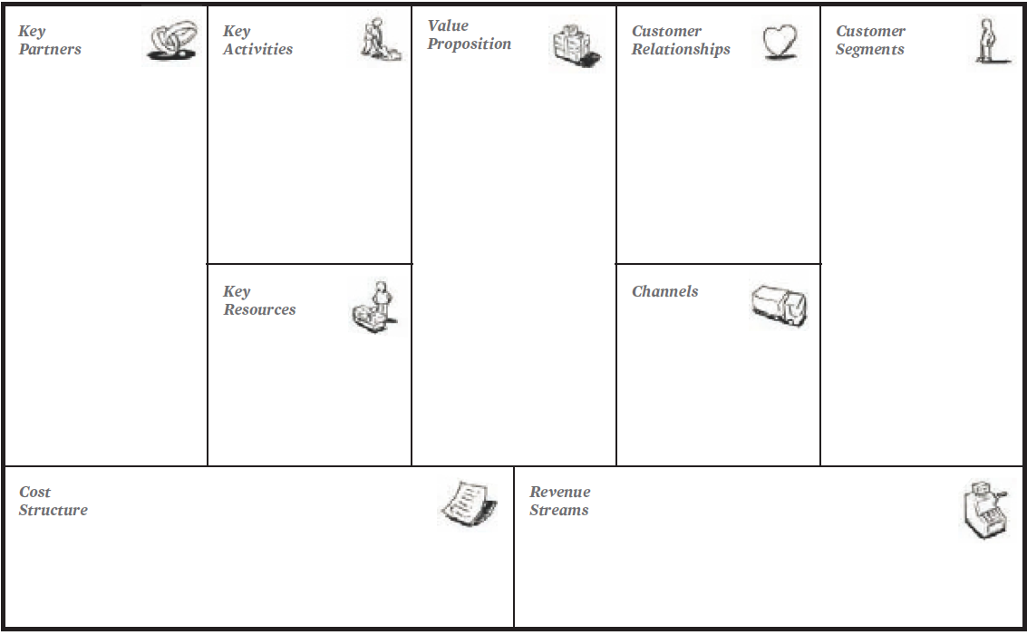
Business model - Canvas
The Business Model Canvas is a strategic management tool that helps entrepreneurs and businesses to visually map out their business model. It includes nine key building blocks, as shown in the righ.

Slide 9
Business models for urban farming
the well-established business models mainly include ‘low-cost specialisation’, ‘differentiation’, and ‘diversification’. Examples can be found the in the course materials
Pölling et al., 2017

Slide 10
Marketing strategies

Slide 11
Market development strategies
Key strategies
pricing - you could implement competitive price structures with offers and discounts or, to command a higher price, provide a product with more value than the competitor’s.
distribution - you could develop new channels to reach target customers, eg sell online if you currently only have a 'brick and mortar' shop
branding - you could create a new brand for products aiming to reach a target market or a specific customer segment.
promotion - you could consider tailoring promotional messages to entice customers with offers, vouchers, loyalty schemes, etc
sales - you could target a different demographic segment or type of customer to create new leads and opportunities.
product development - you could alter an existing product or develop a new one for the untapped market

Slide 12
Some popular strategies
Geographic expansion
Upselling to existing customers
Attracting non-users
Attracting competitors’ customers
New Customer Segments
Product Modification
Strategic Alliances
New Sales Channels

Slide 13
Developing a basic business plan
Ref: ISIFARMER. (n.d.). How to start vertical farming: a complete guide to build a vertical farming business. https://isifarmer.com/learn/how-to-start-vertical-farming

Slide 14
before set-up a vertical farm
Steps:
Determine your goals
Research supply and demand
Regulations and permits
Choose a location
Choose your crops
Choose the vertical farming equipment
Time to calculate the costs
Secure funding
Set-up your farm

Slide 15
after set-up a vertical farm
Steps:
Monitor plant growth
Harvest and sell your products
Analyze your data
Continuously improve

Slide 16
Case studies of urban/vertical farming

Slide 17
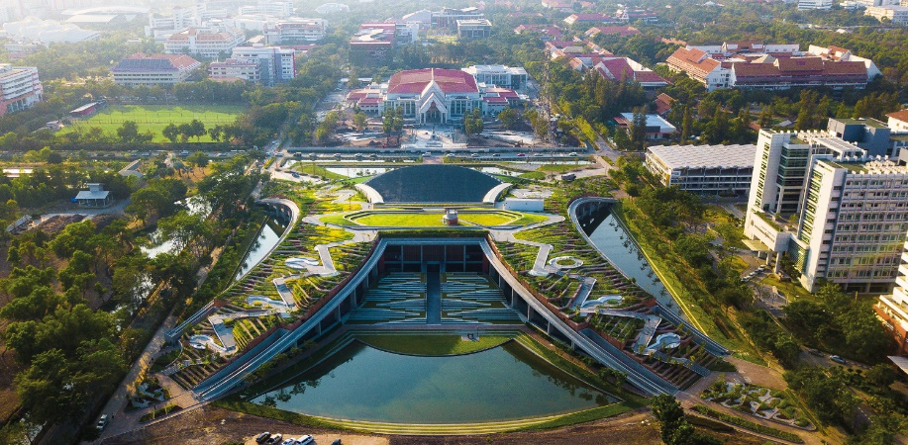
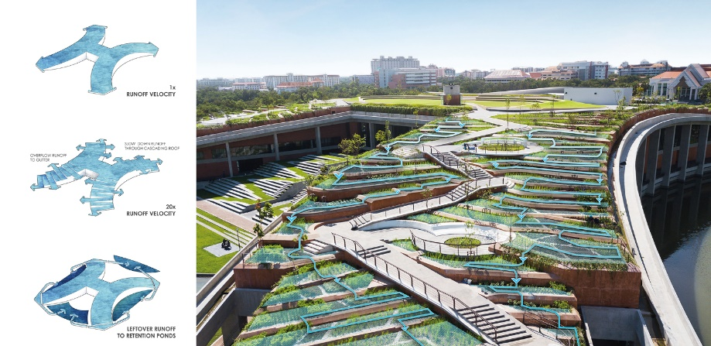
Thammasat University Urban Rooftop Farm (Greenroofs)
Designed by LANDPROCESS, the $31 million TURF incorporates sustainable food production, renewable energy, organic waste, water management and public space within its 22,000 square meters.
TURF grows more than 40 edible species, including rice, indigenous vegetables and herbs, and fruit trees.
The roof is equipped with solar panels, capable of producing up to 500,000 watts per hour to irrigate the urban farm from the retaining ponds and power the building beneath it.

Slide 18
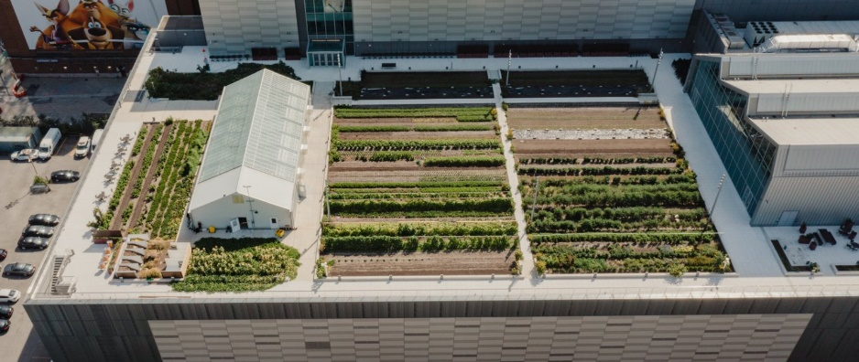
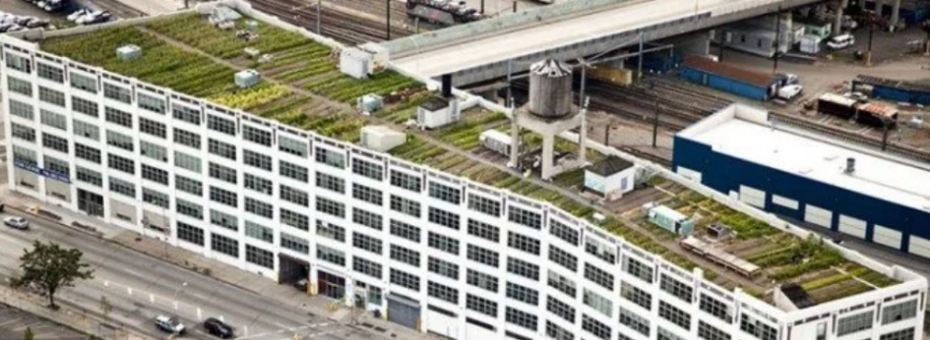
Brooklyn Grange Rooftop Farm (BROOKLYN GRANGE)
The farm's start-up budget was estimated to be $165,000 to get the farm up and running, later increased to $200,000 because the first farm site was over 4,000 square feet.
More than 30 types of organic fruits and vegetables are grown on the Brooklyn farm, with tomatoes being the dominant crop, and others such as peppers, kale, beets, cabbage, herbs, carrots, radishes, beans, and more. The farm produces about 50,000 pounds of organic food each year, which is commonly used to host visitors, sell, and serve CSA members and restaurants.
selling crops only accounts for 1/3 of their income, and the other two important profit channels are organising events and providing green roof design and construction services

Slide 19
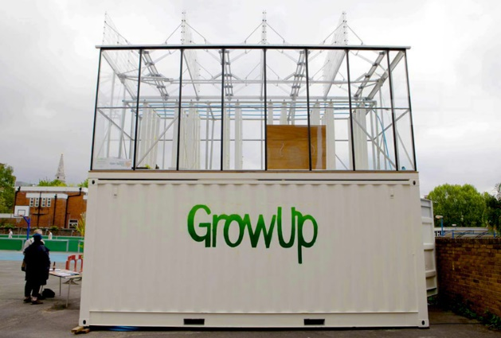
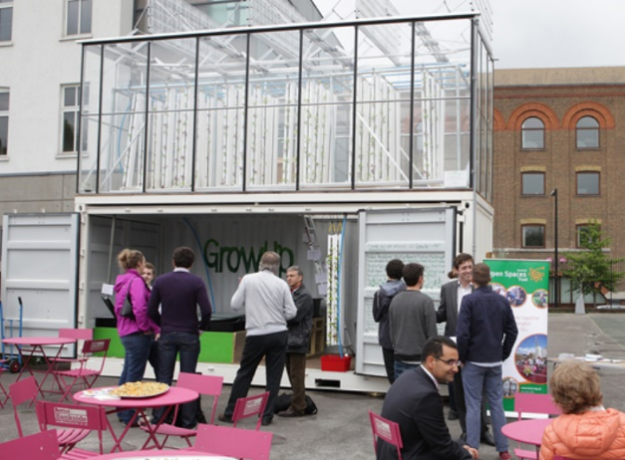
GrowUp’s Aquaponic Urban Farm (Designboom)
After successfully raising over £16,000 through a Kickstarter campaign, the team constructed their GrowUp Box from a reused shipping container that was modified to include a rooftop greenhouse.
With a footprint of only 14 square meters, the GrowUp Box can produce around 100 kilograms of fish and 400 kilograms of lettuce per year.
Part of a hybrid technology system called aquaponics in which methods of cultivating plants in water are synthesized with the practice of raising aquatic animals, the module is fitted with a rooftop greenhouse fed by the nutrient-rich wastewater from tilapia-filled fish tanks.

Slide 20
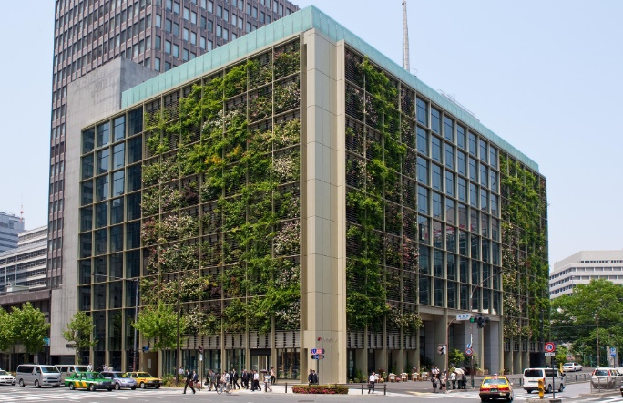
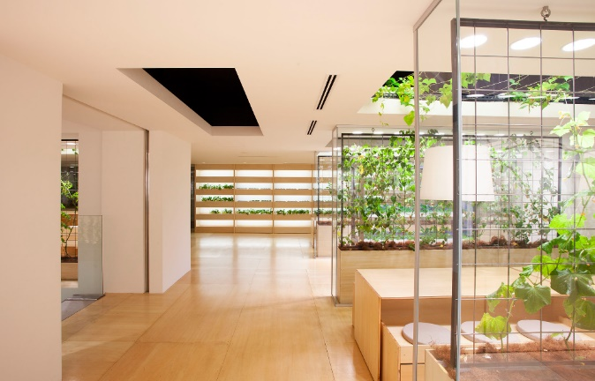
Pasona Urban Farm (Buczynski, 2013)
Throughout the office, vines, trees, plantar boxes and garden beds are a permanent fixture.
An intelligent climate control system monitors humidity, temperature and breeze to balance human comfort during office hours and crop growth after hours, maximising crop yield and annual harvest growth.
As crops harvested in Pasona headquarters are served within the building cafeterias, it highlights the ‘zero food’ mileage concept of a sustainable food distribution system that reduces energy and transportation costs.
Externally, a double-skin green façade features seasonal flowers and orange trees planted in shallow balconies, creating a living green wall and a dynamic identity to the public.

Slide 21
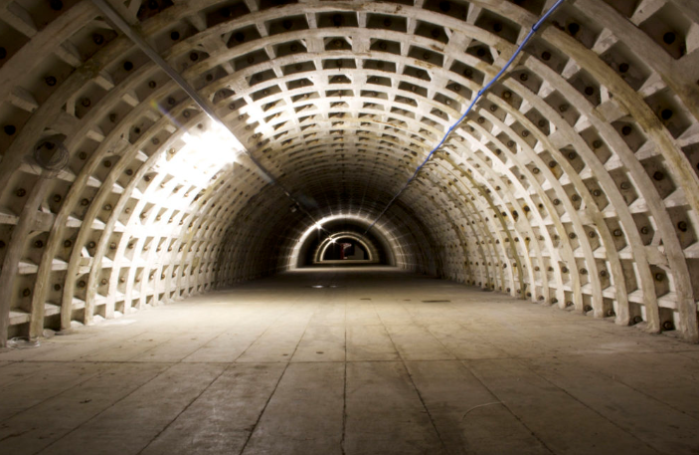
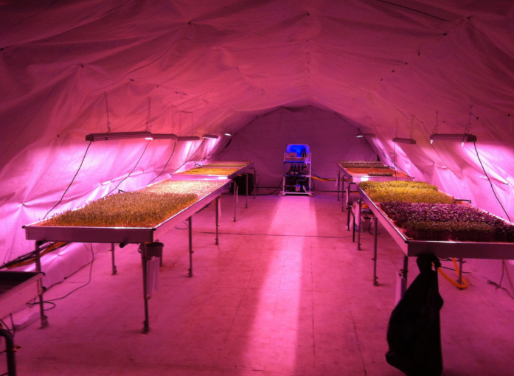
Growing Underground (Walsh, 2021)
the world’s first subterranean farm uses the latest hydroponic technology and LED lighting powered by renewable energy to produce fresh vegetables.
using 70% less water than your typical farming operation. They utilize a closed-loop ebb and flow system where water with nutrients floods the beds of sprouts a few times a day and then is recycled through a reservoir and reused. The plants float in a substrate made from recycled wool carpeting. Lights sit above the plants and are turned on and off to simulate daylight and night time.
By 2022, Growing Underground hopes to be producing over 60 tonnes of produce per year from a 528m2 area. That’s enough to meet the yearly lettuce consumption of 10,000 adults. The farm grows 12 times more per unit area than a traditional greenhouse grows in the UK but it also consumes four times more energy per unit area.

Slide 22
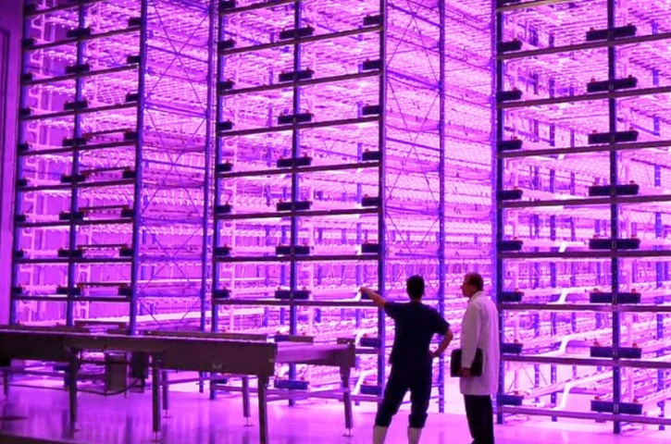
Pink Farm (Verticalfarm Daily)
Pink Farm has 750 square meters available for indoor production of all types of greens, such as lettuce, arugula, chard, spinach, basil, microgreens, among others.
The Pink Farms’ vertical farm produces about three tons per month and up to 130 times more food per square meter of soil. According to Maia, it generates savings of 95% of water and 60% of fertilizers per kilo produced. Bonus: the food is pesticide-free.
Their team works on how to automate specific crops on a large scale in a controlled environment. They have developed a sealed growing system in which there is no air exchange between the growing environment and the external environment.

Slide 23
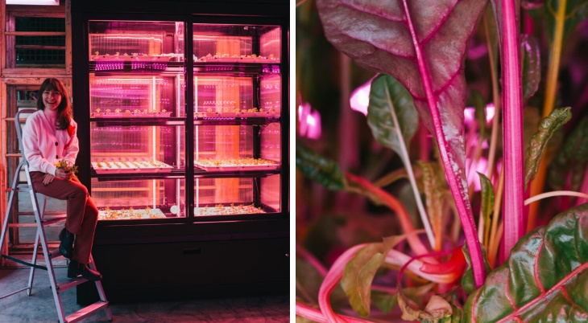
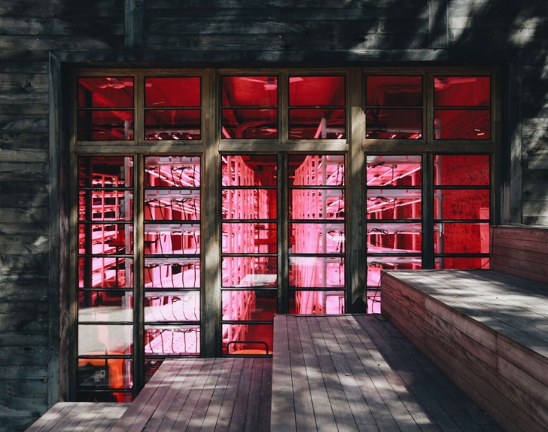
SpaceFarms (SpaceFarms)
SpaceFarms applies 75% less water than traditional farming.
Modular Farm Spots. The first prototype holds two square meters and can regularly produce 15-20 kg of crops per month, regardless of the season, year-round. Crops are grown without pesticides or herbicides with minimal human labor and low utility expenses
Using Precise Heating, Ventilation, and Air Conditioning (HVAC Systems), they have full control over the environment where the micro and leafy greens grow. By managing CO2 emission, water recycling, nutrient intake, temperature and humidity sensors, lighting brightness, and intensity, they create perfect conditions for nurturing fresh, 100% pesticides free, high-quality produce.

