Slide 2
Course: VET-D4
Module: Controlled Environmental Agriculture
Learning Unit:Challenges and Solutions
Author: MDU

Slide 3
Summary
Introduction to Control Environmental Agriculture (CEA)
Methods for Indoor Agriculture
Challenges and Opportunities of CEAs
Sustainability in CEAs
Case Studies
Conclusions

Slide 4
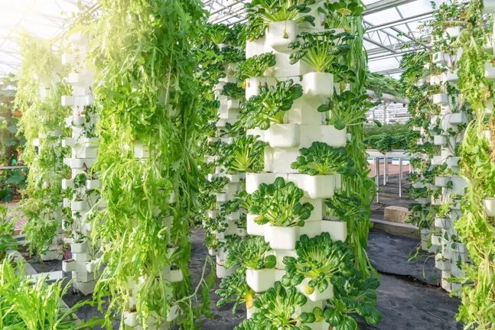
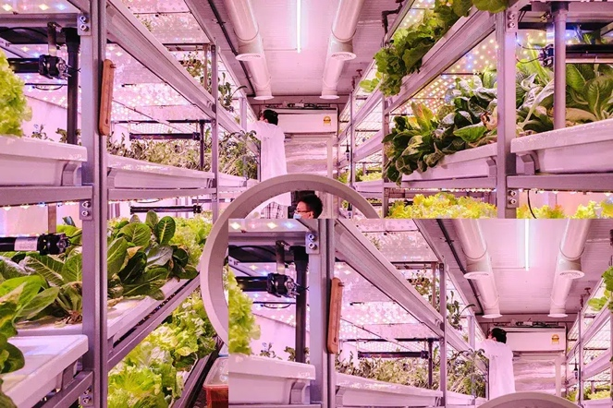
Introduction to Control Environmental Agriculture
Controle environmental agriculture (CEA)
Growing crops indoors in closed environments
Precise control over environmental factors like
Crops grow in structures instead of in the groud
Allows a wide variety of plant species to achieve growth rates year-round
Constant monitoring and manipulation of environmental factors enrure ideal conditions for growth
Examples of vertical farming in controlled environment agriculture in greenhouses (top) and climate-controlled rooms (bottom) (Source: Earth.org, 2022)

Slide 5
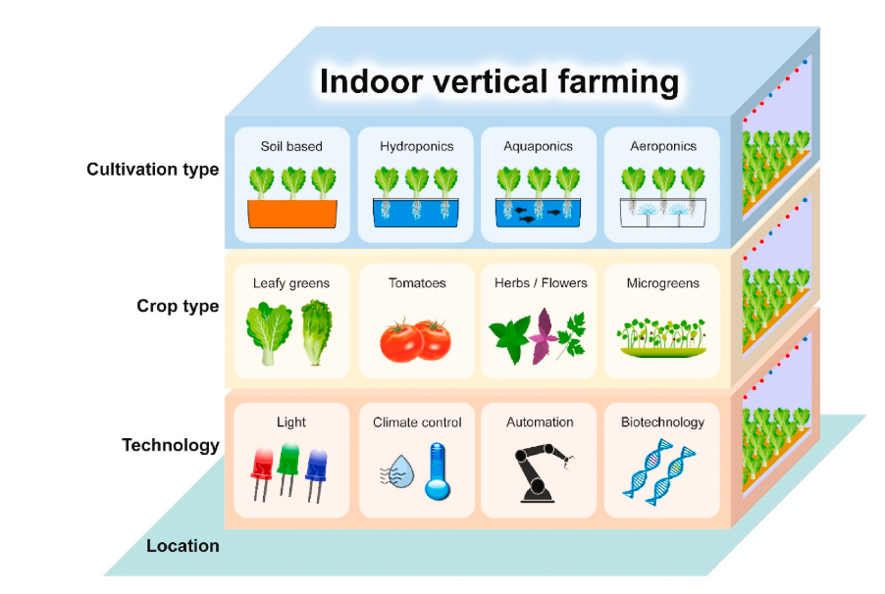
Introduction to Control Environmental Agriculture
There are four main farming methods for indoor agriculture:
Soil-based
Hydroponics
Aquaponics and
Aeroponics
Different types of indoor vertical farming for food production in a controlled environment (Source: Wong et al. 2020).

Slide 6
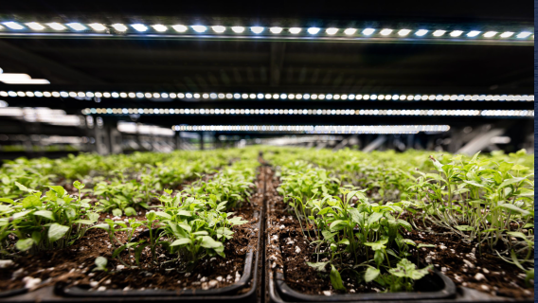
Methods for indoor agriculture
Soil-based
Soil is the primary source of essencial nutrients for plants
Plants cultivated in trays with soil
Advantages:
  Effective moisture retention
  Natural aeration
  Soil can be reused for multiple crop cycles with proper fertilization
  Challenges
  Requires expertise in
    Soil type
    Fertilization
    Pest control
Soil-based indoor agriculture (Source: economic Allience 2022)

Slide 7
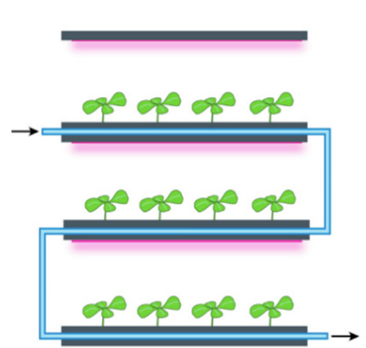
Methods for indoor agriculture
Hydroponics
Cultivation of plants in nutrient-enrich water
Plants are not supported by soil but by inert growing media like cocopeat
Nutrient-rich water circulate through the root system
Close-loop process minimize waste
Advantages:
  Reduced water loss through evaporation, conserving water
  Precise control of nutrients delivery
  Healthier plants and higher crop yields
Schematic representation of a hydroponic systems in vertical farms (Source: Saad et al., 2021 )

Slide 8
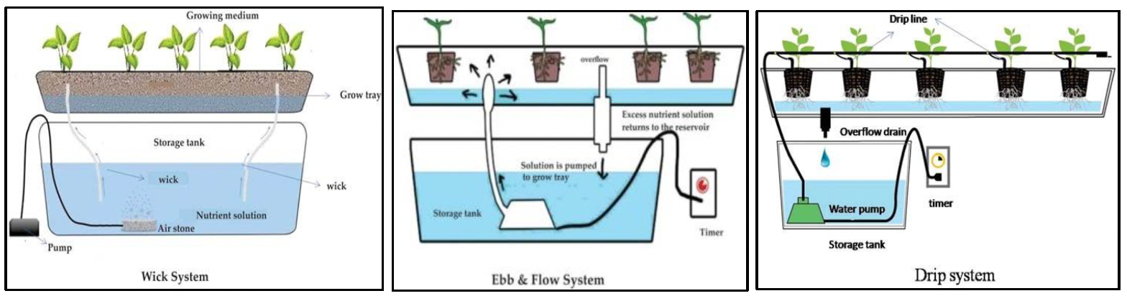
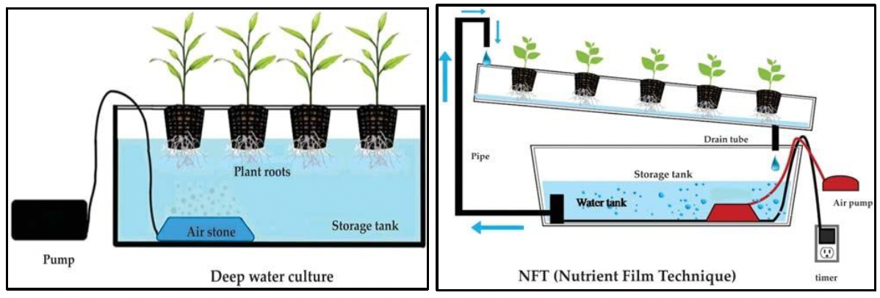
Methods for indoor agriculture - Hydroponics
Diagram of various structures of hydroponic systems (Source: Salim Mir et at. 2022 )

Slide 9
Methods for indoor agriculture
Aquaculture and Aquaponics
Cultivation of plants in nutrient-enrich water
Plants are not supported by soil but by inert growing media like cocopeat
Nutrient-rich water circulate through the root system
Close-loop process minimize waste
Advantages:
  Reduced water loss through evaporation, conserving water
  Precise control of nutrients delivery
  Healthier plants and higher crop yields

Slide 10
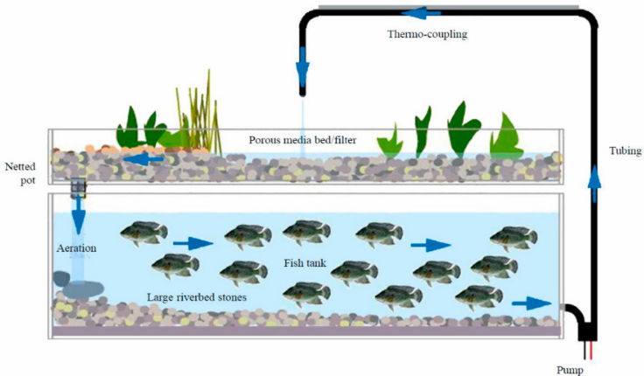
Methods for indoor agriculture - Aquaponics
Schematic representation of a model of aquaponics (Source: Barui et al., 2021)

Slide 11
Methods for indoor agriculture
Aquaculture
Cultivating aquatic organisms under controlled conditions
Includes fish, crustaceans, and aquatic photosynthetic organisms
Aquaponics
Cultivation method fostering a symbiotic relationship between fish and plants
Symbiosis achiever through fertigation (fertilization and irrigation)
Nutrient-rich waste from fish tank enriches hydroponic production beds
Process
  Nurient-rich water undergoes filtration and converion of toxic ammonia into nutrient-rich nitrate
  Plants absorb nutrients and purify wastewater before returning to fish tank
  Plants consume fishe´s CO₂
  Water in fish tanks absorbs heat

Slide 12
Challenges and Opportunities of CEA
 | Opportunities | Challenges
Energy Savings | Efficient light control Creative energu-scaving solutions | Increased energy costs Air conditioning requirements
Water demand | Reduction in water demand Recycling and purification techniques Conversion of wasetewater into drinking water | Logistical challenges in water transport
Productivity per unit area | Year-round, multi-cropproduction Increased crop yield | Limitations on plant varieties suitable for vertical farming Difficulty in quantifying space efficiency
Recycling of organic waste | Effective harnessing of nutrients and organic waste from wastewater
Healthy food provison | Fresh and locally produced foods Products unaffected by polluted soils or irrigated water | Social acceptance
Environmental opportunities and challenges of vertical farming(Source: Kalantari et al. 2018)

Slide 13
Challenges and Opportunities of CEA
 | Opportunities | Challenges
Initial costs | Proper site selection to maximise return on investment | High initial costs
Energy costs | Implementation of strategies to reduce costs: (i) utilizing building waste and (ii) integration into building energy system | High energy costs mainly due to artificial lighting
Economic growth and food prices | Integration into urban economies Transformation of urban spaces into agricultural centers | Initial labour shortage Lack of economic analysis
Economic l opportunities and challenges of vertical farming(Source: Kalantari et al. 2018 and. Barui et al. 2021)

Slide 14
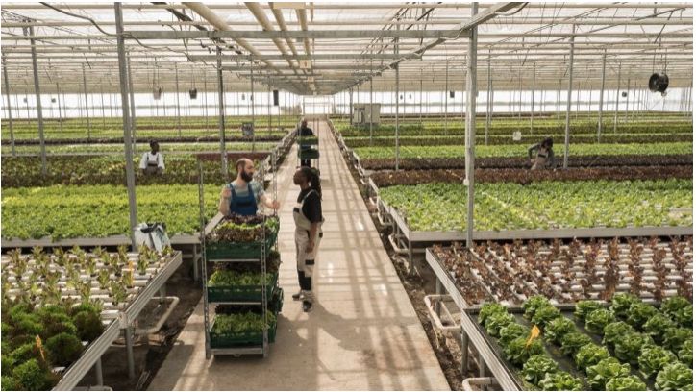
Sustainability in CEA
While CEA may not solve all environmental issues, it offers significant potential as a viable alternative to conventional agriculture
CEA offers a sustainable solution to modern food prodction challenges
  saves resources, in particular water
  Efficient irrigation systems
  Operates year-round
  Maximizes space efficiency
  Reduces needs for long-distance transportation (minimization of food waste)
  Contributes to circular economy
  Recycling materials
  Harnessing rainwater
  Producing energy
(Source: LinkedIn.com)

Slide 15
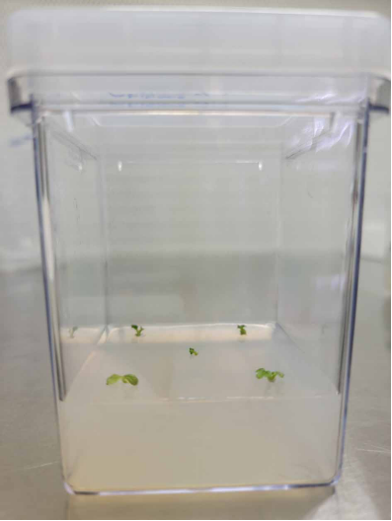
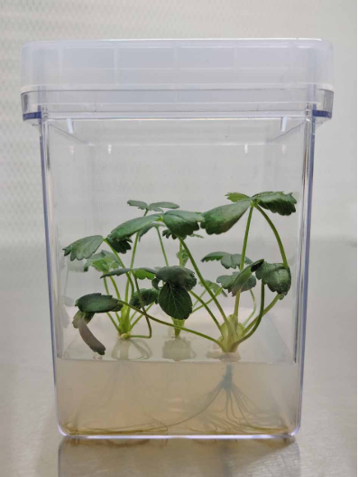
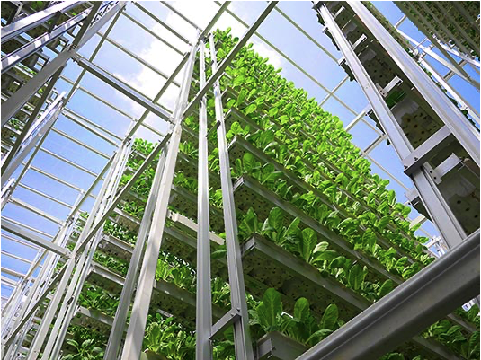
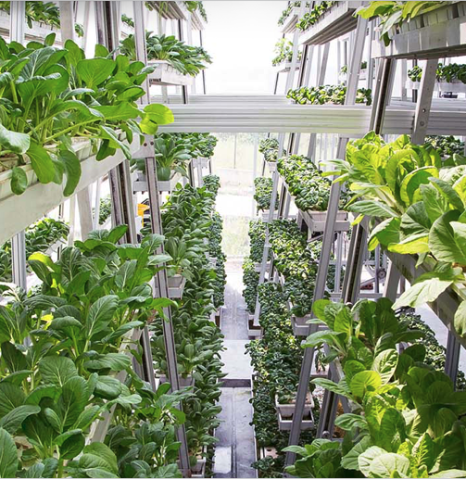
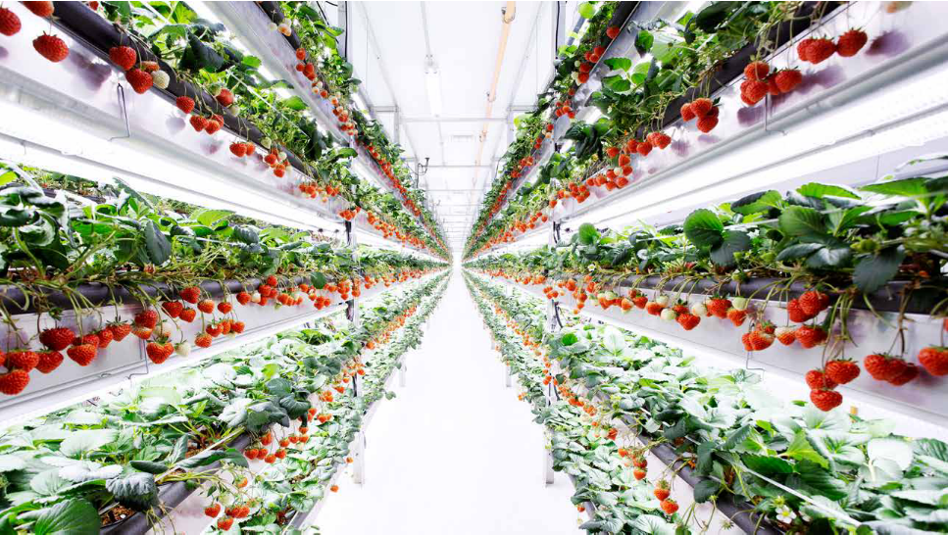
Case Studies
Aerofarms
Nordic Harvest (lasgest vertical farm in Europe)
Sky Green (Singapore)
Oishii farm (pioneer company)

Slide 16
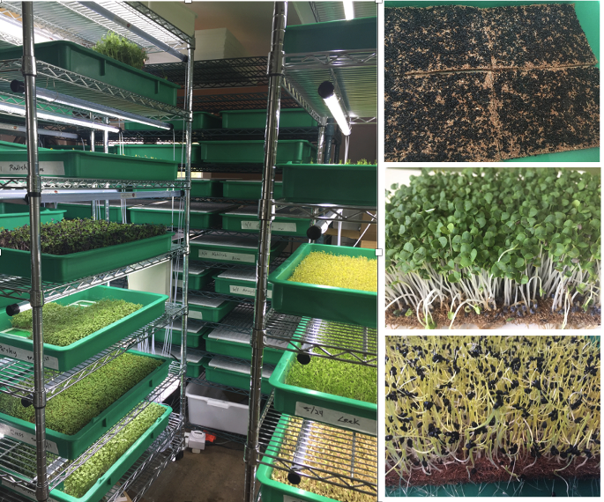
Case Studies
Gotham Greens
Green Spirits Farms
The Plant

Slide 17
Conclusions
Significant advancement in sustainable agriculture have been achieved through innovative yechniques loke hydroponics, aquaculture and aeroponics
Indoor farming options increasingly adopted by companies and growers, offering alternative ways to produce plant goods in urban areas
Initial setup costs and energy requirements can be substantial, but technology advancements and ongoing research are making methods more efficient and cost-effectiveI
Indoor farming offers solutions to challenges associated with conventional farming

Slide 18


