Slide 2
Course: VET
Module: Horizontal Skills
Learning Unit: Soft Skills
Authors: CESIE & OTC

Slide 3
Content
Interpersonal and effective communication
What is effective communication?
Verbal and non-verbal communication
Effective speaking and active listening
Barriers to communication

Slide 4



Interpersonal and effective communication
INTERPERSONAL COMMUNICATION
EFFECTIVE COMMUNICATION
exchange of information, ideas, thoughts, and feelings between individuals
the ability to convey a message in a clear, concise, and impactful manner
Definition
the context of personal relationships, whether they are professional or personal in nature
both interpersonal and broader organizational or public communication contexts
Scope
the successful transmission of information or ideas, ensuring that the message is delivered and received as intended
building relationships and maintaining the quality of interactions
Focus

Slide 5
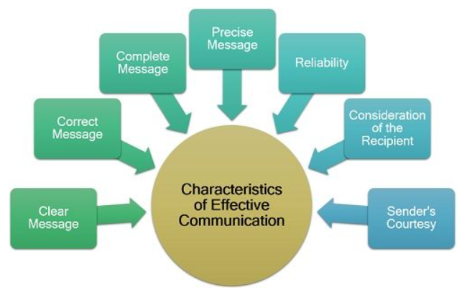

What is effective communication?
The process of conveying information or ideas in a way that is understood,and the intended message is successfully delivered and received
Crucial skill in both personal and professional contexts
It encompasses the nuanced interplay of language, tone, body language, and context
ULTIMATE GOAL
To convey a message with precision and to elicit the desired response or action from the receiver
(Source: theinvestorsbook)

Slide 6
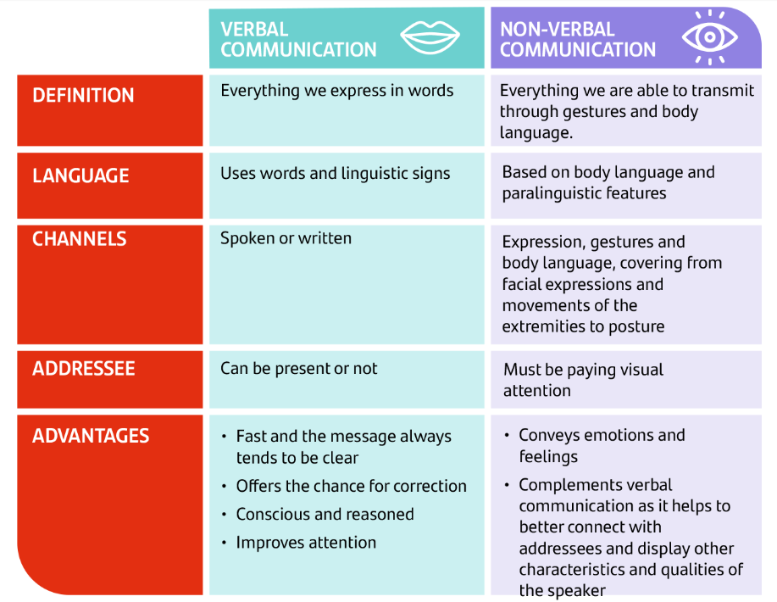
Verbal and non-verbal communication
Two distinct yet intertwined forms of human interaction that collectively shape our ability to convey messages, emotions, and intentions effectively:
Verbal Communication is the use of spoken or written words to convey messages. It's the linguistic component of communication, encompassing not only the words themselves but also their structure, tone, and context
Non-verbal Communication, on the other hand, encompasses all forms of communication without the use of words. It includes body language, facial expressions, eye contact and even silence
(Source: Santander)

Slide 7
Main differences between verbal and non-verbal communication
Basis | Verbal Communication | Non-verbal Communication
Use of words | Use of oral or written words | Other than oral or written words
Types | Oral and written | Facial expression, body movement and posture, gestures, eye contact, touch, space, but also visual, audio, audio-visual, etc.
Understanding | Easy | Comparatively difficult
Structure | Well structured | Lacks in formal structure
Distortion of information | Less possible | Highly possible
Feedback | Less and delayed feedback | Gives a lot of feedback

Slide 8

Effective speaking and active listening
Speaking and listening are two fundamental components of human communication that enable individuals to exchange ideas, information, emotions, and experiences. These two complementary skills are essential for effective and meaningful interactions in both personal and professional contexts. Effective speakers are often effective listeners as well because they understand the importance of receiving feedback and adjusting their communication style accordingly.
(Source: thriveglobal)

Slide 9
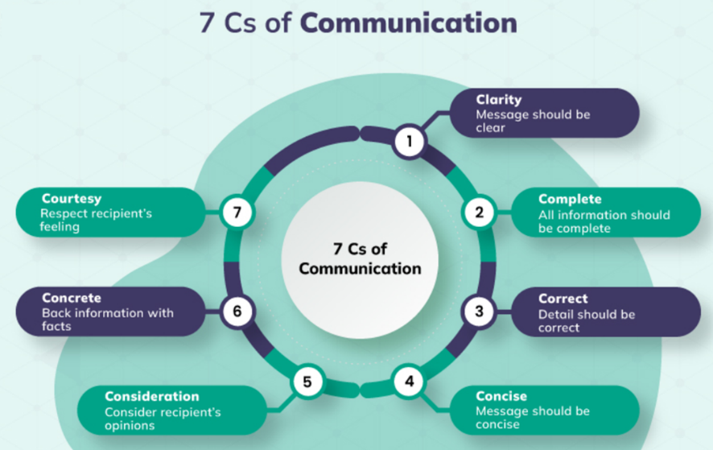
Effective speaking
The act of conveying thoughts, ideas, and messages through spoken words.
To be an effective speaker, however, the mere use of the language is not enough. Effective speaking, in fact, involves a higher level of skill and mastery in conveying messages, engaging an audience, and achieving desired outcomes.
It is characterized by clarity, coherence, and the ability to engage and connect with the audience using various strategies and techniques.
It entails the use of both Verbal and Non-verbal communication
The 7 Cs for effective communication (Source: Crowjack)

Slide 10
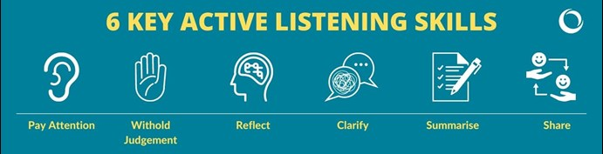
Active listening
The skill of actively receiving, processing, and interpreting spoken or non-verbal messages from others
Dynamic and intentional form of listening that goes beyond merely hearing words and sounds
It involves engaging with the speaker in a way that demonstrates attentiveness, empathy, and a genuine interest in understanding their message and perspective
Main active listening skills (Source: Firstpracticemanagement)

Slide 11

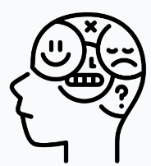
Barriers to communication
They are obstacles that impede the effective exchange of information, ideas, or emotions between individuals or groups:
Physical barriers: external factors that hinder effective communication. These barriers can be related to the environment, distance, noise, or even technological limitations.
Example: Imagine you're in a large conference room with a group of colleagues for an important meeting. The room has poor acoustics, and there's construction noise from outside. The physical barrier in this context is the noisy environment, making it challenging to hear and understand what others are saying.
Psychological barriers are related to individuals' mental states, including emotions, biases, preconceptions, and cognitive limitations that hinder their ability to listen and communicate effectively.
Example: Suppose you're a manager conducting performance evaluations. You have a negative perception of one of your team members based on a past mistake. During the evaluation, your preconceived bias against them affects your ability to objectively assess their performance, resulting in a less constructive conversation.

Slide 12
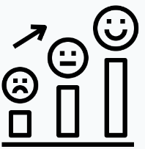

Barriers to communication
Emotional barriers involve intense emotions, such as anger, fear, or stress, that can disrupt communication by clouding judgment, triggering defensive responses, or preventing effective expression of thoughts and feelings.
Example: Imagine a couple engaged in an emotional argument. One partner is furious due to a perceived slight, and the other is overwhelmed with guilt. These intense emotions can make it difficult for either person to express themselves calmly and rationally, hindering effective communication.
Cultural barriers arise when individuals from different cultural backgrounds have varying communication norms, values, and expectations. These differences can lead to misunderstandings, misinterpretations, or offense.
Example: In a multicultural workplace, a team member from a culture that values indirect communication may provide vague responses during meetings, leaving colleagues from more direct communication cultures confused and frustrated. The cultural barrier here is a difference in communication styles.

Slide 13
Practical Activity #1
Group Activity in Principles and key elements of interpersonal and effective communication

Slide 14


Slide 16
Content
What is negotiation?
The main characteristics of a successful negotiator
How to analyze a negotiation situation?
Negotiation styles and techniques

Slide 17
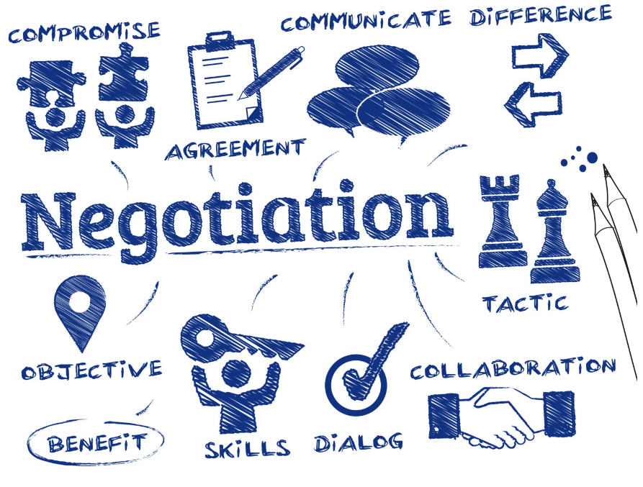


What is negotiation?
Key elements of effective negotiation (Source: QNewsHub)
The process of reaching a mutually beneficial agreement or resolution between two or more parties who have differing interests, needs, or objectives
Crucial skill in both personal and professional contexts
It entails aspects of conflict resolution, decision-making, and problem-solving
It is not about ‘winning’ at the expense of the others…
BUT
finding a middle ground where both sides can benefit.
Key elements of effective negotiation (Source: QNewsHub)

Slide 18

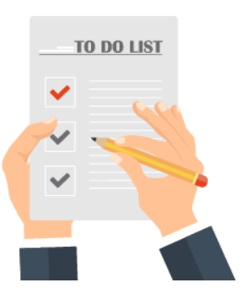

The main characteristics of a successful negotiator
A successful negotiator possesses a combination of skills, traits and characteristics that enable them to effectively navigate complex negotiations and achieve favorable outcomes.
 | CHARACTERISTICS | EXAMPLES
 | Preparation and Planning Successful negotiators invest time in thorough preparation. They research the issues, the other parties, and the context of the negotiation. This includes understanding their own goals and priorities, as well as identifying potential points of agreement and areas of contention | In a land lease negotiation, a successful farmer negotiator would research soil quality, historical crop yields, and local land use regulations.
 | Effective Communication Skills Successful negotiators are skilled in both listening and articulating their ideas clearly. They use active listening techniques to understand the other party's perspective and convey their own thoughts persuasively | In a negotiation with suppliers for farm equipment, clear communication about specifications and delivery timelines is crucial for success

Slide 19




The main characteristics of a successful negotiator
 | CHARACTERISTICS | EXAMPLES
 | Emotional Intelligence A successful negotiator has a high degree of emotional intelligence, allowing them to manage their own emotions and empathize with the emotions of others. This skill helps in building rapport, diffusing conflicts, and making emotionally informed decisions | In negotiations for licensing intellectual property related to biofuel production, recognizing and addressing the fears and concerns of both parties is essential.
 | Adaptability Negotiations rarely go exactly as planned. Successful negotiators are adaptable and flexible, able to pivot and adjust their strategies in response to changing circumstances or unexpected developments. | In negotiations with a fluctuating market, a farmer may adjust pricing strategies based on changing commodity prices
 | Negotiation Ethics Successful negotiators adhere to ethical standards and maintain their integrity throughout the process. They avoid deceptive tactics or behavior that could damage their reputation. | In supply chain negotiations, a successful farmer negotiator ensures fair treatment of farmworkers and environmentally responsible practices
 | Empathy and Relationship Building Building positive relationships with the other party is essential for successful negotiations, especially in ongoing or long-term business relationships. Empathy enables negotiators to understand the needs and motivations of the other party, fostering trust and cooperation | Using statements like, "I can understand how you might feel that way," or "I see why this is important to you." These statements convey that you're actively trying to empathize with their viewpoint

Slide 20



The main characteristics of a successful negotiator
 | CHARACTERISTICS | EXAMPLES
 | Cultural Awareness In international or cross-cultural negotiations, an understanding of cultural differences is vital. Successful negotiators are culturally aware and can adapt their approach to be respectful and effective in diverse settings | In a negotiation with Japanese counterparts, being aware of their preference for indirect communication and non-verbal cues (such as silence) can prevent misinterpretation and facilitate a smoother negotiation process
 | Strategic Thinking Negotiators employ strategic thinking to plan their moves and anticipate the responses of the other party. This includes understanding game theory, assessing the relative value of concessions, and having a clear strategy for achieving their goals | When negotiating land purchase for expansion, strategic thinking involves assessing the long-term viability of the investment and its alignment with the farm's goal.
 | Conflict Resolution Skills Conflicts are a natural part of negotiation. Successful negotiators have strong conflict resolution skills, which they use to find common ground and prevent disputes from escalating | In a negotiation with an aggressive counterpart, identifying signs of escalation, such as raised voices or aggressive language, and taking steps to defuse tension

Slide 21

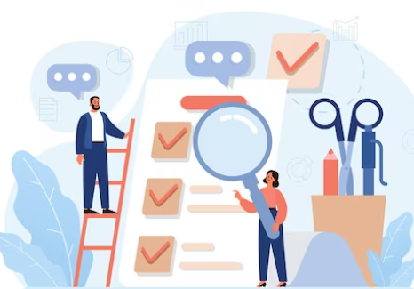
How to analyze a negotiation situation?
Analyzing a negotiation situation involves gathering and processing information, assessing the key factors at play, and formulating a strategy based on this analysis
Understanding the situation and planning your approach increase your chances of reaching a satisfying agreement for everyone involved

Slide 22
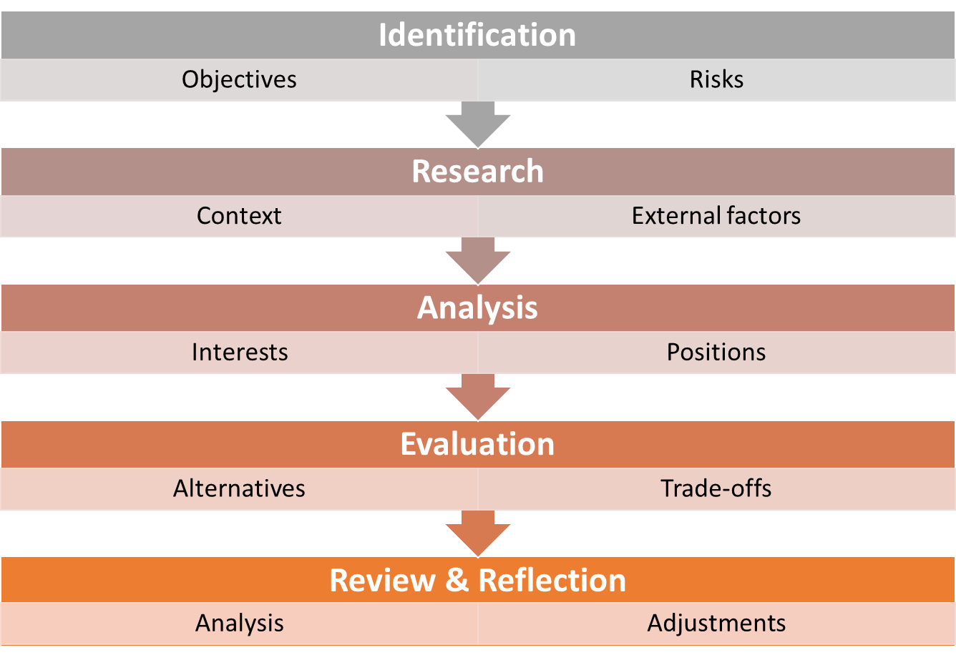
How to analyze a negotiation situation?
To properly analyze a negotiation situation, it is possible to draw inspiration from the following 5-step process:
The five steps of the negotiation analysis (Source: own elaboration)

Slide 23

How to analyze a negotiation situation?
IDENTIFICATION
Identify the Players: First, figure out who is involved in the negotiation. Who are the people or groups that have a stake in the outcome? Make a list.
Assess the Power Balance: Think about who has more influence or power in the negotiation. This can help you understand who might have the upper hand.

Slide 24

How to analyze a negotiation situation?
RESEARCH
Research and gather information about the broader context of the negotiation. This may include industry trends, market conditions, legal and regulatory considerations, and any external factors that could impact the negotiation. Knowing exactly the inner dynamics of the context ensures nothing can take you by surprise.
The research activity must be complemented by the analysis of interests and positions, meaning distinguishing between the other party's stated positions (what they want) and their underlying interests (why they want it).

Slide 25

How to analyze a negotiation situation?
ANALYSIS & EVALUATION
Understand the Interests: Next, try to understand what each party wants. What are their goals and desires in this negotiation? It's like figuring out what each person hopes to get.
Plan Your Approach: Based on what you've learned, make a plan for how you want to negotiate. What will you say or do to get closer to what you want while also considering the other side's interests?

Slide 26
How to analyze a negotiation situation?
ANALYSIS & EVALUATION
Identify Alternatives: Think about different options or solutions that could work for everyone involved. What other choices are there besides the main one being discussed?
Consider Trade-offs: Sometimes, you might need to give up something to get something else. Think about what you're willing to compromise on and what's most important to you.

Slide 27

How to analyze a negotiation situation?
REVIEW & REFLECTION
Anticipate Reactions: Think about how the other parties might react to your proposals and how you'll respond to their suggestions. This helps you be prepared for different scenarios.
Review and Adjust: As the negotiation unfolds, be flexible. If things aren't going as planned, it's okay to adjust your strategy based on new information or changing circumstances.

Slide 28
Practical Activity #2
Case Study
You are about to meet a potential client who is interested in promoting your products in a big supermarket chain. The potential client let you know from the very beginning that he would go for a bargain of your work. From his voice tone and the words used you realized that he is assertive and dominant. What is the best way to do so as to deal with such a personality without losing the negotiation?

Slide 29

Negotiation styles and techniques
Negotiation styles and techniques can vary based on the goals, the relationship between parties, and the context of the negotiation.
In the farming context, negotiations often revolve around issues such as land use, resource allocation, pricing, and regulatory compliance.
1. Competitive Negotiation:
In competitive negotiation, each party pursues their own interests aggressively, often viewing the negotiation as a zero-sum game where one party's gain is the other's loss. This style can be confrontational and focused on winning concessions from the other party.
Example: Competitive negotiations in farming can occur when multiple farmers are vying for limited water resources for irrigation during a drought. Each farmer may aggressively advocate for their allocation of water, attempting to secure a larger share at the expense of others.

Slide 30


Negotiation styles and techniques
2. Collaborative Negotiation:
Also known as integrative or win-win negotiation, it emphasizes finding mutually beneficial solutions. Parties work together to identify common interests and creative solutions that maximize value for all involved.
Example: Collaborative negotiation can occur when farmers within a cooperative seek to collectively purchase agricultural equipment or negotiate with suppliers for bulk purchase discounts. By pooling resources and negotiating together, they achieve better terms and lower costs for all members.
3. Collaborative Negotiation:
Compromise negotiation involves finding middle-ground solutions where each party makes concessions to reach an agreement. It's a balanced approach that may not fully satisfy either side but aims to meet somewhere in the middle.
Example: In a farming context, compromise negotiations could occur when neighboring farmers disagree on land boundaries. Instead of going to court, they might negotiate and agree to a land boundary adjustment that accommodates both parties' needs.

Slide 33
Content
Teamwork and Collaboration skills
Their role in business success
Effective teams and their characteristics
Setting common goals
Conflict resolution

Slide 34



Teamwork and Collaboration skills
Set of abilities and attributes that enable individuals to work effectively with others to achieve common goals and solve problems.
Important skills in both personal and professional contexts.
Teamwork combines the individual efforts of all team members to achieve a goal, is usually overseen by a team leader and those within a team are delegated individual tasks to contribute towards the team’s end goal.
Collaboration implies that people complete a project collectively, work together as equals - usually without a leader - to come up with ideas or make decisions together to achieve a goal.

Slide 35
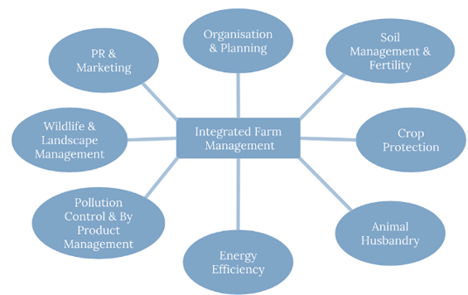
Their role in business success
“Two heads are better than one" couldn't be more relevant! Teamwork and collaboration have in fact emerged as the cornerstone of success for businesses.
In businesses like farms that consist of individuals with varying skill sets, experiences, and knowledge, Teamwork creates a platform where this diversity can be harnessed for the greater good.
The five steps of the negotiation analysis (Source: Penn State University)

Slide 36
Effective teams and their characteristics
Building effective teams is not just a desirable trait but a fundamental necessity for achieving success.
They require a thoughtful approach that considers both individual qualities and the dynamics of group collaboration, while providing a framework for harnessing the diverse talents, skills, and experiences of individuals to collectively achieve goals that would be unattainable for a single person.
To this aim, it is necessary to define clear and specific goals as well as to assign roles and responsibilities based on individual strengths and expertise, always considering the opportunity to form teams with members who bring diverse skills, backgrounds and perspectives.
T
E
A
M
TOGETHER
EVERYONE
ACHIEVES
MORE

Slide 37
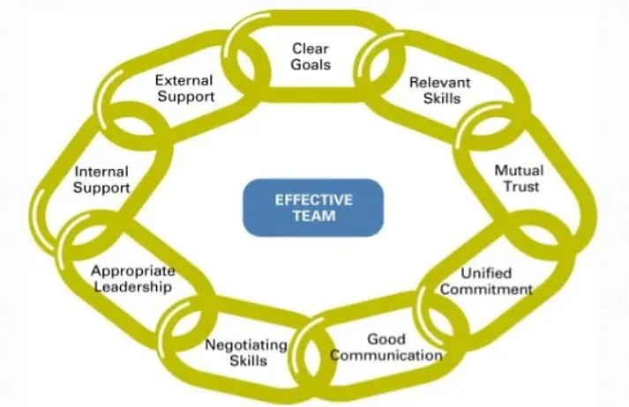
Their role in business success
The fundamental characteristics of effective teams are:
The fundamental characteristics of effective teams (Source: CareerCliff)

Slide 38
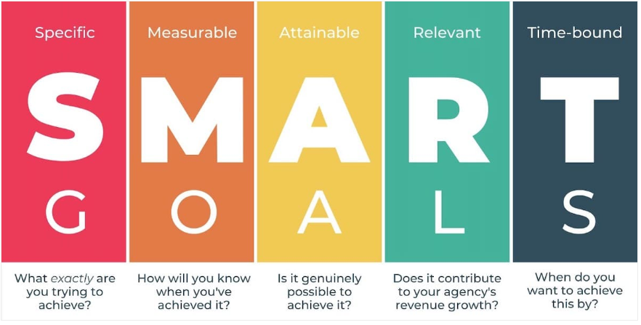
Setting common goals
A fundamental aspect of team success, as it provides a shared direction and purpose for all team members.
It aligns the diverse talents, experiences, and energies of individuals within a team, transforming a group of people into a cohesive unit, working together in harmony towards a single destination.
The fundamental characteristics of effective teams (Source: coachcounselcare)

Slide 39
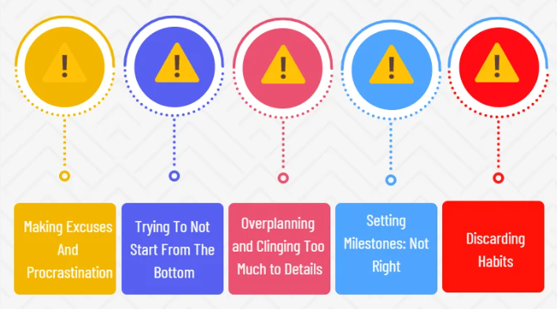
Setting common goals
However, there is always the possibility to make mistakes when trying to set common goals. The most common ones are:
The most common mistakes when setting common goals (Source: Projectcubicle)

Slide 40
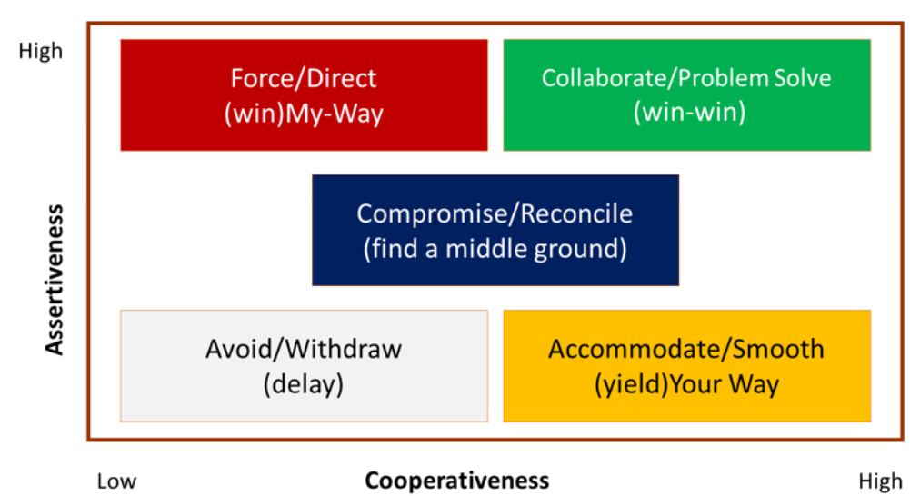
Conflict resolution
Critical aspect of teamwork, as it addresses inevitable disagreements and tensions that arise when individuals with different perspectives, backgrounds, and priorities collaborate.
It is not the presence of conflict that defines the fate of a team; rather, it is the way those conflicts are handled and resolved that truly matters.
There are 5 different approaches to conflict resolution:
  Avoiding
  Competing
  Collaborating
  Accommodating
  Compromising
The fundamental characteristics of effective teams (Source: cmbankng)

Slide 41
Activity #3
Group Activity
Team working and collaboration skills

Slide 44
Content
The Decision-making process
Barriers and Biases during decision making
Creative problem solving

Slide 45
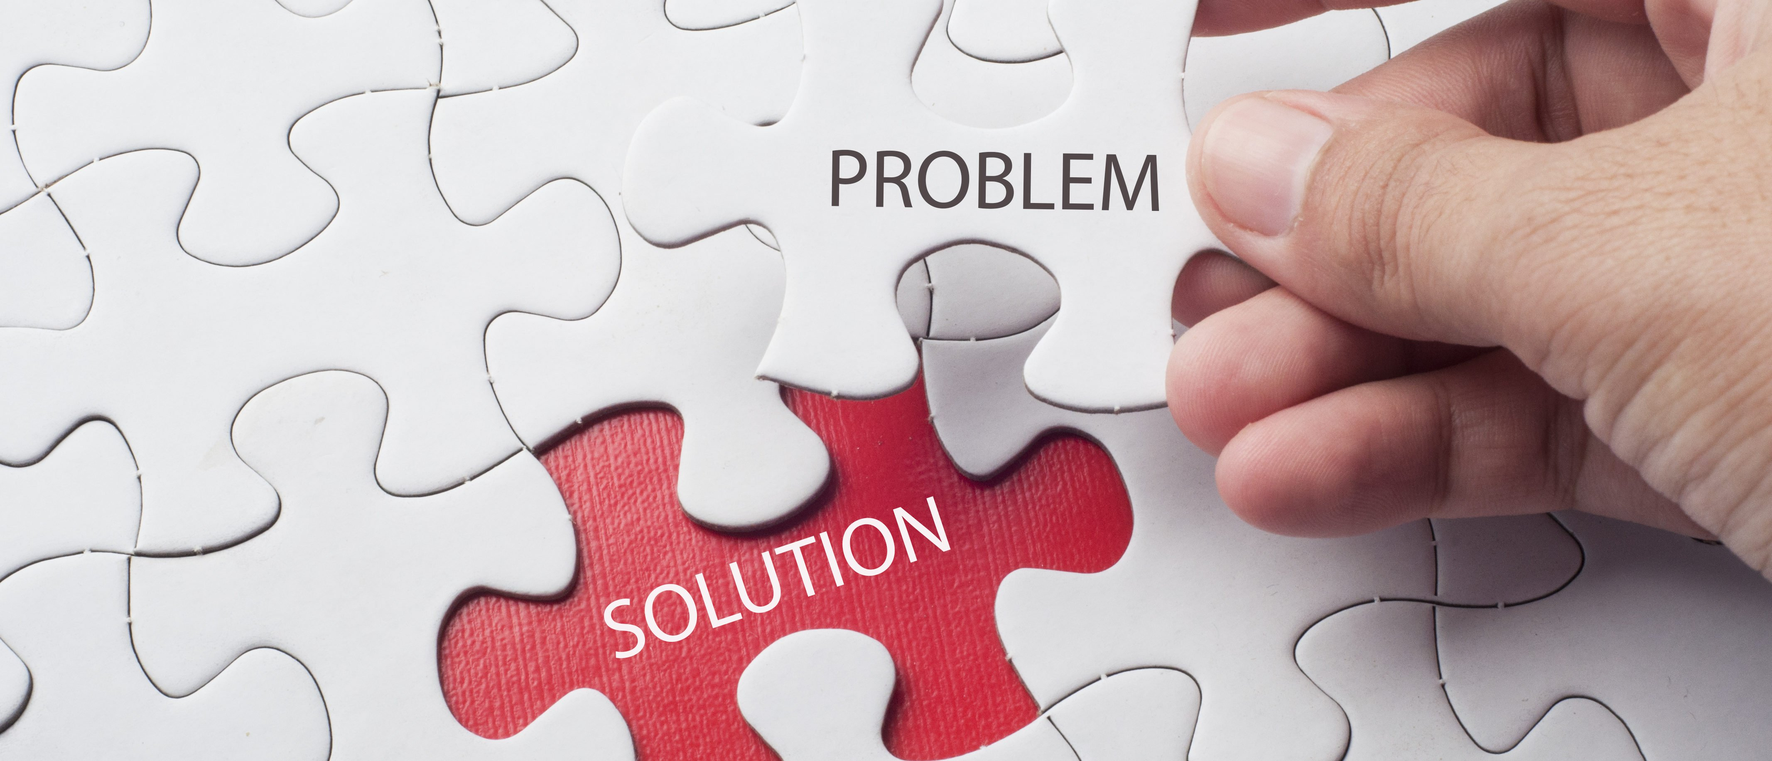
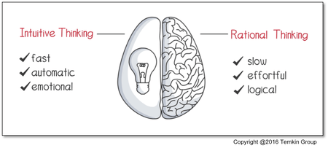
Making Decisions
Whenever there is a problem, a decision should be made
Two main types of Decision Makers

Slide 46
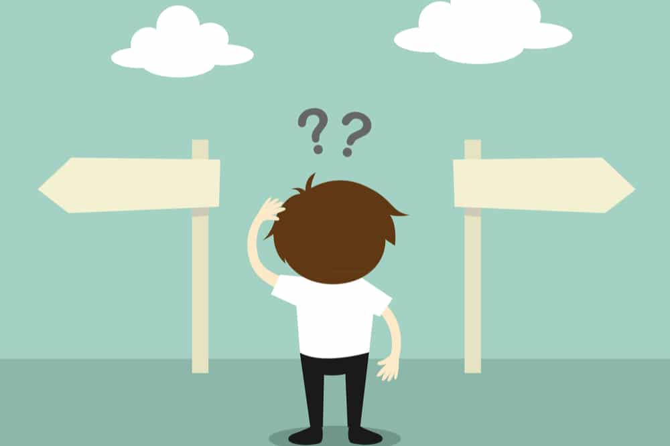

The Decision making Process
“process of making a choice from a number of alternatives to achieve a desired result” (Eisenfuhr, 2011)
3 key Elements of the definition:
  Number of options/ alternatives
  The process itself
  Mental activity taking place for making decisions

Slide 47
The rational decision making process

Slide 48
Activity #4
Group Discussion
Try to apply the rational decision-making process in the cases of:
buying new humidity sensors for your agribusiness and
choosing what to eat for lunch.
How did you apply the process in each case?
Did you have to follow all the steps in both of them?

Slide 49
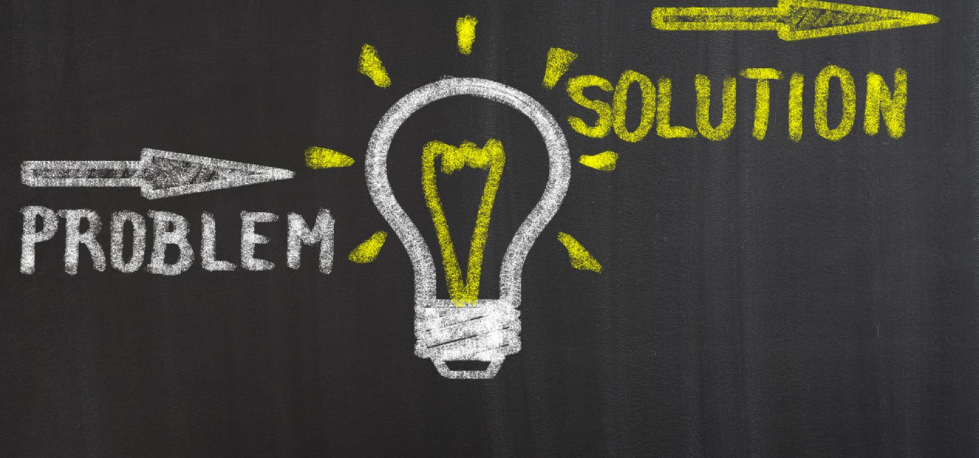

Barriers and biases during decision making
Heuristics
“mental shortcuts that enable people to make quick but less-than-optimal decisions” (Drew, 2023).
This Photo by Unknown Author is licensed under CC BY-NC
2. Complexity of the process based on:
  Specific context
  Nature of the problem
This Photo by Unknown Author is licensed under CC BY-NC

Slide 50
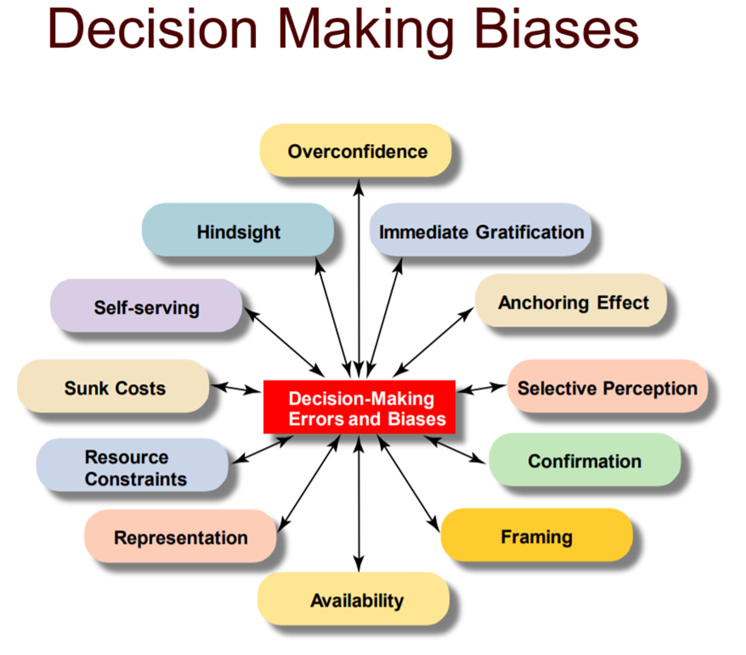
Common errors and Biases
CAN:
Be either conscious or unconscious
Lead to poor decision-making,
Bring forth one's prejudices,
Lead one to overestimate their capabilities,
Lead to misunderstandings with others,
Lead to incorrect thought processes.
Source: Smith et al (2012)

Slide 51
How to overcome biases and errors
Tips
Identify common bias
Seek diverse perspectives
Use structured methods
Develop a growth mindset
Test your decisions
Review your outcomes

Slide 52
Activity #5
Case Study
You are running an agribusiness with two of your best friends. All three of you have a very good educational background on studies relevant to the field of agriculture, management and marketing which are complementary with each other and mandatory on how to run such a business successfully. Your company is interested in participating in a collaboration scheme along with other local agribusinesses with a view to expand their network and reach more customers. However, after one year of participating in this collaboration nothing seems to have changed not only for your company but also for the rest of the network. Your partners based on their experience try to convince you to agree to let the courts resolve the situation as the only solution, because the rest of the partners in the collaboration scheme had done so, and because they strongly believe that this is how things work in similar situations.
- Into what kind of mistakes your partners have fallen that hinder you from coming up with the best decision?

Slide 53
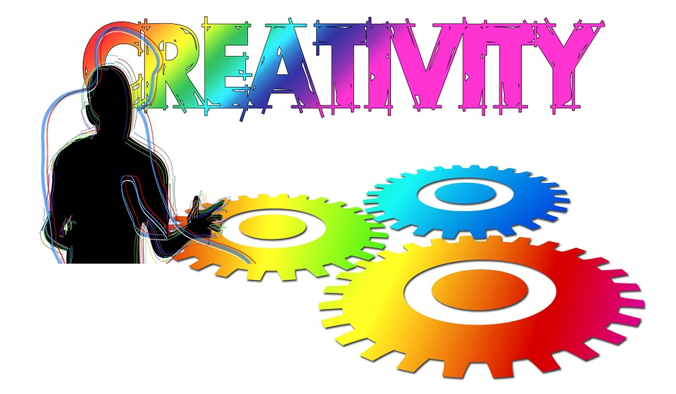
The role of creativity in problem solving
“the tendency to generate or recognize ideas, alternatives, or possibilities that may be useful in solving problems, communicating with others, and entertaining ourselves and others” (Franken, 1994).
“Problem solving with Relevance and Novelty” (Doherty, 2020) where:
Relevance- actual solution that is provided to a specific problem
Novelty- the solution that has not been done before in terms of genuineness

Slide 54


Creative problem solving
Leads to:
Find creative solutions to complex problems
Increase adaptability to change
Spark inovativeness and growth mindset
4 key Principles:
balancing between divergent and convergent thinking
reframing problems as questions
avoiding judging any idea no matter how crazy and /or unfeasible it appears to be
being keen on building a positive environment that enhances the development of creative ideas

Slide 55
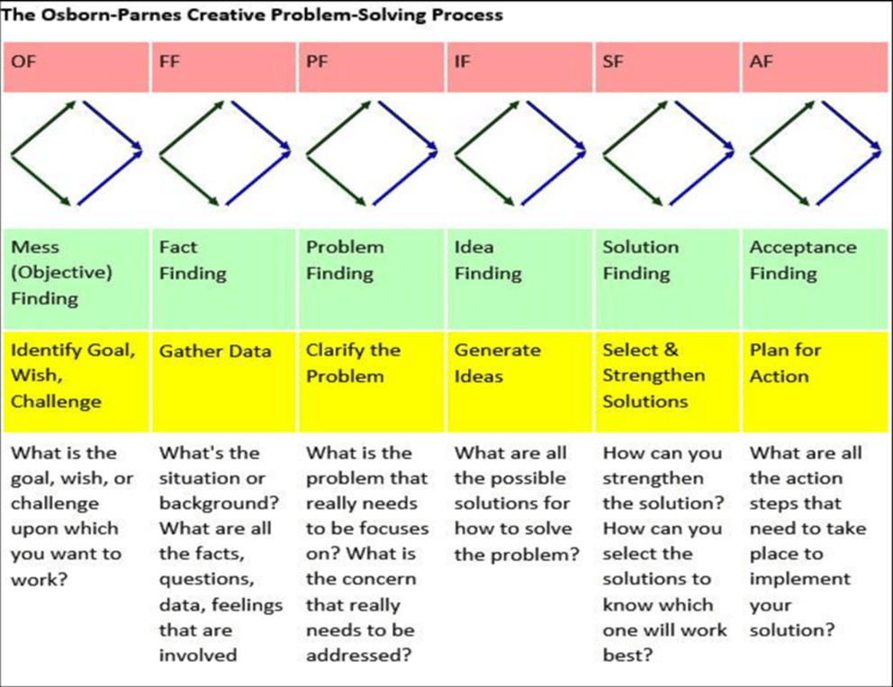
Creative problem solving process

Slide 58
Content
The role of Resilience and Adaptability
Accountability
Ethical behaviour

Slide 59
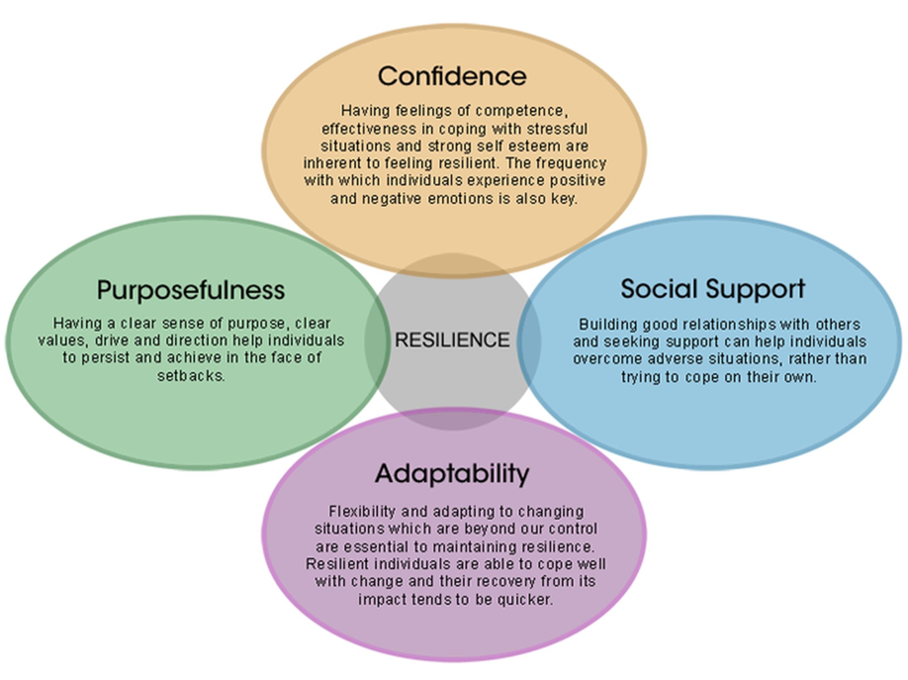
Resilience
“the process of, capacity for, or outcome of successful adaptation despite challenging circumstances” (Garmezy and Masten, 1991).
is associated with inner strength, competence and flexibility
enables people to cope with adversity
minimizes the impact of risk factors (stressful life events)
enhances the supportive factors (optimism, social support, active coping)

Slide 60
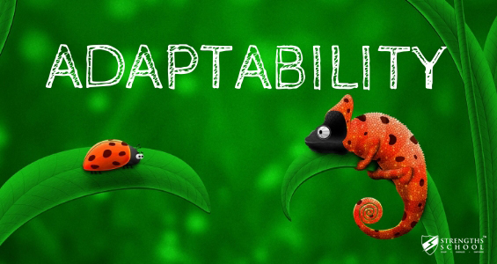
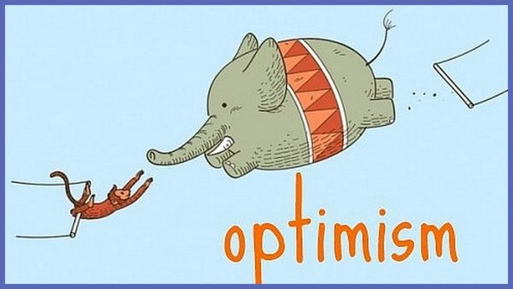
Adaptability is closely related to the ability to easily adjust in changing circumstances
Optimism requires remaining positive during these changing challenges and putting emphasis on the good aspects of a given situation
This Photo by Unknown Author is licensed under CC BY-NC-ND
Both elements are considered as human strength and virtue (Santilli et al, 2017) providing to people qualities that enable them to overcome critical barriers during their lifetime in their personal and /or professional spheres

Slide 61
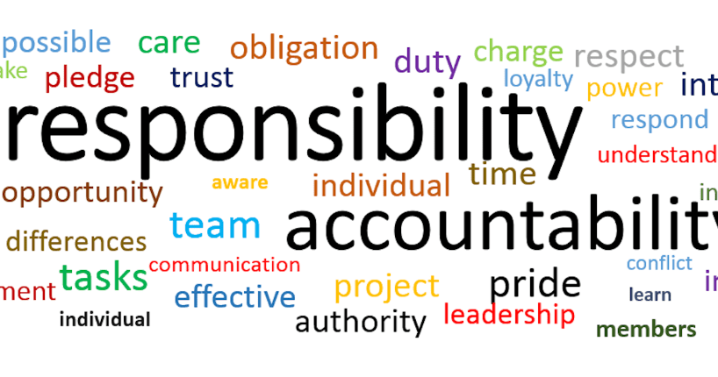
Accountability
“the responsibility and answerability of individuals, organizations, or institutions for their actions, decisions, and outcomes” (Sergeeva, 2021)
Accountability vs responsibility
focuses on the results / outcomes of an action vs remains simply on the completion of tasks
This Photo by Unknown Author is licensed under CC BY-ND

Slide 62
5 key principles
Clear understanding of role
Answerability
Active participation and compliance
Ability to make reasonable decisions
Ability to handle criticism

Slide 63
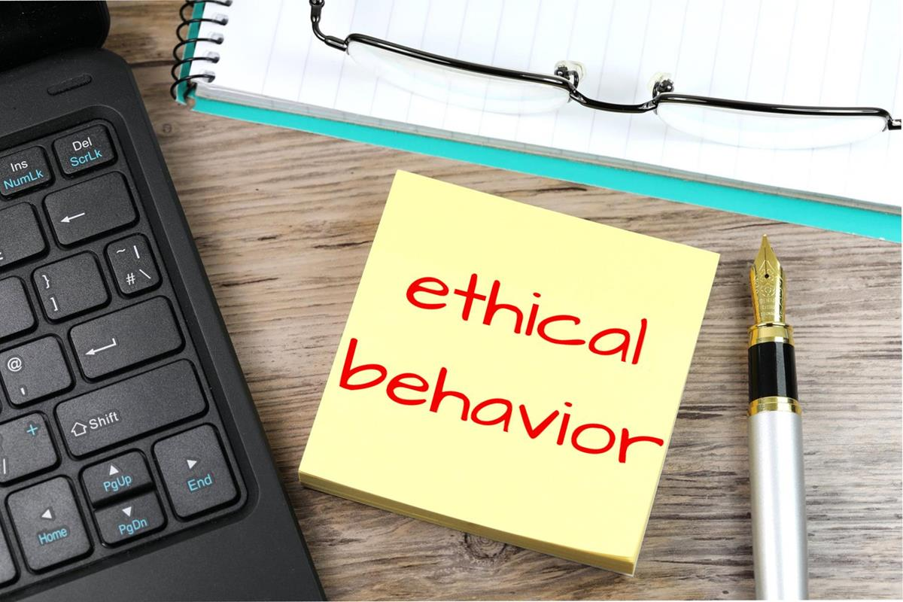
Ethical Behaviour
“a set of rules or principles that defines right and wrong conduct” (Robbins et al, 2012)
Ethical behaviour refers to actions and conduct that align with accepted principles and standards of morality, integrity, and fairness (Peek, 2023).
honesty, transparency, loyalty, responsibility and respect
This Photo by Unknown Author is licensed under CC BY-SA

Slide 65


Slide 66


Slide 67


Slide 68


