Slide 2
Course: VET Module: Horizontal Skills Learning Unit: Green Skills (E2)
Authors: CESIE & OTC

Slide 3
Content
The concept of Sustainability and its three pillars
Bioeconomy and related concepts

Slide 4
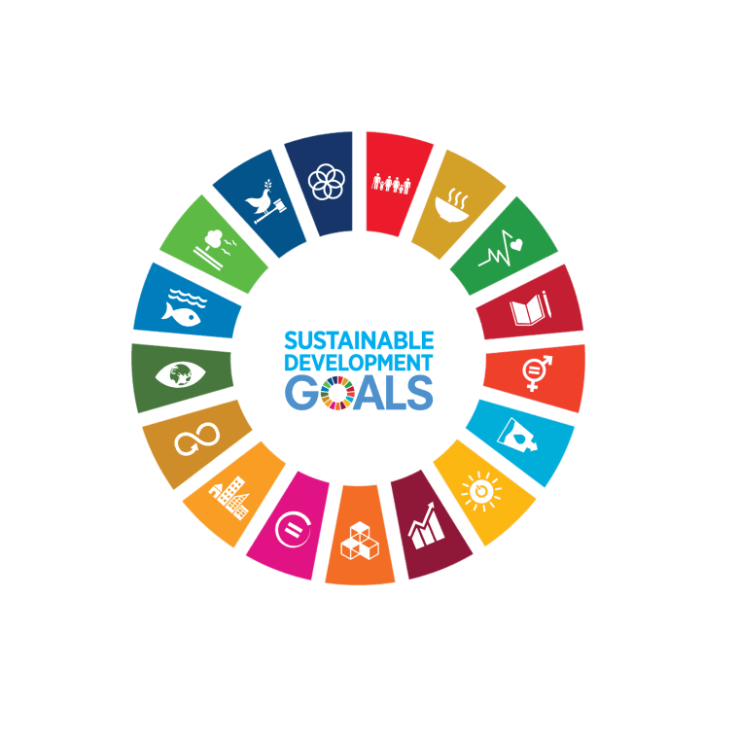
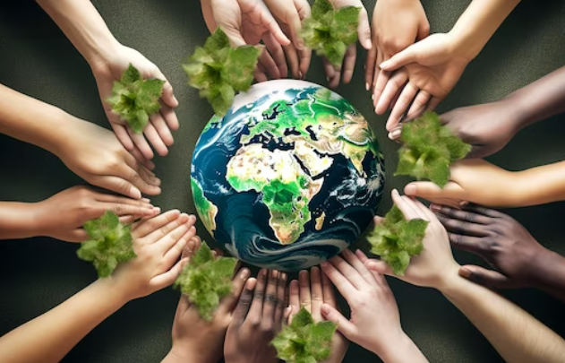
The concept of Sustainability
It is the practice of using resources in a way that preserves the environment, supports societal well-being, and ensures economic viability.
It is a concept which is global in scope, timeless, reflects an ongoing process and includes a moral responsibility for equity and justice.

Slide 5
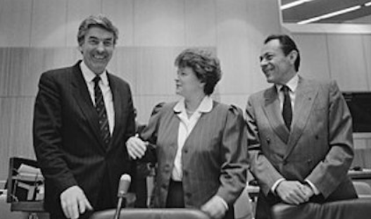
The concept of Sustainability
“Meeting the needs of the present without compromising the ability of future generations to meet their own needs”
The Brundtland Commission (1987)
(Source: IISD, 2017)

Slide 6
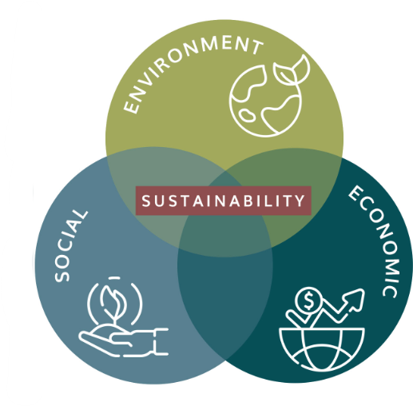
The three pillars of Sustainability
(Source: eeec, 2023)

Slide 7
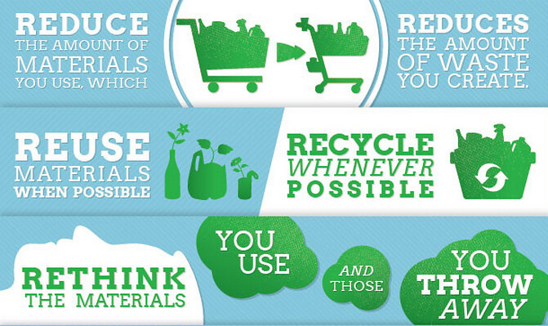
The 4 Rs of Sustainability
There are four key-words that describe the essence of Sustainability:
Reduce - limit waste and reduce levels of consumption
Reuse - instead of throwing away waste, use it again
Recycle - recycle responsibly
Rethink - stop and think about the amount of your consuming
The 4 R’s of sustainability Source

Slide 8
Benefits of sustainable agriculture
There are many reasons that lead to the integration of sustainable agricultural practices, such as:
Promotion of biodiversity of local plant and animal life
Reduction of agricultural waste
Conservation of water
Promotion of soil health and fertility
Capture of carbon in the soil
Promotion of energy efficiency
Decrease of greenhouse gas emissions
Provision of economic opportunities
This Photo by Unknown Author is licensed under CC BY-SA

Slide 9
Practical Activity #1
Group Discussion
Can you provide examples of environmental, social and economic sustainability?

Slide 10
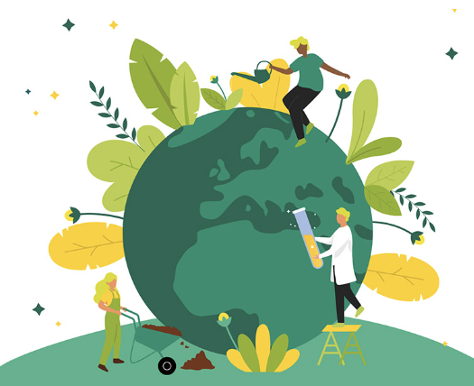
Bioeconomy
It is an economic system where biological resources, processes, and principles are used to provide sustainable solutions to pressing global challenges through their conversion into valuable products.
These resources encompass everything from crops, forests, and marine life to microorganisms and biotechnology.
It applies to various sectors, such as agriculture and forestry, biotechnology and pharmaceuticals, food and beverage, energy as well as waste management.

Slide 11
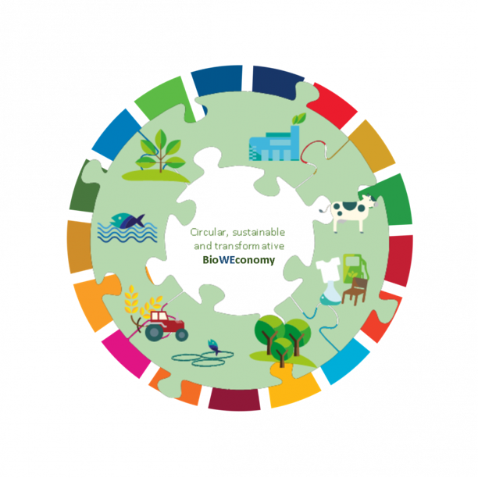
Bioeconomy
“the production, use and conservation of biological resources, including related knowledge, science, technology, and innovation to provide information, products, processes and services to all economic sectors with the aim of moving towards a sustainable economy“ (FAO, 2022).
“using renewable biological resources from land and sea, like crops, forests, fish, animals and micro-organisms to produce food, materials and energy“ (EC, 2018).
(Source)

Slide 12
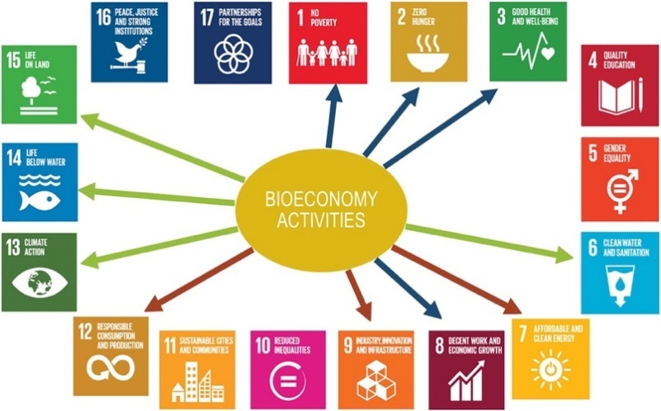
Connection with 17 SDGs
Bioeconomy:
aims at the end of poverty, zero hunger and the reduction of inequalities
relates to the goals of clean water and sanitation, sustainable cities and communities and responsible consumption and production
contributes to sustainable industry and infrastructure and as well at the promotion of economic growth
promotes health and well-being and climate action, which benefits the ecosystem life in total.
(Source)

Slide 13
The relation to Green Economy
Sustainability is part of the wider Green Economy.
The green economy strives to be environmentally conscious, resource-efficient, and socially inclusive (UN Environment Programme, 2022)
Is fueled by investment in:
Carbon-efficient infrastructure
Employment opportunities in sustainable sectors
Improved energy and resource efficiency
Preservation of biodiversity and ecosystems to prevent loss
This Photo by Unknown Author is licensed under CC BY-NC-ND

Slide 14
Circular economy
Involves reusing and recycling products and materials for as long as possible.
Promotes sustainability by maximizing the use of existing products and materials throughout their entire life cycle
Reduces the extraction of materials from the Earth,
Guarantees sufficient materials to support future generations by utilizing existing products to their full extent
make
use
reuse
remake
recycle

Slide 15
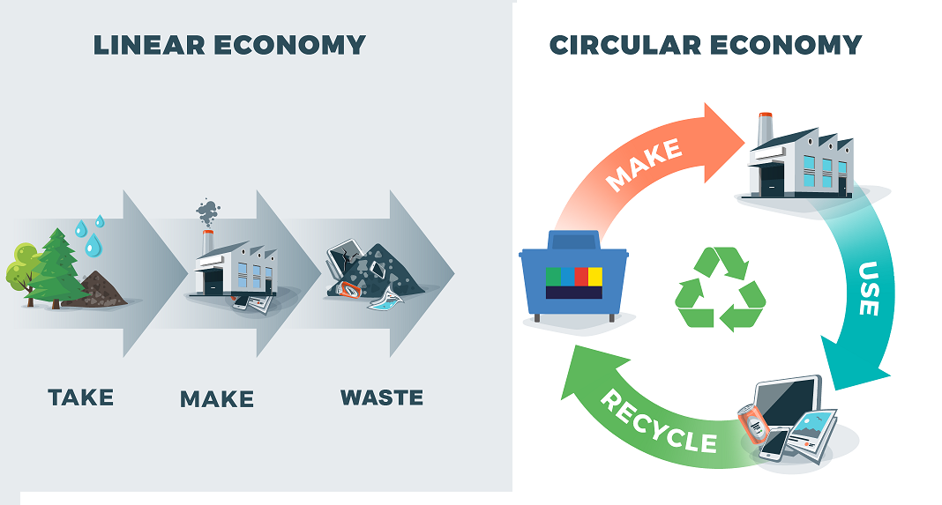
Transition to a Circular economy
(Source)

Slide 16
Practical Activity #2
Group Discussion
Please provide examples of how a company active in the agricultural sector can be aligned with the bioeconomy principles and practices

Slide 19
Content
UN 2030 Agenda and the Sustainable Development Goals (SDGs)
Relation between the SDGs and the bioeconomy and farming context
EU Green New Deal
Farm to Fork strategy

Slide 20
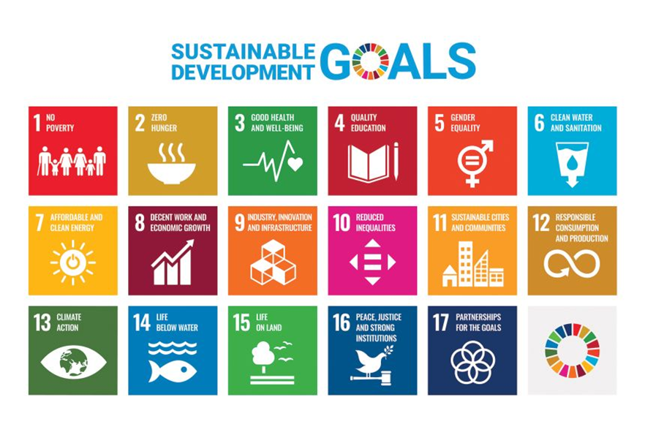
UN 2030 Agenda and the SDGs
Comprehensive global framework adopted by all 193 United Nations member states in September 2015, at its core has 17 goals (SDGs).
MDGs vs. SDGs
The principle of “leave no one behind”
The 3 pillars of sustainability
Holistic approach to interconnected challenges
Example: improving access to education (SDG 4) can lead to better health outcomes (SDG 3) and reduced inequalities (SDG 10)
(Source: United Nations, 2023)

Slide 21
Agriculture
Crucial role of Food & Agriculture in achieving multiple SDGs due to their economic, social, and environmental impacts.
Promoting food security and sustainable agriculture while addressing the environmental and social challenges associated with food production
can lead to a
more equitable, sustainable, and prosperous world for all.

Slide 22
The SDGs and the bioeconomy and farming context
Sustainable Development Goal (SDG) | Relevance of bioeconomy and farming
SDG 2: Zero Hunger | Sustainable farming practices can increase food production while reducing environmental impacts
SDG 8: Decent Work and Economic Growth | Sustainable farming practices and the development of bio-based industries can create jobs, stimulate economic growth, and improve livelihoods
SDG 12: Responsible Consumption and Production | Sustainable farming and bio-based industries promote responsible resource management
SDG 13: Climate Action | Sustainable farming practices and the use of bioenergy from agricultural residues can reduce GHG emissions and enhance carbon sequestration
SDG 14: Life Below Water | Aquaculture and sustainable fisheries can help reduce pressure on wild fish stocks, contributing to the conservation of marine ecosystems
SDG 14: Life on Land | Agroforestry and organic farming, can help protect biodiversity, prevent land degradation, and promote the sustainable management of forests

Slide 23
Practical Activity #3
Group Discussion
What are the potential environmental consequences of a bioeconomy-driven approach to farming, and how can these align with the SDGs related to environmental sustainability?

Slide 24
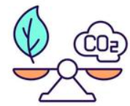
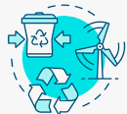
The European Green Deal
Ambitious policy initiative introduced by the European Commission in December 2019 to ignite a fundamental shift in the EU's approach to economic growth, sustainability, and climate change
The main objectives are:
CLIMATE NEUTRALITY
BIODIVERSITY
CIRCULARITY

Slide 25
The European Green Deal: multiple goals
Climate Neutrality by 2050: balancing the amount of greenhouse gases it emits with the amount removed from the atmosphere or offset through various measures. Achieving climate neutrality is vital for combatting climate change and limiting global warming to well below 2 degrees Celsius above pre-industrial levels, as stipulated in the Paris Agreement.
Sustainable and Circular Economy: shifting away from the "take-make-dispose" model to a circular economy in which products and materials are reused, repaired, recycled, or repurposed to reduce waste and minimize resource consumption. It also aims to create green jobs and stimulate innovation in clean technologies.
Biodiversity and Ecosystem Protection: preserving natural habitats, protecting endangered species, and maintaining ecosystem services that are crucial for human well-being. It sets out specific targets for halting biodiversity loss, such as restoring degraded ecosystems and increasing the share of organic farming.

Slide 26
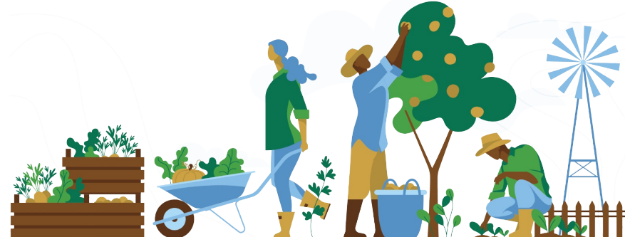
Farm to Fork strategy
Key component of the EU Green Deal's effort to create a more sustainable and resilient food system within the European Union.
It seeks to address environmental challenges, improve public health, and support a fair transition for farmers and consumers toward a more sustainable and healthy food future.
(Source: FAO, 2022)

Slide 27
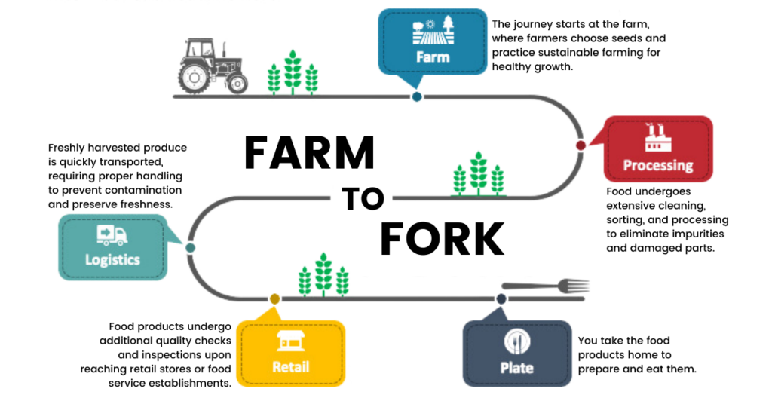
The ‘’Farm to Fork journey’’
(Source: Collidu, 2022)

Slide 28
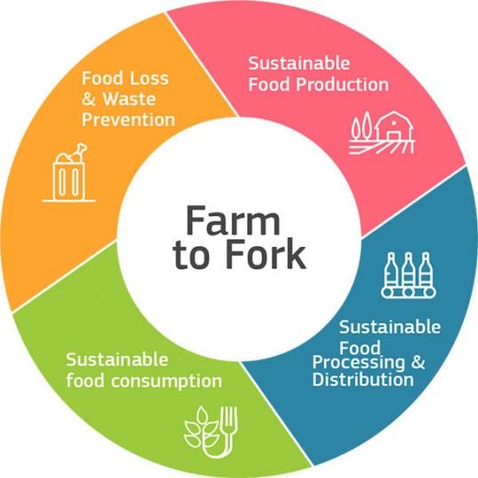
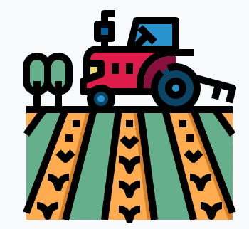
The 4 pillars of the strategy
The strategy is based on four pillars designed to address various aspects of the food system, from production to consumption:
Sustainable Food Production
Sustainable Food Processing & Distribution
Sustainable Food Consumption
Food Loss & Waste Prevention
(Source: European Commission, 2022)

Slide 29
Practical Activity #4
Group Activity
Split in teams of 4.
Each team should try to focus on one specific pillar of the Farm To Fork strategy. Based on this each team will write down 3 examples that represent this pillar as well as the benefits that are connected with them.
All teams present their findings and discussion will take place upon them.

Slide 32
Content
Key elements of waste management, energy efficiency, water, and food waste practices

Slide 33
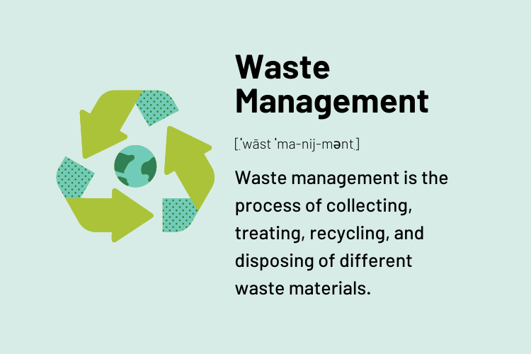
Waste management
Focuses on preserving the value and properties of waste materials by delivering high quality, secondary, raw materials to the economy.
(source)

Slide 34
Connected concepts
Energy Efficiency:
a method, which aims at accomplishing a task with the less possible use of energy, in order to eliminate energy waste
Food and water management:
in 2019 households produced globally 596 million tones food waste, whilst in 2017, the average water consumption of households in Europe was estimated at 147 litres/day per person with the daily minimum to be estimated at 50 litres/day per person

Slide 35
Farm Waste Management
involves a series of practices and strategies to reduce, reuse, and recycle agricultural waste.
Optimize the potential benefits of organic waste.
Minimize the harmful impact of agricultural waste on the environment.

Slide 36
Benefits of Farm Waste Management
Benefits
Prioritizing the use of reusable materials
Encouraging composting and recycling
Recycling of organic waste and saving water
Less greenhouse gas emissions
Saving costs and increasing efficiency
Helps compliance with environmental regulations
Optimizes farm operations,

Slide 37
Practical Activity #5
Group Activity
Split in teams of 4.
Each team should try to provide examples with practices of farm waste management based on their experience. They will also try to provide the short- term as well as the long- term impact of these practices on the business.
All teams present their findings and discussion will take place upon them.

Slide 40
Content
The environmental impact of human activities: the “Anthropocene”
The interdipendence between agriculture and climate change
Calculating the impact of human activities

Slide 41
The ‘’Anthropocene’’
It is the era we found ourselves in where human activities have become the dominant force shaping the Earth's environment.
Related issues are:
CLIMATE CHANGE
BIODIVERSITY LOSS
POLLUTION
LAND-USE CHANGES
RESOURCE DEPLETION
significant and accelerating rise in global temperatures
unprecedented rate at which species are disappearing
introduction of harmful materials (GHG, plastics,
toxic waste, etc.) into the environment
have led to deforestation, soil degradation, and the transformation of once-pristine landscapes
unsustainable extraction of freshwater, minerals, and fisheries taking a toll on Earth's finite resources

Slide 42
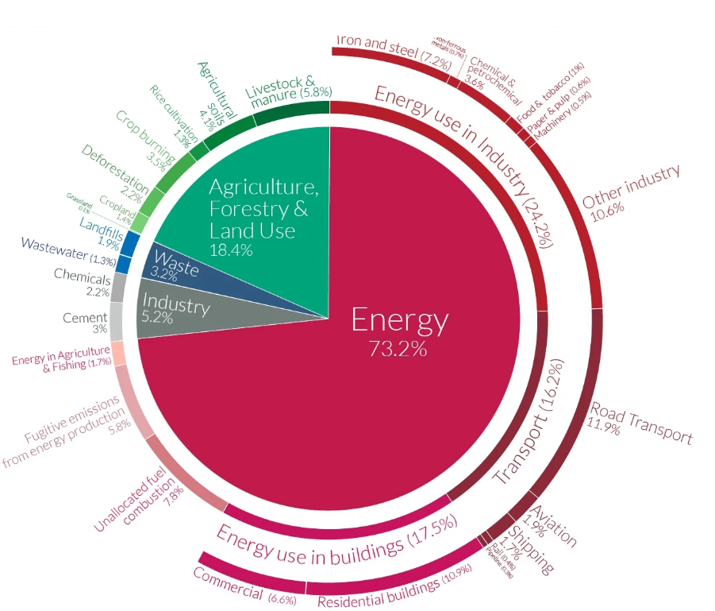
Sectors contributing to climate change
(Source: OurWorldInData, 2021)

Slide 43
The role of agriculture in an ever-changing climate
Agriculture plays a complex and multifaceted role, being both a threat and a potential solution to climate change.
Agriculture as a threat
SOURCE OF GHG EMISSIONS: Besides the energy required to carry out agricultural activities, livestock and manure are the main contributors of methane (enetic fermentation) and nitous oxide (manure management and the use of synthetic fertilizers).
MAIN DRIVER OF DEFORESTATION: Every year the world loses around 5 million hectares of forest. 95% of this occurs in the tropics. At least three-quarters of this is driven by agriculture – clearing forests to grow crops, raise livestock and produce products.

Slide 44
The role of agriculture in an ever-changing climate
Agriculture as a potential solution
SEQUESTER CO2 EMISSIONS: agriculture has the potential to sequester carbon dioxide from the atmosphere through various practices. These include reforestation, afforestation (planting trees on previously non-forested land), and agroforestry (integrating trees into agricultural systems). These practices can act as carbon sinks, helping to offset emissions.
ALTERNTIVE SOURCE OF ENERGY: Agriculture can also contribute to renewable energy production, such as bioenergy. Biofuels derived from crops or agricultural residues, along with biogas from manure, can replace fossil fuels and reduce emissions.

Slide 45
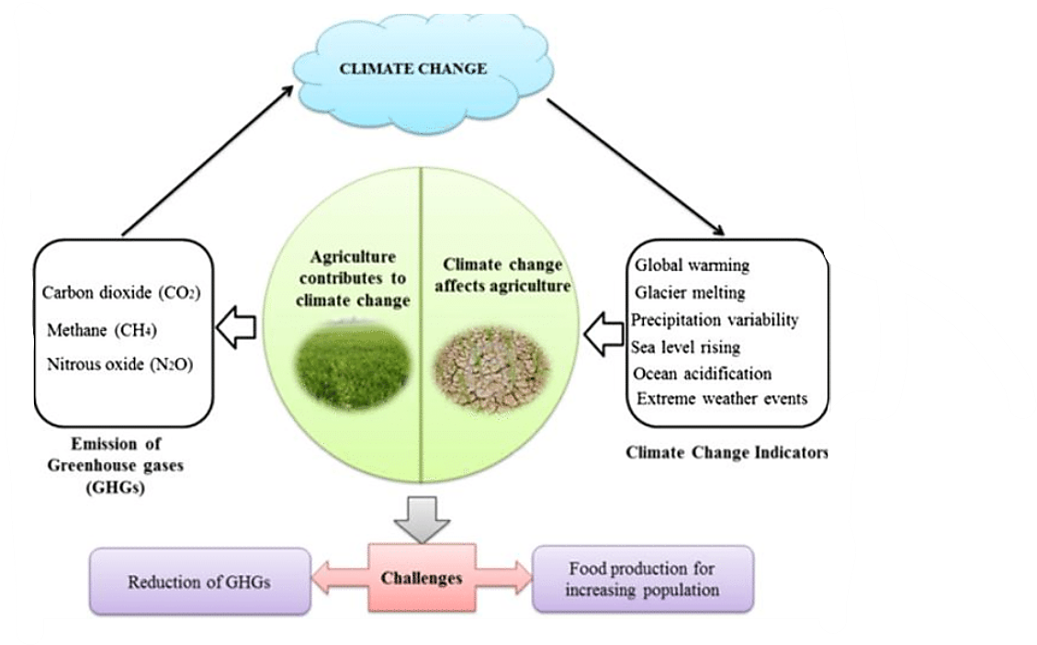
The role of agriculture in an ever-changing climate
(Source: Rogelj et al., 2010)

Slide 46
Environmental footprint
There are several tools and methodologies used to calculate the impact of human activity on the environment, developed in response to growing concerns about sustainability and environmental degradation.
1
ECOLOGICAL FOOTPRINT
It measures the total environmental impact of an individual, community, organization, or even a country in terms of the natural resources and ecosystems required to support their lifestyle or activities.
METHOD: quantification of human demand on Earth's ecosystems by measuring the area of biologically productive land and water needed to produce the resources a population consumes and absorb its waste, all converted into a common unit (global hectares or acres).

Slide 47
Environmental footprint
There are several tools and methodologies used to calculate the impact of human activity on the environment, developed in response to growing concerns about sustainability and environmental degradation.
2
CARBON FOOTPRINT
It measures the amount of greenhouse gas emissions, primarily carbon dioxide (CO2), that are produced directly or indirectly as a result of an individual's, organization's or entity's activities.
METHOD: quantification of the impact in terms of the global warming potential caused by greenhouse gas emissions released in the atmosphere, using the common unit of carbon dioxide equivalents (CO2e).

Slide 48
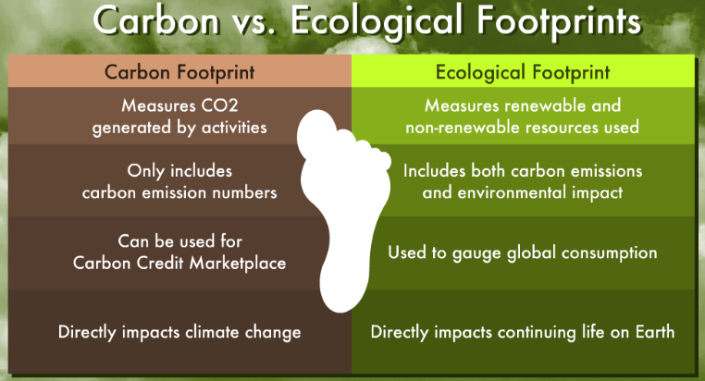
Environmental footprint
(Source: 8BillionTrees, 2023)

Slide 49
Practical Activity #6
Try to calculate your carbon footprint using this link.
https://www.carbonfootprint.com/calculator.aspx
Present your results to your peers.
What kind of actions should you do differently?

Slide 51
Content
The system Thinking Approach

Slide 52
Systems Thinking
a holistic approach aiming at the understanding of a system, by studying the relations and interactions between the elements that compose this system.
a problem-solving method, which takes into consideration all the factors that are involved in a system and breaks down a big problem down into its component parts, figuring out how each part affects the whole

Slide 53
Fundamentals of Systems Thinking
Looking at the big picture
Taking a wider perspective
Having multiple perspectives
Examining inter-relationships within the system
Looking for root causes and solutions
Preventing consequences
Challenging and exploring new opportunities

Slide 54
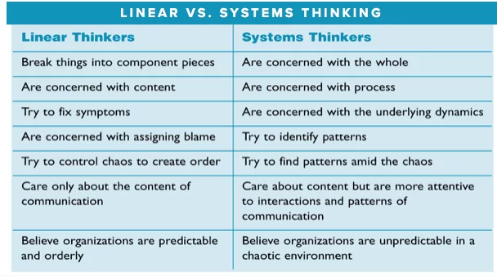

Slide 55
Practical Activity #7
Group Activity
Try to provide examples of an issue that an agribusiness may face identifying potential solutions:
As Linear Thinker
As Systemic Thinker

