Slide 1


Slide 2

Course: VET-E3
Module: Horizontal Skills
Learning Unit: Entrepreneurial Skills
Author: ReadLab

Slide 3
Content
1
Entrepreneurship, Entrepreneur, Entrepreneurial opportunity
6
Spatial Planning - Clusters - Industrial Areas
Entrepreneurial Enviroment
2
7
Agricultural Entrepreneurship
Business Model Canvas
3
8
International Entrepreneurship
Business Plan
4
9
e - Entrepreneurship
Funding
5
10
Sustainable – Green – Cyclical Entrepreneurship
Module: Horizontal Skills/ Learning Unit: Entrepreneurial Skills / Sub Unit: content
3

Slide 4

  Entrepreneurship, Entrepreneur, Entrepreneurial opportunity
1.1 Entrepreneurship
Entrepreneurship is a multifaceted concept, we could define entrepreneurship as starting a business. For this reason, in the international literature entrepreneurship is also defined as start up.
Creativity, innovation, and resource optimization
Entrepreneurship encompasses:
  opportunity discovery
  innovation
  risk reduction
  personal traits
  environmental factors
Module: Horizontal Skills/ Learning Unit: Entrepreneurial Skills/ Sub Unit: Entrepreneurship, Entrepreneur, Entrepreneurial opportunity
4

Slide 5



  Entrepreneurship, Entrepreneur, Entrepreneurial opportunity
1.2 Measurement of Entrepreneurship
Methodologies
Employment rate
business ownership
rate
the rate of establishment of new firms
Module: Horizontal Skills/ Learning Unit: Entrepreneurial Skills / Sub Unit: Entrepreneurship, Entrepreneur, Entrepreneurial opportunity
5

Slide 6




  Entrepreneurship, Entrepreneur, Entrepreneurial opportunity
1.2 Measurement of Entrepreneurship
Global Entrepreneurship Monitor (GEM)
It is a research program that produces annual reports on the entrepreneurial activity of nations. Defines 3 types of business activity:
Economic growth can be the result of The activities related to the established businesses and
Nascent entrepreneurs
New entrepreneurs
Established entrepreneurs
The activities related to the business processes of creating new businesses (start-ups).
Module: Horizontal Skills/ Learning Unit: Entrepreneurial Skills / Sub Unit: Entrepreneurship, Entrepreneur, Entrepreneurial opportunity
6

Slide 7





  Entrepreneurship, Entrepreneur, Entrepreneurial opportunity
1.3 The Entrepreneur
  Makes decisions and takes risks
  Organizes the factors of production in the most efficient way to achieve the maximum possible result
  Uses innovations and follows innovative business initiatives to derive ideas
  He looks for profit opportunities and adopts smart strategies.
Characteristics of an entrepreneur
Module: Horizontal Skills/ Learning Unit: Entrepreneurial Skills / Sub Unit: Entrepreneurship, Entrepreneur, Entrepreneurial opportunity
7

Slide 8


  Entrepreneurship, Entrepreneur, Entrepreneurial opportunity
1.4 Entrepreneurial Opportunity
A business opportunity is the entrepreneur's ability to satisfy a new need that appears in the market.
How is a business opportunity identified?
A combination of understanding a consumer need and simultaneously identifying untapped resources.
Factors that can influence:
  the degree of vigilance and reaction of the entrepreneur to the new information.
  the knowledge and information that some entrepreneurs possess and the fact that others do not at the same time.
  accidental discovery as well as discovery arising from conscious research and business networks.
  personal characteristics, such as risk-taking, optimism, sense of internal control and creativity.
Module: Horizontal Skills/ Learning Unit: Entrepreneurial Skills / Sub Unit: Entrepreneurship, Entrepreneur, Entrepreneurial opportunity
8

Slide 9
2. Entrepreneurial Environment
2.1 Internal Environment Analysis
Tangible Resources | Tangible Resources | Examples
Financial Resources | Financial Resources | Borrowing capacity of the business Equity capacity of the business.
Natural Resources | Natural Resources | Location, completeness of equipment and access to raw materials.
Human Resources | Human Resources | Education, experience, intelligence, insight, adaptability, employee loyalty.
Organizational Resources | Organizational Resources | Business structure, control, coordination, and planning systems.
Intangible Resources | Intangible Resources | Examples
Technological Resources | Technological Resources | Technological Capability
Innovation Resources | Innovation Resources | Employees with significant skills, Research facilities
Reputation | Reputation | Reputation among customers, Reputation among suppliers
Table 2.1 | Table 2.1 | Examples of Tangible and Intangible Resources (Papadakis, 2002)
Module: Horizontal Skills/ Learning Unit: Entrepreneurial Skills/ Sub Unit: Entrepreneurial Environment
9

Slide 10
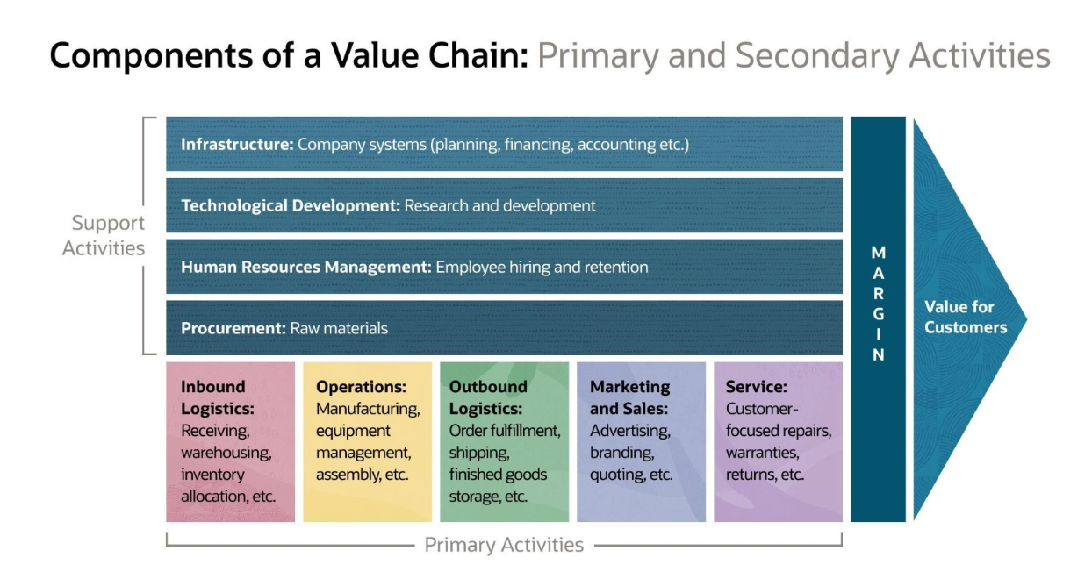
Module: Horizontal Skills/ Learning Unit: Entrepreneurial Skills/ Sub Unit: Entrepreneurial Environment
10

Slide 11
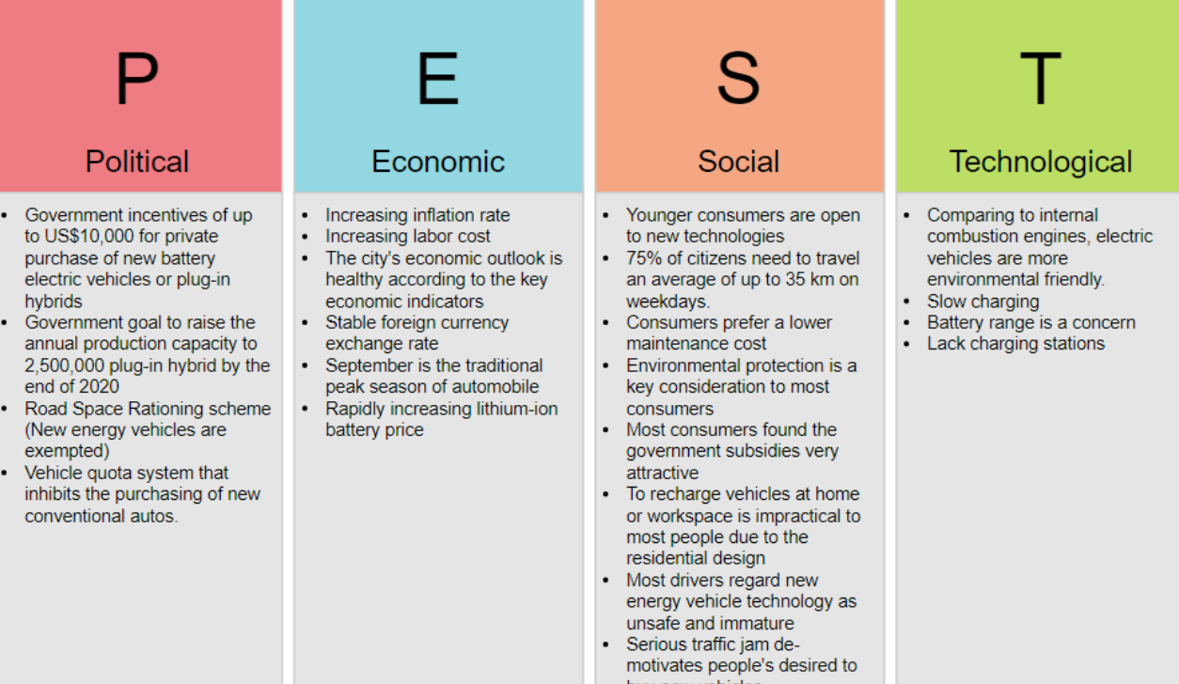
2. Entrepreneurial Environment
2.2 Strategic Analysis of External Environment
Module: Horizontal Skills/ Learning Unit: Entrepreneurial Skills/ Sub Unit: Entrepreneurial Environment
11

Slide 12

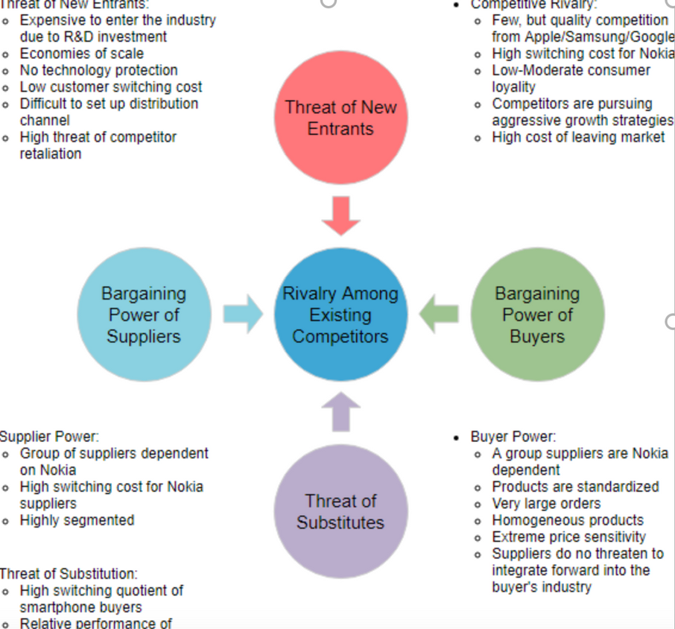
2. Entrepreneurial Environment
2.2 Strategic Analysis of External Environment
Every potential entrepreneur is expected to benefit from the accumulated experience of a business community and to be motivated to be active in this environment.
Undoubtedly, therefore, the level of business activity is a sample of the culture of a society and certainly reflects its cultural characteristics.
Module: Horizontal Skills/ Learning Unit: Entrepreneurial Skills / Sub Unit: Entrepreneurial Environment
12

Slide 13
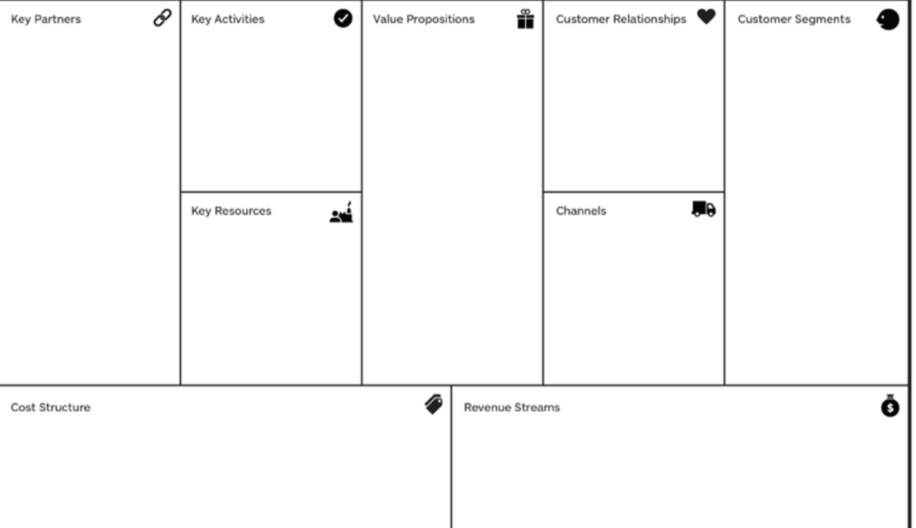
3. Business Model Canvas
The Business Model Canvas includes 9 areas of interest that describe the critical factors that the would-be entrepreneur must analyze to draw clear conclusions about the prospect of his idea.
Module: Horizontal Skills/ Learning Unit: Entrepreneurial Skills/ Sub Unit: Business Model Canvas
13

Slide 14
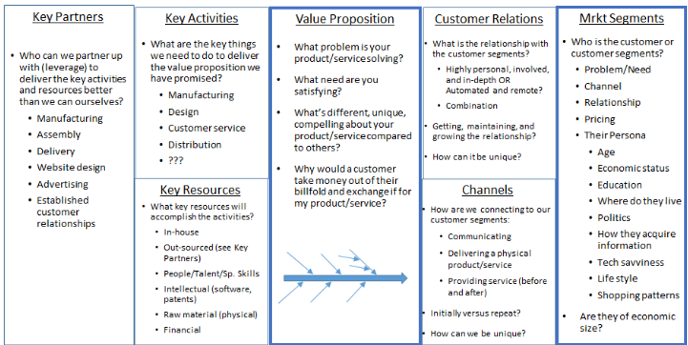
3. Business Model Canvas
Module: Horizontal Skills/ Learning Unit: Entrepreneurial Skills / Sub Unit: Business Model Canvas
14

Slide 15
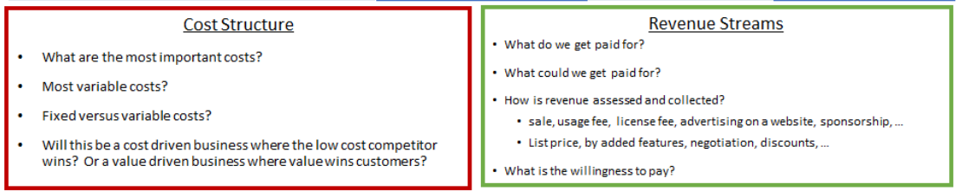
3. Business Model Canvas
The final point of the canvas analysis is the investigation and analysis of the cost elements that create the generated value of our business. What are the major costs we have and what critical resources or activities cost more?
Module: Horizontal Skills/ Learning Unit: Entrepreneurial Skills/ Sub Unit: Business Model Canvas
15

Slide 16

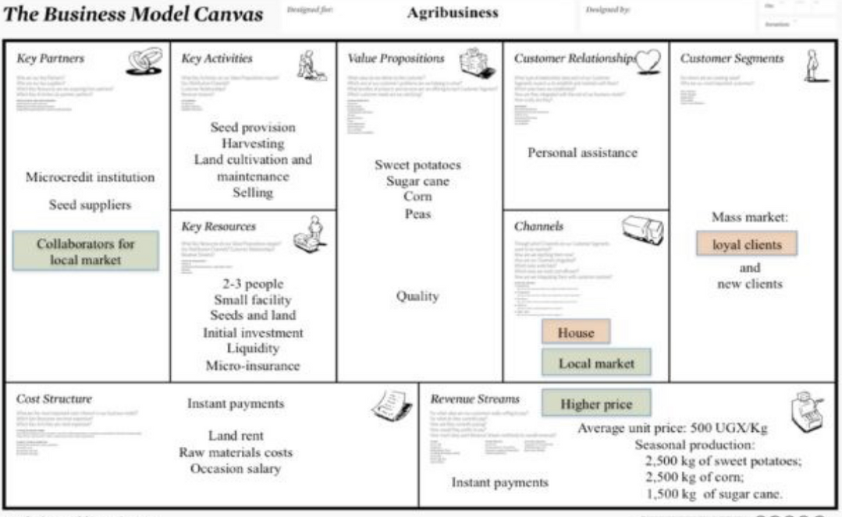
3. Business Model Canvas
The business model canvas reported in the following figure represents the definition of a business, which has been realised from the analysis of a successful business, managed by Cacoda Poe.
Module: Horizontal Skills/ Learning Unit: Entrepreneurial Skills / Sub Unit: Business Model Canvas
16

Slide 17


4. Business Plan
4.1 Definition
Describes where we are, where we want to go and how we will eventually manage to get there.
a) Viability study of a new business
b) Study for the creation of a new business in a new industry
c) Finding financial support for the new projects
d) Study of business functions of a company in order to answer questions
4.2 Executive Summary
  a brief history of the sector in which the organization operates
  the business vision and mission statement
  the main objectives
  the current state of the organization
  the products/services that it offers
  the degree of acceptance by consumers/customers
  the strategy for gaining competitive advantage
  some useful financial data
Module: Horizontal Skills/ Learning Unit: Entrepreneurial Skills / Sub Unit: Business Plan
17

Slide 18




4. Business Plan
4.3 Description of the Company
Company: This section gives the reader an overview of the business. Describe the personal situations and circumstances that led you as an entrepreneur to this step.
Products/Services: Introduce your product or services to the reader. Compare your products with those on the market and showcase the most impressive elements of your products.
Operating Plan: explains how the business will ultimately operate. It includes the location of the business, description of its operation, required equipment, suppliers and required personnel. It is also important to present the management structure of the company.
Management, Organization, Ownership: In this section the management team is presented. How is the company organized and what is its ownership structure? The management structure should have clear levels of authority. Convince your readers of the capabilities of the management team.
Module: Horizontal Skills/ Learning Unit: Entrepreneurial Skills / Sub Unit: Business Plan
18

Slide 19
4. Business Plan
4.4 The Market
  Industry, competition and market: Describe the industry you operate in, with the current state of it, as well as any trends you recognize.
  Primary competitors: dentify the companies you compete with.
  Market: Present your market size.
4.5 The Strategy and its Implementation
Marketing Plan
Mention comparative advantage
Analyze your pricing policy and compare it
Explain the ways in which your products will reach consumers
How do you plan to advertise your products to consumers?
Goals and Strategies
Describe your general objectives, sales volume, profit estimate, entering new markets, increasing market share.
Module: Horizontal Skills/ Learning Unit: Entrepreneurial Skills/ Sub Unit: Business Plan
19

Slide 20


4. Business Plan
4.6 Financial Analysis
4.7 Structure of a Business Plan
It includes the presentation of the financial situation of the company and its financial prospects, in combination with the cost budget and the valuation of the investment plan as well as the choice of financing sources.
The format of a business plan is not standardized, neither in terms of its structure nor its content. The structure of a business plan necessarily includes all the aforementioned sections.
Module: Horizontal Skills/ Learning Unit: Entrepreneurial Skills / Sub Unit: Business Plan
20

Slide 21
5. Funding
Sources of Funding
Loan funds
Equity
Loan Funds
Subsidies
Loan funds
Internal sources of finance include the entrepreneur's personal funds or what he can draw from his environment. Typically, Deakins & Freel (2007) describe them as “3F” (friends, family, and founder).
External sources of financing include short-term bank loans, venture capital companies, official or unofficial investors, financial leases or even subsidies and grants. Bank lending is the most widespread and the most important form of external financing for businesses.
Subsidies are an alternative form of external financing. These subsidies usually correspond to a percentage of the total capital of the investment and are the most attractive and important incentive for the potential investor.
Module: Horizontal Skills/ Learning Unit: Entrepreneurial Skills / Sub Unit: Funding
21

Slide 22
5. Funding
Sources of Funding
Loan funds
Venture Capitals
Start-up & financial constraints
Internal sources of finance include the entrepreneur's personal funds or what he can draw from his environment. Typically, Deakins & Freel (2007) describe them as “3F” (friends, family, and founder).
External sources of financing include short-term bank loans, venture capital companies, official or unofficial investors, financial leases or even subsidies and grants. Bank lending is the most widespread and the most important form of external financing for businesses.
Module: Horizontal Skills/ Learning Unit: Entrepreneurial Skills/ Sub Unit: Funding
22

Slide 23
5. Funding
Sources of Funding
Funding opportunities for farmers
Common Agricultural Policy (CAP)
Research and innovation
Employment in rural areas
EU Funding
The European exchange programme for Entrepreneurs
European Innovation Council (EIC)
Module: Horizontal Skills/ Learning Unit: Entrepreneurial Skills / Sub Unit: Funding
23

Slide 24





6. Spatial Planning – Clusters – Industrial Areas
6.1 Spatial planning
factors influencing the choice of location are:
Manufacturing
Wholesale
Reatil
Providing Services
6.2 Clusters
Clusters, according to Porter, are geographic concentrations of interconnected businesses and organizations in a specific field.
Module: Horizontal Skills/ Learning Unit: Entrepreneurial Skills/ Sub Unit: Spatial Planning – Clusters – Industrial Areas
24

Slide 25

6. Spatial Planning – Clusters – Industrial Areas
6.3 Industrial Zone & Area – Business Parks
  the disposal of the area in its natural state without the organization of basic infrastructure networks.
  the costs of infrastructure-related projects are handled by the companies themselves.
  the undertaking of commitments by the companies which settle in the zone, concerning building conditions and anti-pollution operation.
Module: Horizontal Skills/ Learning Unit: Entrepreneurial Skills / Sub Unit: Spatial Planning – Clusters – Industrial Areas
25

Slide 26

7. Agricultural Entrepreneurship
Agriculture is one of the largest industries in the world, including fishing.
It contributes 3% of global GDP and employs more than one billion people, more than 26% of all workers worldwide, according to the International Labor Organization. This shows her enormous influence on the world.
However, about 500 million small farms worldwide do not make enough money to raise their family above the poverty line, according to the International Fund for Rural Development.
Module: Horizontal Skills/ Learning Unit: Entrepreneurial Skills/ Sub Unit: Agricultural Entrepreneurship
26

Slide 27

8. International Entrepreneurship
The strategic choices through which a business can operate internationally can be imports or exports.
Advantages of exporting:
  enhancing competitiveness
  increasing sales and profits
  gaining global market share
  reducing dependence on existing markets
  etc...
The biggest obstacles for international transactions are changes in the economy of the country of operation.
Module: Horizontal Skills/ Learning Unit: Entrepreneurial Skills / Sub Unit: International Entrepreneurship
27

Slide 28

9. e - Entrepreneurship
Electronic Entrepreneurship is a set of business strategies that aim to support and transform specific areas of business activity, with the use of new technologies.
Today's main uses include:
  automating, simplifying, and redefining business processes
  the creation of personalized relationships
  improving quality and creating services/products
  reducing costs
  increasing the profit margin
E - commerce
E-commerce is defined as the trade of goods and services carried out remotely by electronic means, i.e. based on the electronic transmission of data.
Module: Horizontal Skills/ Learning Unit: Entrepreneurial Skills / Sub Unit: e - Entrepreneurship
28

Slide 29

10. Sustainable - Green - Cyclical Entrepreneurship
10.1 Sustainable Entrepreneurship
10.2 Green entrepreneurship
"Green entrepreneurship" is the name given to that form of economic activity that puts the protection of the environment and nature in general at the center of its strategy. The "green business" maintains a positive attitude towards the protection of the environment in all its activities.
Module: Horizontal Skills/ Learning Unit: Entrepreneurial Skills/ Sub Unit: Sustainable - Green - Cyclical Entrepreneurship
29

Slide 30
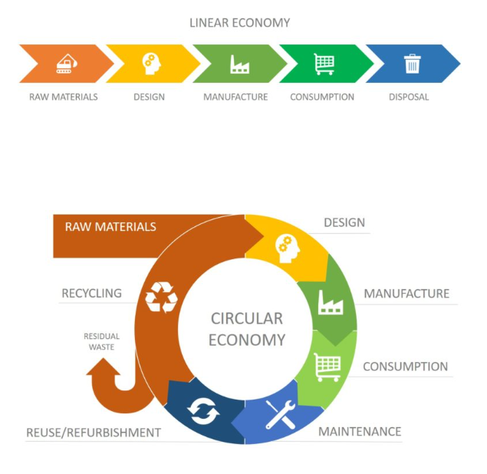


10. Sustainable - Green - Cyclical Entrepreneurship
10.3 Circular Economy and Entrepreneurship
Circular development is a model of economic, social, and environmental production and consumption that aims to build a sustainable society based on a circular model. It aims to develop recyclable and sustainable resources to protect society from waste. The aim is to enable economies and societies in general to become more autonomous and sustainable.
Module: Horizontal Skills/ Learning Unit: Entrepreneurial Skills/ Sub Unit: Sustainable - Green - Cyclical Entrepreneurship
30

Slide 31


